Slide 1
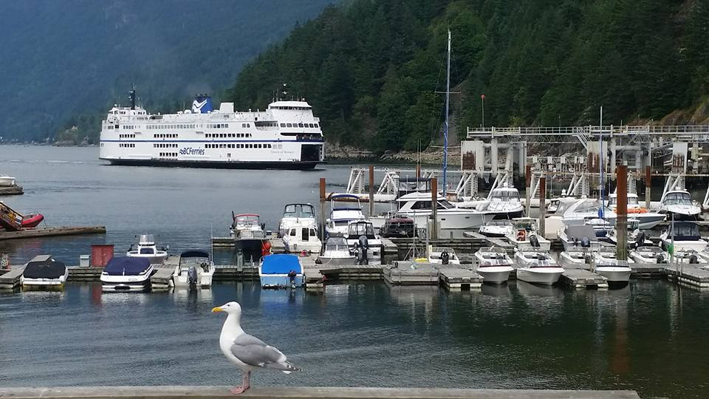
Homecrest Presbyterian Church Worship of the Lord’s Day 15th Sunday in Ordinary Time July 15th, 2018

Slide 2
Gathering Around the WORD Call to Worship
(Based on 2 Samuel 6:5, 14)
Come, let us worship God with the passion and joy of King David and all the people who sang and danced before the ark of the covenant.
Let us worship our Savior with the songs of praise and thanksgiving of the apostle Paul and all who are blessed with every spiritual blessing.
God has blessed us in our Lord Jesus Christ, destined us to be children of God, and sealed us in the Holy Spirit.
In gratitude of our hearts,
let us worship God.

Slide 3
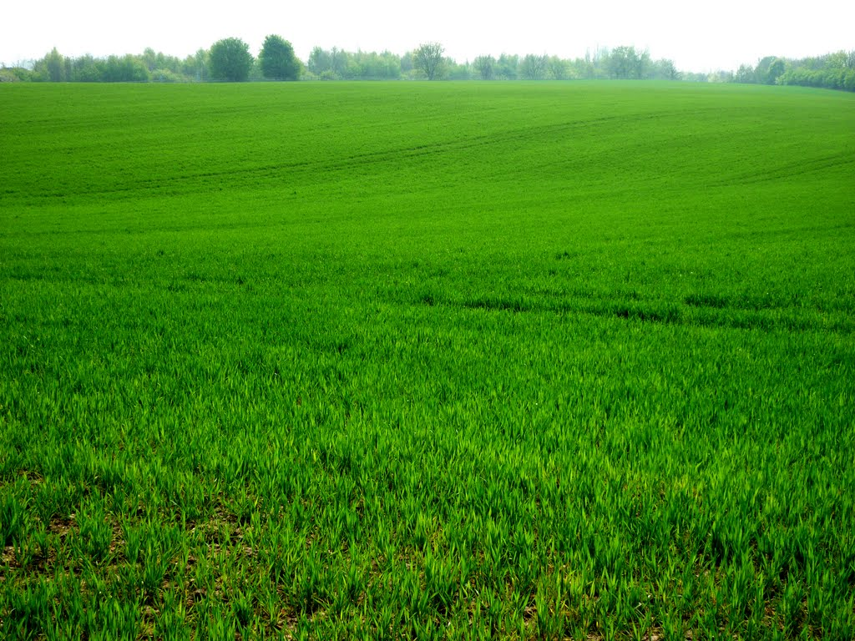
Gathering Around the WORD Gathering Hymn # 20 “All Things Bright and Beautiful”
All things bright and beautiful, all creatures great and small, all things wise and wonderful, the Lord God made them all.

Slide 4
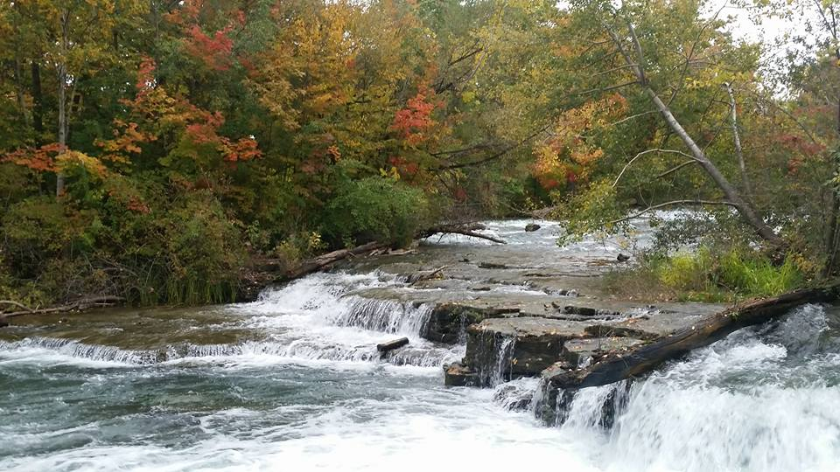
Gathering Around the WORD Gathering Hymn # 20 “All Things Bright and Beautiful”
Each little flower that opens, each little bird that sings, God made their glowing colors; God made their tiny wings.

Slide 5
Gathering Around the WORD Gathering Hymn # 20 “All Things Bright and Beautiful”
All things bright and beautiful, all creatures great and small, all things wise and wonderful, the Lord God made them all.

Slide 6
Gathering Around the WORD Gathering Hymn # 20 “All Things Bright and Beautiful”
The purple-headed mountain, the river running by, the sunset, and the morning that brightens up the sky:

Slide 7
Gathering Around the WORD Gathering Hymn # 20 “All Things Bright and Beautiful”
All things bright and beautiful, all creatures great and small, all things wise and wonderful, the Lord God made them all.

Slide 8
Gathering Around the WORD Gathering Hymn # 20 “All Things Bright and Beautiful”
The cold wind in the winter, the pleasant summer sun, the ripe fruits in the garden, God made them every one.

Slide 9
Gathering Around the WORD Gathering Hymn # 20 “All Things Bright and Beautiful”
All things bright and beautiful, all creatures great and small, all things wise and wonderful, the Lord God made them all.

Slide 10
Gathering Around the WORD Gathering Hymn # 20 “All Things Bright and Beautiful”
God gave us eyes to see them, and lips that we might tell how great is God Almighty, who has made all things well.

Slide 11
Gathering Around the WORD Gathering Hymn # 20 “All Things Bright and Beautiful”
All things bright and beautiful, all creatures great and small, all things wise and wonderful, the Lord God made them all.

Slide 12
Gathering Around the WORD Call to Confession When things are going well, we often take credit and neglect about God’s providence and care. God calls us and humbles us through our confession. In humility and faith, let us confess our sins before God and our neighbors.

Slide 13
Gathering Around the WORD Prayer of Confession (in unison)
Holy, holy, holy God, you are the God of glory. We confess that we often forget that your holiness is dangerous. We take our impurities for granted, make excuses for the sins we commit, and expect you to overlook the harm we cause while still demanding justice from others. We do not deserve your mercy.

Slide 14
Gathering Around the WORD Prayer of Confession (in unison)
Forgive us, and return us to a right relationship with you for the sake of your Son, Jesus Christ. You made us for the purpose of praising you; enliven us with the Holy Spirit so that we can fulfill our calling in the name of our Lord Jesus Christ, Amen.

Slide 15
Gathering Around the WORD Declaration of Forgiveness
According to the riches of his grace, which God has lavished upon us and sealed for us by the promised Holy Spirit, hear this good news: in Jesus Christ, you are forgiven,
Thanks be to God, Amen.

Slide 16
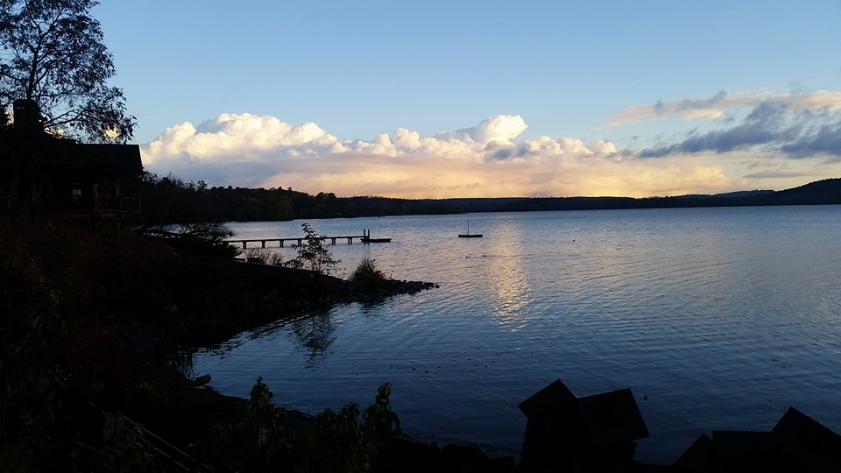
Gathering Around the WORD Gloria Patri
Glory be to the Father
and to the Son and to the Holy Ghost;
As it was in the beginning,
is now, and ever shall be,
world without end. Amen, Amen.

Slide 17
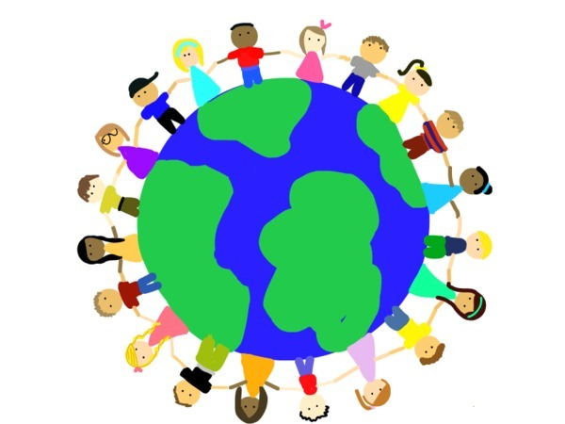
Gathering Around the WORD Passing of the Peace of Christ

Slide 18
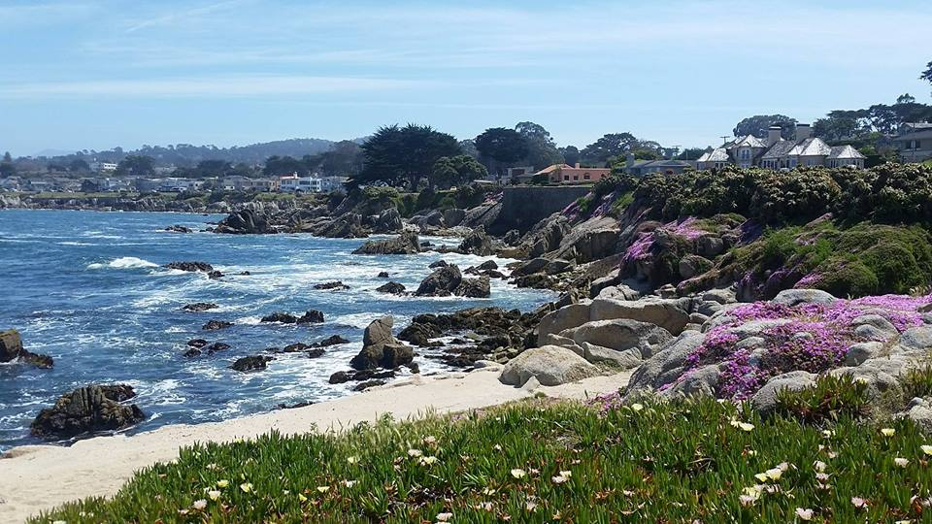
Proclaiming the WORD Message to the Youth/ Prayer of Illumination

Slide 19
Proclaiming the WORD Scripture Reading (2 Samuel 6:1-5, 12-19)
¹David again gathered all the chosen men of Israel, thirty thousand. ²David and all the people with him set out and went from Baale-judah, to bring up from there the ark of God, which is called by the name of the LORD of hosts who is enthroned on the cherubim.³They carried the ark of God on a new cart, and brought it out of the house of Abinadab, which was on the hill.

Slide 20
Proclaiming the WORD Scripture Reading (2 Samuel 6:1-5, 12-19)
Uzzah and Ahio, the sons of Abinadab, were driving the new cart ⁴with the ark of God; and Ahio went in front of the ark. ⁵David and all the house of Israel were dancing before the LORD with all their might, with songs and lyres and harps and tambourines and castanets and cymbals.

Slide 21
Proclaiming the WORD Scripture Reading (2 Samuel 6:1-5, 12-19)
12 So David went and brought up the ark of God from the house of Obed-edom to the city of David with rejoicing; ¹³and when those who bore the ark of the LORD had gone six paces, he sacrificed an ox and a fatling. ¹⁴David danced before the LORD with all his might; David was girded with a linen ephod. ¹⁵So David and all the house of Israel brought up the ark of the LORD with shouting, and with the sound of the trumpet.

Slide 22
Proclaiming the WORD Scripture Reading (2 Samuel 6:1-5, 12-19)
¹⁶As the ark of the LORD came into the city of David, Michal daughter of Saul looked out of the window, and saw King David leaping and dancing before the LORD; and she despised him in her heart.
¹⁷They brought in the ark of the LORD, and set it in its place, inside the tent that David had pitched for it; and David offered burnt offerings and offerings of well-being before the LORD.

Slide 23
Proclaiming the WORD Scripture Reading (2 Samuel 6:1-5, 12-19)
¹⁸When David had finished offering the burnt offerings and the offerings of well-being, he blessed the people in the name of the LORD of hosts, ¹⁹and distributed food among all the people, the whole multitude of Israel, both men and women, to each a cake of bread, a portion of meat, and a cake of raisins. Then all the people went back to their homes.

Slide 24
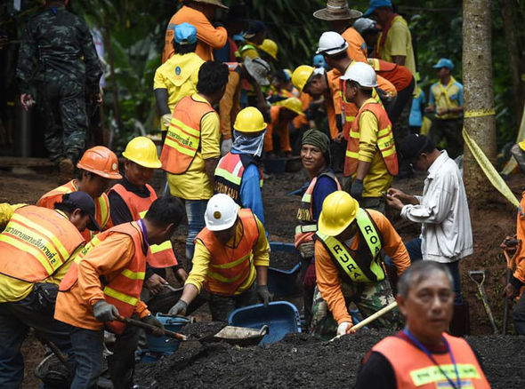
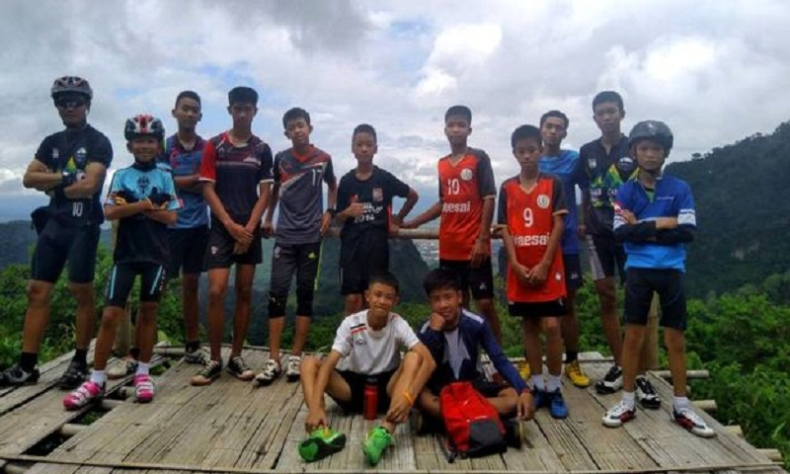
Proclaiming the WORD (2 Samuel 6:1-5, 12-19)
It Takes a Village

Slide 25
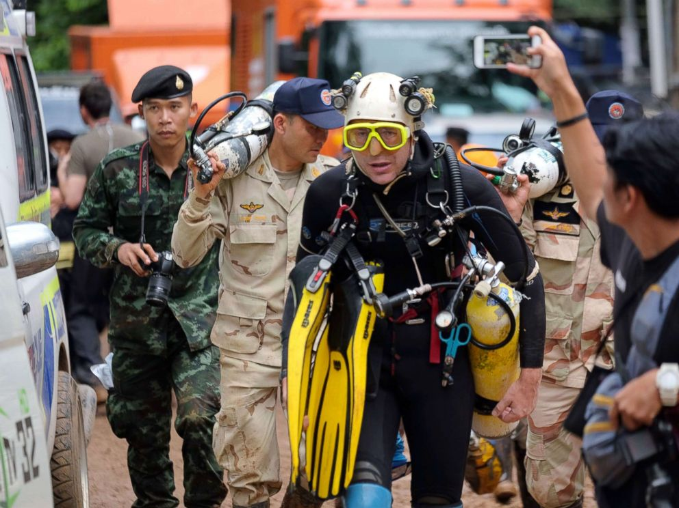
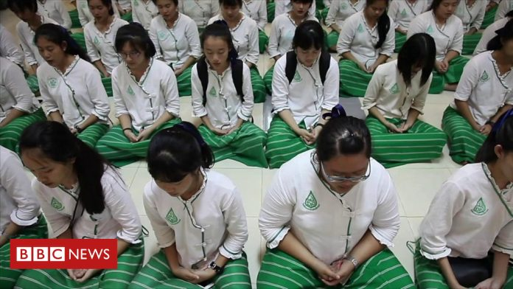
Proclaiming the WORD (2 Samuel 6:1-5, 12-19)
It Takes a Village

Slide 26
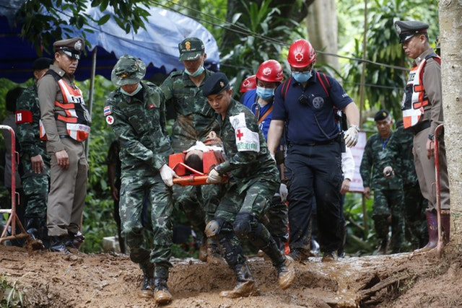
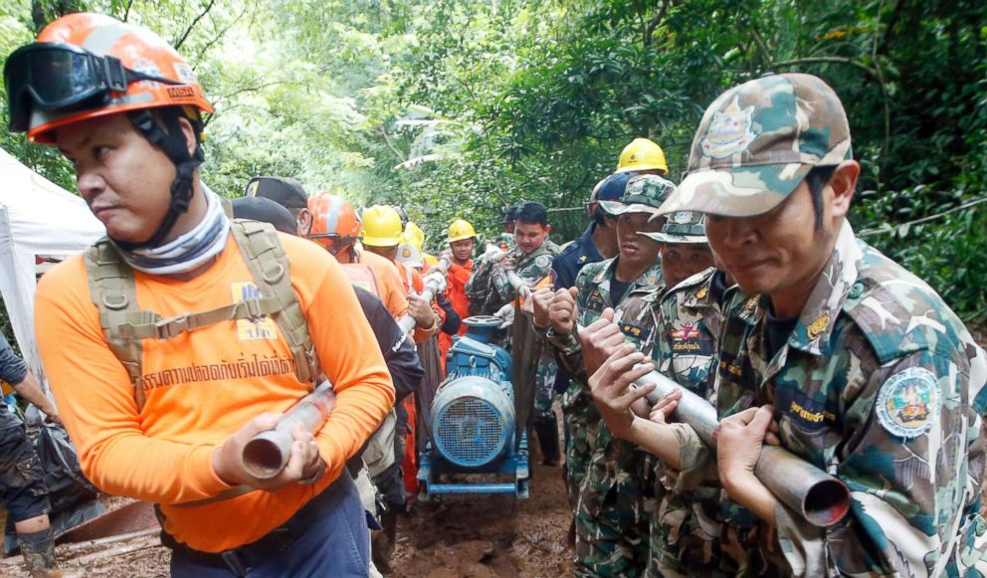
Proclaiming the WORD (2 Samuel 6:1-5, 12-19)
It Takes a Village

Slide 27
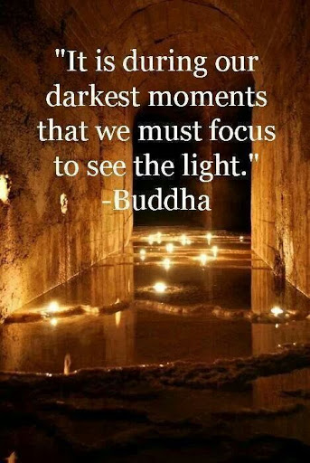
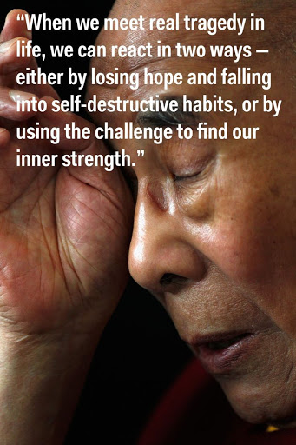
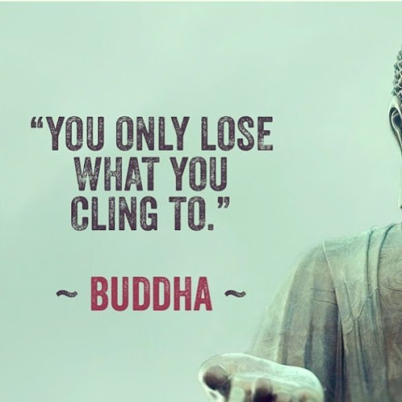
Proclaiming the WORD (2 Samuel 6:1-5, 12-19)
It Takes a Village

Slide 28
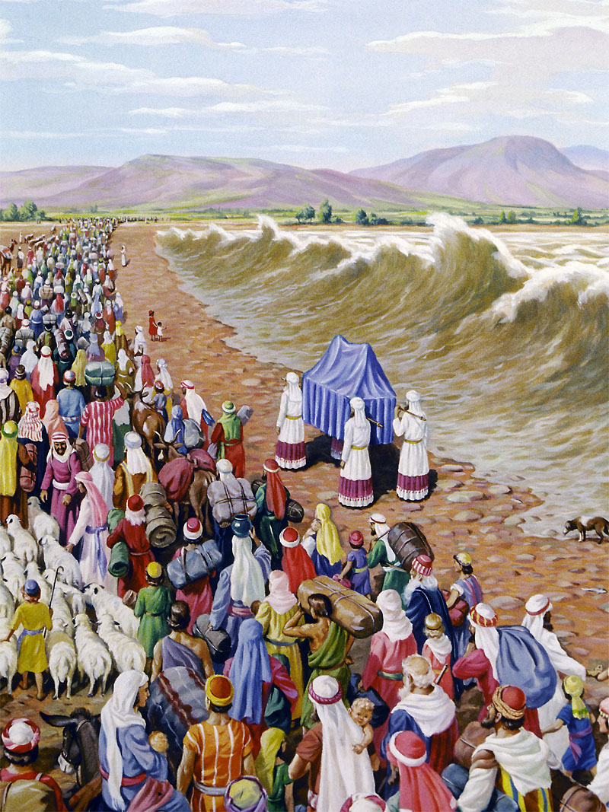
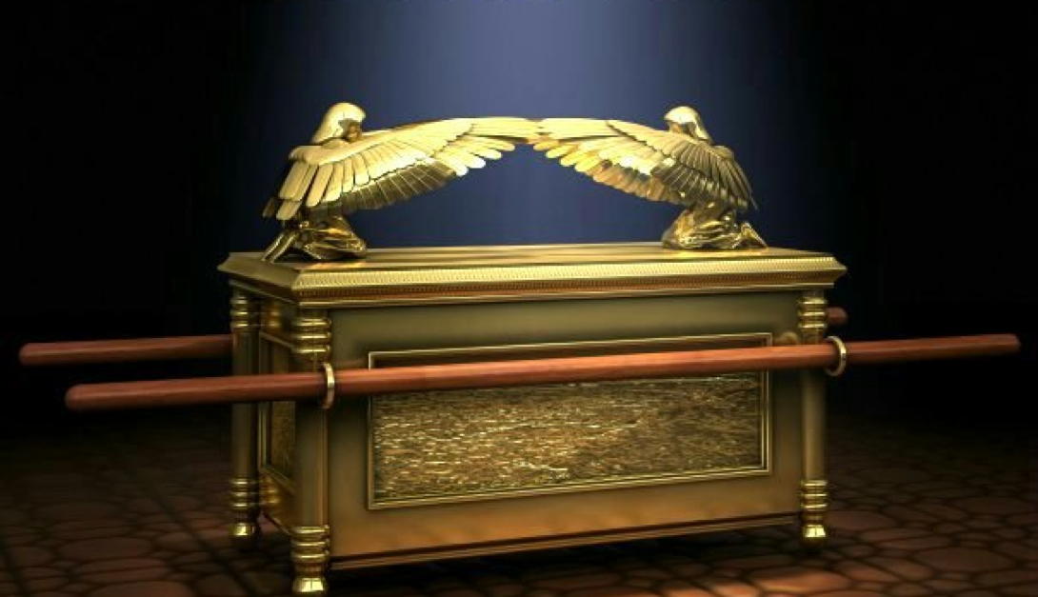
Proclaiming the WORD (2 Samuel 6:1-5, 12-19)
It Takes a Village

Slide 29
Responding Hymn # 329 “God Is Our Refuge and Our Strength”
God is our refuge and our strength, our ever-present aid, and therefore, though the earth be moved, we will not be afraid;

Slide 30
Responding Hymn # 329 “God Is Our Refuge and Our Strength”
Though hills amid the seas be cast, though foaming waters roar, yea, though the mighty billows shake the mountains on the shore.

Slide 31
Responding Hymn # 329 “God Is Our Refuge and Our Strength”
Where God abides a river flows; that city will rejoice. But nations fear and kingdoms shake before God's thundering voice.

Slide 32
Responding Hymn # 329 “God Is Our Refuge and Our Strength”
Since God is in the midst of it, the city walls shall stand, secure and safe with God's sure help, when trouble is at hand.

Slide 33
Bearing and Following the WORD into the World Affirmation of Faith –
Ephesians 1:3-14 (To be read responsively)
³Blessed be the God and Father of our Lord Jesus Christ, who has blessed us in Christ with every spiritual blessing in the heavenly places, ⁴just as he chose us in Christ before the foundation of the world to be holy and blameless before him in love.
⁵He destined us for adoption as his children through Jesus Christ, according to the good pleasure of his will, ⁶to the praise of his glorious grace that he freely bestowed on us in the Beloved.

Slide 34
Bearing and Following the WORD into the World Affirmation of Faith –
Ephesians 1:3-14 (To be read responsively)
⁷In him we have redemption through his blood, the forgiveness of our trespasses, according to the riches of his grace ⁸that he lavished on us.
With all wisdom and insight ⁹he has made known to us the mystery of his will, according to his good pleasure that he set forth in Christ, ¹⁰as a plan for the fullness of time, to gather up all things in him, things in heaven and things on earth.

Slide 35
Bearing and Following the WORD into the World Affirmation of Faith –
Ephesians 1:3-14 (To be read responsively)
¹¹In Christ we have also obtained an inheritance, having been destined according to the purpose of him who accomplishes all things according to his counsel and will, ¹²so that we, who were the first to set our hope on Christ, might live for the praise of his glory.
¹³In him you also, when you had heard the word of truth, the gospel of your salvation, and had believed in him, were marked with the seal of the promised Holy Spirit; ¹⁴this is the pledge of our inheritance toward redemption as God's own people, to the praise of his glory.

Slide 36
Bearing and Following the WORD into the World Announcements &
Sharing of Joys and Concerns
The Sunday afternoon Bible Study and the Women's Group are on summer break. They will resume in September.
Special thanks to those who participated and contributed in our Pot-Luck fellowship lunch gathering yesterday. Thank you.

Slide 37
Bearing and Following the WORD into the World Prayer of the People & The Lord’s Prayer
Our Father, who art in heaven.
Halloweth be thy name.
Thy Kingdom come; Thy will be done
On earth as it is in heaven.
Give us this day our daily bread.
Forgive us our debts; as we forgive our debtors.
Lead us not into temptations, but deliver us from evil.
For Thine is the Kingdom, the Power, and the Glory forever. Amen.

Slide 38
Bearing and Following the WORD into the World Offering of our Gifts and our Lives
Musical Offering

Slide 39
Bearing and Following the WORD into the World Doxology and Offertory Prayer

Slide 40
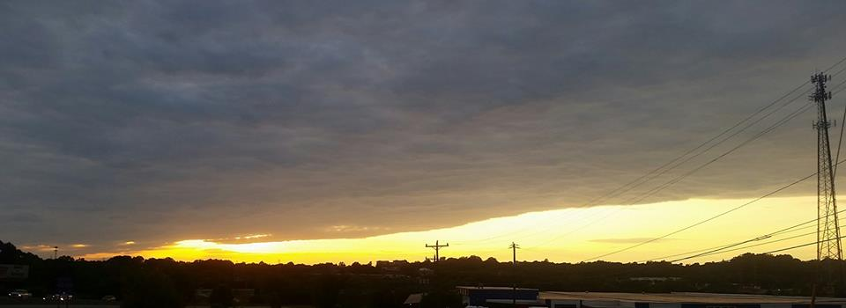
Sending Hymn #327 “From All That Dwell Below the Skies”
From all that dwell below the skies let the Creator's praise arise: Alleluia! Alleluia! Let the Redeemer's name be sung through every land, in every tongue. Alleluia! Alleluia! Alleluia! Alleluia! Alleluia!

Slide 41
Sending Hymn #327 “From All That Dwell Below the Skies”
In every land begin the song; to every land the strains belong: Alleluia! Alleluia! In cheerful sound all voices raise and fill the world with joyful praise. Alleluia! Alleluia! Alleluia! Alleluia! Alleluia!

Slide 42
Sending Hymn #327 “From All That Dwell Below the Skies”
Eternal are thy mercies, Lord; eternal truth attends thy word: Alleluia! Alleluia! Thy praise shall sound from shore to shore, till suns shall rise and set no more. Alleluia! Alleluia! Alleluia! Alleluia! Alleluia!

Slide 43
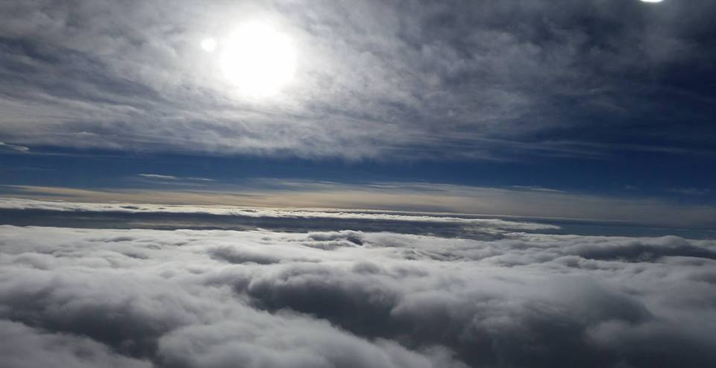
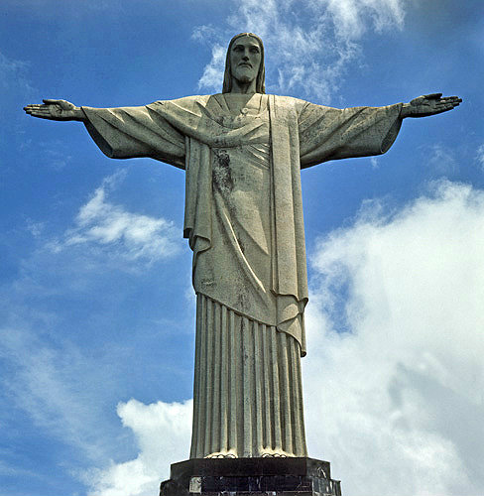
Bearing and Following the WORD into the World The Charge and Benediction

Slide 44
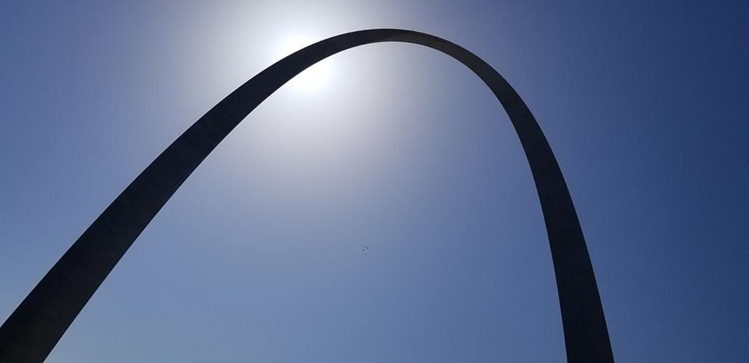
Bearing and Following the WORD into the World Benediction Response
# 547 “Go, My Children, with My Blessing”
(Stanza 3)
“Go, my children, fed and nourished, closer to me. Grow in love and love by serving, joyful and free. Here my Spirit’s power filled you; here my tender comfort stilled you. Go, my children, fed and nourished, joyful and free.”

Slide 45
Homecrest Presbyterian Church Worship of the Lord’s Day 15th Sunday in Ordinary Time July 15th, 2018

