Slide 1
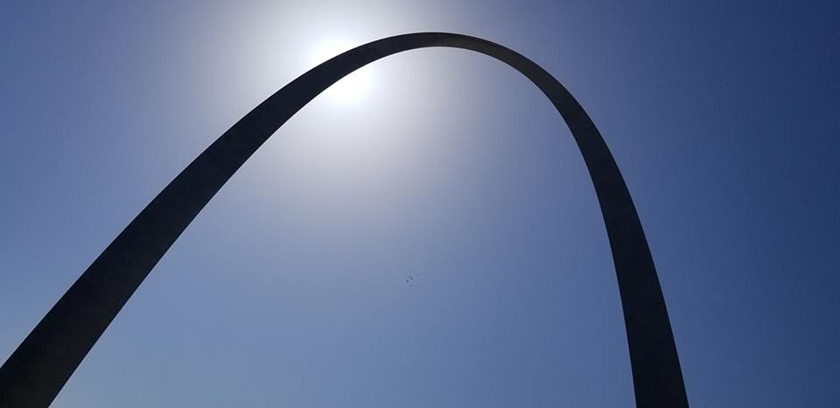
Homecrest Presbyterian Church Worship of the Lord’s Day 14th Sunday in Ordinary Time July 8th, 2018

Slide 2
Gathering Around the WORD Call to Worship
(Psalm 48)
Great is the LORD and greatly to be praised in the city of our God.
His holy mountain, beautiful in elevation, is the joy of all the earth,
We ponder your steadfast love, O God, in the midst of your temple.
Your name, O God, like your praise, reaches to the ends of the earth.

Slide 3
Gathering Around the WORD Call to Worship
(Psalm 48)
Your right hand is filled with victory.
Let Mount Zion be glad, let the towns of Judah rejoice because of your judgments.
Walk about Zion, go all around it, count its towers, consider well its ramparts;
go through its citadels, that you may tell the next generation that this is God, our God forever and ever. He will be our guide forever.

Slide 4
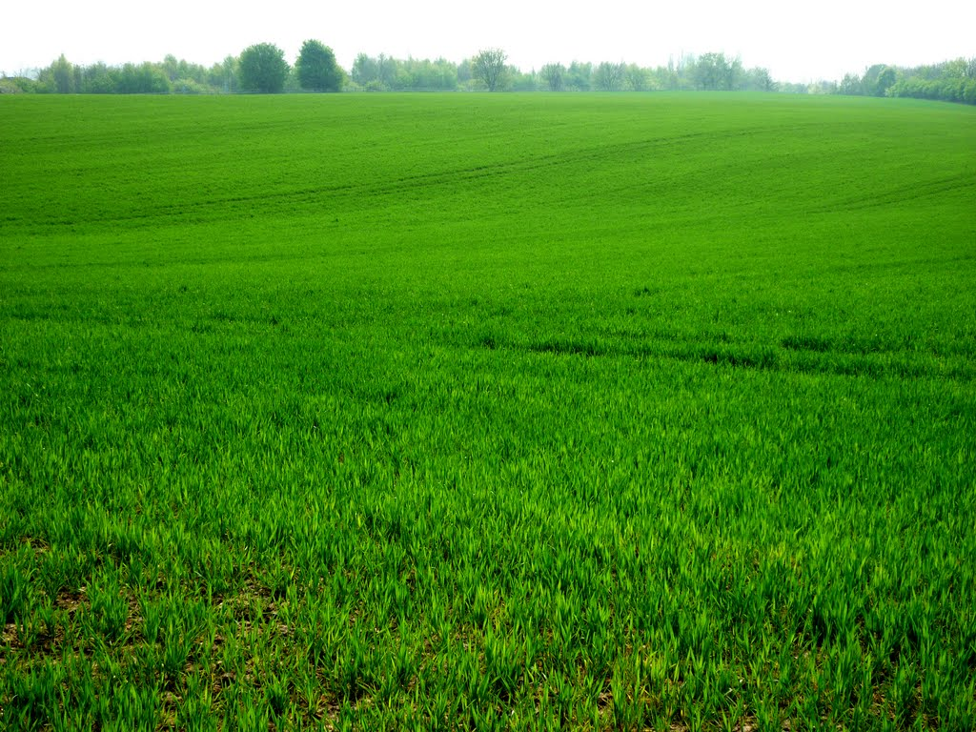
Gathering Around the WORD Gathering Hymn # 187 “Savior, Like a Shepherd Lead Us”
Savior, like a shepherd lead us; much we need your tender care. In your pleasant pastures feed us; for our use your fold prepare. Blessed Jesus, blessed Jesus, you have bought us: we are yours. Blessed Jesus, blessed Jesus, you have bought us: we are yours.

Slide 5
Gathering Around the WORD Gathering Hymn # 187 “Savior, Like a Shepherd Lead Us”
We are yours: in love befriend us; be the guardian of our way. Keep your flock: from sin defend us; seek us when we go astray. Blessed Jesus, blessed Jesus, hear your children when we pray. Blessed Jesus, blessed Jesus, hear your children when we pray.

Slide 6
Gathering Around the WORD Gathering Hymn # 187 “Savior, Like a Shepherd Lead Us”
You have promised to receive us, poor and sinful though we be; you have mercy to relieve us, grace to cleanse, and power to free. Blessed Jesus, blessed Jesus, early let us turn to you. Blessed Jesus, blessed Jesus, early let us turn to you.

Slide 7
Gathering Around the WORD Gathering Hymn # 187 “Savior, Like a Shepherd Lead Us”
Early let us seek your favor; early let us do your will. Blessed Lord and only Savior, with your love our spirits fill. Blessed Jesus, blessed Jesus, you have loved us; love us still. Blessed Jesus, blessed Jesus, you have loved us; love us still.

Slide 8
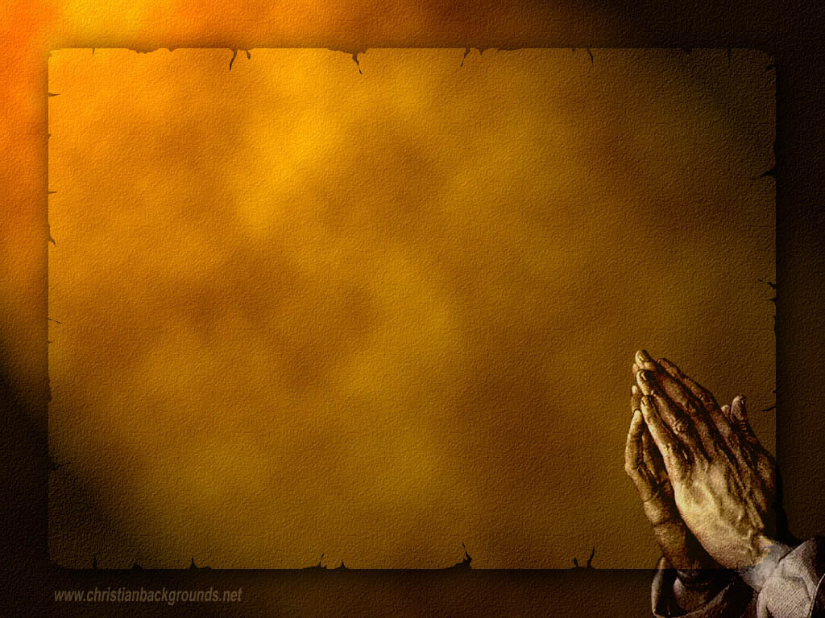
Gathering Around the WORD Call to Confession Our God is merciful and abundance with steadfast love. Yet time after time, we attempt to act according to our own will, instead of God’s. We have disappointed God who entrusted us with all that belongs to God. Let us confess in our hearts our sins to God, whose power is made perfect in our weakness.

Slide 9
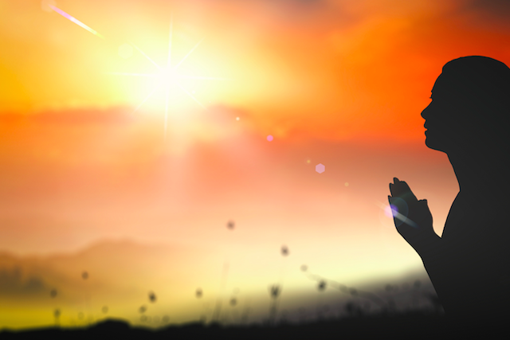
Gathering Around the WORD Prayer of Confession (in unison)
Ezekiel 2:3-4
Holy God, you call us to boldly proclaim your name, yet we are stubborn and rebellious and heedless of your call. By the power of you Spirit, raise us to new life that we may return to faithful living, in Christ’s name we pray, Amen.

Slide 10
Gathering Around the WORD Declaration of Forgiveness
Sisters and brothers, God loves us, forgives us, and frees us from our sins; therefore be at peace and love with boldness and generosity.
God has forgiven us in spite of who we are and what we have done, so therefore let us forgive our brothers and sisters too. Thanks be to God, Amen.

Slide 11
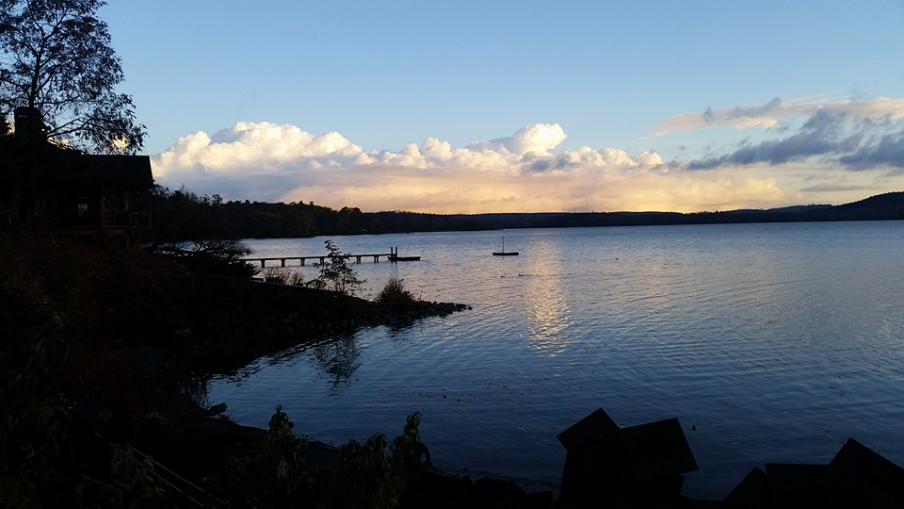
Gathering Around the WORD Gloria Patri
Glory be to the Father
and to the Son and to the Holy Ghost;
As it was in the beginning,
is now, and ever shall be,
world without end. Amen, Amen.

Slide 12
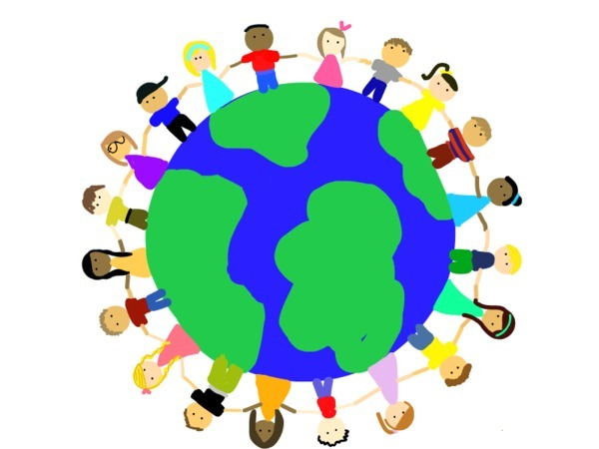
Gathering Around the WORD Passing of the Peace of Christ

Slide 13
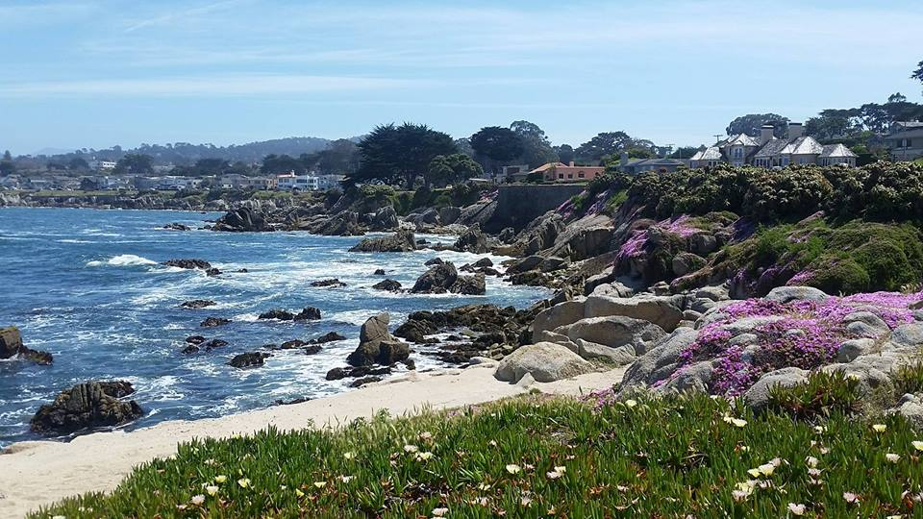
Proclaiming the WORD Message to the Youth/ Prayer of Illumination

Slide 14
Proclaiming the WORD Scripture Reading (Mark 6:1-13)
¹He left that place and came to his hometown, and his disciples followed him. ²On the sabbath he began to teach in the synagogue, and many who heard him were astounded. They said, "Where did this man get all this? What is this wisdom that has been given to him? What deeds of power are being done by his hands! ³Is not this the carpenter, the son of Mary and brother of James and Joses and Judas and Simon, and are not his sisters here with us?" And they took offense at him.

Slide 15
Proclaiming the WORD Scripture Reading (Mark 6:1-13)
⁴Then Jesus said to them, "Prophets are not without honor, except in their hometown, and among their own kin, and in their own house." ⁵And he could do no deed of power there, except that he laid his hands on a few sick people and cured them. ⁶And he was amazed at their unbelief.

Slide 16
Proclaiming the WORD Scripture Reading (Mark 6:1-13)
Then he went about among the villages teaching. ⁷He called the twelve and began to send them out two by two, and gave them authority over the unclean spirits. ⁸He ordered them to take nothing for their journey except a staff; no bread, no bag, no money in their belts; ⁹but to wear sandals and not to put on two tunics. ¹⁰He said to them, "Wherever you enter a house, stay there until you leave the place. ¹¹If any place will not welcome you and they refuse to hear you, as you leave, shake off the dust that is on your feet as a testimony against them."

Slide 17
Proclaiming the WORD Scripture Reading (Mark 6:1-13)
¹²So they went out and proclaimed that all should repent. ¹³They cast out many demons, and anointed with oil many who were sick and cured them.

Slide 18
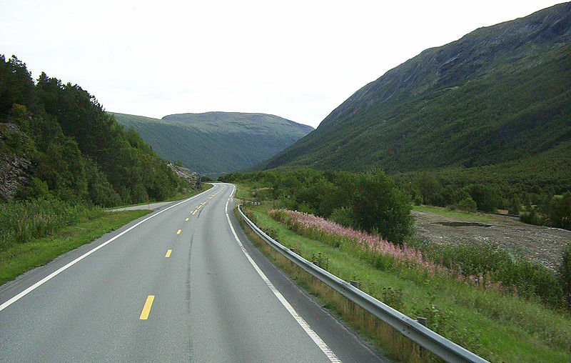
Proclaiming the WORD (Mark 6:1-13)
Travel Lightly

Slide 19
Responding Hymn # 726 “Will You Come and Follow Me?”
“Will you come and follow me
if I but call your name? Will you go where you don’t know
and never be the same? Will you let my love be shown;
will you let my name be known; will you let my life be grown in you
and you in me?”

Slide 20
Responding Hymn # 726 “Will You Come and Follow Me?”
“Will you leave yourself behind
if I but call your name? Will you care for cruel and kind
and never be the same? Will you risk the hostile stare
should your life attract or scare? Will you let me answer prayer
in you and you in me?”

Slide 21
Responding Hymn # 726 “Will You Come and Follow Me?”
“Will you let the blinded see
if I but call your name? Will you set the prisoners free
and never be the same? Will you kiss the leper clean,
and do such as this unseen, and admit to what I mean in you
and you in me?”

Slide 22
Responding Hymn # 726 “Will You Come and Follow Me?”
“Will you love the ‘you’ you hide
if I but call your name? Will you quell the fear inside
and never be the same? Will you use the faith you’ve found
to reshape the world around, through my sight and touch and sound in you and you in me?”

Slide 23
Responding Hymn # 726 “Will You Come and Follow Me?”
Lord, your summons echoes true
when you but call my name. Let me turn and follow you
and never be the same. In your company I’ll go
where your love and footsteps show. Thus I’ll move and live and grow
in you and you in me.

Slide 24
Bearing and Following the WORD into the World Affirmation of Faith – Nicene Creed
We Believe in one God, the Father, the Almighty, maker of heaven and earth, of all that is, seen and unseen.
We Believe in one Lord, Jesus Christ, the only Son of God, eternally begotten of the Father, God from God, light from light, true God from true God, begotten, not made, of one Being with the Father; through him all things were made.

Slide 25
Bearing and Following the WORD into the World Affirmation of Faith – Nicene Creed
For us and for our salvation he came down from heaven, was incarnate of the Holy Spirit
and the Virgin Mary and became truly human.
For our sake he was crucified under Pontius Pilate; he suffered death and was buried.

Slide 26
Bearing and Following the WORD into the World Affirmation of Faith – Nicene Creed
On the third day he rose again in accordance with the Scriptures; he ascended into heaven and is seated at the right hand of the Father. He will come again in glory to judge the living and the dead, and his kingdom will have no end.

Slide 27
Bearing and Following the WORD into the World Affirmation of Faith – Nicene Creed
We Believe in the Holy Spirit,
the Lord, the giver of life, who proceeds from the Father and the Son, who with the Father and the Son
is worshiped and glorified, who has spoken through the prophets. We Believe in one holy catholic
and apostolic Church. We acknowledge one baptism
for the forgiveness of sins. We look for the resurrection of the dead, and the life of the world to come. Amen.

Slide 28
Bearing and Following the WORD into the World Announcements &
Sharing of Joys and Concerns
The Sunday afternoon Bible Study and the Women's Group are on summer break. They will resume in September.
We will be having a Pot-Luck fellowship lunch gathering on Saturday, 7/14 at Noon. The event is free, but we ask all participants to contribute a food item to share with everyone else. We are called to be a community of sharing. If everyone brings something, we will have a lot. Please indicate what you will bring on the sign-up sheet. Please invite you friends and neighbors to attend as well.

Slide 29
Bearing and Following the WORD into the World Prayer of the People & The Lord’s Prayer
Our Father, who art in heaven.
Halloweth be thy name.
Thy Kingdom come; Thy will be done
On earth as it is in heaven.
Give us this day our daily bread.
Forgive us our debts; as we forgive our debtors.
Lead us not into temptations, but deliver us from evil.
For Thine is the Kingdom, the Power, and the Glory forever. Amen.

Slide 30
Bearing and Following the WORD into the World Offering of our Gifts and our Lives
Musical Offering

Slide 31
Bearing and Following the WORD into the World Doxology and Offertory Prayer

Slide 32
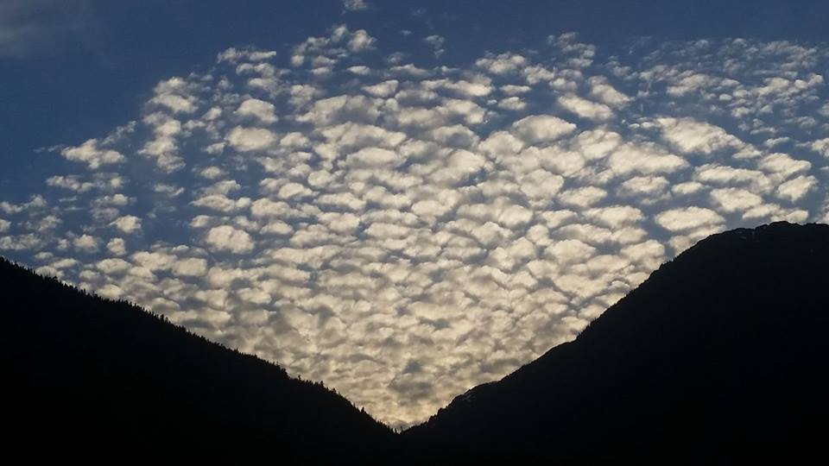
Sending Hymn #666 “O Splendor of God’s Glory Bright”
O splendor of God’s glory bright, from light eternal bringing light; O Light of Light, light’s living spring, true Day, all days illumining:

Slide 33
Sending Hymn #666 “O Splendor of God’s Glory Bright”
Come, Holy Sun of heavenly love, rain down your radiance from above, and to our inward hearts convey the Holy Spirit’s cloudless ray.

Slide 34
Sending Hymn #666 “O Splendor of God’s Glory Bright”
O joyful be the passing day with thoughts as clear as morning’s ray, with faith like noontide shining bright, our souls unshadowed by the night.

Slide 35
Sending Hymn #666 “O Splendor of God’s Glory Bright”
O Lord, with each returning morn, your image to our heart is born; O may we ever clearly view our Savior and our God in you.

Slide 36
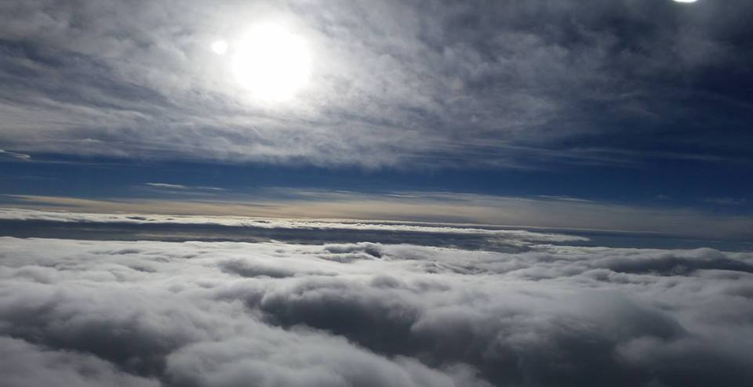
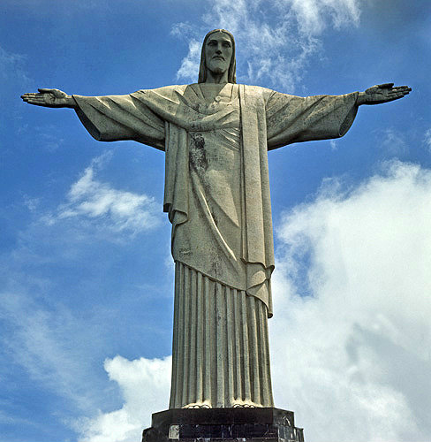
Bearing and Following the WORD into the World The Charge and Benediction

Slide 37
Bearing and Following the WORD into the World Benediction Response
# 547 “Go, My Children, with My Blessing”
(Stanza 2)
“Go, my children, sins forgiven,
at peace and pure. Here you learned how much I love you,
what I can cure. Here you heard my dear Son’s story; here you touched him, saw his glory. Go, my children, sins forgiven, at peace and pure.”

Slide 38
Homecrest Presbyterian Church Worship of the Lord’s Day 14th Sunday in Ordinary Time July 8th, 2018

