Slide 1
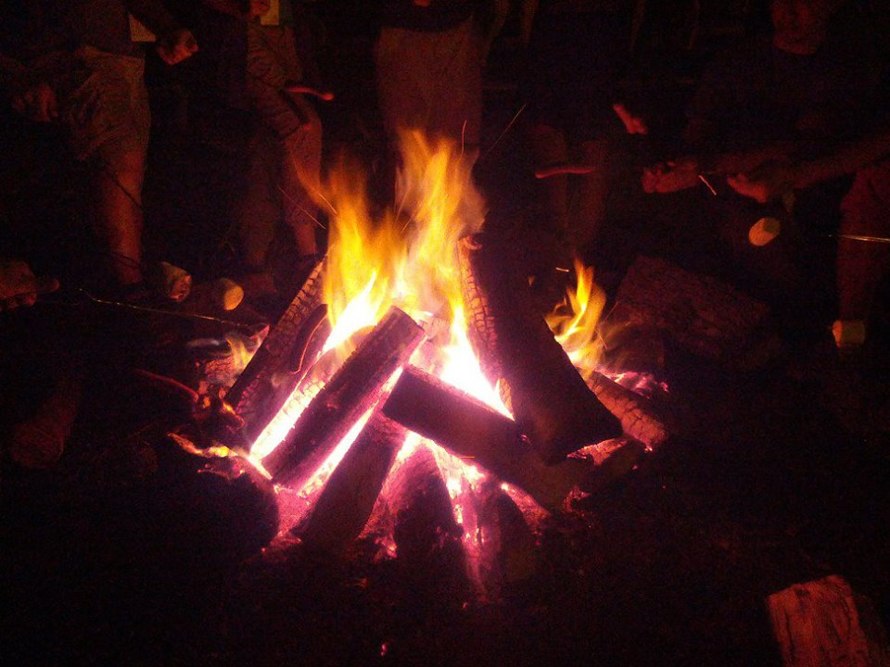
Homecrest Presbyterian Church Worship of the Lord’s Day 1st Sunday after Pentecost May 27th, 2018

Slide 2
Gathering Around the WORD Call to Worship
(Excerpted from Psalm 29)
Jesus said, “The way to see God’s dream for the world is to be born from above by the Spirit.” The way to take part in that dream, says Jesus, is to be born of water and Spirit.
That gift is available to us this day. May we live faithfully in God’s way and not our and abide in God’s love and Spirit. Let us worship God!

Slide 3
Gathering Around the WORD Gathering Hymn # 289 “On Pentecost They Gathered”
On Pentecost they gathered quite early in the day, a band of Christ's disciples, to worship, sing, and pray. A mighty wind came blowing, filled all the swirling air, and tongues of fire aglowing inspired each person there

Slide 4
Gathering Around the WORD Gathering Hymn # 289 “On Pentecost They Gathered”
The people all around them were startled and amazed to understand their language, as Christ the Lord they praised. What universal message, what great good news was here? That Christ, once dead, is risen to vanquish all our fear.

Slide 5
Gathering Around the WORD Gathering Hymn # 289 “On Pentecost They Gathered”
God pours the Holy Spirit on all who would believe, on women, men, and children who would God's grace receive. That Spirit knows no limit, bestowing life and power. The church, formed and reforming, responds in every hour.

Slide 6
Gathering Around the WORD Gathering Hymn # 289 “On Pentecost They Gathered”
O Spirit, sent from heaven on that day long ago, rekindle faith among us in all life's ebb and flow. O give us ears to listen and tongues aflame with praise, so folk of every nation glad songs of joy shall raise.

Slide 7
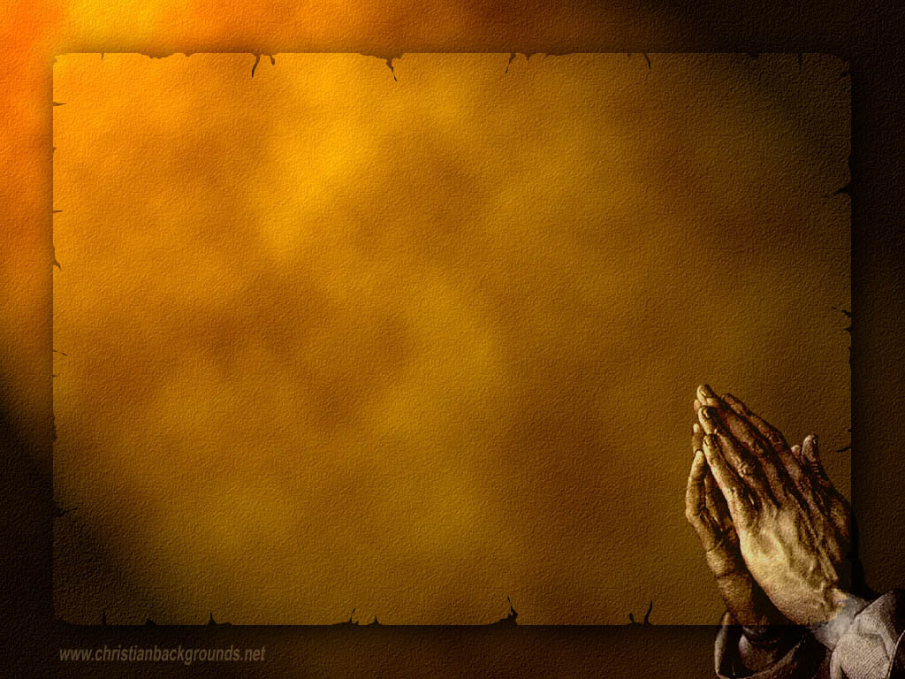
Gathering Around the WORD Call to Confession The Spirit of Pentecost calls us into a community bonded together in God’s covenant among us. In humility and faith, let us humble our hearts by invoking the Holy Spirit to speak honestly among us as we confess our sins before God and our neighbors.

Slide 8
Gathering Around the WORD Prayer of Confession (in unison)
Holy God, we know that you are always there to lead us, yet we somehow lose our way and fall back into fear. We confess that we have stumbled, and we recognize our need for you to lift us up and help us start again. Forgive us our failings, restore us to strength, and reconcile us with you and one another. Through the power of Christ and the gift of your Holy Spirit, Amen.

Slide 9
Gathering Around the WORD Declaration of Forgiveness
Sisters and Brothers, God has embraced us through the Spirit of adoption.
Even though we do not deserve such merit and grace, God still descend upon us, in the form of the Son and the Holy Spirit. God cares for us; God loves us; and God forgives us. Thanks be to God, Amen.

Slide 10
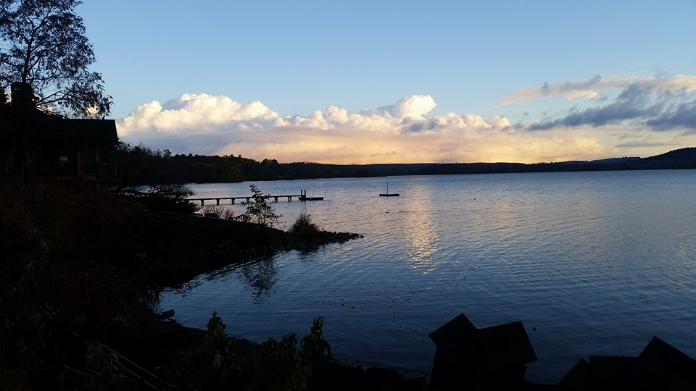
Gathering Around the WORD Gloria Patri
Glory be to the Father
and to the Son and to the Holy Ghost;
As it was in the beginning,
is now, and ever shall be,
world without end. Amen, Amen.

Slide 11
Gathering Around the WORD Passing of the Peace of Christ
(John 14:27)
Jesus said, “Peace I leave with you; my peace I give to you. I do not give to you as the world gives. Do not let your hearts be troubled, and do not let them be afraid.”

Slide 12
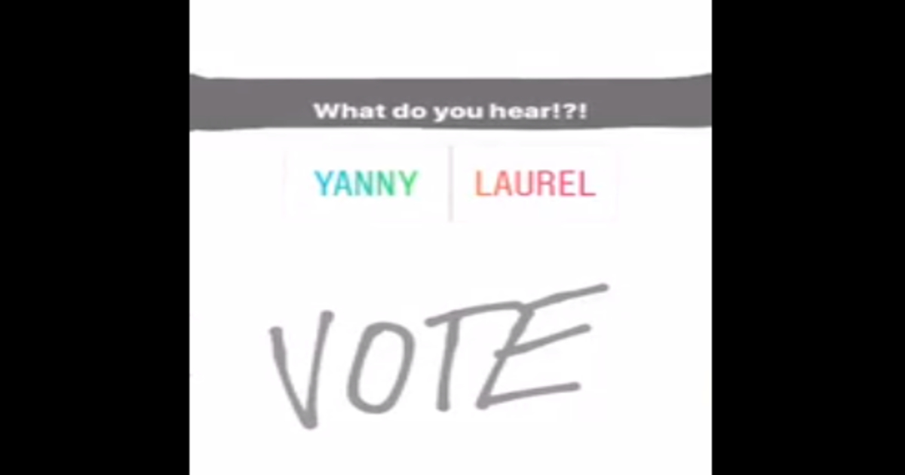
Proclaiming the WORD Message to the Youth/ Prayer of Illumination

Slide 13
Proclaiming the WORD Responsive Reading (Psalm 29)
¹ Ascribe to the LORD, O heavenly beings, ascribe to the LORD glory and strength. ² Ascribe to the LORD the glory of his name; worship the LORD in holy splendor.
³ The voice of the LORD is over the waters; the God of glory thunders, the LORD, over mighty waters. ⁴ The voice of the LORD is powerful; the voice of the LORD is full of majesty.

Slide 14
Proclaiming the WORD Responsive Reading (Psalm 29)
⁵ The voice of the LORD breaks the cedars; the LORD breaks the cedars of Lebanon. ⁶ He makes Lebanon skip like a calf, and Sirion like a young wild ox.
⁷ The voice of the LORD flashes forth flames of fire. ⁸ The voice of the LORD shakes the wilderness; the LORD shakes the wilderness of Kadesh.

Slide 15
Proclaiming the WORD Responsive Reading (Psalm 29)
⁹ The voice of the LORD
causes the oaks to whirl, and strips the forest bare; and in his temple all say, “Glory!”
¹⁰ The LORD sits enthroned over the flood; the LORD sits enthroned as king for ever. ¹¹ May the LORD give strength to his people! May the LORD bless his people with peace!

Slide 16
Proclaiming the WORD Scripture Reading (John 3:1-17)
¹Now there was a Pharisee named Nicodemus, a leader of the Jews. ²He came to Jesus by night and said to him, “Rabbi, we know that you are a teacher who has come from God; for no one can do these signs that you do apart from the presence of God.” ³Jesus answered him, “Very truly, I tell you, no one can see the kingdom of God without being born from above.” ⁴Nicodemus said to him, “How can anyone be born after having grown old? Can one enter a second time into the mother’s womb and be born?”

Slide 17
Proclaiming the WORD Scripture Reading (John 3:1-17)
⁵Jesus answered, “Very truly, I tell you, no one can enter the kingdom of God without being born of water and Spirit. ⁶What is born of the flesh is flesh, and what is born of the Spirit is spirit. ⁷Do not be astonished that I said to you, ‘You must be born from above.’ ⁸The wind blows where it chooses, and you hear the sound of it, but you do not know where it comes from or where it goes. So it is with everyone who is born of the Spirit.” ⁹Nicodemus said to him, “How can these things be?” ¹⁰Jesus answered him, “Are you a teacher of Israel, and yet you do not understand these things?

Slide 18
Proclaiming the WORD Scripture Reading (John 3:1-17)
¹¹“Very truly, I tell you, we speak of what we know and testify to what we have seen; yet you do not receive our testimony. ¹²If I have told you about earthly things and you do not believe, how can you believe if I tell you about heavenly things? ¹³No one has ascended into heaven except the one who descended from heaven, the Son of Man. ¹⁴And just as Moses lifted up the serpent in the wilderness, so must the Son of Man be lifted up, ¹⁵that whoever believes in him may have eternal life.

Slide 19
Proclaiming the WORD Scripture Reading (John 3:1-17)
¹⁶“For God so loved the world that he gave his only Son, so that everyone who believes in him may not perish but may have eternal life.
¹⁷“Indeed, God did not send the Son into the world to condemn the world, but in order that the world might be saved through him.”

Slide 20
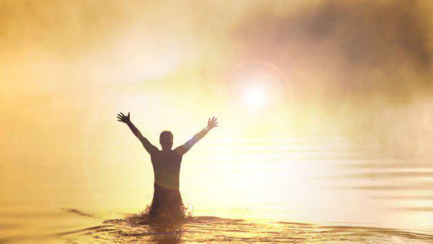
Proclaiming the WORD (John 3:1-17)
Seriously…Born Again?!?

Slide 21
Responding Hymn # 297 “In Christ Called to Baptize”
In Christ called to banquet,
one table we share, a haven of welcome, a circle of care. Although we are many,
we share in one bread. One cup of thanksgiving
proclaims Christ, our head.

Slide 22
Responding Hymn # 297 “In Christ Called to Baptize”
In Christ called to baptize,
we witness to grace and gather a people
from each land and race. In deep, flowing waters,
we share in Christ’s death, then, rising to new life,
give thanks with each breath.

Slide 23
Responding Hymn # 297 “In Christ Called to Baptize”
In Christ called to witness,
by grace we will preach the life-giving gospel;
God’s love we will teach. By grace may our living
give proof to our praise in costly compassion
reflecting Christ’s ways.

Slide 24
Responding Hymn # 297 “In Christ Called to Baptize”
Unite us, anoint us, O Spirit of love, for you are within us, around us, above. Equip us for service
with gifts you bestow. In Christ is our calling.
In Christ may we grow.

Slide 25
Bearing and Following the WORD into the World Announcements &
Sharing of Joys and Concerns
The afternoon Bible Study Group will be meeting today downstairs at 12:30 in the basement.
The Women's Group will continue to meet on Wednesdays at 7:30pm over at the Manse
(2048 E 14th Street). They are currently studying
the book of Isaiah. For more information, please
contact Margaret or Cara.

Slide 26
Bearing and Following the WORD into the World Announcements &
Sharing of Joys and Concerns
The Memorial Service for Virginia Udell Gray Facella (Mother-in-Law of Harvey Watt)
will be held at 2pm this coming Saturday, 6/2.
The next Session meeting will be on Monday, 6/4.

Slide 27
Bearing and Following the WORD into the World Affirmation of Faith - Pentecost
WE BELIEVE that the eternal Father of our Lord Jesus Christ, who out of nothing created heaven and earth and everything in them, who still upholds and rules them by his eternal counsel and providence, is our God and Father because of Christ his Son.
WE BELIEVE in Jesus Christ, the eternal Word made flesh. He is the long-awaited Savior, fully human and fully divine, conceived by the Spirit of God and born of the virgin Mary, sent by God to reconcile the world to himself.

Slide 28
Bearing and Following the WORD into the World Affirmation of Faith - Pentecost
WE BELIEVE that Jesus, in the events of his earthly life—his temptations and suffering, his teaching and miracles, his battles with demons and talks with sinners—made present in deed and in word the coming rule of God.
WE BELIEVE that at Pentecost the Holy Spirit was given to the church. Jesus stays with us in the Spirit, who renews our hearts, moves us to faith, leads us in the truth, stands by us in our need, and makes our obedience fresh and vibrant.

Slide 29
Bearing and Following the WORD into the World Prayer of the People & The Lord’s Prayer
Our Father, who art in heaven.
Halloweth be thy name.
Thy Kingdom come; Thy will be done
On earth as it is in heaven.
Give us this day our daily bread.
Forgive us our debts; as we forgive our debtors.
Lead us not into temptations, but deliver us from evil.
For Thine is the Kingdom, the Power, and the Glory forever. Amen.

Slide 30
Bearing and Following the WORD into the World Offering of our Gifts and our Lives
Musical Offering

Slide 31
Bearing and Following the WORD into the World Doxology and Offertory Prayer

Slide 32
Sending Hymn #308 “O God in Whom All Life Begins”
O God in whom all life begins, who births the seed to fruit, bestow your blessing on our lives; here let your love find root. Bring forth in us the Spirit’s gifts of patience, joy, and peace; deliver us from numbing fear, and grant our faith increase.

Slide 33
Sending Hymn #308 “O God in Whom All Life Begins”
Unite in mutual ministry our minds and hands and hearts that we may have the grace to seek the power your peace imparts. So let our varied gifts combine to glorify your Name that in all things by word and deed we may your love proclaim.

Slide 34
Sending Hymn #308 “O God in Whom All Life Begins”
Through tears and laughter,
grief and joy, enlarge our trust and care; so bind us in community that we may risk and dare. Be with us when we gather here to worship, sing, and pray; then send us forth in power and faith to live the words we say.

Slide 35
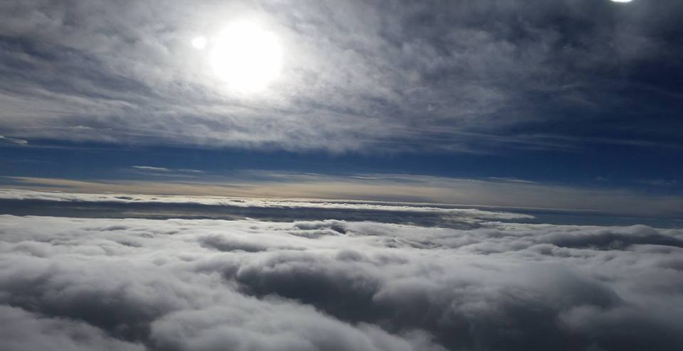
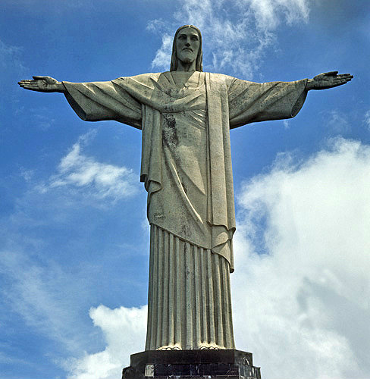
Bearing and Following the WORD into the World The Charge and Benediction

Slide 36
Bearing and Following the WORD into the World Benediction Response
# 540 “Farewell, Good Friends”
Farewell, Good friends!
Farewell, Good friends!
Shalom, Shalom! Till we meet again, till we meet again, Shalom, Shalom.

Slide 37
Homecrest Presbyterian Church Worship of the Lord’s Day 1st Sunday after Pentecost May 27th, 2018

