Slide 1
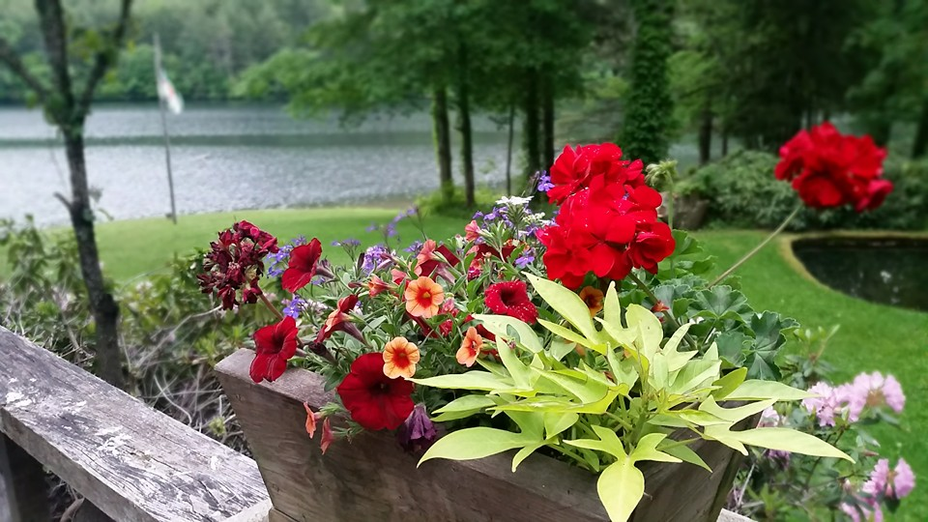
Homecrest Presbyterian Church Worship of the Lord’s Day 7th Sunday of Easter May 13th, 2018

Slide 2
Gathering Around the WORD Call to Worship
(Based on Ephesians 1:15-20)
The risen Christ has granted us a spirit of wisdom and revelation of our faith. With the eyes of our hearts enlightened,
we see the greatness of Christ’s power at work. God has put this power to work in Christ when God raised his son from the dead, who is now seated at the heavenly throne.
Let us join our hearts, sing praises and worship in God’s name.

Slide 3
Gathering Around the WORD Gathering Hymn # 267 “Come, Christians Join to Sing”
Come, Christians, join to sing:
Alleluia! Amen! Loud praise to Christ our King Alleluia! Amen! Let all, with heart and voice,
Before his throne rejoice;
Praise is his gracious choice: Alleluia! Amen!

Slide 4
Gathering Around the WORD Gathering Hymn # 267 “Come, Christians Join to Sing”
Come, lift your hearts on high: Alleluia! Amen! Let praises fill the sky: Alleluia! Amen! He is our guide and friend; to us he'll condescend; his love shall never end: Alleluia! Amen!

Slide 5
Gathering Around the WORD Gathering Hymn # 267 “Come, Christians Join to Sing”
Praise yet our Christ again: Alleluia! Amen! Life shall not end the strain: Alleluia! Amen! On heaven's blissful shore his goodness we'll adore, singing forevermore: Alleluia! Amen!

Slide 6
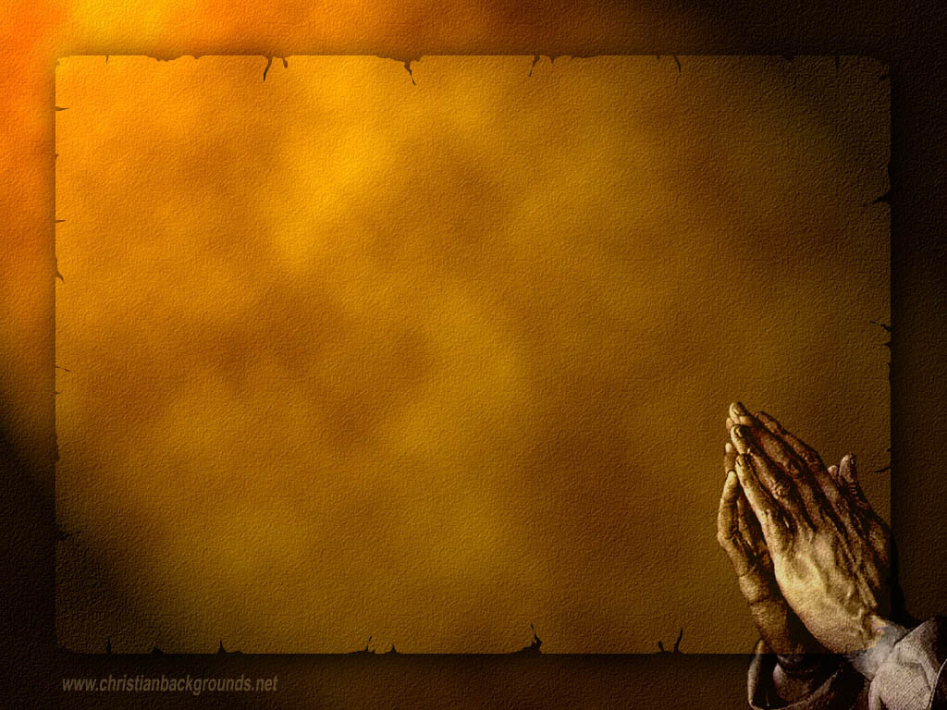
Gathering Around the WORD Call to Confession The Lord is merciful and gracious unto us and his faithfulness is steadfast. When we come before Him in humility, we surrender ourselves and acknowledge Him as our Lord and our Savior.

Slide 7
Gathering Around the WORD Prayer of Confession (in unison)
O Lord, though you have called us to delight in your teachings, we have become cynical and full of doubt. Do no judge us, we pray, but heal us and restore us to you. Guard us and protect us from evil, and sanctify us in the truth. In Jesus’ name we pray, Amen.

Slide 8
Gathering Around the WORD Declaration of Forgiveness (John 15:13)
In Christ, God has promised to forgive us and reconcile us to God and one another. Through Christ, we have been raised from the depth of our sins and empowered to proclaim and to bear witness of His resurrection.
Through the blood of Jesus Christ,
our hearts have been cleansed and our sins have been forgiven, Thanks be to God.

Slide 9
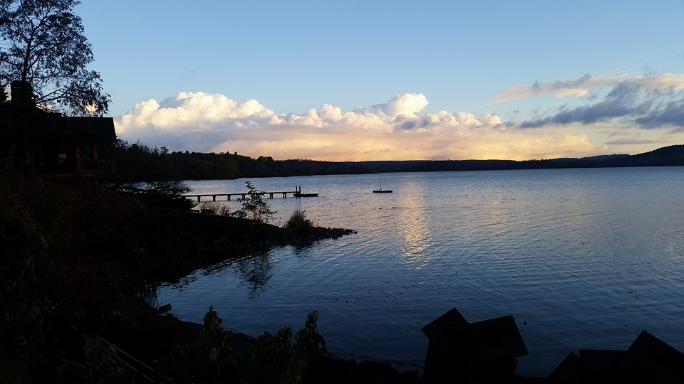
Gathering Around the WORD Gloria Patri
Glory be to the Father
and to the Son and to the Holy Ghost;
As it was in the beginning,
is now, and ever shall be,
world without end. Amen, Amen.

Slide 10
Gathering Around the WORD Passing of the Peace of Christ
(I John 4:4-8)
Beloved, let us love one another, because love is from God; everyone who loves is born of God and knows God. Whoever does not love does not know God, for God IS LOVE. Let us pass the peace of Christ and the love of God to our neighbors.

Slide 11
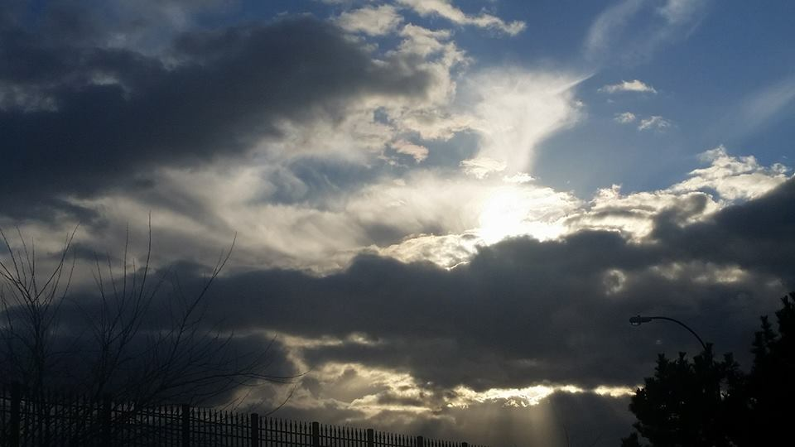
Proclaiming the WORD Message to the Youth/ Prayer of Illumination

Slide 12
Proclaiming the WORD Scripture Reading (Exodus 1:8-22)
⁸ Now a new king arose over Egypt, who did not know Joseph. ⁹ He said to his people, "Look, the Israelite people are more numerous and more powerful than we. ¹⁰ Come, let us deal shrewdly with them, or they will increase and, in the event of war, join our enemies and fight against us and escape from the land." ¹¹ Therefore they set taskmasters over them to oppress them with forced labor. They built supply cities, Pithom and Rameses, for Pharaoh. ¹² But the more they were oppressed, the more they multiplied and spread, so that the Egyptians came to dread the Israelites.

Slide 13
Proclaiming the WORD Scripture Reading (Exodus 1:8-22)
¹³ The Egyptians became ruthless in imposing tasks on the Israelites, ¹⁴ and made their lives bitter with hard service in mortar and brick and in every kind of field labor. They were ruthless in all the tasks that they imposed on them. ¹⁵ The king of Egypt said to the Hebrew midwives, one of whom was named Shiphrah and the other Puah, ¹⁶ "When you act as midwives to the Hebrew women, and see them on the birthstool, if it is a boy, kill him; but if it is a girl, she shall live." ¹⁷ But the midwives feared God; they did not do as the king of Egypt commanded them, but they let the boys live.

Slide 14
Proclaiming the WORD Scripture Reading (Exodus 1:8-22)
¹⁸ So the king of Egypt summoned the midwives and said to them, "Why have you done this, and allowed the boys to live?" ¹⁹ The midwives said to Pharaoh, "Because the Hebrew women are not like the Egyptian women; for they are vigorous and give birth before the midwife comes to them." ²⁰ So God dealt well with the midwives; and the people multiplied and became very strong. ²¹ And because the midwives feared God, he gave them families. ²² Then Pharaoh commanded all his people, "Every boy that is born to the Hebrews you shall throw into the Nile, but you shall let every girl live."

Slide 15
Proclaiming the WORD Scripture Reading (I John 5:9-13)
⁹If we receive human testimony, the testimony of God is greater; for this is the testimony of God that he has testified to his Son. ¹⁰Those who believe in the Son of God have the testimony in their hearts. Those who do not believe in God have made him a liar by not believing in the testimony that God has given concerning his Son. ¹¹And this is the testimony: God gave us eternal life, and this life is in his Son. ¹²Whoever has the Son has life; whoever does not have the Son of God does not have life.
¹³I write these things to you who believe in the name of the Son of God, so that you may know that you have eternal life.

Slide 16
Proclaiming the WORD (Exodus 1:8-22 and I John 5:9-13)
A Testimony of Life

Slide 17
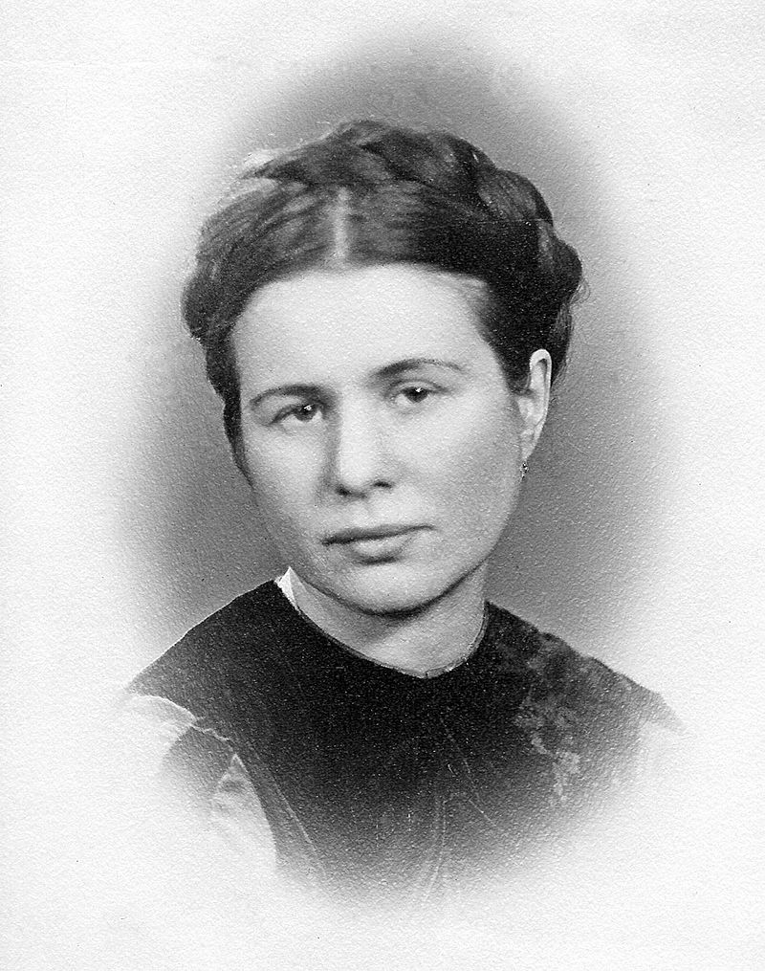
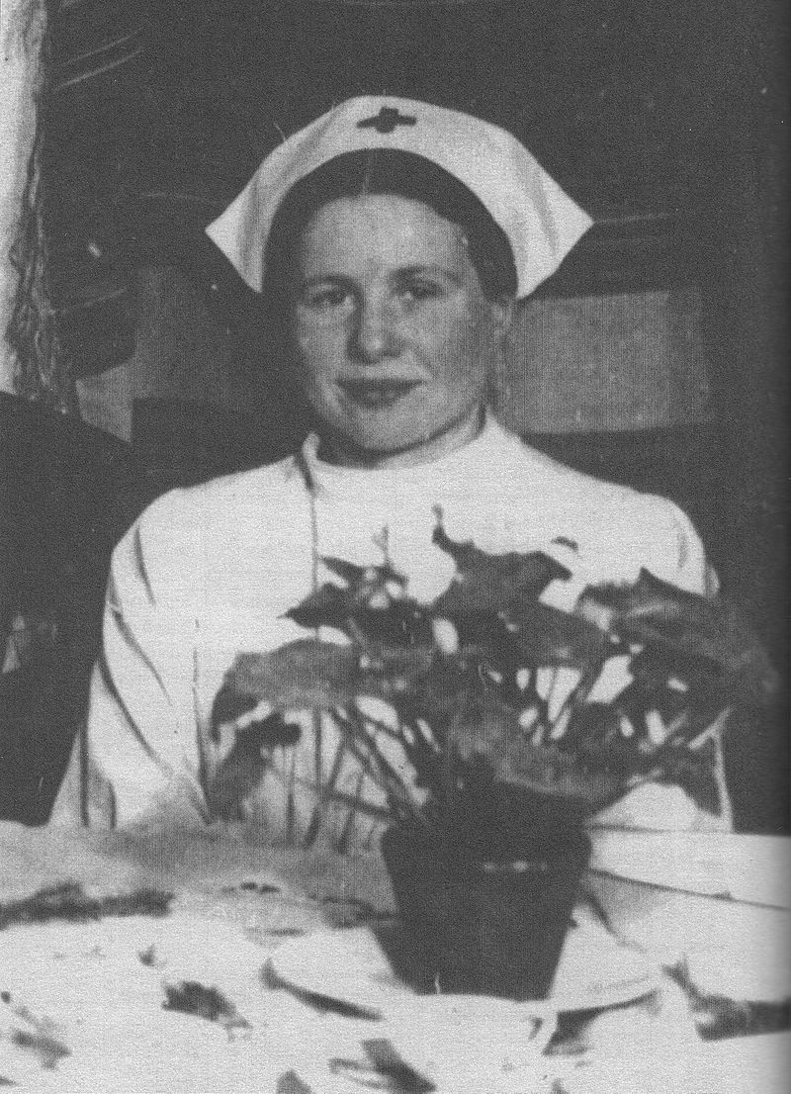
Proclaiming the WORD (Exodus 1:8-22 and I John 5:9-13)
A Testimony of Life
Irena Sendler
(1910-2008)

Slide 18
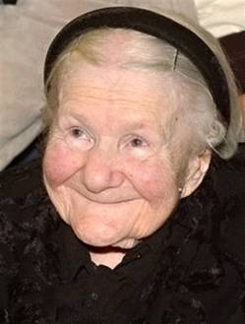
Proclaiming the WORD (Exodus 1:8-22 and I John 5:9-13)
A Testimony of Life
Irena Sendler
(1910-2008)

Slide 19
Responding Hymn # 263 “All Hail the Power of Jesus’ Name”
All hail the power of Jesus' name! Let angels prostrate fall; bring forth the royal diadem, and crown him Lord of all! Bring forth the royal diadem, and crown him Lord of all!

Slide 20
Responding Hymn # 263 “All Hail the Power of Jesus’ Name”
Ye chosen seed of Israel's race, ye ransomed from the fall, hail him who saves you by his grace, and crown him Lord of all! Hail him who saves you by his grace, and crown him Lord of all!

Slide 21
Responding Hymn # 263 “All Hail the Power of Jesus’ Name”
Let every kindred, every tribe on this terrestrial ball to him all majesty ascribe, and crown him Lord of all! To him all majesty ascribe, and crown him Lord of all!

Slide 22
Responding Hymn # 263 “All Hail the Power of Jesus’ Name”
O that with yonder sacred throng we at his feet may fall! We'll join the everlasting song, and crown him Lord of all! We'll join the everlasting song, and crown him Lord of all!

Slide 23
Bearing and Following the WORD into the World Announcements &
Sharing of Joys and Concerns
The afternoon Bible Study Group will be meeting today downstairs at 12:30 in the basement.
The Women's Group will continue to meet on Wednesdays at 7:30pm over at the Manse
(2048 E 14th Street). They are currently studying
the book of Isaiah. For more information, please
contact Margaret or Cara.
Guest Speaker next Sunday: Rev. Dr. Cheni Khonge

Slide 24
Bearing and Following the WORD into the World A Litany of Prayer for Mother’s Day
Lord, on this day set aside to honor and remember mothers,
we give you thanks for our mothers.
We are grateful that you chose to give us life through them,
and that they received the gift of life from you,
and gave it to us.
Thank you for the sacrifices they made
in carrying us and giving us birth.

Slide 25
Bearing and Following the WORD into the World A Litany of Prayer for Mother’s Day
We thank you for the women who raised us,
who were our mothers in childhood.
Whether birth mom, adopted mom, older sister, aunt,
grandmother, stepmother or someone else,
we thank you for those women
who held us and fed us,
who cared for us and kissed away our pain.
We pray that our lives may reflect the love they showed us,
and that they would be pleased to be called our moms.

Slide 26
Bearing and Following the WORD into the World A Litany of Prayer for Mother’s Day
We pray for moms whose children are grown.
Grant them joy and satisfaction
for a job well done.
We pray for moms experiencing changes they could not predict.
Grant them rest and peace
as they trust you for the future.
We pray for pregnant women who will soon be moms.
Grant them patience and good counsel
in the coming months.

Slide 27
Bearing and Following the WORD into the World A Litany of Prayer for Mother’s Day
We pray for moms who face the demands of single parenthood.
Grant them strength and wisdom.
We pray for moms who enjoy financial abundance.
Grant them time to share with their families.
We pray for moms who are raising their children in poverty.
Grant them relief and justice.
We pray for step-moms.
Grant them patience, understanding and love.

Slide 28
Bearing and Following the WORD into the World A Litany of Prayer for Mother’s Day
We pray for moms who are separated
from their children.
Grant them faith and hope.
We pray for moms in marriages that are in crisis.
Grant them support and insight.
We pray for moms who gave up their children for adoption.
Grant them peace and confidence
as they trust in your providence.
We pray for adoptive mothers.
Grant them joy and gratitude
for the gift you have provided.

Slide 29
Bearing and Following the WORD into the World A Litany of Prayer for Mother’s Day
We pray for women who think about becoming mothers.
Grant them wisdom and discernment.
We pray for women who desperately want,
or wanted, to be mothers.
Grant them grace to accept your timing.
We pray for women who have assumed
the mother’s role in a child’s life.
Grant them joy and the appreciation of others.
We pray for persons who are grieving the loss of their mother.
Grant them comfort and hope in Christ’s resurrection.

Slide 30
Bearing and Following the WORD into the World A Litany of Prayer for Mother’s Day
Lord, we thank you for the gift of motherhood.
We thank you for the many examples of faithful mothers in scripture, like Sarah, Leah, Rachel, Hannah, Elizabeth, Priscilla, Lydia, Eunice and Lois.
We are mindful this day of all these women,
and especially Mary the mother of our Lord Jesus Christ, who had the courage in faith to say “yes” to your calling.
May these women gathered here today emulate these examples of faith.

Slide 31
Bearing and Following the WORD into the World A Litany of Prayer for Mother’s Day
And may they model for all the rest of us what it means to be your disciple. Bless them on this special day; in the name of Jesus Christ, who taught us to pray saying…
“Our Father, who arts in heaven….” Amen.

Slide 32
Bearing and Following the WORD into the World Prayer of the People & The Lord’s Prayer
Our Father, who art in heaven.
Halloweth be thy name.
Thy Kingdom come; Thy will be done
On earth as it is in heaven.
Give us this day our daily bread.
Forgive us our debts; as we forgive our debtors.
Lead us not into temptations, but deliver us from evil.
For Thine is the Kingdom, the Power, and the Glory forever. Amen.

Slide 33
Bearing and Following the WORD into the World Offering of our Gifts and our Lives
Musical Offering

Slide 34
Bearing and Following the WORD into the World Doxology and Offertory Prayer

Slide 35
Sending Hymn #643 “Now Thank We All Our God”
Now thank we all our God with heart and hands and voices, who wondrous things hath done, in whom this world rejoices; who, from our mothers' arms, hath blessed us on our way with countless gifts of love, and still is ours today.

Slide 36
Sending Hymn #643 “Now Thank We All Our God”
O may this bounteous God through all our life be near us, with ever joyful hearts and blessed peace to cheer us; and keep us in God's grace, and guide us when perplexed, and free us from all ills in this world and the next.

Slide 37
Sending Hymn #643 “Now Thank We All Our God”
All praise and thanks to God, who reigns in highest heaven, to Father and to Son and Spirit now be given: the one eternal God, whom heaven and earth adore, the God who was, and is, and shall be evermore.

Slide 38
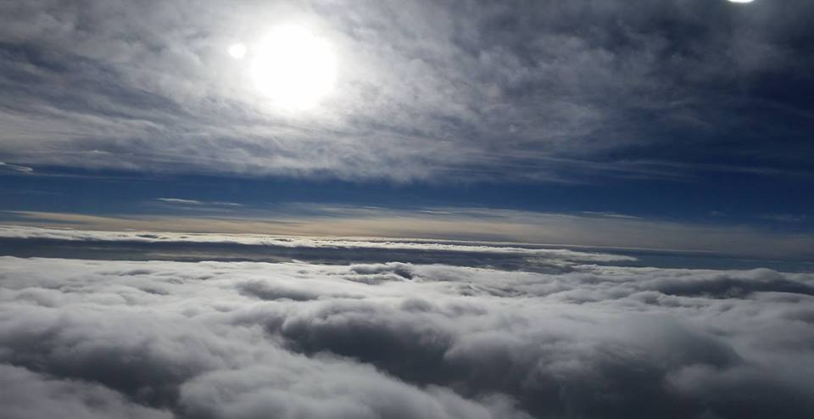
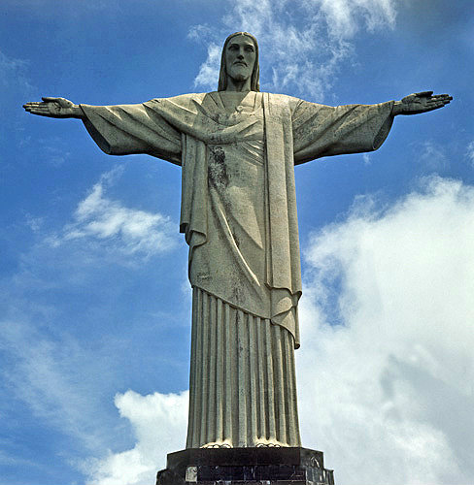
Bearing and Following the WORD into the World The Charge and Benediction

Slide 39
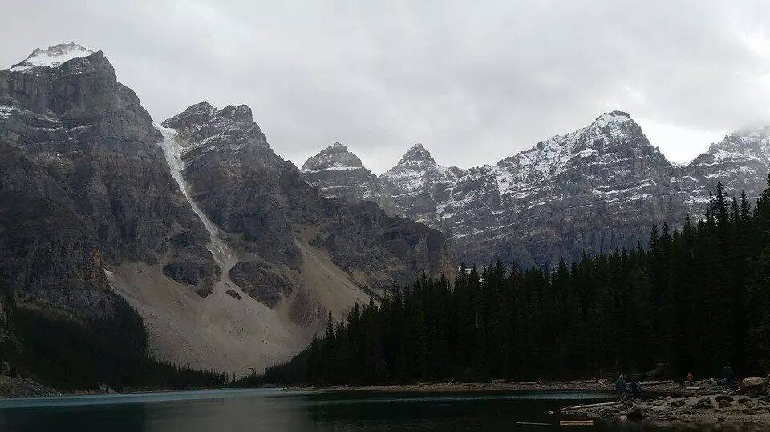
Bearing and Following the WORD into the World Benediction Response
# 547 “Lord, Dismiss Us With Your Blessing: (Stanza 3)
Savior, when your love shall call us,
from our struggling pilgrim way, let no fear of death appall us,
glad your summons to obey. May we ever, may we ever
reign with you in endless day.

Slide 40
Homecrest Presbyterian Church Worship of the Lord’s Day 7th Sunday of Easter May 13th, 2018

