Slide 1
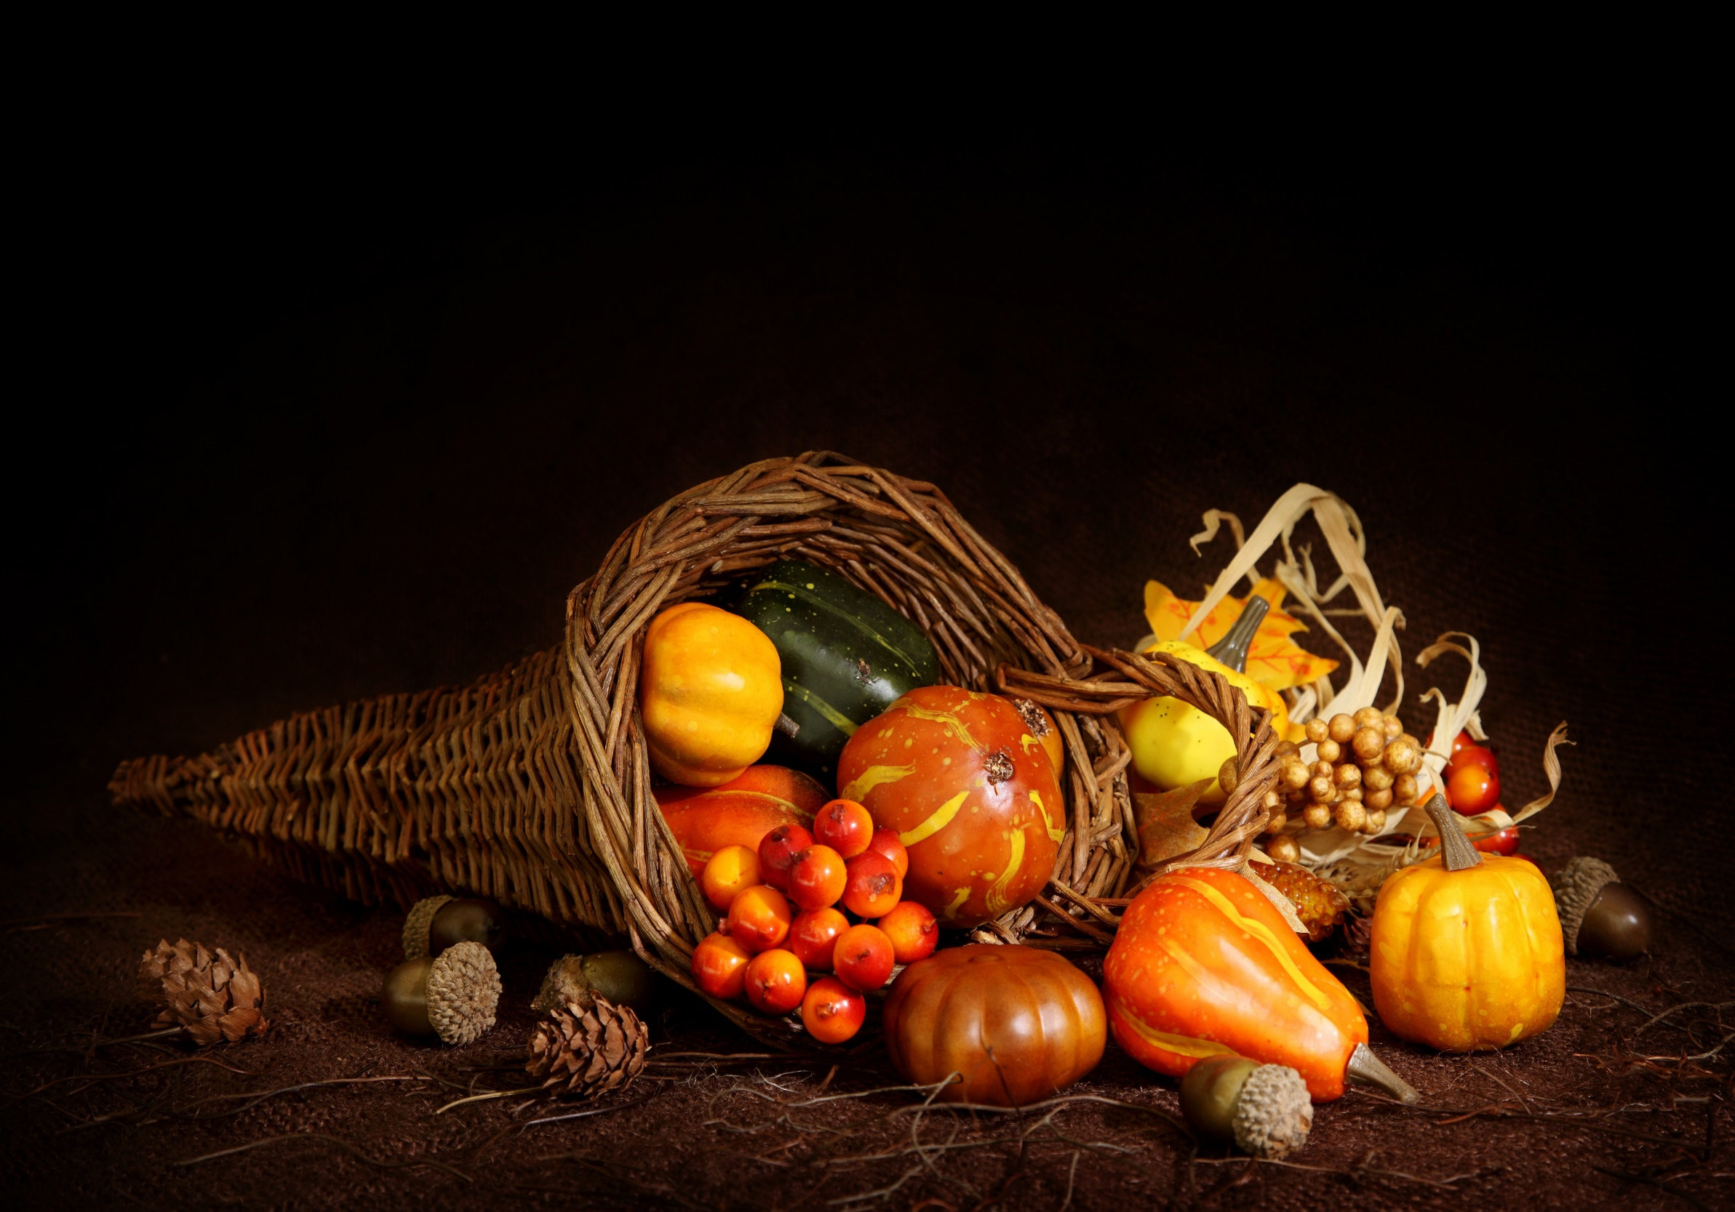
Homecrest Presbyterian Church Worship of the Lord’s Day November 12th, 2017

Slide 2
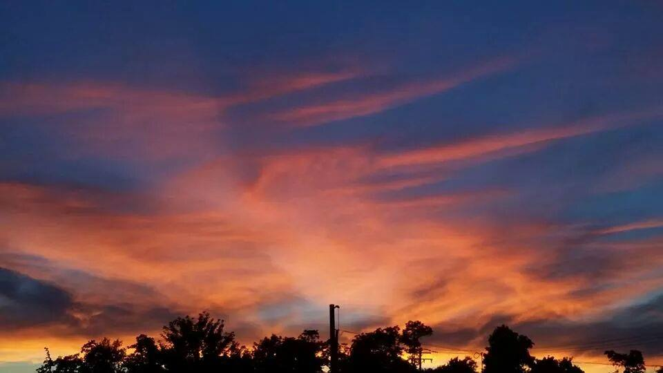
Gathering Around the WORD Call To Worship
(Based on Psalm 13)
How long, O LORD? Will you forget us forever? How long will you hide your face from us?
How long must we bear pain in our souls, and have sorrow in our hearts all day long? How long shall our enemy be exalted over us?
Consider and answer us, O LORD our God! Give light to our eyes, or we will sleep the sleep of death, and our enemy will say, "I have prevailed"; our foes will rejoice because we are shaken. But we trusted in your steadfast love; our hearts shall rejoice in your salvation. We will sing to the LORD, because he has dealt bountifully with us.

Slide 3
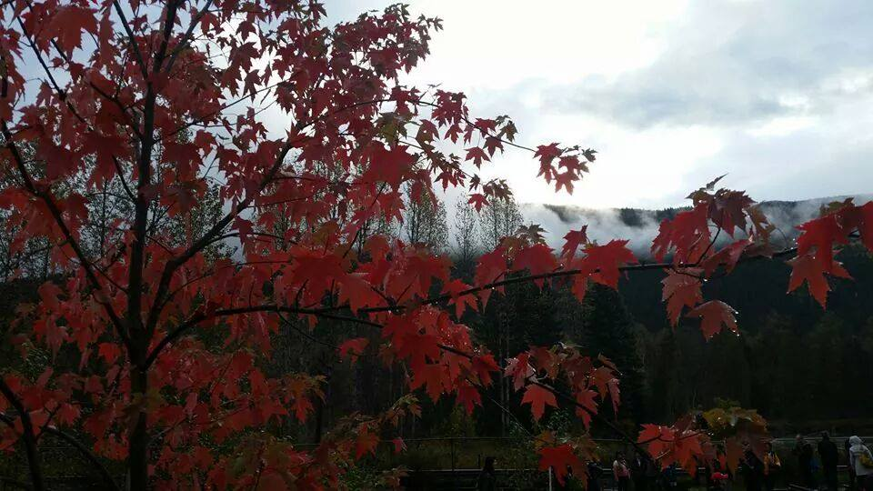
Gathering Around the WORD Gathering Hymn # 686 “God of Our Life”
God of our life,
through all the circling years, we trust in thee. In all the past,
through all our hopes and fears, thy hand we see. With each new day,
when morning lifts the veil, we own thy mercies, Lord, which never fail.

Slide 4
Gathering Around the WORD Gathering Hymn # 686 “God of Our Life”
God of the past,
our times are in thy hand. With us abide. Lead us by faith
to hope's true promised land. Be thou our guide. With thee to bless,
the darkness shines as light, and faith's fair vision changes into sight.

Slide 5
Gathering Around the WORD Gathering Hymn # 686 “God of Our Life”
God of the coming years,
through paths unknown we follow thee. When we are strong, Lord,
leave us not alone. Our refuge be. Be thou for us in life our daily bread, our heart's true home
when all our years have sped.

Slide 6
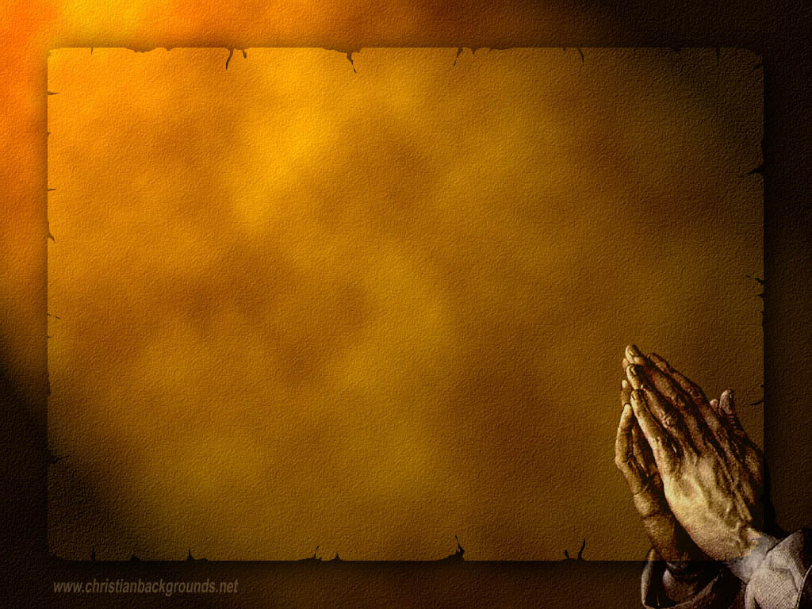
Gathering Around the WORD Call to Confession Our hope is built on nothing less than Jesus and his righteousness. Trusting in the mercy of God, let us confess our sins that we might find forgiveness and new life together in Christ.

Slide 7
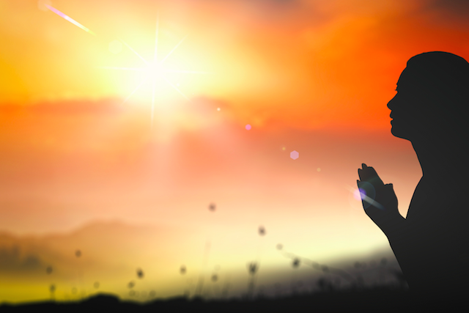
Gathering Around the WORD Prayer of Confession (in Unison)
Holy and gracious God, you are all light and wonder and glory. You are our strength and our delight; you give us all we need to live. Yet we are distracted by all that glitters, continually grasping for more. Rather than trusting in your provision, we chase after our own happiness. Forgive us, Lord, and turn us back to you. Overwhelm us with your goodness and cover us with grace, for we know that you are the source of life, the fount of all that is good. In the name of Jesus we pray, Amen.

Slide 8
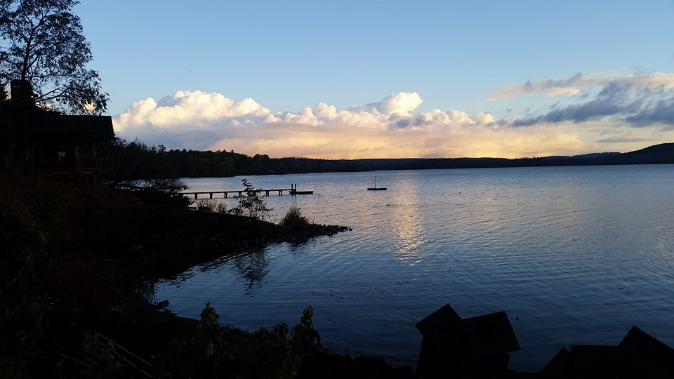
Gathering Around the WORD Gloria Patri
Glory be to the Father
and to the Son and to the Holy Ghost;
As it was in the beginning,
is now, and ever shall be,
world without end. Amen, Amen.

Slide 9
Gathering Around the WORD Passing of the Peace of Christ

Slide 10
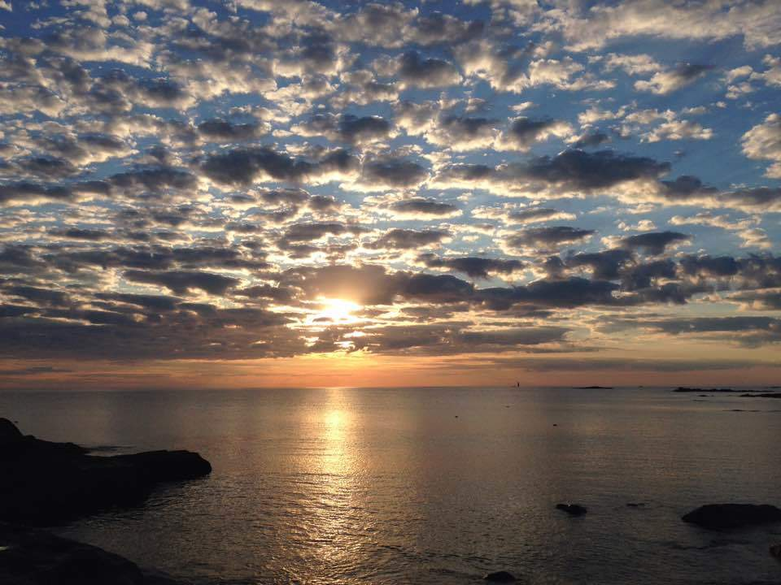
Proclaiming the WORD Message to the Youth/ Prayer of Illumination

Slide 11
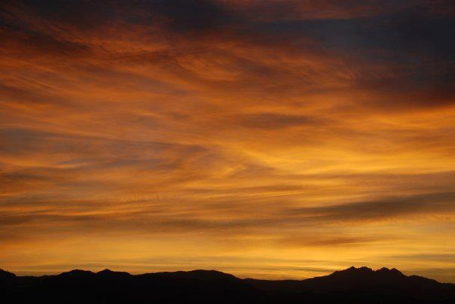
Proclaiming the WORD Scripture Reading (Joshua 24:1-3a, 14-25)
¹Then Joshua gathered all the tribes of Israel to Shechem, and summoned the elders, the heads, the judges, and the officers of Israel; and they presented themselves before God. ²And Joshua said to all the people, “Thus says the LORD, the God of Israel: Long ago your ancestors — Terah and his sons Abraham and Nahor — lived beyond the Euphrates and served other gods. ^{3a}Then I took your father Abraham from beyond the River and led him through all the land of Canaan and made his offspring many.

Slide 12
Proclaiming the WORD Scripture Reading (Joshua 24:1-3a, 14-25)
¹⁴“Now therefore revere the LORD, and serve him in sincerity and in faithfulness; put away the gods that your ancestors served beyond the River and in Egypt, and serve the LORD. ¹⁵Now if you are unwilling to serve the LORD, choose this day whom you will serve, whether the gods your ancestors served in the region beyond the River or the gods of the Amorites in whose land you are living; but as for me and my household, we will serve the LORD.”

Slide 13
Proclaiming the WORD Scripture Reading (Joshua 24:1-3a, 14-25)
¹⁶Then the people answered, “Far be it from us that we should forsake the LORD to serve other gods; ¹⁷for it is the LORD our God who brought us and our ancestors up from the land of Egypt, out of the house of slavery, and who did those great signs in our sight. He protected us along all the way that we went, and among all the peoples through whom we passed; ¹⁸and the LORD drove out before us all the peoples, the Amorites who lived in the land. Therefore we also will serve the LORD, for he is our God.”

Slide 14
Proclaiming the WORD Scripture Reading (Joshua 24:1-3a, 14-25)
¹⁹But Joshua said to the people, “You cannot serve the LORD, for he is a holy God. He is a jealous God; he will not forgive your transgressions or your sins. ²⁰If you forsake the LORD and serve foreign gods, then he will turn and do you harm, and consume you, after having done you good.” ²¹And the people said to Joshua, “No, we will serve the LORD!”

Slide 15
Proclaiming the WORD Scripture Reading (Joshua 24:1-3a, 14-25)
²²Then Joshua said to the people, “You are witnesses against yourselves that you have chosen the LORD, to serve him.” And they said, “We are witnesses.” ²³He said, “Then put away the foreign gods that are among you, and incline your hearts to the LORD, the God of Israel.” ²⁴The people said to Joshua, “The LORD our God we will serve, and him we will obey.” ²⁵So Joshua made a covenant with the people that day, and made statutes and ordinances for them at Shechem.

Slide 16
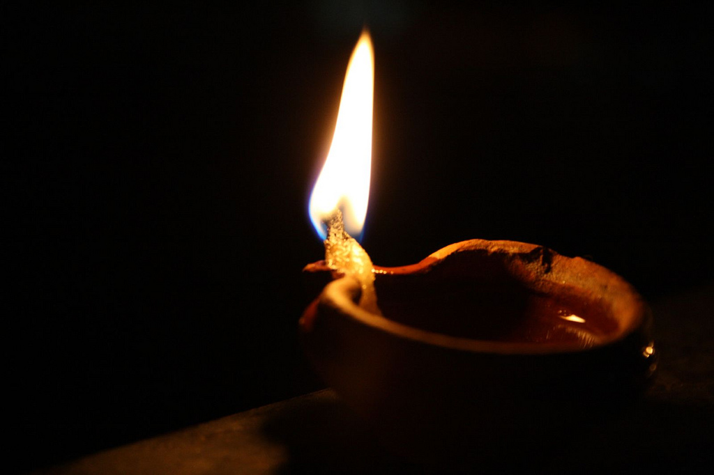
Proclaiming the WORD Scripture Reading (Matthew 25:1-13)
¹“Then the kingdom of heaven will be like this. Ten bridesmaids took their lamps and went to meet the bridegroom. ²Five of them were foolish, and five were wise. ³When the foolish took their lamps, they took no oil with them; ⁴but the wise took flasks of oil with their lamps. ⁵As the bridegroom was delayed, all of them became drowsy and slept. ⁶But at midnight there was a shout, ‘Look! Here is the bridegroom! Come out to meet him.’ ⁷Then all those bridesmaids got up and trimmed their lamps.

Slide 17
Proclaiming the WORD Scripture Reading (Matthew 25:1-13)
⁸The foolish said to the wise, ‘Give us some of your oil, for our lamps are going out.’ ⁹But the wise replied, ‘No! there will not be enough for you and for us; you had better go to the dealers and buy some for yourselves.’ ¹⁰And while they went to buy it, the bridegroom came, and those who were ready went with him into the wedding banquet; and the door was shut. ¹¹Later the other bridesmaids came also, saying, ‘Lord, lord, open to us.’ ¹²But he replied, ‘Truly I tell you, I do not know you.’ ¹³Keep awake therefore, for you know neither the day nor the hour.”

Slide 18
Proclaiming the WORD (Joshua 24:1-3a, 14-25
and Matthew 25:1-13)
Choose Wisely

Slide 19
Proclaiming the WORD (Joshua 24:1-3a, 14-25
and Matthew 25:1-13)
Choose Wisely

Slide 20
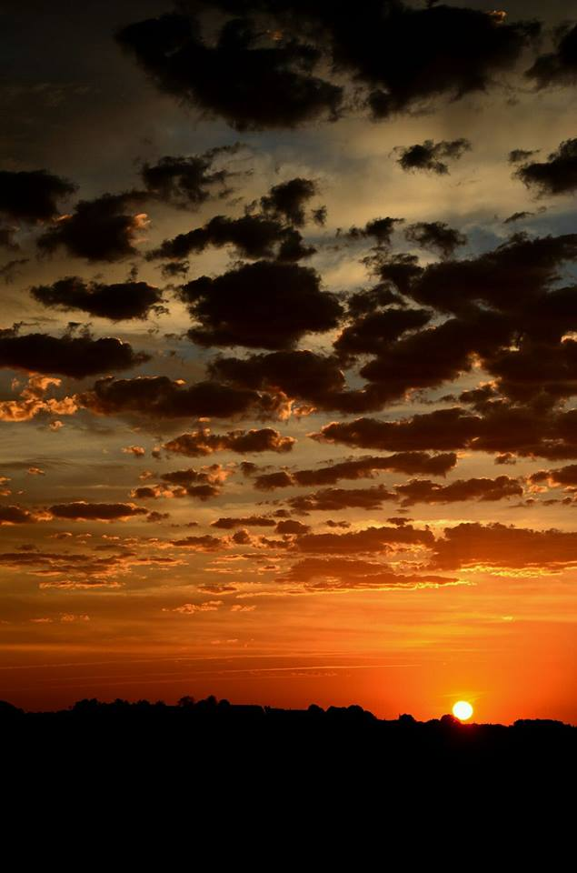
Responding Hymn # 362 “Rejoice! Rejoice Believers”
Rejoice! Rejoice, believers, and let your lights appear; the evening is advancing and darker night is near. The Bridegroom is arising and soon he will draw nigh. Up, watch with expectation; at midnight comes the cry.

Slide 21
Responding Hymn # 362 “Rejoice! Rejoice Believers”
See that your lamps are burning; replenish them with oil; look now for your salvation, the end of sin and toil. The marriage feast is waiting; the gates wide open stand; arise, O heirs of glory; the Bridegroom is at hand!

Slide 22
Responding Hymn # 362 “Rejoice! Rejoice Believers”
Our hope and expectation, O Jesus, now appear; arise, thou Sun so longed for, above this shadowed sphere! With hearts and hands uplifted, we plead, O Lord, to see the day of earth’s redemption, and ever be with thee!

Slide 23
Bearing and Following the WORD into the World Affirmation of Faith – A Brief Statement of Faith (Presbyterian Church USA) Sections 1-2
In life and in death we belong to God. Through the grace of our Lord Jesus Christ, the love of God, and the communion of the Holy Spirit, we trust in the one triune God,
the Holy One of Israel, whom alone we worship and serve.
We trust in Jesus Christ, Fully human, fully God.

Slide 24
Bearing and Following the WORD into the World Affirmation of Faith – A Brief Statement of Faith (Presbyterian Church USA) Sections 1-2
Jesus proclaimed the reign of God: preaching good news to the poor and release to the captives, teaching by word and deed and blessing the children, healing the sick and binding up the brokenhearted, eating with outcasts, forgiving sinners, and calling all to repent and believe the gospel. to life eternal.

Slide 25
Bearing and Following the WORD into the World Affirmation of Faith – A Brief Statement of Faith (Presbyterian Church USA) Sections 1-2
Unjustly condemned for blasphemy and sedition, Jesus was crucified, suffering the depths of human pain and giving his life for the sins of the world. God raised this Jesus from the dead, vindicating his sinless life, breaking the power of sin and evil, delivering us from death to life eternal.

Slide 26
Bearing and Following the WORD into the World Announcements &
Sharing of Joys and Concerns
The afternoon Bible Study Group will resume this afternoon, downstairs in the basement at 12:30pm next Sunday.
The Women's Group will continue to meet every Wednesday 7:30pm over at the Manse (2048 E 14th Street). For more information, please see Margaret and Cara.

Slide 27
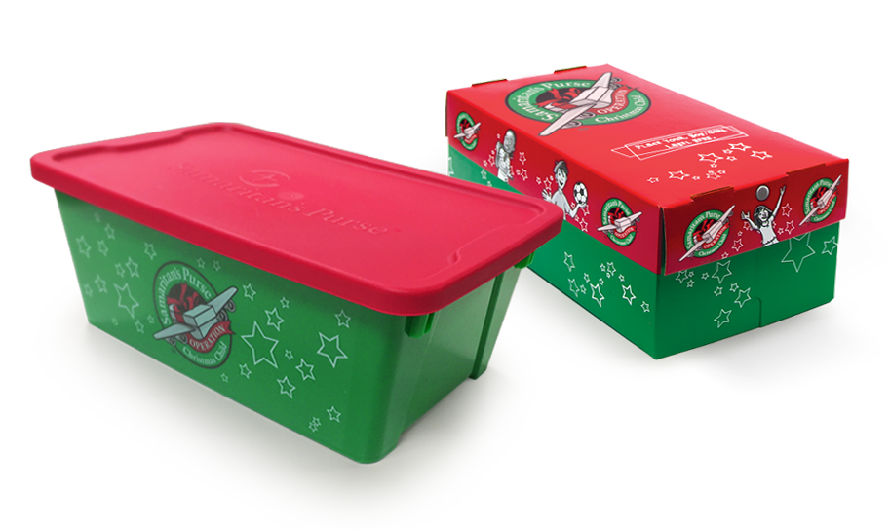
Bearing and Following the WORD into the World Announcements &
Sharing of Joys and Concerns
Operation Christmas Child Shoeboxes will be dropped off sometime this week. Thanks for all those who contributed.

Slide 28
Bearing and Following the WORD into the World Announcements &
Sharing of Joys and Concerns
Our Annual Thanksgiving Dinner will be on this coming Saturday, 11/18 at 6pm.

Slide 29
Bearing and Following the WORD into the World Prayer of the People & The Lord’s Prayer
Our Father, who art in heaven.
Halloweth be thy name.
Thy Kingdom come; Thy will be done
On earth as it is in heaven.
Give us this day our daily bread.
Forgive us our debts; as we forgive our debtors.
Lead us not into temptations, but deliver us from evil.
For Thine is the Kingdom, the Power, and the Glory forever. Amen.

Slide 30
Bearing and Following the WORD into the World Offering of our Gifts and our Lives
Musical Offering

Slide 31
Bearing and Following the WORD into the World Doxology and Offertory Prayer

Slide 32
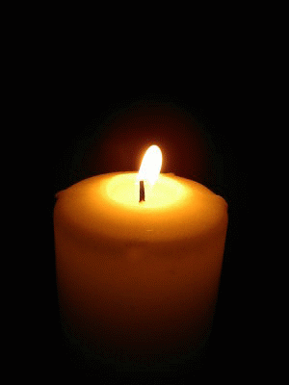
Sending Hymn #350 “Keep Your Lamps Trimmed and Burning”
Keep your lamps trimmed and burning; keep your lamps trimmed and burning; keep your lamps trimmed and burning, for the time is drawing nigh. Sisters, don’t grow weary; brothers, don’t grow weary; children, don’t grow weary, for the time is drawing nigh.

Slide 33
Sending Hymn #350 “Keep Your Lamps Trimmed and Burning”
It’s our faith makes us happy; it’s our faith makes us happy; it’s our faith makes us happy, for the time is drawing nigh. Sisters, don’t grow weary; brothers, don’t grow weary; children, don’t grow weary, for the time is drawing nigh.

Slide 34
Sending Hymn #350 “Keep Your Lamps Trimmed and Burning”
We are climbing Jacob’s ladder; we are climbing Jacob’s ladder; we are climbing Jacob’s ladder, for the time is drawing nigh. Sisters, don’t grow weary; brothers, don’t grow weary; children, don’t grow weary, for the time is drawing nigh.

Slide 35
Sending Hymn #350 “Keep Your Lamps Trimmed and Burning”
Every round goes higher, higher; every round goes higher, higher; every round goes higher, higher, for the time is drawing nigh Sisters, don’t grow weary; brothers, don’t grow weary; children, don’t grow weary, for the time is drawing nigh.

Slide 36
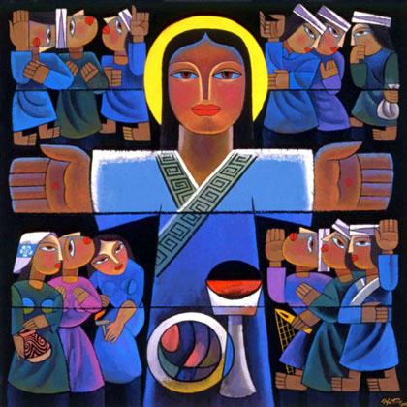
Bearing and Following the WORD into the World The Charge and Benediction

Slide 37
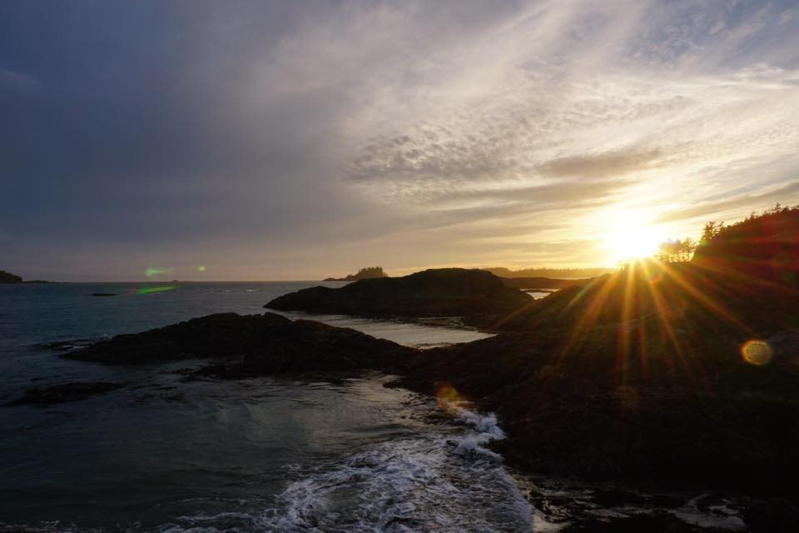
Bearing and Following the WORD into the World Benediction Response
# 547 “Go, My Children, with My Blessing”
(Stanza 3)
“Go, my children, fed and nourished,
closer to me. Grow in love and love by serving,
joyful and free. Here my Spirit’s power filled you;
here my tender comfort stilled you. Go, my children, fed and nourished,
joyful and free.”

Slide 38
Homecrest Presbyterian Church Worship of the Lord’s Day November 12th, 2017

