Slide 1
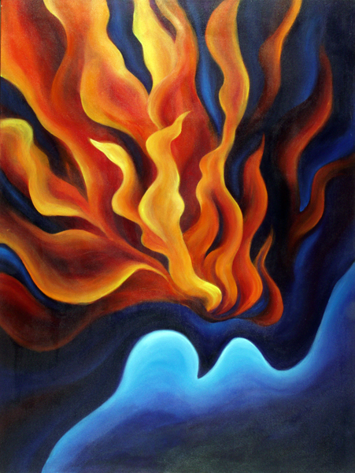
Homecrest Presbyterian Church Worship of the Lord’s Day June 4th, 2017 Pentecost Sunday Celebration of the Lord’s Supper

Slide 2
Gathering Around the WORD Call To Worship (Based on Psalm 104 and Acts 2)
Praise the Lord from whom all blessings flow! The day of Pentecost has come and
we have gathered together in this place. We are nothing without you, O Lord.
Send forth your presence and grant us your mercies and love. Creator God, reign down
your Spirit that we, too, may prophesy!

Slide 3
Gathering Around the WORD Call To Worship (Based on Psalm 104 and Acts 2)
Praise the Lord who sends forth his Spirit! Praise the Lord who renews the face of the earth. Jesus Christ, reign down your Spirit that we, too, may see visions! May the glory of the Lord endure forever!
May the Lord rejoice in his works. Everlasting Father, reign down your Spirit that we, too, may dream dreams! Praise the Lord! Praise the Father,
Son, and Holy Spirit; praise the Lord!

Slide 4
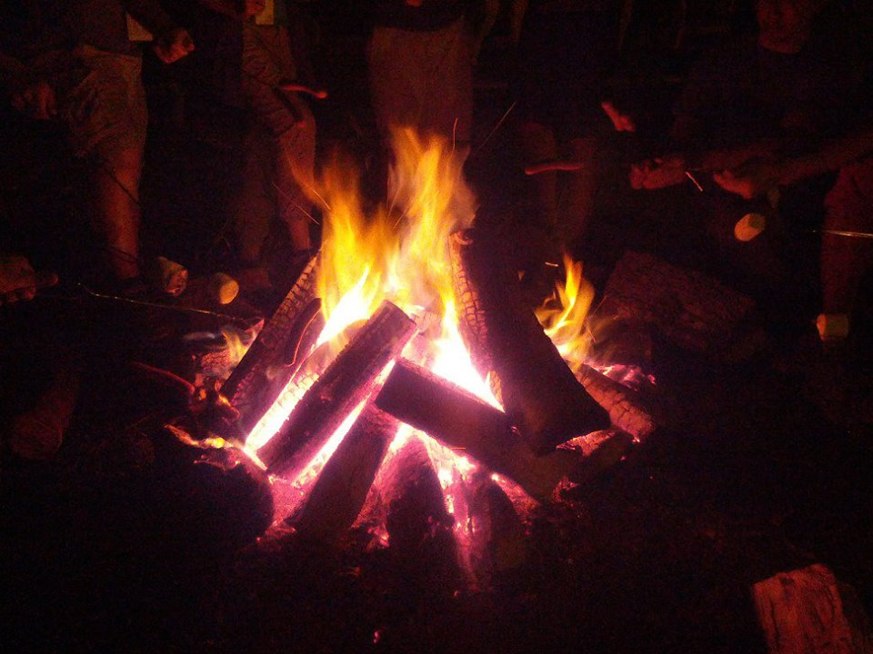
Gathering Hymn #279 “Come, Holy Spirit, Heavenly Dove”
Come, Holy Spirit, heavenly Dove, with all thy quickening powers; kindle a flame of sacred love in these cold hearts of ours.

Slide 5
Gathering Hymn #279 “Come, Holy Spirit, Heavenly Dove”
In vain we tune our formal songs; in vain we strive to rise; hosannas languish on our tongues, and our devotion dies.

Slide 6
Gathering Hymn #279 “Come, Holy Spirit, Heavenly Dove”
Dear Lord, and shall we ever live at this poor dying rate? Our love so faint, so cold to thee, and thine to us so great!

Slide 7
Gathering Hymn #279 “Come, Holy Spirit, Heavenly Dove”
Come, Holy Spirit, heavenly Dove, with all thy quickening powers; come, shed abroad a Savior's love, and that shall kindle ours.

Slide 8
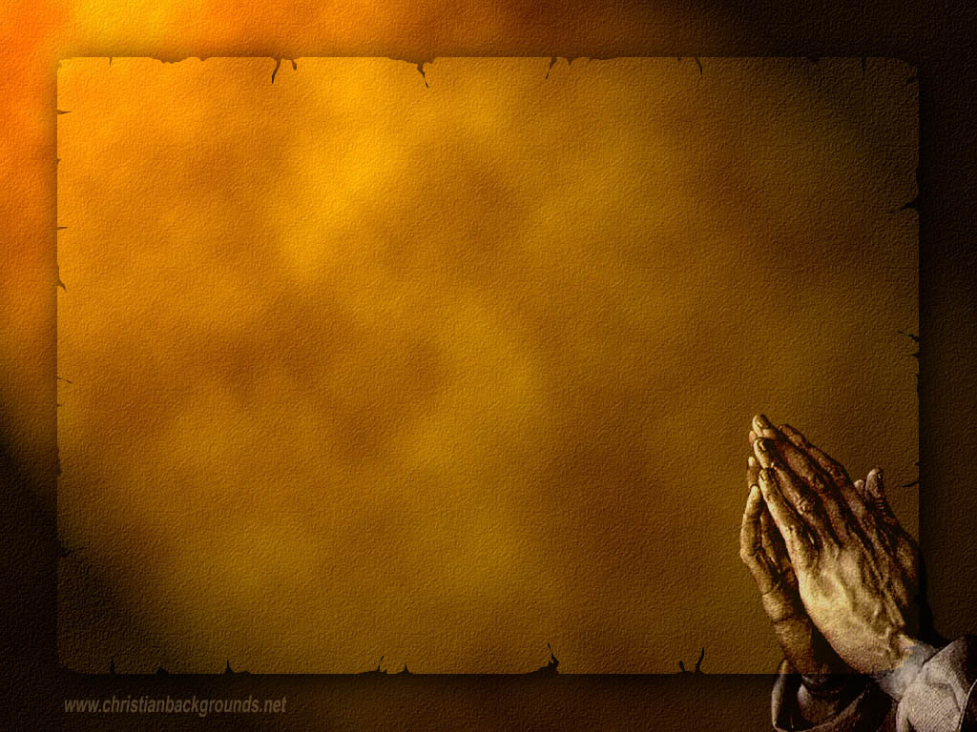
Gathering Around the WORD Call to Confession (Acts 2:21) Everyone who calls upon the name of the Lord shall be saved. Come, then, let us confess our sins to the one who is faithful to forgive. Let us adore the one who is mighty to save!

Slide 9
Gathering Around the WORD Prayer of Confession (in unison)
(Excerpt from the Confession of 1967)
God the Holy Spirit, fulfills the work of reconciliation in us.
Create and renew the church as the community in which we are reconciled to God and to one another. Enables us to receive forgiveness as we forgive one another and to enjoy the peace of God as we make peace among themselves. In spite of our sin, give us power to become representatives of Jesus Christ and his gospel of reconciliation to all. Amen.

Slide 10
Gathering Around the WORD Declaration of Forgiveness (John 20:22-23) Jesus said, “Receive the Holy Spirit. If you forgive the sins of any, they are forgiven them; If you retain the sins of any, they are retained.” Friends, through the spirit of forgiveness, God has given us a new beginning and a new life. Thanks be to God, Amen.

Slide 11
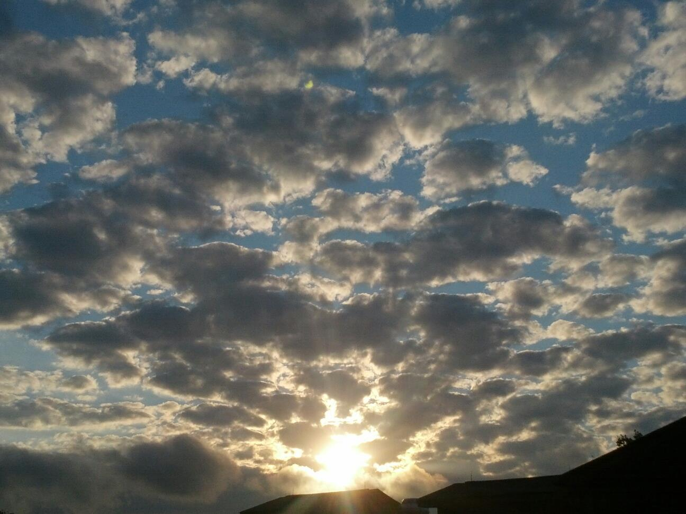
Gathering Around the WORD Gloria Patri
Glory be to the Father
and to the Son and to the Holy Ghost;
As it was in the beginning,
is now, and ever shall be,
world without end. Amen, Amen.

Slide 12
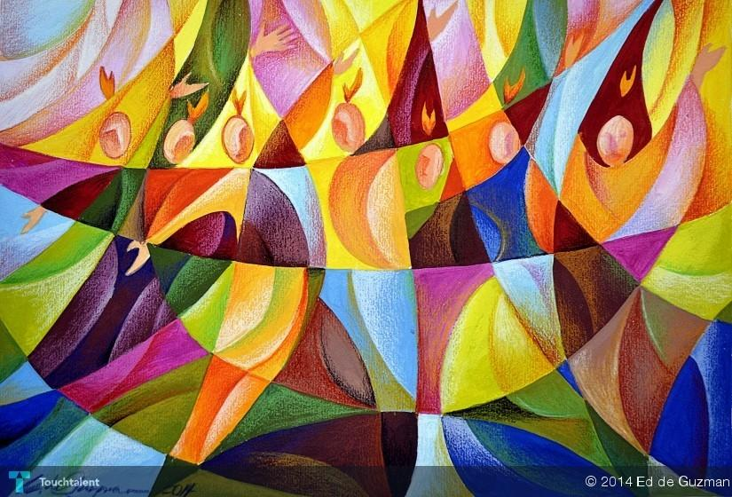
Gathering Around the WORD Passing of the Peace of Christ

Slide 13
Proclaiming the WORD Message to the Youth/ Prayer of Illumination

Slide 14
Proclaiming the WORD Scripture Reading (Acts 2:1-21)
When the day of Pentecost had come, they were all together in one place. ² And suddenly from heaven there came a sound like the rush of a violent wind, and it filled the entire house where they were sitting. ³ Divided tongues, as of fire, appeared among them, and a tongue rested on each of them. ⁴ All of them were filled with the Holy Spirit and began to speak in other languages, as the Spirit gave them ability

Slide 15
Proclaiming the WORD Scripture Reading (Acts 2:1-21)
⁵ Now there were devout Jews from every nation under heaven living in Jerusalem. ⁶ And at this sound the crowd gathered and was bewildered, because each one heard them speaking in the native language of each. ⁷ Amazed and astonished, they asked, "Are not all these who are speaking Galileans? ⁸ And how is it that we hear, each of us, in our own native language? ⁹ Parthians, Medes, Elamites, and residents of Mesopotamia, Judea and Cappadocia, Pontus and Asia,

Slide 16
Proclaiming the WORD Scripture Reading (Acts 2:1-21)
¹⁰ Phrygia and Pamphylia, Egypt and the parts of Libya belonging to Cyrene, and visitors from Rome, both Jews and proselytes, ¹¹ Cretans and Arabs-- in our own languages we hear them speaking about God's deeds of power." ¹² All were amazed and perplexed, saying to one another, "What does this mean?" ¹³ But others sneered and said, "They are filled with new wine."

Slide 17
Proclaiming the WORD Scripture Reading (Acts 2:1-21)
¹⁴ But Peter, standing with the eleven, raised his voice and addressed them, "Men of Judea and all who live in Jerusalem, let this be known to you, and listen to what I say. ¹⁵ Indeed, these are not drunk, as you suppose, for it is only nine o'clock in the morning. ¹⁶ No, this is what was spoken through the prophet Joel:

Slide 18
Proclaiming the WORD Scripture Reading (Acts 2:1-21)
¹⁷ 'In the last days it will be, God declares, that I will pour out my Spirit upon all flesh, and your sons and your daughters shall prophesy, and your young men shall see visions, and your old men shall dream dreams. ¹⁸ Even upon my slaves, both men and women, in those days I will pour out my Spirit; and they shall prophesy.

Slide 19
Proclaiming the WORD Scripture Reading (Acts 2:1-21)
¹⁹ And I will show portents in the heaven above and signs on the earth below, blood, and fire, and smoky mist. ²⁰ The sun shall be turned to darkness and the moon to blood, before the coming of the Lord's great and glorious day. ²¹ Then everyone who calls on the name of the Lord shall be saved.'

Slide 20
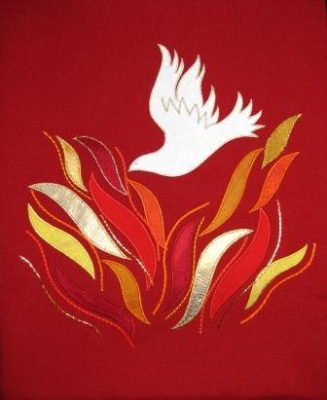
Proclaiming the WORD Scripture Reading (1 Corinthians 12:3-13)
³No one can say “Jesus is Lord” except by the Holy Spirit.
⁴Now there are varieties of gifts, but the same Spirit; ⁵and there are varieties of services, but the same Lord;⁶and there are varieties of activities, but it is the same God who activates all of them in everyone. ⁷To each is given the manifestation of the Spirit for the common good.

Slide 21
Proclaiming the WORD Scripture Reading (1 Corinthians 12:3-13)
⁸To one is given through the Spirit the utterance of wisdom, and to another the utterance of knowledge according to the same Spirit, ⁹to another faith by the same Spirit, to another gifts of healing by the one Spirit, ¹⁰to another the working of miracles, to another prophecy, to another the discernment of spirits, to another various kinds of tongues, to another the interpretation of tongues. ¹¹All these are activated by one and the same Spirit, who allots to each one individually just as the Spirit chooses.

Slide 22
Proclaiming the WORD Scripture Reading (1 Corinthians 12:3-13)
¹²For just as the body is one and has many members, and all the members of the body, though many, are one body, so it is with Christ. ¹³For in the one Spirit we were all baptized into one body — Jews or Greeks, slaves or free — and we were all made to drink of one Spirit.

Slide 23
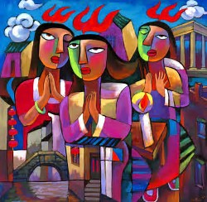
Proclaiming the WORD One in All; All in One
(Acts 2:1-21 and 1 Corinthians 12:3-13)
(Artwork by Qi He)

Slide 24
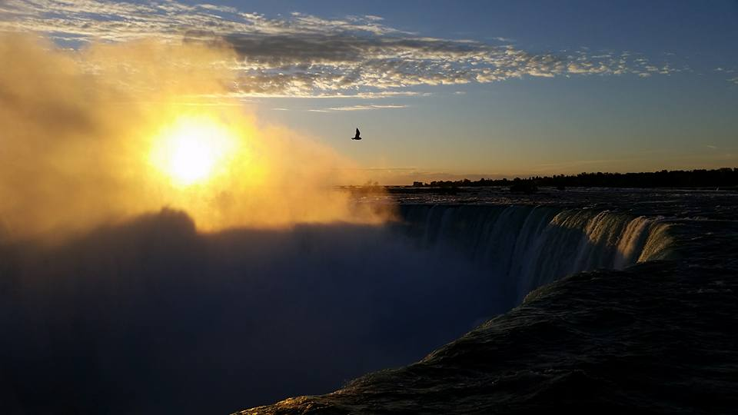
Responding Hymn # 688 “Spirit of God, Descend Upon My Heart” (Stanza 1)
Spirit of God, descend upon my heart; wean it from earth,
through all its pulses move; stoop to my weakness,
mighty as thou art, and make me love thee
as I ought to love.

Slide 25
Responding Hymn # 688 “Spirit of God, Descend Upon My Heart” (Stanza 4)
Teach me to feel that
thou art always nigh. Teach me the struggles
of the soul to bear, to check the rising doubt, the rebel sigh. Teach me the patience
of unanswered prayer.

Slide 26
Responding Hymn # 688 “Spirit of God, Descend Upon My Heart” (Stanza 5)
Teach me to love thee as thine angels love, one holy passion filling all my frame; the baptism of the
heaven-descended Dove, my heart an altar, and thy love the flame.

Slide 27
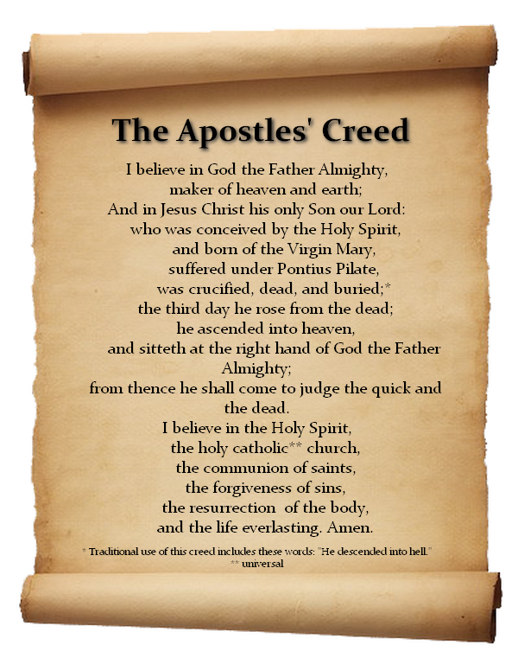
Responding to the WORD
Affirmation of Faith

Slide 28
Bearing and Following the WORD into the World Announcements &
Sharing of Joys and Concerns
The afternoon Bible Study Group will continue next week downstairs at 12:30pm. We are currently studying the 365 Days Daily Devotional written by John Calvin, in commemoration of the 500th Anniversary of the Protestant Reformation. All are welcomed.
The Women's Group will resume meeting this week over at the Manse (2048 E 14th Street) every Wednesday evening @ 7:30pm. They are currently studying the book of Mark. For more information, please contact Margaret Lesman or Cara Chin.

Slide 29
Bearing and Following the WORD into the World Announcements &
Sharing of Joys and Concerns
Next Session meeting will be Tomorrow, 6/5 7pm.
Special thanks to David Dwan for sharing his musical skill with us while Brian is away on vacation this week and the next.

Slide 30
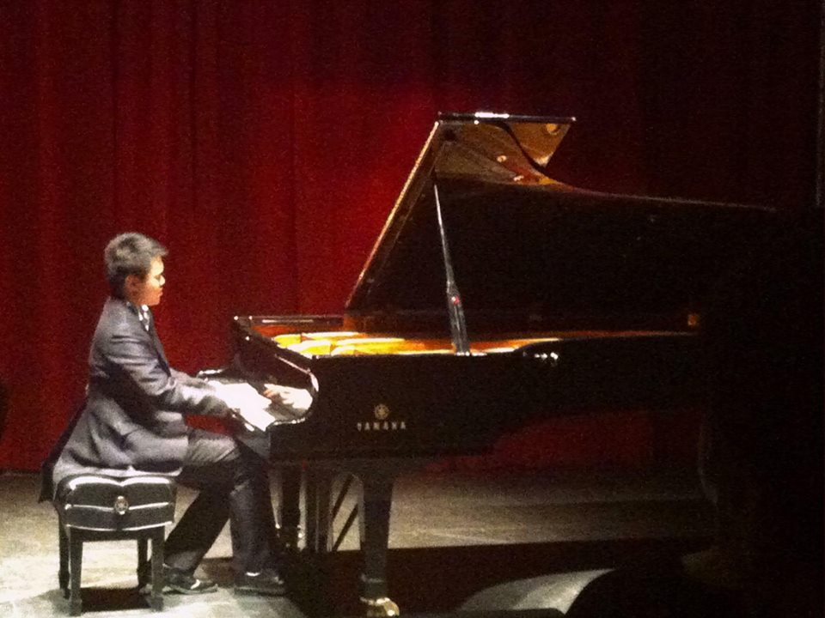
Bearing and Following the WORD into the World Announcements &
Sharing of Joys and Concerns
Our music director – Brian Lam will be having a recital at Brooklyn College Recital Hall on 6/11 at 5:30pm (Refreshment 5-5:30pm)
Special Ticket rate of $15 for Church members only. Please let me know by Today if you are interested.

Slide 31
Bearing and Following the WORD into the World Prayer of the People & The Lord’s Prayer
Our Father, who art in heaven.
Halloweth be thy name.
Thy Kingdom come; Thy will be done
On earth as it is in heaven.
Give us this day our daily bread.
Forgive us our debts; as we forgive our debtors.
Lead us not into temptations, but deliver us from evil.
For Thine is the Kingdom, the Power, and the Glory forever. Amen.

Slide 32
Bearing and Following the WORD into the World Offering of our Gifts and our Lives
Musical Offering

Slide 33
Bearing and Following the WORD into the World Doxology and Offertory Prayer

Slide 34
Bearing and Following the WORD into the World Holy Communion Hymn
#527 “Eat This Bread”
Eat this bread; drink this cup;
come to me and never be hungry.
Eat this bread; drink this cup;
trust in me and you will not thirst. (2X)

Slide 35
Bearing and Following the WORD into the World Holy Communion
We celebrate the Spirit of God, who hovered over creation and brought order out of formlessness.
We praise You, Spirit of God.
We celebrate the Spirit of God, who filled Jesus with power and wisdom and, through Him, made the life of God available to all.
We praise You, Spirit of God.

Slide 36
Bearing and Following the WORD into the World Holy Communion
We celebrate the Spirit of God, who has been poured out on all people, and leads us into the Kingdom of God. We praise You, Spirit of God.
The Lord be with you. And also with you.
Lift up your hearts. We lift them up to the Lord.
Let us give thanks to the Lord our God.
It is right to give our thanks and praise.

Slide 37
Bearing and Following the WORD into the World Holy Communion
Friends, as we’ve gathered at the Lord's table, we recognize the Spirit's presence among us,
and we open our hearts to embrace the Spirit's leading.
This is the table of the Heavenly Feast, the joyful celebration of the people of God. Christ invites those who confess their faith and baptized in Him to eat the bread of life and to drink the cup of salvation.

Slide 38
Bearing and Following the WORD into the World Holy Communion
Lord, we come knowing that we depend on You for life and truth and love. We come knowing that You welcome us with open and accepting arms.
We come ready to meet with You, and be changed by the encounter. Amen.
With thanksgiving, we will receive this bread which our Lord Jesus took, after He blessed it, broke it, and gave it to his disciples, saying, this is my body, broken for you.

Slide 39
Bearing and Following the WORD into the World Holy Communion
With confidence, we dedicate this cup that Jesus blessed, saying, this is the new covenant sealed in my blood. As often as we eat this bread and drink from this cup, we remember the saving grace of our Lord Jesus Christ.

Slide 40
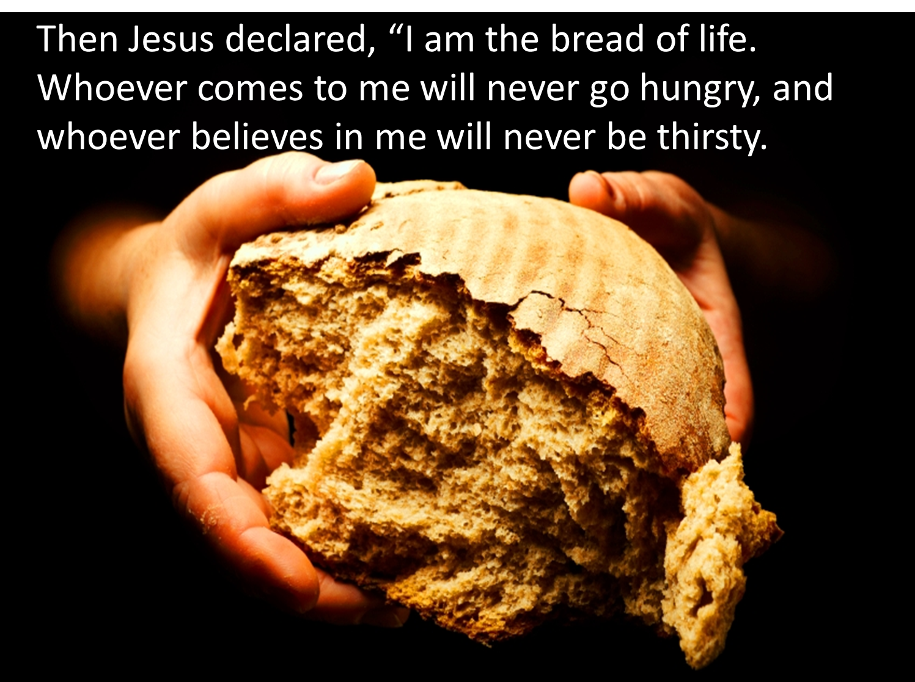
Bearing and Following the WORD into the World Holy Communion

Slide 41
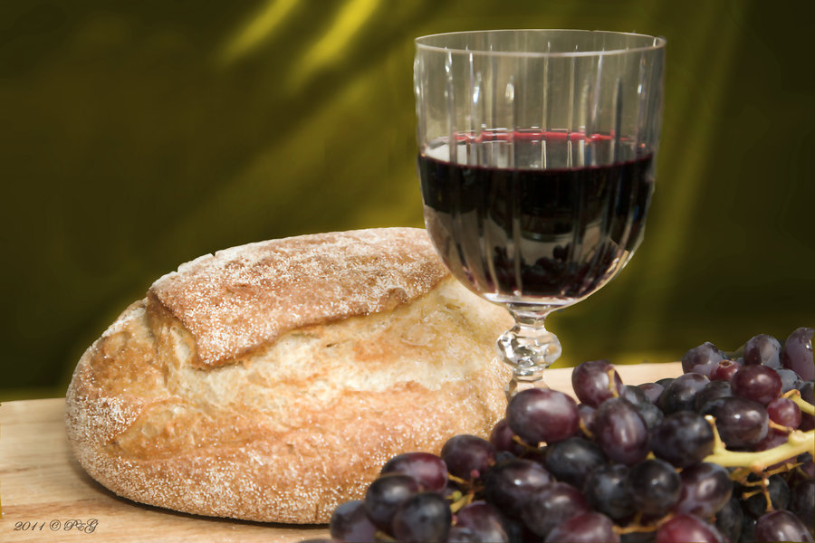
Bearing and Following the WORD into the World Holy Communion
Distribution of the Elements

Slide 42
Bearing and Following the WORD into the World Holy Communion
Prayer after Communion
May the love we find at this table be reflected in our lives; May the power we receive at this table make us peacemakers and healers;
And may the Spirit who fills us again at this table lead us to be those who proclaim God's Kingdom in every word we speak and in everything we do. In Christ’s name we pray, Amen

Slide 43
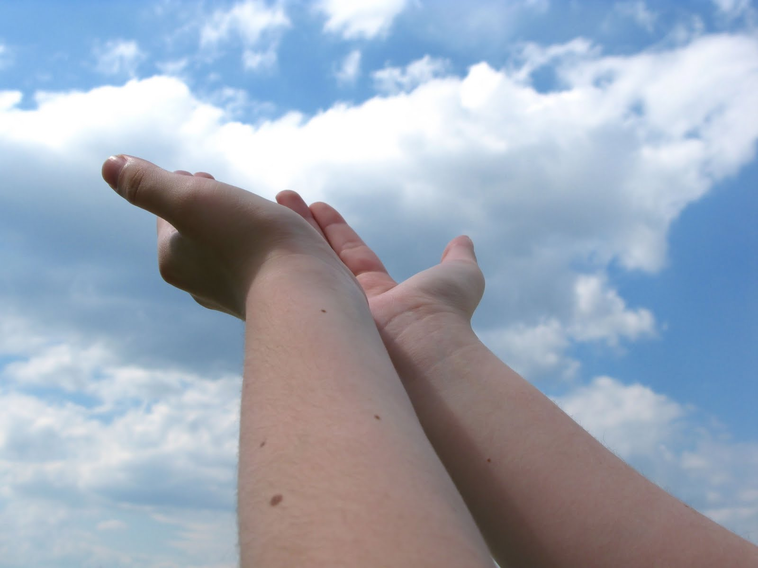
Bearing and Following the WORD into the World Deacons’ Benevolence Offering

Slide 44
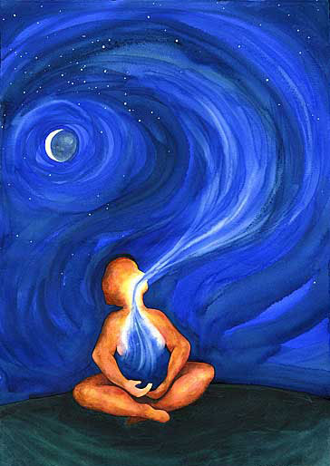
Responding Hymn # 286 “Breathe on me, Breath of God”
Breathe on me, Breath of God; fill me with life anew, that I may love what thou dost love, and do what thou wouldst do.

Slide 45
Responding Hymn # 286 “Breathe on me, Breath of God”
Breathe on me, Breath of God, until my heart is pure, until with thee I will one will, to do and to endure.

Slide 46
Responding Hymn # 286 “Breathe on me, Breath of God”
Breathe on me, Breath of God, till I am wholly thine, until this earthly part of me glows with thy fire divine.

Slide 47
Responding Hymn # 286 “Breathe on me, Breath of God”
Breathe on me, Breath of God, so shall I never die, but live with thee the perfect life of thine eternity.

Slide 48
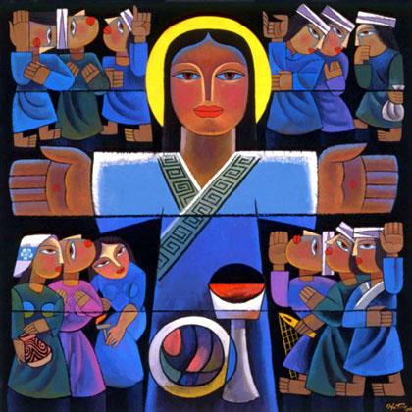
Bearing and Following the WORD into the World The Charge and Benediction

Slide 49
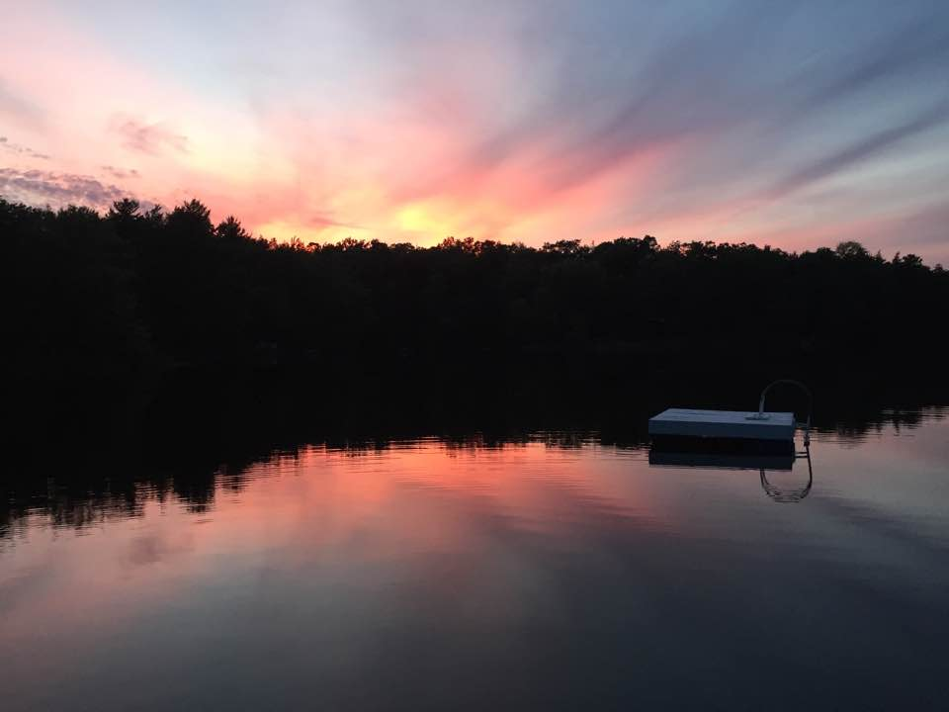
Bearing and Following the WORD into the World Benediction Response
# 540 “Farewell, Good Friends”
Farewell, Good friends!
Farewell, Good friends! Shalom, shalom! Till we meet again, till we meet again,
Shalom, Shalom.

Slide 50
Homecrest Presbyterian Church Worship of the Lord’s Day June 4th, 2017 Pentecost Sunday Celebration of the Lord’s Supper

