Slide 1
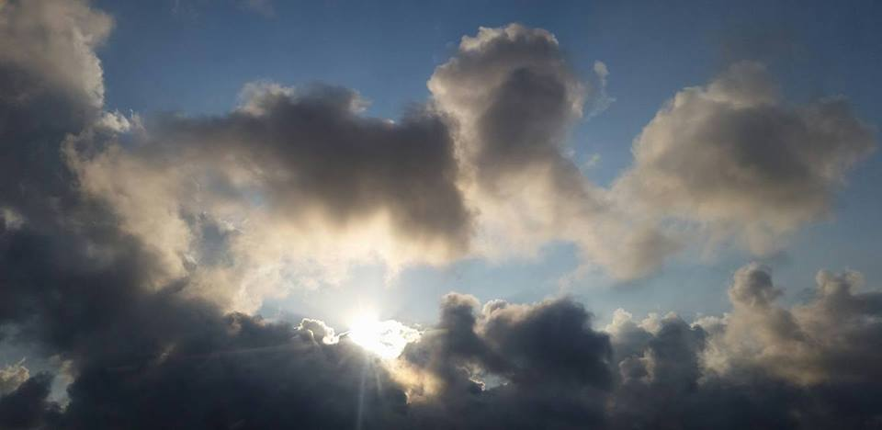
Homecrest Presbyterian Church Worship of the Lord’s Day May 28th, 2017 7th Sunday of Easter Ascension Sunday

Slide 2
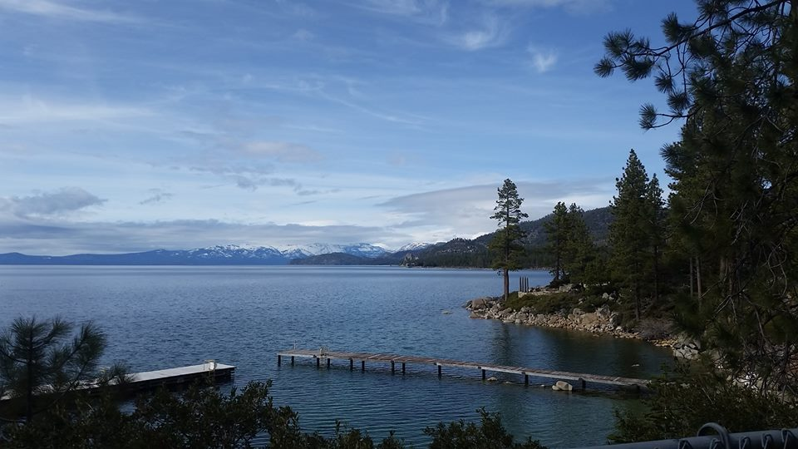
Gathering Around the WORD Call To Worship (Based on Psalm 68:1-10, 32-35)
Let the righteous be joyful!
Let them rejoice before God.
Let us all be jubilant with joy!
Sing to God, all peoples of the world.
Sing praises to God most high.
From the sanctuary of heaven,
God gives life and renews the face of the earth.
Let us come and worship God!

Slide 3
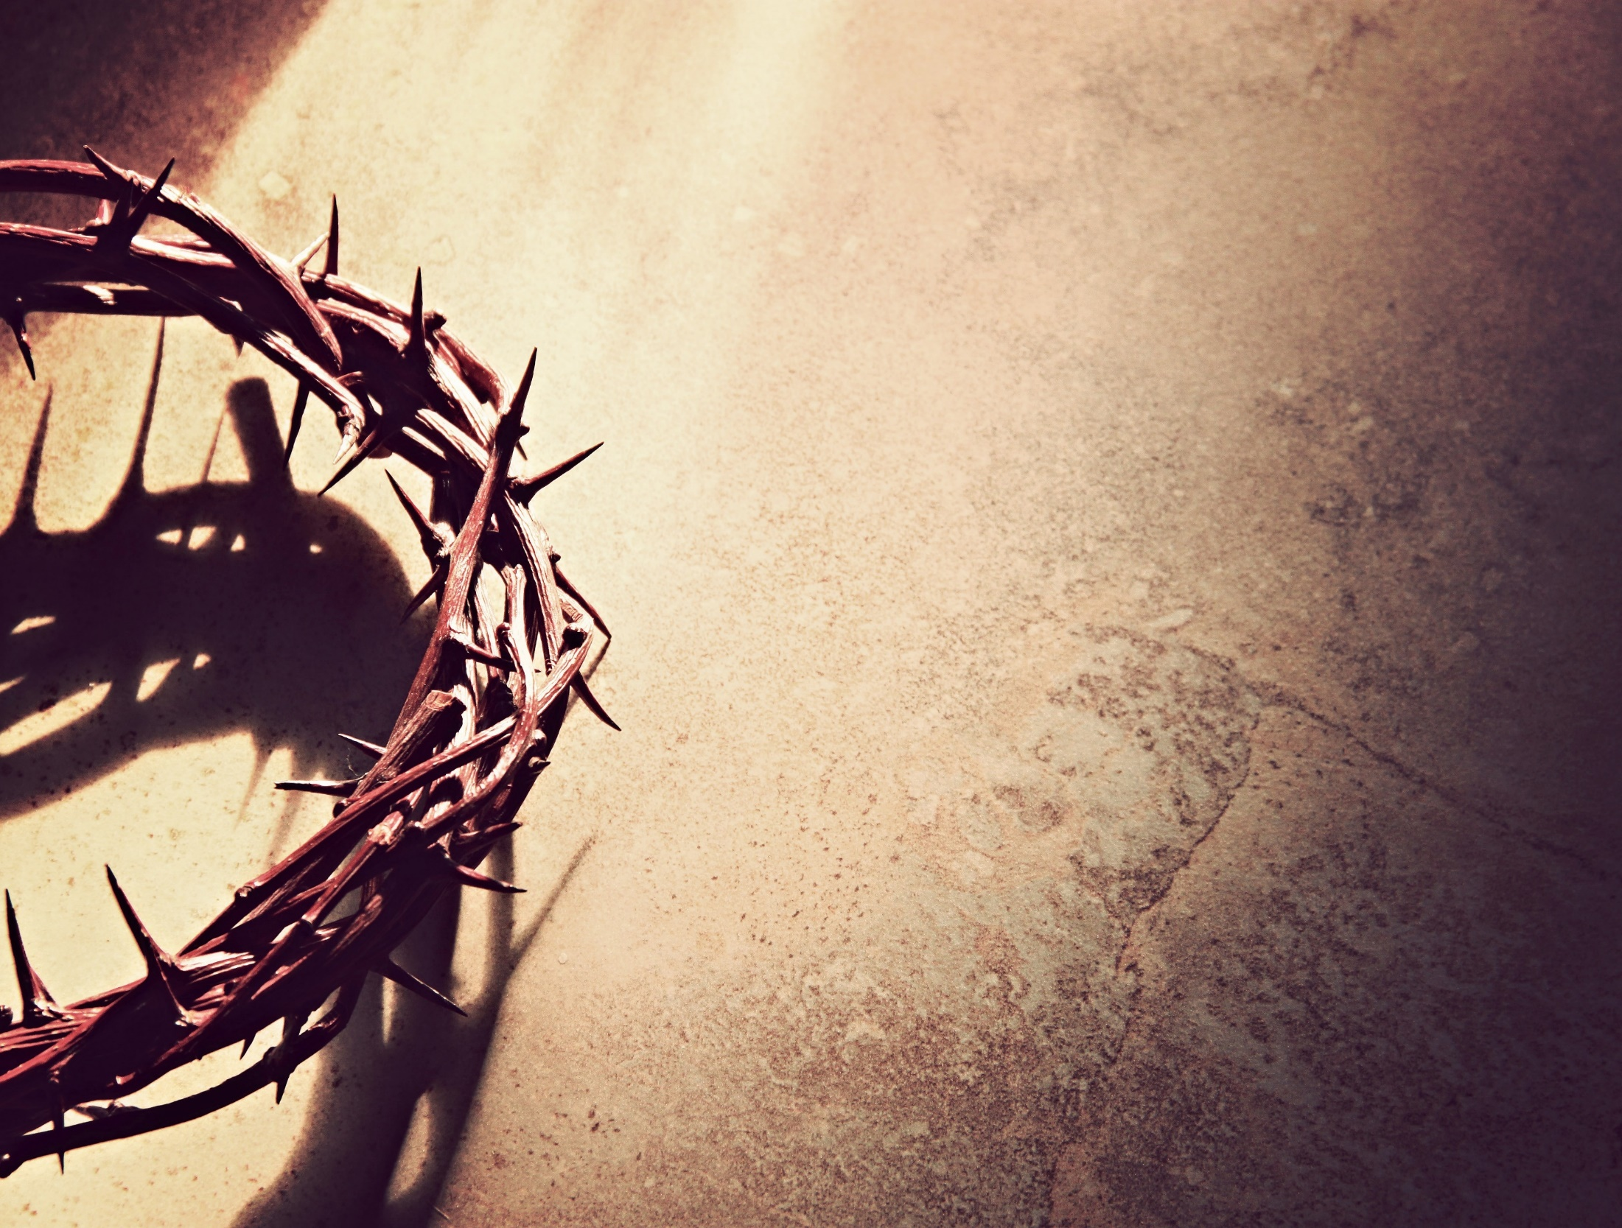
Gathering Hymn #41 “O Worship the King, All Glorious Above”
O worship the King, all glorious above! O gratefully sing God's power and God’s love: our shield and defender, the Ancient of Days, pavilioned in splendor and girded with praise.

Slide 4
Gathering Hymn #41 “O Worship the King, All Glorious Above”
O tell of God's might; O sing of God's grace, whose robe is the light, whose canopy space, whose chariots of wrath the deep thunderclouds form; and bright is God's path on the wings of the storm.

Slide 5
Gathering Hymn #41 “O Worship the King, All Glorious Above”
The earth with its store of wonders untold, Almighty, your power has founded of old; established it fast by a changeless decree, and round it has cast, like a mantle, the sea.

Slide 6
Gathering Hymn #41 “O Worship the King, All Glorious Above”
Your bountiful care what tongue can recite? It breathes in the air; it shines in the light; it streams from the hills; it descends to the plain, and sweetly distills in the dew and the rain.

Slide 7
Gathering Hymn #41 “O Worship the King, All Glorious Above”
Frail children of dust, and feeble as frail, in you do we trust, nor find you to fail; your mercies, how tender, how firm to the end, our Maker, Defender, Redeemer, and Friend.

Slide 8
Gathering Around the WORD Call to Confession (1 Peter 5:7) Sisters and brothers, God not only desires our repentance, but longs to offer us forgiveness. Therefore, let us cast our anxiety on God, because God cares of us eternally.

Slide 9
Gathering Around the WORD Prayer of Confession (in unison)
Loving God, we confess that we do not always bring honor and glory to your name. We are rebellious and weak; we flee before your goodness. Forgive, restore, and strengthen us by the grace and mercy of Christ, that we may rise up again in peace to love and serve your world, Amen.

Slide 10
Gathering Around the WORD Declaration of Forgiveness Children of God, the Spirit of God is resting on you, to restore, support, and strengthen you. Therefore, be at peace in the One who forgives and loves you; We shall rise up and give thanks to our God. Amen.

Slide 11
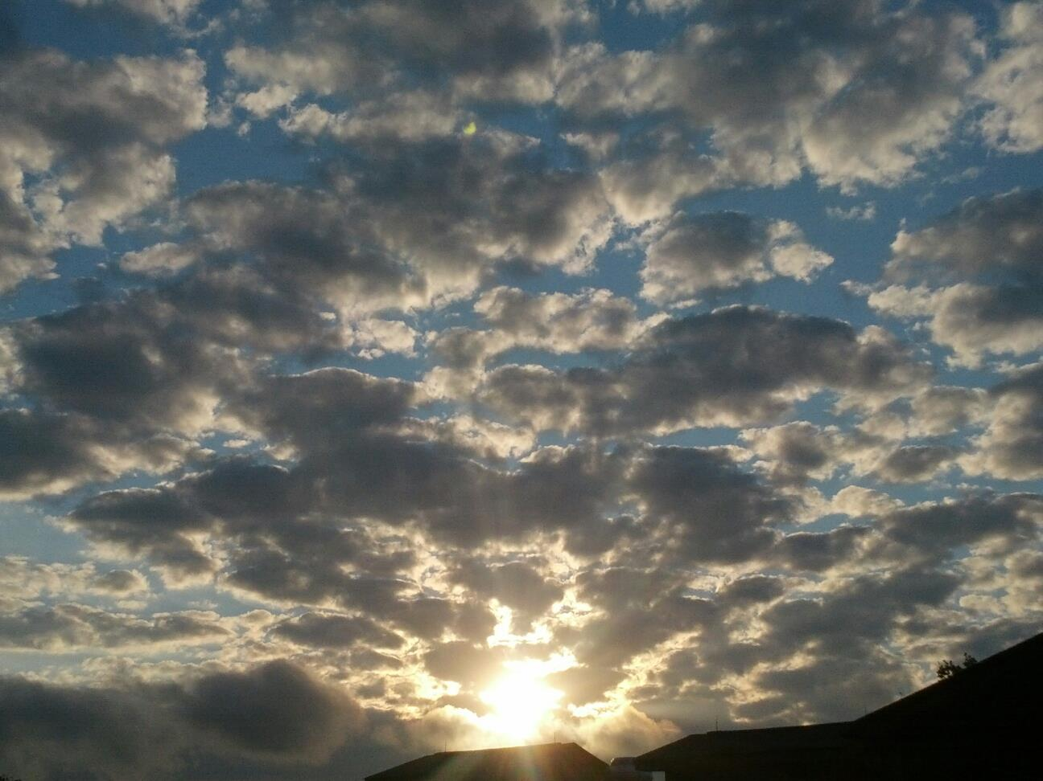
Gathering Around the WORD Gloria Patri
Glory be to the Father
and to the Son and to the Holy Ghost;
As it was in the beginning,
is now, and ever shall be,
world without end. Amen, Amen.

Slide 12
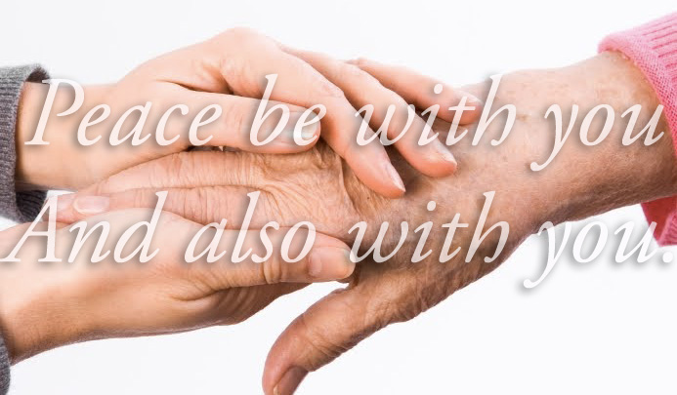
Gathering Around the WORD Passing of the Peace of Christ

Slide 13
Proclaiming the WORD Message to the Youth/ Prayer of Illumination

Slide 14
Proclaiming the WORD Scripture Reading (Acts 1:1-14)
In the first book, Theophilus, I wrote about all that Jesus did and taught from the beginning ² until the day when he was taken up to heaven, after giving instructions through the Holy Spirit to the apostles whom he had chosen. ³ After his suffering he presented himself alive to them by many convincing proofs, appearing to them during forty days and speaking about the kingdom of God.

Slide 15
Proclaiming the WORD Scripture Reading (Acts 1:1-14)
⁴ While staying with them, he ordered them not to leave Jerusalem, but to wait there for the promise of the Father. "This," he said, "is what you have heard from me; ⁵ for John baptized with water, but you will be baptized with the Holy Spirit not many days from now."

Slide 16
Proclaiming the WORD Scripture Reading (Acts 1:1-14)
⁶ So when they had come together, they asked him, "Lord, is this the time when you will restore the kingdom to Israel?" ⁷ He replied, "It is not for you to know the times or periods that the Father has set by his own authority. ⁸ But you will receive power when the Holy Spirit has come upon you; and you will be my witnesses in Jerusalem, in all Judea and Samaria, and to the ends of the earth." ⁹ When he had said this, as they were watching, he was lifted up, and a cloud took him out of their sight.

Slide 17
Proclaiming the WORD Scripture Reading (Acts 1:1-14)
¹⁰ While he was going and they were gazing up toward heaven, suddenly two men in white robes stood by them. ¹¹ They said, "Men of Galilee, why do you stand looking up toward heaven? This Jesus, who has been taken up from you into heaven, will come in the same way as you saw him go into heaven."

Slide 18
Proclaiming the WORD Scripture Reading (Acts 1:1-14)
¹² Then they returned to Jerusalem from the mount called Olivet, which is near Jerusalem, a sabbath day's journey away. ¹³ When they had entered the city, they went to the room upstairs where they were staying, Peter, and John, and James, and Andrew, Philip and Thomas, Bartholomew and Matthew, James son of Alphaeus, and Simon the Zealot, and Judas son of James. ¹⁴ All these were constantly devoting themselves to prayer, together with certain women, including Mary the mother of Jesus, as well as his brothers.

Slide 19
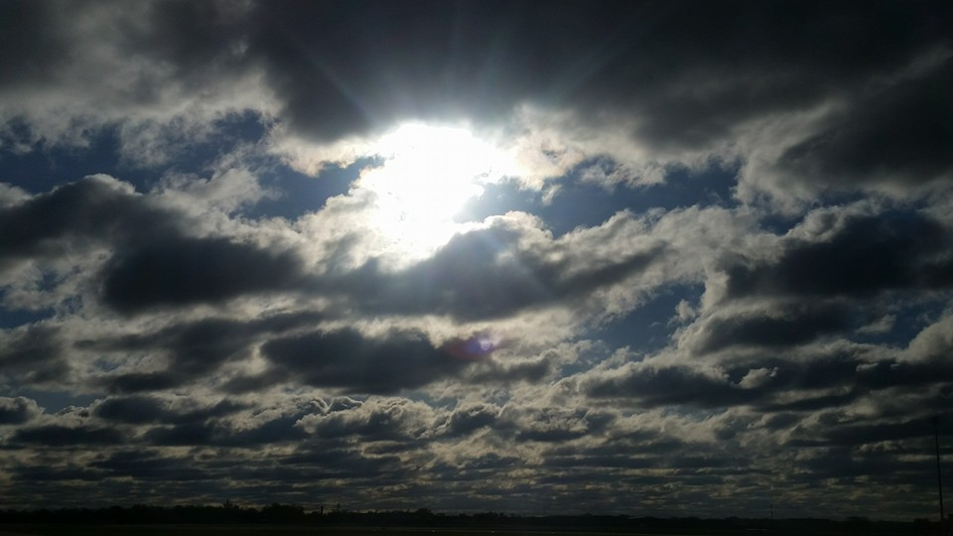
Proclaiming the WORD What are you staring at?
(Acts 1:1-14)

Slide 20
Responding Hymn # 804 “Rejoice, Ye Pure in Heart”
Rejoice, ye pure in heart! Rejoice, give thanks, and sing! Your festal banner wave on high, the cross of Christ your King. Rejoice! Rejoice! Rejoice, give thanks, and sing!

Slide 21
Responding Hymn # 804 “Rejoice, Ye Pure in Heart”
With voice as full and strong as ocean’s surging praise, send forth the sturdy hymns of old, the psalms of ancient days. Rejoice! Rejoice! Rejoice, give thanks, and sing!

Slide 22
Responding Hymn # 804 “Rejoice, Ye Pure in Heart”
Yes, on through life's long path, still chanting as ye go, from youth to age, by night and day, in gladness and in woe: Rejoice! Rejoice! Rejoice, give thanks, and sing!

Slide 23
Responding Hymn # 804 “Rejoice, Ye Pure in Heart”
At last the march shall end; the wearied ones shall rest; the pilgrims find their home at last, Jerusalem the blest. Rejoice! Rejoice! Rejoice, give thanks, and sing!

Slide 24
Responding Hymn # 804 “Rejoice, Ye Pure in Heart”
Then on, ye pure in heart! Rejoice, give thanks, and sing! Your festal banner wave on high, the cross of Christ your King. Rejoice! Rejoice! Rejoice, give thanks, and sing!

Slide 25
Responding to the WORD
Minutes of Mission

Slide 26
Bearing and Following the WORD into the World Announcements &
Sharing of Joys and Concerns
The afternoon Bible Study Group will continue today downstairs at 12:30pm. We are continuing the series with 365 Days Daily Devotional written by John Calvin, in commemoration of the 500th Anniversary of the Protestant Reformation. All are welcomed.
The Women's Group will NOT be meeting this week, but will resume next week over at the Manse (2048 E 14th Street) every Wednesday evening @ 7:30pm. They are currently studying the book of Mark. For more information, please contact Margaret Lesman or Cara Chin.

Slide 27
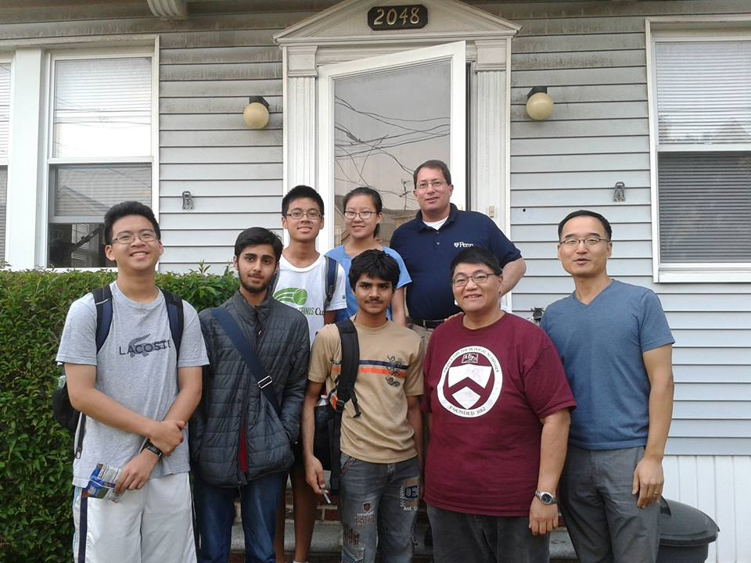
Bearing and Following the WORD into the World Announcements &
Sharing of Joys and Concerns
FREE SAT Preparation Courses, 5/30 - 6/2 4-7pm over at the Manse. Invite your neighbors/friends and their youths.

Slide 28
Bearing and Following the WORD into the World Announcements &
Sharing of Joys and Concerns
Next Sunday (6/4) is Pentecost Sunday. Wear the color Red to signify the arrival of the Holy Spirit.
Next Session meeting will be Monday, 6/5 7pm.

Slide 29
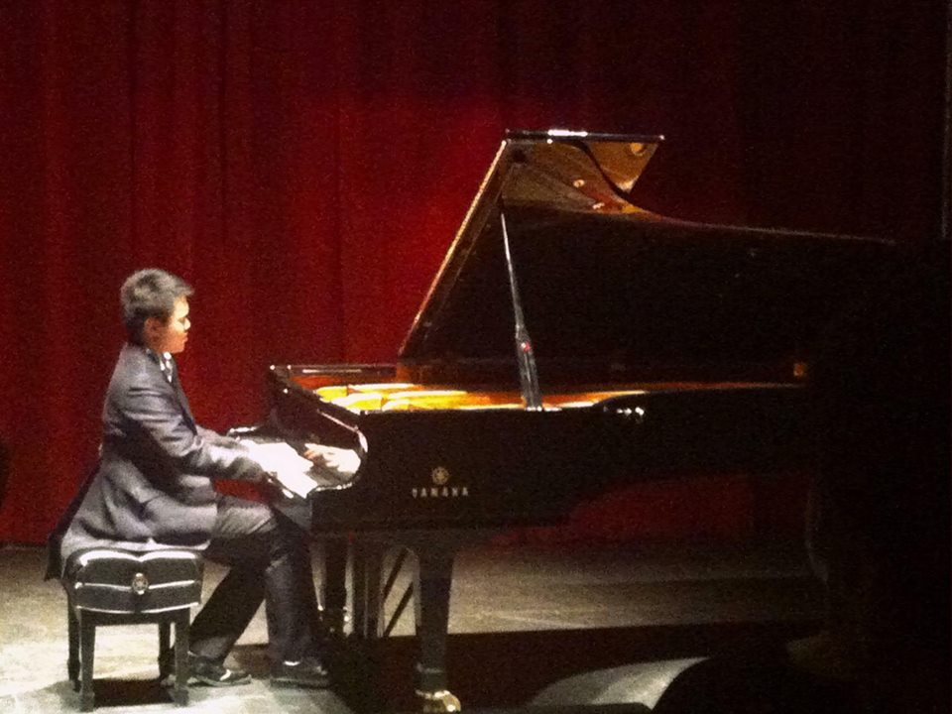
Bearing and Following the WORD into the World Announcements &
Sharing of Joys and Concerns
Our music director – Brian Lam will be having a recital at Brooklyn College Recital Hall on 6/11 at 5:30pm
Special Ticket rate of $15 for Church members only. Please let me know by next Sunday, 6/4. See Brian if you are interested.

Slide 30
Bearing and Following the WORD into the World Prayer of the People & The Lord’s Prayer
Our Father, who art in heaven.
Halloweth be thy name.
Thy Kingdom come; Thy will be done
On earth as it is in heaven.
Give us this day our daily bread.
Forgive us our debts; as we forgive our debtors.
Lead us not into temptations, but deliver us from evil.
For Thine is the Kingdom, the Power, and the Glory forever. Amen.

Slide 31
Bearing and Following the WORD into the World Offering of our Gifts and our Lives
Musical Offering

Slide 32
Bearing and Following the WORD into the World Doxology and Offertory Prayer

Slide 33
Responding Hymn # 291 “Spirit, Spirit of Gentleness”
Spirit, spirit of gentleness, blow through the wilderness,
calling and free. Spirit, spirit of restlessness, stir me from placidness,
wind, wind on the sea.

Slide 34
Responding Hymn # 291 “Spirit, Spirit of Gentleness”
You moved on the waters; you called to the deep; then you coaxed up the mountains from the valleys of sleep; and over the eons you called to each thing, "Awake from your slumbers and rise on your wings."

Slide 35
Responding Hymn # 291 “Spirit, Spirit of Gentleness”
Spirit, spirit of gentleness, blow through the wilderness,
calling and free. Spirit, spirit of restlessness, stir me from placidness,
wind, wind on the sea.

Slide 36
Responding Hymn # 291 “Spirit, Spirit of Gentleness”
You swept through the desert; you stung with the sand; and you goaded your people with a law and a land. When they were confounded with idols and lies, then you spoke through your prophets to open their eyes.

Slide 37
Responding Hymn # 291 “Spirit, Spirit of Gentleness”
Spirit, spirit of gentleness, blow through the wilderness,
calling and free. Spirit, spirit of restlessness, stir me from placidness,
wind, wind on the sea.

Slide 38
Responding Hymn # 291 “Spirit, Spirit of Gentleness”
You sang in a stable; you cried from a hill; then you whispered in silence when the whole world was still. And down in the city, you called once again when you blew through your people on the rush of the wind.

Slide 39
Responding Hymn # 291 “Spirit, Spirit of Gentleness”
Spirit, spirit of gentleness, blow through the wilderness,
calling and free. Spirit, spirit of restlessness, stir me from placidness,
wind, wind on the sea.

Slide 40
Responding Hymn # 291 “Spirit, Spirit of Gentleness”
You call from tomorrow; you break ancient schemes; from the bondage of sorrow the captives dream dreams. Our women see visions; our men clear their eyes. With bold new decisions your people arise.

Slide 41
Responding Hymn # 291 “Spirit, Spirit of Gentleness”
Spirit, spirit of gentleness, blow through the wilderness,
calling and free. Spirit, spirit of restlessness, stir me from placidness,
wind, wind on the sea.

Slide 42
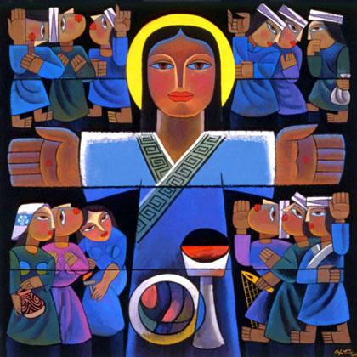
Bearing and Following the WORD into the World The Charge and Benediction

Slide 43
Bearing and Following the WORD into the World Benediction Response
# 540 “Farewell, Good Friends”
Farewell, Good friends!
Farewell, Good friends! Shalom, shalom! Till we meet again, till we meet again,
Shalom, Shalom.

Slide 44
Homecrest Presbyterian Church Worship of the Lord’s Day May 28th, 2017 7th Sunday of Easter Ascension Sunday

