Slide 1
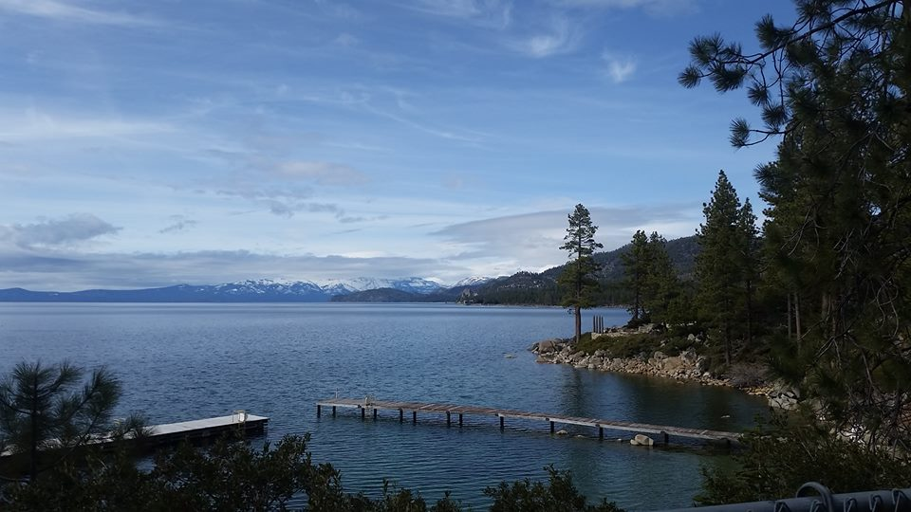
Homecrest Presbyterian Church Worship of the Lord’s Day May 7th, 2017 4th Sunday of Easter

Slide 2
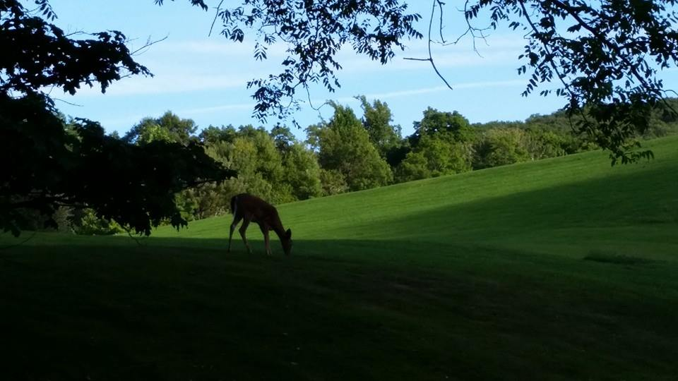
Gathering Around the WORD Call To Worship (Psalm 23)
The LORD is our shepherd, we shall not want.
He makes us lie down in green pastures; he leads us beside still waters;
He restores our souls. He leads us in right paths for his name's sake.
Even though we walk through the darkest valley, we fear no evil;
for you are with us;

Slide 3
Gathering Around the WORD Call To Worship (Psalm 23)
Your rod and your staff -- they comfort us.
You prepare a table before us in the presence of our enemies;
You anoint our heads with oil; our cups overflow. Surely goodness and mercy shall follow us all the days of our lives, and we shall dwell in the house of the LORD our whole life long.

Slide 4
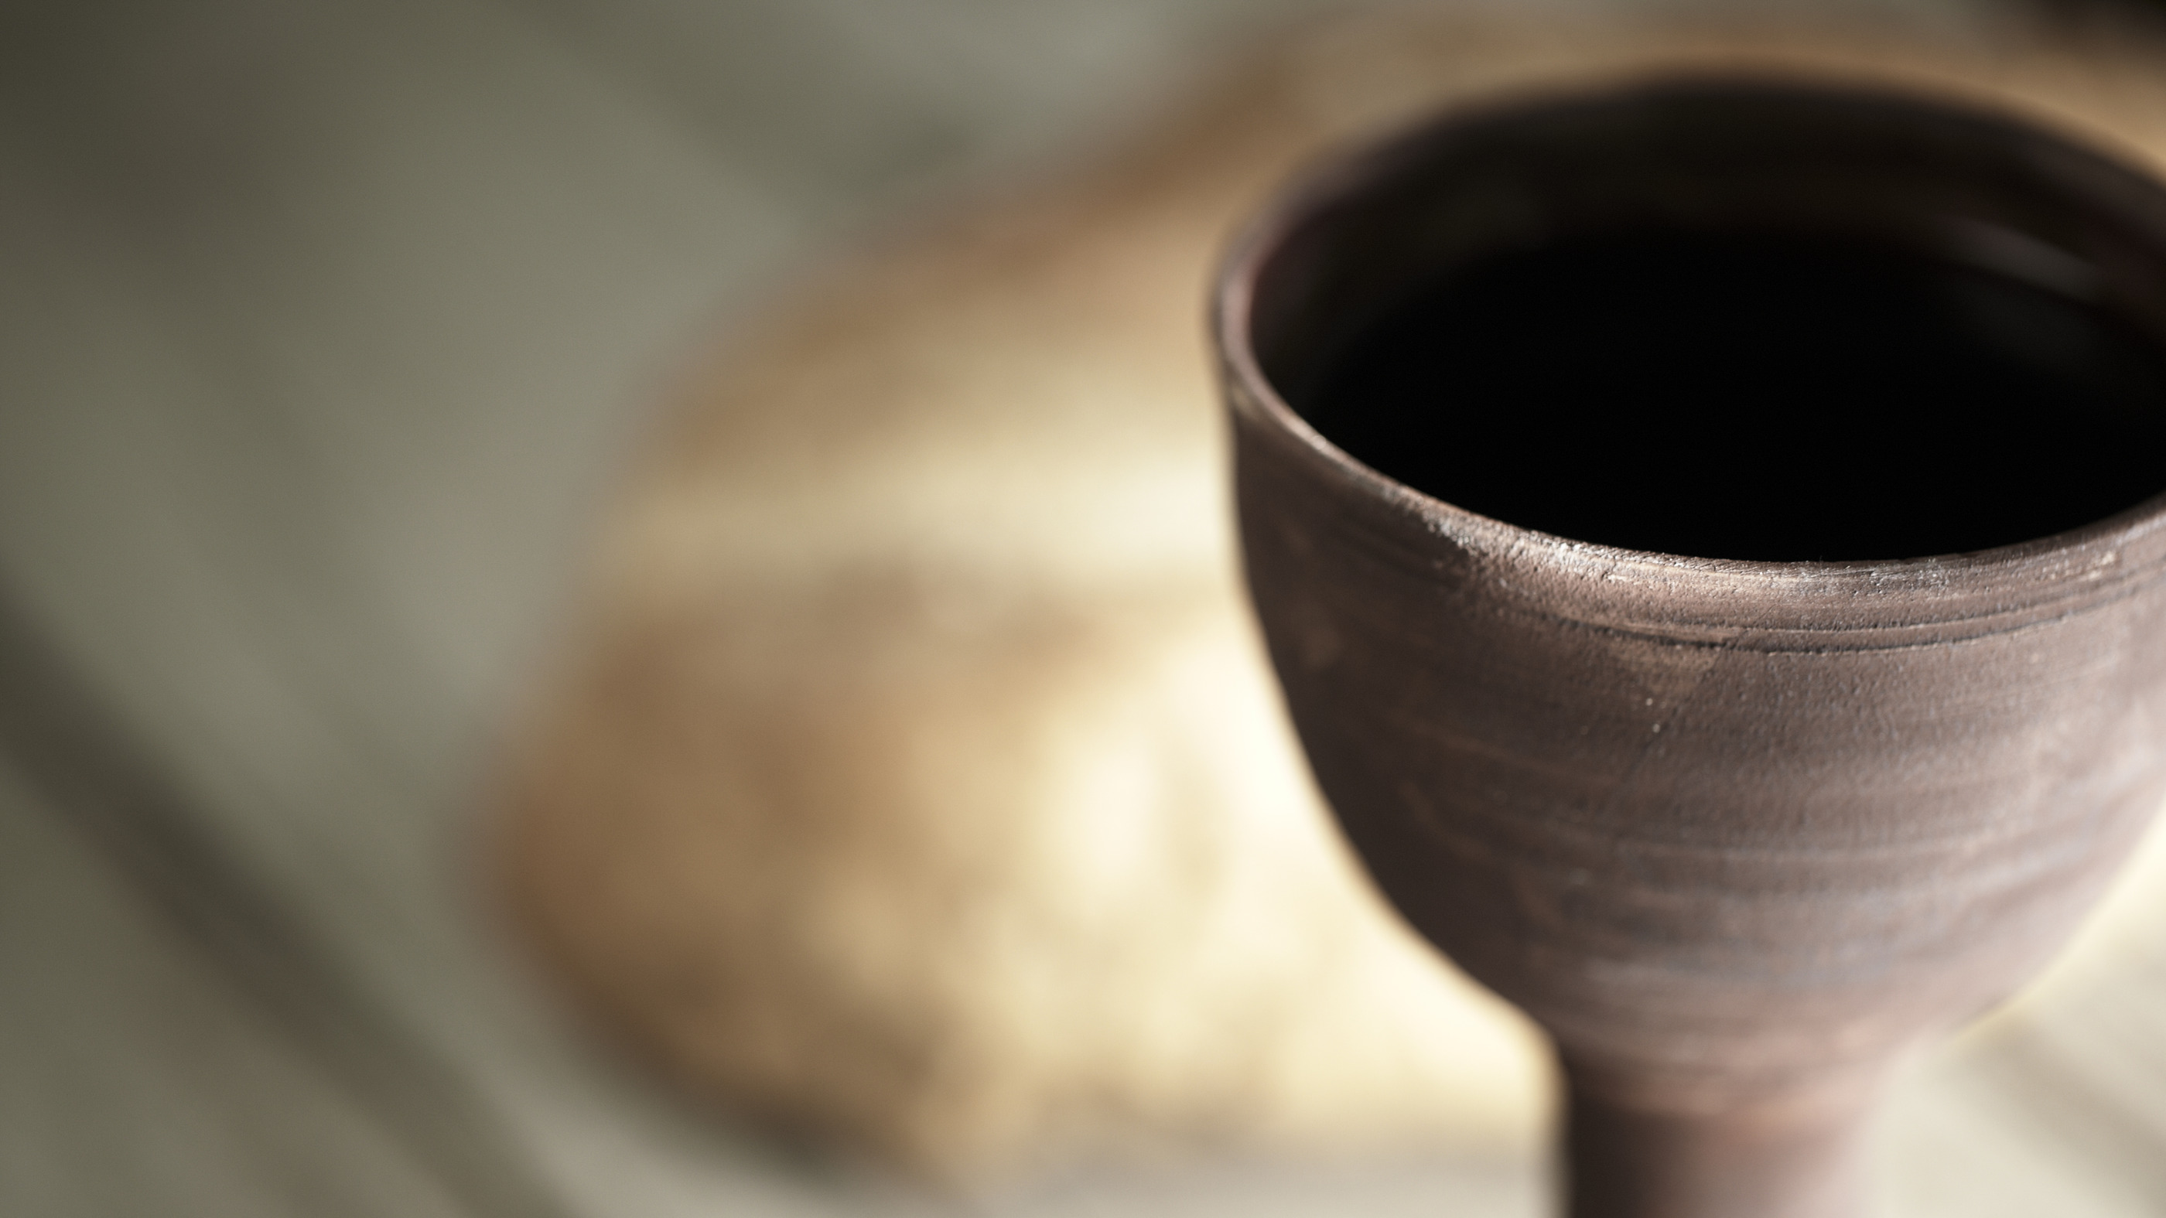
Gathering Hymn #504 “We Come as Guest Invited”
We come as guests invited when Jesus bids us dine, his friends on earth united to share the bread and wine; the bread of life is broken; the wine is freely poured for us, in solemn token of Christ our dying Lord.

Slide 5
Gathering Hymn #504 “We Come as Guest Invited”
We eat and drink, receiving from Christ the grace we need, and in our hearts believing on him by faith we feed; with wonder and thanksgiving for love that knows no end, we find in Jesus living our ever-present friend.

Slide 6
Gathering Hymn #504 “We Come as Guest Invited”
One bread is ours for sharing, one single fruitful vine, our fellowship declaring renewed in bread and wine: renewed, sustained, and given by token, sign, and word, the pledge and seal of heaven, the love of Christ our Lord.

Slide 7
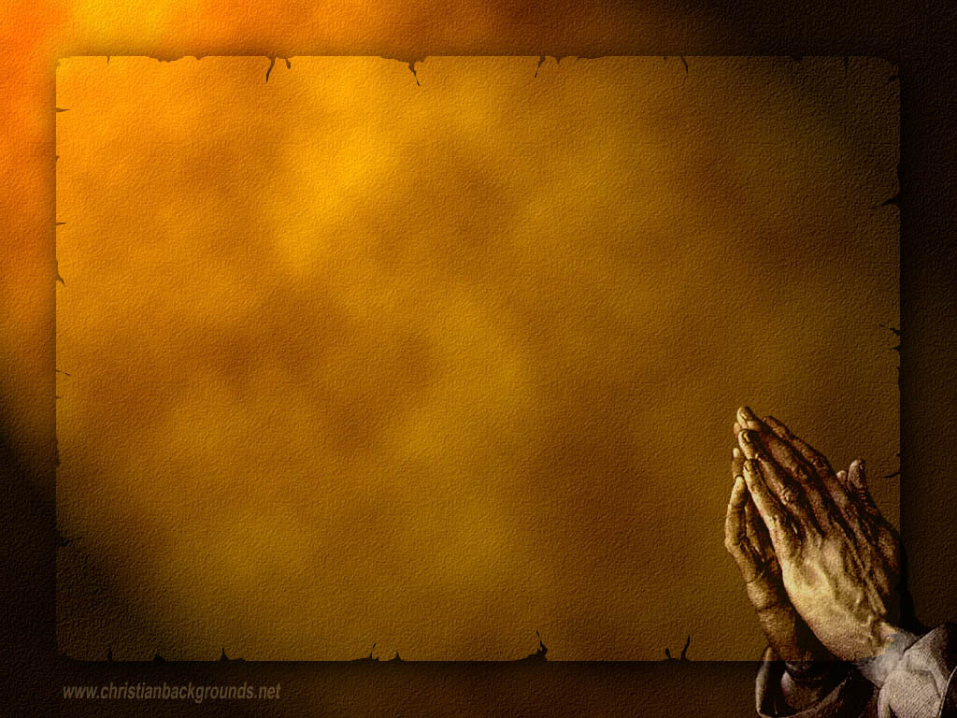
Gathering Around the WORD Call to Confession God is our Shepherd who protects us and keeps us from going astray. God calls us into confession and into the path of righteousness. God is willing to forgive us and embrace us just as we are in spite of our shortcomings. As exemplified through Christ’s humility, let us confess our sins before God and our neighbors.

Slide 8
Gathering Around the WORD Prayer of Confession (in unison)
Holy and merciful God, we confess that we have not followed Christ’s example and his command to love you and one another. We’ve neglected your grace. We have gone astray and fallen short of your glory. Forgive us, Lord. Lead us back into your fold and guard our souls in Jesus’ name. Amen.

Slide 9
Gathering Around the WORD Declaration of Forgiveness Our God is willing to forgive and forget. Like our mother, our God embraces us and loves us unconditionally. Thanks be to God for her tender care and a compassionate heart. We can therefore live freely as God’s beloved people. Thanks be to God, Amen.

Slide 10
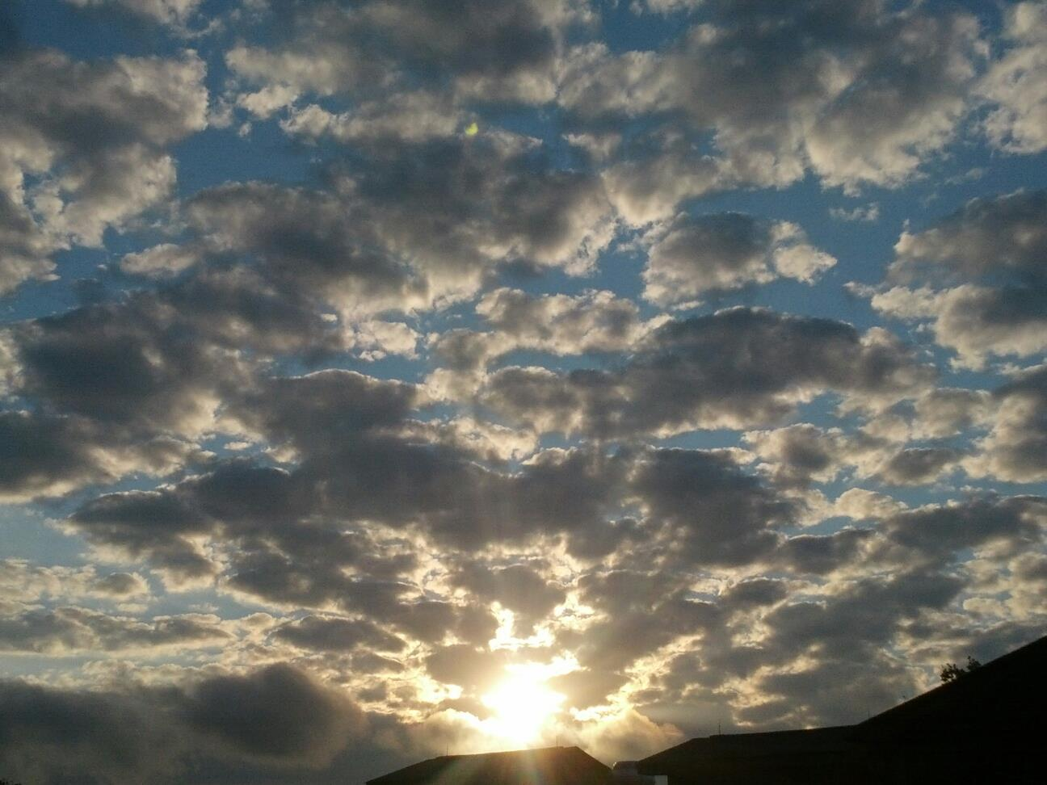
Gathering Around the WORD Gloria Patri
Glory be to the Father
and to the Son and to the Holy Ghost;
As it was in the beginning,
is now, and ever shall be,
world without end. Amen, Amen.

Slide 11
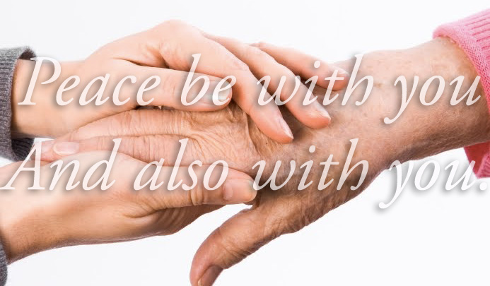
Gathering Around the WORD Passing of the Peace of Christ

Slide 12
Proclaiming the WORD Message to the Youth/ Prayer of Illumination

Slide 13
Refugees (By Brian Bilston)
They have no need of our help So do not tell me These haggard faces could belong to you or me Should life have dealt a different hand We need to see them for who they really are Chancers and scroungers Layabouts and loungers With bombs up their sleeves Cut-throats and thieves They are not Welcome here We should make them Go back to where they came from

Slide 14
Refugees (By Brian Bilston)
They cannot Share our food Share our homes Share our countries Instead let us Build a wall to keep them out It is not okay to say These are people just like us A place should only belong to those who are born there Do not be so stupid to think that The world can be looked at another way (now read from bottom to top)

Slide 15
Refugees (By Brian Bilston)
They have no need of our help So do not tell me These haggard faces could belong to you or me Should life have dealt a different hand We need to see them for who they really are Chancers and scroungers Layabouts and loungers With bombs up their sleeves Cut-throats and thieves They are not Welcome here We should make them Go back to where they came from

Slide 16
Proclaiming the WORD Scripture Reading (Acts 2:37-47)
³⁷ Now when they heard this, they were cut to the heart and said to Peter and to the other apostles, "Brothers, what should we do?" ³⁸ Peter said to them, "Repent, and be baptized every one of you in the name of Jesus Christ so that your sins may be forgiven; and you will receive the gift of the Holy Spirit. ³⁹ For the promise is for you, for your children, and for all who are far away, everyone whom the Lord our God calls to him."

Slide 17
Proclaiming the WORD Scripture Reading (Acts 2:37-47)
⁴⁰ And he testified with many other arguments and exhorted them, saying, "Save yourselves from this corrupt generation." ⁴¹ So those who welcomed his message were baptized, and that day about three thousand persons were added.
⁴² They devoted themselves to the apostles' teaching and fellowship, to the breaking of bread and the prayers. ⁴³ Awe came upon everyone, because many wonders and signs were being done by the apostles.

Slide 18
Proclaiming the WORD Scripture Reading (Acts 2:37-47)
⁴⁴ All who believed were together and had all things in common; ⁴⁵ they would sell their possessions and goods and distribute the proceeds to all, as any had need. ⁴⁶ Day by day, as they spent much time together in the temple, they broke bread at home and ate their food with glad and generous hearts, ⁴⁷ praising God and having the goodwill of all the people. And day by day the Lord added to their number those who were being saved.

Slide 19
Proclaiming the WORD A Fellowship of Believers
(Acts 2:42-47)

Slide 20
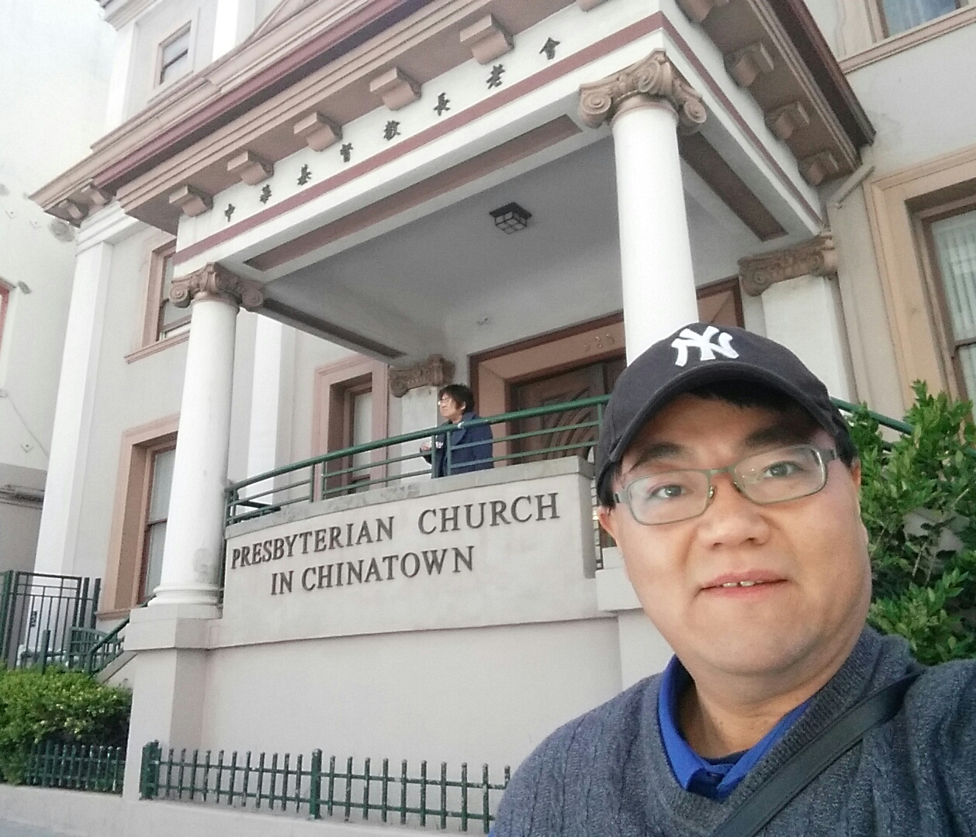
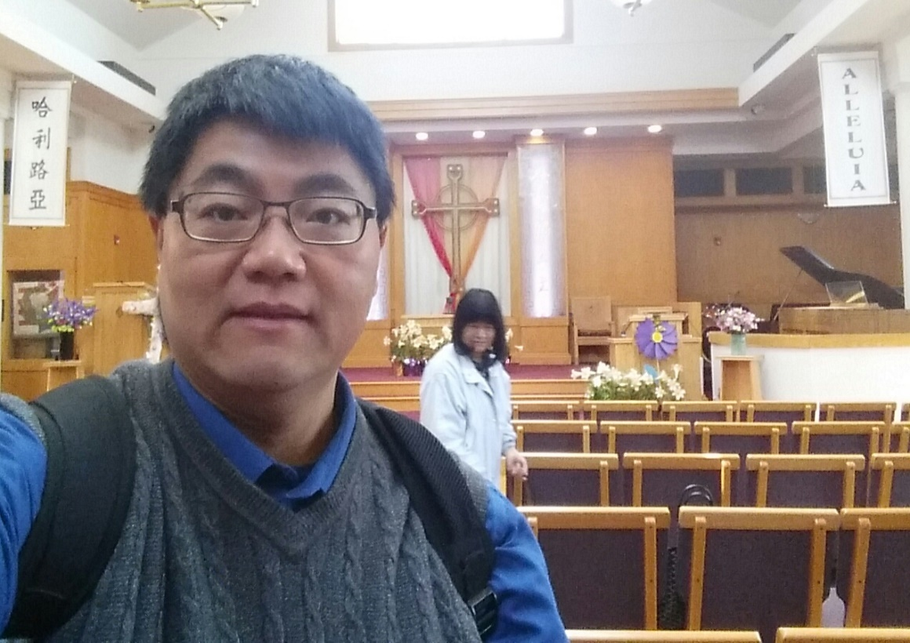
Proclaiming the WORD A Fellowship of Believers
(Acts 2:42-47)

Slide 21
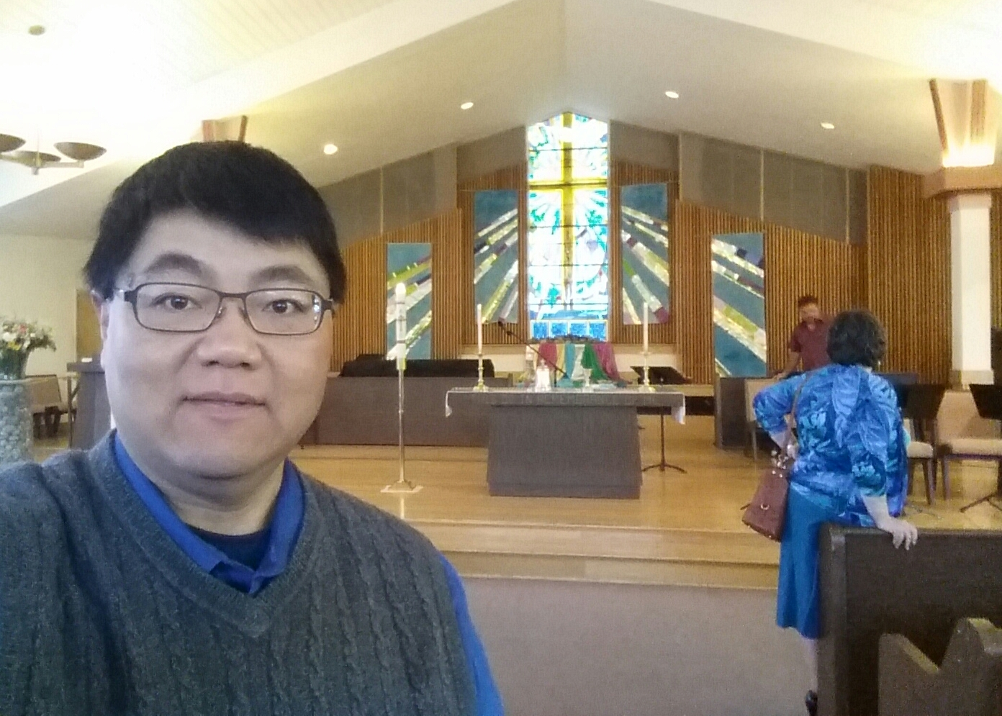
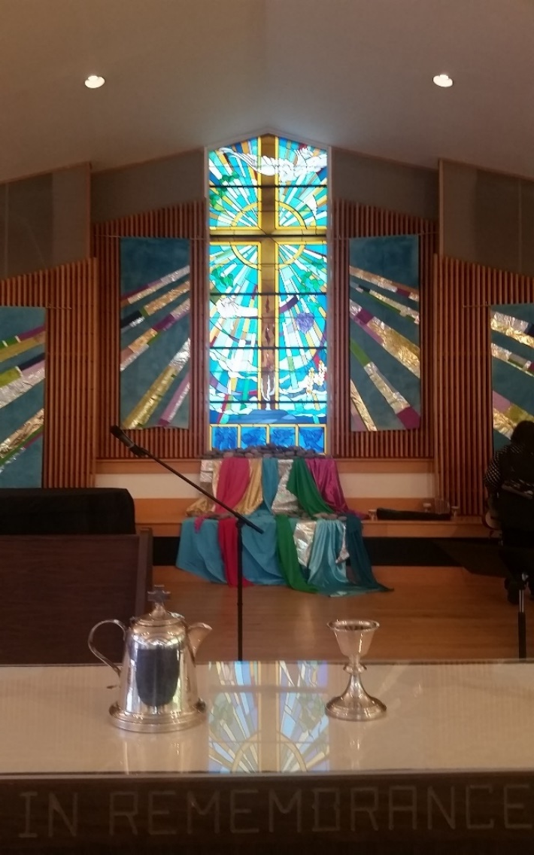
Proclaiming the WORD A Fellowship of Believers
(Acts 2:42-47)

Slide 22
Proclaiming the WORD A Fellowship of Believers
(Acts 2:42-47)

Slide 23
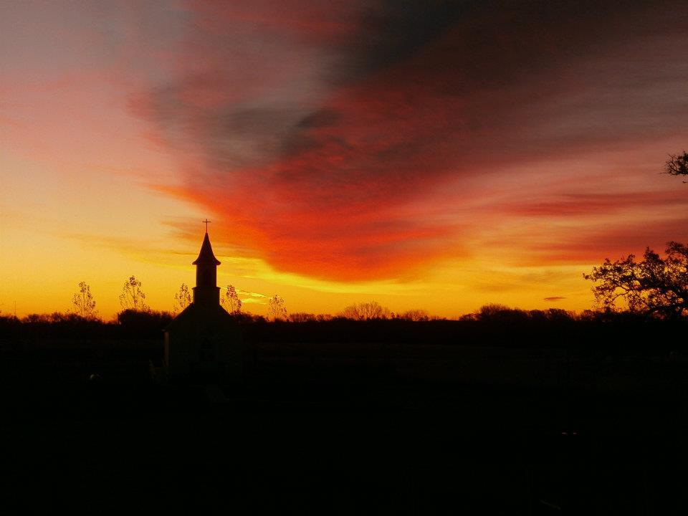
Responding Hymn # 321 “The Church’s One Foundation”
The church's one foundation is Jesus Christ her Lord. She is his new creation by water and the word. From heaven he came and sought her to be his holy bride. With his own blood he bought her, and for her life he died.

Slide 24
Responding Hymn # 321 “The Church’s One Foundation”
Elect from every nation, yet one o'er all the earth, her charter of salvation: one Lord, one faith, one birth. One holy name she blesses, partakes one holy food, and to one hope she presses, with every grace endued.

Slide 25
Responding Hymn # 321 “The Church’s One Foundation”
Though with a scornful wonder this world sees her oppressed, by schisms rent asunder, by heresies distressed, yet saints their watch are keeping; their cry goes up: "How long?" And soon the night of weeping shall be the morn of song.

Slide 26
Responding Hymn # 321 “The Church’s One Foundation”
Mid toil and tribulation, and tumult of her war, she waits the consummation of peace forevermore: till with the vision glorious her longing eyes are blest, and the great church victorious shall be the church at rest.

Slide 27
Responding Hymn # 321 “The Church’s One Foundation”
Yet she on earth has union with God, the Three in One, and mystic sweet communion with those whose rest is won: O happy ones and holy! Lord, give us grace that we, like them, the meek and lowly, may live eternally.

Slide 28
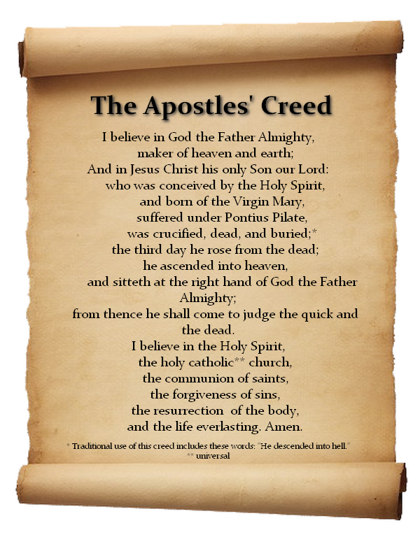
Responding to the WORD
Affirmation of Faith

Slide 29
Bearing and Following the WORD into the World Announcements &
Sharing of Joys and Concerns
The afternoon Bible Study Group will resume next Sunday downstairs at 12:30pm. We are continuing the series with 365 Days Daily Devotional written by John Calvin, in commemoration of the 500th Anniversary of the Protestant Reformation. All are welcomed.
The Session will be meeting Tomorrow on 5/8, 7pm.
The Women's Group will be meeting over at the Manse (2048 E 14th Street) every Wednesday evening @ 7:30pm. They are currently studying the book of Mark. For more information, please contact Margaret Lesman or Cara Chin.

Slide 30
Bearing and Following the WORD into the World Announcements &
Sharing of Joys and Concerns
FREE SAT Preparation Courses, 5/30 - 6/2 4-7pm over at the Manse. For more information, please see Pastor Samson and pick up one of the flyers on the back table. Invite your neighbors/friends and their children.

Slide 31
Bearing and Following the WORD into the World Prayer of the People & The Lord’s Prayer
Our Father, who art in heaven.
Halloweth be thy name.
Thy Kingdom come; Thy will be done
On earth as it is in heaven.
Give us this day our daily bread.
Forgive us our debts; as we forgive our debtors.
Lead us not into temptations, but deliver us from evil.
For Thine is the Kingdom, the Power, and the Glory forever. Amen.

Slide 32
Bearing and Following the WORD into the World Offering of our Gifts and our Lives

Slide 33
Bearing and Following the WORD into the World Doxology and Offertory Prayer

Slide 34
Bearing and Following the WORD into the World Holy Communion Hymn
#288 “Spirit of the Living God” (2X)
Spirit of the Living God,
Fall afresh on me.
Spirit of the Living God,
Fall afresh on me. Melt me; Mold me; Fill me; Use me. Spirit of the living God,
Fall afresh on me.

Slide 35
Bearing and Following the WORD into the World Holy Communion
Friends, we gather now as one body, joined around this table of LOVE as we bear witness to our risen LORD Jesus Christ. Here we celebrate God's presence among us, united in Christ's spirit.

Slide 36
Bearing and Following the WORD into the World Holy Communion
We have come to this table of the Heavenly Feast, the joyful celebration of the people of God. Christ invites us to confess our sins and to be baptized in Him, so we may eat this bread of life and drink this cup of our salvation.

Slide 37
Bearing and Following the WORD into the World Holy Communion
The Lord be with you. And also with you.
Lift up your hearts. We lift them up to the Lord.
Let us give thanks to the Lord our God.
It is right to give our thanks and praise.

Slide 38
Bearing and Following the WORD into the World Holy Communion
By your life-giving Spirit, you have renewed us and re-created us. We’ve called upon your name and you’ve heard us. Therefore we join our voices with saints and angels and all the faithful of every time and place singing:

Slide 39
Bearing and Following the WORD into the World Holy Communion
Holy, Holy, Holy Lord,
God of power and might,
Heaven and earth are full of your glory.
Hosanna in the highest.
Blessed is he who comes in the name of the Lord.
Hosanna in the highest.

Slide 40
Bearing and Following the WORD into the World Holy Communion
We give you thanks that you have made us one with him as he is one with you and the Holy Spirit.
With thanksgiving, we remember how Jesus took bread, blessed and broke it, and gave it to his disciples, saying, this is my body, given for you.
In the same way, he took the cup, saying,
this is the new covenant sealed in my blood.
Do this, in remembrance of me.

Slide 41
Bearing and Following the WORD into the World Holy Communion
With thanks and praise we offer ourselves to you, O God.
Sharing this holy meal, remembering Christ’s dying and rising, and praying: Come Lord Jesus!
Christ has died, Christ is risen,
Christ will come again.

Slide 42
Bearing and Following the WORD into the World Holy Communion
Jesus said, "I am the bread of life. They who come to me shall never hunger; they who believe in me shall never thirst." These are the gift of God for the people of God.

Slide 43
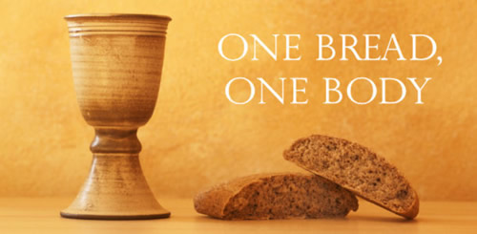
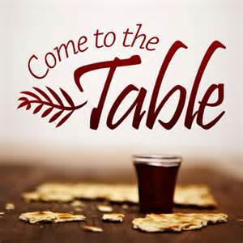
Bearing and Following the WORD into the World Holy Communion

Slide 44
Bearing and Following the WORD into the World
Prayer after the Communion: (in unison)
:
Lord Jesus Christ, fill us with your dreams and your vision of that glorious day when you shall come once again. Empower us with your Spirit to be the fellowship of believers whom you have called us to be, proclaiming your witness and presence into the world.

Slide 45
Bearing and Following the WORD into the World
Prayer after the Communion: (in unison)
:
Send us out now into the world.
Teach us how to serve others,
as Christ has demonstrated to us.
Through Christ, with Christ, in Christ, in the unity of the Holy Spirit, all glory and honor are yours, Almighty God, now and forever, Amen.

Slide 46
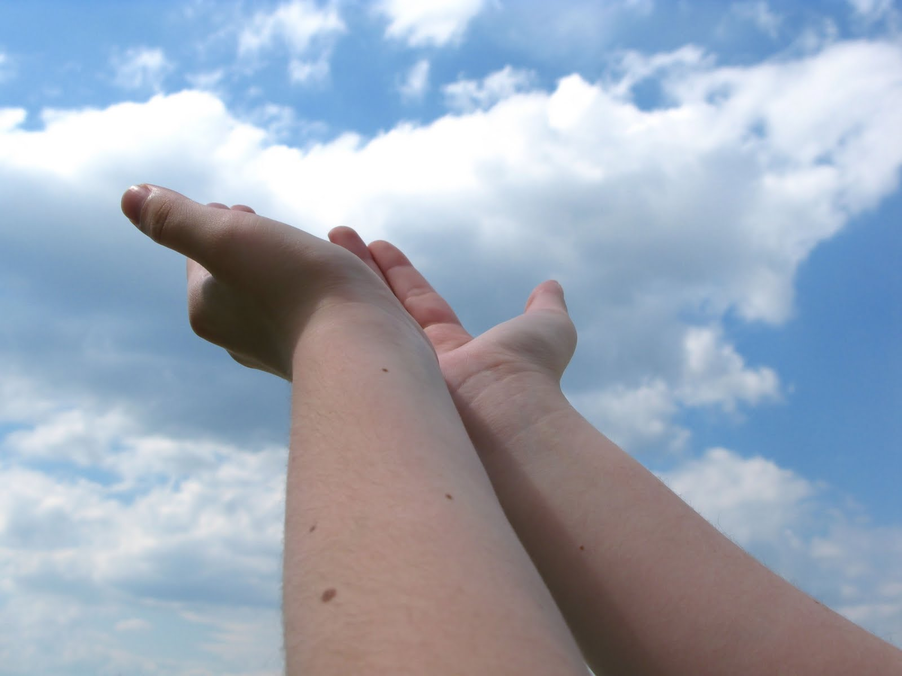
Bearing and Following the WORD into the World Deacons’ Benevolence Offering

Slide 47
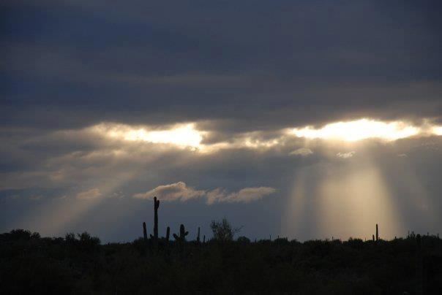
Sending Hymn # 733 “We Are All One in Mission”
We all are one in mission; we all are one in call, our varied gifts united by Christ, the Lord of all. A single, great commission compels us from above to plan and work together that all may know Christ’s love.

Slide 48
Sending Hymn # 733 “We Are All One in Mission”
We all are called for service to witness in God’s name. Our ministries are different; our purpose is the same: to touch the lives of others by God’s surprising grace, so every folk and nation may feel God’s warm embrace.

Slide 49
Sending Hymn # 733 “We Are All One in Mission”
Now let us be united and let our song be heard. Now let us be a vessel for God’s redeeming word. We all are one in mission; we all are one in call, our varied gifts united by Christ, the Lord of all.

Slide 50
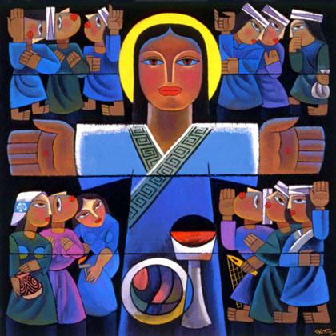
Bearing and Following the WORD into the World The Charge and Benediction

Slide 51
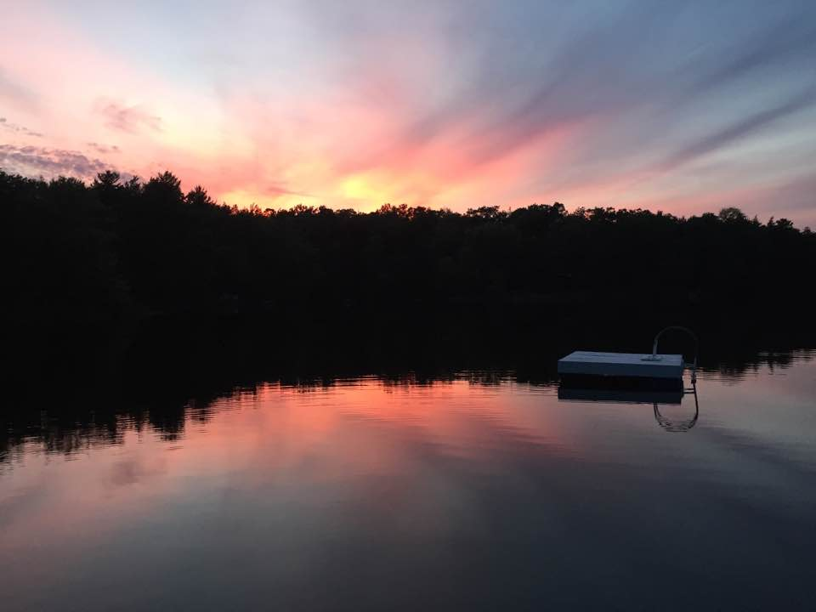
Bearing and Following the WORD into the World Benediction Response
# 540 “Farewell, Good Friends”
Farewell, Good friends!
Farewell, Good friends! Shalom, shalom! Till we meet again, till we meet again,
Shalom, Shalom.

Slide 52
Homecrest Presbyterian Church Worship of the Lord’s Day May 7th, 2017 4th Sunday of Easter

