Slide 1
Homecrest Presbyterian Church Worship of the Lord’s Day March 12th, 2017 2nd Sunday in Lent

Slide 2
Gathering Around the WORD Call to Worship (Psalm 121:1, 5, 8)
From where will our help come?
Our help comes from the Lord,
who made heaven and earth.
Who is our keeper?
The Lord is our keeper, by day and by night.
How low will God protect us?
God will keep our going out and our coming in from this time on and forevermore.
Come and let us worship God in this Holy place and in this Holy time.

Slide 3
Gathering Hymn # 12 “Immortal, Invisible, God Only Wise”
Immortal, invisible, God only wise, in light inaccessible
hid from our eyes, most blessed, most glorious,
the Ancient of Days, almighty, victorious,
thy great name we praise.

Slide 4
Gathering Hymn # 12 “Immortal, Invisible, God Only Wise”
Unresting, unhasting,
and silent as light, nor wanting, nor wasting,
thou rulest in might: thy justice, like mountains
high soaring above; thy clouds, which are fountains
of goodness and love.

Slide 5
Gathering Hymn # 12 “Immortal, Invisible, God Only Wise”
To all, life thou givest,
to both great and small. In all life thou livest,
the true life of all. We blossom and flourish
like leaves on the tree, then wither and perish;
but naught changeth thee.

Slide 6
Gathering Hymn # 12 “Immortal, Invisible, God Only Wise”
Thou reignest in glory;
thou dwellest in light. Thine angels adore thee,
all veiling their sight. All praise we would render;
O help us to see 'tis only the splendor
of light hideth thee!

Slide 7
Gathering Around the WORD Call to Confession We cannot earn God’s grace or favor. It comes to us, not as something owed, but as a gift freely given to us. Confident in God’s love for us, even when we are ungodly, let us confess our sins in faith before God and our neighbors.

Slide 8
Gathering Around the WORD Prayer of Confession (in unison) Lord, you know who we are. You know everything we have done. We thirst for things that will never satisfy us. We commit ourselves to things that will never last. We worship things that will never bring salvation. Still, we offer us the gift of living water. Still, you offer us the gift of eternal life. Forgive us, O Lord, and give us this living water, so that we may never thirst again. Amen.

Slide 9
Gathering Around the WORD Declaration of Forgiveness (John 3:16-17) "For God so loved the world that he gave his only Son, so that everyone who believes in him may not perish but may have eternal life. Indeed, God did not send the Son into the world to condemn the world, but in order that the world might be saved through him.” Believe the Good News, in Jesus Christ we are forgiven. Thanks be to God, Amen

Slide 10
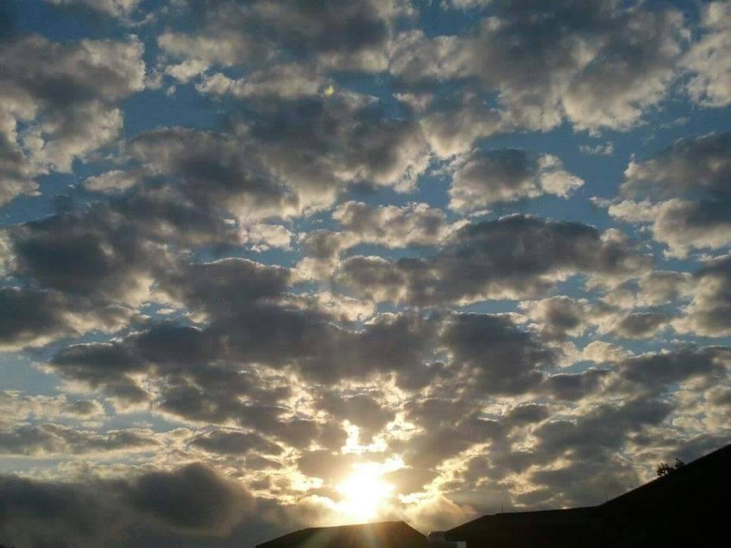
Gathering Around the WORD Gloria Patri
Glory be to the Father
and to the Son and to the Holy Ghost;
As it was in the beginning,
is now, and ever shall be,
world without end. Amen, Amen.

Slide 11
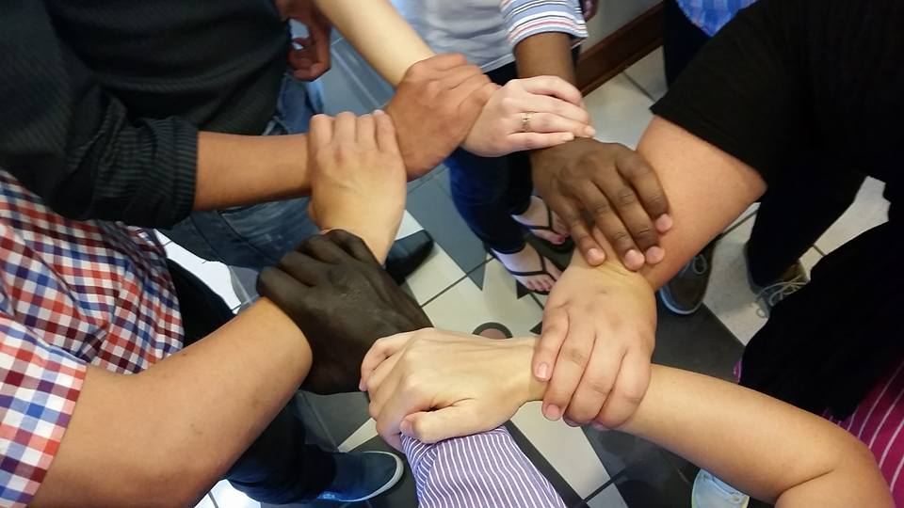
Gathering Around the WORD Passing of the Peace of Christ
Beloved, let us love one another, because love is from God; everyone who loves is born of God and knows God. Whoever does not love does not know God, for God is love. Sisters and Brothers, let us pass the peace of Christ and the love of God with one another. (I John 4:7-8)

Slide 12
Proclaiming the WORD Message to the Youth/ Prayer of Illumination

Slide 13
Proclaiming the WORD Scripture Reading – John 3:1-17
Now there was a Pharisee named Nicodemus, a leader of the Jews. ² He came to Jesus by night and said to him, "Rabbi, we know that you are a teacher who has come from God; for no one can do these signs that you do apart from the presence of God." ³ Jesus answered him, "Very truly, I tell you, no one can see the kingdom of God without being born from above." ⁴ Nicodemus said to him, "How can anyone be born after having grown old? Can one enter a second time into the mother's womb and be born?"

Slide 14
Proclaiming the WORD Scripture Reading – John 3:1-17
⁵ Jesus answered, "Very truly, I tell you, no one can enter the kingdom of God without being born of water and Spirit. ⁶ What is born of the flesh is flesh, and what is born of the Spirit is spirit. ⁷ Do not be astonished that I said to you, 'You must be born from above.' ⁸ The wind blows where it chooses, and you hear the sound of it, but you do not know where it comes from or where it goes. So it is with everyone who is born of the Spirit." ⁹ Nicodemus said to him, "How can these things be?" ¹⁰ Jesus answered him, "Are you a teacher of Israel, and yet you do not understand these things?

Slide 15
Proclaiming the WORD Scripture Reading – John 3:1-17
¹¹ "Very truly, I tell you, we speak of what we know and testify to what we have seen; yet you do not receive our testimony. ¹² If I have told you about earthly things and you do not believe, how can you believe if I tell you about heavenly things? ¹³ No one has ascended into heaven except the one who descended from heaven, the Son of Man. ¹⁴ And just as Moses lifted up the serpent in the wilderness, so must the Son of Man be lifted up, ¹⁵ that whoever believes in him may have eternal life.

Slide 16
Proclaiming the WORD Scripture Reading – John 3:1-17
¹⁶ "For God so loved the world that he gave his only Son, so that everyone who believes in him may not perish but may have eternal life. ¹⁷ "Indeed, God did not send the Son into the world to condemn the world, but in order that the world might be saved through him.

Slide 17
Proclaiming the WORD (John 3:1-17)
Born of the Spirit

Slide 18
Responding Hymn # 462 “I Love to Tell the Story”
I love to tell the story
of unseen things above, of Jesus and his glory,
of Jesus and his love. I love to tell the story,
because I know 'tis true; it satisfies my longings
as nothing else could do.

Slide 19
Responding Hymn # 462 “I Love to Tell the Story”
I love to tell the story;
‘twill be my theme in glory to tell the old, old story
of Jesus and his love.

Slide 20
Responding Hymn # 462 “I Love to Tell the Story”
I love to tell the story; 'tis pleasant to repeat what seems, each time I tell it, more wonderfully sweet! I love to tell the story, for some have never heard the message of salvation from God’s own holy Word.

Slide 21
Responding Hymn # 462 “I Love to Tell the Story”
I love to tell the story;
‘twill be my theme in glory to tell the old, old story
of Jesus and his love.

Slide 22
Responding Hymn # 462 “I Love to Tell the Story”
I love to tell the story, for those who know it best seem hungering and thirsting to hear it, like the rest. And when, in scenes of glory, I sing the new, new song, 'twill be the old, old story that I have loved so long.

Slide 23
Responding Hymn # 462 “I Love to Tell the Story”
I love to tell the story;
‘twill be my theme in glory to tell the old, old story
of Jesus and his love.

Slide 24
Responding to the WORD
Affirmation of Faith –
Presbyterian Church (USA)’s
A Brief Statement of Faith Sections 1-2
In life and in death we belong to God. Through the grace of our Lord Jesus Christ, the love of God, and the communion
of the Holy Spirit,
we trust in the one triune God,
the Holy One of Israel,
whom alone we worship and serve.

Slide 25
Responding to the WORD
Affirmation of Faith –
Presbyterian Church (USA)’s
A Brief Statement of Faith Sections 1-2
We trust in Jesus Christ, Fully human, fully God. Jesus proclaimed the reign of God: preaching good news to the poor and release to the captives, teaching by word and deed and blessing the children, healing the sick and binding up the brokenhearted, eating with outcasts, forgiving sinners, and calling all to repent and believe the gospel.

Slide 26
Responding to the WORD
Affirmation of Faith –
Presbyterian Church (USA)’s
A Brief Statement of Faith Sections 1-2
Unjustly condemned for blasphemy and sedition, Jesus was crucified, suffering the depths of human pain and giving his life for the sins of the world.
God raised this Jesus from the dead, vindicating his sinless life, breaking the power of sin and evil, delivering us from death to life eternal.

Slide 27
Bearing and Following the WORD into the World Announcements &
Sharing of Joys and Concerns
The afternoon Bible Study Group will resume downstairs in the basement today, at 12:30pm. We are currently studying a new series on “365 Days with John Calvin” edited by Joel R. Beeke in commemoration of the 500th Anniversary of the Protestant Reformation this year.
The Women's Group meets on every Wednesdays at 7:30pm over at the Manse (2048 E 14th Street). They are currently studying Gospel of Mark. For more information, please see Margaret and Cara.

Slide 28
Bearing and Following the WORD into the World Announcements &
Sharing of Joys and Concerns
Our Annual St. Patrick’s Day Dinner will be this coming Saturday, 3/18 6pm For tickets, please see Paul.
Lenten Breakfast will be scheduled for three consecutive Sundays, March 26th, April 2nd, and April 9th.

Slide 29
Bearing and Following the WORD into the World Announcements &
Sharing of Joys and Concerns
We will be visiting and distributing Palm Crosses at the nursing home on Palm Sunday, 4/9 after service. We will be making these crosses on Saturday, 4/8.
Good Friday Worship Service, 4/14 7pm. We will be joint by Sheepshead Bay Resurrection once again this year.

Slide 30
Bearing and Following the WORD into the World Prayer of the People & The Lord’s Prayer
Our Father, who art in heaven.
Halloweth be thy name.
Thy Kingdom come; Thy will be done
On earth as it is in heaven.
Give us this day our daily bread.
Forgive us our debts; as we forgive our debtors.
Lead us not into temptations, but deliver us from evil.
For Thine is the Kingdom, the Power, and the Glory forever. Amen.

Slide 31
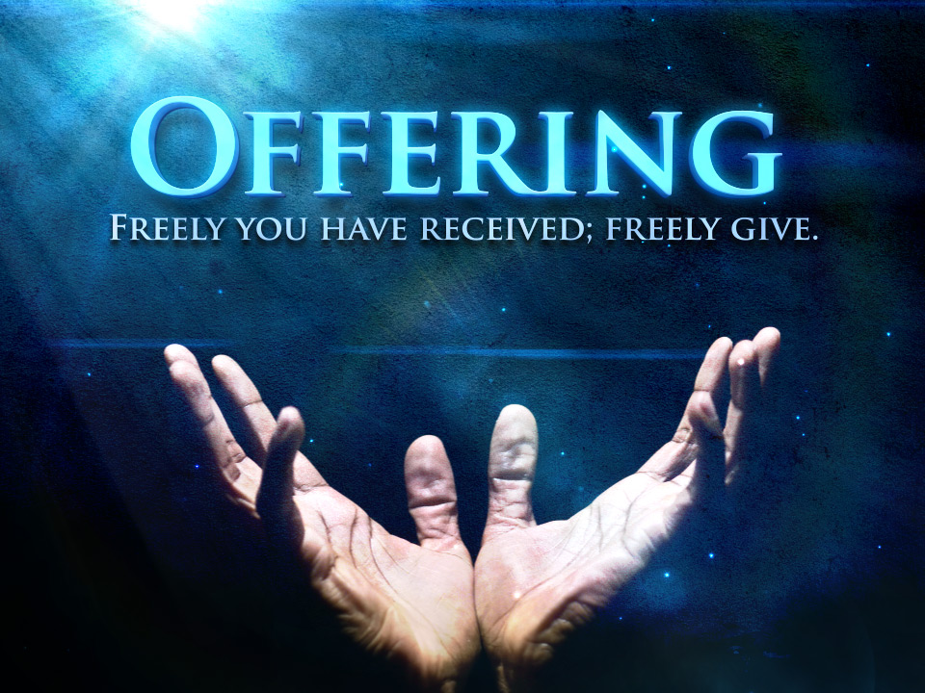
Bearing and Following the WORD into the World Offering of our Gifts and our Lives

Slide 32
Bearing and Following the WORD into the World Doxology and Offertory Prayer

Slide 33
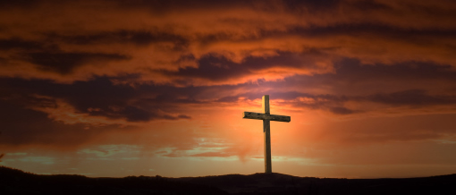
Sending Hymn # 167 “Forty Days and Forty Nights”
Forty days and forty nights you were fasting in the wild; forty days and forty nights tempted, and yet undefiled.

Slide 34
Sending Hymn # 167 “Forty Days and Forty Nights”
Shall not we your sorrow share and from worldly joys abstain, fasting with unceasing prayer, strong with you to suffer pain?

Slide 35
Sending Hymn # 167 “Forty Days and Forty Nights”
Then if Satan on us press, flesh or spirit to assail, victor in the wilderness, grant that we not faint nor fail!

Slide 36
Sending Hymn # 167 “Forty Days and Forty Nights”
So shall we have peace divine: holier gladness ours shall be; round us, too, shall angels shine, such as served you faithfully.

Slide 37
Sending Hymn # 167 “Forty Days and Forty Nights”
Keep, O keep us, Savior dear, ever constant by your side, that with you we may appear at the eternal Eastertide.

Slide 38
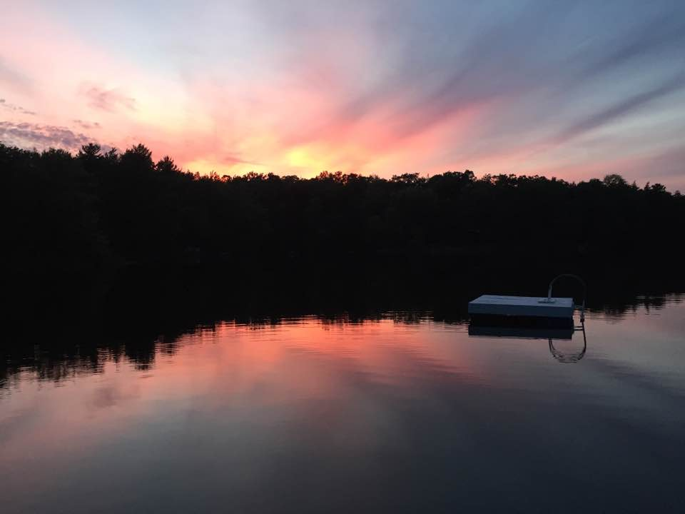
Bearing and Following the WORD into the World The Charge and Benediction

Slide 39
Bearing and Following the WORD into the World Benediction Response
# 547 “Go, My Children, with My Blessing”
(Stanza 1)
Go, my children, with my blessing, never alone.
Waking, sleeping, I am with you, you are my own. In my love’s baptismal river
I have made you mine forever.
Go, my children, with my blessing, you are my own.

Slide 40
Homecrest Presbyterian Church Worship of the Lord’s Day March 12th, 2017 2nd Sunday in Lent

