Slide 1
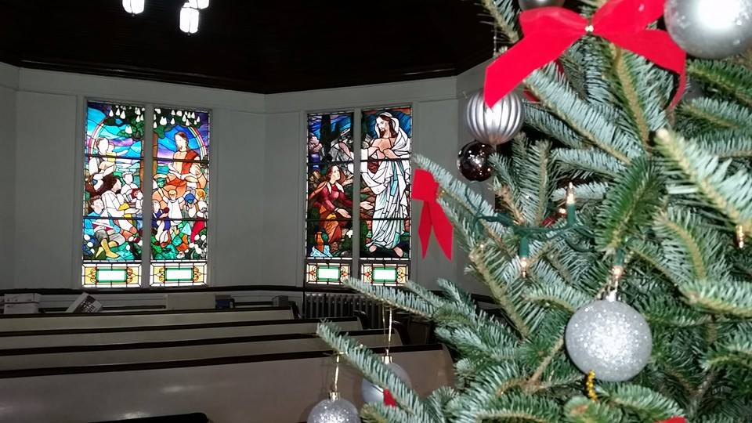
Homecrest Presbyterian Church Worship of the Lord’s Day 4th Sunday in Advent December 18th, 2016

Slide 2
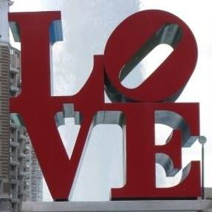
Gathering Around the WORD Lighting of the 4th Advent Candle / Call to Worship

Slide 3
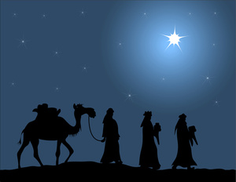
Gathering Hymn # 83 “Come, Thou Long-Expected Jesus”
Come, thou long-expected Jesus, born to set thy people free; from our fears and sins release us; let us find our rest in thee.

Slide 4
Gathering Hymn # 83 “Come, Thou Long-Expected Jesus”
Israel’s strength and consolation, hope of all the earth thou art; dear desire of every nation, joy of every longing heart.

Slide 5
Gathering Hymn # 83 “Come, Thou Long-Expected Jesus”
Born thy people to deliver, born a child and yet a king, born to reign in us forever, now thy gracious kingdom bring.

Slide 6
Gathering Hymn # 83 “Come, Thou Long-Expected Jesus”
By thine own eternal Spirit rule in all our hearts alone; by thine all-sufficient merit raise us to thy glorious throne.

Slide 7
Gathering Around the WORD Call to Confession In Jesus Christ our Lord, the grace of God has appeared, bringing new hope and salvation to humankind. Let us therefore, with confidence and joy, come before God with a contrite spirit and confessing our sins before God and our neighbors.

Slide 8
Gathering Around the WORD Prayer of Confession (in unison) Great and glorious God, through Jesus Christ our Savior you have shown us that the blessed age of grace has appeared and the hopeful time of salvation has come. Yet we cling to the glories of the present age – worldly passions and impious pursuits, self-indulgent, crooked, and ungodly ways. Redeem us from evil and cleanse us from our sins, though Christ, who gave himself for us, so that we might be your people, holy and whole. Amen.

Slide 9
Gathering Around the WORD Declaration of Forgiveness Friends, we are created by God because God loved us. Yet we’ve fallen short of God’s expectation and glory. Nevertheless, God is willing to forgive our human weaknesses and personal prides through the saving grace and the work of our Lord Jesus Christ. This is the Good News that would sustain us not only during this season of Advent but for all the days ahead, until Christ comes to us once again. Thanks be to God, Amen.

Slide 10
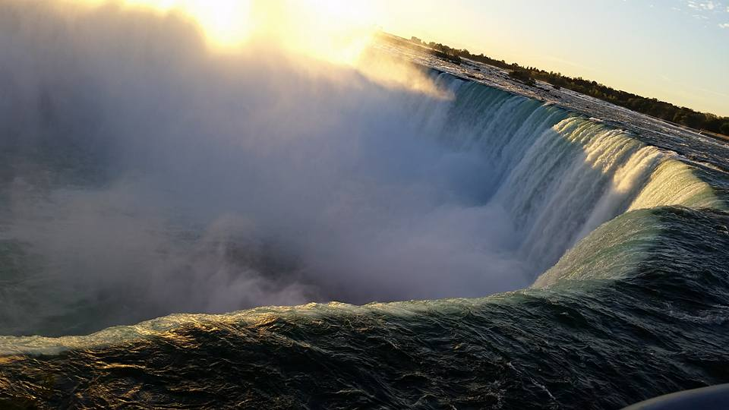
Gathering Around the WORD Gloria Patri
Glory be to the Father
and to the Son and to the Holy Ghost;
As it was in the beginning,
is now, and ever shall be,
world without end. Amen, Amen.

Slide 11
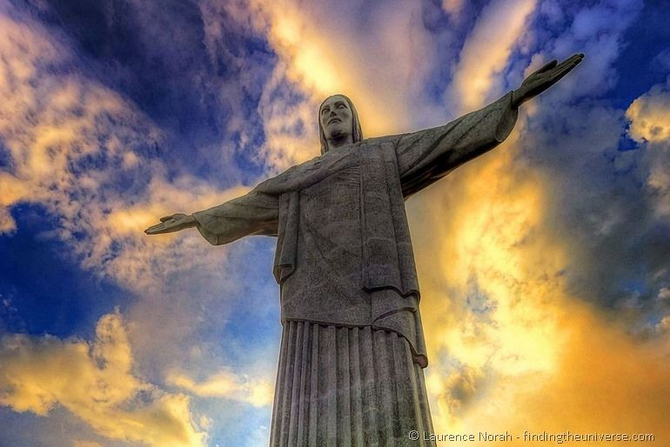
Gathering Around the WORD Passing of the Peace of Christ
Jesus said, “Peace I leave with you; my peace I give to you. I do not give to you as the world gives. Do not let your hearts be troubled, and do not let them be afraid.” (John 14:27)

Slide 12
Proclaiming the WORD Message to the Youth/ Prayer of Illumination

Slide 13
Proclaiming the WORD Scripture Reading (Isaiah 7:10-16)
¹⁰Again the LORD spoke to Ahaz, saying, ¹¹Ask a sign of the LORD your God; let it be deep as Sheol or high as heaven. ¹²But Ahaz said, I will not ask, and I will not put the LORD to the test. ¹³Then Isaiah said: “Hear then, O house of David! Is it too little for you to weary mortals, that you weary my God also?

Slide 14
Proclaiming the WORD Scripture Reading (Isaiah 7:10-16)
¹⁴Therefore the Lord himself will give you a sign. Look, the young woman is with child and shall bear a son, and shall name him Immanuel. ¹⁵He shall eat curds and honey by the time he knows how to refuse the evil and choose the good. ¹⁶For before the child knows how to refuse the evil and choose the good, the land before whose two kings you are in dread will be deserted.

Slide 15
Proclaiming the WORD Scripture Reading (Matthew 1:18-25)
¹⁸Now the birth of Jesus the Messiah took place in this way. When his mother Mary had been engaged to Joseph, but before they lived together, she was found to be with child from the Holy Spirit. ¹⁹Her husband Joseph, being a righteous man and unwilling to expose her to public disgrace, planned to dismiss her quietly. ²⁰But just when he had resolved to do this, an angel of the Lord appeared to him in a dream and said, “Joseph, son of David, do not be afraid to take Mary as your wife, for the child conceived in her is from the Holy Spirit.

Slide 16
Proclaiming the WORD Scripture Reading (Matthew 1:18-25)
²¹She will bear a son, and you are to name him Jesus, for he will save his people from their sins.” ²²All this took place to fulfill what had been spoken by the Lord through the prophet: ²³ “Look, the virgin shall conceive and bear a son, and they shall name him Emmanuel,” which means, “God is with us.”
²⁴When Joseph awoke from sleep, he did as the angel of the Lord commanded him; he took her as his wife, ²⁵but had no marital relations with her until she had borne a son; and he named him Jesus.

Slide 17
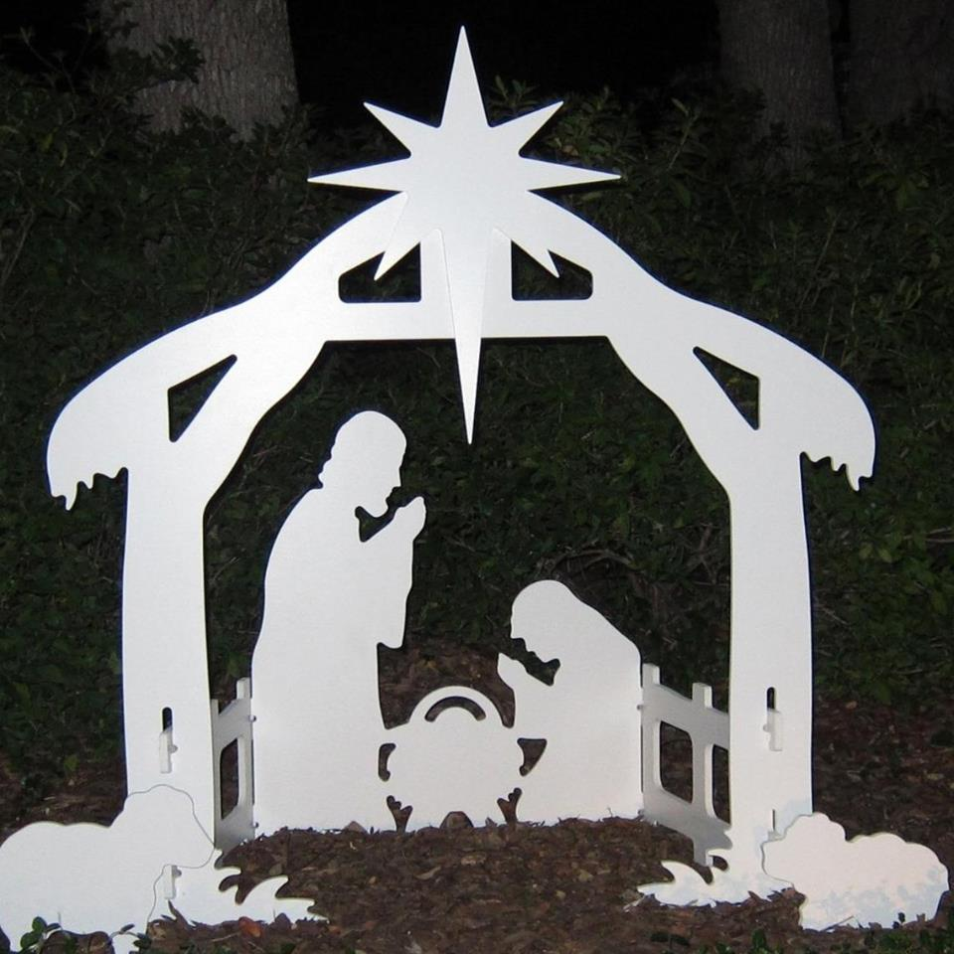
Proclaiming the WORD One Final Wish
(Isaiah 7:10-16 and Matthew 1:18-25)

Slide 18
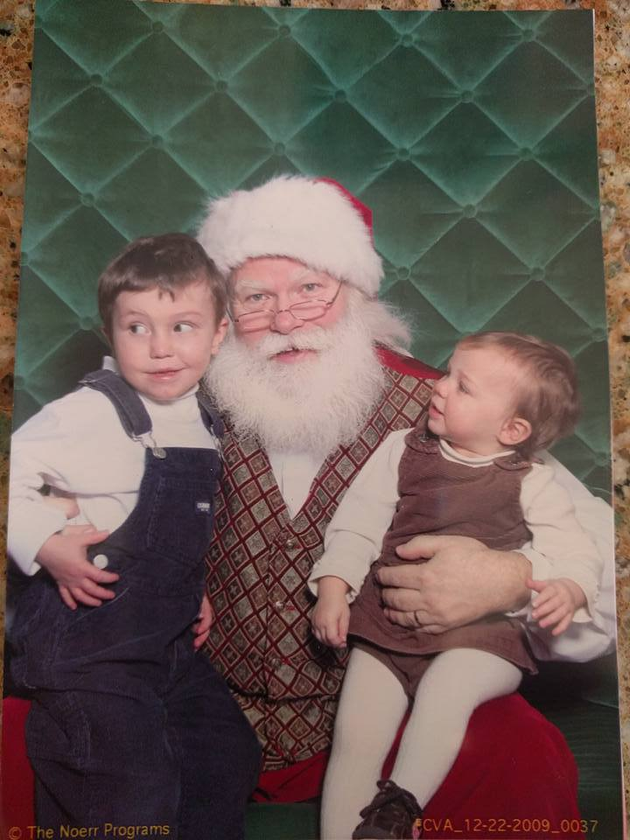
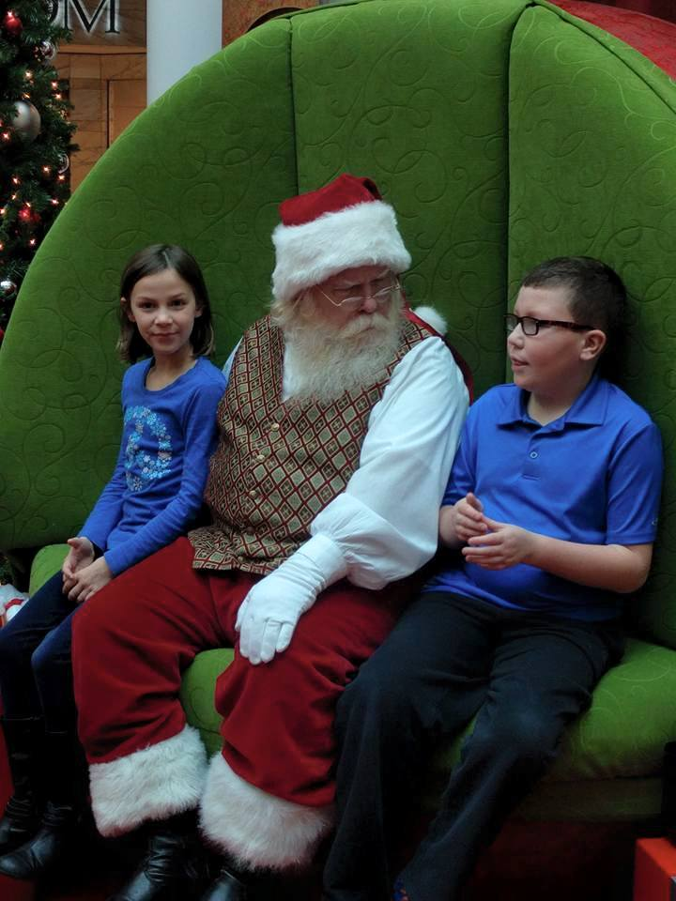
Proclaiming the WORD One Final Wish
(Isaiah 7:10-16 and Matthew 1:18-25)

Slide 19
Proclaiming the WORD One Final Wish
(Isaiah 7:10-16 and Matthew 1:18-25)

Slide 20
Responding Hymn # 110 “Love Has Come”
Love has come: a light in the darkness! Love shines forth in the Bethlehem skies. See, all heaven has come to proclaim it; hear how their song of joy arises: Love! Love! Born unto you, a Savior! Love! Love! Glory to God on high.

Slide 21
Responding Hymn # 110 “Love Has Come”
Love is born! Come, share in the wonder. Love is God now asleep in the hay. See the glow in the eyes of his mother; what is the name her heart is saying? Love! Love!
Love is the name she whispers. Love! Love! Jesus, Emmanuel.

Slide 22
Responding Hymn # 110 “Love Has Come”
Love has come and never will leave us! Love is life everlasting and free. Love is Jesus within and among us. Love is the peace our hearts are seeking. Love! Love! Love is the gift of Christmas. Love! Love! Praise to you, God on high!

Slide 23
Responding to the WORD
Affirmation of Faith
Submitted by Rev. Rebecca F. Harrison, Transitional Pastor, Spanish Springs Presbyterian Church, Sparks, NV
We are an Advent people, a people of hope.
For us, Advent is a time of waiting, and so we wait. We wait for the coming of the One who is the fulfillment of God’s promise, the fulfillment of hope, the declaration that we have been redeemed.

Slide 24
Responding to the WORD
Affirmation of Faith
Submitted by Rev. Rebecca F. Harrison, Transitional Pastor, Spanish Springs Presbyterian Church, Sparks, NV
Even so, we are not a naïve people. We know that the world in which we live will continue to be filled with pain and sorrow. We know that hatred and violence will continue to exist. We know that death and separation will continue to be a part of our lives.

Slide 25
Responding to the WORD
Affirmation of Faith
Submitted by Rev. Rebecca F. Harrison, Transitional Pastor, Spanish Springs Presbyterian Church, Sparks, NV
But because we are an Advent people, we know that none of these things will win in the end. The Holy One is coming, to make holy once again all that was, is, and ever will be.
And in our waiting and our hoping, we work and worship, pray and play, in all things hoping that peace, love and joy will reign in our lives and in our world, now and forever.

Slide 26
Bearing and Following the WORD into the World Announcements &
Sharing of Joys and Concerns
The afternoon Bible Study Group will resume downstairs in the basement at 12:30pm. We will be spending time together in study and discussion base on the Advent Calendar Devotional – A Journey of Memories.

Slide 27
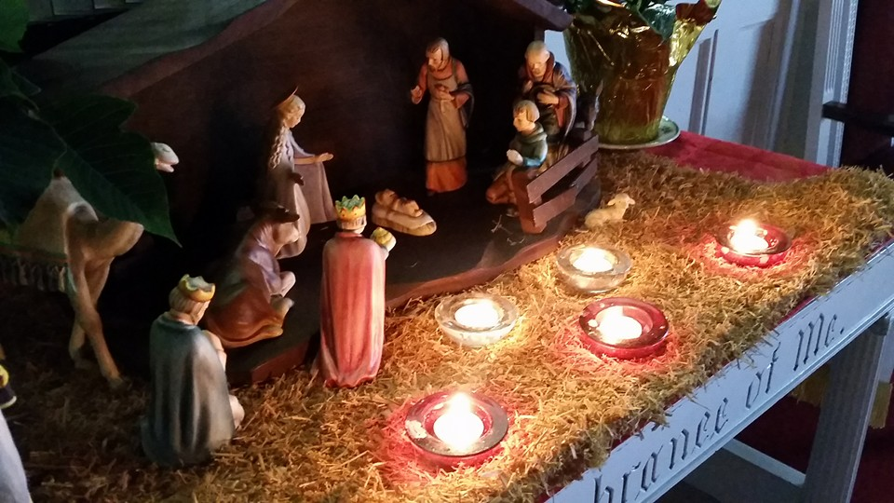
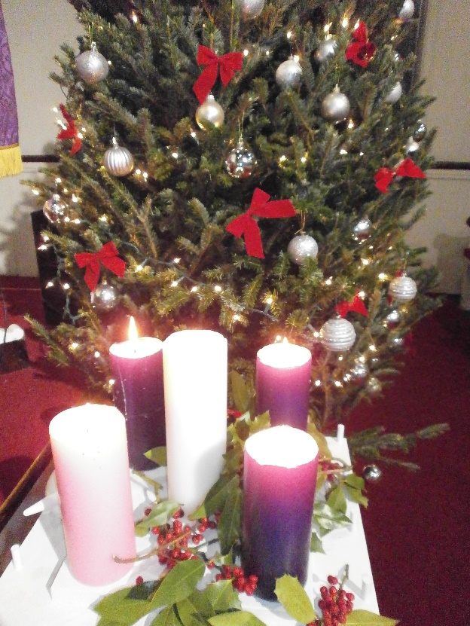
Bearing and Following the WORD into the World
Our annual Christmas Card is now available to be picked up on the back table. You may take additional ones to invite your friends, relatives, and neighbors to join our Christmas Eve Candlelight Service on Saturday, 12/24 at 8pm.
There will also be a refreshment and Carol Singing
time immediately after the service. Please contribute
refreshment items to be shared for that evening.

Slide 28
Bearing and Following the WORD into the World Prayer of the People & The Lord’s Prayer
Our Father, who art in heaven.
Halloweth be thy name.
Thy Kingdom come; Thy will be done
On earth as it is in heaven.
Give us this day our daily bread.
Forgive us our debts; as we forgive our debtors.
Lead us not into temptations, but deliver us from evil.
For Thine is the Kingdom, the Power, and the Glory forever. Amen.

Slide 29
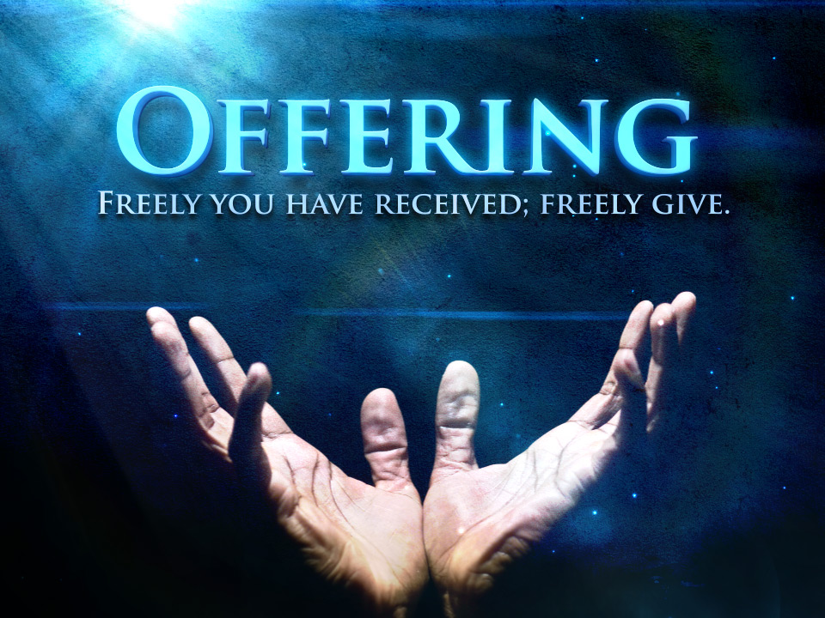
Bearing and Following the WORD into the World Offering of our Gifts and our Lives

Slide 30
Bearing and Following the WORD into the World Doxology and Offertory Prayer

Slide 31
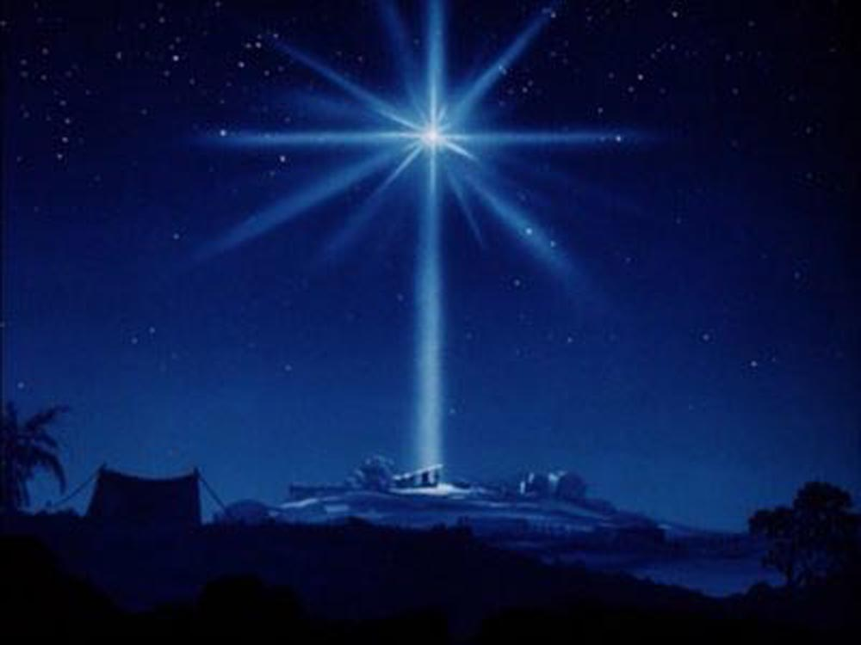
Sending Hymn # 159 “O Sing a Song of Bethlehem”
O sing a song of Bethlehem, of shepherds watching there, and of the news that came to them from angels in the air. The light that shone on Bethlehem fills all the world today. Of Jesus' birth and peace on earth the angels sing alway.

Slide 32
Sending Hymn # 159 “O Sing a Song of Bethlehem”
O sing a song of Nazareth, of sunny days of joy; O sing of fragrant flowers' breath, and of the sinless boy. For now the flowers of Nazareth in every heart may grow. Now spreads the fame of his dear name on all the winds that blow.

Slide 33
Sending Hymn # 159 “O Sing a Song of Bethlehem”
O sing a song of Galilee, of lake and woods and hill, of him who walked upon the sea and bade its waves be still. For though, like waves on Galilee, dark seas of trouble roll, when faith has heard the Master's word, falls peace upon the soul.

Slide 34
Sending Hymn # 159 “O Sing a Song of Bethlehem”
O sing a song of Calvary, its glory and dismay, of him who hung upon the tree, and took our sins away. For he who died on Calvary is risen from the grave, and Christ, our Lord, by heaven adored, is mighty now to save.

Slide 35
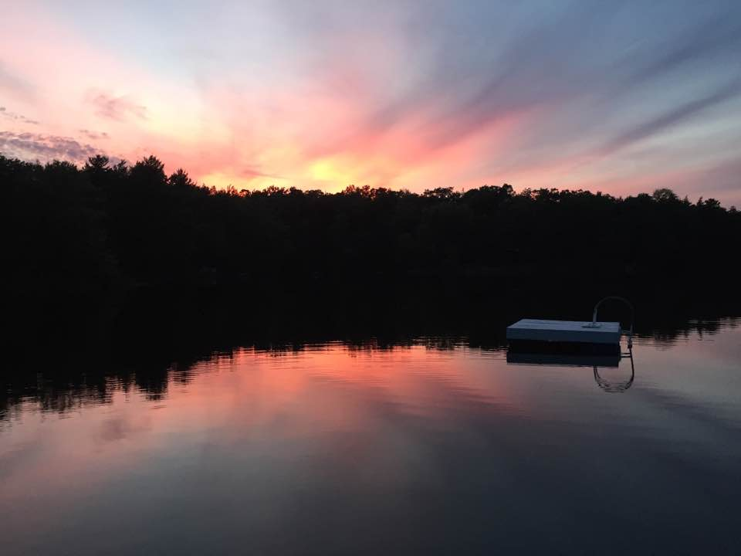
Bearing and Following the WORD into the World The Charge and Benediction

Slide 36
Bearing and Following the WORD into the World Benediction Response
#541 “God Be With You Till We Meet Again”
(Stanza 4)
God be with you till we meet again; keep love's banner floating o'er you; smite death's threatening wave before you: God be with you till we meet again.

Slide 37
Homecrest Presbyterian Church Worship of the Lord’s Day 4th Sunday in Advent December 18th, 2016

