Slide 1
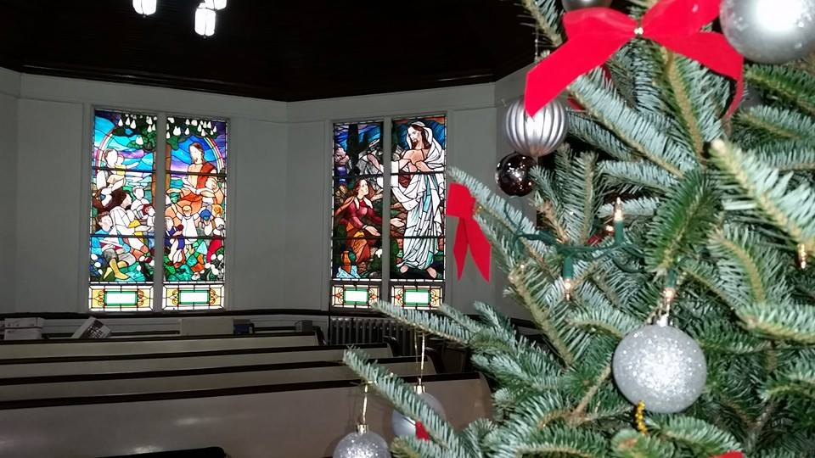
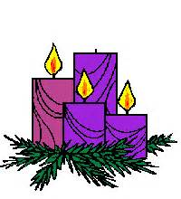
Homecrest Presbyterian Church Worship of the Lord’s Day 3rd Sunday in Advent December 11th, 2016

Slide 2
Gathering Around the WORD Lighting of the 3rd Advent Candle / Call to Worship

Slide 3
Gathering Hymn # 106 “Prepare the Way, O Zion”
Prepare the way, O Zion, your Christ is drawing near! Let every hill and valley a level way appear. Greet One who comes in glory, foretold in sacred story. O blest is Christ who came in God’s most holy name.

Slide 4
Gathering Hymn # 106 “Prepare the Way, O Zion”
He brings God’s rule, O Zion; he comes from heaven above. His rule is peace and freedom, and justice, truth, and love. Lift high your praise resounding, for grace and joy abounding. O blest is Christ who came in God’s most holy name.

Slide 5
Gathering Hymn # 106 “Prepare the Way, O Zion”
Fling wide your gates, O Zion; your Savior’s rule embrace, and tidings of salvation proclaim in every place. All lands will bow rejoicing, their adoration voicing. O blest is Christ who came in God’s most holy name.

Slide 6
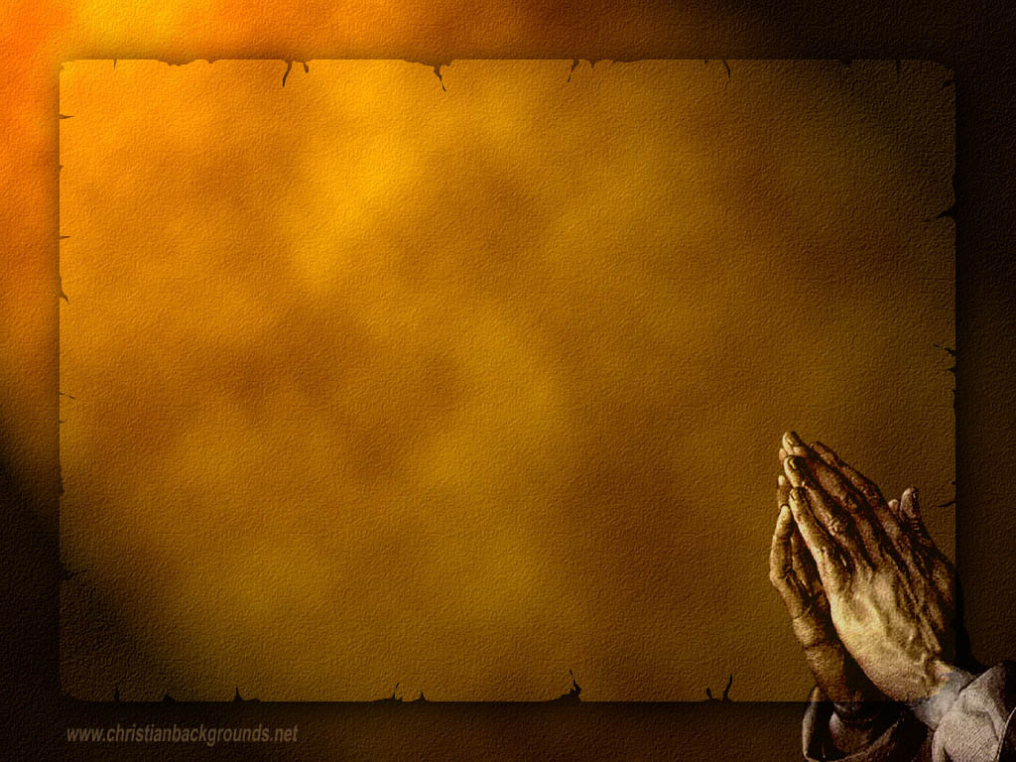
Gathering Around the WORD Call to Confession John the Baptist called us into repentance that we must turn around before it’s too late. Some thought he was a lunatic, some thought he was a prophet. Some even thought he was the Messiah, but what do you think? Regardless, the message of repentance remains true for us today, as we prepare our hearts for the coming of Christ once again.

Slide 7
Gathering Around the WORD Prayer of Confession (in unison) God of majesty and glory, we are thirsty for your grace. You made a way for us in the wilderness, and still, in our foolishness, we go astray. We hide our eyes from your presence. We do not listen to your word. We are lifeless when we ought to dance and speechless when we ought to sing. Forgive us, O Lord. Speak peace to our fearful hearts, strengthen our weak hands, and make firm our feeble knees as we seek to follow in your holy way. Amen

Slide 8
Gathering Around the WORD Declaration of Forgiveness God is merciful and discerning of our prayers. God hears us when we confess of our sins. God is willing to redeem us through His son Jesus Christ. Thanks be to God, Amen.

Slide 9
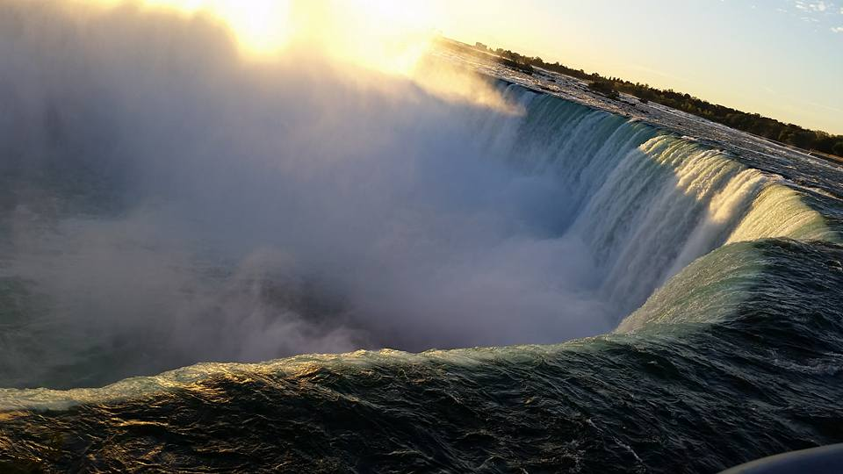
Gathering Around the WORD Gloria Patri
Glory be to the Father
and to the Son and to the Holy Ghost;
As it was in the beginning,
is now, and ever shall be,
world without end. Amen, Amen.

Slide 10
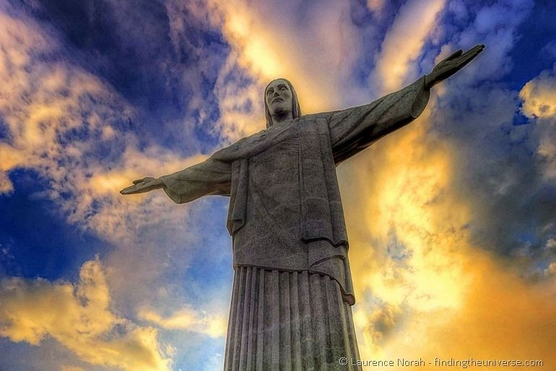
Gathering Around the WORD Passing of the Peace of Christ
Jesus said, “Peace I leave with you; my peace I give to you. I do not give to you as the world gives. Do not let your hearts be troubled, and do not let them be afraid.” (John 14:27)

Slide 11
Proclaiming the WORD Message to the Youth/ Prayer of Illumination

Slide 12
Proclaiming the WORD Responsive Reading (Matthew 11:2-11)
²When John heard in prison what the Messiah was doing, he sent word by his disciples ³and said to him, “Are you the one who is to come, or are we to wait for another?” ⁴Jesus answered them, “Go and tell John what you hear and see: ⁵the blind receive their sight, the lame walk, the lepers are cleansed, the deaf hear, the dead are raised, and the poor have good news brought to them. ⁶And blessed is anyone who takes no offense at me.”

Slide 13
Proclaiming the WORD Responsive Reading (Matthew 11:2-11)
⁷As they went away, Jesus began to speak to the crowds about John: “What did you go out into the wilderness to look at? A reed shaken by the wind? ⁸What then did you go out to see? Someone dressed in soft robes? Look, those who wear soft robes are in royal palaces. ⁹What then did you go out to see? A prophet? Yes, I tell you, and more than a prophet. ¹⁰This is the one about whom it is written, ‘See, I am sending my messenger ahead of you, who will prepare your way before you.’ ¹¹Truly I tell you, among those born of women no one has arisen greater than John the Baptist; yet the least in the kingdom of heaven is greater than he.”

Slide 14
Proclaiming the WORD Scripture Reading (Luke 1:47-55)
“My soul magnifies the Lord, ⁴⁷ and my spirit rejoices in God my Savior, ⁴⁸ for he has looked with favor on the lowliness
of his servant. Surely, from now on all generations will call me
blessed; ⁴⁹ for the Mighty One has done great things for me, and holy is his name. ⁵⁰ His mercy is for those who fear him from generation to generation.

Slide 15
Proclaiming the WORD Scripture Reading (Luke 1:47-55)
⁵¹ He has shown strength with his arm; he has scattered the proud in the thoughts of
their hearts. ⁵² He has brought down the powerful from their thrones, and lifted up the lowly; ⁵³ he has filled the hungry with good things, and sent the rich away empty. ⁵⁴ He has helped his servant Israel, in remembrance of his mercy, ⁵⁵ according to the promise he made to our ancestors, to Abraham and to his descendants forever.”

Slide 16
Proclaiming the WORD Almost But Not Yet
(Matthew 11:2-11
and Luke 1:47-55)

Slide 17
Responding Hymn # 99 “My Soul Gives Glory to My God” (Song of Mary)
My soul gives glory to my God; my heart pours out its praise. God lifted up my lowliness in many marvelous ways.

Slide 18
Responding Hymn # 99 “My Soul Gives Glory to My God” (Song of Mary)
My God has done
great things for me: yes, holy is God’s name. All people will declare me blessed, and blessings they shall claim.

Slide 19
Responding Hymn # 99 “My Soul Gives Glory to My God” (Song of Mary)
From age to age to all who fear, such mercy love imparts, dispensing justice far and near, dismissing selfish hearts.

Slide 20
Responding Hymn # 99 “My Soul Gives Glory to My God” (Song of Mary)
Love casts the mighty
from their thrones, promotes the insecure, leaves hungry spirits satisfied; the rich seem suddenly poor.

Slide 21
Responding Hymn # 99 “My Soul Gives Glory to My God” (Song of Mary)
Praise God,
whose loving covenant supports those in distress, remembering past promises with present faithfulness.

Slide 22
Responding to the WORD
Affirmation of Faith
Submitted by Rev. Rebecca F. Harrison, Transitional Pastor, Spanish Springs Presbyterian Church, Sparks, NV
We are an Advent people, a people of hope.
For us, Advent is a time of waiting, and so we wait. We wait for the coming of the One who is the fulfillment of God’s promise, the fulfillment of hope, the declaration that we have been redeemed.

Slide 23
Responding to the WORD
Affirmation of Faith
Submitted by Rev. Rebecca F. Harrison, Transitional Pastor, Spanish Springs Presbyterian Church, Sparks, NV
Even so, we are not a naïve people. We know that the world in which we live will continue to be filled with pain and sorrow. We know that hatred and violence will continue to exist. We know that death and separation will continue to be a part of our lives.

Slide 24
Responding to the WORD
Affirmation of Faith
Submitted by Rev. Rebecca F. Harrison, Transitional Pastor, Spanish Springs Presbyterian Church, Sparks, NV
But because we are an Advent people, we know that none of these things will win in the end. The Holy One is coming, to make holy once again all that was, is, and ever will be.
And in our waiting and our hoping, we work and worship, pray and play, in all things hoping that peace, love and joy will reign in our lives and in our world, now and forever.

Slide 25
Bearing and Following the WORD into the World Announcements &
Sharing of Joys and Concerns
The afternoon Bible Study Group will resume downstairs in the basement at 12:30pm. We will be spending time together in study and discussion base on the Advent Calendar Devotional – A Journey of Memories.
The Women's Group will be organizing luncheon on next Saturday, 12/17 at Noon over at the Three Stars Restaurant on Ave. U/E 15th Street. For more information, please see Margaret and Cara.
Special thanks for those who participated in the Used Coats Drive for donation to local charitable organization.

Slide 26
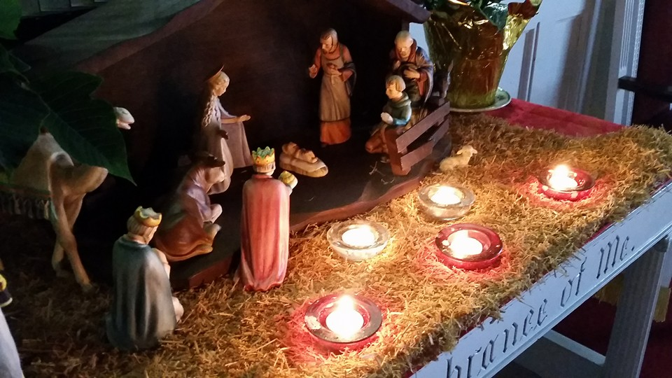
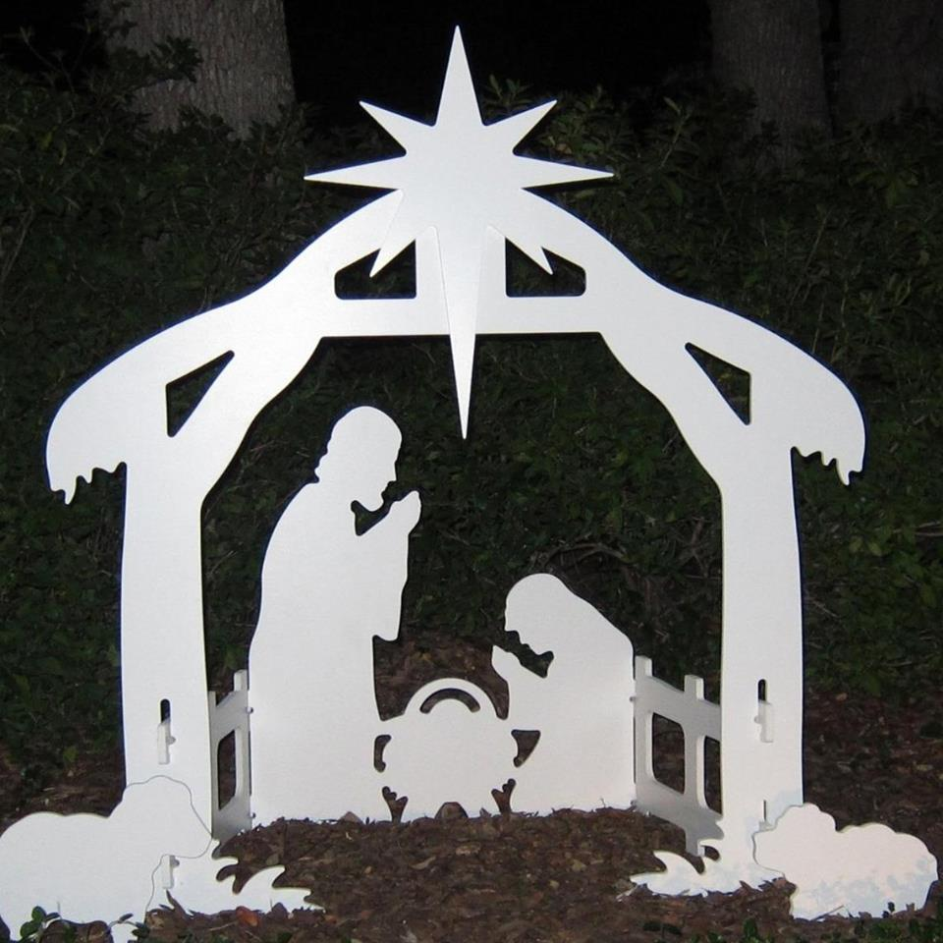
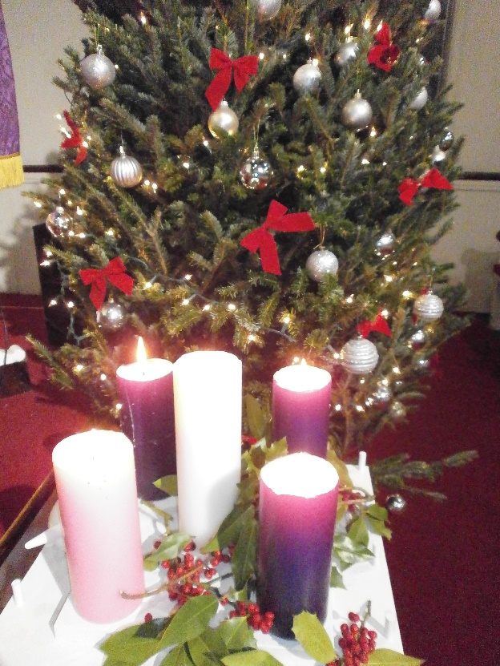
Bearing and Following the WORD into the World
Our annual Christmas Card is now available to be picked up on the back table. You may take additional ones to invite your friends, relatives, and neighbors to join our
Christmas Eve Candlelight Service on Saturday, 12/24 at 7pm. There will also be a refreshment and Carol Singing time immediately after the service. Please contribute refreshment items to be shared for that evening.

Slide 27
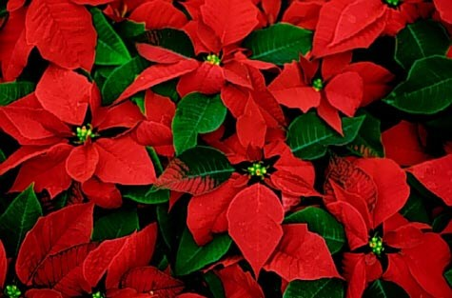
Bearing and Following the WORD into the World Announcements &
Sharing of Joys and Concerns
Christmas Poisettia order $10 each.
For more info., please sign up with Paul.

Slide 28
Bearing and Following the WORD into the World Prayer of the People & The Lord’s Prayer
Our Father, who art in heaven.
Halloweth be thy name.
Thy Kingdom come; Thy will be done
On earth as it is in heaven.
Give us this day our daily bread.
Forgive us our debts; as we forgive our debtors.
Lead us not into temptations, but deliver us from evil.
For Thine is the Kingdom, the Power, and the Glory forever. Amen.

Slide 29
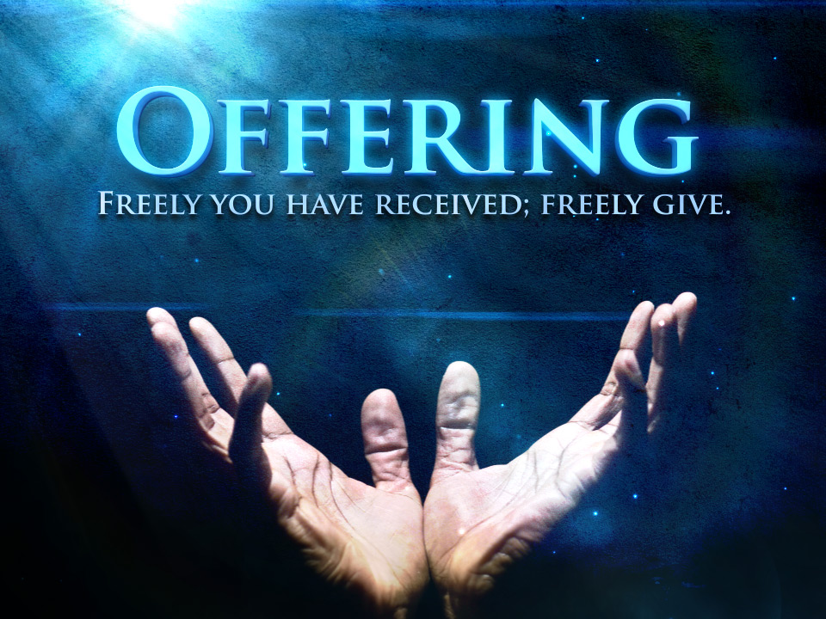
Bearing and Following the WORD into the World Offering of our Gifts and our Lives

Slide 30
Bearing and Following the WORD into the World Doxology and Offertory Prayer

Slide 31
Sending Hymn # 93 “Lift Up Your Heads, Ye Mighty Gates”
Lift up your heads, ye mighty gates; behold the King of glory waits; the King of kings is drawing near; the Savior of the world is here.

Slide 32
Sending Hymn # 93 “Lift Up Your Heads, Ye Mighty Gates”
Lift up your heads, ye mighty gates; behold the King of glory waits; the King of kings is drawing near; the Savior of the world is here.

Slide 33
Sending Hymn # 93 “Lift Up Your Heads, Ye Mighty Gates”
Redeemer, come! I open wide my heart to thee; here, Lord, abide. Let me thy inner presence feel; thy grace and love in me reveal.

Slide 34
Bearing and Following the WORD into the World The Charge and Benediction

Slide 35
Bearing and Following the WORD into the World Benediction Response
#541 “God Be With You Till We Meet Again”
(Stanza 3)
God be with you till we meet again; when life's perils thick confound you, put unfailing arms around you: God be with you till we meet again.

Slide 36
Homecrest Presbyterian Church Worship of the Lord’s Day 3rd Sunday in Advent December 11th, 2016

