Slide 1
Homecrest Presbyterian Church Worship of the Lord’s Day October 2nd, 2016

Slide 2
Gathering Around the WORD Call To Worship
Today we are invited to a joyful feast, hosted by our Savior Jesus Christ.
All who are hungry will find the bread of life here. All who thirsty will find will find a fountain of grace here. All who are lost will find safety here.
All who are lonely will find a friend here.
All who are broken will find healing here. All who have been wandering will find a home here.
For this is a heavenly banquet, and you are welcome here! Come, let us worship God!

Slide 3
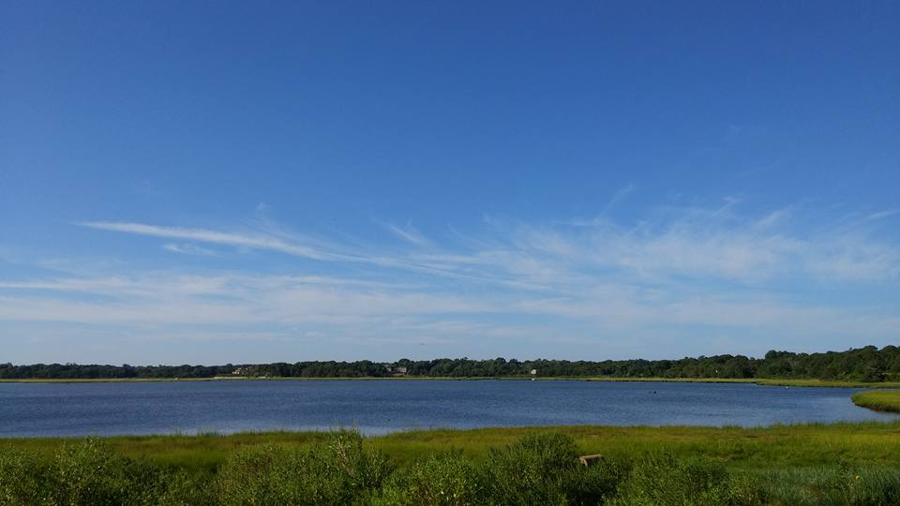
Gathering Hymn # 305 “Come Sing, O Church, In Joy!”
Come sing, O church, in joy! Come join, O church, in song! For Christ the Lord has led us through the ages long! In bold accord, come celebrate the journey now and praise the Lord!

Slide 4
Gathering Hymn # 305 “Come Sing, O Church, In Joy!”
Long years have come and gone, and still God reigns supreme, empowering us to catch the vision, dream the dream! In bold accord, come celebrate the journey now and praise the Lord!

Slide 5
Gathering Hymn # 305 “Come Sing, O Church, In Joy!”
Let courage be our friend; let wisdom be our guide, as we in mission magnify the Crucified! In bold accord, come celebrate the journey now and praise the Lord!

Slide 6
Gathering Hymn # 305 “Come Sing, O Church, In Joy!”
Come sing, O church, in joy! Come join, O church, in song! For Christ the Lord has triumphed
o'er the ages long! In bold accord, come celebrate the journey now and praise the Lord!

Slide 7
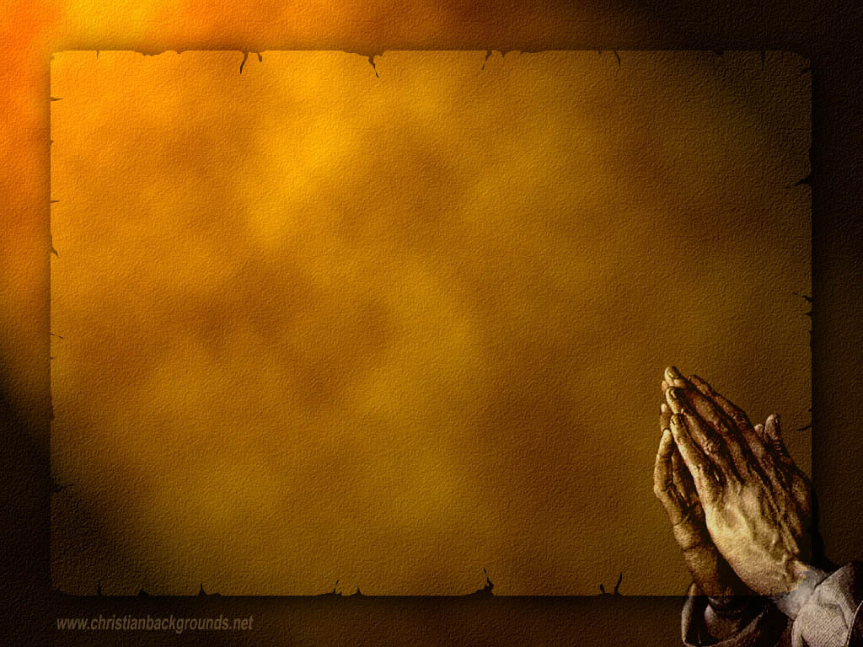
Gathering Around the WORD Call to Confession (Based on John 3:16-17) "For God so loved the world that he gave his only Son, so that whoever believes in him may not perish but may have eternal life. Indeed, God did not send the Son into the world to condemn the world, but in order that the world might be saved through him.”

Slide 8
Gathering Around the WORD Prayer of Confession (in unison) Gracious God, we gather here today as a rebellious people. We want to act out your intentions for us, but we get sidetracked by the false glitter of the world. You tell us to honor creation but we use other people, animals, and plants for our own gain.

Slide 9
Gathering Around the WORD Prayer of Confession (in unison) You offer bread to every living creature, and we steal that bread from our brothers and sisters in the name of greed. You promise us new life but we shrink back in fear, clinging to our death-dealing ways. Heal us, O Lord, lest we destroy ourselves and the planet. We need your healing presence among us, through Jesus Christ we pray, Amen.

Slide 10
Gathering Around the WORD Declaration of Forgiveness Through Christ, we have been received as God’s children. We have been redeemed by God’s mercy and love and our sins have been forgiven. Thanks be to God, Amen.

Slide 11
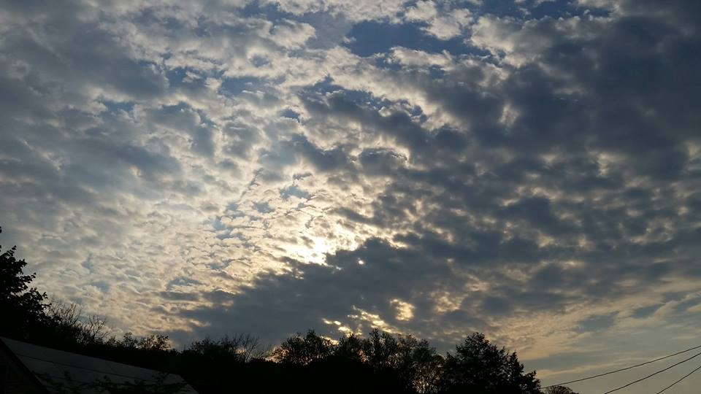
Gathering Around the WORD Gloria Patri
Glory be to the Father
and to the Son and to the Holy Ghost;
As it was in the beginning,
is now, and ever shall be,
world without end. Amen, Amen.

Slide 12
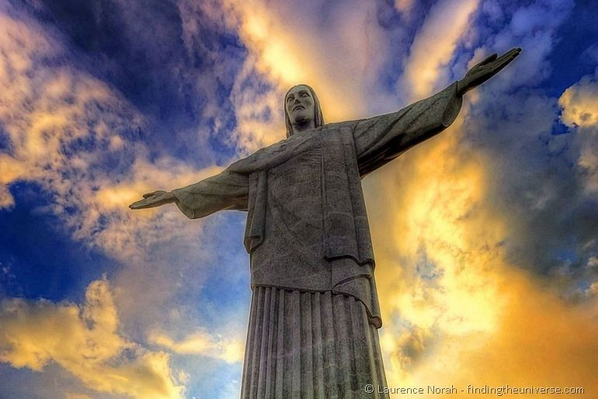
Gathering Around the WORD Passing of the Peace of Christ
Jesus said, “Peace I leave with you; my peace I give to you. I do not give to you as the world gives. Do not let your hearts be troubled, and do not let them be afraid.” (John 14:27)

Slide 13
Proclaiming the WORD Message to the Youth/ Prayer of Illumination

Slide 14
Proclaiming the WORD Scripture Reading (Luke 17:5-10)
⁵The apostles said to the Lord,
"Increase our faith!" ⁶The Lord replied,
"If you had faith the size of a mustard seed, you could say to this mulberry tree, 'Be uprooted and planted in the sea,' and it would obey you.

Slide 15
Proclaiming the WORD Scripture Reading (Luke 17:5-10)
⁷"Who among you would say to your slave who has just come in from plowing or tending sheep in the field, 'Come here at once and take your place at the table'? ⁸Would you not rather say to him, 'Prepare supper for me, put on your apron and serve me while I eat and drink; later you may eat and drink'? ⁹Do you thank the slave for doing what was commanded? ¹⁰So you also, when you have done all that you were ordered to do, say, 'We are worthless slaves; we have done only what we ought to have done!'"
.

Slide 16
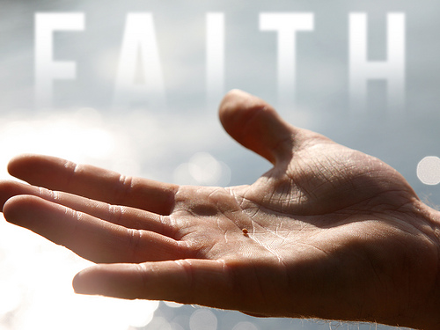
Proclaiming the WORD Seed of Faith
(Luke 17:5-10)

Slide 17
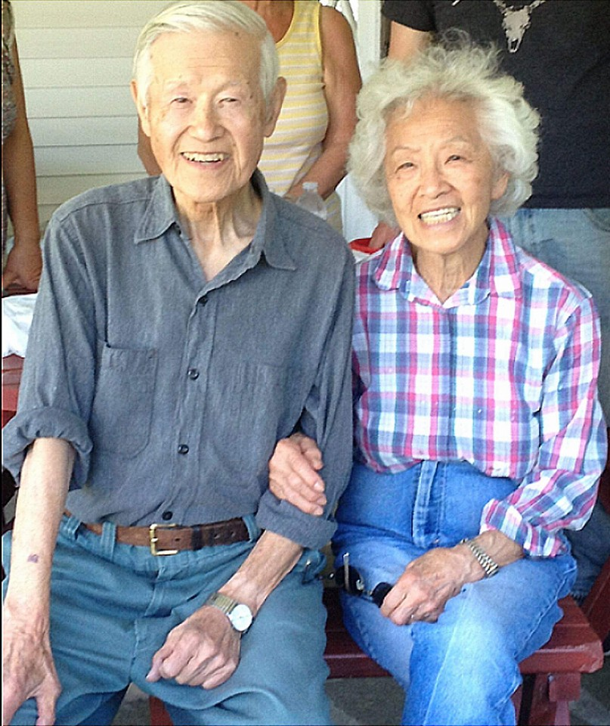
Proclaiming the WORD Seed of Faith
(Luke 17:5-10)

Slide 18
Proclaiming the WORD Seed of Faith
(Luke 17:5-10)

Slide 19
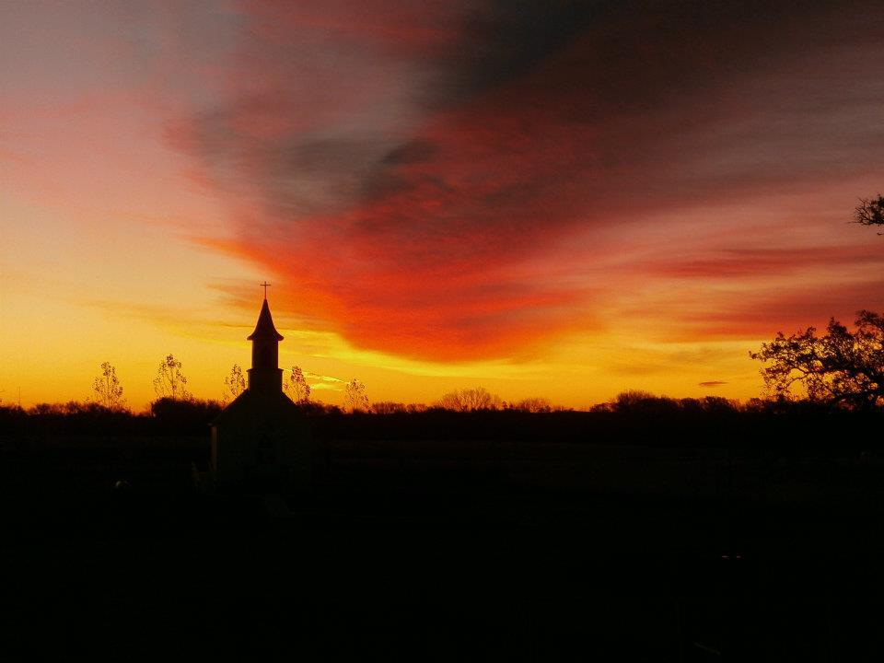
Responding Hymn # 321 “The Church’s One Foundation”
The church's one foundation is Jesus Christ her Lord. She is his new creation by water and the word. From heaven he came and sought her to be his holy bride. With his own blood he bought her, and for her life he died.

Slide 20
Responding Hymn # 321 “The Church’s One Foundation”
Elect from every nation, yet one o'er all the earth, her charter of salvation: one Lord, one faith, one birth. One holy name she blesses, partakes one holy food, and to one hope she presses, with every grace endued.

Slide 21
Responding Hymn # 321 “The Church’s One Foundation”
Yet she on earth has union with God, the Three in One, and mystic sweet communion with those whose rest is won: O happy ones and holy! Lord, give us grace that we, like them, the meek and lowly, may live eternally.

Slide 22
Responding to the WORD
Affirmation of Faith – Excerpts from Confession of Belhar
We Believe that Christ's work of reconciliation is made manifest in the church as the community of believers who have been reconciled with God and with one another;
We Believe that unity is, therefore, both a gift and an obligation for the church of Jesus Christ; that through the working of God's Spirit it is a binding force, yet simultaneously a reality which must be earnestly pursued and sought: one which the people of God must continually be built up to attain;

Slide 23
Responding to the WORD
Affirmation of Faith – Excerpts from Confession of Belhar
We Believe that this unity must become visible so that the world may believe that separation, enmity and hatred between people and groups is sin which Christ has already conquered, and accordingly that anything which threatens this unity may have no place in the church and must be resisted;
We Believe that God has entrusted the church with the message of reconciliation in and through Jesus Christ.

Slide 24
Responding to the WORD
Affirmation of Faith – Excerpts from Confession of Belhar
We Believe that the church is called to be the salt of the earth and the light of the world.
We Believe that the church is witness both by word and by deed to the new heaven and the new earth in which righteousness dwells.
We Believe in one holy, universal Christian church, the communion of saints called from the entire human family.

Slide 25
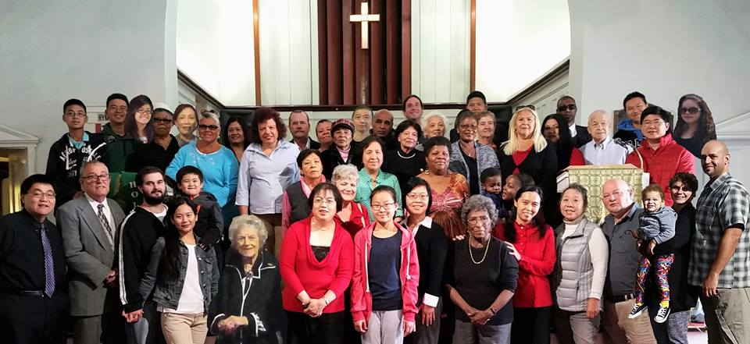
Bearing and Following the WORD into the World Announcements &
Sharing of Joys and Concerns
We will be taking a group photo for this year’s Christmas Card immediately after service. Please stay behind.

Slide 26
Bearing and Following the WORD into the World Announcements &
Sharing of Joys and Concerns
The Sunday afternoon Bible Study groups will resume next Sunday after worship service downstairs in the basement at 12:30pm. We are currently studying the 30 Days with the Belhar Confession – Reflections on Unity, Reconciliation and Justice, published by the PC (USA).
The Women's Group will be meeting on every Wednesday, @ 7:30pm over at the Manse (2048 E 14th Street). For more information, please see Margaret or Cara.

Slide 27
Bearing and Following the WORD into the World Announcements &
Sharing of Joys and Concerns
The next Session Meeting will be Monday, 10/10 at 7pm. All active elders please attend.
Pastor Samson will be away on vacation for 10/16 and 10/23. Rev. Grace Bowen will be our guest speakers for those Sundays.

Slide 28
Bearing and Following the WORD into the World Announcements &
Sharing of Joys and Concerns
The NYC Presbytery’s Presbyterian Women group will be having its Fall Gathering on Saturday, 10/22 at Rutgers Presbyterian Church (Broadway/W 73rd Street) from 9:30am-2:30pm. The Guest Speaker will be Rev. Grace May of Women of Wonder, Inc.
In addition, the NYC Presbytery will be hosting its annual Presbytery Resource Day on Saturday, 10/29. This year it will be at First Presbyterian of Manhattan
(12 W 12th Street/5th Ave).
Please see flyer for additional information.

Slide 29
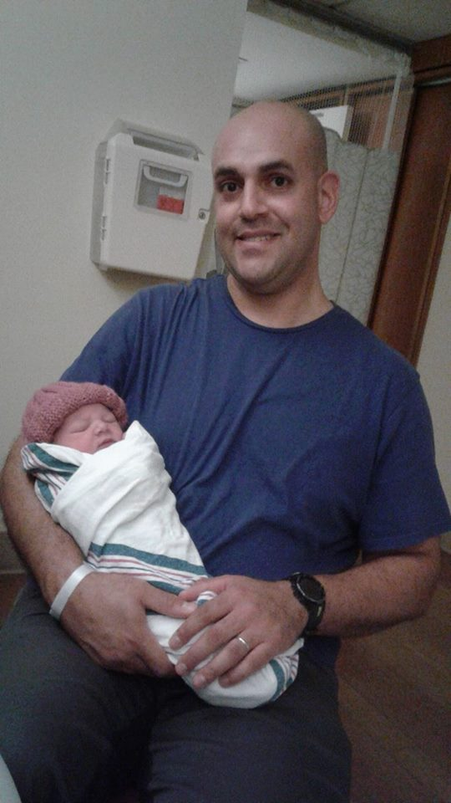
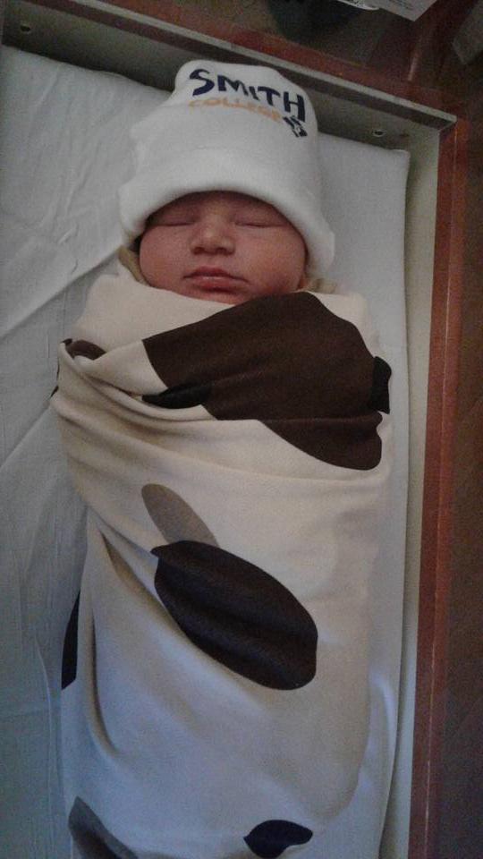
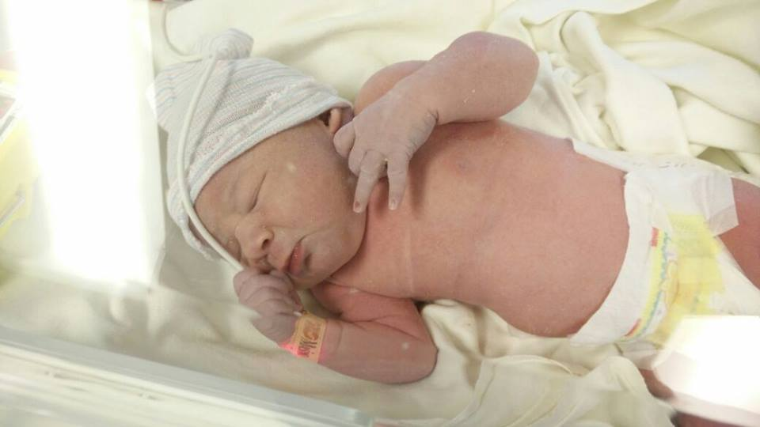
Bearing and Following the WORD into the World Announcements &
Sharing of Joys and Concerns
Chloe Jane Weisman
8lbs 8oz. 20 in.
born 9/28/16 @12:18 pm

Slide 30
Bearing and Following the WORD into the World Prayer of the People & The Lord’s Prayer
Our Father, who art in heaven.
Halloweth be thy name.
Thy Kingdom come; Thy will be done
On earth as it is in heaven.
Give us this day our daily bread.
Forgive us our debts; as we forgive our debtors.
Lead us not into temptations, but deliver us from evil.
For Thine is the Kingdom, the Power, and the Glory forever. Amen.

Slide 31
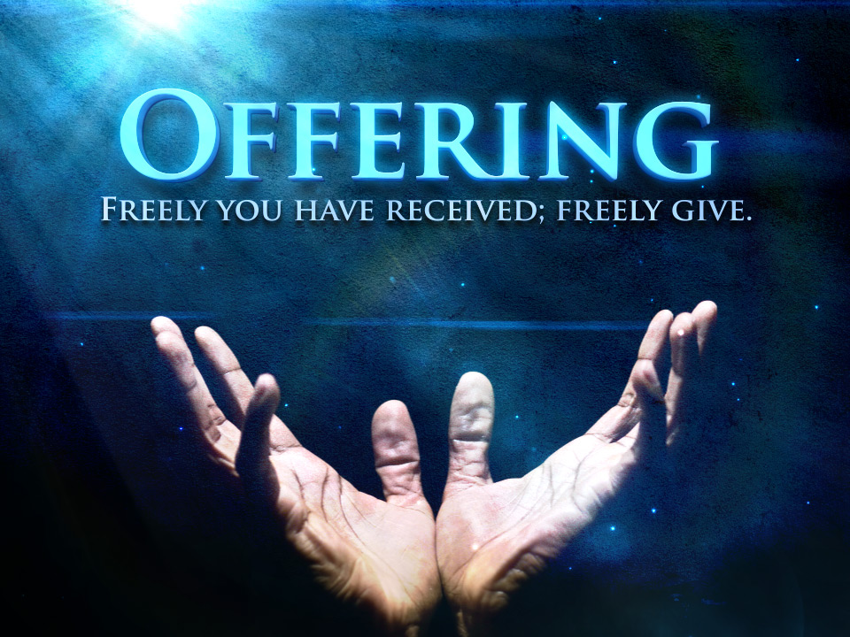
Bearing and Following the WORD into the World Offering of our Gifts and our Lives

Slide 32
Bearing and Following the WORD into the World Doxology and Offertory Prayer

Slide 33
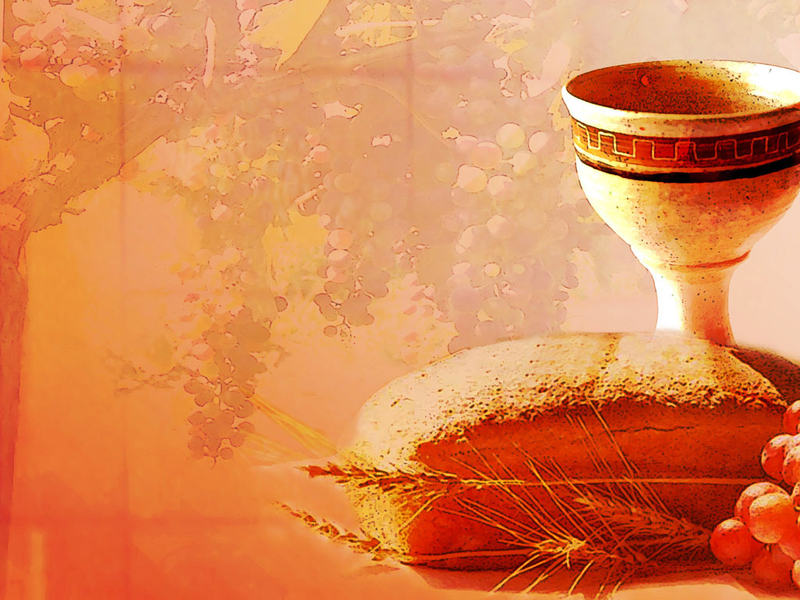
Communion Hymn # 509 “All Who Hunger, Gather Gladly”
All who hunger, gather gladly; holy manna is our bread. Come from wilderness and wandering. Here, in truth, we will be fed. You that yearn for days of fullness, all around us is our food. Taste and see the grace eternal. Taste and see that God is good.

Slide 34
Communion Hymn # 509 “All Who Hunger, Gather Gladly”
All who hunger, never strangers, seeker, be a welcome guest. Come from restlessness and roaming. Here, in joy, we keep the feast. We that once were lost and scattered in communion's love have stood. Taste and see the grace eternal. Taste and see that God is good.

Slide 35
Communion Hymn # 509 “All Who Hunger, Gather Gladly”
All who hunger, sing together; Jesus Christ is living bread. Come from loneliness and longing. Here, in peace, we have been led. Blest are those who from this table live their days in gratitude. Taste and see the grace eternal. Taste and see that God is good.

Slide 36
Bearing and Following the WORD into the World Holy Communion
Friends, we gather now as one body, joined around this table of GRACE. Here we celebrate God's presence among us, united in Christ's spirit, broken and whole all at once. Christ is the host of this table and we are Christ’s invited guests from all walks of life and from all corners of the earth.
We recognize our uniqueness as God created us, as well as the Spirit of Unity that binds us together as One through our common faith in Jesus Christ.

Slide 37
Bearing and Following the WORD into the World Holy Communion
Through God’s reconciling love and unconditional grace, transformation takes place around this table, where strangers become friends, sinners redeemed, brokenness restored and wounded healed.
Welcome to the table of the Heavenly Feast, the joyful celebration of the people of God. Christ invites those who confess their faith and baptized in Him to eat the bread of life and to drink the cup of the new covenant.

Slide 38
Bearing and Following the WORD into the World Holy Communion
The Lord be with you. And also with you.
Lift up your hearts. We lift them up to the Lord.
Let us give thanks to the Lord our God.
It is right to give our thanks and praise.

Slide 39
Bearing and Following the WORD into the World Holy Communion
On this World Communion Sunday, it is our greatest joy to give you thanks and praise to feast among your people whom you’ve scattered and united all around the world. God’s presence is felt in all of our lives, whoever, wherever, whenever two or three are gathered in Christ’s name.

Slide 40
Bearing and Following the WORD into the World Holy Communion
Therefore we praise you, joining our voices with the choir of creation and all the saints of all times and places who forever sing to the glory of your name:
Holy, Holy, Holy Lord, God of power and might, heaven and earth are full of your glory. Hosanna in the highest. Blessed is he who comes in the name of the Lord. Hosanna in the highest.

Slide 41
Bearing and Following the WORD into the World Holy Communion
With thanksgiving, we will receive this bread which our Lord Jesus took, after He blessed it, broke it, and gave it to his disciples, saying, this is my body, given for you.
In the same way, we dedicate this cup which Jesus blessed, saying, this is the new covenant sealed in my blood.
Do this in remembrance of me.

Slide 42
Bearing and Following the WORD into the World Holy Communion
With thanks and praise we offer ourselves to you, O God. Sharing this holy meal, remembering Christ’s dying and rising, and praying: Come Lord Jesus!
Jesus said, "I am the bread of life. Those who come to me shall never hunger; those who believe in me shall never thirst." These are the gift of God for the people of God.

Slide 43
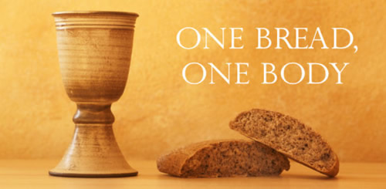
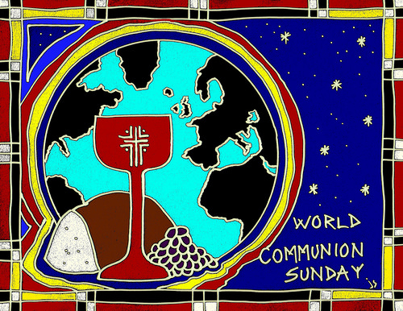
Bearing and Following the WORD into the World Holy Communion

Slide 44
Bearing and Following the WORD into the World
Prayer after the Communion: (in unison)
:
Lord Jesus Christ, in Spirit you have fed us with your body and quenched us with your blood. We look forward to the day when you shall come again to fill our hearts with grace, peace and hope.
Enable us now to go out to share your love to others. Humble our hearts so we may serve others, as you have served us through your Son Jesus Christ.

Slide 45
Bearing and Following the WORD into the World
Prayer after the Communion: (in unison)
:
Through Christ, with Christ, in Christ, in the unity of the Holy Spirit, all glory and honor are yours, Almighty God, now and forever, Amen.

Slide 46
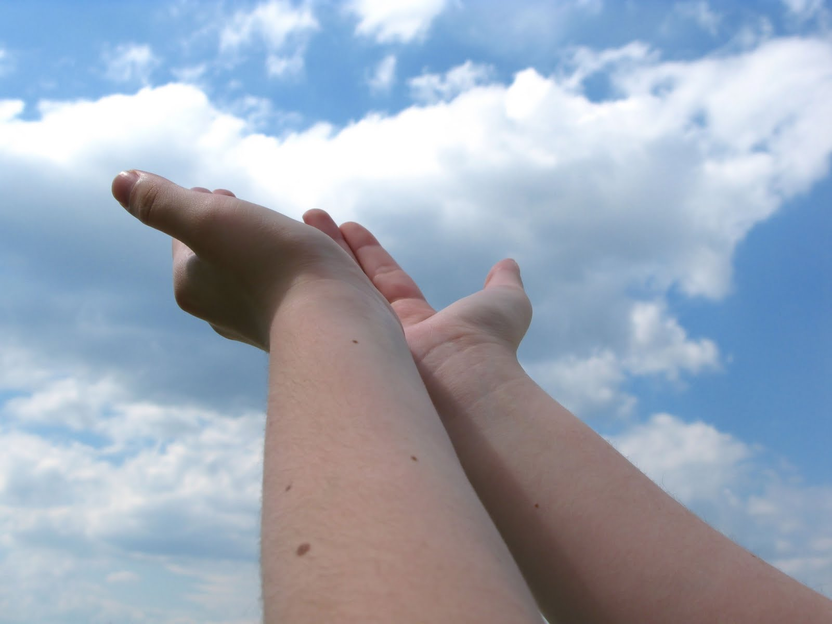
Bearing and Following the WORD into the World Deacons’ Benevolence Offering

Slide 47
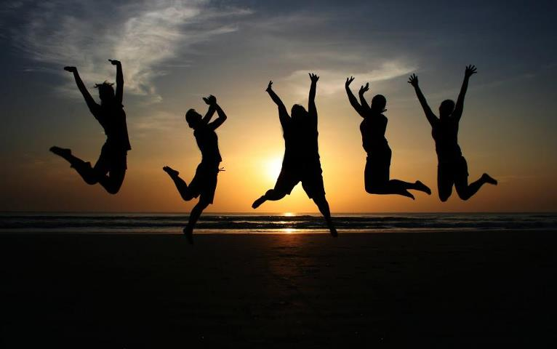
Sending Hymn # 300 “We Are One in the Spirit”
We are one in the Spirit;
we are one in the Lord; we are one in the Spirit;
we are one in the Lord, and we pray that all unity
may one day be restored: And they’ll know we are Christians
by our love, by our love; yes, they’ll know we are Christians
by our love.

Slide 48
Sending Hymn # 300 “We Are One in the Spirit”
We will walk with each other;
we will walk hand in hand; we will walk with each other;
we will walk hand in hand, and together we’ll spread the news
that God is in our land: And they’ll know we are Christians
by our love, by our love; yes, they’ll know we are Christians
by our love.

Slide 49
Sending Hymn # 300 “We Are One in the Spirit”
We will work with each other;
we will work side by side; we will work with each other;
we will work side by side, and we’ll guard human dignity
and save human pride: And they’ll know we are Christians
by our love, by our love; yes, they’ll know we are Christians
by our love.

Slide 50
Sending Hymn # 300 “We Are One in the Spirit”
All praise to the Father,
from whom all things come, and all praise to Christ Jesus,
God’s only Son, and all praise to the Spirit, who makes us one: And they’ll know we are Christians
by our love, by our love; yes, they’ll know we are Christians
by our love.

Slide 51
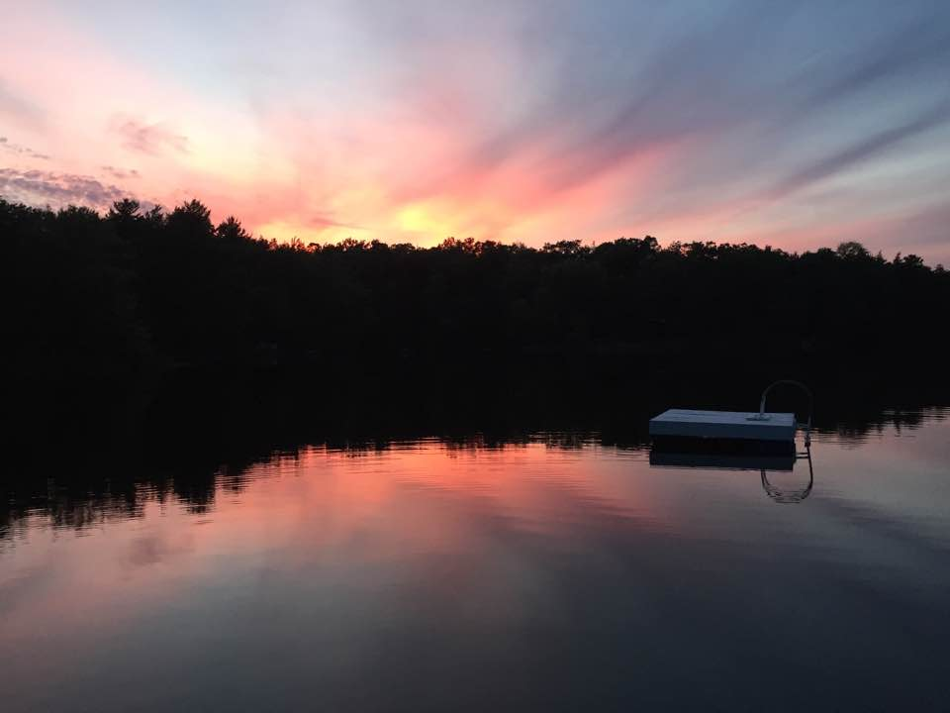
Bearing and Following the WORD into the World The Charge and Benediction

Slide 52
Bearing and Following the WORD into the World Benediction Response
#541 “God Be With You Till We Meet Again”
(Stanza 3)
God be with you till we meet again;
when life's perils thick confound you, put unfailing arms around you:
God be with you till we meet again.

Slide 53
Homecrest Presbyterian Church Worship of the Lord’s Day October 2nd, 2016

