Slide 1
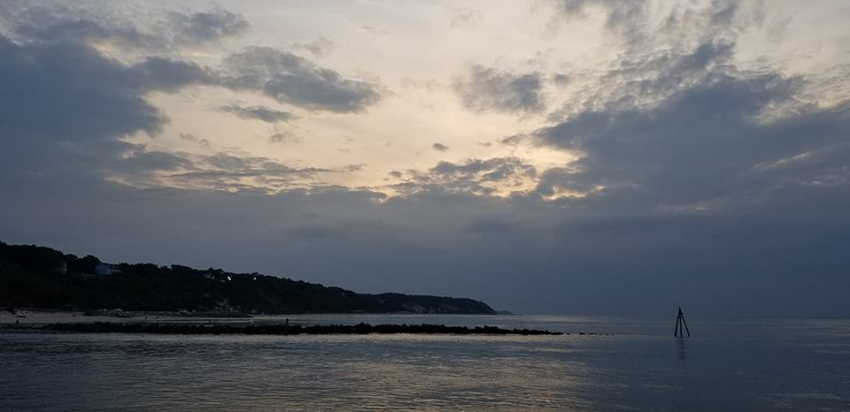
Homecrest Presbyterian Church Worship of the Lord’s Day August 26th, 2018 21st Sunday in Ordinary Time

Slide 2
Gathering Around the WORD Call to Worship (Based on Psalm 34:1 and 3)
We will bless the Lord at all times;
His praise shall continually be in our mouths.
O magnify the Lord with us,
And let us exalt God’s name together.

Slide 3
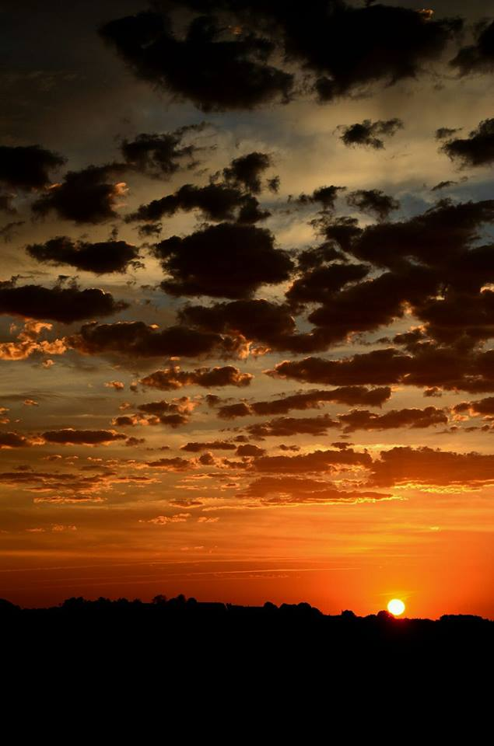
Gathering Around the WORD Gathering Hymn # 14 “For the Beauty of the Earth”
For the beauty of the earth, for the glory of the skies, for the love which from our birth over and around us lies: Lord of all, to thee we raise this our hymn of grateful praise.

Slide 4
Gathering Around the WORD Gathering Hymn # 14 “For the Beauty of the Earth”
For the wonder of each hour of the day and of the night, hill and vale, and tree and flower, sun and moon, and stars of light: Lord of all, to thee we raise this our hymn of grateful praise.

Slide 5
Gathering Around the WORD Gathering Hymn # 14 “For the Beauty of the Earth”
For the joy of ear and eye, for the heart and mind’s delight, for the mystic harmony linking sense to sound and sight: Lord of all, to thee we raise this our hymn of grateful praise.

Slide 6
Gathering Around the WORD Gathering Hymn # 14 “For the Beauty of the Earth”
For the joy of human love, brother, sister, parent, child, friends on earth, and friends above, for all gentle thoughts and mild: Lord of all, to thee we raise this our hymn of grateful praise.

Slide 7
Gathering Around the WORD Gathering Hymn # 14 “For the Beauty of the Earth”
For thyself, best gift divine to the world so freely given; for that great, great love of thine, peace on earth and joy in heaven: Lord of all, to thee we raise this our hymn of grateful praise.

Slide 8
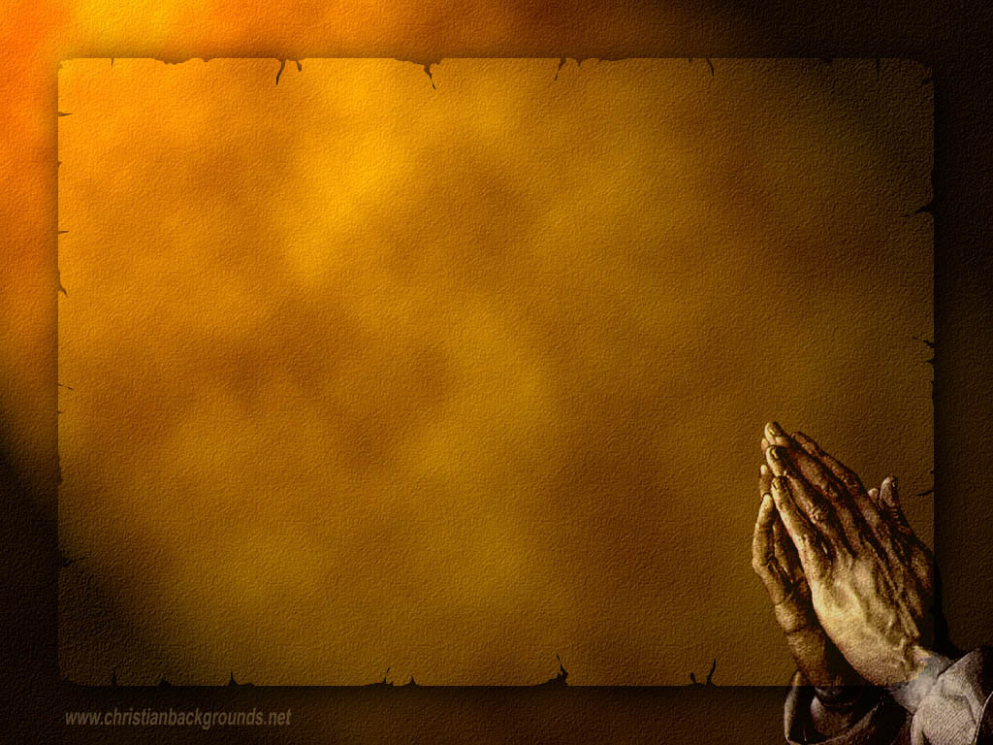
Gathering Around the WORD Call to Confession (Psalm 34:18) The Psalmist reminds us that God is near to the brokenhearted, let us consider how we have lived, confessing our sins and trusting in God’s mercy to save. In humility and faith, let us come before God and confess our sins in the witness of our neighbors.

Slide 9
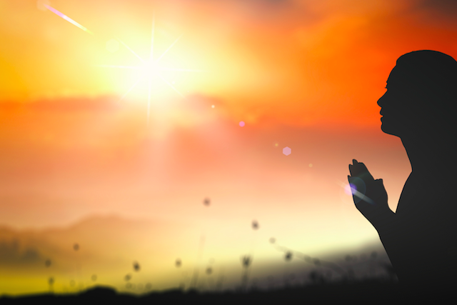
Gathering Around the WORD Prayer of Confession (in Unison)
God of our redemption, we confess that we have not been faithful servants. We have not served you with sincere hearts nor trusted in your salvation. We have forsaken you, the living God, and have chosen to follow the lifeless idols of worldly power and wealth. Forgive us our sin, O God. Lead us to heartfelt repentance that we may honor your with our lips and serve you with our lives; through our Savior, Jesus Christ, Amen.

Slide 10
Gathering Around the WORD Declaration of Forgiveness
(Romans 5:8, Hebrews 4:16)
The proof of God’s amazing love is this: while we were sinners Christ died for us. Because we have faith in him, we dare to approach God with confidence.
Through the sacrificial love of Christ, God has redeemed us and given us a new life worthy of our repentance. Thanks be God, Amen.

Slide 11
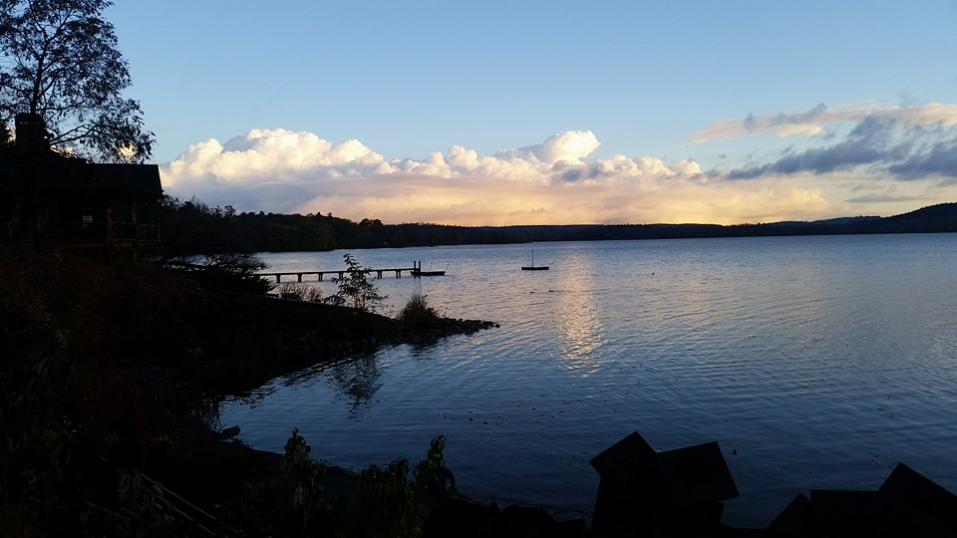
Gathering Around the WORD Gloria Patri
Glory be to the Father
and to the Son and to the Holy Ghost;
As it was in the beginning,
is now, and ever shall be,
world without end. Amen, Amen.

Slide 12
Gathering Around the WORD Passing of the Peace of Christ

Slide 13
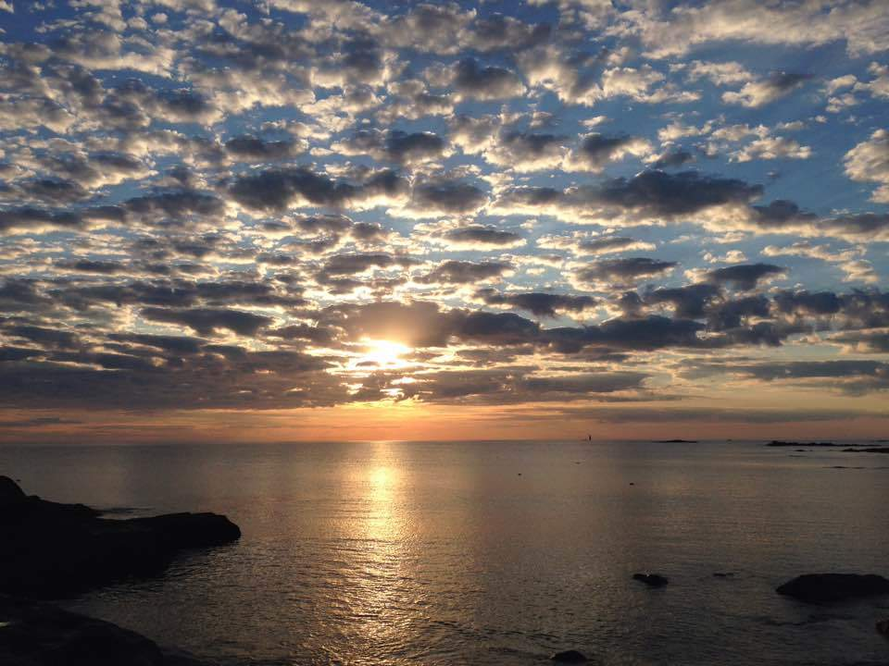
Proclaiming the WORD Message to the Youth/ Prayer of Illumination

Slide 14
Proclaiming the WORD Responsive Reading (Psalm 84)
¹How lovely is your dwelling place,
O LORD of hosts!
²My soul longs, indeed it faints
for the courts of the LORD;
my heart and my flesh sing for joy
to the living God.
³Even the sparrow finds a home,
and the swallow a nest for herself,
where she may lay her young,
at your altars, O LORD of hosts,
my King and my God.
⁴Happy are those who live in your house,
ever singing your praise.

Slide 15
Proclaiming the WORD Responsive Reading (Psalm 84)
⁵Happy are those whose strength is in you,
in whose heart are the highways to Zion.
⁶As they go through the valley of Baca
they make it a place of springs;
the early rain also covers it with pools.
⁷They go from strength to strength;
the God of gods will be seen in Zion.
⁸O LORD God of hosts, hear my prayer;
give ear, O God of Jacob!

Slide 16
Proclaiming the WORD Responsive Reading (Psalm 84)
⁹Behold our shield, O God;
look on the face of your anointed.
¹⁰For a day in your courts is better
than a thousand elsewhere.
I would rather be a doorkeeper in the house of my God than live in the tents of wickedness.
¹¹For the LORD God is a sun and shield;
he bestows favor and honor.
No good thing does the LORD withhold
from those who walk uprightly.
¹²O LORD of hosts,
happy is everyone who trusts in you.

Slide 17
Proclaiming the WORD Responsive Reading (Ephesians 6:10-20)
¹⁰Finally, be strong in the Lord and in the strength of his power. ¹¹Put on the whole armor of God, so that you may be able to stand against the wiles of the devil. ¹²For our struggle is not against enemies of blood and flesh, but against the rulers, against the authorities, against the cosmic powers of this present darkness, against the spiritual forces of evil in the heavenly places. ¹³Therefore take up the whole armor of God, so that you may be able to withstand on that evil day, and having done everything, to stand firm.

Slide 18
Proclaiming the WORD Responsive Reading (Ephesians 6:10-20)
¹⁴Stand therefore, and fasten the belt of truth around your waist, and put on the breastplate of righteousness. ¹⁵As shoes for your feet put on whatever will make you ready to proclaim the gospel of peace. ¹⁶With all of these, take the shield of faith, with which you will be able to quench all the flaming arrows of the evil one. ¹⁷Take the helmet of salvation, and the sword of the Spirit, which is the word of God.
¹⁸Pray in the Spirit at all times in every prayer and supplication. To that end keep alert and always persevere in supplication for all the saints. ¹⁹Pray also for me, so that when I speak, a message may be given to me to make known with boldness the mystery of the gospel, ²⁰for which I am an ambassador in chains. Pray that I may declare it boldly, as I must speak.

Slide 19
Proclaiming the WORD Responsive Reading (Ephesians 6:10-20)
¹⁸Pray in the Spirit at all times in every prayer and supplication. To that end keep alert and always persevere in supplication for all the saints. ¹⁹Pray also for me, so that when I speak, a message may be given to me to make known with boldness the mystery of the gospel, ²⁰for which I am an ambassador in chains. Pray that I may declare it boldly, as I must speak.

Slide 20
Proclaiming the WORD (Psalm 84 and Ephesians 6:10-20)
Put on the Armour of God

Slide 21
Responding Hymn # 630 “Fairest Lord Jesus”
Fairest Lord Jesus, Ruler of all nature, O thou of God to earth come down, thee will I cherish, thee will I honor, thou, my soul's glory, joy, and crown.

Slide 22
Responding Hymn # 630 “Fairest Lord Jesus”
Fair are the meadows, fairer still the woodlands, robed in the blooming garb of spring. Jesus is fairer; Jesus is purer, who makes the woeful heart to sing.

Slide 23
Responding Hymn # 630 “Fairest Lord Jesus”
Fair is the sunshine, fairer still the moonlight, and all the twinkling, starry host. Jesus shines brighter; Jesus shines purer, than all the angels heaven can boast.

Slide 24
Responding Hymn # 630 “Fairest Lord Jesus”
Beautiful Savior, Ruler of the nations, Son of God and Son of Man! Glory and honor, praise, adoration, now and forevermore be thine!

Slide 25
Responding to the WORD
Affirmation of Faith –
PC(USA) – A Brief Statement of Faith (Sections 1 and 2)
In life and in death we belong to God. Through the grace of our Lord Jesus Christ, the love of God, and the communion of the Holy Spirit, we trust in the one triune God,
the Holy One of Israel, whom alone we worship and serve.

Slide 26
Responding to the WORD
Affirmation of Faith –
PC(USA) – A Brief Statement of Faith (Sections 1 and 2)
We trust in Jesus Christ, Fully human, fully God. Jesus proclaimed the reign of God: preaching good news to the poor and release to the captives, teaching by word and deed and
blessing the children, healing the sick and binding up the brokenhearted, eating with outcasts, forgiving sinners, and calling all to repent and believe the gospel.

Slide 27
Responding to the WORD
Affirmation of Faith –
PC(USA) – A Brief Statement of Faith (Sections 1 and 2)
Unjustly condemned for blasphemy and sedition, Jesus was crucified, suffering the depths of human pain and giving his life for the sins of the world. God raised this Jesus from the dead, vindicating his sinless life, breaking the power of sin and evil, delivering us from death to life eternal.

Slide 28
Bearing and Following the WORD into the World Announcements &
Sharing of Joys and Concerns
Special thanks to David Dwan for playing the piano for us today while our organist Brian Lam is away on vacation. Brian will return on 9/16.
Our Wednesday Night Women’s Group and Sunday afternoon Bible Study are currently on summer break. They will resume in September.
The next Session Meeting will be Monday, 9/10 at 7pm.

Slide 29
Bearing and Following the WORD into the World Announcements &
Sharing of Joys and Concerns
Our neighboring church – King’s Chapel will be hosting a special one-day event for the women of the church on how to study, pray and practice God’s Word more effectively on Saturday, September 29th (10am-3pm). This is also a great opportunity to connect and to fellowship with other Christian women in this area. The cost of registration and lunch is $15. For more information, please pick up on of the flyers on the back table.

Slide 30
Bearing and Following the WORD into the World Prayer of the People & The Lord’s Prayer
Our Father, who art in heaven.
Halloweth be thy name.
Thy Kingdom come; Thy will be done
On earth as it is in heaven.
Give us this day our daily bread.
Forgive us our debts; as we forgive our debtors.
Lead us not into temptations, but deliver us from evil.
For Thine is the Kingdom, the Power, and the Glory forever. Amen.

Slide 31
Bearing and Following the WORD into the World Offering of our Gifts and our Lives
Musical Offering

Slide 32
Bearing and Following the WORD into the World Doxology and Offertory Prayer

Slide 33
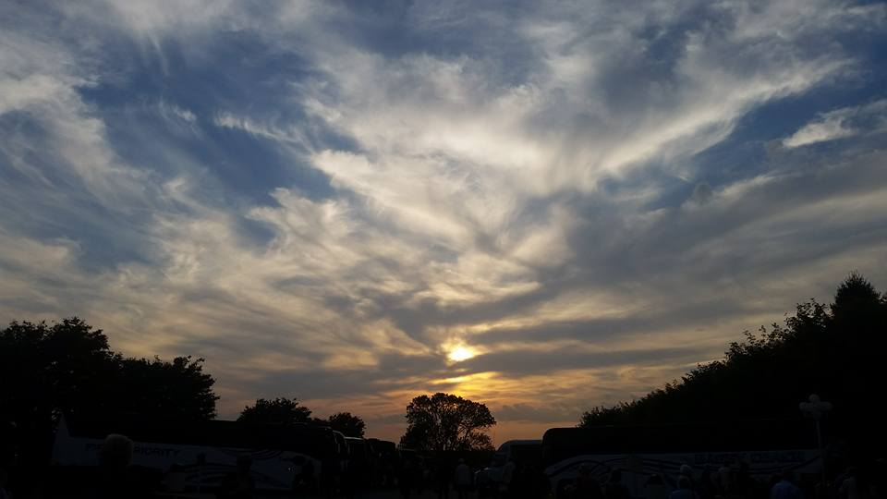
Sending Hymn # 39 “Great Is Thy Faithfulness”
Great is thy faithfulness,
O God my Father; there is no shadow of turning with thee. Thou changest not; thy compassions they fail not. As thou hast been thou forever wilt be. Great is thy faithfulness! Great is thy faithfulness! Morning by morning, new mercies I see. All I have needed thy hand hath provided. Great is thy faithfulness, Lord unto me!

Slide 34
Sending Hymn # 39 “Great Is Thy Faithfulness”
Summer and winter, and springtime and harvest, sun, moon, and stars in their courses above join with all nature in manifold witness to thy great faithfulness, mercy, and love. Great is thy faithfulness! Great is thy faithfulness! Morning by morning, new mercies I see. All I have needed thy hand hath provided. Great is thy faithfulness, Lord unto me!

Slide 35
Sending Hymn # 39 “Great Is Thy Faithfulness”
Pardon for sin and a peace that endureth, thine own dear presence to cheer and to guide, strength for today and bright hope for tomorrow: blessings all mine, with ten thousand beside! Great is thy faithfulness! Great is thy faithfulness! Morning by morning, new mercies I see. All I have needed thy hand hath provided. Great is thy faithfulness, Lord unto me!

Slide 36
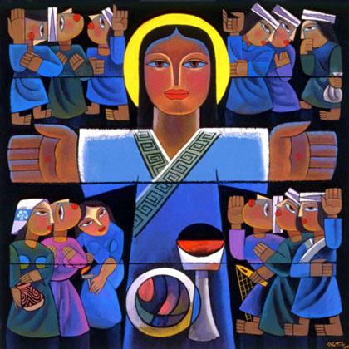
Bearing and Following the WORD into the World The Charge and Benediction

Slide 37
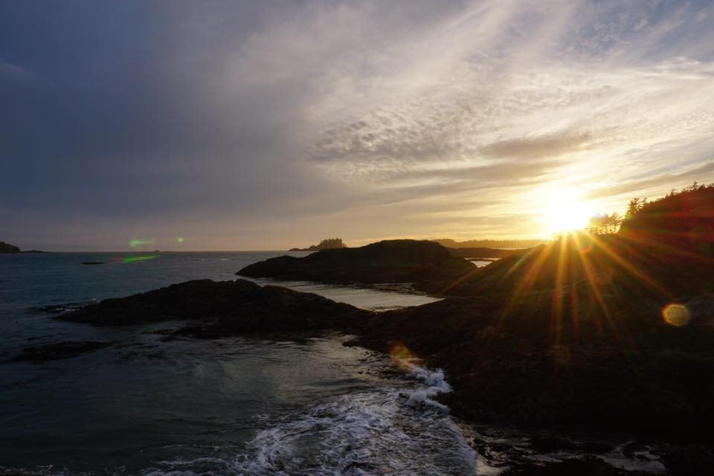
Bearing and Following the WORD into the World Benediction Response
# 546 “Lord, Dismiss Us with Your Blessing” (Stanza 2)
Thanks we give and adoration
for your gospel's joyful sound; may the fruits of your salvation
in our hearts and lives abound. Ever faithful, ever faithful
to your truth may we be found.

Slide 38
Homecrest Presbyterian Church Worship of the Lord’s Day August 26th, 2018 21th Sunday in Ordinary Time

