Slide 1
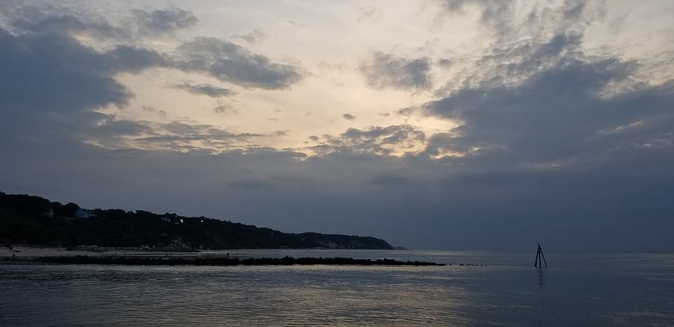
Homecrest Presbyterian Church Worship of the Lord’s Day August 19th, 2018 20th Sunday in Ordinary Time

Slide 2
Gathering Around the WORD Call to Worship (Based on Matthew 11:28-30)
Jesus said, "Come to me, all you that are weary and are carrying heavy burdens, and I will give you rest. Take my yoke upon you, and learn from me; for I am gentle and humble in heart, and you will find rest for your souls. For my yoke is easy, and my burden is light."
Indeed we have come resting upon God’s promise of a new day.
We shall come with full confidence to worship God, knowing that God is
in our midst. Thanks be to God. Amen.

Slide 3
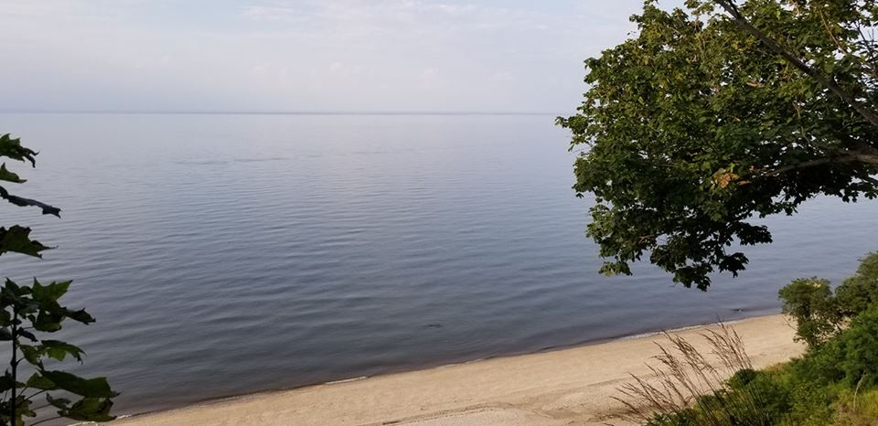
Gathering Around the WORD Gathering Hymn # 772 “Live Into Hope”
Live into hope of captives freed, of sight regained, the end of greed. The oppressed shall be the first to see the year of God's own jubilee!

Slide 4
Gathering Around the WORD Gathering Hymn # 772 “Live Into Hope”
Live into hope! The blind shall see with insight and with clarity, removing shades of pride and fear, a vision of our God brought near.

Slide 5
Gathering Around the WORD Gathering Hymn # 772 “Live Into Hope”
Live into hope of liberty, the right to speak, the right to be, the right to have one's daily bread, to hear God's word and thus be fed.

Slide 6
Gathering Around the WORD Gathering Hymn # 772 “Live Into Hope”
Live into hope of captives freed from chains of fear or want or greed. God now proclaims our full release to faith and hope and joy and peace.

Slide 7
Gathering Around the WORD Call to Confession (Ephesians 5:15-16) Seeking the wisdom of the Lord, let us consider how we have lived, confessing our sins and trusting in the mercy of our God.

Slide 8
Gathering Around the WORD Prayer of Confession (in Unison)
Merciful God, we confess that we have not been faithful children. We have not lived by your law; we have remained silent in the face of evil; we have not refrained from deceit; we have not followed in the way of peace; and we have not honored all that is true and good. We have been foolish and immature people who resist the holy wisdom you graciously offer. Forgive us our sin, O God, and lead us to sincere repentance through Jesus Christ our Lord, Amen.

Slide 9
Gathering Around the WORD Declaration of Forgiveness
The Lord is gracious and merciful! God shows great and steadfast love to us through Jesus Christ, our bread of life. By his flesh and blood our sins are forgiven and we have been given an eternal life.
In Jesus’s name, we are forgiven sinners. Thanks be God, Amen.

Slide 10
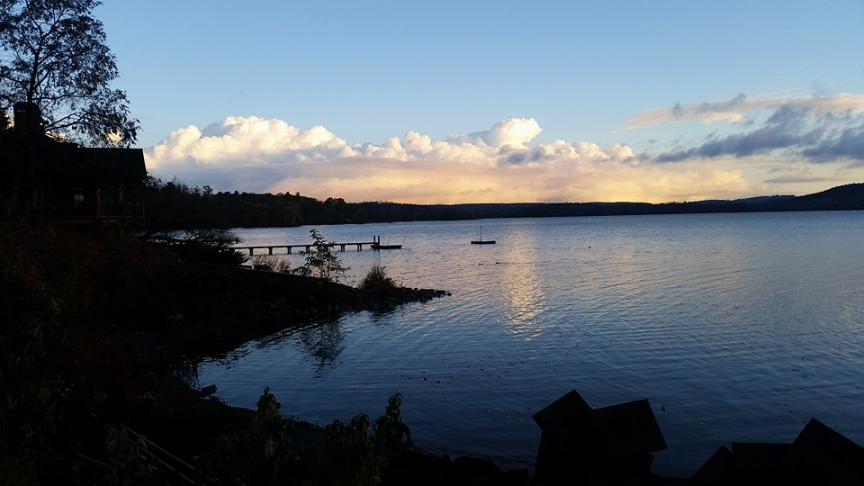
Gathering Around the WORD Gloria Patri
Glory be to the Father
and to the Son and to the Holy Ghost;
As it was in the beginning,
is now, and ever shall be,
world without end. Amen, Amen.

Slide 11
Gathering Around the WORD Passing of the Peace of Christ

Slide 12
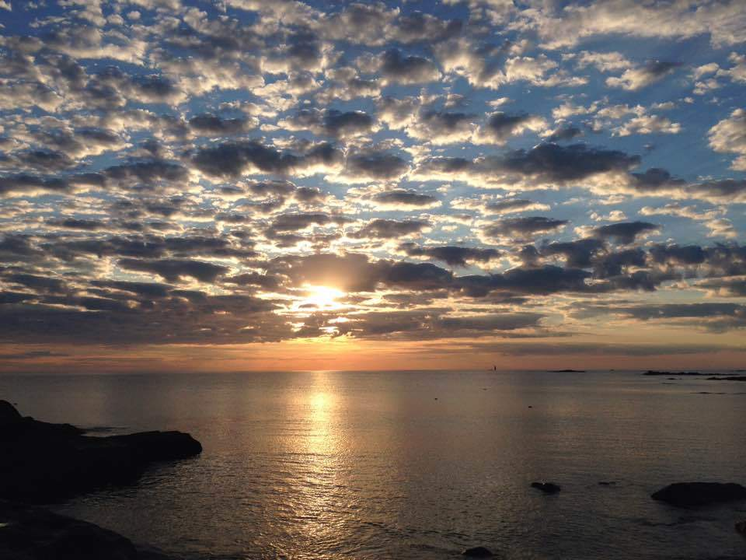
Proclaiming the WORD Message to the Youth/ Prayer of Illumination

Slide 13
Proclaiming the WORD Scripture Reading (1 Kings 3:3-14)
Solomon loved the LORD, walking in the statutes of his father David; only, he sacrificed and offered incense at the high places.
⁴The king went to Gibeon to sacrifice there, for that was the principal high place; Solomon used to offer a thousand burnt offerings on that altar. ⁵At Gibeon the LORD appeared to Solomon in a dream by night; and God said, "Ask what I should give you."

Slide 14
Proclaiming the WORD Scripture Reading (1 Kings 3:3-14)
⁶And Solomon said, "You have shown great and steadfast love to your servant my father David, because he walked before you in faithfulness, in righteousness, and in uprightness of heart toward you; and you have kept for him this great and steadfast love, and have given him a son to sit on his throne today. ⁷And now, O LORD my God, you have made your servant king in place of my father David, although I am only a little child; I do not know how to go out or come in. ⁸And your servant is in the midst of the people whom you have chosen, a great people, so numerous they cannot be numbered or counted.

Slide 15
Proclaiming the WORD Scripture Reading (1 Kings 3:3-14)
⁹Give your servant therefore an understanding mind to govern your people, able to discern between good and evil; for who can govern this your great people?" ¹⁰It pleased the Lord that Solomon had asked this. ¹¹God said to him, "Because you have asked this, and have not asked for yourself long life or riches, or for the life of your enemies, but have asked for yourself understanding to discern what is right, ¹²I now do according to your word. Indeed I give you a wise and discerning mind; no one like you has been before you and no one like you shall arise after you.

Slide 16
Proclaiming the WORD Scripture Reading (1 Kings 3:3-14)
¹³I give you also what you have not asked, both riches and honor all your life; no other king shall compare with you. ¹⁴If you will walk in my ways, keeping my statutes and my commandments, as your father David walked, then I will lengthen your life."

Slide 17
Proclaiming the WORD Scripture Reading (Ephesians 5:15-20)
¹⁵Be careful then how you live, not as unwise people but as wise, ¹⁶making the most of the time, because the days are evil. ¹⁷So do not be foolish, but understand what the will of the Lord is. ¹⁸Do not get drunk with wine, for that is debauchery; but be filled with the Spirit, ¹⁹as you sing psalms and hymns and spiritual songs among yourselves, singing and making melody to the Lord in your hearts, ²⁰giving thanks to God the Father at all times and for everything in the name of our Lord Jesus Christ.

Slide 18
Proclaiming the WORD (I Kings 3:3-14 and Ephesians 5:15-20)
Ask and Choose Wisely

Slide 19
Responding Hymn # 65 “Guide Me, O Thou Great Jehovah”
Guide me, O thou great Jehovah, pilgrim through this barren land. I am weak, but thou art mighty. Hold me with thy powerful hand. Bread of heaven, bread of heaven, feed me till I want no more; feed me till I want no more.

Slide 20
Responding Hymn # 65 “Guide Me, O Thou Great Jehovah”
Open now the crystal fountain, whence the healing stream doth flow. Let the fire and cloudy pillar lead me all my journey through. Strong deliverer, strong deliverer, be thou still my strength and shield; be thou still my strength and shield.

Slide 21
Responding Hymn # 65 “Guide Me, O Thou Great Jehovah”
When I tread the verge of Jordan, bid my anxious fears subside. Death of death, and hell's destruction, land me safe on Canaan's side. Songs of praises, songs of praises I will ever give to thee; I will ever give to thee.

Slide 22
Responding to the WORD
Affirmation of Faith –
Psalm 111:1-10 (To be read responsively)
¹Praise the LORD!
We will give thanks to the LORD with our whole hearts,
in the company of the upright, in the congregation.
²Great are the works of the LORD,
studied by all who delight in them.
³Full of honor and majesty is his work,
and his righteousness endures forever.
⁴He has gained renown by his wonderful deeds;
the LORD is gracious and merciful.

Slide 23
Responding to the WORD
Affirmation of Faith –
Psalm 111:1-10 (To be read responsively)
⁵He provides food for those who fear him;
he is ever mindful of his covenant.
⁶He has shown his people the power of his works,
in giving them the heritage of the nations.
⁷The works of his hands are faithful and just;
all his precepts are trustworthy.
⁸They are established forever and ever,
to be performed with faithfulness and uprightness.

Slide 24
Responding to the WORD
Affirmation of Faith –
Psalm 111:1-10 (To be read responsively)
⁹He sent redemption to his people;
he has commanded his covenant forever.
Holy and awesome is his name.
¹⁰The fear of the LORD is the beginning of wisdom;
all those who practice it have a good understanding.
His praise endures forever.

Slide 25
Bearing and Following the WORD into the World Announcements &
Sharing of Joys and Concerns
The Sunday afternoon Bible Study and the Women's Group are on summer break. They will resume in September.

Slide 26
Bearing and Following the WORD into the World Announcements &
Sharing of Joys and Concerns
Our neighboring church – King’s Chapel will be hosting a special one-day event for the women of the church on how to study, pray and practice God’s Word more effectively on Saturday, September 29th (10am-3pm). This is also a great opportunity to connect and to fellowship with other Christian women in this area. The cost of registration and lunch is $15. For more information, please pick up on of the flyers on the back table.

Slide 27
Bearing and Following the WORD into the World Prayer of the People & The Lord’s Prayer
Our Father, who art in heaven.
Halloweth be thy name.
Thy Kingdom come; Thy will be done
On earth as it is in heaven.
Give us this day our daily bread.
Forgive us our debts; as we forgive our debtors.
Lead us not into temptations, but deliver us from evil.
For Thine is the Kingdom, the Power, and the Glory forever. Amen.

Slide 28
Bearing and Following the WORD into the World Offering of our Gifts and our Lives
Musical Offering

Slide 29
Bearing and Following the WORD into the World Doxology and Offertory Prayer

Slide 30
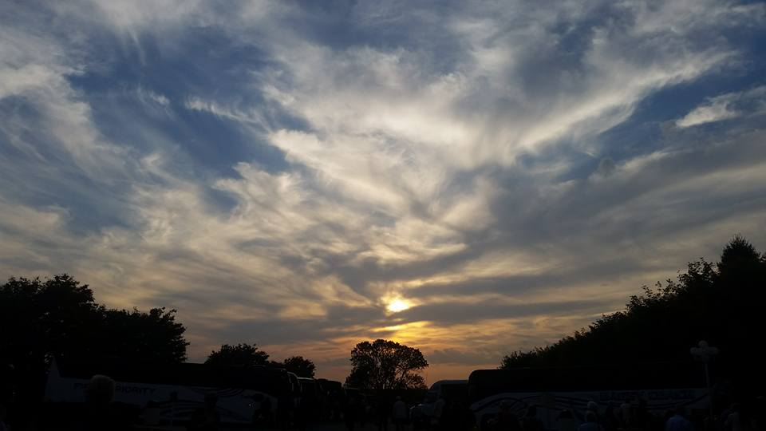
Sending Hymn # 761 “Called as Partners in Christ’s Service”
Called as partners in Christ’s service, called to ministries of grace, we respond with deep commitment fresh new lines of faith to trace. May we learn the art of sharing, side by side and friend with friend, equal partners in our caring to fulfill God’s chosen end.

Slide 31
Sending Hymn # 761 “Called as Partners in Christ’s Service”
Christ’s example, Christ’s inspiring, Christ’s clear call to work and worth, let us follow, never faltering, reconciling folk on earth. Men and women, richer, poorer, all God’s people, young and old, blending human skills together gracious gifts from God unfold.

Slide 32
Sending Hymn # 761 “Called as Partners in Christ’s Service”
Thus new patterns for Christ’s mission, in a small or global sense, help us bear each other’s burdens, breaking down each wall or fence. Words of comfort, words of vision, words of challenge, said with care, bring new power and strength for action, make us colleagues, free and fair.

Slide 33
Sending Hymn # 761 “Called as Partners in Christ’s Service”
So God grant us for tomorrow ways to order human life that surround each person’s sorrow with a calm that conquers strife. Make us partners in our living, our compassion to increase, messengers of faith, thus giving hope and confidence and peace.

Slide 34
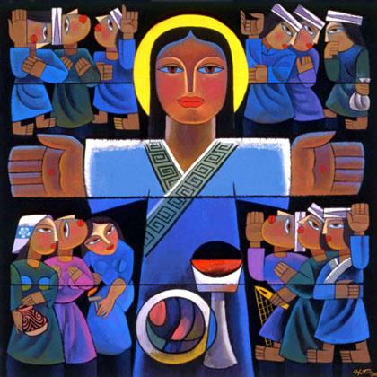
Bearing and Following the WORD into the World The Charge and Benediction

Slide 35
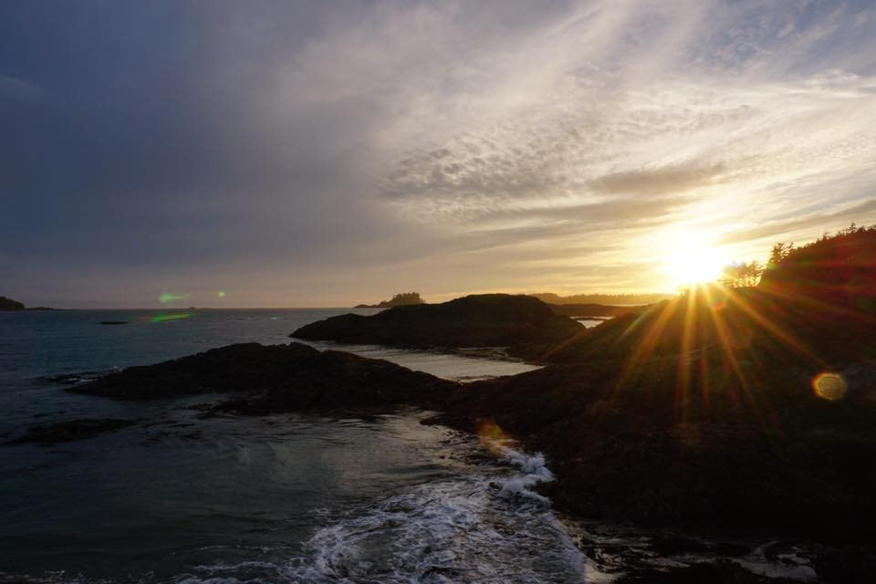
Bearing and Following the WORD into the World Benediction Response
# 546 “Lord, Dismiss Us with Your Blessing” (Stanza 1)
Lord, dismiss us with your blessing;
fill our hearts with joy and peace; let us each, your love possessing, triumph in redeeming grace. O refresh us, O refresh us, traveling through this wilderness.

Slide 36
Homecrest Presbyterian Church Worship of the Lord’s Day August 19th, 2018 20th Sunday in Ordinary Time

