Slide 1
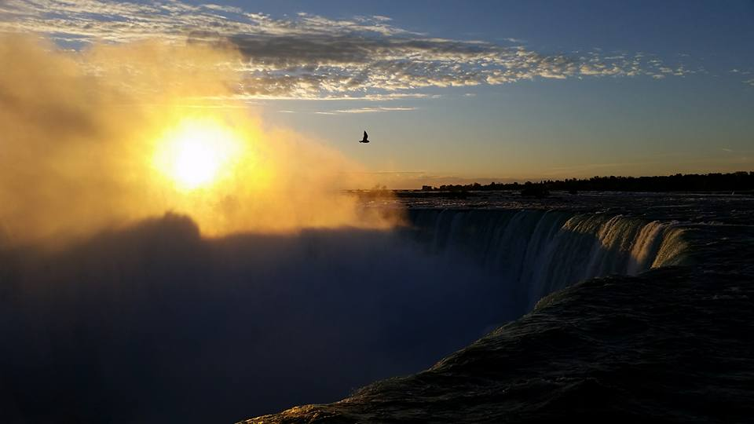
Homecrest Presbyterian Church Worship of the Lord’s Day July 29th, 2018 17th Sunday in Ordinary Time

Slide 2
Gathering Around the WORD Call to Worship (Based on Genesis 1:1-2, Mark 1:1, 9-11)
In the beginning, God created the heavens and the earth. The Spirit of God swept over the face of the waters; then God said: Let there be light, and God saw that it was good.
At the beginning of his ministry, Jesus was baptized by John. The heavens opened, and the Spirit descended like a dove; then God said:
This is my beloved Son, in whom I am well pleased. We have gathered to bear witness to these happenings. Let us worship God.

Slide 3
Gathering Around the WORD Gathering Hymn # 39 “Great is Thy Faithfulness”
Great is thy faithfulness, O God my Father; there is no shadow of turning with thee. Thou changest not; thy compassions they fail not. As thou hast been thou forever wilt be. Great is thy faithfulness! Great is thy faithfulness! Morning by morning, new mercies I see. All I have needed thy hand hath provided. Great is thy faithfulness, Lord unto me!

Slide 4
Gathering Around the WORD Gathering Hymn # 39 “Great is Thy Faithfulness”
Summer and winter, and springtime and harvest, sun, moon, and stars in their courses above join with all nature in manifold witness to thy great faithfulness, mercy, and love. Great is thy faithfulness! Great is thy faithfulness! Morning by morning, new mercies I see. All I have needed thy hand hath provided. Great is thy faithfulness, Lord unto me!

Slide 5
Gathering Around the WORD Gathering Hymn # 39 “Great is Thy Faithfulness”
Pardon for sin and a peace that endureth, thine own dear presence to cheer and to guide, strength for today and bright hope for tomorrow: blessings all mine, with ten thousand beside! Great is thy faithfulness! Great is thy faithfulness! Morning by morning, new mercies I see. All I have needed thy hand hath provided. Great is thy faithfulness, Lord unto me!

Slide 6
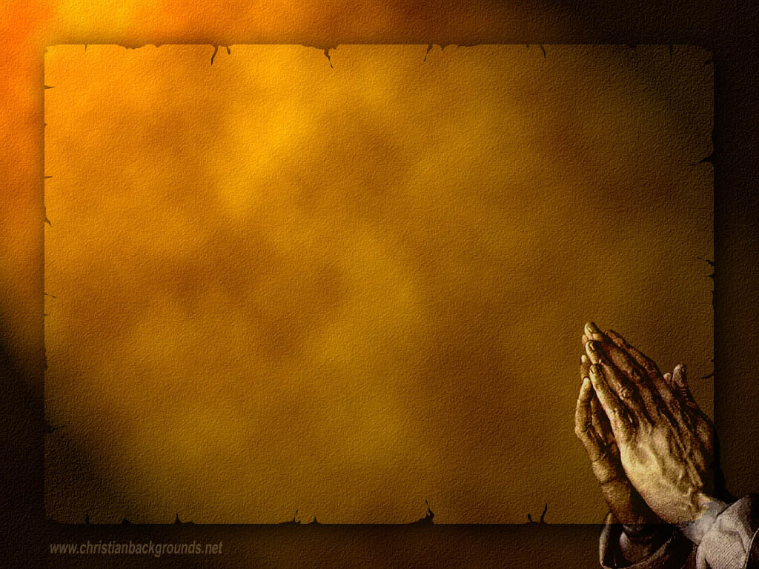
Gathering Around the WORD Call to Confession Through our baptism, Christ has drawn us out of the water and cleanse us of our sins. Christ has offered us this new hope, new life, and a new beginning. In humility and faith, let us come before God and our neighbors, confessing our sins and seeking God’s mercy and grace.

Slide 7
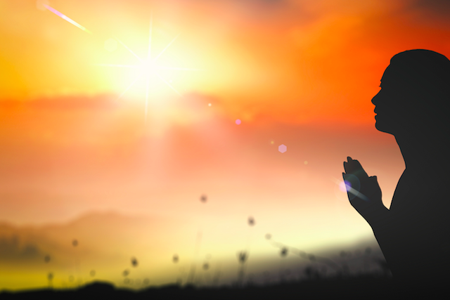
Gathering Around the WORD Prayer of Confession (in Unison)
(Psalm 51:10-12)
Create in us a clean heart, O God, and put a new and right spirit within us. Do not cast us away from your presence, and do not take your holy spirit from us. Restore to us the joy of your salvation, and sustain in us a willing spirit. Lord, hear our prayers we pray. Amen.

Slide 8
Gathering Around the WORD Declaration of Forgiveness
(Isaiah 42:6 and 9)
The Lord declares, “I have called you in righteousness, I have taken you by the hand and kept you; I have given you as a covenant to the people, a light to the nations. See, the former things have come to pass, and new things I have now declared.” Through Christ, God has given us a new life. We have been forgiven. Thanks be to God, Amen.

Slide 9
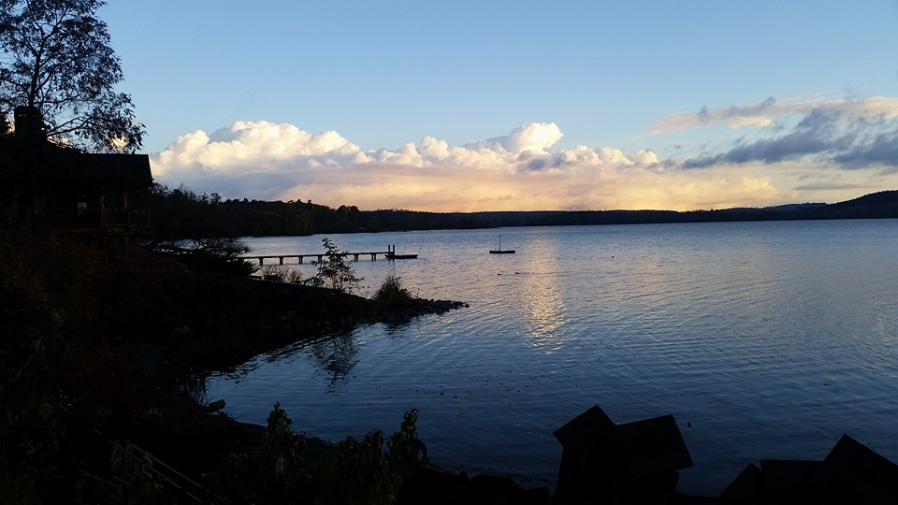
Gathering Around the WORD Gloria Patri
Glory be to the Father
and to the Son and to the Holy Ghost;
As it was in the beginning,
is now, and ever shall be,
world without end. Amen, Amen.

Slide 10
Gathering Around the WORD Passing of the Peace of Christ

Slide 11
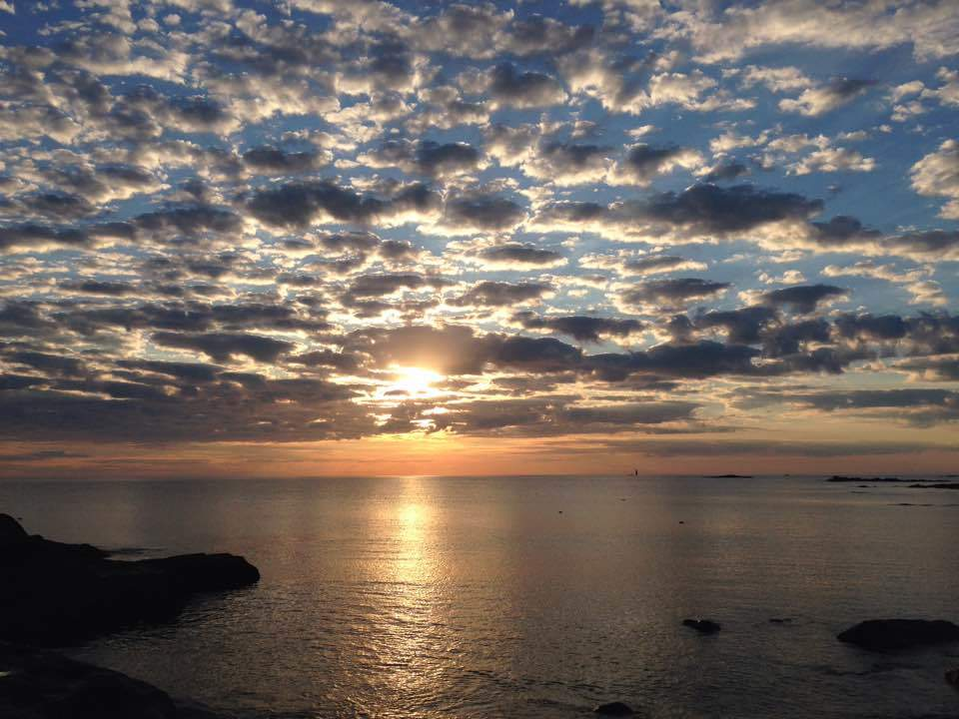
Proclaiming the WORD Message to the Youth/ Prayer of Illumination

Slide 12
Proclaiming the WORD Scripture Reading (John 6:1-14)
¹After this Jesus went to the other side of the Sea of Galilee, also called the Sea of Tiberias. ²A large crowd kept following him, because they saw the signs that he was doing for the sick. ³Jesus went up the mountain and sat down there with his disciples. ⁴Now the Passover, the festival of the Jews, was near. ⁵When he looked up and saw a large crowd coming towards him, Jesus said to Philip, "Where are we to buy bread for these people to eat?" ⁶He said this to test him, for he himself knew what he was going to do. ⁷Philip answered him, "Six months' wages would not buy enough bread for each of them to get a little."

Slide 13
Proclaiming the WORD Scripture Reading (John 6:1-14)
⁸One of his disciples, Andrew, Simon Peter's brother, said to him, ⁹"There is a boy here who has five barley loaves and two fish. But what are they among so many people?" ¹⁰Jesus said, "Make the people sit down." Now there was a great deal of grass in the place; so they sat down, about five thousand in all. ¹¹Then Jesus took the loaves, and when he had given thanks, he distributed them to those who were seated; so also the fish, as much as they wanted. ¹²When they were satisfied, he told his disciples, "Gather up the fragments left over, so that nothing may be lost."

Slide 14
Proclaiming the WORD Scripture Reading (John 6:1-14)
¹³So they gathered them up, and from the fragments of the five barley loaves, left by those who had eaten, they filled twelve baskets. ¹⁴When the people saw the sign that he had done, they began to say, "This is indeed the prophet who is to come into the world."

Slide 15
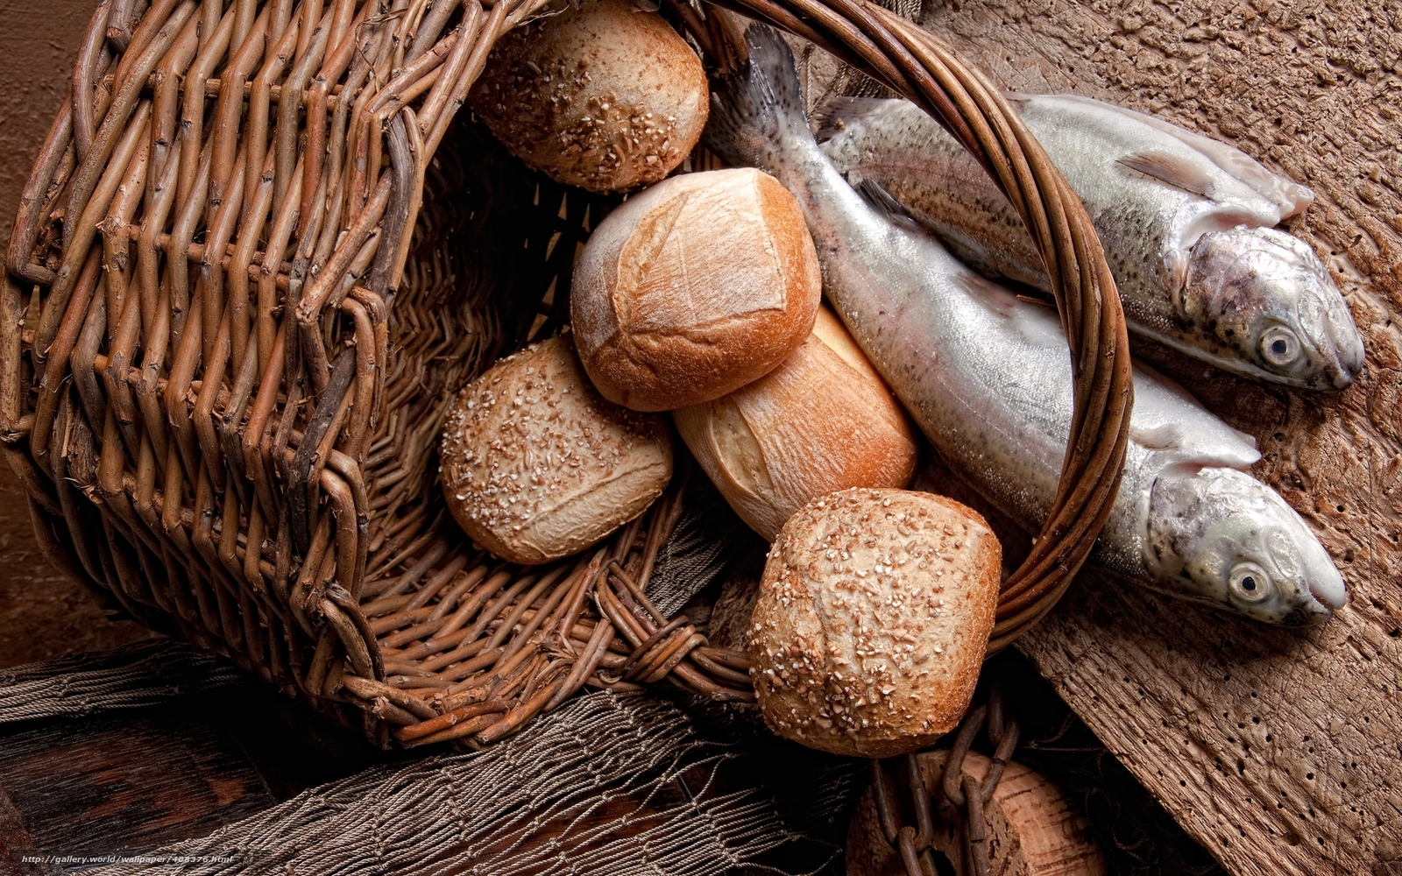
Proclaiming the WORD (John 6:1-14)
Offering of a Child

Slide 16
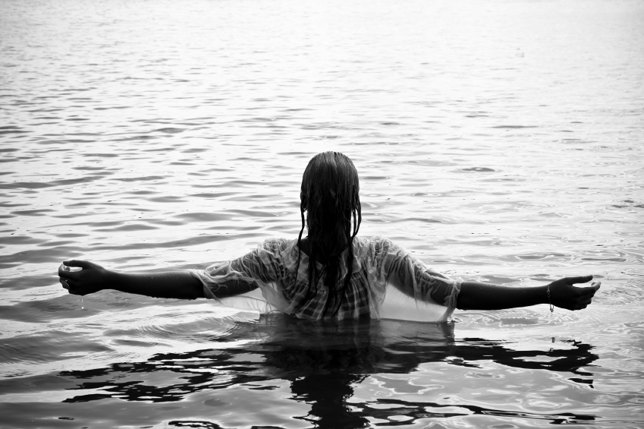
Proclaiming the WORD (John 6:1-14)
Offering of a Child

Slide 17
Responding Hymn # 481 “I Believe In God the Father” (Apostles’ Creed)
I believe in God the Father,
merciful and mighty Lord, maker of the earth and heavens,
whom we worship and adore; and in Jesus Christ the Son,
only Savior, sovereign one, by the Holy Spirit given,
born of Mary, blessed virgin.

Slide 18
Responding Hymn # 481 “I Believe In God the Father” (Apostles’ Creed)
Under Pilate, Jesus suffered,
faithful to his final breath. He was crucified and buried,
and descended into death. From the grave he did arise;
and ascended through the skies; now enthroned with God in heaven, he will judge the dead and living.

Slide 19
Responding Hymn # 481 “I Believe In God the Father” (Apostles’ Creed)
I believe in God the Spirit,
and the church in every place; saints in glorious communion,
all forgiven, full of grace; flesh and blood will live again;
life in Christ will never end. Holy Spirit, Son and Father:
I will praise your name forever.

Slide 20
Responding to the WORD
Isabel Siyue Dai

Slide 21
Bearing and Following the WORD into the World Announcements &
Sharing of Joys and Concerns
The Sunday afternoon Bible Study and the Women's Group are on summer break. They will resume in September.
Pastor Samson will be on vacation the next couple of weeks. Rev. Grace Bowen and Rev. Cheni Khnoje will be our guest speakers for 8/5 and 8/12 respectively. They have been with us before. Please extend our warmest welcome to them.

Slide 22
Bearing and Following the WORD into the World Prayer of the People & The Lord’s Prayer
Our Father, who art in heaven.
Halloweth be thy name.
Thy Kingdom come; Thy will be done
On earth as it is in heaven.
Give us this day our daily bread.
Forgive us our debts; as we forgive our debtors.
Lead us not into temptations, but deliver us from evil.
For Thine is the Kingdom, the Power, and the Glory forever. Amen.

Slide 23
Bearing and Following the WORD into the World Offering of our Gifts and our Lives
Musical Offering

Slide 24
Bearing and Following the WORD into the World Doxology and Offertory Prayer

Slide 25
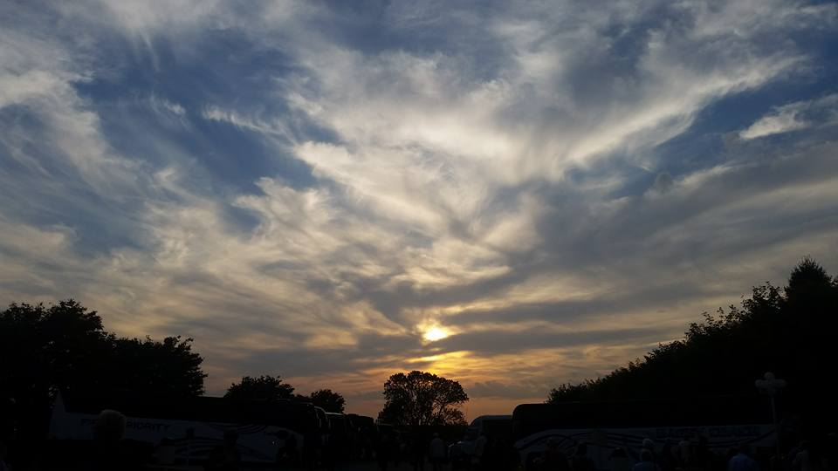
Sending Hymn # 475 “Come, Thou Fount of Every Blessing”
Come, thou Fount of every blessing; tune my heart to sing thy grace; streams of mercy, never ceasing, call for songs of loudest praise. Teach me some melodious sonnet, sung by flaming tongues above; praise the mount! I’m fixed upon it, mount of God’s unchanging love!

Slide 26
Sending Hymn # 475 “Come, Thou Fount of Every Blessing”
Here I raise my Ebenezer; hither by thy help I’m come; and I hope, by thy good pleasure, safely to arrive at home. Jesus sought me when a stranger, wandering from the fold of God; he, to rescue me from danger, interposed his precious blood.

Slide 27
Sending Hymn # 475 “Come, Thou Fount of Every Blessing”
O to grace how great a debtor daily I’m constrained to be! Let that grace now, like a fetter, bind my wandering heart to thee. Prone to wander, Lord, I feel it, prone to leave the God I love; here’s my heart; O take and seal it; seal it for thy courts above.

Slide 28
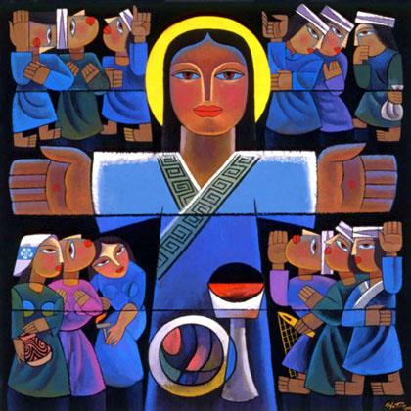
Bearing and Following the WORD into the World The Charge and Benediction

Slide 29
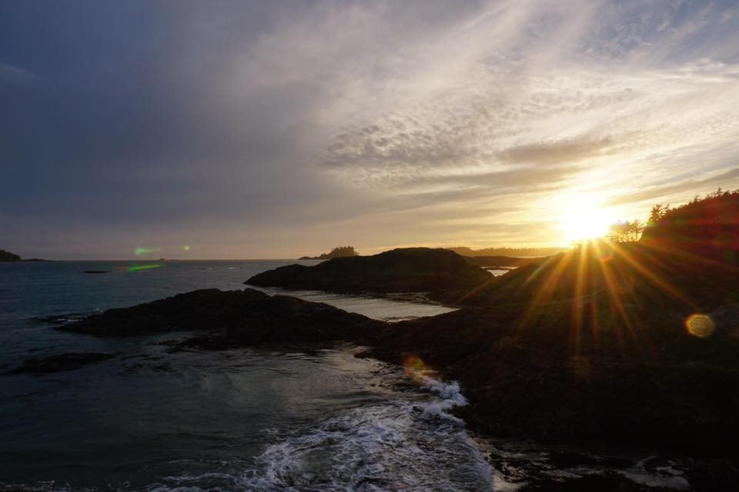
Bearing and Following the WORD into the World Benediction Response
# 542 “Go, My Children, With My Blessing” (Stanza 2)
God be with you till we meet again; unseen wings protecting hide you, daily manna still provide you:
God be with you till we meet again.

Slide 30
Homecrest Presbyterian Church Worship of the Lord’s Day July 29th, 2018 17th Sunday in Ordinary Time

