Slide 1
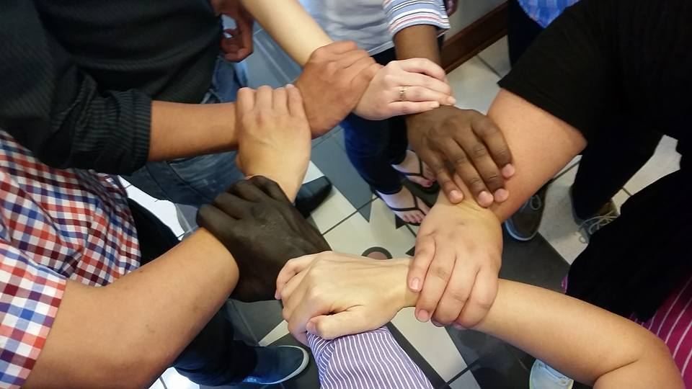
Homecrest Presbyterian Church Worship of the Lord’s Day 16th Sunday in Ordinary Time July 22nd, 2018

Slide 2
Gathering Around the WORD Call to Worship
(Based on Ephesians 2:22)
Come into the presence of the Most High God with songs of praise and shouts of thanksgiving.
For our Savior frees us from slavery;
our Savior heals our diseases;
our Savior is our peace.
You are a holy temple in the Lord Jesus Christ. Come, let us worship God.

Slide 3
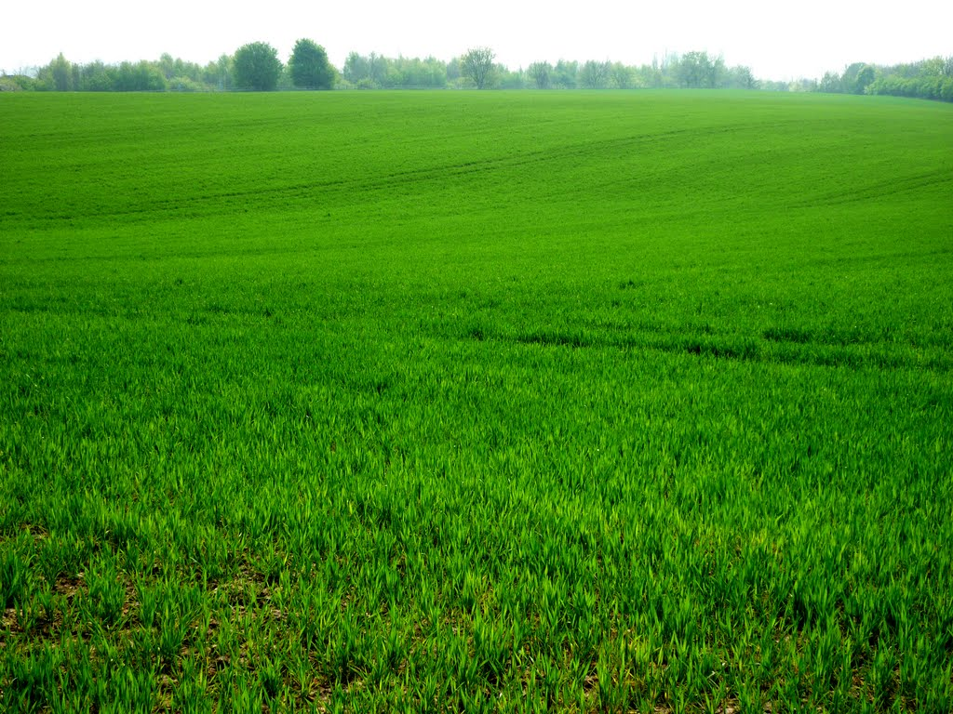
Gathering Around the WORD Gathering Hymn # 309 “Come, Great God of All the Ages”
Come, great God of all the ages; make your earthly mission known; speak through every deed and person; let your way and will be shown. Guide the church to true commitment; give direction now, we ask; fit us for the work of building; dedicate us to the task.

Slide 4
Gathering Around the WORD Gathering Hymn # 309 “Come, Great God of All the Ages”
Come, Christ Jesus, flesh and spirit, sure foundation, cornerstone; help us form the church eternal; may your vision be our own. Send a message to each follower; lead all people to your way; urge us to strong faith and action as we build the church today.

Slide 5
Gathering Around the WORD Gathering Hymn # 309 “Come, Great God of All the Ages”
Come, great Spirit, in and with us, tune our ears to hear your call; through the moving of your presence, let redeeming love recall ministry in dedication, love embodied in our deeds; challenge us to do your bidding, see your purpose, fill all needs.

Slide 6
Gathering Around the WORD Gathering Hymn # 309 “Come, Great God of All the Ages”
Come, O come, in celebration, household of the one true God; in commitment and rejoicing let us go where Christ has trod; as we act in faith and reverence, let us, Lord, the future see; place us in the church triumphant, now and for eternity.

Slide 7
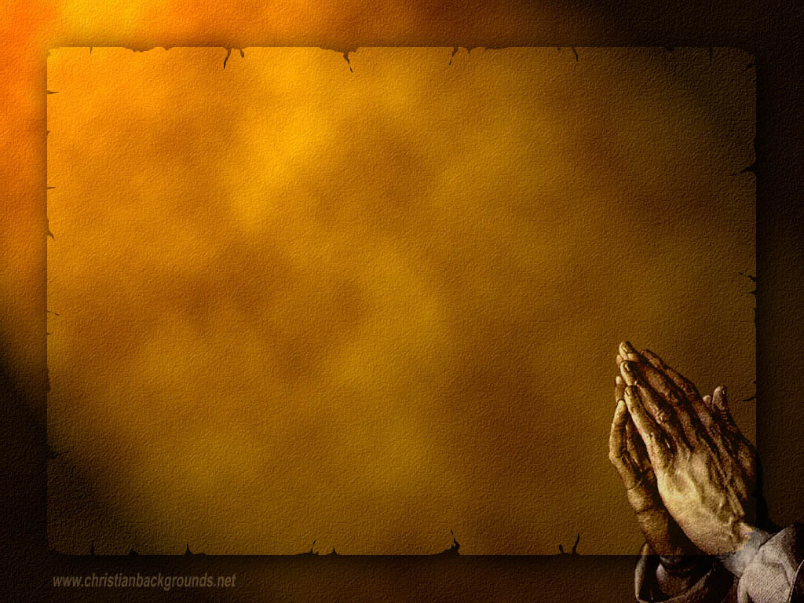
Gathering Around the WORD Call to Confession Through Christ, God redeems us and has given us a second chance in life. God is willing to listen when we call upon God’s name. In our repentance and contrite spirit, God calls us into confession of our sins in the witness of our neighbors. In humility and faith, let us join our hearts for the prayer of confession.

Slide 8
Gathering Around the WORD Prayer of Confession (in unison)
Merciful God, you are our peace and in your flesh you have brought us together. But too often we place walls between us and you, between “us” and “them,” between us and those who are different from us.

Slide 9
Gathering Around the WORD Prayer of Confession (in unison)
Forgive us, for when we shut out the strangers, we shut out you. Help us to act like the members of the household of God that we are. Inspire us to set larger tables instead of building bigger walls.
May we pursue goodness and mercy and relentlessly as you pursue us. This we pray in your holy and mighty name. Amen.

Slide 10
Gathering Around the WORD Declaration of Forgiveness
Our Lord Jesus gives us rest and peace. Our Master’s touch heals us and his shed blood is our salvation. In Jesus Christ, our sins are forgiven.
Thanks be to God, Amen.

Slide 11
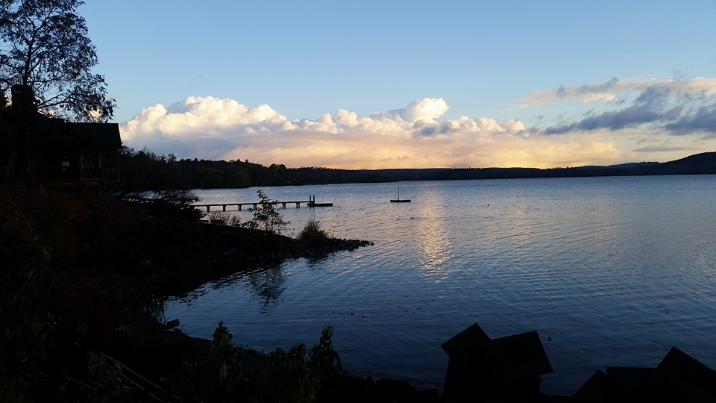
Gathering Around the WORD Gloria Patri
Glory be to the Father
and to the Son and to the Holy Ghost;
As it was in the beginning,
is now, and ever shall be,
world without end. Amen, Amen.

Slide 12
Gathering Around the WORD Passing of the Peace of Christ

Slide 13
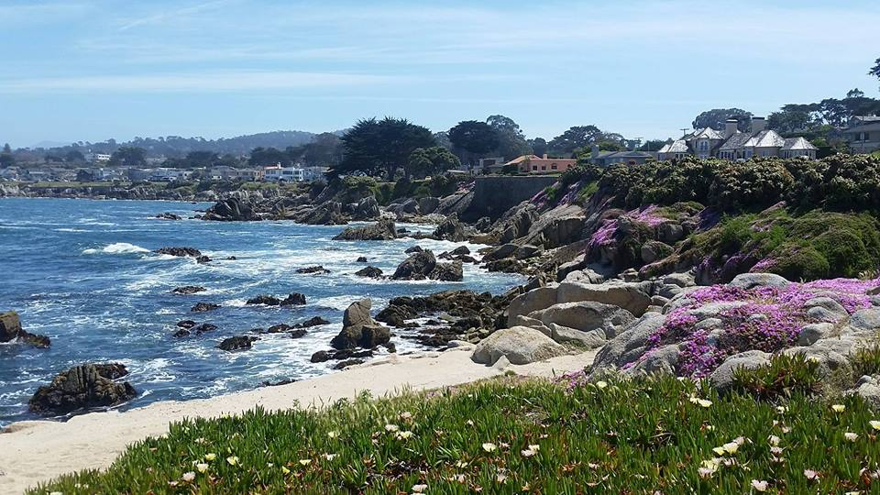
Proclaiming the WORD Message to the Youth/ Prayer of Illumination

Slide 14
Proclaiming the WORD Scripture Reading (Ephesians 2:11-22)
¹¹So then, remember that at one time you Gentiles by birth, called "the uncircumcision" by those who are called "the circumcision" — a physical circumcision made in the flesh by human hands — ¹²remember that you were at that time without Christ, being aliens from the commonwealth of Israel, and strangers to the covenants of promise, having no hope and without God in the world. ¹³But now in Christ Jesus you who once were far off have been brought near by the blood of Christ.

Slide 15
Proclaiming the WORD Scripture Reading (Ephesians 2:11-22)
¹⁴For he is our peace; in his flesh he has made both groups into one and has broken down the dividing wall, that is, the hostility between us. ¹⁵He has abolished the law with its commandments and ordinances, so that he might create in himself one new humanity in place of the two, thus making peace, ¹⁶and might reconcile both groups to God in one body through the cross, thus putting to death that hostility through it. ¹⁷So he came and proclaimed peace to you who were far off and peace to those who were near; ¹⁸for through him both of us have access in one Spirit to the Father.
¹⁹So then you are no longer strangers and aliens, but you are citizens with the saints and also members of the household of God, ²⁰built upon the foundation of the apostles and prophets, with Christ Jesus himself as the cornerstone. ²¹In him the whole structure is joined together and grows into a holy temple in the Lord; ²²in whom you also are built together spiritually into a dwelling-place for God.

Slide 16
Proclaiming the WORD Scripture Reading (Ephesians 2:11-22)
¹⁹So then you are no longer strangers and aliens, but you are citizens with the saints and also members of the household of God, ²⁰built upon the foundation of the apostles and prophets, with Christ Jesus himself as the cornerstone. ²¹In him the whole structure is joined together and grows into a holy temple in the Lord; ²²in whom you also are built together spiritually into a dwelling-place for God.

Slide 17
Proclaiming the WORD (Ephesians 2:11-22)
No Longer Strangers and Aliens

Slide 18
Proclaiming the WORD (Ephesians 2:11-22)
No Longer Strangers and Aliens

Slide 19
Proclaiming the WORD (Ephesians 2:11-22)
No Longer Strangers and Aliens

Slide 20
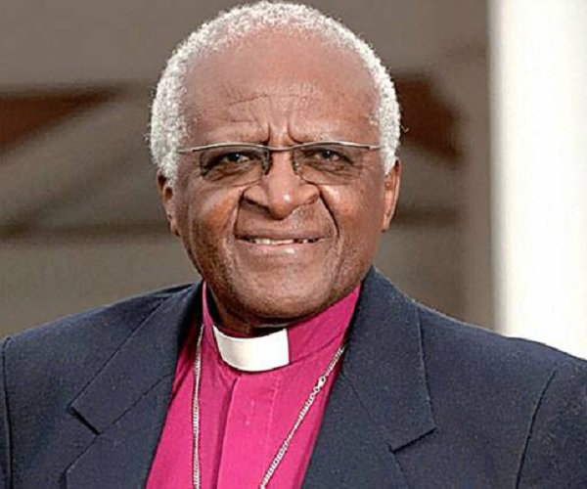
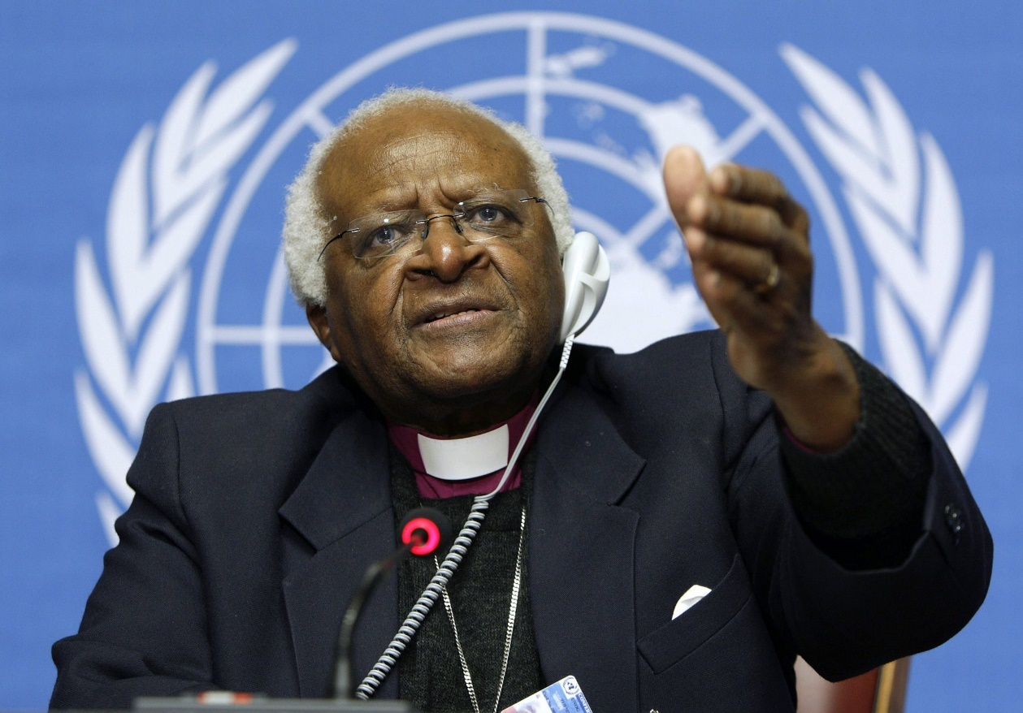
Proclaiming the WORD (Ephesians 2:11-22)
No Longer Strangers and Aliens

Slide 21
Responding Hymn # 766 “The Church of Christ Cannot be Bound”
The church of Christ cannot be bound by walls of wood or stone. Where charity and love are found there can the church be known.

Slide 22
Responding Hymn # 766 “The Church of Christ Cannot be Bound”
True faith will open up the door and step into the street. True service will seek out the poor and ask to wash their feet.

Slide 23
Responding Hymn # 766 “The Church of Christ Cannot be Bound”
True love will not sit idly by when justice is denied. True mercy hears the homeless cry and welcomes them inside.

Slide 24
Responding Hymn # 766 “The Church of Christ Cannot be Bound”
If what we have we freely share to meet our neighbor's need, then we extend the Spirit's care through every selfless deed.

Slide 25
Responding Hymn # 766 “The Church of Christ Cannot be Bound”
The church of Christ cannot be bound by walls of wood or stone. Where charity and love are found, there can the church be known.

Slide 26
Bearing and Following the WORD into the World Affirmation of Faith – Exodus 20:1-17 (in unison)
God spoke all these words, saying, I am the LORD your God. You shall have no other gods before me. You shall not make for yourself an idol, whether in the form of anything that is in heaven above, or that is on the earth beneath,
or that is in the water under the earth. You shall not bow down to them or worship them.

Slide 27
Bearing and Following the WORD into the World Affirmation of Faith – Exodus 20:1-17 (in unison)
You shall not make wrongful use of the name of the LORD your God. Remember the sabbath day, and keep it holy. Honor your father and your mother. You shall not murder. You shall not commit adultery. You shall not steal. You shall not bear false witness against your neighbor. You shall not covet your neighbor's house; you shall not covet your neighbor's wife, or anything that belongs to your neighbor.

Slide 28
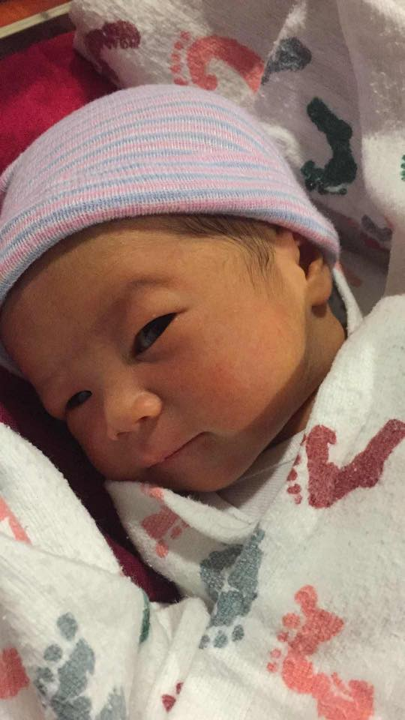
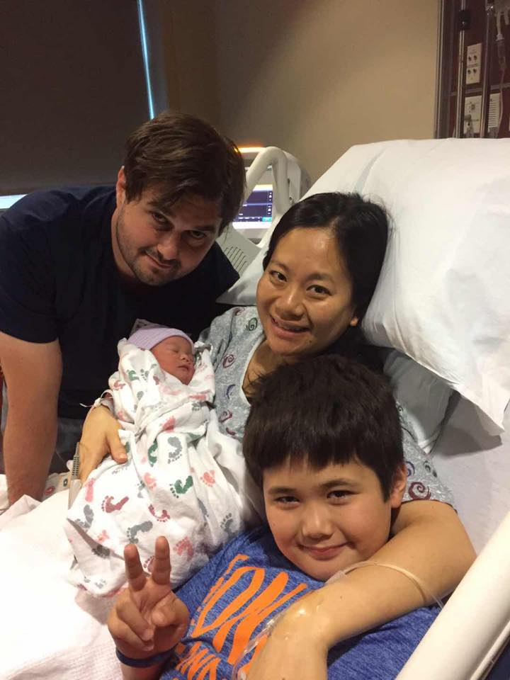
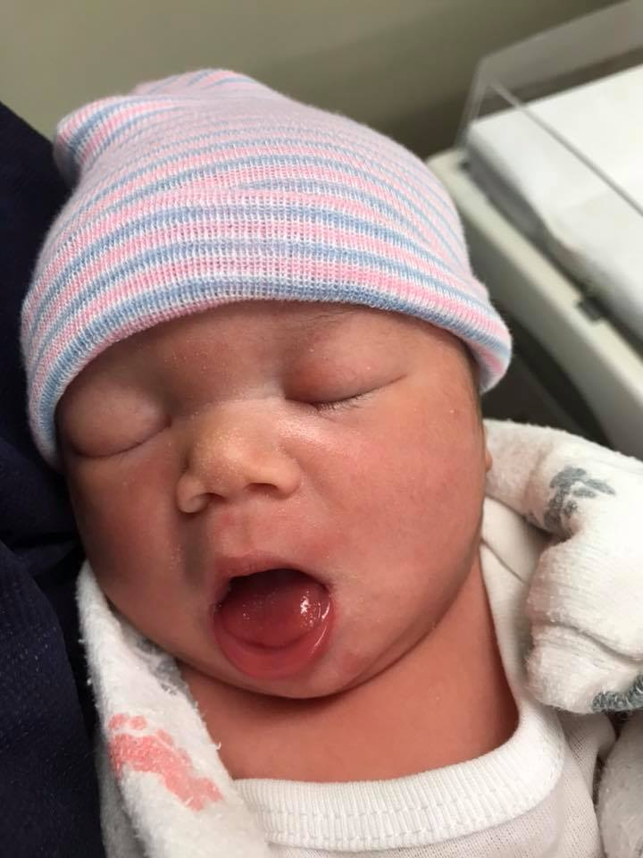
Bearing and Following the WORD into the World Announcements &
Sharing of Joys and Concerns
The Sunday afternoon Bible Study and the Women's Group are on summer break. They will resume in September.
Jayne Mia Sizemore Born: 7/9/18, 7lb. 9oz, 19 ½”

Slide 29
Bearing and Following the WORD into the World Prayer of the People & The Lord’s Prayer
Our Father, who art in heaven.
Halloweth be thy name.
Thy Kingdom come; Thy will be done
On earth as it is in heaven.
Give us this day our daily bread.
Forgive us our debts; as we forgive our debtors.
Lead us not into temptations, but deliver us from evil.
For Thine is the Kingdom, the Power, and the Glory forever. Amen.

Slide 30
Bearing and Following the WORD into the World Offering of our Gifts and our Lives
Musical Offering

Slide 31
Bearing and Following the WORD into the World Doxology and Offertory Prayer

Slide 32
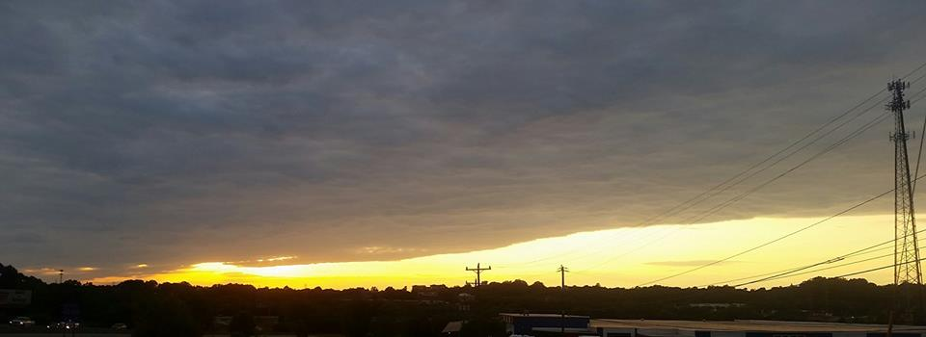
Sending Hymn #550 “Give Praise to the Lord” (Psalm 149)
Give praise to the Lord, and sing a new song; amid all the saints God's praises prolong; a song to your Maker and Ruler now raise, all children of Zion: rejoice and give praise.

Slide 33
Sending Hymn #550 “Give Praise to the Lord” (Psalm 149)
With timbrel and harp and joyful acclaim, with gladness, O God,
we praise your great name; for now in your people
good pleasure you seek; with robes of salvation you cover the meek.

Slide 34
Sending Hymn #550 “Give Praise to the Lord” (Psalm 149)
In glory exult, all saints of the Lord; with song in the night high praises accord; go forth in God's service and
strong in God's might to conquer all evil and stand for the right.

Slide 35
Sending Hymn #550 “Give Praise to the Lord” (Psalm 149)
For this is God's word:
the saints shall not fail, but over the earth their power shall prevail; all kingdoms and nations
shall yield to their sway. To God give the glory; sing praises for aye.

Slide 36
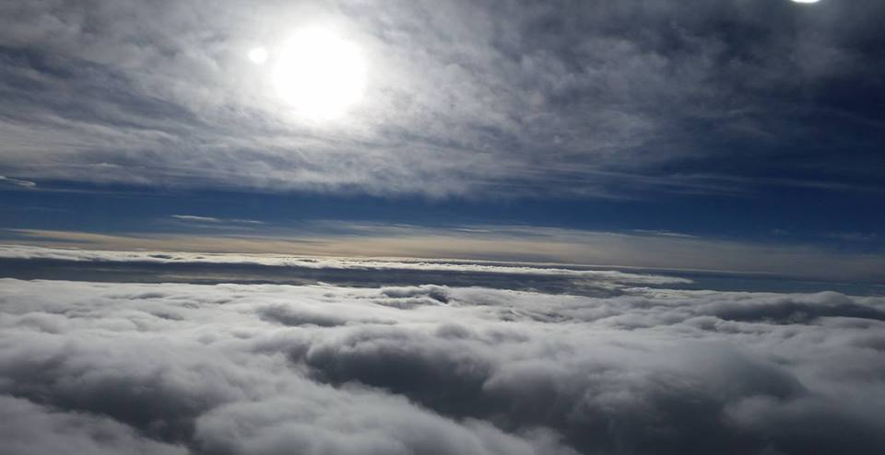
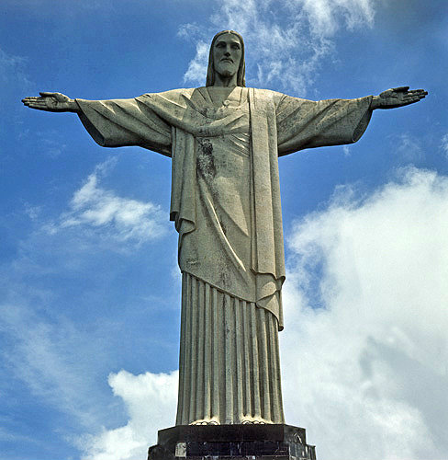
Bearing and Following the WORD into the World The Charge and Benediction

Slide 37
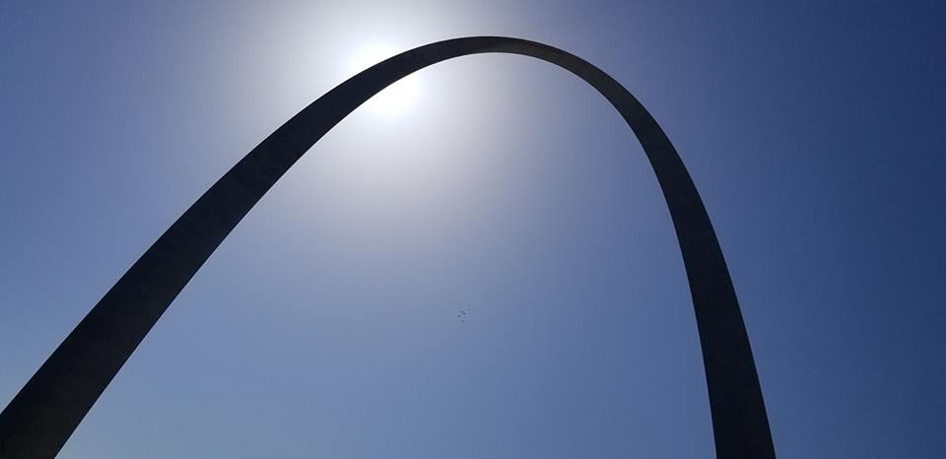
Bearing and Following the WORD into the World Benediction Response
# 542 “God Be with You Till We Meet Again” (Stanza 1)
God be with you till we meet again;
loving counsels guide, uphold you, with a shepherd's care enfold you:
God be with you till we meet again.

Slide 38
Homecrest Presbyterian Church Worship of the Lord’s Day 16th Sunday in Ordinary Time July 22nd, 2018

