Slide 1
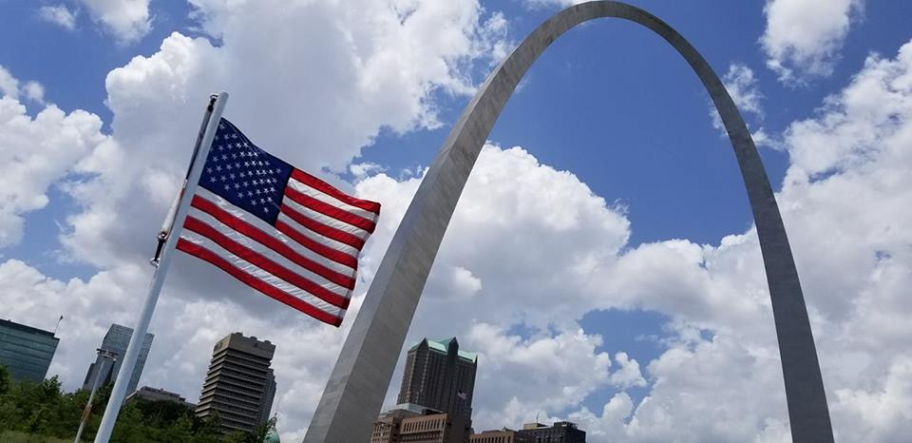
Homecrest Presbyterian Church Worship of the Lord’s Day 6th Sunday after Pentecost July 1st, 2018

Slide 2
Gathering Around the WORD Call to Worship
The signs of God’s kingdom surprise and startle us.
Against all odds, seeds grow, yeast rises,
and love abounds.
Lift up your eyes on high and see all that God has created.
Because God is great in strength,
mighty in power, and not one thing is missing.
For those who wait for the LORD shall be renewed,
and will run and not be weary.

Slide 3
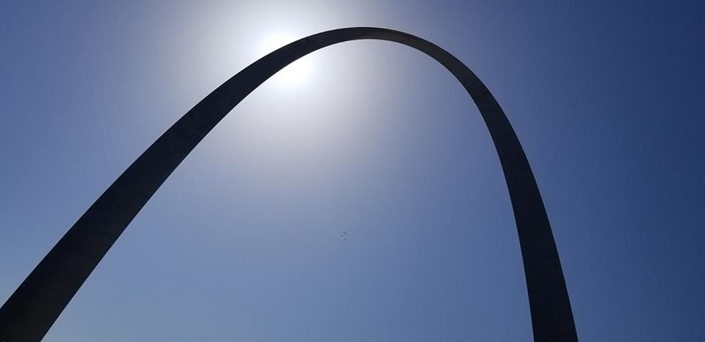
Gathering Around the WORD Gathering Hymn # 343 “Where Cross the Crowded Ways of Life”
Where cross the crowded ways of life, where sound the cries of race and clan, above the noise of selfish strife, we hear your voice, O Son of Man.

Slide 4
Gathering Around the WORD Gathering Hymn # 343 “Where Cross the Crowded Ways of Life”
In haunts of wretchedness and need, on shadowed thresholds fraught with fears, from paths where hide the lures of greed, we catch the vision of your tears.

Slide 5
Gathering Around the WORD Gathering Hymn # 343 “Where Cross the Crowded Ways of Life”
From tender childhood's helplessness, from human grief and burdened toil, from famished souls, from sorrow's stress, your heart has never known recoil.

Slide 6
Gathering Around the WORD Gathering Hymn # 343 “Where Cross the Crowded Ways of Life”
The cup of water given for you still holds the freshness of your grace; yet long these multitudes to view the sweet compassion of your face.

Slide 7
Gathering Around the WORD Gathering Hymn # 343 “Where Cross the Crowded Ways of Life”
O Master, from the mountainside, make haste to heal these hearts of pain; among these restless throngs abide; O tread the city's streets again;

Slide 8
Gathering Around the WORD Gathering Hymn # 343 “Where Cross the Crowded Ways of Life”
Till all the world shall learn your love, and follow where your feet have trod; till glorious from your heaven above shall come the city of our God.

Slide 9
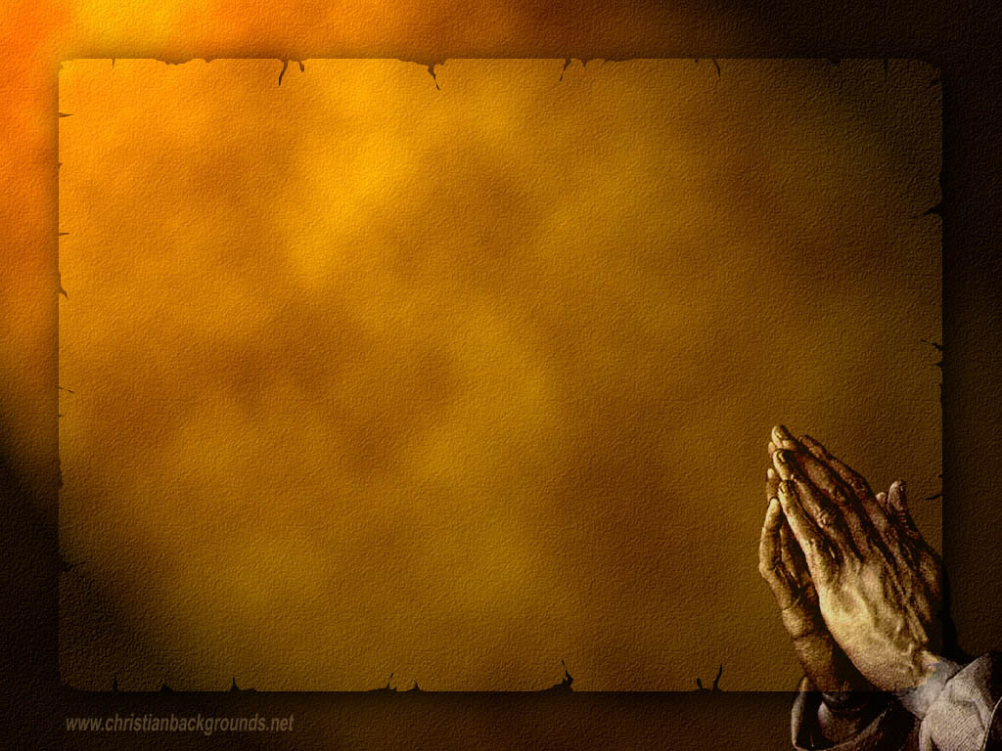
Gathering Around the WORD Call to Confession Through Christ, God has invited us into full communion with Him, even though our sins have separated us from God. Through God’s mercy and grace, we have been set apart and called to come to God once again with signs of faith and penitence of our hearts. Come, let us confess our sins before God and our neighbors.

Slide 10
Gathering Around the WORD Prayer of Confession (in unison)
Like seeds sown in God’s soil, we strive to grow in ways that feed and shelter. Like yeast worked into flour, we yearn for love to ferment and grace to rise. But we quickly weed out the new or strange taking root in carefully planted gardens,
and we are too impatient to let the leaven yield the bread you intended.

Slide 11
Gathering Around the WORD Prayer of Confession (in unison)
Forgive us, Lord: when our imagination fail to see the seeds of the kingdom you sow in our midst, when we fail to appreciate the unexpected ways you are working among us. Renew our vision. Strengthen our faith. For we long to be part of the surprising miracles you call into being, Amen.

Slide 12
Gathering Around the WORD Declaration of Forgiveness
Hear the Good News! In baptism God’s vision of the kindom is opened to us. In baptism the Spirit strengthens us for the long work of faith.
The seeds of faith are watered; the yeast of faith is activated, and the ever-widening kindom of God grows within us. By the grace of God in Jesus Christ, we are forgiven. Thanks be to God.

Slide 13
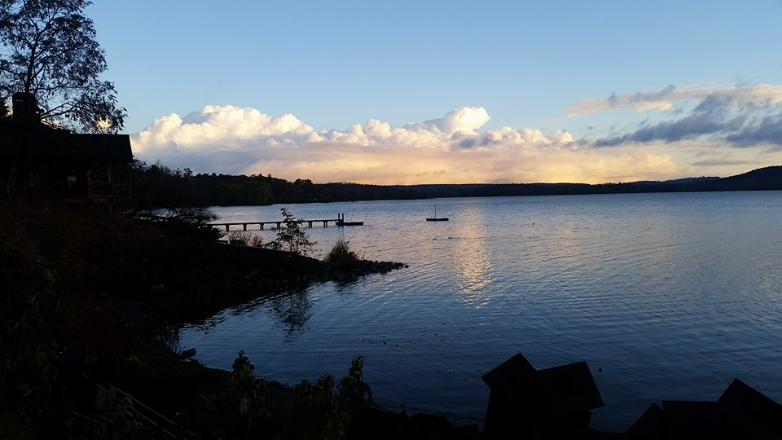
Gathering Around the WORD Gloria Patri
Glory be to the Father
and to the Son and to the Holy Ghost;
As it was in the beginning,
is now, and ever shall be,
world without end. Amen, Amen.

Slide 14
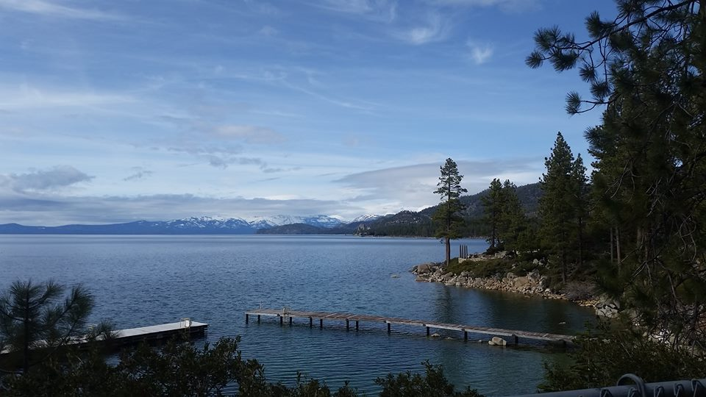
Gathering Around the WORD Passing of the Peace of Christ
(Colossians 3:15 and 17)
Let the peace of Christ rule in your hearts, to which indeed you were called in the same body. Let us be thankful. Whatever you do, whether in word or in deed, do everything in the name of our Lord Jesus, giving thanks to God the Father through him.

Slide 15
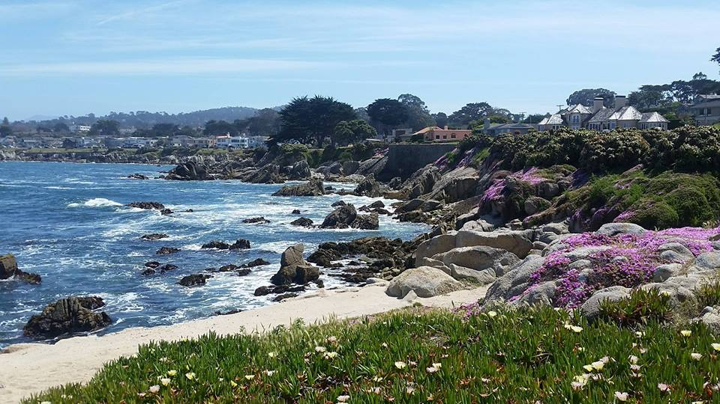
Proclaiming the WORD Message to the Youth/ Prayer of Illumination

Slide 16
Proclaiming the WORD Scripture Reading (Mark 5:21-43)
²¹When Jesus had crossed again in the boat to the other side, a great crowd gathered around him; and he was by the sea. ²²Then one of the leaders of the synagogue named Jairus came and, when he saw him, fell at his feet ²³and begged him repeatedly, "My little daughter is at the point of death. Come and lay your hands on her, so that she may be made well, and live."
²⁴So he went with him.

Slide 17
Proclaiming the WORD Scripture Reading (Mark 5:21-43)
And a large crowd followed him and pressed in on him. ²⁵Now there was a woman who had been suffering from hemorrhages for twelve years. ²⁶She had endured much under many physicians, and had spent all that she had; and she was no better, but rather grew worse. ²⁷She had heard about Jesus, and came up behind him in the crowd and touched his cloak, ²⁸for she said, "If I but touch his clothes, I will be made well." ²⁹Immediately her hemorrhage stopped; and she felt in her body that she was healed of her disease.

Slide 18
Proclaiming the WORD Scripture Reading (Mark 5:21-43)
³⁰Immediately aware that power had gone forth from him, Jesus turned about in the crowd and said, "Who touched my clothes?" ³¹And his disciples said to him, "You see the crowd pressing in on you; how can you say, 'Who touched me?'" ³²He looked all around to see who had done it. ³³But the woman, knowing what had happened to her, came in fear and trembling, fell down before him, and told him the whole truth. ³⁴He said to her, "Daughter, your faith has made you well; go in peace, and be healed of your disease."

Slide 19
Proclaiming the WORD Scripture Reading (Mark 5:21-43)
³⁵While he was still speaking, some people came from the leader's house to say, "Your daughter is dead. Why trouble the teacher any further?" ³⁶But overhearing what they said, Jesus said to the leader of the synagogue, "Do not fear, only believe." ³⁷He allowed no one to follow him except Peter, James, and John, the brother of James. ³⁸When they came to the house of the leader of the synagogue, he saw a commotion, people weeping and wailing loudly.

Slide 20
Proclaiming the WORD Scripture Reading (Mark 5:21-43)
³⁹When he had entered, he said to them, "Why do you make a commotion and weep? The child is not dead but sleeping." ⁴⁰And they laughed at him. Then he put them all outside, and took the child's father and mother and those who were with him, and went in where the child was. ⁴¹He took her by the hand and said to her, "Talitha cum," which means, "Little girl, get up!" ⁴²And immediately the girl got up and began to walk about (she was twelve years of age). At this they were overcome with amazement. ⁴³He strictly ordered them that no one should know this, and told them to give her something to eat.

Slide 21
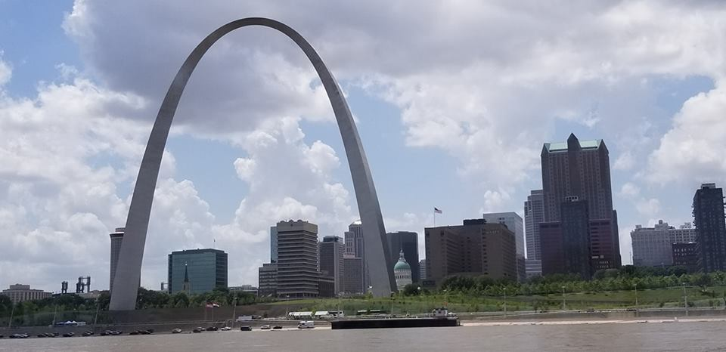
Proclaiming the WORD (Mark 5:21-43)
From the Galilee to the Mississippi

Slide 22
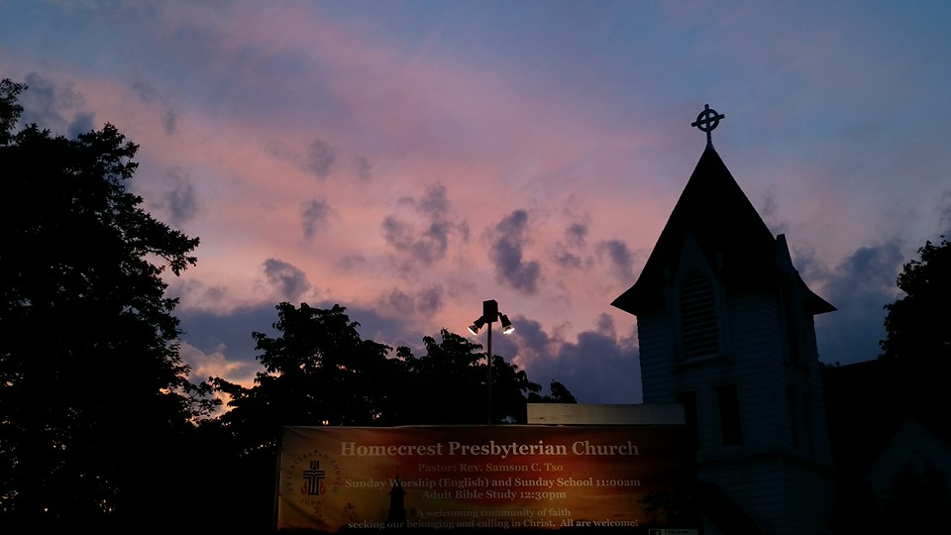
Responding Hymn # 317 “In Christ There is No East or West”
In Christ there is no east or west, in him no south or north, but one great fellowship of love throughout the whole wide earth.

Slide 23
Responding Hymn # 317 “In Christ There is No East or West”
In Christ shall true hearts everywhere their high communion find; his service is the golden cord close-binding humankind.

Slide 24
Responding Hymn # 317 “In Christ There is No East or West”
Join hands, disciples of the faith, whate'er your race may be. All children of the living God are surely kin to me.

Slide 25
Responding Hymn # 317 “In Christ There is No East or West”
In Christ now meet both east and west; in him meet south and north. All Christly souls are one in him throughout the whole wide earth.

Slide 27
Bearing and Following the WORD into the World Announcements &
Sharing of Joys and Concerns
The Women's Group will continue to meet on Wednesdays at 7:30pm over at the Manse
(2048 E 14th Street). They are currently studying
the book of Isaiah. For more information, please
contact Margaret or Cara.

Slide 28
Bearing and Following the WORD into the World Announcements &
Sharing of Joys and Concerns
We will be having a Pot-Luck fellowship lunch gathering on Saturday, 7/14 at Noon. The event will be free. Please indicate what you will bring on the sign-up sheet. Please invite you friends and neighbors to attend as well.

Slide 29
Bearing and Following the WORD into the World Prayer of the People & The Lord’s Prayer
Our Father, who art in heaven.
Halloweth be thy name.
Thy Kingdom come; Thy will be done
On earth as it is in heaven.
Give us this day our daily bread.
Forgive us our debts; as we forgive our debtors.
Lead us not into temptations, but deliver us from evil.
For Thine is the Kingdom, the Power, and the Glory forever. Amen.

Slide 30
Bearing and Following the WORD into the World Offering of our Gifts and our Lives
Musical Offering

Slide 31
Bearing and Following the WORD into the World Doxology and Offertory Prayer

Slide 32
Bearing and Following the WORD into the World Holy Communion Hymn
# 527 “Eat This Bread”
Eat this bread, drink this cup;
Come to Christ and never be hungry.
Eat this bread, drink this cup,
Trust in Christ and you will not thirst. (3x)

Slide 33
Bearing and Following the WORD into the World Holy Communion
Sisters and brothers, this is the joyful feast of the people in the kindom of God! They will come from the east and the west and from the north and the south and sit at table in the kingdom of God. This is the Lord’s Table. Our Savior invites those who trust him to share the feast he has prepared.

Slide 34
Bearing and Following the WORD into the World Holy Communion
God be with you, And also with you.
Lift up your hearts. We lift them to God,
Let us give thanks to God most high.
It is right to give God thanks and praise,

Slide 35
Bearing and Following the WORD into the World Holy Communion
Holy God, you made the world to hum in harmony; you listened and you called it good. In time we broke off from singing the song and went our own way, but you called us back and when the time was right you came in flesh and blood to live as one of us.

Slide 36
Bearing and Following the WORD into the World Holy Communion
In Christ, dividing walls are broken down – no Jew or Greek, male or female, slave or free. You are there on every spectrum, in every color, at every table. By your Spirit, make us one. By your Spirit, make us whole. By your Spirit, make this bread and wine your body and blood, that we may know communion with you and with each other.

Slide 37
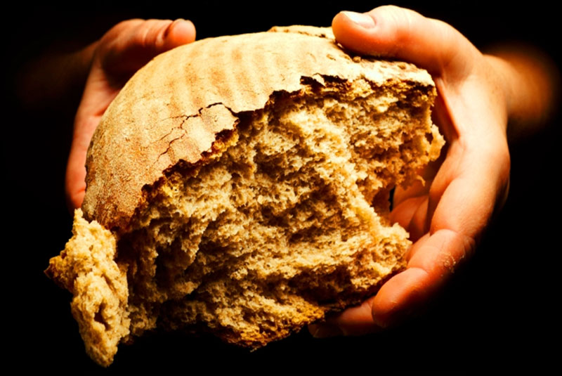
Bearing and Following the WORD into the World Holy Communion
Loving God, in gratitude we remember that on the night before the crucifixion, Jesus took bread and after giving thanks to you broke it and gave it to the disciples, saying: “This is my body which is given for you.
Do this in remembrance of me.”

Slide 38
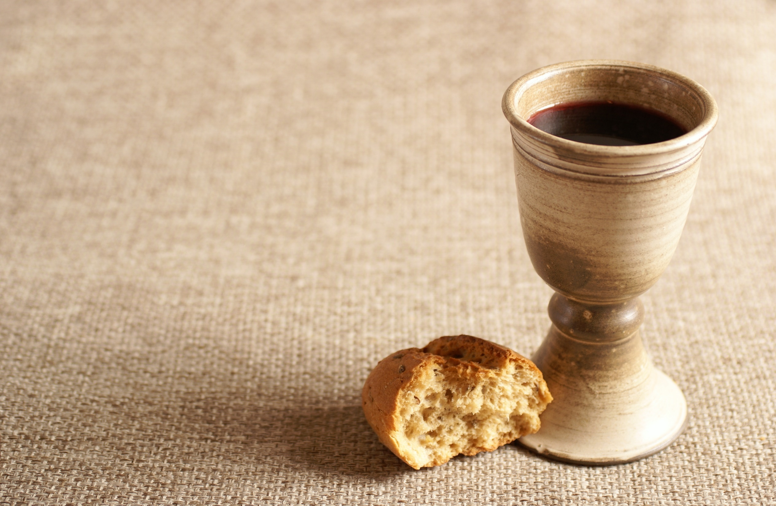
Bearing and Following the WORD into the World Holy Communion
In the same way after supper Jesus took the cup and after giving thanks, gave it to them and said: “This cup is the new covenant in my blood. Do this, as often as you drink it, in remembrance of me.”

Slide 39
Bearing and Following the WORD into the World Holy Communion
In gratitude for what Christ has done for us, we proclaim our hope and our joy, as we pray: Holy God, send your Holy Spirit upon us and these gifts, that all who eat and drink at this table may be one body and one people, a living sacrifice in Jesus Christ. Through this meal unite us with the risen Christ so that we may give ourselves for the life of the world.

Slide 40
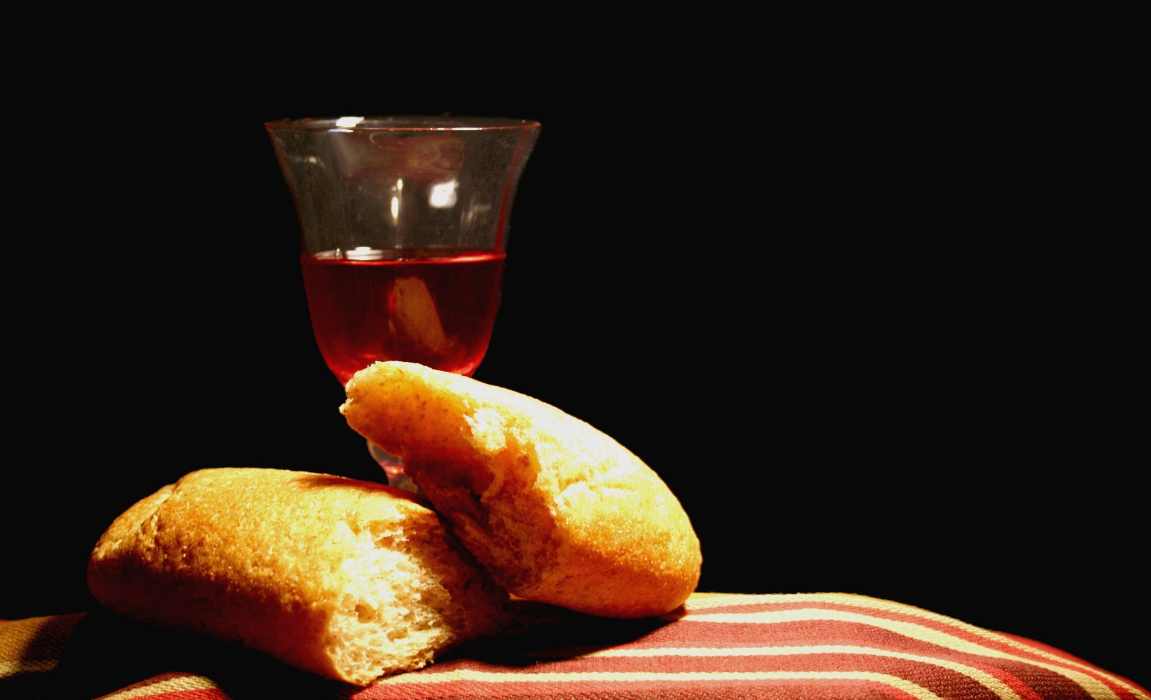
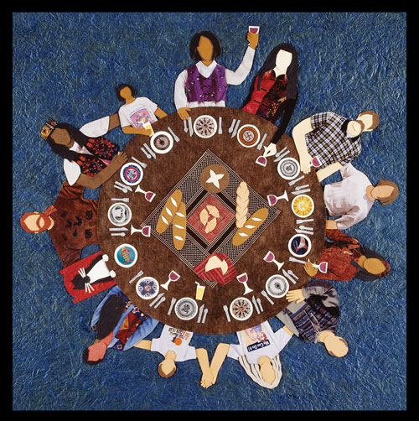
Bearing and Following the WORD into the World Holy Communion

Slide 41
Bearing and Following the WORD into the World
Prayer after the Communion: (in unison)
:
God of glory, you have nourished us with bread from heaven. Take our hearts, our lives, and our hands; mold us, change us, and send us out, so that we may be your body in the world you love, for the sake of Jesus Christ, who calls us to join our voices and hearts together as we pray, Amen.

Slide 42
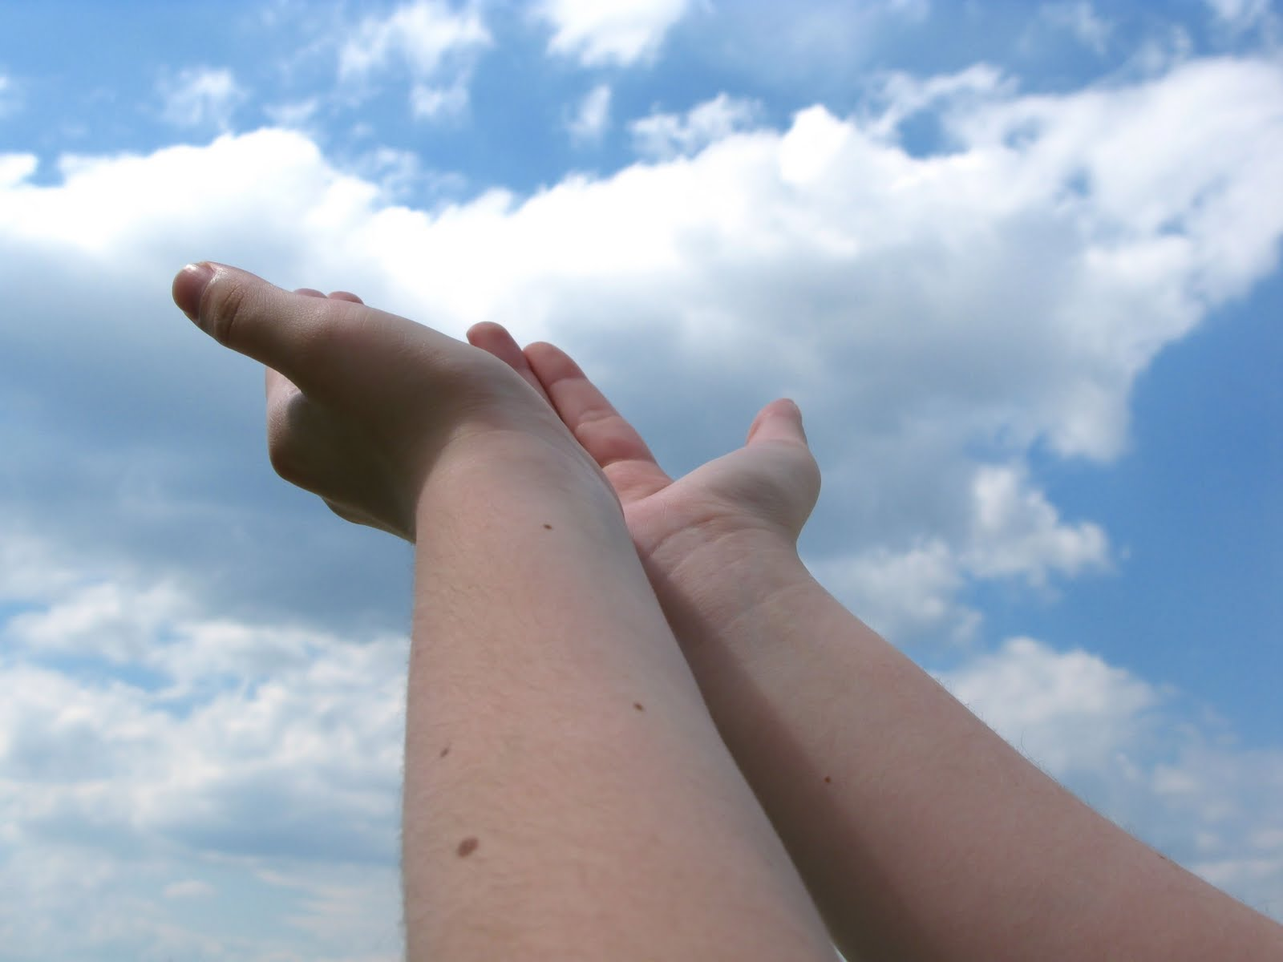
Bearing and Following the WORD into the World Deacons’ Benevolence Offering

Slide 43
Sending Hymn #338 “O Beautiful for Spacious Skies”
O beautiful for spacious skies, for amber waves of grain, for purple mountain majesties above the fruited plain! America! America! God shed his grace on thee, and crown thy good with brotherhood from sea to shining sea!

Slide 44
Sending Hymn #338 “O Beautiful for Spacious Skies”
O beautiful for heroes proved in liberating strife, who more than self their country loved, and mercy more than life! America! America! God mend thine every flaw; confirm thy soul in self-control, thy liberty in law!

Slide 45
Sending Hymn #338 “O Beautiful for Spacious Skies”
O beautiful for patriot dream that sees beyond the years thine alabaster cities gleam, undimmed by human tears! America! America! May God thy gold refine till all success be nobleness and every gain divine!

Slide 46
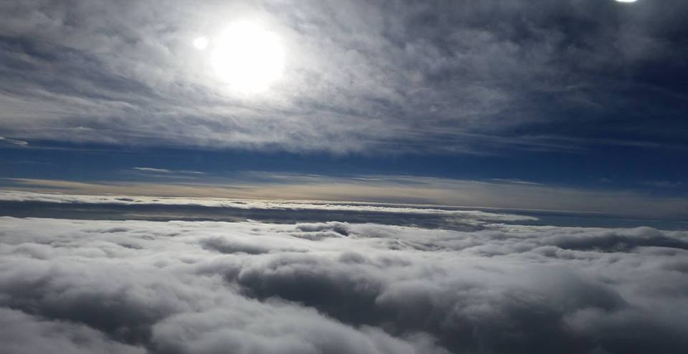
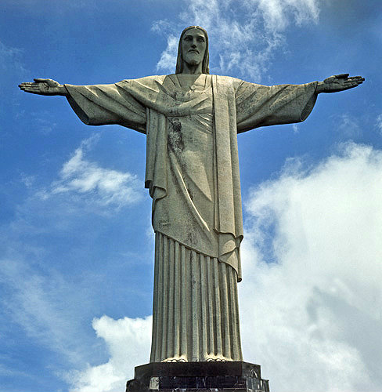
Bearing and Following the WORD into the World The Charge and Benediction

Slide 47
Bearing and Following the WORD into the World Benediction Response
# 547 “Go, My Children, with My Blessing”
(Stanza 1)
“Go, my children, with my blessing, never alone. Waking, sleeping, I am with you, you are my own. In my love’s baptismal river
I have made you mine forever. Go, my children, with my blessing,
you are my own.”

Slide 48
Homecrest Presbyterian Church Worship of the Lord’s Day 6th Sunday after Pentecost July 1st, 2018

