Slide 1
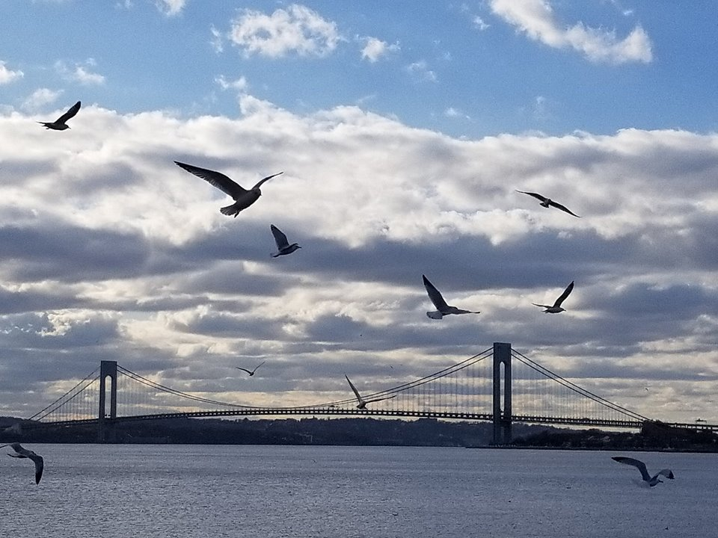
Homecrest Presbyterian Church Worship of the Lord’s Day 3rd Sunday after Pentecost June 10th, 2018

Slide 2
Gathering Around the WORD Call to Worship
(Psalm 138)
O Give thanks to the Lord with your whole heart.
On the day we called, you answered us.
God’s steadfast love endures forever.
Thanks be to God.
Let us come and worship God!

Slide 3
Gathering Around the WORD Gathering Hymn # 39 “Great Is Thy Faithfulness”
Great is thy faithfulness,
O God my Father; there is no shadow of turning with thee. Thou changest not;
thy compassions they fail not. As thou hast been thou forever wilt be.

Slide 4
Gathering Around the WORD Gathering Hymn # 39 “Great Is Thy Faithfulness”
Great is thy faithfulness! Great is thy faithfulness! Morning by morning, new mercies I see. All I have needed thy hand hath provided. Great is thy faithfulness, Lord unto me!

Slide 5
Gathering Around the WORD Gathering Hymn # 39 “Great Is Thy Faithfulness”
Summer and winter, and
springtime and harvest, sun, moon, and stars
in their courses above join with all nature in manifold witness to thy great faithfulness, mercy, and love.

Slide 6
Gathering Around the WORD Gathering Hymn # 39 “Great Is Thy Faithfulness”
Great is thy faithfulness! Great is thy faithfulness! Morning by morning, new mercies I see. All I have needed thy hand hath provided. Great is thy faithfulness, Lord unto me!

Slide 7
Gathering Around the WORD Gathering Hymn # 39 “Great Is Thy Faithfulness”
Pardon for sin and a peace that endureth, thine own dear presence
to cheer and to guide, strength for today and
bright hope for tomorrow: blessings all mine,
with ten thousand beside!

Slide 8
Gathering Around the WORD Gathering Hymn # 39 “Great Is Thy Faithfulness”
Great is thy faithfulness! Great is thy faithfulness! Morning by morning, new mercies I see. All I have needed thy hand hath provided. Great is thy faithfulness, Lord unto me!

Slide 9
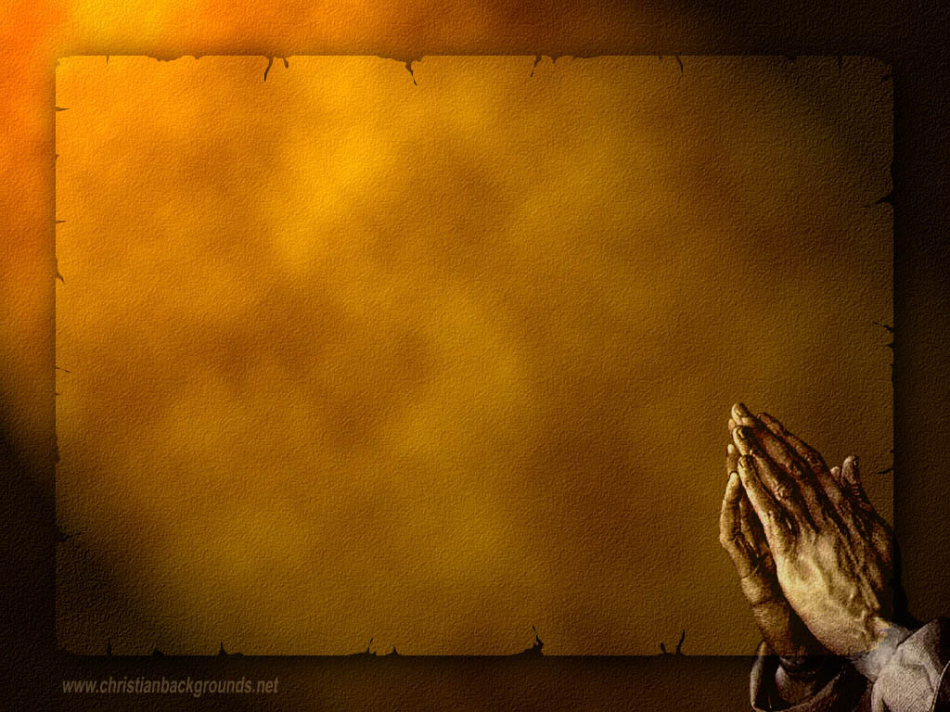
Gathering Around the WORD Call to Confession Friends, God knows what’s our on hearts even more than we know ourselves. Let us confess our sins, for God has already forgiven us and is calling us to return to the Lord.

Slide 10
Gathering Around the WORD Prayer of Confession (in unison)
Gracious God, have mercy on us, for we have failed to be faithful to you, though you have been faithful to us. You show us your wisdom, but we prefer to go our own way. Our broken relationships with you and one another have created poverty in us and our neighbors. In your mercy, reconcile us to you and one another for the work of justice, peace, and love, through Jesus Christ, our redeemer, Amen.

Slide 11
Gathering Around the WORD Declaration of Forgiveness
Sisters and brothers, do not lose heart. When we call, God hears us; when we confess, God forgives us.
We believe and so we proclaim that in Jesus Christ, we are forgiven. Thanks be to God, Amen.

Slide 12
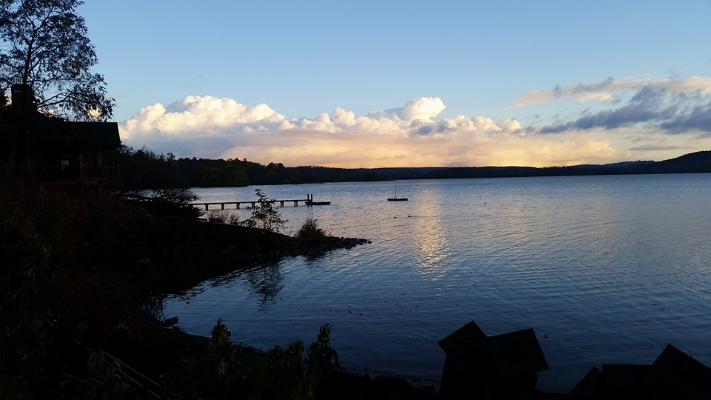
Gathering Around the WORD Gloria Patri
Glory be to the Father
and to the Son and to the Holy Ghost;
As it was in the beginning,
is now, and ever shall be,
world without end. Amen, Amen.

Slide 13
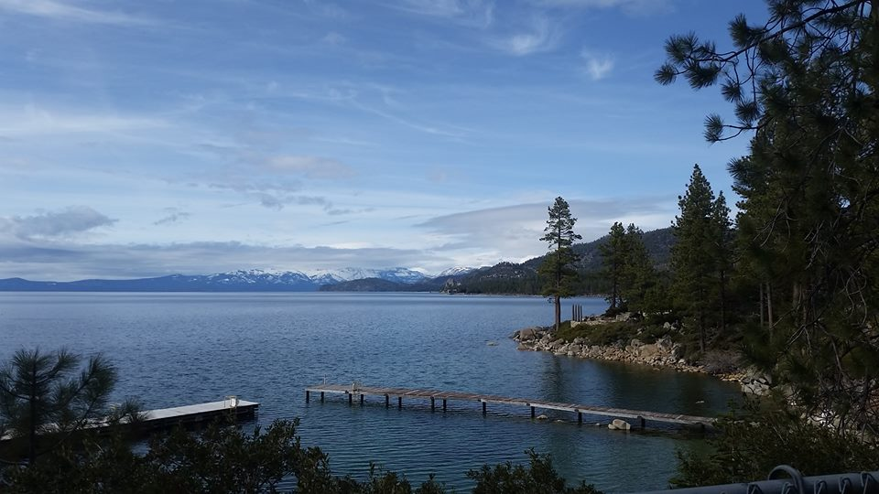
Gathering Around the WORD Passing of the Peace of Christ
(John 14:27)
Jesus said, “Peace I leave with you; my peace I give to you. I do not give to you as the world gives. Do not let your hearts be troubled, and do not let them be afraid.”

Slide 14
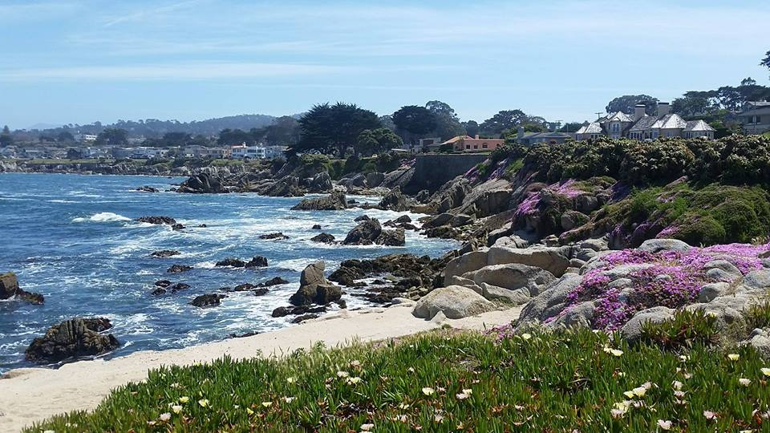
Proclaiming the WORD Message to the Youth/ Prayer of Illumination

Slide 15
Proclaiming the WORD Responsive Reading (Psalm 138:1-8)
¹ I give you thanks, O LORD, with my whole heart; before the gods I sing your praise; ² I bow down toward your holy temple and give thanks to your name for your steadfast love and your faithfulness; for you have exalted your name and your word above everything. ³ On the day I called, you answered me, you increased my strength of soul.
⁴ All the kings of the earth shall praise you,
O LORD, for they have heard the words of your mouth.

Slide 16
Proclaiming the WORD Responsive Reading (Psalm 138:1-8)
⁵ They shall sing of the ways of the LORD, for great is the glory of the LORD. ⁶ For though the LORD is high, he regards the lowly; but the haughty he perceives from far away.
⁷ Though I walk in the midst of trouble, you preserve me against the wrath of my enemies; you stretch out your hand, and your right hand delivers me. ⁸ The LORD will fulfill his purpose for me; your steadfast love, O LORD, endures forever. Do not forsake the work of your hands.

Slide 17
Proclaiming the WORD Scripture Reading (2 Corinthians 4:13-5:1)
^{4:13}But just as we have the same spirit of faith that is in accordance with scripture — “I believed, and so I spoke” — we also believe, and so we speak, ¹⁴because we know that the one who raised the Lord Jesus will raise us also with Jesus, and will bring us with you into his presence. ¹⁵Yes, everything is for your sake, so that grace, as it extends to more and more people, may increase thanksgiving, to the glory of God.

Slide 18
Proclaiming the WORD Scripture Reading (2 Corinthians 4:13-5:1)
¹⁶So we do not lose heart. Even though our outer nature is wasting away, our inner nature is being renewed day by day. ¹⁷For this slight momentary affliction is preparing us for an eternal weight of glory beyond all measure, ¹⁸because we look not at what can be seen but at what cannot be seen; for what can be seen is temporary, but what cannot be seen is eternal.
^{5:1}For we know that if the earthly tent we live in is destroyed, we have a building from God, a house not made with hands, eternal in the heavens.

Slide 19
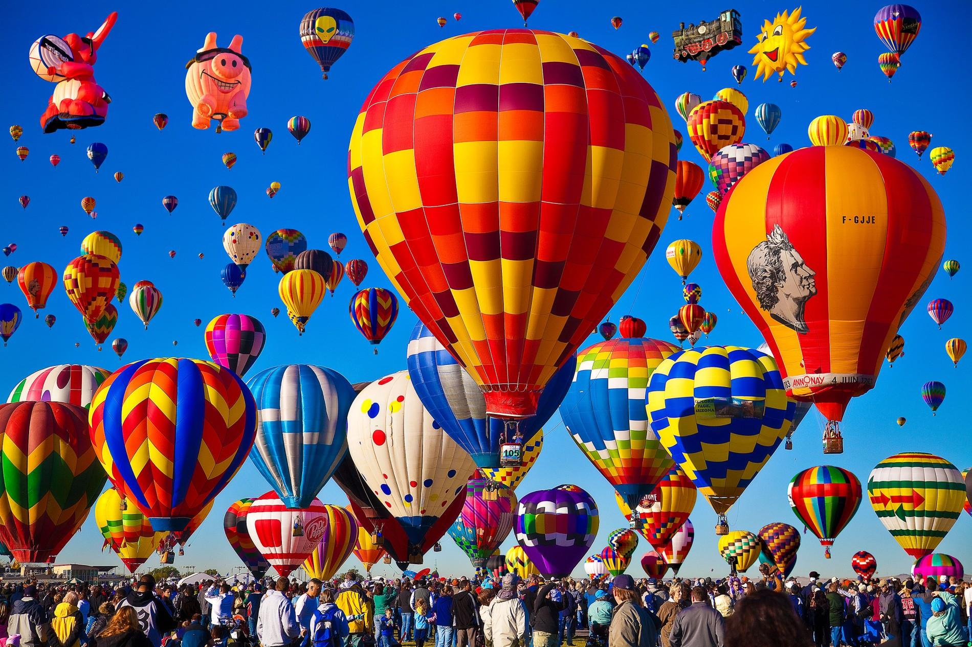
Proclaiming the WORD (Psalm 138:1-8 and 2 Corinthians 4:13-5:1)
Heavenly Tent-Making

Slide 20
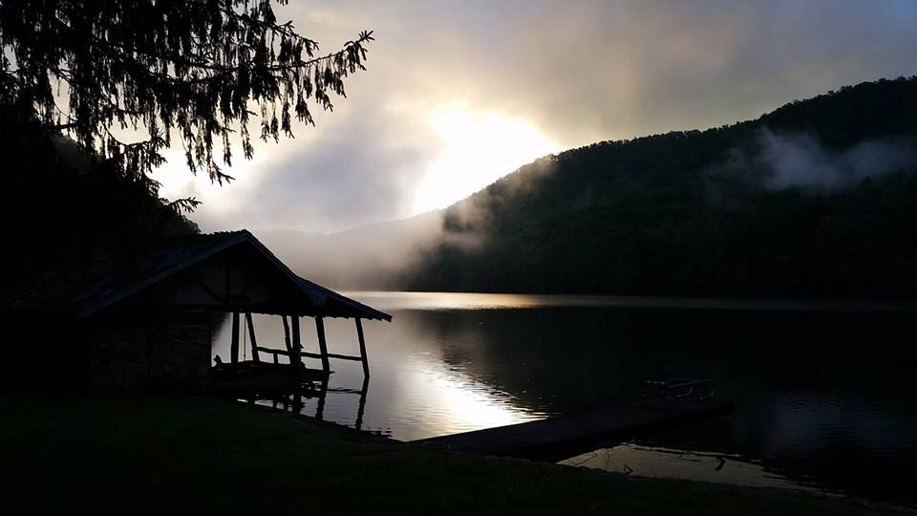
Proclaiming the WORD (Psalm 138:1-8 and 2 Corinthians 4:13-5:1)
Heavenly Tent-Making

Slide 21
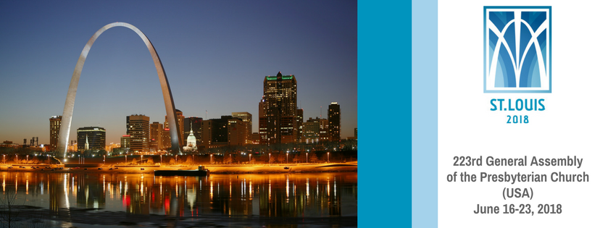
Proclaiming the WORD (Psalm 138:1-8 and
2 Corinthians 4:13-5:1)
Heavenly Tent-Making

Slide 22
Proclaiming the WORD (Psalm 138:1-8 and 2 Corinthians 4:13-5:1)
Heavenly Tent-Making

Slide 23
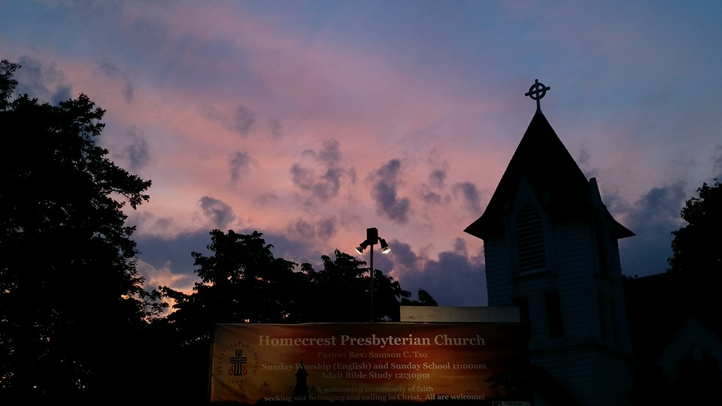
Responding Hymn # 321 “The Church’s One Foundation”
The church's one foundation is Jesus Christ her Lord. She is his new creation by water and the word. From heaven he came and sought her to be his holy bride. With his own blood he bought her, and for her life he died.

Slide 24
Responding Hymn # 321 “The Church’s One Foundation”
Elect from every nation, yet one o'er all the earth, her charter of salvation: one Lord, one faith, one birth. One holy name she blesses, partakes one holy food, and to one hope she presses, with every grace endued.

Slide 25
Responding Hymn # 321 “The Church’s One Foundation”
Though with a scornful wonder this world sees her oppressed, by schisms rent asunder, by heresies distressed, yet saints their watch are keeping; their cry goes up: "How long?" And soon the night of weeping shall be the morn of song.

Slide 26
Responding Hymn # 321 “The Church’s One Foundation”
Mid toil and tribulation, and tumult of her war, she waits the consummation of peace forevermore: till with the vision glorious her longing eyes are blest, and the great church victorious shall be the church at rest.

Slide 27
Responding Hymn # 321 “The Church’s One Foundation”
Yet she on earth has union with God, the Three in One, and mystic sweet communion with those whose rest is won: O happy ones and holy! Lord, give us grace that we, like them, the meek and lowly, may live eternally.

Slide 28
Bearing and Following the WORD into the World Affirmation of Faith –
A Brief Statement of Faith – PC(USA) Sections 1-2
In life and in death we belong to God. Through the grace of our Lord Jesus Christ, the love of God, and the communion of the Holy Spirit, we trust in the one triune God,
the Holy One of Israel, whom alone we worship and serve.

Slide 29
Bearing and Following the WORD into the World Affirmation of Faith –
A Brief Statement of Faith – PC(USA) Sections 1-2
We trust in Jesus Christ, Fully human, fully God. Jesus proclaimed the reign of God: preaching good news to the poor and release to the captives, teaching by word and deed and blessing the children, healing the sick and
binding up the brokenhearted, eating with outcasts, forgiving sinners, and calling all to repent and believe the gospel.

Slide 30
Bearing and Following the WORD into the World Affirmation of Faith –
A Brief Statement of Faith – PC(USA) Sections 1-2
Unjustly condemned for blasphemy and sedition, Jesus was crucified, suffering the depths of human pain and giving his life for the sins of the world. God raised this Jesus from the dead, vindicating his sinless life, breaking the power of sin and evil, delivering us from death to life eternal.

Slide 31
Bearing and Following the WORD into the World Announcements &
Sharing of Joys and Concerns
The afternoon Bible Study Group will be meeting today downstairs at 12:30 in the basement.
The Women's Group will continue to meet on Wednesdays at 7:30pm over at the Manse
(2048 E 14th Street). They are currently studying
the book of Isaiah. For more information, please
contact Margaret or Cara.

Slide 32
Bearing and Following the WORD into the World Announcements &
Sharing of Joys and Concerns
Rev. Grace Bowen will be our guest speaker for the upcoming two Sundays, as Pastor Samson will be taking part of the biennial General Assembly of the Presbyterian Church (USA) in St. Louis on 6/15-24.
Our Director of Music Brian Lam’s annual piano recital will be on Saturday, 6/30 2:30pm at Steinway Hall (6th Ave./43rd St. in Manhattan).
He and his students will perform. Ticket is $15.
Please see Brian if you are interested.

Slide 33
Bearing and Following the WORD into the World Prayer of the People & The Lord’s Prayer
Our Father, who art in heaven.
Halloweth be thy name.
Thy Kingdom come; Thy will be done
On earth as it is in heaven.
Give us this day our daily bread.
Forgive us our debts; as we forgive our debtors.
Lead us not into temptations, but deliver us from evil.
For Thine is the Kingdom, the Power, and the Glory forever. Amen.

Slide 34
Bearing and Following the WORD into the World Offering of our Gifts and our Lives
Musical Offering

Slide 35
Bearing and Following the WORD into the World Doxology and Offertory Prayer

Slide 36
Sending Hymn #307 “God of Grace and God of Glory”
God of grace and God of glory, on thy people pour thy power; crown thine ancient church's story; bring its bud to glorious flower. Grant us wisdom, grant us courage, for the facing of this hour, for the facing of this hour.

Slide 37
Sending Hymn #307 “God of Grace and God of Glory”
Lo! the hosts of evil round us scorn thy Christ, assail his ways! From the fears that long have bound us free our hearts to faith and praise. Grant us wisdom, grant us courage, for the living of these days, for the living of these days.

Slide 38
Sending Hymn #307 “God of Grace and God of Glory”
Cure thy children's warring madness; bend our pride to thy control; shame our wanton, selfish gladness, rich in things and poor in soul. Grant us wisdom, grant us courage, lest we miss thy kingdom's goal, lest we miss thy kingdom's goal.

Slide 39
Sending Hymn #307 “God of Grace and God of Glory”
Save us from weak resignation to the evils we deplore. Let the gift of thy salvation be our glory evermore. Grant us wisdom, grant us courage, serving thee whom we adore, serving thee whom we adore.

Slide 40
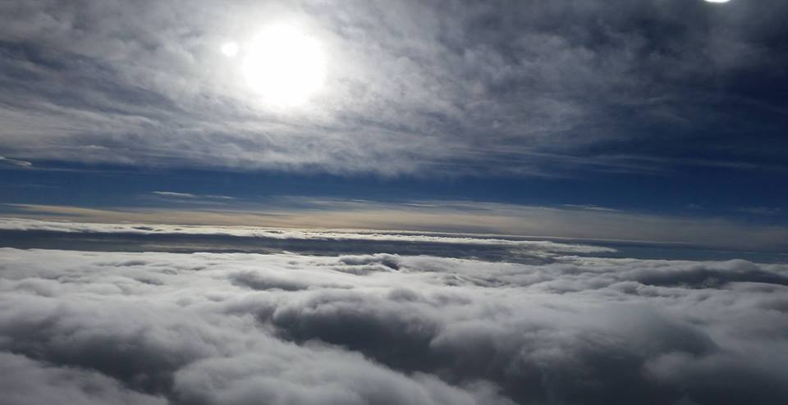
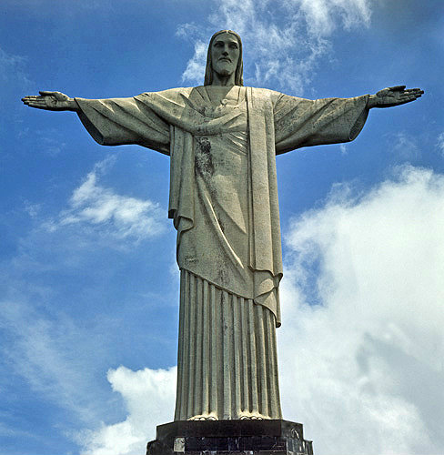
Bearing and Following the WORD into the World The Charge and Benediction

Slide 41
Bearing and Following the WORD into the World Benediction Response
# 540 “Farewell, Good Friends”
Farewell, Good friends!
Farewell, Good friends!
Shalom, Shalom! Till we meet again, till we meet again, Shalom, Shalom.

Slide 42
Homecrest Presbyterian Church Worship of the Lord’s Day 3rd Sunday after Pentecost June 10th, 2018

