Slide 1
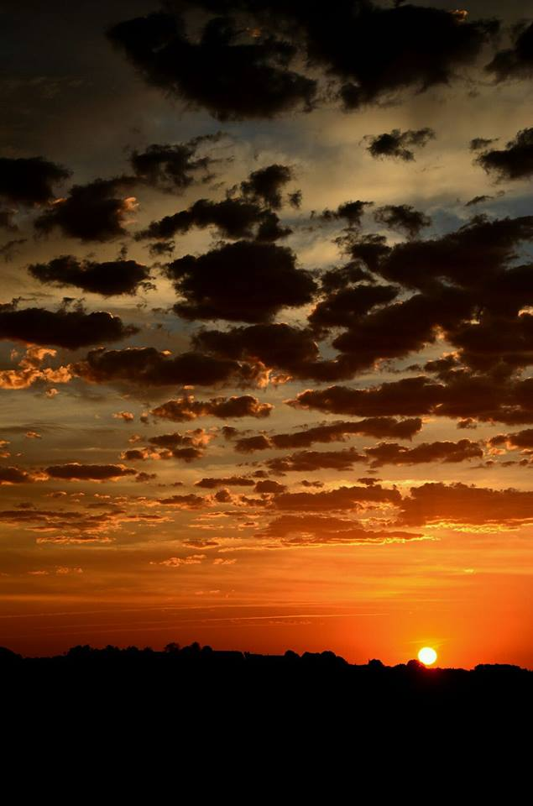
Homecrest Presbyterian Church Worship of the Lord’s Day 2nd Sunday after Pentecost June 3rd, 2018

Slide 2
Gathering Around the WORD Call to Worship
(Deuteronomy 5:12-15)
The Law commanded us to observe the Sabbath day and keep it holy.
Six days we labor and do all our works –
but the seventh day is a Sabbath to the Lord our God.
Remember that you were a slave in the land of Egypt, but God brought you out from there with a mighty hand and an outstretched arm.
We give thanks and praise to God who has delivered us and set us free. Let us come and worship God!

Slide 3
Gathering Around the WORD Gathering Hymn # 258 “A Hymn of Glory Let us Sing”
A hymn of glory let us sing! New songs throughout the world shall ring: Christ, by a road before untrod, ascends unto the throne of God.

Slide 4
Gathering Around the WORD Gathering Hymn # 258 “A Hymn of Glory Let us Sing”
The holy apostolic band upon the Mount of Olives stand, and with his followers they see their Lord ascend in majesty.

Slide 5
Gathering Around the WORD Gathering Hymn # 258 “A Hymn of Glory Let us Sing”
To all, the shining angels cry, "Why stand and gaze upon the sky? This is the Savior!" thus they say; "this is his glorious triumph-day."

Slide 6
Gathering Around the WORD Gathering Hymn # 258 “A Hymn of Glory Let us Sing”
"You see him now, ascending high up to the portals of the sky. Hereafter you shall Jesus see returning in great majesty."

Slide 7
Gathering Around the WORD Gathering Hymn # 258 “A Hymn of Glory Let us Sing”
O risen Christ, ascended Lord, all praise to you let earth accord. You are, while endless ages run, with Father and with Spirit one.

Slide 8
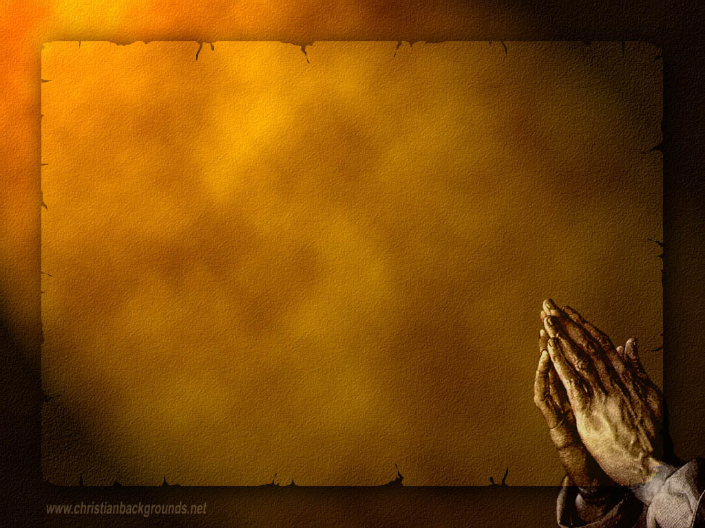
Gathering Around the WORD Call to Confession The hardness of our hearts grieves God. We prefer to follow our own counsel rather than to seek and submit to the counsel of God. Confessing our sin, may God soften our stubborn hearts and guide our feet to walk in the ways of righteousness.

Slide 9
Gathering Around the WORD Prayer of Confession (in unison)
Psalm 139:1-6
O LORD, you have searched us and known us. You know when we sit down and when we rise up; you discern our thoughts from far away. You search out our path and our lying down and are acquainted with all our ways. Even before a word is on our tongue, O LORD, you know it completely. You hem us in, behind and before, and lay your hand upon us. Such knowledge is too wonderful for us; it is so high that we cannot attain it. Forgive us of our transgressions and deliver us by your mercy and grace, Amen.

Slide 10
Gathering Around the WORD Declaration of Forgiveness
The mercy of our Lord is from everlasting to everlasting, through His Son Jesus Christ, God has shone his face upon us. Through the gift of the Holy Spirit, God has comforted us and stood by us by our sides.
This is the good news that in Jesus Christ, we are a forgiven sinner. No longer do we live in the darkness of our sins but we live in the everlasting light of Christ. Thanks be to God, Amen.

Slide 11
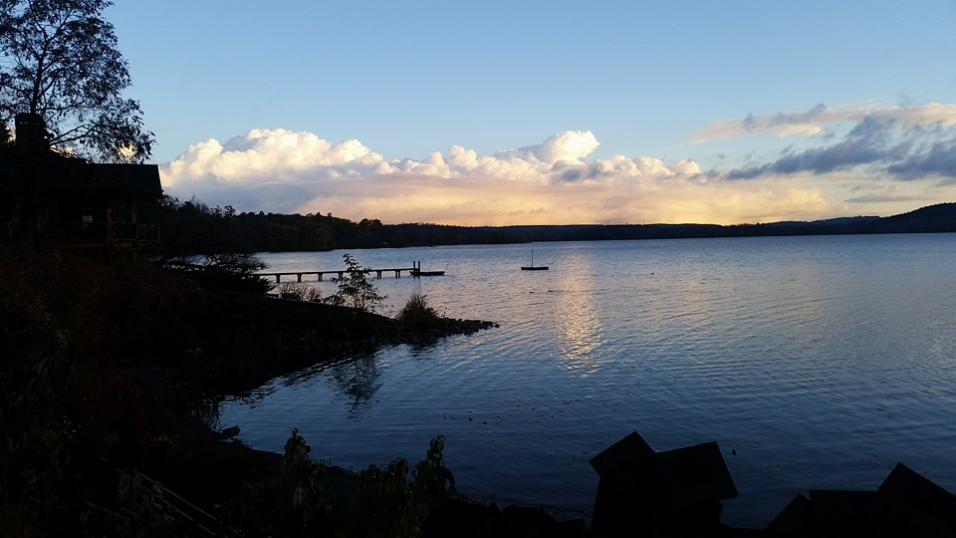
Gathering Around the WORD Gloria Patri
Glory be to the Father
and to the Son and to the Holy Ghost;
As it was in the beginning,
is now, and ever shall be,
world without end. Amen, Amen.

Slide 12
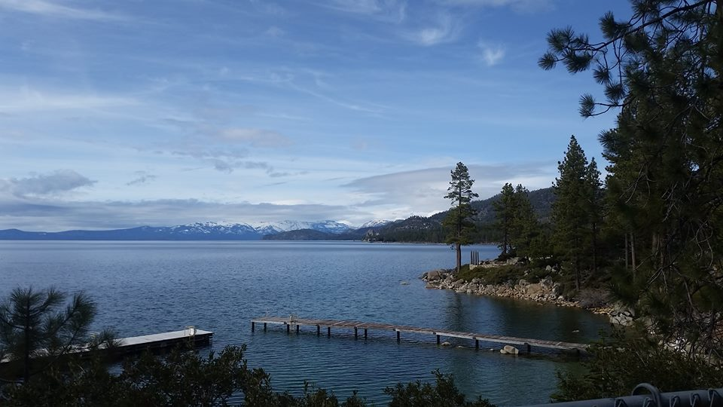
Gathering Around the WORD Passing of the Peace of Christ
(John 14:27)
Jesus said, “Peace I leave with you; my peace I give to you. I do not give to you as the world gives. Do not let your hearts be troubled, and do not let them be afraid.”

Slide 13
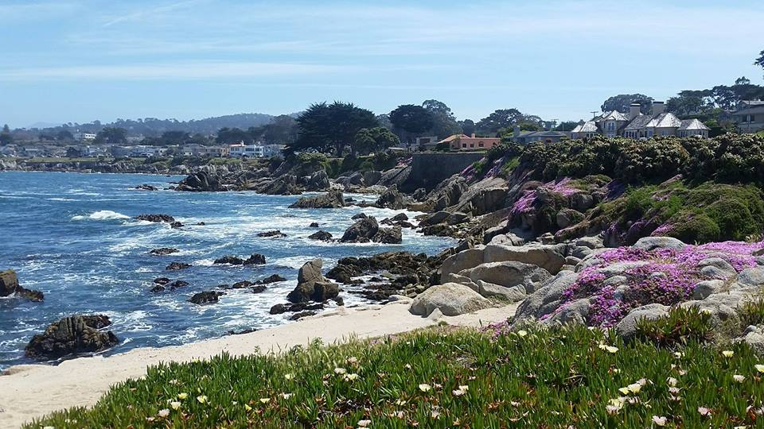
Proclaiming the WORD Message to the Youth/ Prayer of Illumination

Slide 14
Proclaiming the WORD Scripture Reading (Mark 2:23-3:6)
^{2:23}One sabbath he was going through the grainfields; and as they made their way his disciples began to pluck heads of grain. ²⁴The Pharisees said to him, “Look, why are they doing what is not lawful on the sabbath?” ²⁵And he said to them, “Have you never read what David did when he and his companions were hungry and in need of food? ²⁶He entered the house of God, when Abiathar was high priest, and ate the bread of the Presence, which it is not lawful for any but the priests to eat, and he gave some to his companions.” ²⁷Then he said to them, “The sabbath was made for humankind, and not humankind for the sabbath; ²⁸so the Son of Man is lord even of the sabbath.”

Slide 15
Proclaiming the WORD Scripture Reading (Mark 2:23-3:6)
^{3:1}Again he entered the synagogue, and a man was there who had a withered hand. ²They watched him to see whether he would cure him on the sabbath, so that they might accuse him. ³And he said to the man who had the withered hand, “Come forward.” 4Then he said to them, “Is it lawful to do good or to do harm on the sabbath, to save life or to kill?” But they were silent. ⁵He looked around at them with anger; he was grieved at their hardness of heart and said to the man, “Stretch out your hand.” He stretched it out, and his hand was restored. ⁶The Pharisees went out and immediately conspired with the Herodians against him, how to destroy him.

Slide 16
Proclaiming the WORD Scripture Reading (2 Corinthians 4:5-12)
⁵For we do not proclaim ourselves; we proclaim Jesus Christ as Lord and ourselves as your slaves for Jesus’ sake. ⁶For it is the God who said, “Let light shine out of darkness,” who has shone in our hearts to give the light of the knowledge of the glory of God in the face of Jesus Christ.

Slide 17
Proclaiming the WORD Scripture Reading (2 Corinthians 4:5-12)
⁷But we have this treasure in clay jars, so that it may be made clear that this extraordinary power belongs to God and does not come from us. ⁸We are afflicted in every way, but not crushed; perplexed, but not driven to despair; 9persecuted, but not forsaken; struck down, but not destroyed; ¹⁰always carrying in the body the death of Jesus, so that the life of Jesus may also be made visible in our bodies. ¹¹For while we live, we are always being given up to death for Jesus’ sake, so that the life of Jesus may be made visible in our mortal flesh. ¹²So death is at work in us, but life in you.

Slide 18
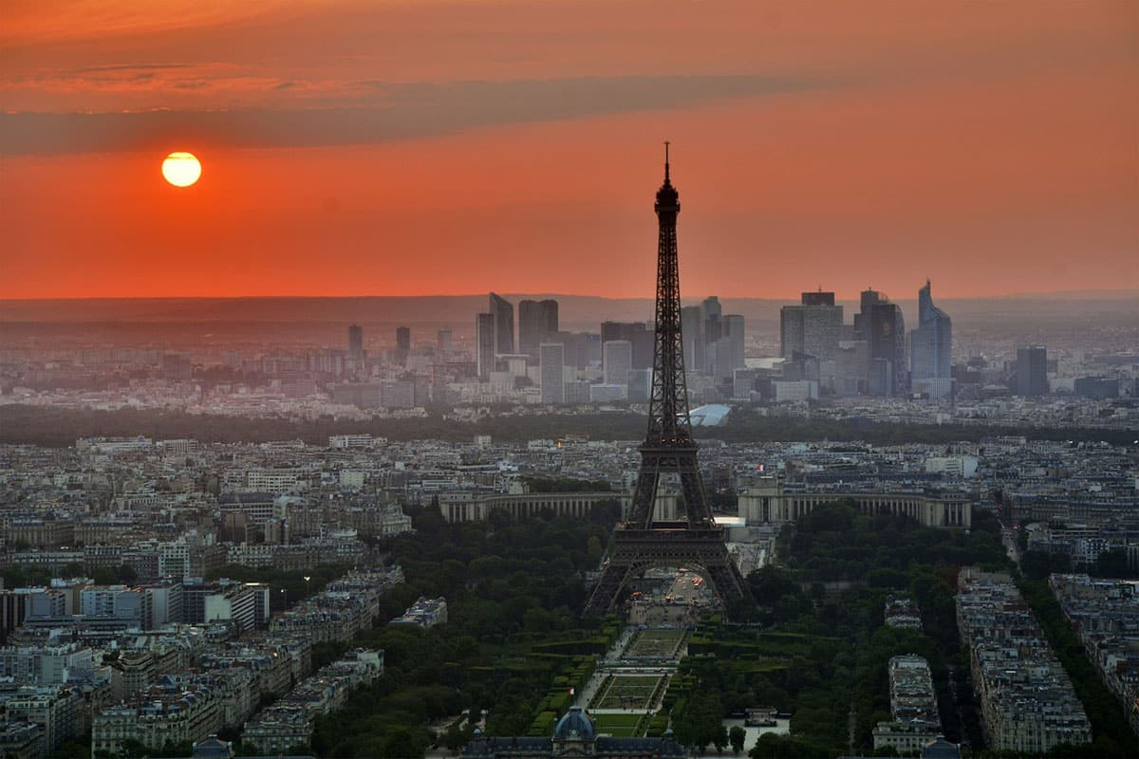
Proclaiming the WORD (Mark 2:23-3:6 and 2 Corinthians 4:5-12)
Mission Possible

Slide 19
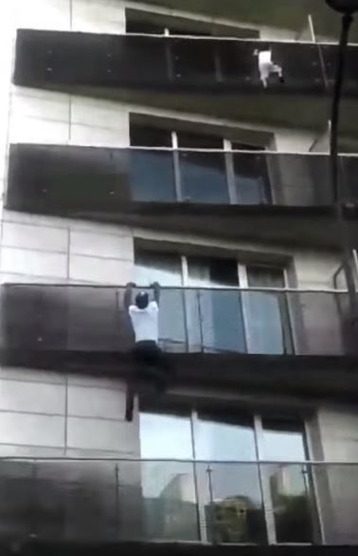
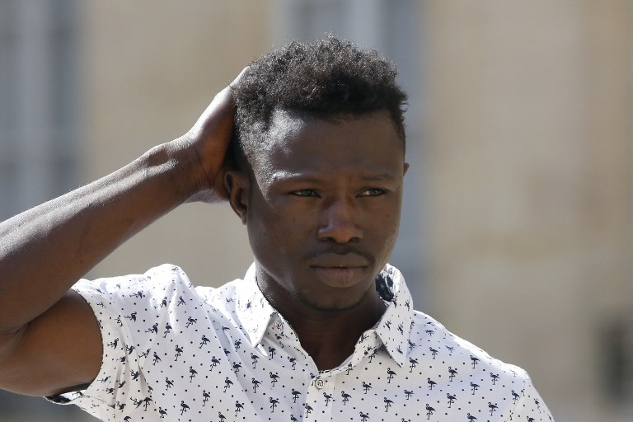
Proclaiming the WORD (Mark 2:23-3:6 and
2 Corinthians 4:5-12)
Mission Possible

Slide 20
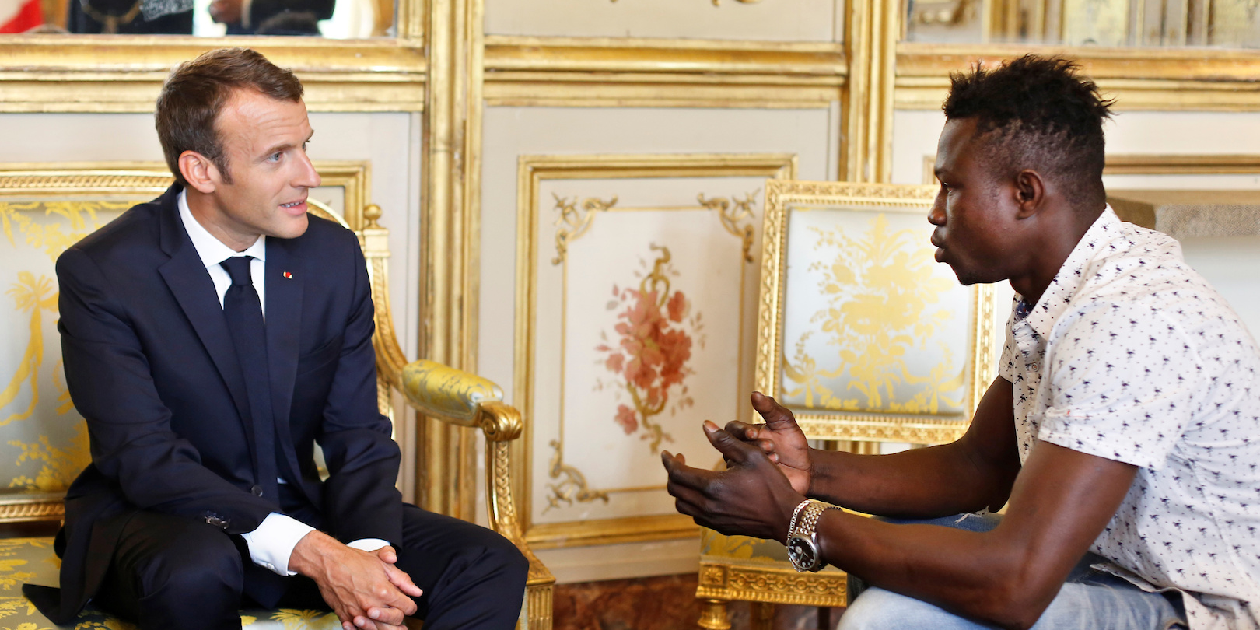
Proclaiming the WORD (Mark 2:23-3:6 and 2 Corinthians 4:5-12)
Mission Possible

Slide 21
Proclaiming the WORD (Mark 2:23-3:6 and 2 Corinthians 4:5-12)
Mission Possible

Slide 22
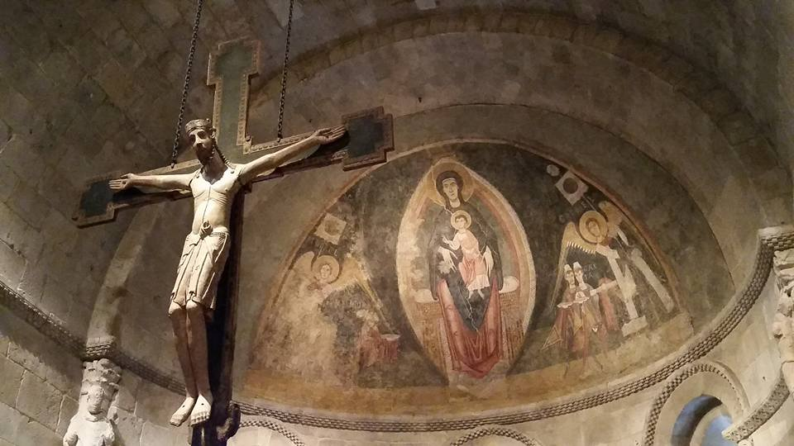
Responding Hymn # 829 “My Faith Looks Up to Thee”
My faith looks up to thee, thou Lamb of Calvary, Savior divine! Now hear me while I pray; take all my guilt away; O let me from this day be wholly thine!

Slide 23
Responding Hymn # 829 “My Faith Looks Up to Thee”
May thy rich grace impart strength to my fainting heart, my zeal inspire; as thou hast died for me, O may my love to thee pure, warm, and changeless be, a living fire!

Slide 24
Responding Hymn # 829 “My Faith Looks Up to Thee”
While life’s dark maze I tread and griefs around me spread, be thou my guide; bid darkness turn to day; wipe sorrow’s tears away; nor let me ever stray from thee aside.

Slide 25
Responding Hymn # 829 “My Faith Looks Up to Thee”
When ends life’s transient dream, when death’s cold, sullen stream shall o’er me roll; blest Savior, then, in love, fear and distrust remove; O bear me safe above, a ransomed soul!

Slide 26
Bearing and Following the WORD into the World Affirmation of Faith – Nicene Creed
We Believe in one God, the Father, the Almighty, maker of heaven and earth, of all that is, seen and unseen.
We Believe in one Lord, Jesus Christ, the only Son of God, eternally begotten of the Father, God from God, light from light, true God from true God, begotten, not made, of one Being with the Father; through him all things were made.

Slide 27
Bearing and Following the WORD into the World Affirmation of Faith – Nicene Creed
For us and for our salvation he came down from heaven, was incarnate of the Holy Spirit
and the Virgin Mary and became truly human.
For our sake he was crucified under Pontius Pilate; he suffered death and was buried.

Slide 28
Bearing and Following the WORD into the World Affirmation of Faith – Nicene Creed
On the third day he rose again in accordance with the Scriptures; he ascended into heaven and is seated at the right hand of the Father. He will come again in glory to judge the living and the dead, and his kingdom will have no end.

Slide 29
Bearing and Following the WORD into the World Affirmation of Faith – Nicene Creed
We Believe in the Holy Spirit,
the Lord, the giver of life, who proceeds from the Father and the Son, who with the Father and the Son
is worshiped and glorified, who has spoken through the prophets. We Believe in one holy catholic
and apostolic Church. We acknowledge one baptism
for the forgiveness of sins. We look for the resurrection of the dead, and the life of the world to come. Amen.

Slide 30
Bearing and Following the WORD into the World Announcements &
Sharing of Joys and Concerns
The afternoon Bible Study Group will be meeting today downstairs at 12:30 in the basement.
The Women's Group will continue to meet on Wednesdays at 7:30pm over at the Manse
(2048 E 14th Street). They are currently studying
the book of Isaiah. For more information, please
contact Margaret or Cara.

Slide 31
Bearing and Following the WORD into the World Announcements &
Sharing of Joys and Concerns
The next Session meeting will be on Tomorrow, 6/4
Our Director of Music Brian Lam’s annual piano recital will be on Saturday, 6/30 2:30pm at Steinway Hall (6th Ave./43rd St. in Manhattan).
He and his students will perform. Ticket is $15.
Please see Brian if you are interested.

Slide 32
Bearing and Following the WORD into the World Prayer of the People & The Lord’s Prayer
Our Father, who art in heaven.
Halloweth be thy name.
Thy Kingdom come; Thy will be done
On earth as it is in heaven.
Give us this day our daily bread.
Forgive us our debts; as we forgive our debtors.
Lead us not into temptations, but deliver us from evil.
For Thine is the Kingdom, the Power, and the Glory forever. Amen.

Slide 33
Bearing and Following the WORD into the World Offering of our Gifts and our Lives
Musical Offering

Slide 34
Bearing and Following the WORD into the World Doxology and Offertory Prayer

Slide 35
Bearing and Following the WORD into the World Holy Communion Hymn
# 516 “For the Bread Which You Have Broken”
For the bread which you have broken, for the wine which you have poured, for the words which you have spoken, now we give you thanks, O Lord.

Slide 36
Bearing and Following the WORD into the World Holy Communion Hymn
# 516 “For the Bread Which You Have Broken”
By this promise that you love us, by your gift of peace restored, by your call to heaven above us, hallow all our lives, O Lord.

Slide 37
Bearing and Following the WORD into the World Holy Communion Hymn
# 516 “For the Bread Which You Have Broken”
With the saints who now adore you seated at the heavenly board, may the church still waiting for you keep love's tie unbroken, Lord.

Slide 38
Bearing and Following the WORD into the World Holy Communion Hymn
# 516 “For the Bread Which You Have Broken”
In your service, Lord, defend us; in our hearts keep watch and ward; in the world to which you send us let your kingdom come, O Lord.

Slide 39
Bearing and Following the WORD into the World Holy Communion
We celebrate the Spirit of God, who hovered over creation and brought order out of formlessness.
We praise You, Spirit of God.
We celebrate the Spirit of God, who filled Jesus
with power and wisdom and, through Him, made the life of God available to all.
We praise You, Spirit of God.

Slide 40
Bearing and Following the WORD into the World Holy Communion
We celebrate the Spirit of God, who has been poured out on all people, and leads us into the Kingdom of God.
We praise You, Spirit of God.

Slide 41
Bearing and Following the WORD into the World Holy Communion
The Lord be with you. And also with you.
Lift up your hearts. We lift them up to the Lord.
Let us give thanks to the Lord our God.
It is right to give our thanks and praise.

Slide 42
Bearing and Following the WORD into the World Holy Communion
Friends, as we’ve gathered at the Lord's table, we recognize the Spirit's presence among us, and we open our hearts to embrace the Spirit's leading.
This is the table of the Heavenly Feast, the joyful celebration of the people of God. Christ invites those who confess their faith in Him to eat this bread of life and to drink this cup of salvation.

Slide 43
Bearing and Following the WORD into the World Holy Communion
Lord, we come knowing that we depend on You for life and truth and love.
We come knowing that You
welcome us with open and accepting arms.
We come ready to meet with You,
and be changed by the encounter. Amen.

Slide 44
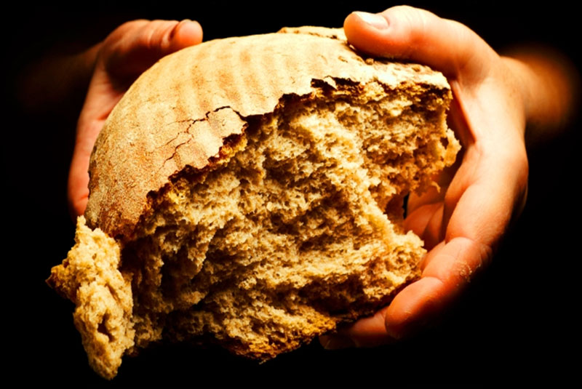
Bearing and Following the WORD into the World Holy Communion
With thanksgiving, we will receive this bread which our Lord Jesus took, after He blessed it, broke it, and gave it to his disciples, saying, this is my body, broken for you.

Slide 45
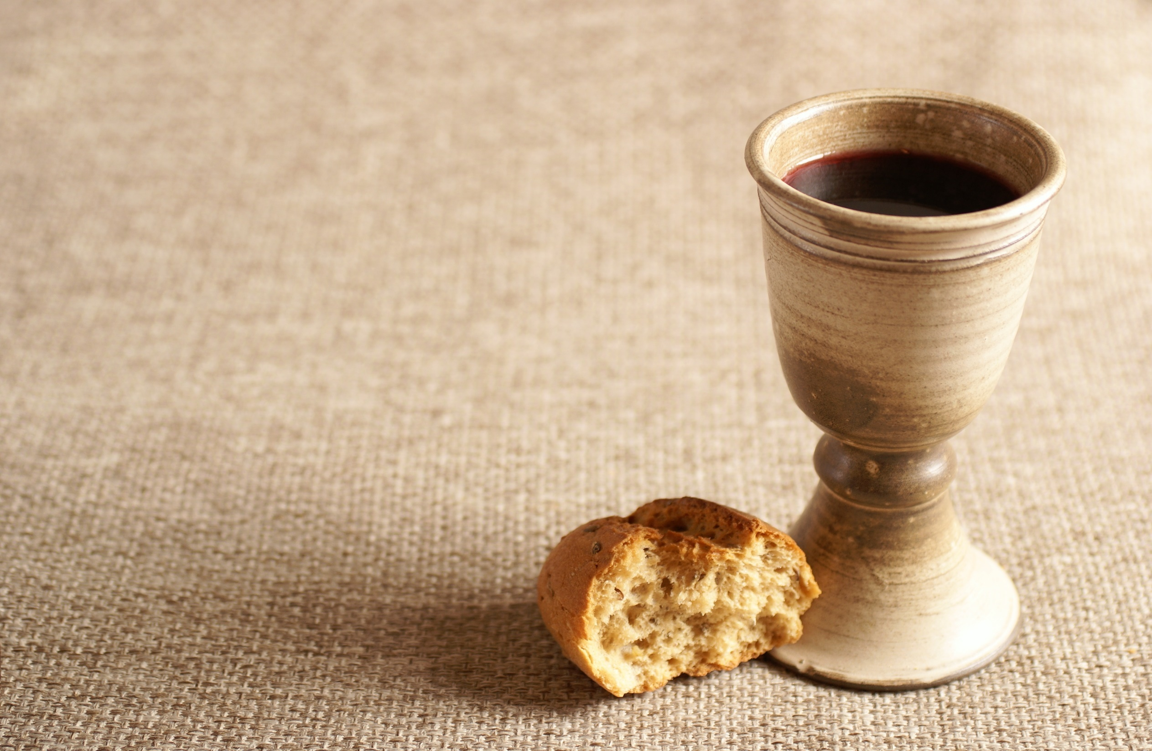
Bearing and Following the WORD into the World Holy Communion
With confidence, we dedicate this cup that Jesus blessed, saying, this is the new covenant sealed in my blood. As often as we eat this bread and drink from this cup, we remember the saving grace of our Lord Jesus Christ.

Slide 46
Bearing and Following the WORD into the World Holy Communion
Jesus said, "I am the bread of life. Those who come to me shall never hunger; those who believe in me shall never thirst." These are the gift of God for the people of God.

Slide 47
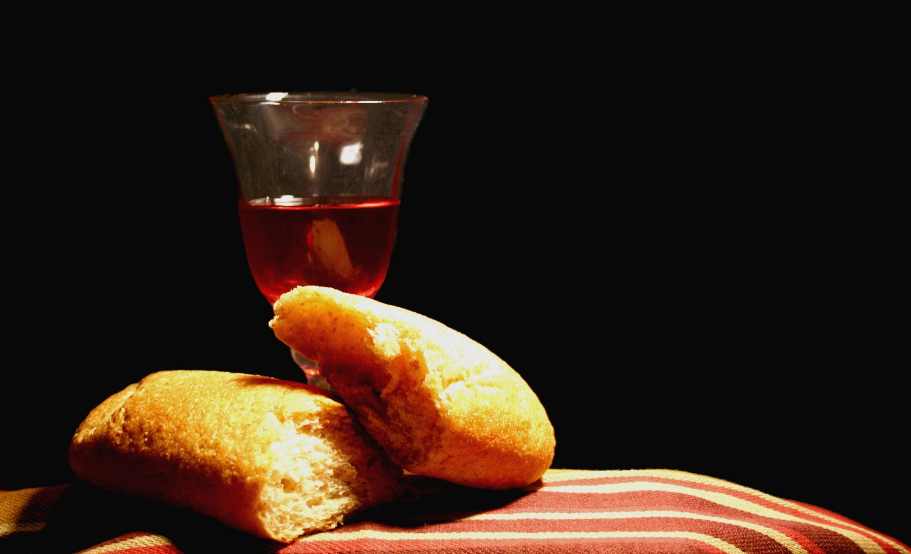
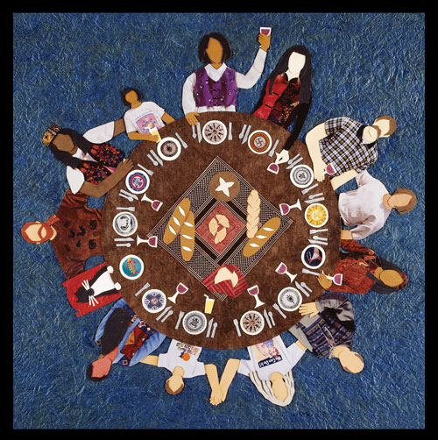
Bearing and Following the WORD into the World Holy Communion

Slide 48
Bearing and Following the WORD into the World
Prayer after the Communion: (in unison)
:
May the love we find at this table be reflected in our lives; May the power we receive at this table make us peacemakers, healers, and witnesses to this world; And may the Spirit who fills us again at this table lead us to be those who proclaim God's Kingdom in every word we speak and in everything we do. In Christ’s name we pray, Amen.

Slide 49
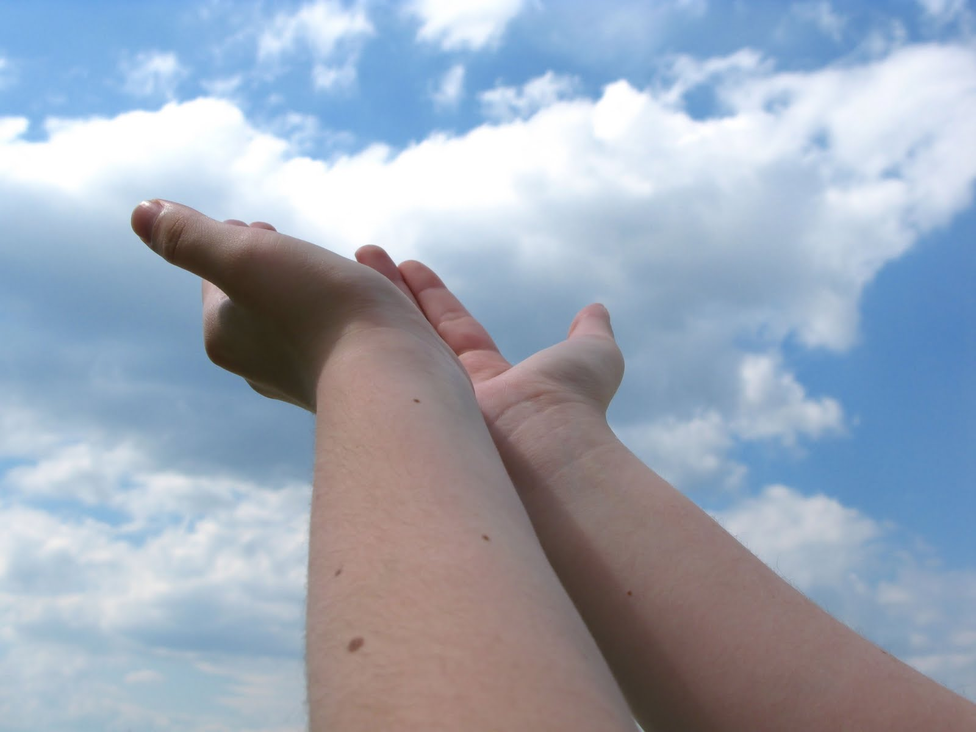
Bearing and Following the WORD into the World Deacons’ Benevolence Offering

Slide 50
Sending Hymn #298 “Lord, You Give the Great Commission”
Lord, you give the great commission: “Heal the sick and preach the word.” Lest the church neglect its mission, and the gospel go unheard, help us witness to your purpose with renewed integrity: with the Spirit’s gifts empower us for the work of ministry.

Slide 51
Sending Hymn #298 “Lord, You Give the Great Commission”
Lord, you call us to your service: “In my name baptize and teach.” That the world may trust your promise, life abundant meant for each, give us all new fervor, draw us closer in community: with the Spirit’s gifts empower us for the work of ministry.

Slide 52
Sending Hymn #298 “Lord, You Give the Great Commission”
Lord, you make the common holy: “This, my body; this, my blood.” Let us all, for earth’s true glory, daily lift life heavenward, asking that the world around us share your children’s liberty: with the Spirit’s gifts empower us for the work of ministry.

Slide 53
Sending Hymn #298 “Lord, You Give the Great Commission”
Lord, you show us love’s true measure: “Father, what they do, forgive.” Yet we hoard as private treasure all that you so freely give. May your care and mercy lead us to a just society: with the Spirit’s gifts empower us for the work of ministry.

Slide 54
Sending Hymn #298 “Lord, You Give the Great Commission”
Lord, you bless with words assuring: “I am with you to the end.” Faith and hope and love restoring, may we serve as you intend, and, amid the cares that claim us, hold in mind eternity: with the Spirit’s gifts empower us for the work of ministry.

Slide 55
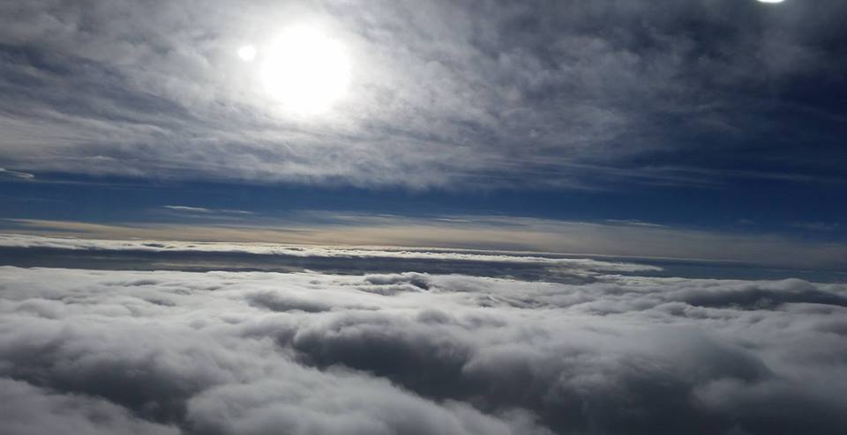
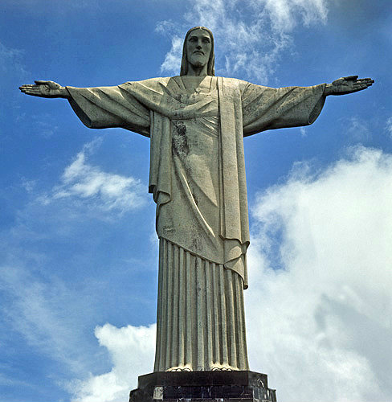
Bearing and Following the WORD into the World The Charge and Benediction

Slide 56
Bearing and Following the WORD into the World Benediction Response
# 540 “Farewell, Good Friends”
Farewell, Good friends!
Farewell, Good friends!
Shalom, Shalom! Till we meet again, till we meet again, Shalom, Shalom.

Slide 57
Homecrest Presbyterian Church Worship of the Lord’s Day 2nd Sunday after Pentecost June 3rd, 2018

