Slide 1
Homecrest Presbyterian Church Worship of the Lord’s Day 6th Sunday of Easter, May 6th, 2018

Slide 2
Gathering Around the WORD Call to Worship
(Based on Psalm 98:1-8)
Sing to our God a new song.
God has done marvelous things!
Make a joyful noise to the Lord!
Break forth into joyous song and sing praises.
Let the sea roar and all that fills it.
Let the world of its people sing together for joy!

Slide 3
Gathering Around the WORD Gathering Hymn # 300 “We Are One in the Spirit” (They’ll know we are Christians by our Love)
We are one in the Spirit; we are one in the Lord; we are one in the Spirit; we are one in the Lord, and we pray that all unity
may one day be restored: And they’ll know we are Christians by our love, by our love; Yes, they’ll know we are Christians by our love.

Slide 4
Gathering Around the WORD Gathering Hymn # 300 “We Are One in the Spirit” (They’ll know we are Christians by our Love)
We will walk with each other;
we will walk hand in hand; we will walk with each other;
we will walk hand in hand, and together we’ll spread the news
that God is in our land: And they’ll know we are Christians by our love, by our love; Yes, they’ll know we are Christians by our love.

Slide 5
Gathering Around the WORD Gathering Hymn # 300 “We Are One in the Spirit” (They’ll know we are Christians by our Love)
We will work with each other;
we will work side by side; we will work with each other;
we will work side by side, and we’ll guard human dignity
and save human pride: And they’ll know we are Christians by our love, by our love; Yes, they’ll know we are Christians by our love.

Slide 6
Gathering Around the WORD Gathering Hymn # 300 “We Are One in the Spirit” (They’ll know we are Christians by our Love)
All praise to the Father,
from whom all things come, and all praise to Christ Jesus, God’s only Son, and all praise to the Spirit, who makes us one: And they’ll know we are Christians by our love, by our love; Yes, they’ll know we are Christians by our love.

Slide 7
Gathering Around the WORD Call to Confession (John 15:12) We have been called to follow Christ by obeying his one commandment: that we love one another as he has loved us. However, time after time, we have fallen short of God’s hope and expectation of us. We have sinned against God. In humility and faith, let us humble our hearts by confessing our trespasses against God and our neighbors and come before God with our contrite spirit.

Slide 8
Gathering Around the WORD Prayer of Confession (in unison)
Loving God, we have not loved you or one another with our own hearts. Forgive us, we pray, and lead us toward the path of righteousness and wholeness. Fill our hearts with joy and live according to your purpose and our calling. In Christ’s name we pray, Amen.

Slide 9
Gathering Around the WORD Declaration of Forgiveness (John 15:13)
Christ loves us so much that he laid down his life for us and calls us as his friends. If we can forgive our friends, imagine how much more does Christ forgive us!
Through Christ’s resurrected hope and the Spirit’s reconciling peace, we have been invited to start anew in faith and in action. Thanks be to God.

Slide 10
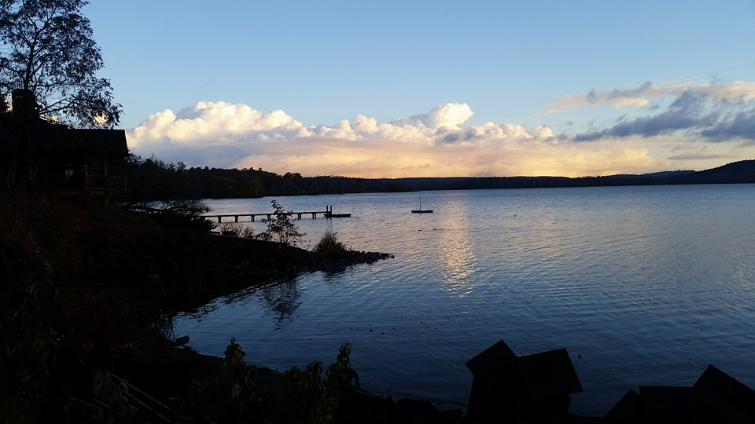
Gathering Around the WORD Gloria Patri
Glory be to the Father
and to the Son and to the Holy Ghost;
As it was in the beginning,
is now, and ever shall be,
world without end. Amen, Amen.

Slide 11
Gathering Around the WORD Passing of the Peace of Christ
(I John 4:4-8)
Beloved, let us love one another, because love is from God; everyone who loves is born of God and knows God. Whoever does not love does not know God, for God IS LOVE. Let us pass the peace of Christ and the love of God to our neighbors.

Slide 12
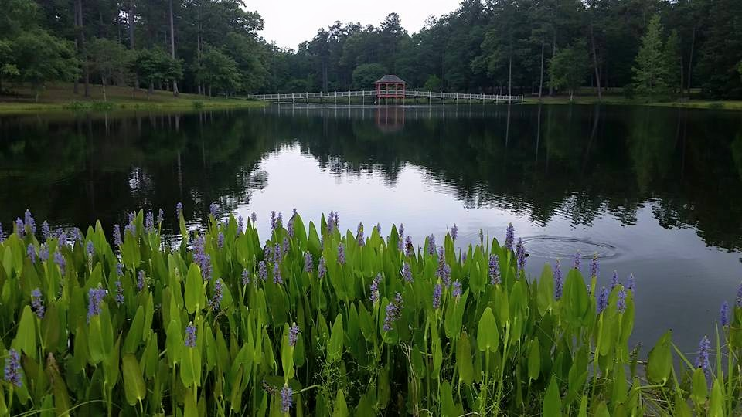
Proclaiming the WORD Message to the Youth/ Prayer of Illumination

Slide 13
Proclaiming the WORD Scripture Reading (I John 5:1-6)
¹Everyone who believes that Jesus is the Christ has been born of God, and everyone who loves the parent loves the child. ²By this we know that we love the children of God, when we love God and obey his commandments. ³For the love of God is this, that we obey his commandments. And his commandments are not burdensome, ⁴for whatever is born of God conquers the world. And this is the victory that conquers the world, our faith. ⁵Who is it that conquers the world but the one who believes that Jesus is the Son of God?

Slide 14
Proclaiming the WORD Scripture Reading (I John 5:1-6)
⁶This is the one who came by water and blood, Jesus Christ, not with the water only but with the water and the blood. And the Spirit is the one that testifies, for the Spirit is the truth.

Slide 15
Proclaiming the WORD Scripture Reading (John 15:9-17)
⁹As the Father has loved me, so I have loved you; abide in my love.¹⁰If you keep my commandments, you will abide in my love, just as I have kept my Father’s commandments and abide in his love. ¹¹I have said these things to you so that my joy may be in you, and that your joy may be complete.

Slide 16
Proclaiming the WORD Scripture Reading (John 15:9-17)
¹²“This is my commandment, that you love one another as I have loved you. ¹³No one has greater love than this, to lay down one’s life for one’s friends. ¹⁴You are my friends if you do what I command you. ¹⁵I do not call you servants any longer, because the servant does not know what the master is doing; but I have called you friends, because I have made known to you everything that I have heard from my Father.

Slide 17
Proclaiming the WORD Scripture Reading (John 15:9-17)
¹⁶You did not choose me but I chose you. And I appointed you to go and bear fruit, fruit that will last, so that the Father will give you whatever you ask him in my name.
¹⁷I am giving you these commands so that you may love one another.”

Slide 18
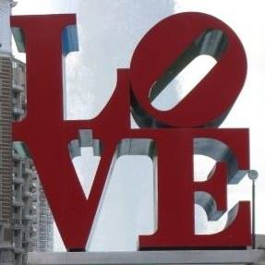
Proclaiming the WORD (I John 5:1-6 and John 15:9-17)
Chosen in His Love

Slide 19
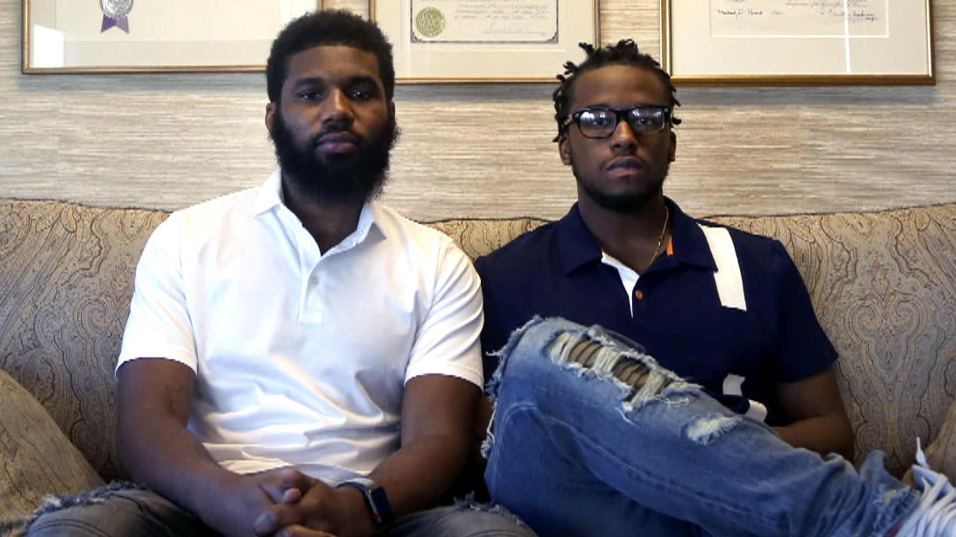

Slide 20
Proclaiming the WORD (I John 5:1-6 and John 15:9-17)
Chosen in His Love

Slide 21
Responding Hymn # 298 “Lord, You Give the Great Commission”
Lord, you give the great commission: “Heal the sick and preach the word.” Lest the church neglect its mission, and the gospel go unheard, help us witness to your purpose with renewed integrity: with the Spirit’s gifts empower us for the work of ministry.

Slide 22
Responding Hymn # 298 “Lord, You Give the Great Commission”
Lord, you call us to your service: “In my name baptize and teach.” That the world may trust your promise, life abundant meant for each, give us all new fervor, draw us closer in community: with the Spirit’s gifts empower us for the work of ministry

Slide 23
Responding Hymn # 298 “Lord, You Give the Great Commission”
Lord, you make the common holy: “This, my body; this, my blood.” Let us all, for earth’s true glory, daily lift life heavenward, asking that the world around us share your children’s liberty: with the Spirit’s gifts empower us for the work of ministry.

Slide 24
Responding Hymn # 298 “Lord, You Give the Great Commission”
Lord, you show us love’s true measure: “Father, what they do, forgive.” Yet we hoard as private treasure all that you so freely give. May your care and mercy lead us to a just society: with the Spirit’s gifts empower us for the work of ministry.

Slide 25
Responding Hymn # 298 “Lord, You Give the Great Commission”
Lord, you bless with words assuring: “I am with you to the end.” Faith and hope and love restoring, may we serve as you intend, and, amid the cares that claim us, hold in mind eternity: with the Spirit’s gifts empower us for the work of ministry.

Slide 27
Bearing and Following the WORD into the World Announcements &
Sharing of Joys and Concerns
The afternoon Bible Study Group will be meeting today downstairs at 12:30 in the basement.
The Session will be meeting Tomorrow at 7pm.
The Women's Group will continue to meet on Wednesdays at 7:30pm over at the Manse
(2048 E 14th Street). They are currently studying
the book of Isaiah. For more information, please
contact Margaret or Cara.

Slide 28
Bearing and Following the WORD into the World Prayer of the People & The Lord’s Prayer
Our Father, who art in heaven.
Halloweth be thy name.
Thy Kingdom come; Thy will be done
On earth as it is in heaven.
Give us this day our daily bread.
Forgive us our debts; as we forgive our debtors.
Lead us not into temptations, but deliver us from evil.
For Thine is the Kingdom, the Power, and the Glory forever. Amen.

Slide 29
Bearing and Following the WORD into the World Offering of our Gifts and our Lives
Musical Offering

Slide 30
Bearing and Following the WORD into the World Doxology and Offertory Prayer

Slide 31
Bearing and Following the WORD into the World Holy Communion Hymn
# 509 “All Who Hunger, Gather Gladly”
All who hunger, gather gladly; holy manna is our bread. Come from wilderness and wandering. Here, in truth, we will be fed. You that yearn for days of fullness, all around us is our food. Taste and see the grace eternal. Taste and see that God is good.

Slide 32
Bearing and Following the WORD into the World Holy Communion Hymn
# 509 “All Who Hunger, Gather Gladly”
All who hunger, never strangers, seeker, be a welcome guest. Come from restlessness and roaming. Here, in joy, we keep the feast. We that once were lost and scattered in communion's love have stood. Taste and see the grace eternal. Taste and see that God is good.

Slide 33
Bearing and Following the WORD into the World Holy Communion Hymn
# 509 “All Who Hunger, Gather Gladly”
All who hunger, sing together; Jesus Christ is living bread. Come from loneliness and longing. Here, in peace, we have been led. Blest are those who from this table live their days in gratitude. Taste and see the grace eternal. Taste and see that God is good.

Slide 34
Bearing and Following the WORD into the World Holy Communion
Friends, we gather now as one body, joined around this table of LOVE as we bear witness to our risen LORD Jesus Christ. Here we celebrate God's presence among us, united in Christ's spirit.

Slide 35
Bearing and Following the WORD into the World Holy Communion
This is the table of the Heavenly Feast, the joyful celebration of the people of God. Christ invites those who confess their faith in Him to eat the bread of life and to drink the cup of the new covenant and salvation.

Slide 36
Bearing and Following the WORD into the World Holy Communion
The Lord be with you. And also with you.
Lift up your hearts. We lift them up to the Lord.
Let us give thanks to the Lord our God.
It is right to give our thanks and praise.

Slide 37
Bearing and Following the WORD into the World Holy Communion
O Lord our God, how great are your works. Through your body and your spirit, you have made your presence known by the breaking of the bread and feasting in the Kingdom of God.
By your life-giving Spirit, you have renewed us and re-created us. We have called upon your name and you have heard us.

Slide 38
Bearing and Following the WORD into the World Holy Communion
Therefore, we join our voices with saints and angels and all the faithful of every time and place singing:
Holy, Holy, Holy Lord, God of power and might,
Heaven and earth are full of your glory.
Hosanna in the highest.
Blessed is he who comes in the name of the Lord.
Hosanna in the highest.

Slide 39
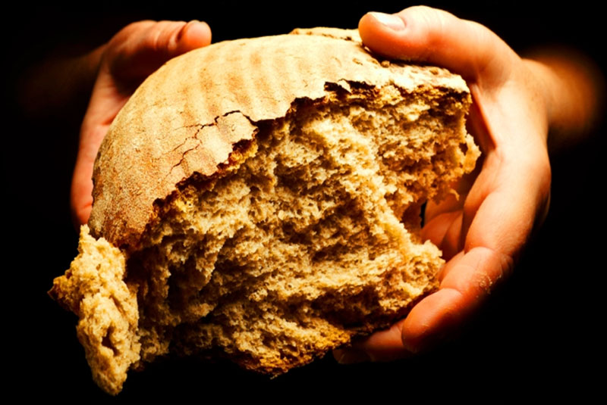
Bearing and Following the WORD into the World Holy Communion
We give you thanks that you have made us one with him as he is one with you and the Holy Spirit. With thanksgiving, we remember how Jesus took bread, blessed and broke it, and gave it to his disciples, saying, this is my body, given for you.

Slide 40
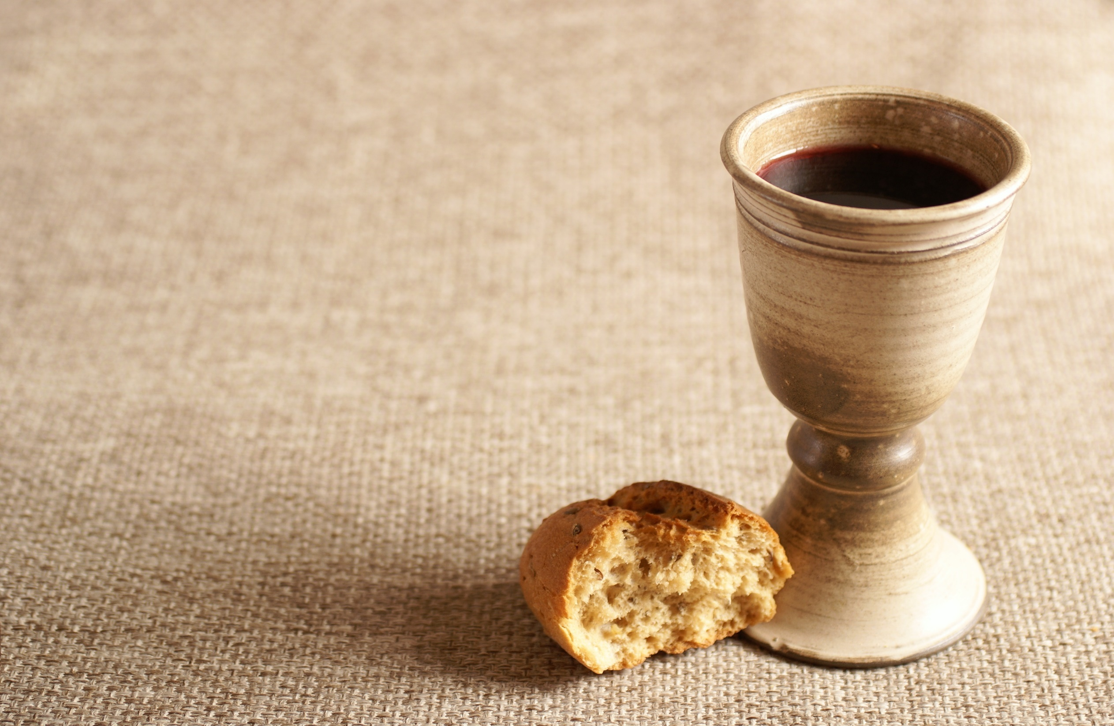
Bearing and Following the WORD into the World Holy Communion
In the same way, he took the cup, saying, this is the new covenant sealed in my blood. Do this, remembering me.

Slide 41
Bearing and Following the WORD into the World Holy Communion
With thanks and praise we offer ourselves to you, O God. Sharing this holy meal, remembering Christ’s dying and rising, and praying:
Come Lord Jesus!
Christ has died, Christ is risen, Christ will come again.

Slide 42
Bearing and Following the WORD into the World Holy Communion
Jesus said, "I am the bread of life. They who come to me shall never hunger; they who believe in me shall never thirst." These are the gift of God for the people of God.

Slide 43
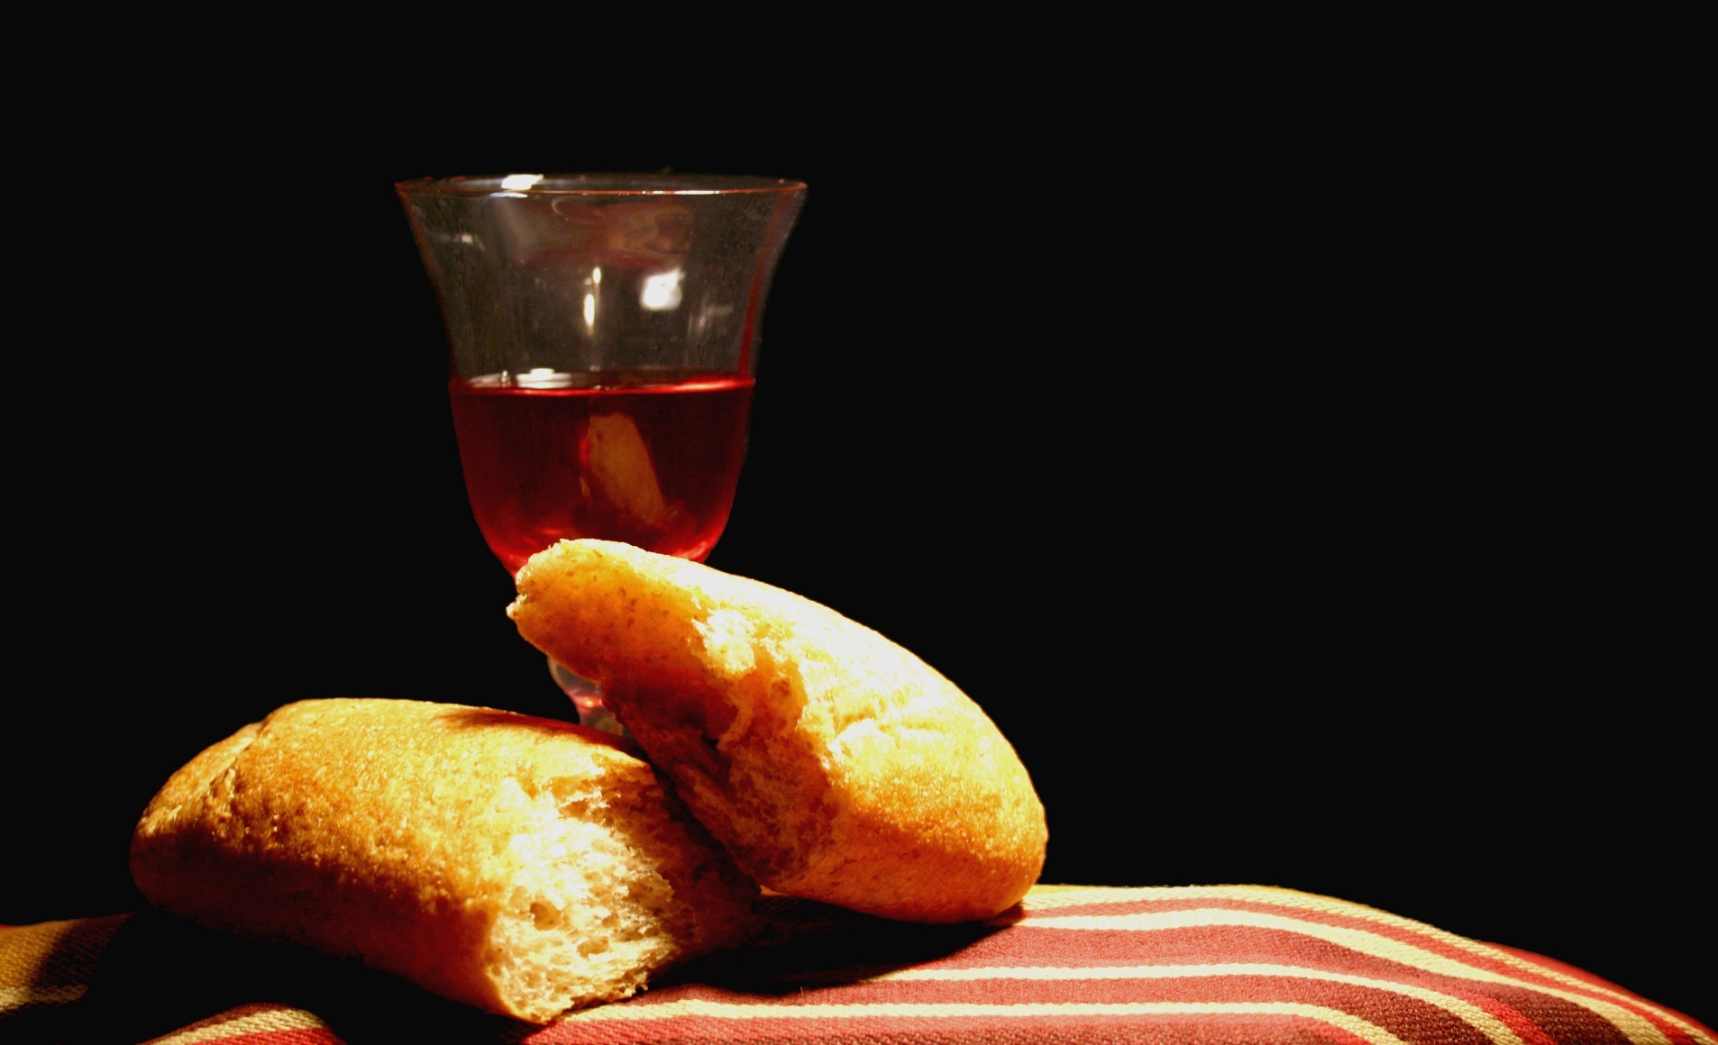
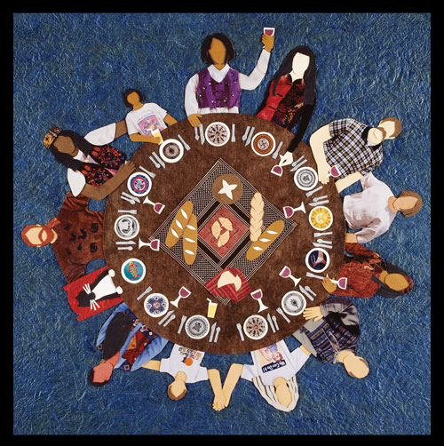
Bearing and Following the WORD into the World Holy Communion

Slide 44
Bearing and Following the WORD into the World
Prayer after the Communion: (in unison)
:
Lord Jesus Christ, fill us with dreams and visions of that great and glorious day when you will come again, and we shall eat and drink with you in the joy of your eternal realm.

Slide 45
Bearing and Following the WORD into the World
Prayer after the Communion: (in unison)
:
Fill us now, O God, abundantly by your grace. Teach us how to serve others, as you have demonstrated to us through your Son Jesus Christ.
Through Christ, with Christ, in Christ, in the unity of the Holy Spirit, all glory and honor are yours, Almighty God, now and forever, Amen.

Slide 46
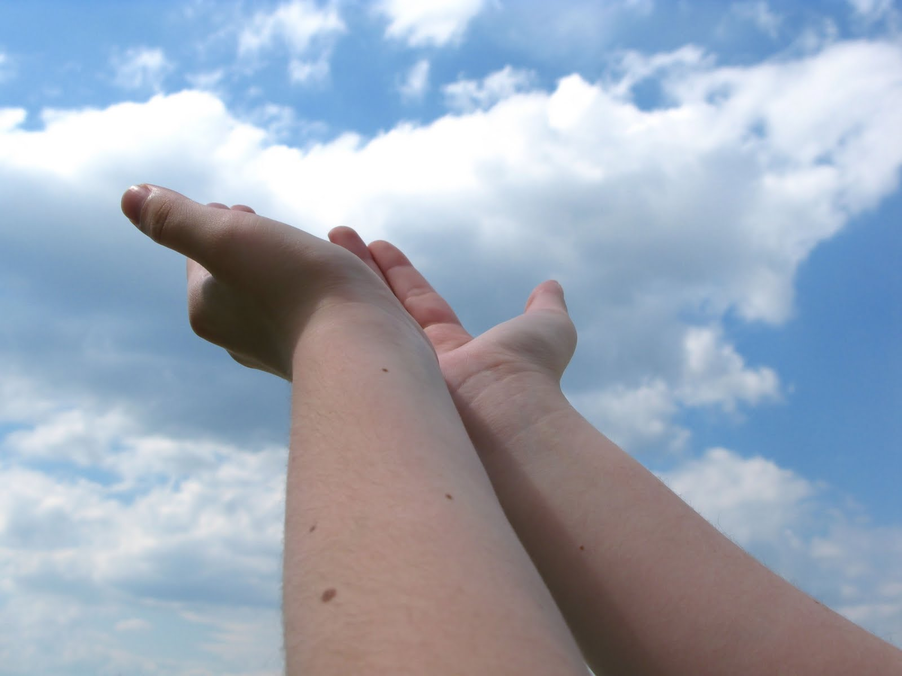
Bearing and Following the WORD into the World Deacons’ Benevolence Offering

Slide 47
Sending Hymn #761 “Called as Partners in Christ’s Service”
Called as partners in Christ’s service, called to ministries of grace, we respond with deep commitment fresh new lines of faith to trace. May we learn the art of sharing, side by side and friend with friend, equal partners in our caring to fulfill God’s chosen end.

Slide 48
Sending Hymn #761 “Called as Partners in Christ’s Service”
Christ’s example, Christ’s inspiring, Christ’s clear call to work and worth, let us follow, never faltering, reconciling folk on earth. Men and women, richer, poorer, all God’s people, young and old, blending human skills together gracious gifts from God unfold.

Slide 49
Sending Hymn #761 “Called as Partners in Christ’s Service”
Thus new patterns for Christ’s mission, in a small or global sense, help us bear each other’s burdens, breaking down each wall or fence. Words of comfort, words of vision, words of challenge, said with care, bring new power and strength for action, make us colleagues, free and fair.

Slide 50
Sending Hymn #761 “Called as Partners in Christ’s Service”
So God grant us for tomorrow ways to order human life that surround each person’s sorrow with a calm that conquers strife. Make us partners in our living, our compassion to increase, messengers of faith, thus giving hope and confidence and peace.

Slide 51
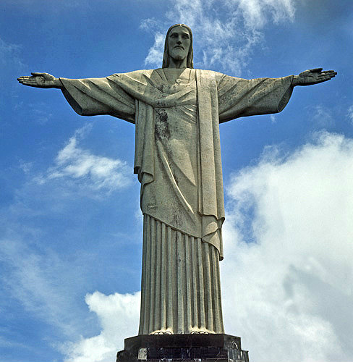
Bearing and Following the WORD into the World The Charge and Benediction

Slide 52
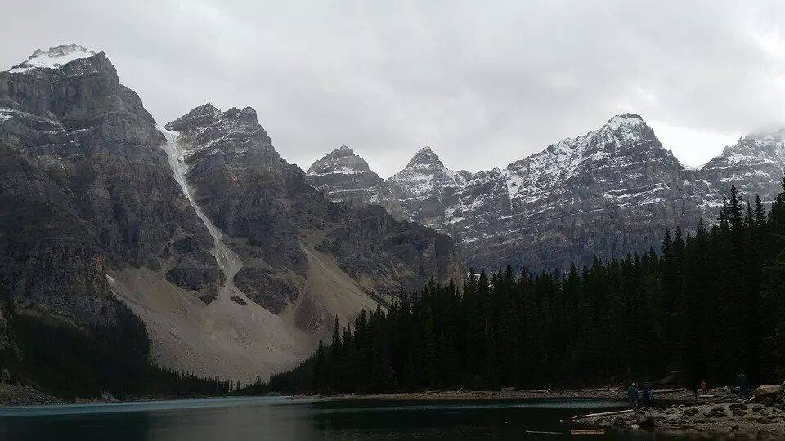
Bearing and Following the WORD into the World Benediction Response
# 547 “Lord, Dismiss Us With Your Blessing: (Stanza 2)
Thanks we give and adoration
for your gospel's joyful sound; may the fruits of your salvation
in our hearts and lives abound. Ever faithful, ever faithful
to your truth may we be found.

Slide 53
Homecrest Presbyterian Church Worship of the Lord’s Day 6th Sunday of Easter, May 6th, 2018

