Slide 1
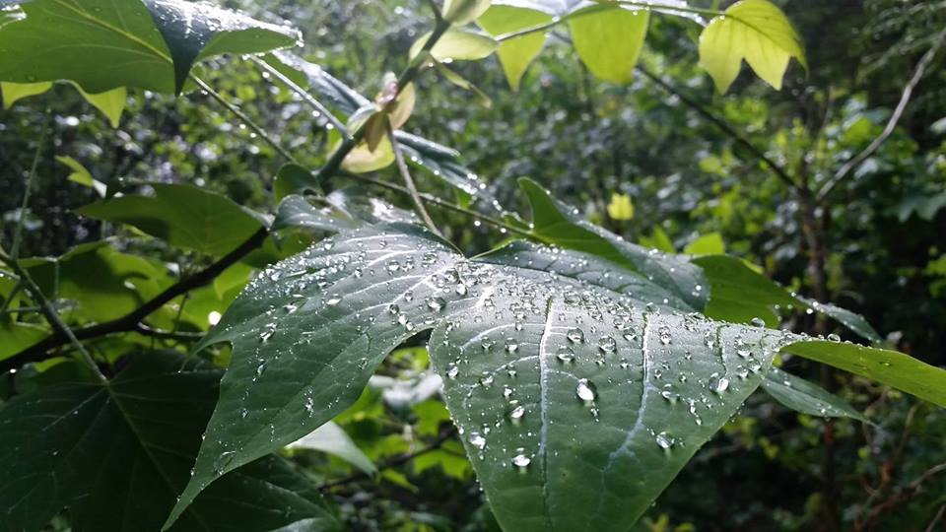
Homecrest Presbyterian Church Worship of the Lord’s Day 5th Sunday of Easter, April 29th, 2018

Slide 2
Gathering Around the WORD Call to Worship
In the wilderness, water brings life.
Seek us out, O God, and take us to the water.
In the word of God, the good news gives light.
Seek us out, O God,
and fill us with understanding.
In the bread and the wine,
the body of our Savior nourishes everyone.
Seek us out, O God, and give us yourself.
In the water of life, the word that feeds,
the food of eternity.
We have come to praise the Vine
that gives all goodness.

Slide 3
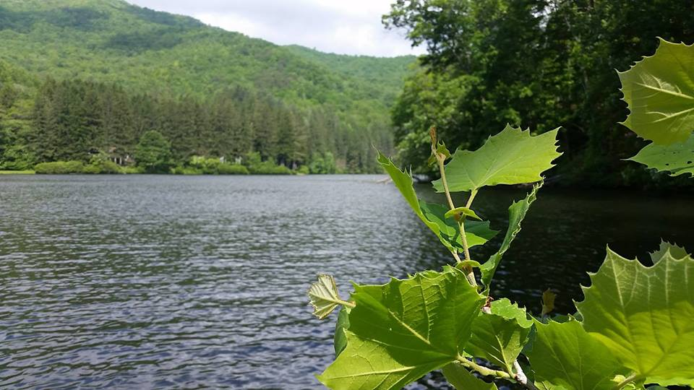
Gathering Around the WORD Gathering Hymn # 624 “I Greet Thee, Who My Sure Redeemer Art”
I greet thee, who my sure Redeemer art, my only trust and Savior of my heart, who pain didst undergo for my poor sake; I pray thee from our hearts all cares to take.

Slide 4
Gathering Around the WORD Gathering Hymn # 624 “I Greet Thee, Who My Sure Redeemer Art”
Thou art the King of mercy and of grace, reigning omnipotent in every place: so come, O King, and our whole being sway; shine on us with the light of thy pure day.

Slide 5
Gathering Around the WORD Gathering Hymn # 624 “I Greet Thee, Who My Sure Redeemer Art”
Thou art the life, by which alone we live, and all our substance
and our strength receive; sustain us by thy faith
and by thy power, and give us strength in every trying hour.

Slide 6
Gathering Around the WORD Gathering Hymn # 624 “I Greet Thee, Who My Sure Redeemer Art”
Thou hast the true and perfect gentleness; no harshness hast thou and no bitterness. O grant to us the grace we find in thee, that we may dwell in perfect unity.

Slide 7
Gathering Around the WORD Gathering Hymn # 624 “I Greet Thee, Who My Sure Redeemer Art”
Our hope is in no other save in thee; our faith is built upon thy promise free; Lord, give us peace,
and make us calm and sure, that in thy strength we evermore endure.

Slide 8
Gathering Around the WORD Call to Confession (1 John 1:8-9) If we say that we have no sin, we deceive ourselves, and the truth is not in us. If we confess our sins, he who is faithful and just will forgive us our sins and cleanse us from all unrighteousness. In humility and faith, let us confess our sins before God, in the presence of our neighbors as our witnesses.

Slide 9
Gathering Around the WORD Prayer of Confession (in unison)
God of mercy, we confess that we have not borne the fruit of the Spirit. We have not loved others as you have loved us. We have denied the promises of baptism and cut ourselves off from you. Forgive us, restore us, that we may abide in your love and live out your mercy, for the sake of Jesus Christ in whose name we pray, Amen.

Slide 10
Gathering Around the WORD Declaration of Forgiveness (John 15:3)
We have already been cleansed by the word that God has spoken to us.
In baptism God claimed us and joined us to Christ, as branches to a vine.
Therefore, we believe the promise that is given to us: in Jesus Christ, we are forgiven. Thanks be to God.

Slide 11
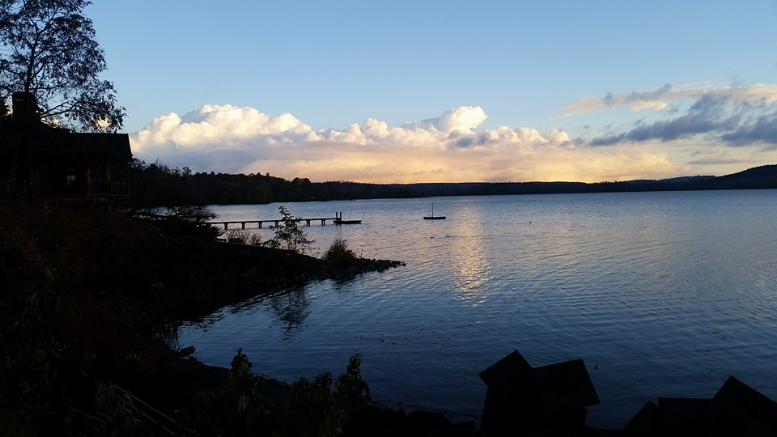
Gathering Around the WORD Gloria Patri
Glory be to the Father
and to the Son and to the Holy Ghost;
As it was in the beginning,
is now, and ever shall be,
world without end. Amen, Amen.

Slide 12
Gathering Around the WORD Passing of the Peace of Christ
(I John 4:4-8)
Beloved, let us love one another, because love is from God; everyone who loves is born of God and knows God. Whoever does not love does not know God, for God IS LOVE.
No one has ever seen God;
but if we love one another,
God lives in us and his love is made perfect in us. Thanks be to God.

Slide 13
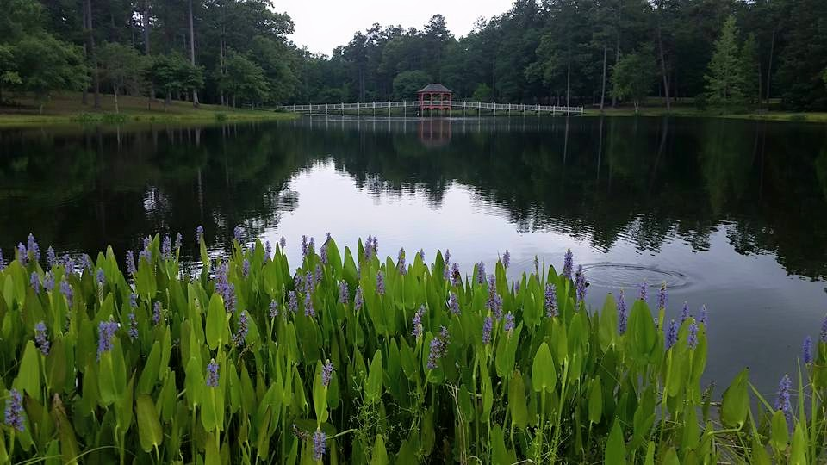
Proclaiming the WORD Message to the Youth/ Prayer of Illumination

Slide 14
Proclaiming the WORD Scripture Reading (I John 4:7-21)
⁷Beloved, let us love one another, because love is from God; everyone who loves is born of God and knows God. ⁸Whoever does not love does not know God, for God is love. ⁹God's love was revealed among us in this way: God sent his only Son into the world so that we might live through him. ¹⁰In this is love, not that we loved God but that he loved us and sent his Son to be the atoning sacrifice for our sins. ¹¹Beloved, since God loved us so much, we also ought to love one another. ¹²No one has ever seen God; if we love one another, God lives in us, and his love is perfected in us.

Slide 15
Proclaiming the WORD Scripture Reading (I John 4:7-21)
¹³By this we know that we abide in him and he in us, because he has given us of his Spirit. ¹⁴And we have seen and do testify that the Father has sent his Son as the Savior of the world. ¹⁵God abides in those who confess that Jesus is the Son of God, and they abide in God. ¹⁶So we have known and believe the love that God has for us.

Slide 16
Proclaiming the WORD Scripture Reading (I John 4:7-21)
God is love, and those who abide in love abide in God, and God abides in them. ¹⁷Love has been perfected among us in this: that we may have boldness on the day of judgment, because as he is, so are we in this world. ¹⁸There is no fear in love, but perfect love casts out fear; for fear has to do with punishment, and whoever fears has not reached perfection in love.
¹⁹We love because he first loved us.

Slide 17
Proclaiming the WORD Scripture Reading (I John 4:7-21)
²⁰Those who say, “I love God,” and hate their brothers or sisters, are liars; for those who do not love a brother or sister whom they have seen, cannot love God whom they have not seen. ²¹The commandment we have from him is this: those who love God must love their brothers and sisters also.

Slide 18
Proclaiming the WORD Scripture Reading (Acts 8:26-40)
²⁶Then an angel of the Lord said to Philip, “Get up and go toward the south to the road that goes down from Jerusalem to Gaza.” (This is a wilderness road.) ²⁷So he got up and went. Now there was an Ethiopian eunuch, a court official of the Candace, queen of the Ethiopians, in charge of her entire treasury. He had come to Jerusalem to worship ²⁸and was returning home; seated in his chariot, he was reading the prophet Isaiah.

Slide 19
Proclaiming the WORD Scripture Reading (Acts 8:26-40)
²⁹Then the Spirit said to Philip, “Go over to this chariot and join it.” ³⁰So Philip ran up to it and heard him reading the prophet Isaiah. He asked, “Do you understand what you are reading?” ³¹He replied, “How can I, unless someone guides me?” And he invited Philip to get in and sit beside him. ³²Now the passage of the scripture that he was reading was this:

Slide 20
Proclaiming the WORD Scripture Reading (Acts 8:26-40)
“Like a sheep he was led to the slaughter, and like a lamb silent before its shearer, so he does not open his mouth. ³³ In his humiliation justice was denied him. Who can describe his generation? For his life is taken away from the earth.”

Slide 21
Proclaiming the WORD Scripture Reading (Acts 8:26-40)
³⁴The eunuch asked Philip, “About whom, may I ask you, does the prophet say this, about himself or about someone else?” ³⁵Then Philip began to speak, and starting with this scripture, he proclaimed to him the good news about Jesus. ³⁶As they were going along the road, they came to some water; and the eunuch said, “Look, here is water! What is to prevent me from being baptized?”

Slide 22
Proclaiming the WORD Scripture Reading (Acts 8:26-40)
³⁷And Phillip said,“If you believe with all your heart, you may.” And he replied, “I believe that Jesus Christ is the Son of God.” ³⁸He commanded the chariot to stop, and both of them, Philip and the eunuch, went down into the water, and Philip baptized him. ³⁹When they came up out of the water, the Spirit of the Lord snatched Philip away; the eunuch saw him no more, and went on his way rejoicing. ⁴⁰But Philip found himself at Azotus, and as he was passing through the region, he proclaimed the good news to all the towns until he came to Caesarea.

Slide 23
Proclaiming the WORD (I John 4:7-21 and John 8:26-40)

Slide 24
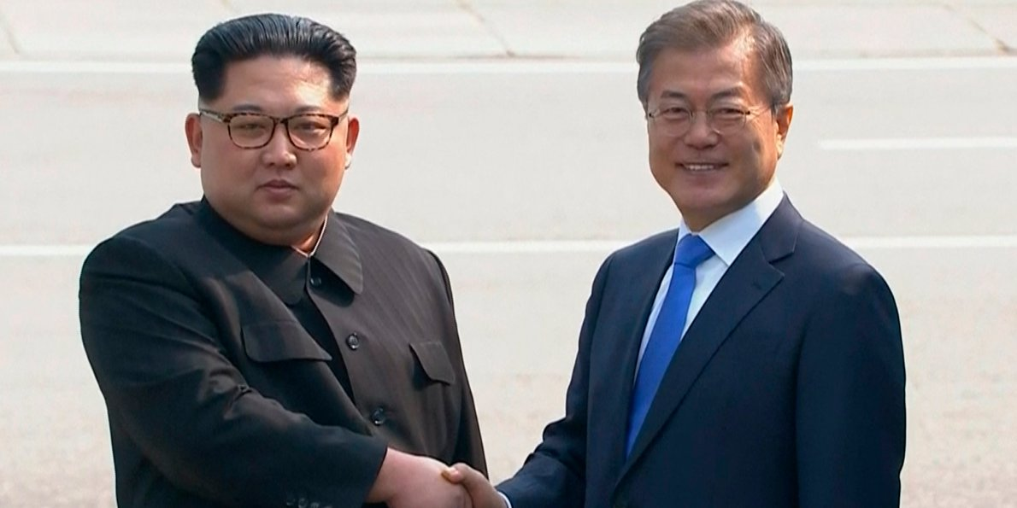
Proclaiming the WORD (I John 4:7-21 and John 8:26-40)
Fearless LOVE

Slide 25
Proclaiming the WORD (I John 4:7-21 and John 8:26-40)

Slide 26
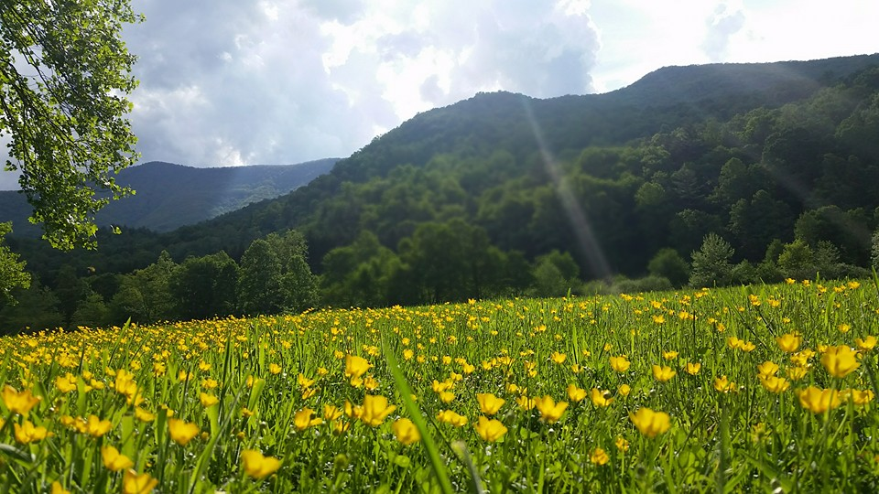
Responding Hymn # 366 “Love Divine, All Loves Excelling”
Love divine, all loves excelling, Joy of heaven, to earth come down, fix in us thy humble dwelling; all thy faithful mercies crown. Jesus, thou art all compassion; pure, unbounded love thou art; visit us with thy salvation; enter every trembling heart.

Slide 27
Responding Hymn # 366 “Love Divine, All Loves Excelling”
Breathe, O breathe thy loving Spirit into every troubled breast; let us all in thee inherit; let us find the promised rest. Take away the love of sinning; Alpha and Omega be; end of faith, as its beginning, set our hearts at liberty.

Slide 28
Responding Hymn # 366 “Love Divine, All Loves Excelling”
Come, Almighty, to deliver; let us all thy life receive; suddenly return, and never, nevermore thy temples leave. Thee we would be always blessing, serve thee as thy hosts above, pray, and praise thee without ceasing, glory in thy perfect love.

Slide 29
Responding Hymn # 366 “Love Divine, All Loves Excelling”
Finish then thy new creation; pure and spotless let us be; let us see thy great salvation perfectly restored in thee: changed from glory into glory, till in heaven we take our place, till we cast our crowns before thee, lost in wonder, love, and praise.

Slide 30
Bearing and Following the WORD into the World An Easter Affirmation of Faith
By: Brian Miller
We believe in God the Father, who created the world, was faithful when we were not, and who continuously seeks to redeem the world.
We believe in God the Son, Jesus Christ, who humbled himself by becoming human and moving into our neighborhood; was sent by the Father to give us life; embodied and taught the righteous love of God; and who, though he knew no sin, became sin and was put to death on a cross.

Slide 31
Bearing and Following the WORD into the World
We believe that three days later, Jesus Christ was raised from the dead by the power of God; was seen in bodily form by his disciples.
We believe that the life, death, and resurrection of Jesus gives us victory over any form of sin and brokenness and allows us to know the full love of God for the world.
We believe in God the Holy Spirit, who actively works in our lives, giving us grace to be like Jesus, and sends us to show God’s love for the world.

Slide 32
Bearing and Following the WORD into the World Announcements &
Sharing of Joys and Concerns
The afternoon Bible Study Group will be meeting today downstairs at 12:30 in the basement.
The Women's Group will continue to meet on Wednesdays at 7:30pm over at the Manse
(2048 E 14th Street). They are currently studying
the book of Isaiah. For more information, please
contact Margaret or Cara.

Slide 33
Bearing and Following the WORD into the World Prayer of the People & The Lord’s Prayer
Our Father, who art in heaven.
Halloweth be thy name.
Thy Kingdom come; Thy will be done
On earth as it is in heaven.
Give us this day our daily bread.
Forgive us our debts; as we forgive our debtors.
Lead us not into temptations, but deliver us from evil.
For Thine is the Kingdom, the Power, and the Glory forever. Amen.

Slide 34
Bearing and Following the WORD into the World Offering of our Gifts and our Lives
Musical Offering

Slide 35
Bearing and Following the WORD into the World Doxology and Offertory Prayer

Slide 36
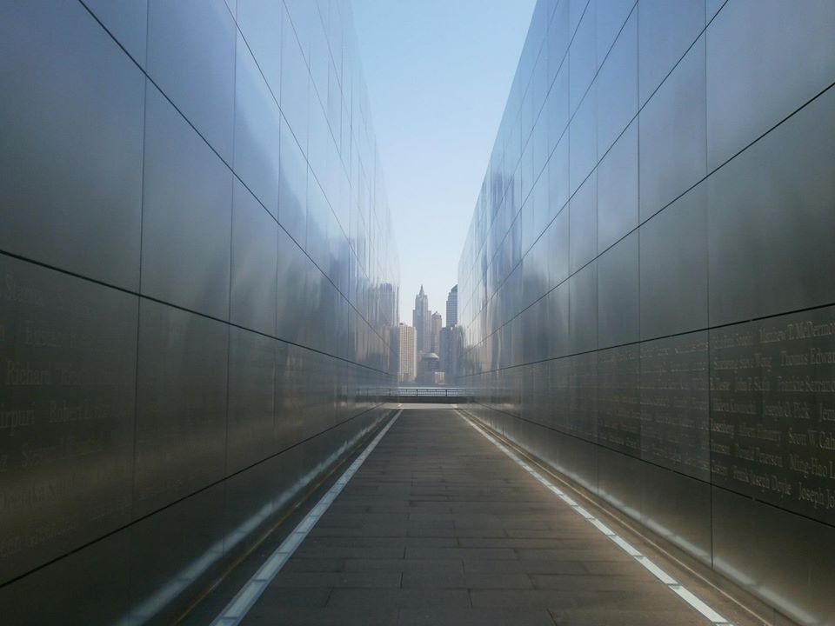
Sending Hymn #318 “In Christ There Is No East or West”
In Christ there is no east or west, in him no south or north, but one great fellowship of love throughout the whole wide earth.

Slide 37
Sending Hymn #318 “In Christ There Is No East or West”
In Christ shall true hearts everywhere their high communion find; his service is the golden cord close-binding humankind.

Slide 38
Sending Hymn #318 “In Christ There Is No East or West”
Join hands, disciples of the faith, whate'er your race may be. All children of the living God are surely kin to me.

Slide 39
Sending Hymn #318 “In Christ There Is No East or West”
In Christ now meet both east and west; in him meet south and north. All Christly souls are one in him throughout the whole wide earth.

Slide 40
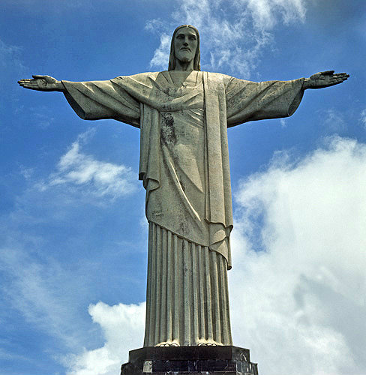
Bearing and Following the WORD into the World The Charge and Benediction

Slide 41
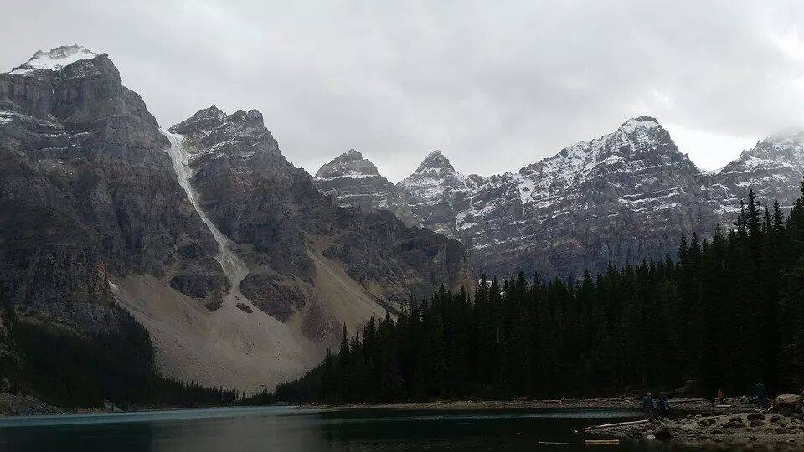
Bearing and Following the WORD into the World Benediction Response
# 547 “Lord, Dismiss Us With Your Blessing: (Stanza 1)
Lord, dismiss us with your blessing;
fill our hearts with joy and peace; let us each, your love possessing,
triumph in redeeming grace. O refresh us, O refresh us, traveling through this wilderness.

Slide 42
Homecrest Presbyterian Church Worship of the Lord’s Day 5th Sunday of Easter, April 29th, 2018

