Slide 1
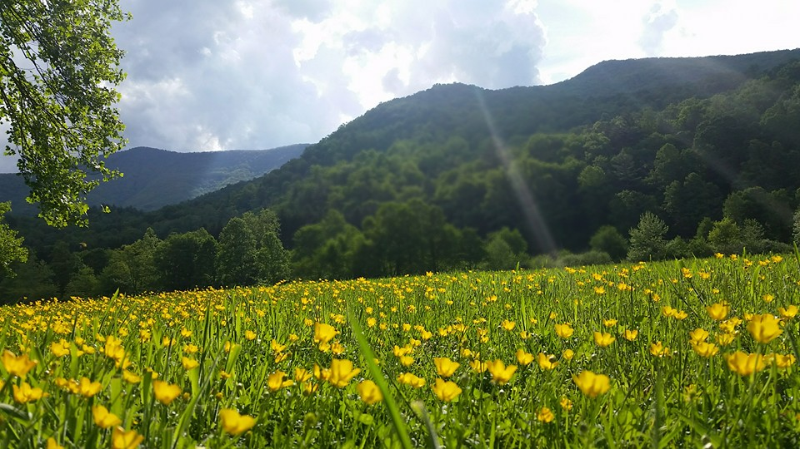
Homecrest Presbyterian Church Worship of the Lord’s Day 4th Sunday of Easter, April 22nd, 2018

Slide 2
Gathering Around the WORD Call to Worship
(Based on Psalm 23:1, John 10:14-16)
The Lord Jesus Christ is our shepherd.
He lays down his life for his sheep.
The Lord Jesus Christ is our shepherd.
He knows us, and we belong to him.
The Lord Jesus Christ is our shepherd.
He speaks, and we listen for his voice. Let us come and worship God!

Slide 3
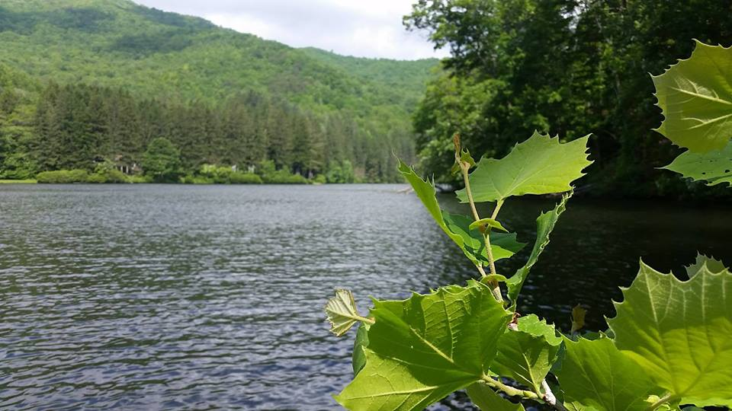
Gathering Around the WORD Gathering Hymn # 394 “Christ is Made a Sure Foundation”
Christ is made the sure foundation, Christ the head and cornerstone, chosen of the Lord and precious, binding all the church in one; holy Zion's help forever, and our confidence alone.

Slide 4
Gathering Around the WORD Gathering Hymn # 394 “Christ is Made a Sure Foundation”
To this temple, where we call you, come, O Lord of hosts, and stay; come, with all your loving-kindness; hear your people as we pray, and your fullest benediction shed within these walls today.

Slide 5
Gathering Around the WORD Gathering Hymn # 394 “Christ is Made a Sure Foundation”
Here bestow on all your servants what they seek from you to gain; what they gain from you, forever with the blessed to retain; and hereafter in your glory evermore with you to reign.

Slide 6
Gathering Around the WORD Gathering Hymn # 394 “Christ is Made a Sure Foundation”
Laud and honor to the Father, laud and honor to the Son, laud and honor to the Spirit, ever three and ever one: one in might and one in glory while unending ages run!

Slide 7
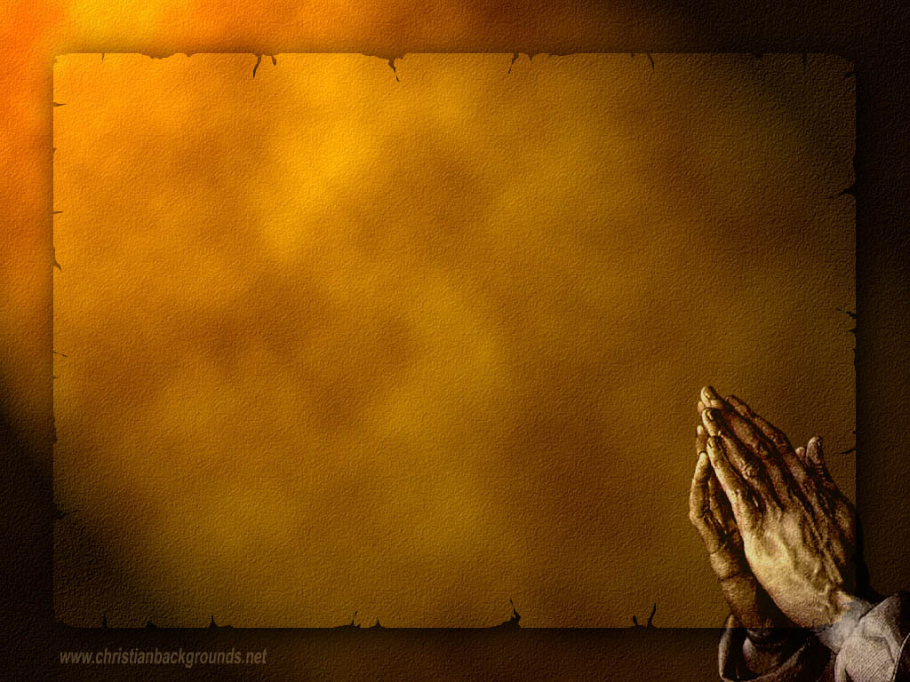
Gathering Around the WORD Call to Confession If we are honest with ourselves, our hearts condemn us. But God, who knows everything, is greater than our hearts; and God’s deep desire for us is mercy, love, and peace. Therefore let us confess our sins before God and our neighbors as our witnesses.

Slide 8
Gathering Around the WORD Prayer of Confession (in unison)
Lord, have mercy on us. We talk about love, but our actions betray us. We talk about love, but we neglect the poor. We talk about love, but we fail to love one another. Lord have mercy on us. Forgive us, and abide in us by the power of your Spirit so that our lives may show our love for Jesus Christ, in whose body we live and in whose name we pray, Amen.

Slide 9
Gathering Around the WORD Declaration of Forgiveness
We seek God’s grace with boldness because we trust in Jesus Christ, the One who loves us and laid down his life for us.
This is the good news of the gospel: in Jesus Christ we are forgiven. Thanks be to God.

Slide 10
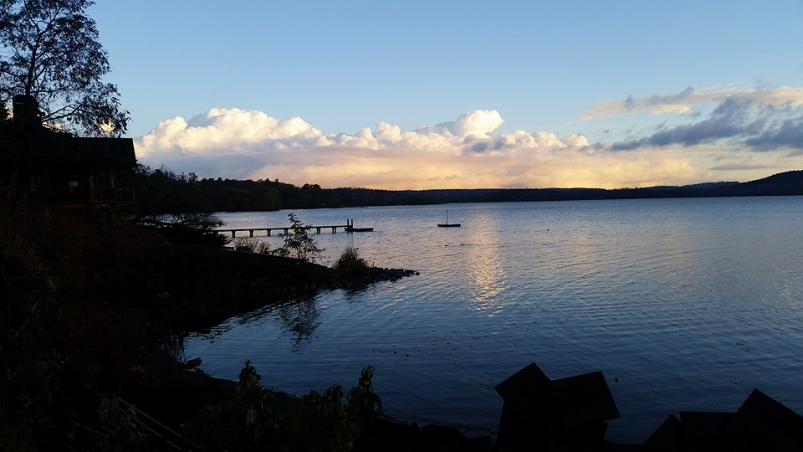
Gathering Around the WORD Gloria Patri
Glory be to the Father
and to the Son and to the Holy Ghost;
As it was in the beginning,
is now, and ever shall be,
world without end. Amen, Amen.

Slide 11
Gathering Around the WORD Passing of the Peace of Christ
(John 14:27) Jesus said, “Peace I leave with you; my peace I give you. I do not give to you as the world gives. Do not let your hearts be troubled and do not be afraid.”
May the Peace of our Lord be with you,
and also with you.

Slide 12
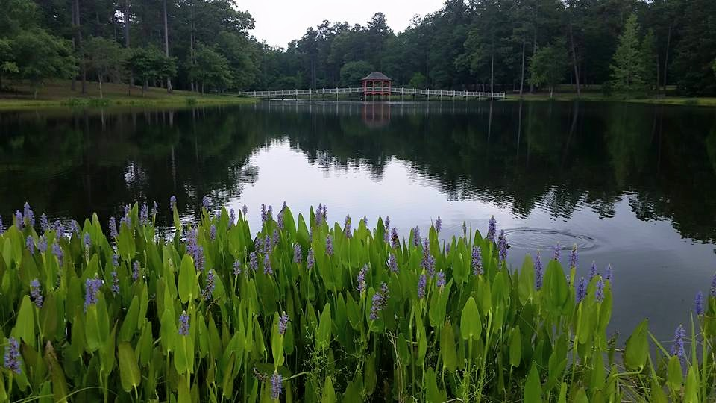
Proclaiming the WORD Message to the Youth/ Prayer of Illumination

Slide 13
Proclaiming the WORD Scripture Reading (I John 3:16-24)
¹⁶We know love by this, that he laid down his life for us — and we ought to lay down our lives for one another. ¹⁷How does God’s love abide in anyone who has the world’s goods and sees a brother or sister in need and yet refuses help?
¹⁸Little children, let us love, not in word or speech, but in truth and action. ¹⁹And by this we will know that we are from the truth and will reassure our hearts before him ²⁰whenever our hearts condemn us; for God is greater than our hearts, and he knows everything.

Slide 14
Proclaiming the WORD Scripture Reading (I John 3:16-24)
²¹Beloved, if our hearts do not condemn us, we have boldness before God; ²²and we receive from him whatever we ask, because we obey his commandments and do what pleases him.
²³And this is his commandment, that we should believe in the name of his Son Jesus Christ and love one another, just as he has commanded us. ²⁴All who obey his commandments abide in him, and he abides in them. And by this we know that he abides in us, by the Spirit that he has given us.

Slide 15
Proclaiming the WORD Scripture Reading (John 10:11-18)
¹¹“I am the good shepherd. The good shepherd lays down his life for the sheep. ¹²The hired hand, who is not the shepherd and does not own the sheep, sees the wolf coming and leaves the sheep and runs away — and the wolf snatches them and scatters them. ¹³The hired hand runs away because a hired hand does not care for the sheep.

Slide 16
Proclaiming the WORD Scripture Reading (John 10:11-18)
¹⁴I am the good shepherd. I know my own and my own know me, ¹⁵just as the Father knows me and I know the Father. And I lay down my life for the sheep. ¹⁶I have other sheep that do not belong to this fold. I must bring them also, and they will listen to my voice. So there will be one flock, one shepherd. ¹⁷For this reason the Father loves me, because I lay down my life in order to take it up again. ¹⁸No one takes it from me, but I lay it down of my own accord. I have power to lay it down, and I have power to take it up again. I have received this command from my Father.”

Slide 17
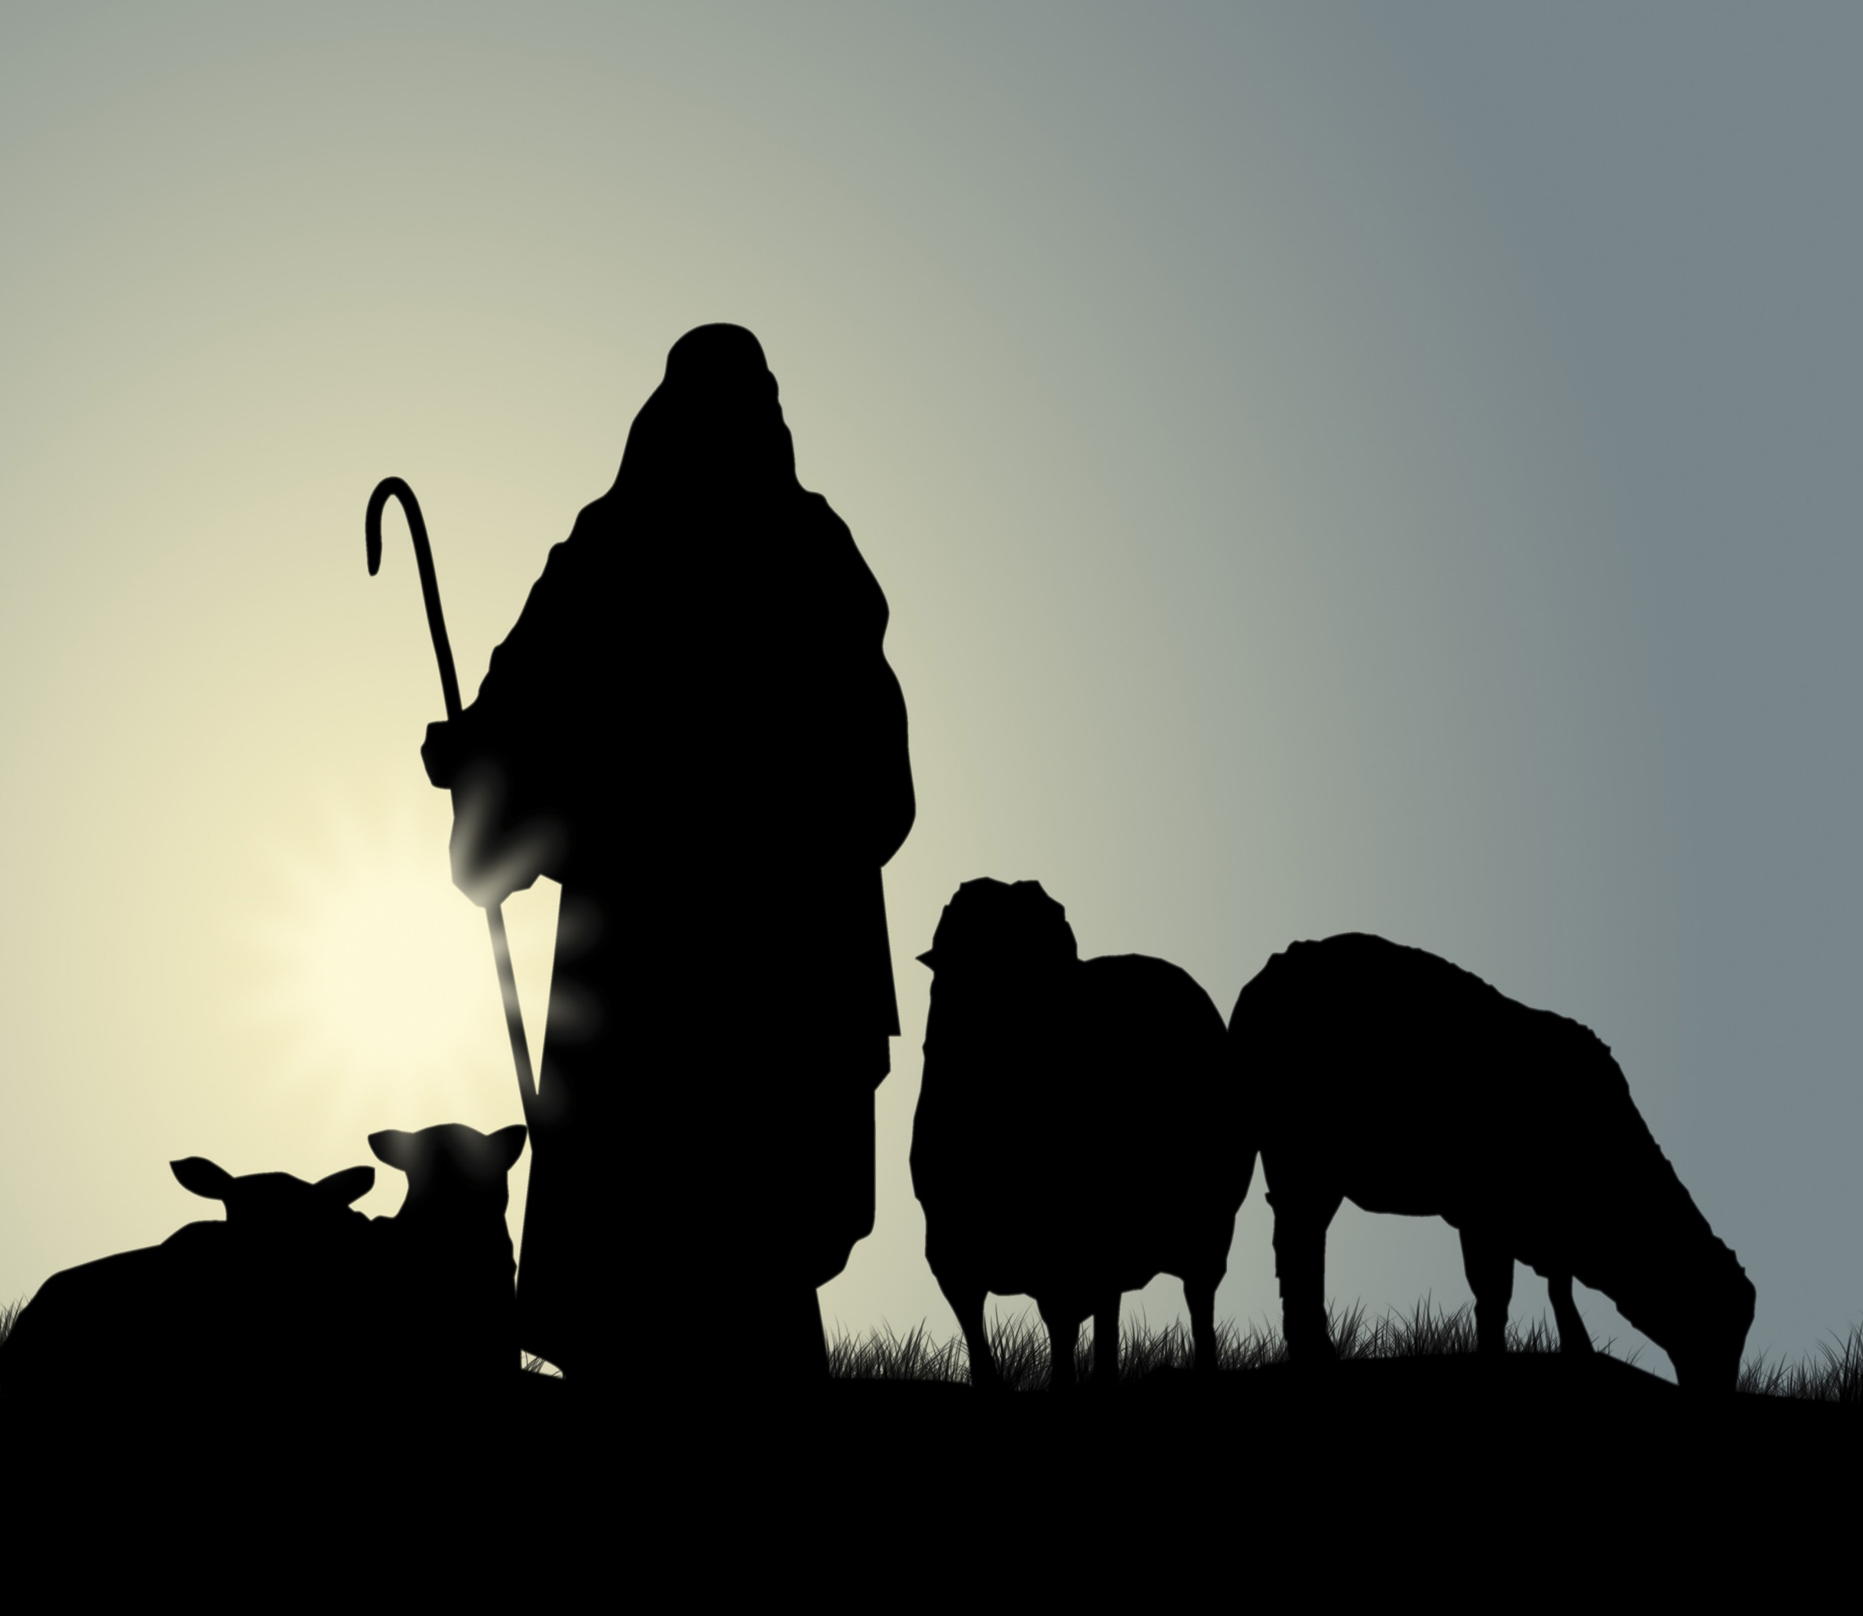
Proclaiming the WORD (I John 3:16-24 and John 10:11-18)
Laying Down for the Sheep

Slide 18
Responding Hymn # 803 “My Shepherd Will Supply My Need”
My shepherd will supply my need; Jehovah is his name. In pastures fresh he makes me feed, beside the living stream. He brings my wandering spirit back when I forsake his ways, and leads me, for his mercy's sake, in paths of truth and grace.

Slide 19
Responding Hymn # 803 “My Shepherd Will Supply My Need”
When I walk through the shades of death your presence is my stay; one word of your supporting breath drives all my fears away. Your hand, in sight of all my foes, does still my table spread; my cup with blessings overflows; your oil anoints my head.

Slide 20
Responding Hymn # 803 “My Shepherd Will Supply My Need”
The sure provisions of my God attend me all my days; O may your house be my abode, and all my work be praise. There would I find a settled rest, while others go and come; no more a stranger, or a guest, but like a child at home.

Slide 21
Bearing and Following the WORD into the World An Easter Affirmation of Faith
By: Brian Miller
We believe in God the Father, who created the world, was faithful when we were not, and who continuously seeks to redeem the world.
We believe in God the Son, Jesus Christ, who humbled himself by becoming human and moving into our neighborhood; was sent by the Father to give us life; embodied and taught the righteous love of God; and who, though he knew no sin, became sin and was put to death on a cross.

Slide 22
Bearing and Following the WORD into the World
We believe that three days later, Jesus Christ was raised from the dead by the power of God; was seen in bodily form by his disciples.
We believe that the life, death, and resurrection of Jesus gives us victory over any form of sin and brokenness and allows us to know the full love of God for the world.
We believe in God the Holy Spirit, who actively works in our lives, giving us grace to be like Jesus, and sends us to show God’s love for the world.

Slide 23
Bearing and Following the WORD into the World Announcements &
Sharing of Joys and Concerns
The afternoon Bible Study Group will be meeting today downstairs at 12:30 in the basement.
The Women's Group will continue to meet on Wednesdays at 7:30pm over at the Manse
(2048 E 14th Street). They are currently studying
the book of Isaiah. For more information, please
contact Margaret or Cara.

Slide 24
Bearing and Following the WORD into the World Prayer of the People & The Lord’s Prayer
Our Father, who art in heaven.
Halloweth be thy name.
Thy Kingdom come; Thy will be done
On earth as it is in heaven.
Give us this day our daily bread.
Forgive us our debts; as we forgive our debtors.
Lead us not into temptations, but deliver us from evil.
For Thine is the Kingdom, the Power, and the Glory forever. Amen.

Slide 25
Bearing and Following the WORD into the World Offering of our Gifts and our Lives
Musical Offering

Slide 26
Bearing and Following the WORD into the World Doxology and Offertory Prayer

Slide 27
Sending Hymn #353 “My Hope is Built on Nothing Less”
My hope is built on nothing less than Jesus' blood and righteousness; I dare not trust the sweetest frame, but wholly lean on Jesus' name. On Christ, the solid Rock, I stand; all other ground is sinking sand; all other ground is sinking sand.

Slide 28
Sending Hymn #353 “My Hope is Built on Nothing Less”
When darkness seems to hide his face, I rest on his unchanging grace; in every high and stormy gale, my anchor holds within the veil. On Christ, the solid Rock, I stand; all other ground is sinking sand; all other ground is sinking sand.

Slide 29
Sending Hymn #353 “My Hope is Built on Nothing Less”
His oath, his covenant, his blood support me in the whelming flood; when all around my soul gives way, he then is all my hope and stay. On Christ, the solid Rock, I stand; all other ground is sinking sand; all other ground is sinking sand.

Slide 30
Sending Hymn #353 “My Hope is Built on Nothing Less”
When he shall come with trumpet sound, O may I then in him be found, dressed in his righteousness alone, faultless to stand before the throne.
On Christ, the solid Rock, I stand; all other ground is sinking sand; all other ground is sinking sand.

Slide 31
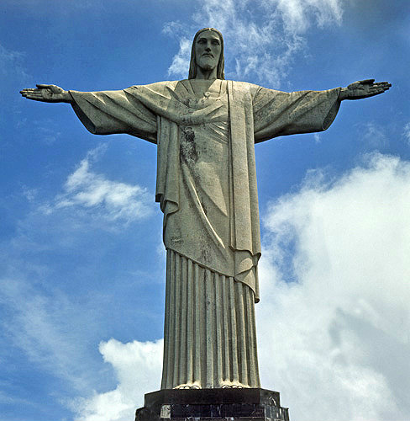
Bearing and Following the WORD into the World The Charge and Benediction

Slide 32
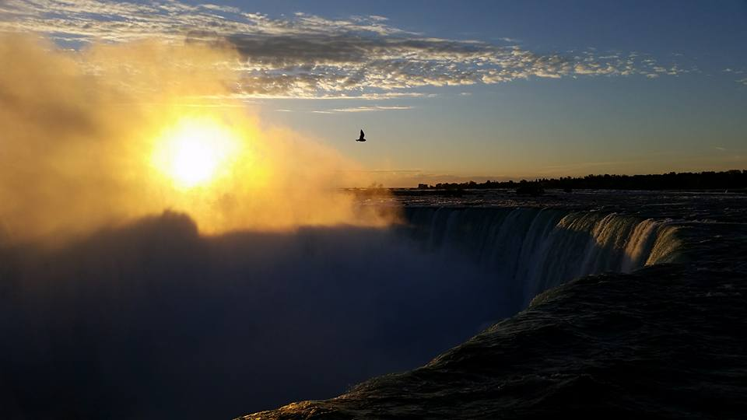
Bearing and Following the WORD into the World Benediction Response
# 547 “Go, My Children, with My Blessing”(Stanza 3)
Go, my children, fed and nourished,
closer to me. Grow in love and love by serving,
joyful and free. Here my Spirit’s power filled you;
Here my tender comfort stilled you. Go, my children, fed and nourished,
joyful and free.

Slide 33
Homecrest Presbyterian Church Worship of the Lord’s Day 4th Sunday of Easter, April 22nd, 2018

