Slide 1
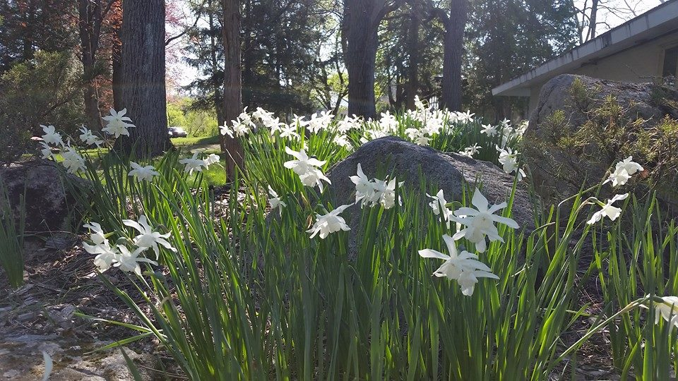
Homecrest Presbyterian Church Worship of the Lord’s Day 3rd Sunday of Easter, April 15th, 2018

Slide 2
Gathering Around the WORD Call to Worship
(Based on Luke 24:36)
The bread of life opens our eyes.
The word of life opens our ears.
The risen one shows us God’s own brokenness,
and by those wounds we are healed.
Our risen Christ revealed himself to the disciples and said, “Peace be with you.”
For indeed He is risen and we shall live in God’s peace forever and ever.

Slide 3
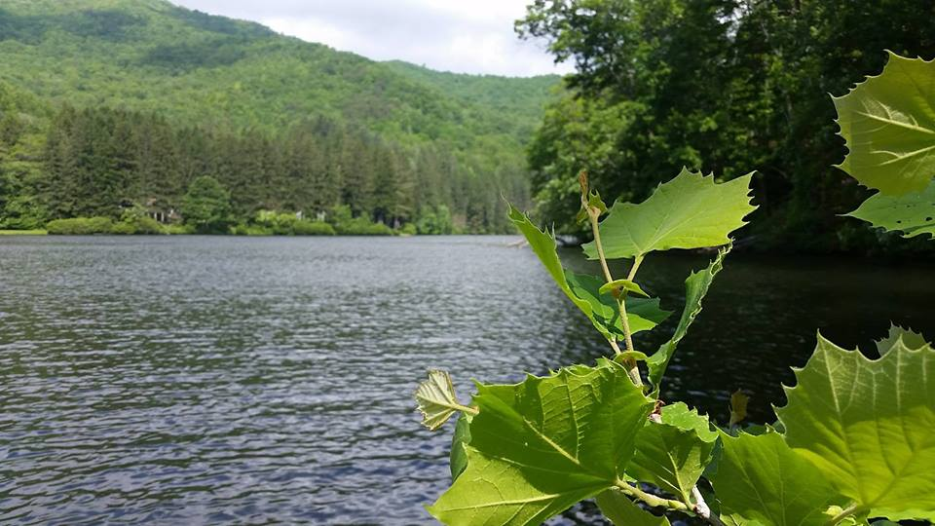
Gathering Around the WORD Gathering Hymn # 254 “That Easter Day with Joy was Bright”
That Easter day with joy was bright; the sun shone out with fairer light when, to their longing eyes restored, the apostles saw their risen Lord.

Slide 4
Gathering Around the WORD Gathering Hymn # 254 “That Easter Day with Joy was Bright”
He bade them see his hands, his side, where yet the glorious wounds abide, the tokens true which made it plain their Lord indeed was risen again.

Slide 5
Gathering Around the WORD Gathering Hymn # 254 “That Easter Day with Joy was Bright”
From every weapon death can wield, your own redeemed forever shield; O Lord of all, with us abide in this our joyful Eastertide.

Slide 6
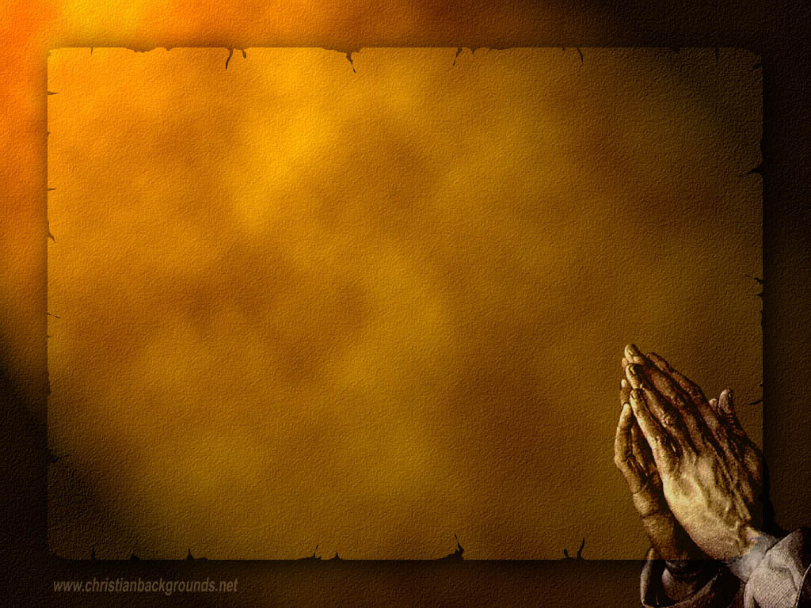
Gathering Around the WORD Call to Confession The One who calls us to repent, hears us. In trust that our Creator knows us through and through, let us open our hearts to the healing of God’s forgiveness.

Slide 7
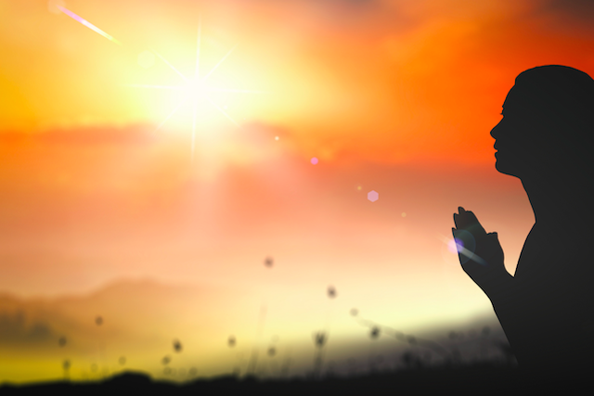
Gathering Around the WORD Prayer of Confession
Good and gracious God, we are creatures of dust, ignorant of your revelation, misunderstanding your life, death, and resurrection among us, needing forgiveness. We repent of our failure to give as you have given to us. We beg your mercy for our fallen world. We seek your Word, that we may live with the faith of Jesus. Be our solace in this life and always. We ask this as your own children, holy and complete. Forgive us and lead us. Amen.

Slide 8
Gathering Around the WORD Declaration of Forgiveness
Christ was sent on a mission to this earth in order to save us. Christ willingly gave himself up on the cross and died our death, so that we may live.
This was God’s ultimate act of mercy, grace and love. Our deaths have been conquered and our sins have been forgiven. Thanks be to God, Amen.

Slide 9
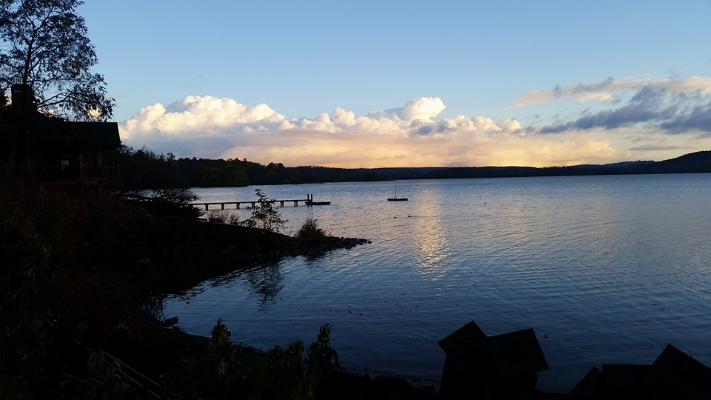
Gathering Around the WORD Gloria Patri
Glory be to the Father
and to the Son and to the Holy Ghost;
As it was in the beginning,
is now, and ever shall be,
world without end. Amen, Amen.

Slide 10
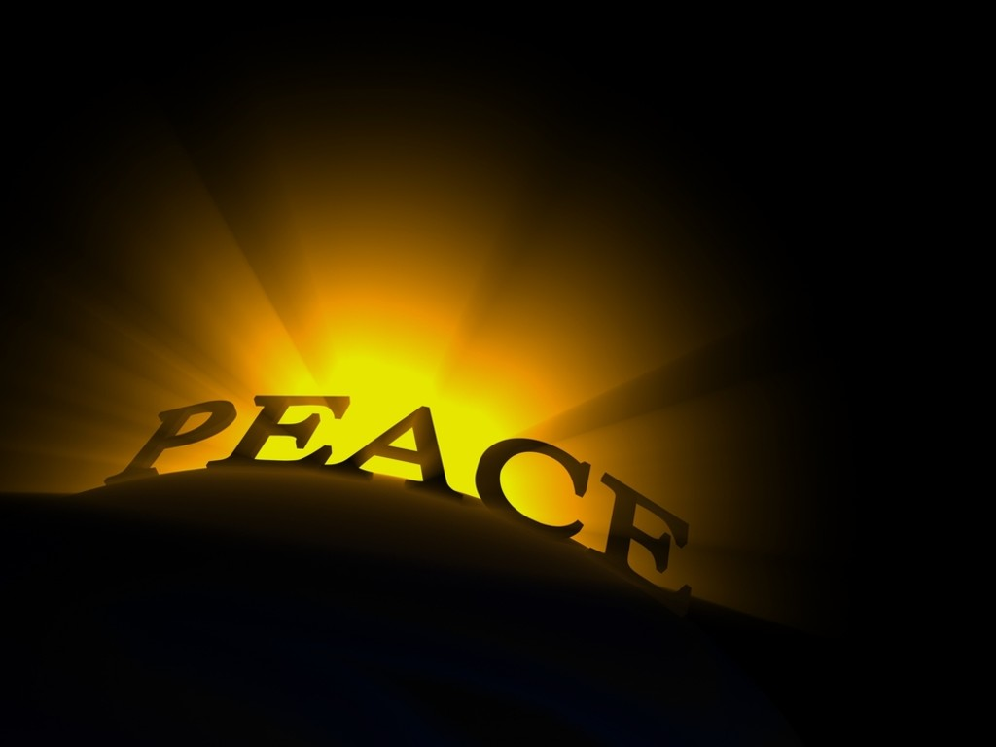
Gathering Around the WORD Passing of the Peace of Christ
(John 14:27) Jesus said, “Peace I leave with you; my peace I give you. I do not give to you as the world gives. Do not let your hearts be troubled and do not be afraid.”
May the Peace of our Lord be with you,
and also with you.

Slide 11
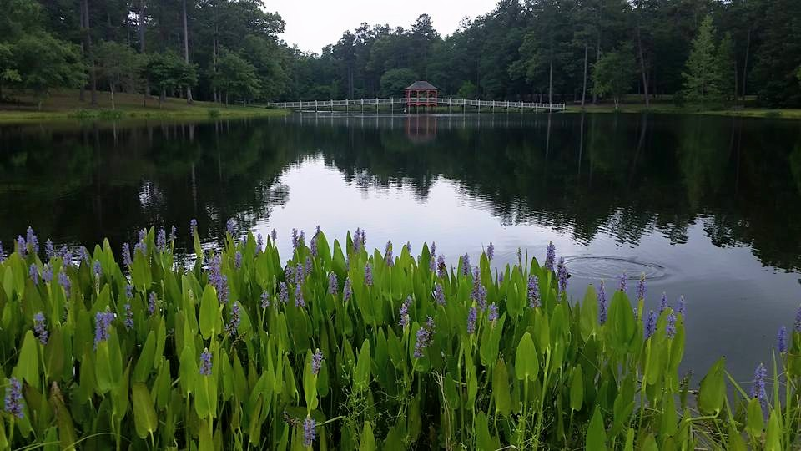
Proclaiming the WORD Message to the Youth/ Prayer of Illumination

Slide 12
Proclaiming the WORD Scripture Reading (Luke 24:36-48)
Jesus himself stood among them and said to them, “Peace be with you.” ³⁷They were startled and terrified, and thought that they were seeing a ghost. ³⁸He said to them, “Why are you frightened, and why do doubts arise in your hearts? ³⁹Look at my hands and my feet; see that it is I myself. Touch me and see; for a ghost does not have flesh and bones as you see that I have.”

Slide 13
Proclaiming the WORD Scripture Reading (Luke 24:36-48)
⁴⁰And when he had said this, he showed them his hands and his feet. ⁴¹While in their joy they were disbelieving and still wondering, he said to them, “Have you anything here to eat?”
⁴²They gave him a piece of broiled fish, ⁴³and he took it and ate in their presence.

Slide 14
Proclaiming the WORD Scripture Reading (Luke 24:36-48)
⁴⁴Then he said to them, “These are my words that I spoke to you while I was still with you — that everything written about me in the law of Moses, the prophets, and the psalms must be fulfilled.” ⁴⁵Then he opened their minds to understand the scriptures, ⁴⁶and he said to them, “Thus it is written, that the Messiah is to suffer and to rise from the dead on the third day, ⁴⁷and that repentance and forgiveness of sins is to be proclaimed in his name to all nations, beginning from Jerusalem. ⁴⁸You are witnesses of these things.”

Slide 15
Proclaiming the WORD Scripture Reading (Acts 3:12-19)
¹²When Peter saw it, he addressed the people, “You Israelites, why do you wonder at this, or why do you stare at us, as though by our own power or piety we had made him walk?
¹³The God of Abraham, the God of Isaac, and the God of Jacob, the God of our ancestors has glorified his servant Jesus, whom you handed over and rejected in the presence of Pilate, though he had decided to release him.

Slide 16
Proclaiming the WORD Scripture Reading (Acts 3:12-19)
¹⁴But you rejected the Holy and Righteous One and asked to have a murderer given to you, ¹⁵and you killed the Author of life, whom God raised from the dead. To this we are witnesses. ¹⁶And by faith in his name, his name itself has made this man strong, whom you see and know; and the faith that is through Jesus has given him this perfect health in the presence of all of you.

Slide 17
Proclaiming the WORD Scripture Reading (Acts 3:12-19)
¹⁷“And now, friends, I know that you acted in ignorance, as did also your rulers. ¹⁸In this way God fulfilled what he had foretold through all the prophets, that his Messiah would suffer. ¹⁹Repent therefore, and turn to God so that your sins may be wiped out.”

Slide 18
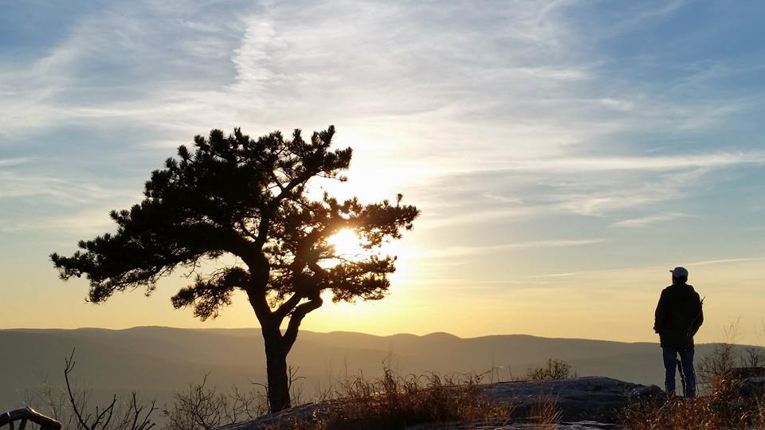
Proclaiming the WORD (Acts 3:12-19 and Luke 24:36-48)
You Are My Witnesses

Slide 19
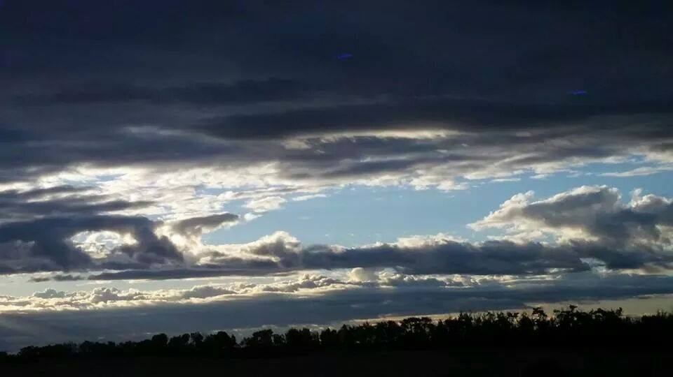
Responding Hymn # 251 “Christ Has Arisen, Alleluia”
Christ has arisen, alleluia. Rejoice and praise him, alleluia. For our redeemer burst from the tomb, even from death, dispelling its gloom.

Slide 20
Responding Hymn # 251 “Christ Has Arisen, Alleluia”
Let us sing praise to him with endless joy. Death's fearful sting
he has come to destroy. Our sin forgiving, alleluia! Jesus is living, alleluia!

Slide 21
Responding Hymn # 251 “Christ Has Arisen, Alleluia”
For three long days the grave did its worst until its strength by God was dispersed. He who gives life did death undergo, and in its conquest his might did show.

Slide 22
Responding Hymn # 251 “Christ Has Arisen, Alleluia”
Let us sing praise to him with endless joy. Death's fearful sting
he has come to destroy. Our sin forgiving, alleluia! Jesus is living, alleluia!

Slide 23
Responding Hymn # 251 “Christ Has Arisen, Alleluia”
The angel said to them, "Do not fear. You look for Jesus who is not here. See for yourselves the tomb is all bare. Only the grave clothes are lying there."

Slide 24
Responding Hymn # 251 “Christ Has Arisen, Alleluia”
Let us sing praise to him with endless joy. Death's fearful sting
he has come to destroy. Our sin forgiving, alleluia! Jesus is living, alleluia!

Slide 25
Responding Hymn # 251 “Christ Has Arisen, Alleluia”
"Go spread the news:
he's not in the grave. He has arisen this world to save. Jesus' redeeming labors are done. Even the battle with sin is won."

Slide 26
Responding Hymn # 251 “Christ Has Arisen, Alleluia”
Let us sing praise to him with endless joy. Death's fearful sting
he has come to destroy. Our sin forgiving, alleluia! Jesus is living, alleluia!

Slide 27
Responding Hymn # 251 “Christ Has Arisen, Alleluia”
Christ has arisen to set us free. Alleluia, to him praises be. Jesus is living! Let us all sing; he reigns triumphant, heavenly King.

Slide 28
Responding Hymn # 251 “Christ Has Arisen, Alleluia”
Let us sing praise to him with endless joy. Death's fearful sting
he has come to destroy. Our sin forgiving, alleluia! Jesus is living, alleluia!

Slide 29
Bearing and Following the WORD into the World An Easter Affirmation of Faith
By: Brian Miller
We believe in God the Father, who created the world, was faithful when we were not, and who continuously seeks to redeem the world.
We believe in God the Son, Jesus Christ, who humbled himself by becoming human and moving into our neighborhood; was sent by the Father to give us life; embodied and taught the righteous love of God; and who, though he knew no sin, became sin and was put to death on a cross.

Slide 30
Bearing and Following the WORD into the World
We believe that three days later, Jesus Christ was raised from the dead by the power of God; was seen in bodily form by his disciples.
We believe that the life, death, and resurrection of Jesus gives us victory over any form of sin and brokenness and allows us to know the full love of God for the world.
We believe in God the Holy Spirit, who actively works in our lives, giving us grace to be like Jesus, and sends us to show God’s love for the world.

Slide 31
Bearing and Following the WORD into the World Announcements &
Sharing of Joys and Concerns
The afternoon Bible Study Group will be meeting today downstairs at 12:30 in the basement.
The Women's Group will continue to meet on Wednesdays at 7:30pm over at the Manse
(2048 E 14th Street). They are currently studying
the book of Isaiah. For more information, please
contact Margaret or Cara.

Slide 32
Bearing and Following the WORD into the World Prayer of the People & The Lord’s Prayer
Our Father, who art in heaven.
Halloweth be thy name.
Thy Kingdom come; Thy will be done
On earth as it is in heaven.
Give us this day our daily bread.
Forgive us our debts; as we forgive our debtors.
Lead us not into temptations, but deliver us from evil.
For Thine is the Kingdom, the Power, and the Glory forever. Amen.

Slide 33
Bearing and Following the WORD into the World Offering of our Gifts and our Lives
Musical Offering

Slide 34
Bearing and Following the WORD into the World Doxology and Offertory Prayer

Slide 35
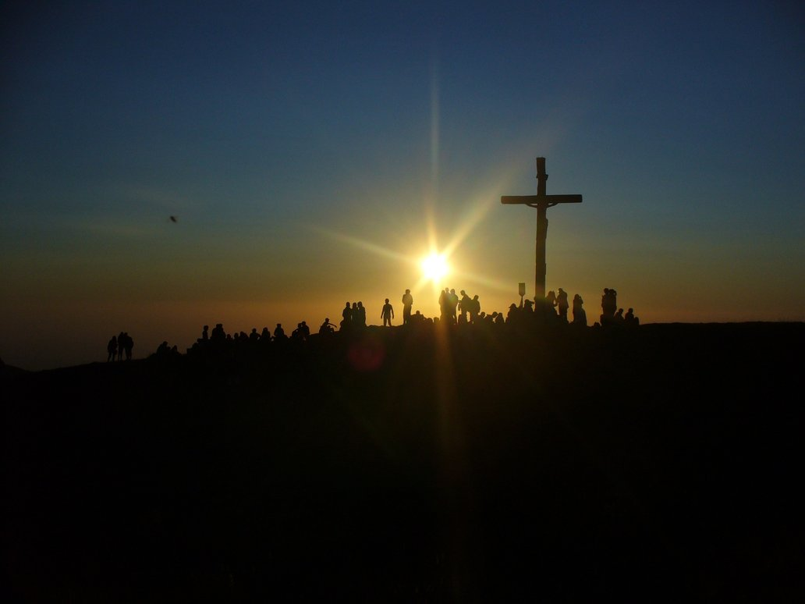
Sending Hymn #245 “Christ the Lord is Risen Today”
Christ the Lord is risen today! Alleluia! All creation, join to say: Alleluia! Raise your joys and triumphs high, Alleluia! Sing, O heavens, and earth reply, Alleluia!

Slide 36
Sending Hymn #245 “Christ the Lord is Risen Today”
Love’s redeeming work is done, Alleluia! Fought the fight, the battle won, Alleluia! Death in vain forbids him rise, Alleluia! Christ has opened paradise. Alleluia!

Slide 37
Sending Hymn #245 “Christ the Lord is Risen Today”
Lives again our glorious King, Alleluia! Where, O death, is now your sting? Alleluia! Jesus died, our souls to save, Alleluia! Where your victory, O grave? Alleluia!

Slide 38
Sending Hymn #245 “Christ the Lord is Risen Today”
Hail the Lord of earth and heaven! Alleluia! Praise to you by both be given, Alleluia! Every knee to you shall bow, Alleluia! Risen Christ, triumphant now. Alleluia!

Slide 39
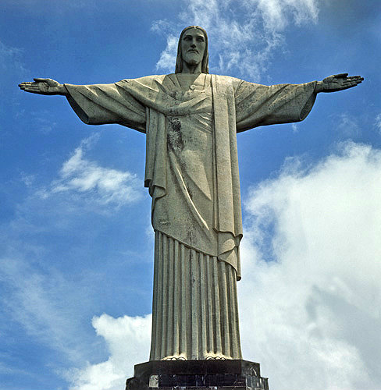
Bearing and Following the WORD into the World The Charge and Benediction

Slide 40
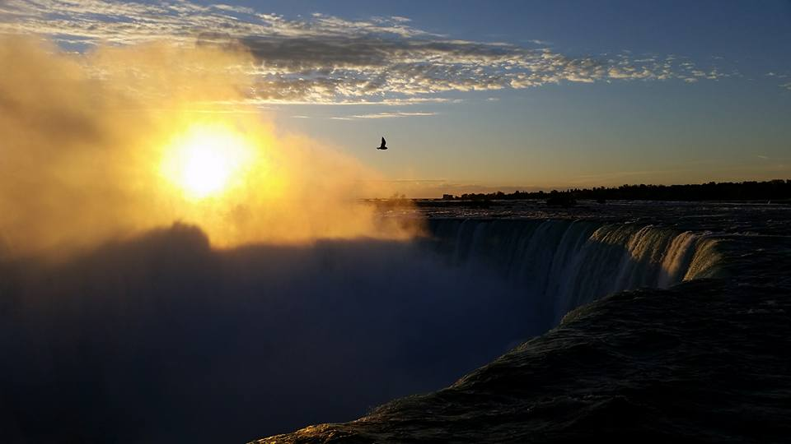
Bearing and Following the WORD into the World Benediction Response
# 547 “Go, My Children, with My Blessing”
(Stanza 2)
Go, my children, sins forgiven,
at peace and pure. Here you learned how much I love you,
what I can cure. Here you heard my dear Son’s story;
here you touched him, saw his glory. Go, my children, sins forgiven,
at peace and pure.”

Slide 41
Homecrest Presbyterian Church Worship of the Lord’s Day 3rd Sunday of Easter, April 15th, 2018

