Slide 1
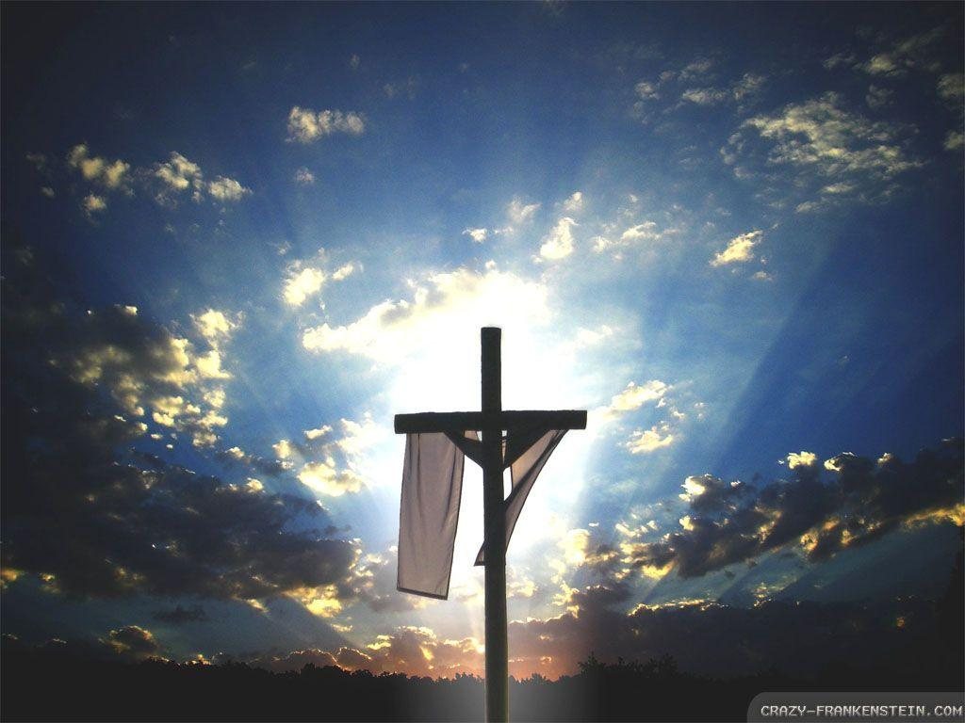
Homecrest Presbyterian Church Worship of the Lord’s Day 2nd Sunday of Easter, April 8th, 2018

Slide 2
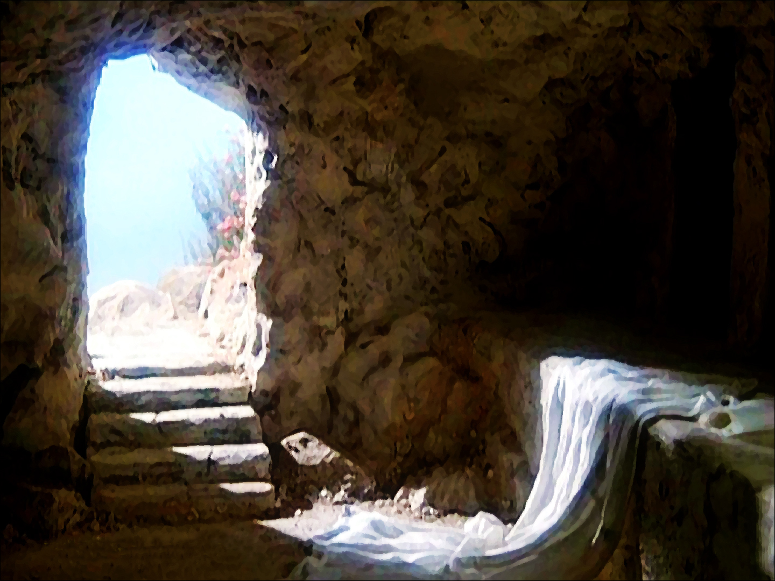
Gathering Around the WORD Call to Worship
(Based on Psalm 133:1-3, John 20:21-22)
Peace be with you.
How good and pleasant it is
when we live together in unity.
Receive the Holy Spirit.
It is like precious oil on the head,
the blessing of the Lord.

Slide 3
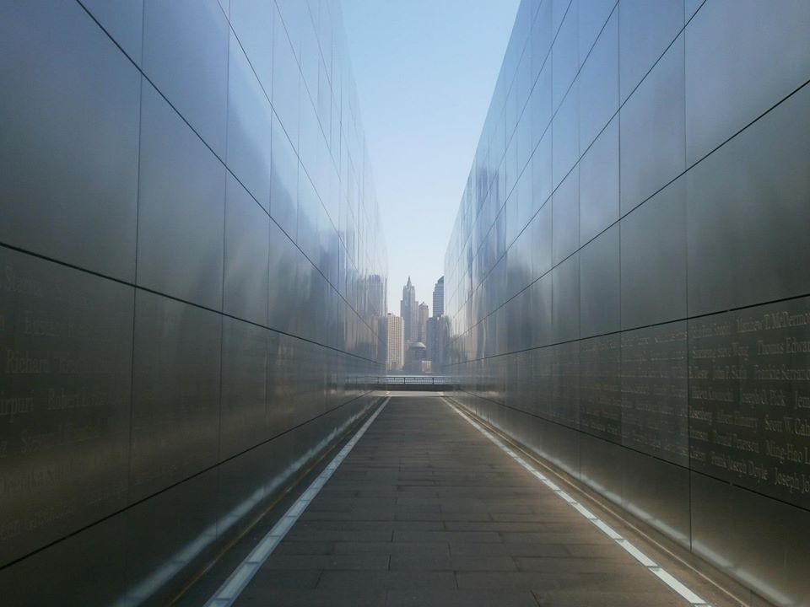
Gathering Around the WORD Gathering Hymn # 248 “Christ is Risen! Shout Hosanna!”
Christ is risen! Shout Hosanna! Celebrate this day of days! Christ is risen! Hush in wonder: all creation is amazed. In the desert all-surrounding, see, a spreading tree has grown. Healing leaves of grace abounding bring a taste of love unknown.

Slide 4
Gathering Around the WORD Gathering Hymn # 248 “Christ is Risen! Shout Hosanna!”
Christ is risen! Raise your spirits from the caverns of despair. Walk with gladness in the morning. See what love can do and dare. Drink the wine of resurrection, not a servant, but a friend. Jesus is our strong companion. Joy and peace shall never end.

Slide 5
Gathering Around the WORD Gathering Hymn # 248 “Christ is Risen! Shout Hosanna!”
Christ is risen! Earth and heaven nevermore shall be the same. Break the bread of new creation where the world is still in pain. Tell its grim, demonic chorus: "Christ is risen! Get you gone!"' God the First and Last is with us. Sing Hosanna everyone!

Slide 6
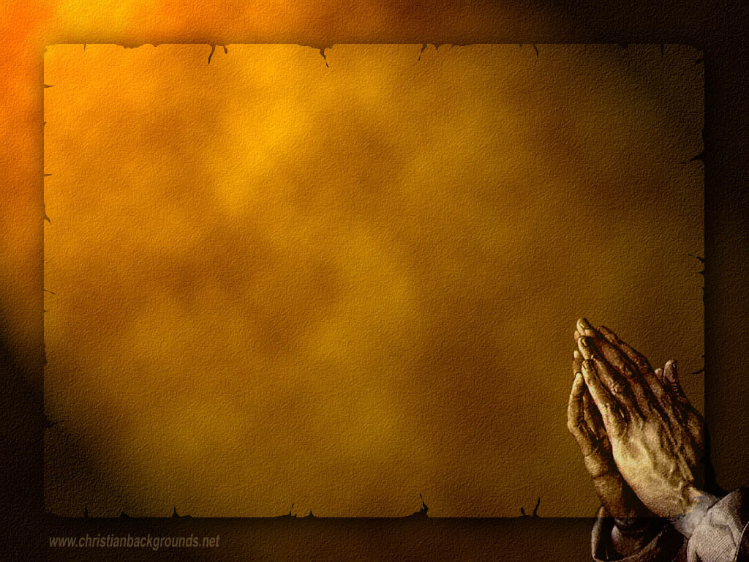
Gathering Around the WORD Call to Confession (Based on 1 John 1:8-9) If we say we have no sin, we deceive ourselves and the truth is not in us. But if we confess our sins, God who is faithful and just will forgive us our sins and cleanse us from all unrighteousness. In humility and faith, let us confess our sins to God in the presence of our neighbors.

Slide 7
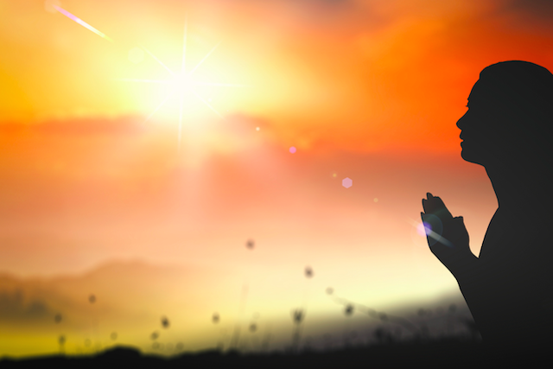
Gathering Around the WORD Prayer of Confession
You have shown yourself to us,
O God, by Word and Spirit, with signs and wonders, in flesh and blood, yet we still struggle to live and believe the good news of Jesus Christ. Have mercy on us, O God. Forgive us. Enter into our lives and cast out our fear so that we may come to trust in you and have life in Jesus’ name, Amen.

Slide 8
Gathering Around the WORD Declaration of Forgiveness
Sisters and brothers, we have an advocate with God – Jesus Christ, the righteous one – who offered his life in love to save the world from sin. This is the good news of the gospel: in Jesus Christ, we are forgiven. Thanks be to God, Amen.

Slide 9
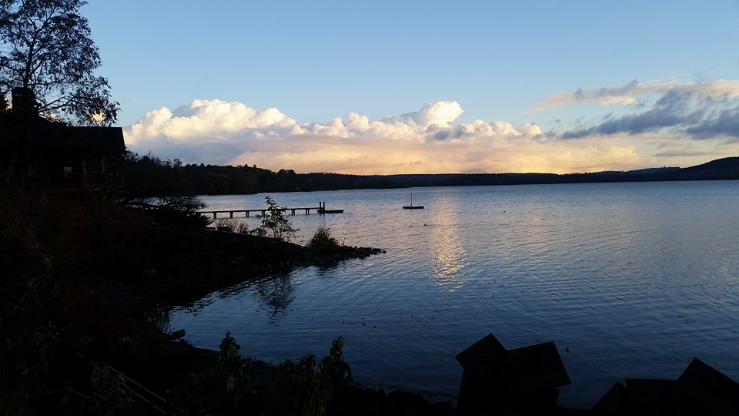
Gathering Around the WORD Gloria Patri
Glory be to the Father
and to the Son and to the Holy Ghost;
As it was in the beginning,
is now, and ever shall be,
world without end. Amen, Amen.

Slide 10
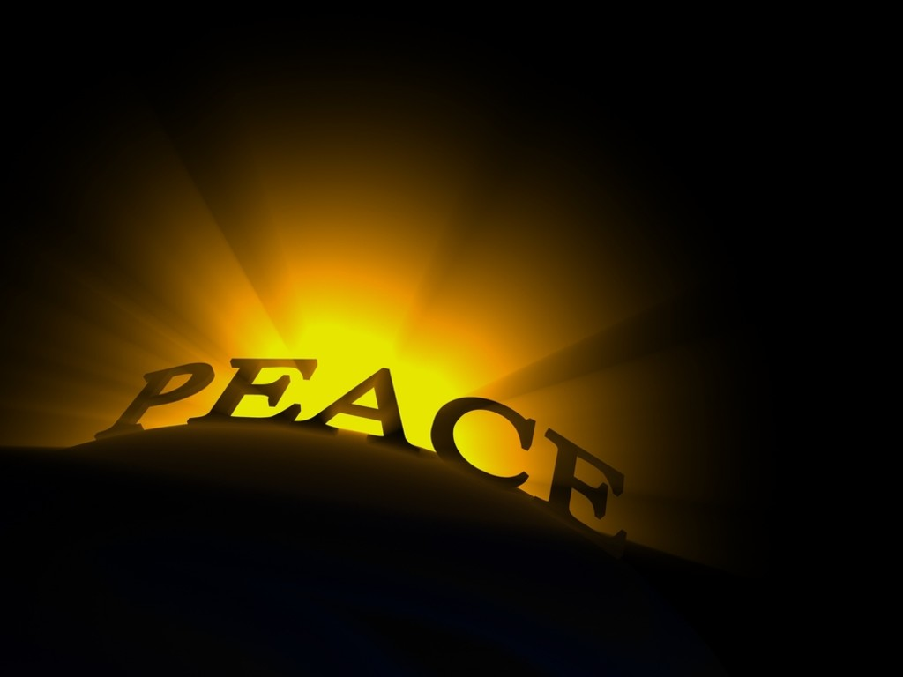
Gathering Around the WORD Passing of the Peace of Christ
(John 14:27) Jesus said, “Peace I leave with you; my peace I give you. I do not give to you as the world gives. Do not let your hearts be troubled and do not be afraid.”
May the Peace of our Lord be with you,
and also with you.

Slide 11
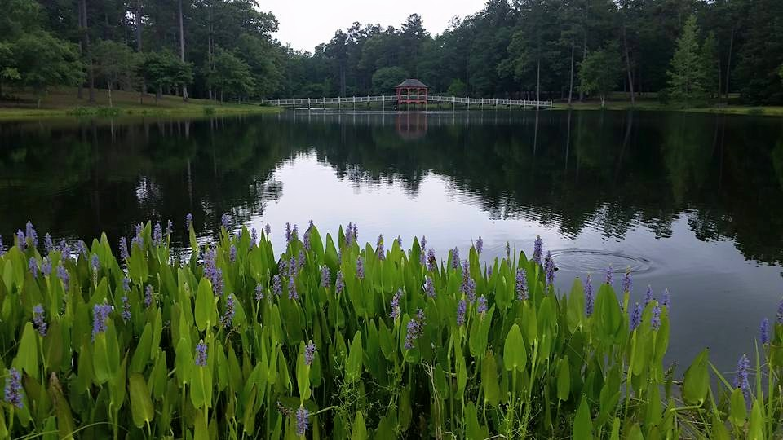
Proclaiming the WORD Message to the Youth/ Prayer of Illumination

Slide 12
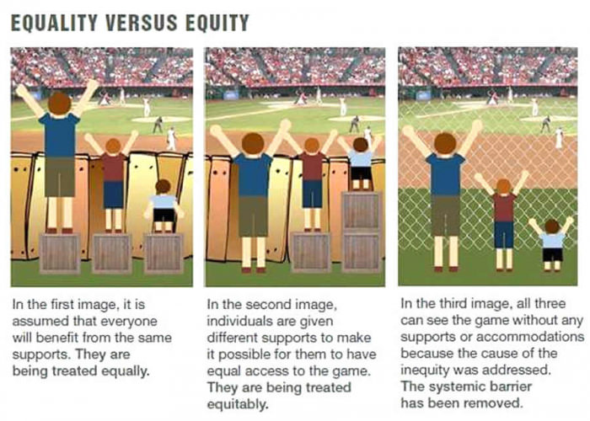
Proclaiming the WORD Message to the Youth/ Prayer of Illumination

Slide 13
Proclaiming the WORD Scripture Reading (1 John 1:1-2:2)
^{1:1}We declare to you what was from the beginning, what we have heard, what we have seen with our eyes, what we have looked at and touched with our hands, concerning the word of life — ²this life was revealed, and we have seen it and testify to it, and declare to you the eternal life that was with the Father and was revealed to us — ³we declare to you what we have seen and heard so that you also may have fellowship with us; and truly our fellowship is with the Father and with his Son Jesus Christ. ⁴We are writing these things so that our joy may be complete.

Slide 14
Proclaiming the WORD Scripture Reading (1 John 1:1-2:2)
⁵This is the message we have heard from him and proclaim to you, that God is light and in him there is no darkness at all. ⁶If we say that we have fellowship with him while we are walking in darkness, we lie and do not do what is true; ⁷but if we walk in the light as he himself is in the light, we have fellowship with one another, and the blood of Jesus his Son cleanses us from all sin.

Slide 15
Proclaiming the WORD Scripture Reading (1 John 1:1-2:2)
⁸If we say that we have no sin, we deceive ourselves, and the truth is not in us. ⁹If we confess our sins, he who is faithful and just will forgive us our sins and cleanse us from all unrighteousness. ¹⁰If we say that we have not sinned, we make him a liar, and his word is not in us.

Slide 16
Proclaiming the WORD Scripture Reading (1 John 1:1-2:2)
^{2:1}My little children, I am writing these things to you so that you may not sin. But if anyone does sin, we have an advocate with the Father, Jesus Christ the righteous; ²and he is the atoning sacrifice for our sins, and not for ours only but also for the sins of the whole world.

Slide 17
Proclaiming the WORD Scripture Reading (Acts 4:32-36)
³²Now the whole group of those who believed were of one heart and soul, and no one claimed private ownership of any possessions, but everything they owned was held in common. ³³With great power the apostles gave their testimony to the resurrection of the Lord Jesus, and great grace was upon them all. ³⁴There was not a needy person among them, for as many as owned lands or houses sold them and brought the proceeds of what was sold. ³⁵ They laid it at the apostles’ feet, and it was distributed to each as any had need.

Slide 18
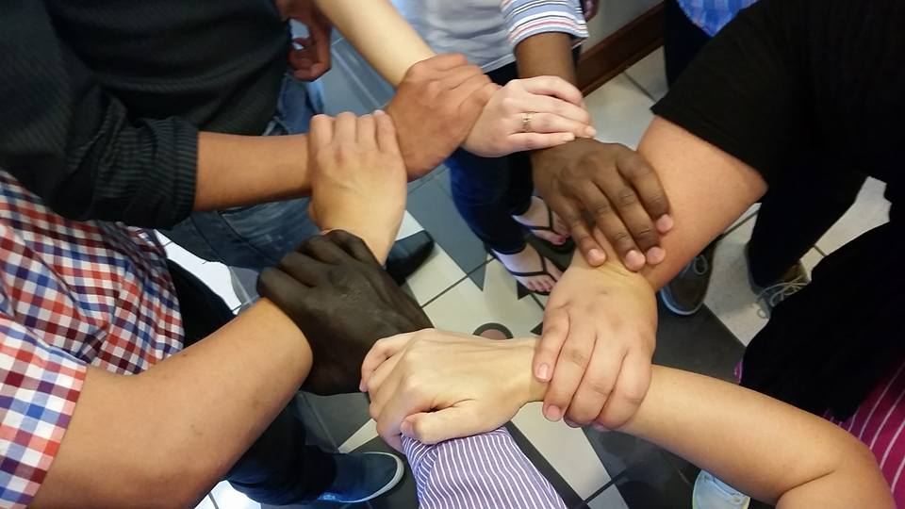
Proclaiming the WORD (Acts 4:32-35 and I John 1:1-2:2)
Sharing Community; Sharing Faith

Slide 19
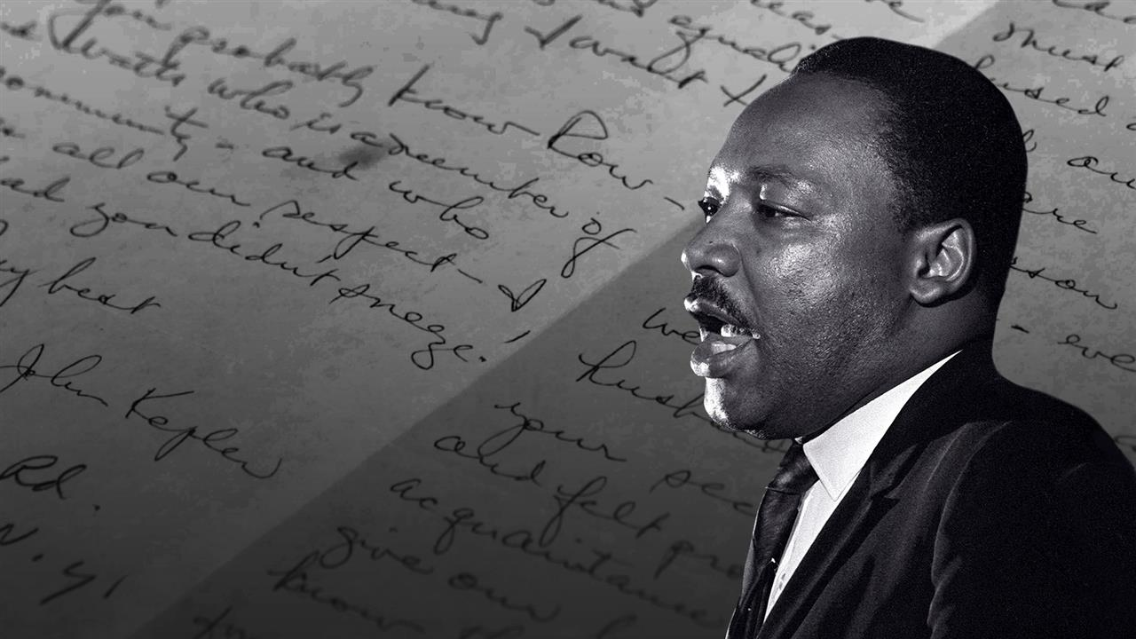
Proclaiming the WORD (Acts 4:32-35 and I John 1:1-2:2)
Sharing Community;
Sharing Faith

Slide 20
Proclaiming the WORD (Acts 4:32-35 and I John 1:1-2:2)
Sharing Community; Sharing Faith

Slide 21
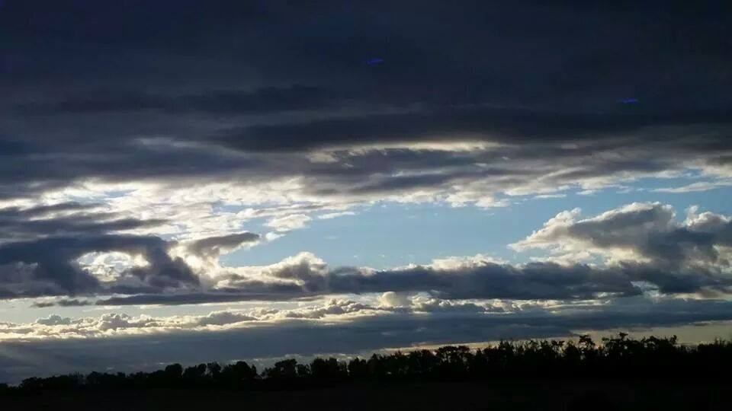
Responding Hymn # 239 “Good Christians All, Rejoice and Sing”
Good Christians all, rejoice and sing! Now is the triumph of our King! To all the world glad news we bring: Alleluia! Alleluia! Alleluia!

Slide 22
Responding Hymn # 239 “Good Christians All, Rejoice and Sing”
The Lord of life is risen today! Death’s mighty stone is rolled away. Let all the earth rejoice and say: Alleluia! Alleluia! Alleluia!

Slide 23
Responding Hymn # 239 “Good Christians All, Rejoice and Sing”
Praise we in songs of victory that love, that life which cannot die, and sing with hearts uplifted high: Alleluia! Alleluia! Alleluia!

Slide 24
Responding Hymn # 239 “Good Christians All, Rejoice and Sing”
Your name we bless, O risen Lord, and sing today with one accord the life laid down, the life restored: Alleluia! Alleluia! Alleluia!

Slide 25
Bearing and Following the WORD into the World An Easter Affirmation of Faith
“I Believe in the Resurrection” By: Ed Baker
I believe in the resurrection.
I believe that Jesus died on the cross,
his hands and feet held to the wood by metal spikes.
I believe that his body was pierced by the soldier’s spear, and even the sun was darkened
as all creation grieved the death of God’s eternal Son.

Slide 26
Bearing and Following the WORD into the World An Easter Affirmation of Faith
“I Believe in the Resurrection” By: Ed Baker
I believe in the resurrection.
I believe that Jesus’ body was placed in a borrowed tomb, where it lay for three days.
I believe that the power of God, his heavenly Father,
brought life to his dead body
and rolled the stone away from the entrance
so all might see that Jesus was no longer there.

Slide 27
Bearing and Following the WORD into the World An Easter Affirmation of Faith
“I Believe in the Resurrection” By: Ed Baker
I believe in the resurrection.
I believe that the unbelievable story of the women was true, just as the angel had announced:
“He is not here; he has risen, just as he said.”

Slide 28
Bearing and Following the WORD into the World An Easter Affirmation of Faith
“I Believe in the Resurrection” By: Ed Baker
I believe in the resurrection.
I believe that there is no force in the universe
that could stop, hinder, contain, or successfully oppose
the risen Savior, my Lord, Jesus Christ.

Slide 29
Bearing and Following the WORD into the World An Easter Affirmation of Faith
“I Believe in the Resurrection” By: Ed Baker
No nails are long enough to hold him to any cross
unless he wills it to be so.
No tomb can be sealed so tightly—
by Pilate or Herod, or Caesar himself.
Were there an army of a thousand men guarding the tomb, it would make no difference.
Jesus said he would lay down his life and take it up again. And he did.

Slide 30
Bearing and Following the WORD into the World An Easter Affirmation of Faith
“I Believe in the Resurrection” By: Ed Baker
I believe in the resurrection.
I believe that Jesus appeared to eleven discouraged, defeated,
demoralized disciples in a room where the doors were locked and all hope was lost.
I believe that when he showed them
his nail-pierced hands and his spear-pierced side,
they fell at his feet and cried out,
“My Lord and my God!”

Slide 31
Bearing and Following the WORD into the World An Easter Affirmation of Faith
“I Believe in the Resurrection” By: Ed Baker
I believe that in the days that followed, hundreds saw him alive.
All their doubt was removed; their fear was gone.
What could the world do to them? Jesus was alive.

Slide 32
Bearing and Following the WORD into the World An Easter Affirmation of Faith
“I Believe in the Resurrection” By: Ed Baker
I believe in the resurrection.
I believe that Jesus lives today—
as powerfully and perfectly alive as he was two thousand years ago,
and for all time past and yet to come.
I believe he empowers his followers to follow in his footsteps, fight the forces of evil,
and find their peace and joy and eternal hope in him.

Slide 33
Bearing and Following the WORD into the World An Easter Affirmation of Faith
“I Believe in the Resurrection” By: Ed Baker
I believe in the resurrection.
I believe that Jesus calls women, men, and children
to join him in changing the world, one heart and life at a time, starting with their own.
One day soon, he will come again on the clouds of heaven with an army of celestial warriors whose numbers are beyond counting
and whose power is beyond imagining.

Slide 34
Bearing and Following the WORD into the World An Easter Affirmation of Faith
“I Believe in the Resurrection” By: Ed Baker
Then Jesus will establish his eternal kingdom,
where there will be no more soldiers or spears
or sepulchers or battles or bleeding wounds or crosses.
I believe all this because
I believe in the resurrection

Slide 35
Bearing and Following the WORD into the World Prayer of the People & The Lord’s Prayer
Our Father, who art in heaven.
Halloweth be thy name.
Thy Kingdom come; Thy will be done
On earth as it is in heaven.
Give us this day our daily bread.
Forgive us our debts; as we forgive our debtors.
Lead us not into temptations, but deliver us from evil.
For Thine is the Kingdom, the Power, and the Glory forever. Amen.

Slide 36
Bearing and Following the WORD into the World Offering of our Gifts and our Lives
Musical Offering

Slide 37
Bearing and Following the WORD into the World Doxology and Offertory Prayer

Slide 38
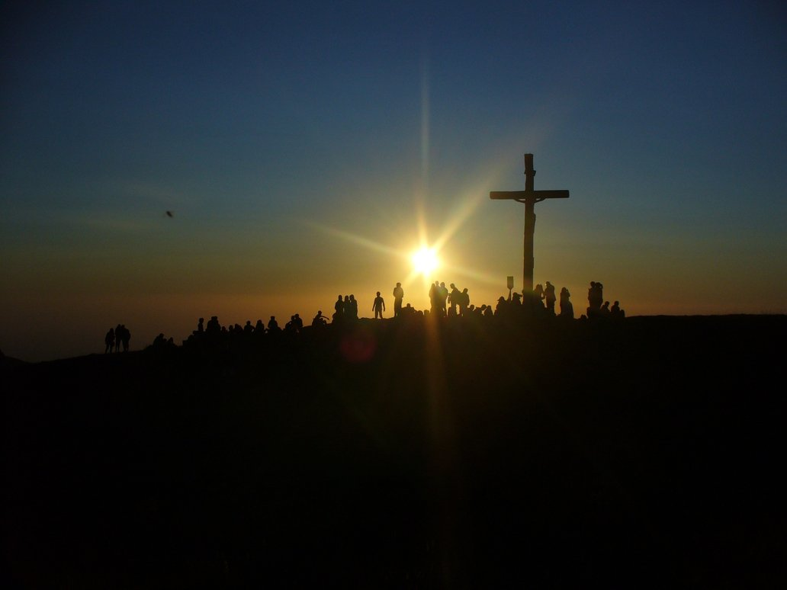
Sending Hymn #249 “Because You Live, O Christ”
Because you live, O Christ, the garden of the world has come to flower; the darkness of the tomb is flooded with your resurrection power.
The stone has rolled away and death cannot imprison! O sing this Easter day, for Jesus Christ has risen, has risen, has risen, has risen!

Slide 39
Sending Hymn #249 “Because You Live, O Christ”
Because you live, O Christ, the spirit bird of hope is freed for flying; our cages of despair no longer keep us closed and life-denying.
The stone has rolled away and death cannot imprison! O sing this Easter day, for Jesus Christ has risen, has risen, has risen, has risen!

Slide 40
Sending Hymn #249 “Because You Live, O Christ”
Because you live, O Christ, the rainbow of your peace will span creation; the colors of your love will draw all humankind to adoration.
The stone has rolled away and death cannot imprison! O sing this Easter day, for Jesus Christ has risen, has risen, has risen, has risen!

Slide 41
Sending Hymn #249 “Because You Live, O Christ”
Because you live, O Christ, the garden of the world has come to flower; the darkness of the tomb is flooded with your resurrection power.
The stone has rolled away and death cannot imprison! O sing this Easter day, for Jesus Christ has risen, has risen, has risen, has risen!

Slide 42
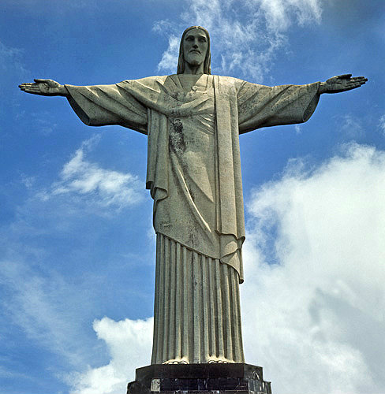
Bearing and Following the WORD into the World The Charge and Benediction

Slide 43
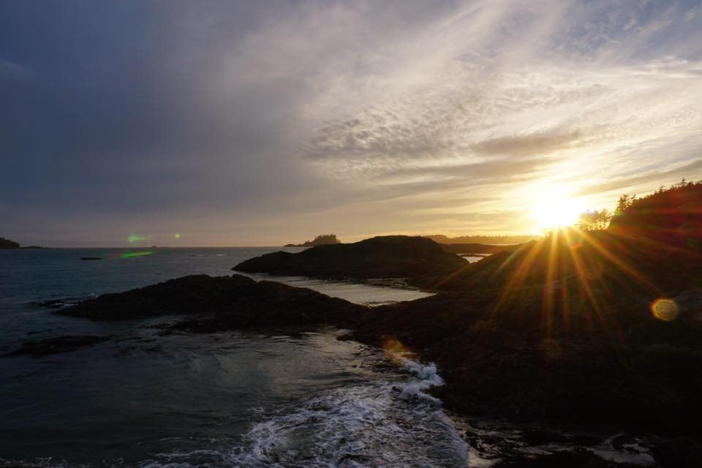
Bearing and Following the WORD into the World Benediction Response
# 547 “Go, My Children, with My Blessing”
(Stanza 1)
“Go, my children, with my blessing,
never alone. Waking, sleeping, I am with you,
you are my own. In my love’s baptismal river
I have made you mine forever. Go, my children, with my blessing,
you are my own.”

Slide 44
Homecrest Presbyterian Church Worship of the Lord’s Day 2nd Sunday of Easter, April 8th, 2018

