Slide 1
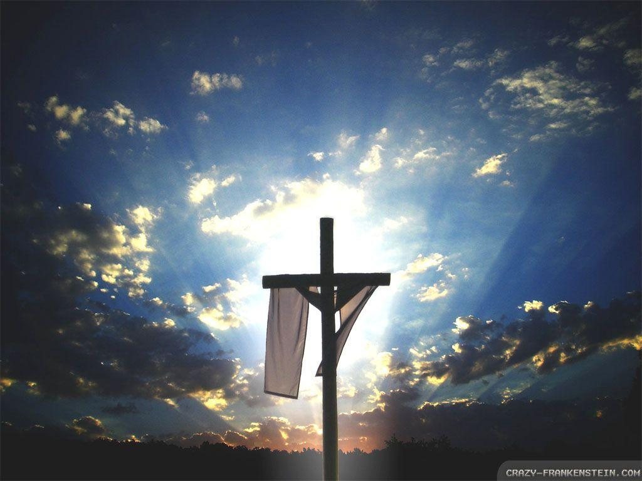
Homecrest Presbyterian Church Worship of the Lord’s Day Resurrection/Easter Sunday, April 1st, 2018

Slide 2
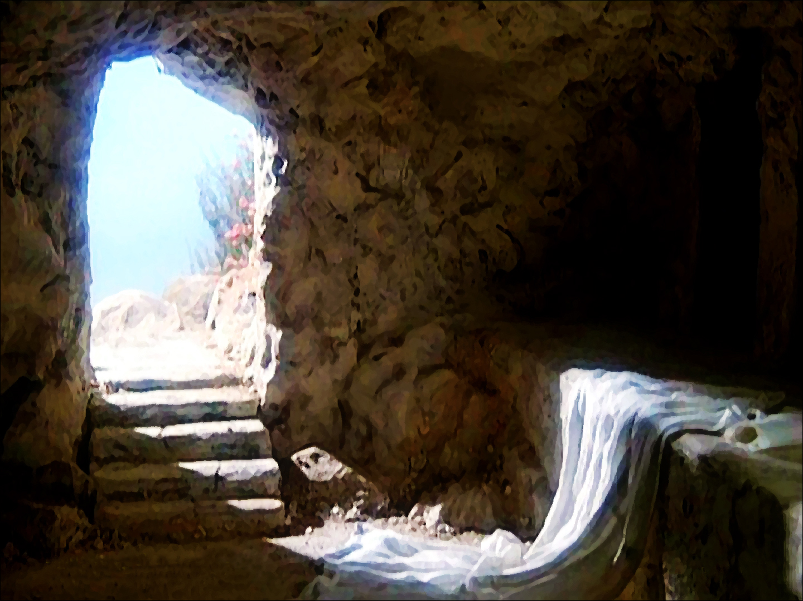
Gathering Around the WORD Call to Worship
(Based on Psalm 118:24)
Alleluia! Christ is risen!
Christ is risen, indeed! Alleluia!
This is the day that the Lord has made;
let us rejoice and be glad in it.
Alleluia! Christ is risen!
Christ is risen, indeed! Alleluia!

Slide 3
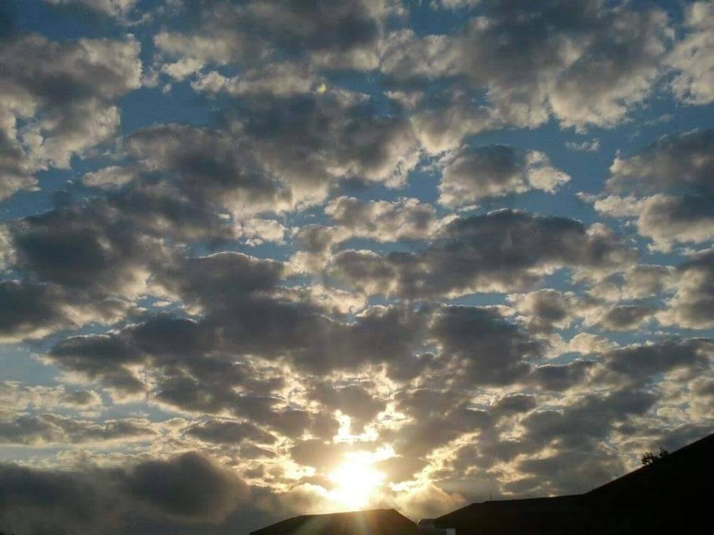
Gathering Around the WORD Gathering Hymn # 238 “Thine is the Glory”
Thine is the glory, risen, conquering Son; endless is the victory thou o'er death hast won. Angels in bright raiment rolled the stone away, kept the folded grave-clothes where thy body lay. Thine is the glory, risen, conquering Son; endless is the victory thou o'er death hast won.

Slide 4
Gathering Around the WORD Gathering Hymn # 238 “Thine is the Glory”
Thine is the glory, risen, conquering Son; endless is the victory thou o'er death hast won.

Slide 5
Gathering Around the WORD Gathering Hymn # 238 “Thine is the Glory”
Lo! Jesus meets us, risen from the tomb; lovingly he greets us, scatters fear and gloom. Let the church with gladness hymns of triumph sing, for the Lord now liveth; death hath lost its sting. Thine is the glory, risen, conquering Son; endless is the victory thou o'er death hast won.

Slide 6
Gathering Around the WORD Gathering Hymn # 238 “Thine is the Glory”
Thine is the glory, risen, conquering Son; endless is the victory thou o'er death hast won.

Slide 7
Gathering Around the WORD Gathering Hymn # 238 “Thine is the Glory”
No more we doubt thee, glorious Prince of life! Life is naught without thee; aid us in our strife. Make us more than conquerors through thy deathless love; bring us safe through Jordan to thy home above.

Slide 8
Gathering Around the WORD Gathering Hymn # 238 “Thine is the Glory”
Thine is the glory, risen, conquering Son; endless is the victory thou o'er death hast won.

Slide 9
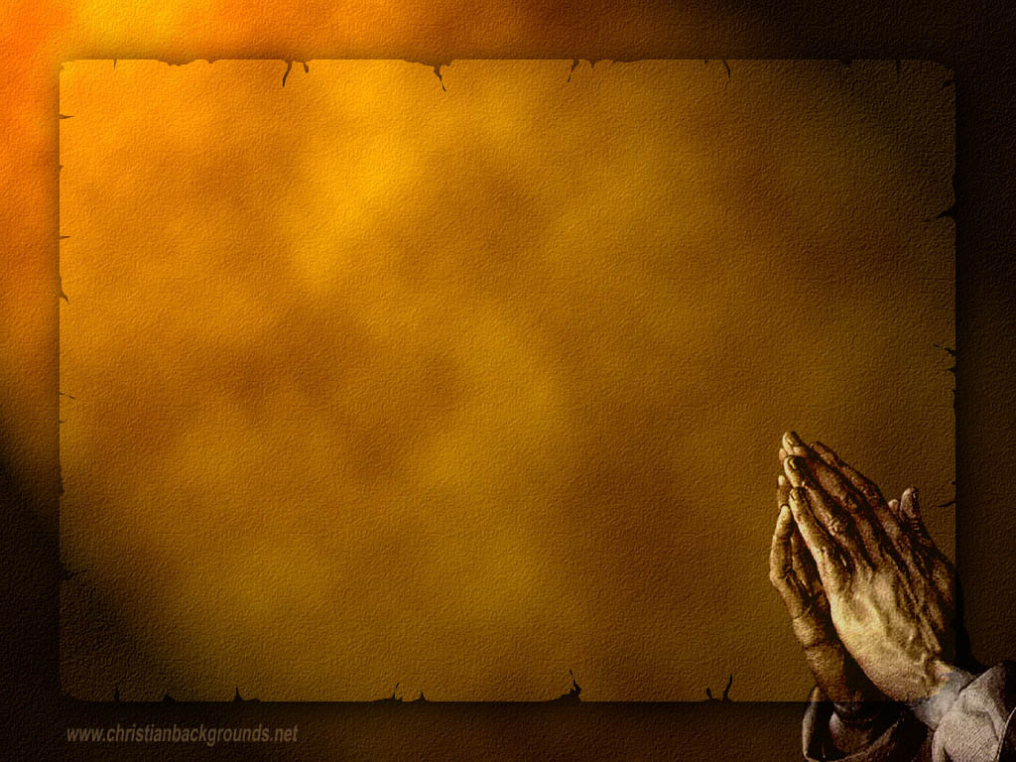
Gathering Around the WORD Call to Confession Through Christ’s resurrection from the dead, he has given us new hope and new life. As evidence of God’s power and victory over the darkness of evil and our sins, let us repent and confess of our sins before God and our neighbors.

Slide 10
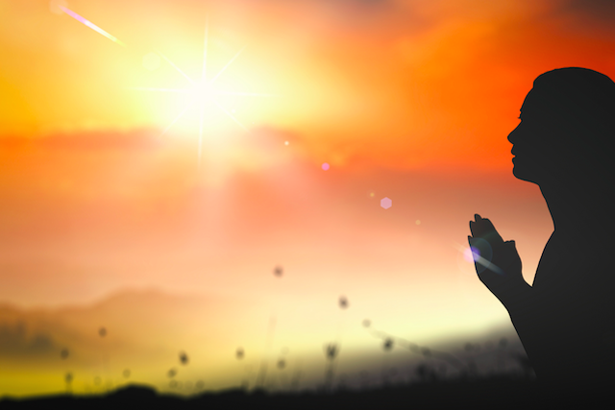
Gathering Around the WORD Prayer of Confession
Risen Christ, through the power of the Holy Spirit, we have been raised from the water of baptism to share in your glorious resurrection. Yet we have not lived as Easter people.
We are unsure of your promise, confused about your will, and afraid in the face of danger. Forgive us O God, let our lives be a testimony to your resurrection through the love of God and by the power of the Holy Spirit. Amen.

Slide 11
Gathering Around the WORD Declaration of Forgiveness
Sisters and Brothers, Hear the good news! Even though Christ has died, but he is alive and lives amongst us right now.
Through our faith, our earthly deaths have already been conquered and our sins forgiven. We can look forward to our life eternal with Christ, through Christ, and in Christ. Thanks be to God, Amen.

Slide 12
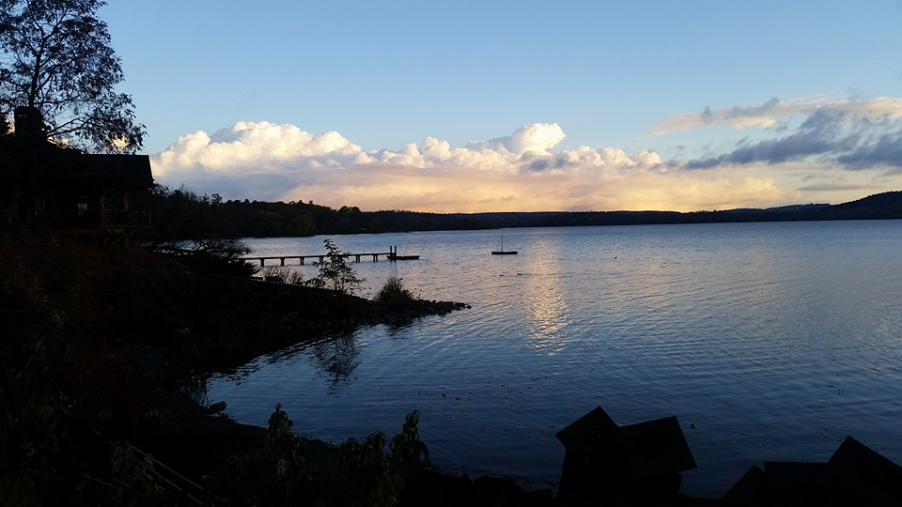
Gathering Around the WORD Gloria Patri
Glory be to the Father
and to the Son and to the Holy Ghost;
As it was in the beginning,
is now, and ever shall be,
world without end. Amen, Amen.

Slide 13
Gathering Around the WORD Passing of the Peace of Christ
(John 14:27) Jesus said, “Peace I leave with you; my peace I give you. I do not give to you as the world gives. Do not let your hearts be troubled and do not be afraid.”
May the Peace of our Lord be with you,
and also with you.

Slide 14
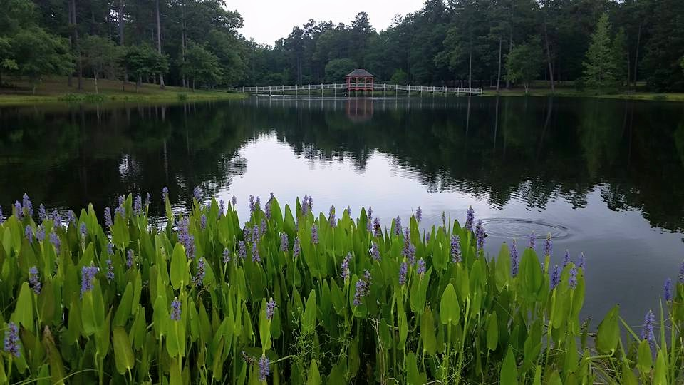
Proclaiming the WORD Message to the Youth/ Prayer of Illumination

Slide 15
Proclaiming the WORD Scripture Reading (Luke 24:13-49)
¹³ Now on that same day two of them were going to a village called Emmaus, about seven miles from Jerusalem, ¹⁴and talking with each other about all these things that had happened. ¹⁵While they were talking and discussing, Jesus himself came near and went with them, ¹⁶but their eyes were kept from recognizing him. ¹⁷And he said to them, “What are you discussing with each other while you walk along?” They stood still, looking sad.

Slide 16
Proclaiming the WORD Scripture Reading (Luke 24:13-49)
¹⁸Then one of them, whose name was Cleopas, answered him, “Are you the only stranger in Jerusalem who does not know the things that have taken place there in these days?” ¹⁹He asked them, “What things?” They replied, “The things about Jesus of Nazareth, who was a prophet mighty in deed and word before God and all the people, ²⁰and how our chief priests and leaders handed him over to be condemned to death and crucified him. ²¹But we had hoped that he was the one to redeem Israel. Yes, and besides all this, it is now the third day since these things took place.

Slide 17
Proclaiming the WORD Scripture Reading (Luke 24:13-49)
²²Moreover, some women of our group astounded us. They were at the tomb early this morning, ²³and when they did not find his body there, they came back and told us that they had indeed seen a vision of angels who said that he was alive. ²⁴Some of those who were with us went to the tomb and found it just as the women had said;
but they did not see him.”

Slide 18
Proclaiming the WORD Scripture Reading (Luke 24:13-49)
Then he said to them, “Oh, how foolish you are, and how slow of heart to believe all that the prophets have declared! ²⁶Was it not necessary that the Messiah should suffer these things and then enter into his glory?” ²⁷Then beginning with Moses and all the prophets, he interpreted to them the things about himself in all the scriptures.

Slide 19
Proclaiming the WORD Scripture Reading (Luke 24:13-49)
²⁸As they came near the village to which they were going, Jesus walked ahead as if he were going on. ²⁹But they urged him strongly, saying, “Stay with us, because it is almost evening and the day is now nearly over.” So Jesus went in to stay with them. ³⁰When he was at the table with them, he took bread, blessed and broke it, and gave it to them. ³¹Then their eyes were opened, and they recognized him; and he vanished from their sight. ³²They said to each other, “Were not our hearts burning within us while he was talking to us on the road, while he was opening the scriptures to us?”

Slide 20
Proclaiming the WORD Scripture Reading (Luke 24:13-49)
³³That same hour they got up and returned to Jerusalem; and they found the eleven and their companions gathered together. ³⁴They were saying, “The Lord has risen indeed, and he has appeared to Simon!” ³⁵Then they told what had happened on the road, and how he had been made known to them in the breaking of the bread.

Slide 21
Proclaiming the WORD Scripture Reading (Luke 24:13-49)
³⁶While they were talking about this, Jesus himself stood among them and said to them, “Peace be with you.” ³⁷They were startled and terrified, and thought that they were seeing a ghost. ³⁸He said to them, “Why are you frightened, and why do doubts arise in your hearts? ³⁹Look at my hands and my feet; see that it is I myself. Touch me and see; for a ghost does not have flesh and bones as you see that I have.”

Slide 22
Proclaiming the WORD Scripture Reading (Luke 24:13-49)
⁴⁰And when he had said this, he showed them his hands and his feet. ⁴¹While in their joy they were disbelieving and still wondering, he said to them, “Have you anything here to eat?” ⁴²They gave him a piece of broiled fish, ⁴³and he took it and ate in their presence.

Slide 23
Proclaiming the WORD Scripture Reading (Luke 24:13-49)
⁴⁴Then he said to them, “These are my words that I spoke to you while I was still with you — that everything written about me in the law of Moses, the prophets, and the psalms must be fulfilled.” ⁴⁵Then he opened their minds to understand the scriptures, ⁴⁶and he said to them, “Thus it is written, that the Messiah is to suffer and to rise from the dead on the third day, ⁴⁷and that repentance and forgiveness of sins is to be proclaimed in his name to all nations, beginning from Jerusalem. ⁴⁸You are witnesses of these things. ⁴⁹And see, I am sending upon you what my Father promised; so stay here in the city until you have been clothed with power from on high.”

Slide 24
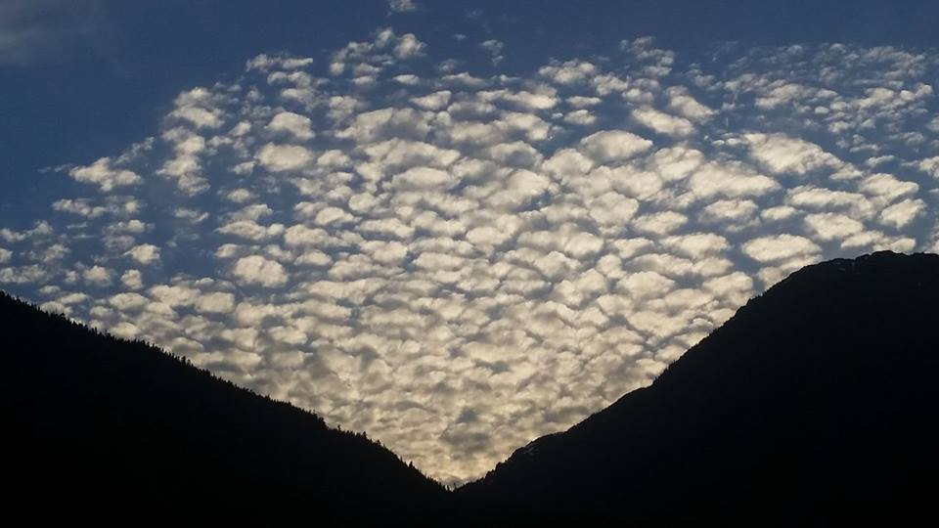
Proclaiming the WORD (Luke 24:13-49)
Don’t Be Fooled; Be My Witnesses

Slide 25
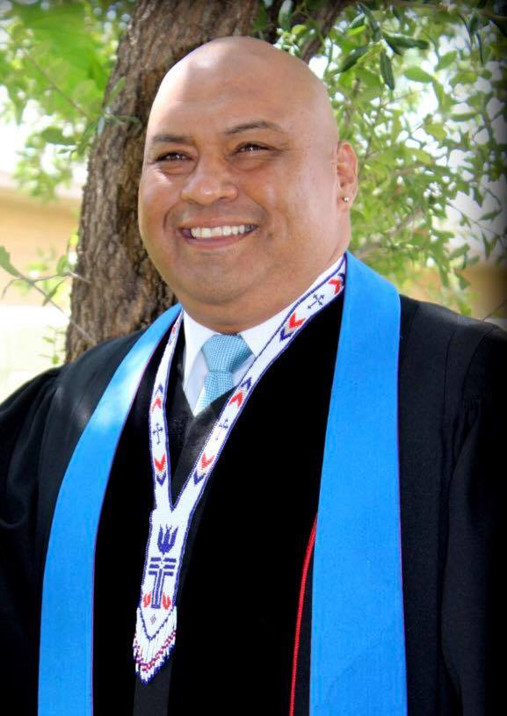
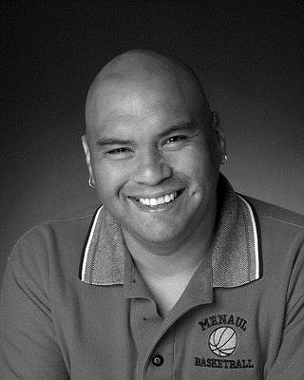
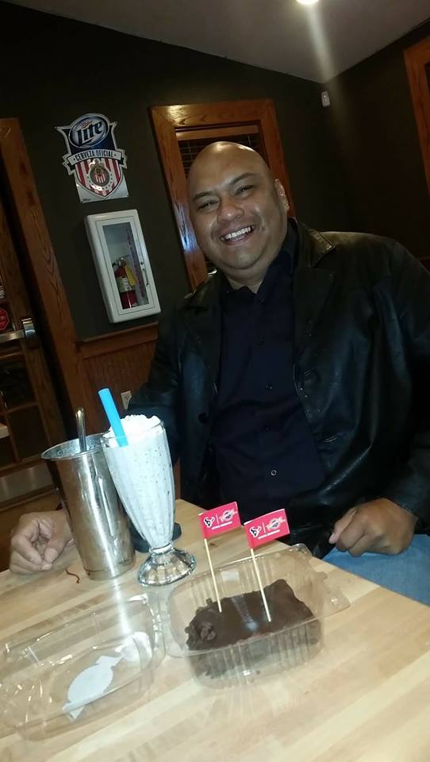
Proclaiming the WORD (Luke 24:13-49)
Don’t Be Fooled; Be My Witnesses

Slide 26
Proclaiming the WORD (Luke 24:13-49)
Don’t Be Fooled; Be My Witnesses

Slide 27
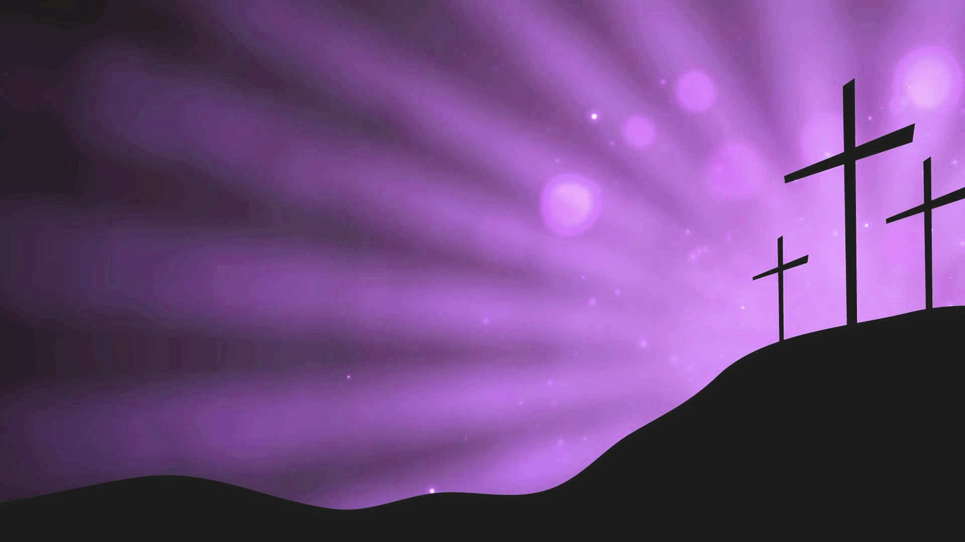
Responding Hymn # 232 “Jesus Christ is Risen Today”
Jesus Christ is risen today, Alleluia! our triumphant holy day, Alleluia! who did once upon the cross, Alleluia! suffer to redeem our loss. Alleluia!

Slide 28
Responding Hymn # 232 “Jesus Christ is Risen Today”
Hymns of praise then let us sing, Alleluia! unto Christ, our heavenly King, Alleluia! who endured the cross and grave, Alleluia! sinners to redeem and save. Alleluia!

Slide 29
Responding Hymn # 232 “Jesus Christ is Risen Today”
But the pains which he endured, Alleluia! our salvation have procured. Alleluia! Now above the sky he's King, Alleluia! where the angels ever sing. Alleluia!

Slide 30
Responding Hymn # 232 “Jesus Christ is Risen Today”
Sing we to our God above, Alleluia! praise eternal as God's love. Alleluia! Praise our God, ye heavenly host, Alleluia! Father, Son, and Holy Ghost. Alleluia!

Slide 31
Bearing and Following the WORD into the World An Easter Affirmation of Faith
By: Brian Miller
We believe in God the Father, who created the world, was faithful when we were not, and who continuously seeks to redeem the world.
We believe in God the Son, Jesus Christ, who humbled himself by becoming human and moving into our neighborhood; was sent by the Father to give us life; embodied and taught the righteous love of God; and who, though he knew no sin, became sin and was put to death on a cross.

Slide 32
Bearing and Following the WORD into the World An Easter Affirmation of Faith
By: Brian Miller
We believe that three days later, Jesus Christ was raised from the dead by the power of God; was seen in bodily form by his disciples.
We believe that the life, death, and resurrection of Jesus gives us victory over any form of sin and brokenness and allows us to know the full love of God for the world.

Slide 33
Bearing and Following the WORD into the World An Easter Affirmation of Faith
By: Brian Miller
We believe in God the Holy Spirit, who actively works in our lives, giving us grace to be like Jesus, and sends us to show God’s love for the world.

Slide 34
Bearing and Following the WORD into the World Announcements &
Sharing of Joys and Concerns
The afternoon Bible Study Group will NOT be meeting today. It will continue today downstairs at 12:30 in the basement.
The Women's Group will continue to meet on Wednesdays at 7:30pm over at the Manse
(2048 E 14th Street). They are currently studying
the book of Isaiah. For more information, please
contact Margaret or Cara.
The next Session Meeting will be Monday, 4/9

Slide 35
Bearing and Following the WORD into the World Prayer of the People & The Lord’s Prayer
Our Father, who art in heaven.
Halloweth be thy name.
Thy Kingdom come; Thy will be done
On earth as it is in heaven.
Give us this day our daily bread.
Forgive us our debts; as we forgive our debtors.
Lead us not into temptations, but deliver us from evil.
For Thine is the Kingdom, the Power, and the Glory forever. Amen.

Slide 36
Bearing and Following the WORD into the World Offering of our Gifts and our Lives
Musical Offering

Slide 37
Bearing and Following the WORD into the World Doxology and Offertory Prayer

Slide 38
Bearing and Following the WORD into the World Holy Communion Hymn
# 460 “Break Thou The Bread of Life”
Break thou the bread of life, dear Lord, to me, as thou didst break the loaves beside the sea. Beyond the sacred page I seek thee, Lord. My spirit pants for thee, O living Word!

Slide 39
Bearing and Following the WORD into the World Holy Communion Hymn
# 460 “Break Thou The Bread of Life”
Bless thou the truth, dear Lord, now unto me, as thou didst bless the bread by Galilee. Then shall all bondage cease, all fetters fall. And I shall find my peace, my all in all.

Slide 40
Bearing and Following the WORD into the World Holy Communion Hymn
# 460 “Break Thou The Bread of Life”
Break thou the bread of life, dear Lord, to me, as thou didst break the loaves beside the sea. Beyond the sacred page I seek thee, Lord. My spirit pants for thee, O living Word!

Slide 41
Bearing and Following the WORD into the World Holy Communion
Welcome to the feast of the Thanksgiving that our risen Lord has prepared. We come not because we are righteous or holier than others, but we come because we need God’s saving grace, as exhibited through God’s love being poured out to us upon the cross. So, Come just as you are, in faith and embraced by God’s love.

Slide 42
Bearing and Following the WORD into the World Holy Communion
The Lord be with you. And also with you.
Lift up your hearts. We lift them up to the Lord.
Let us give thanks to the Lord our God.
It is right to give our thanks and praise.

Slide 43
Bearing and Following the WORD into the World Holy Communion
This is the day that you have made, O Lord – the first day of the week, when you created light out of darkness by the power of your Word and Spirit, when you created life out of death, raising Jesus from the grave.

Slide 44
Bearing and Following the WORD into the World Holy Communion
Throughout our lives, we have searched for this light in the midst of darkness. We have come to seek this risen Christ by our faith and not by sight, as we proclaim:
Holy, Holy, Holy Lord, God of power of might,
Heaven and earth are full of your glory.
Hosanna in the highest.
Blessed is he who comes in the name of the Lord.
Hosanna in the highest.

Slide 45
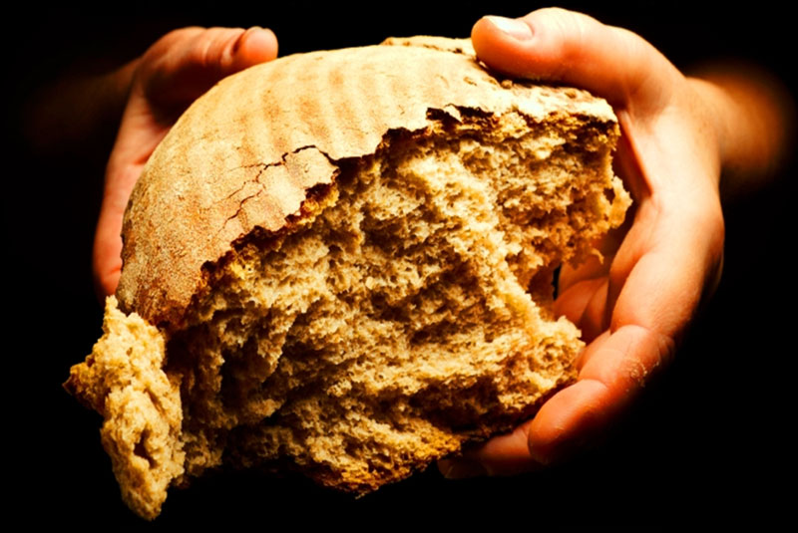
Bearing and Following the WORD into the World Holy Communion
You are holy, O God of majesty, and blessed is Jesus Christ our Lord. We remember how he took bread, and when he had given thanks, he broke it and gave it to his disciples, saying, “This is my body, which is given for you. Do this in remembrance of me.”

Slide 46
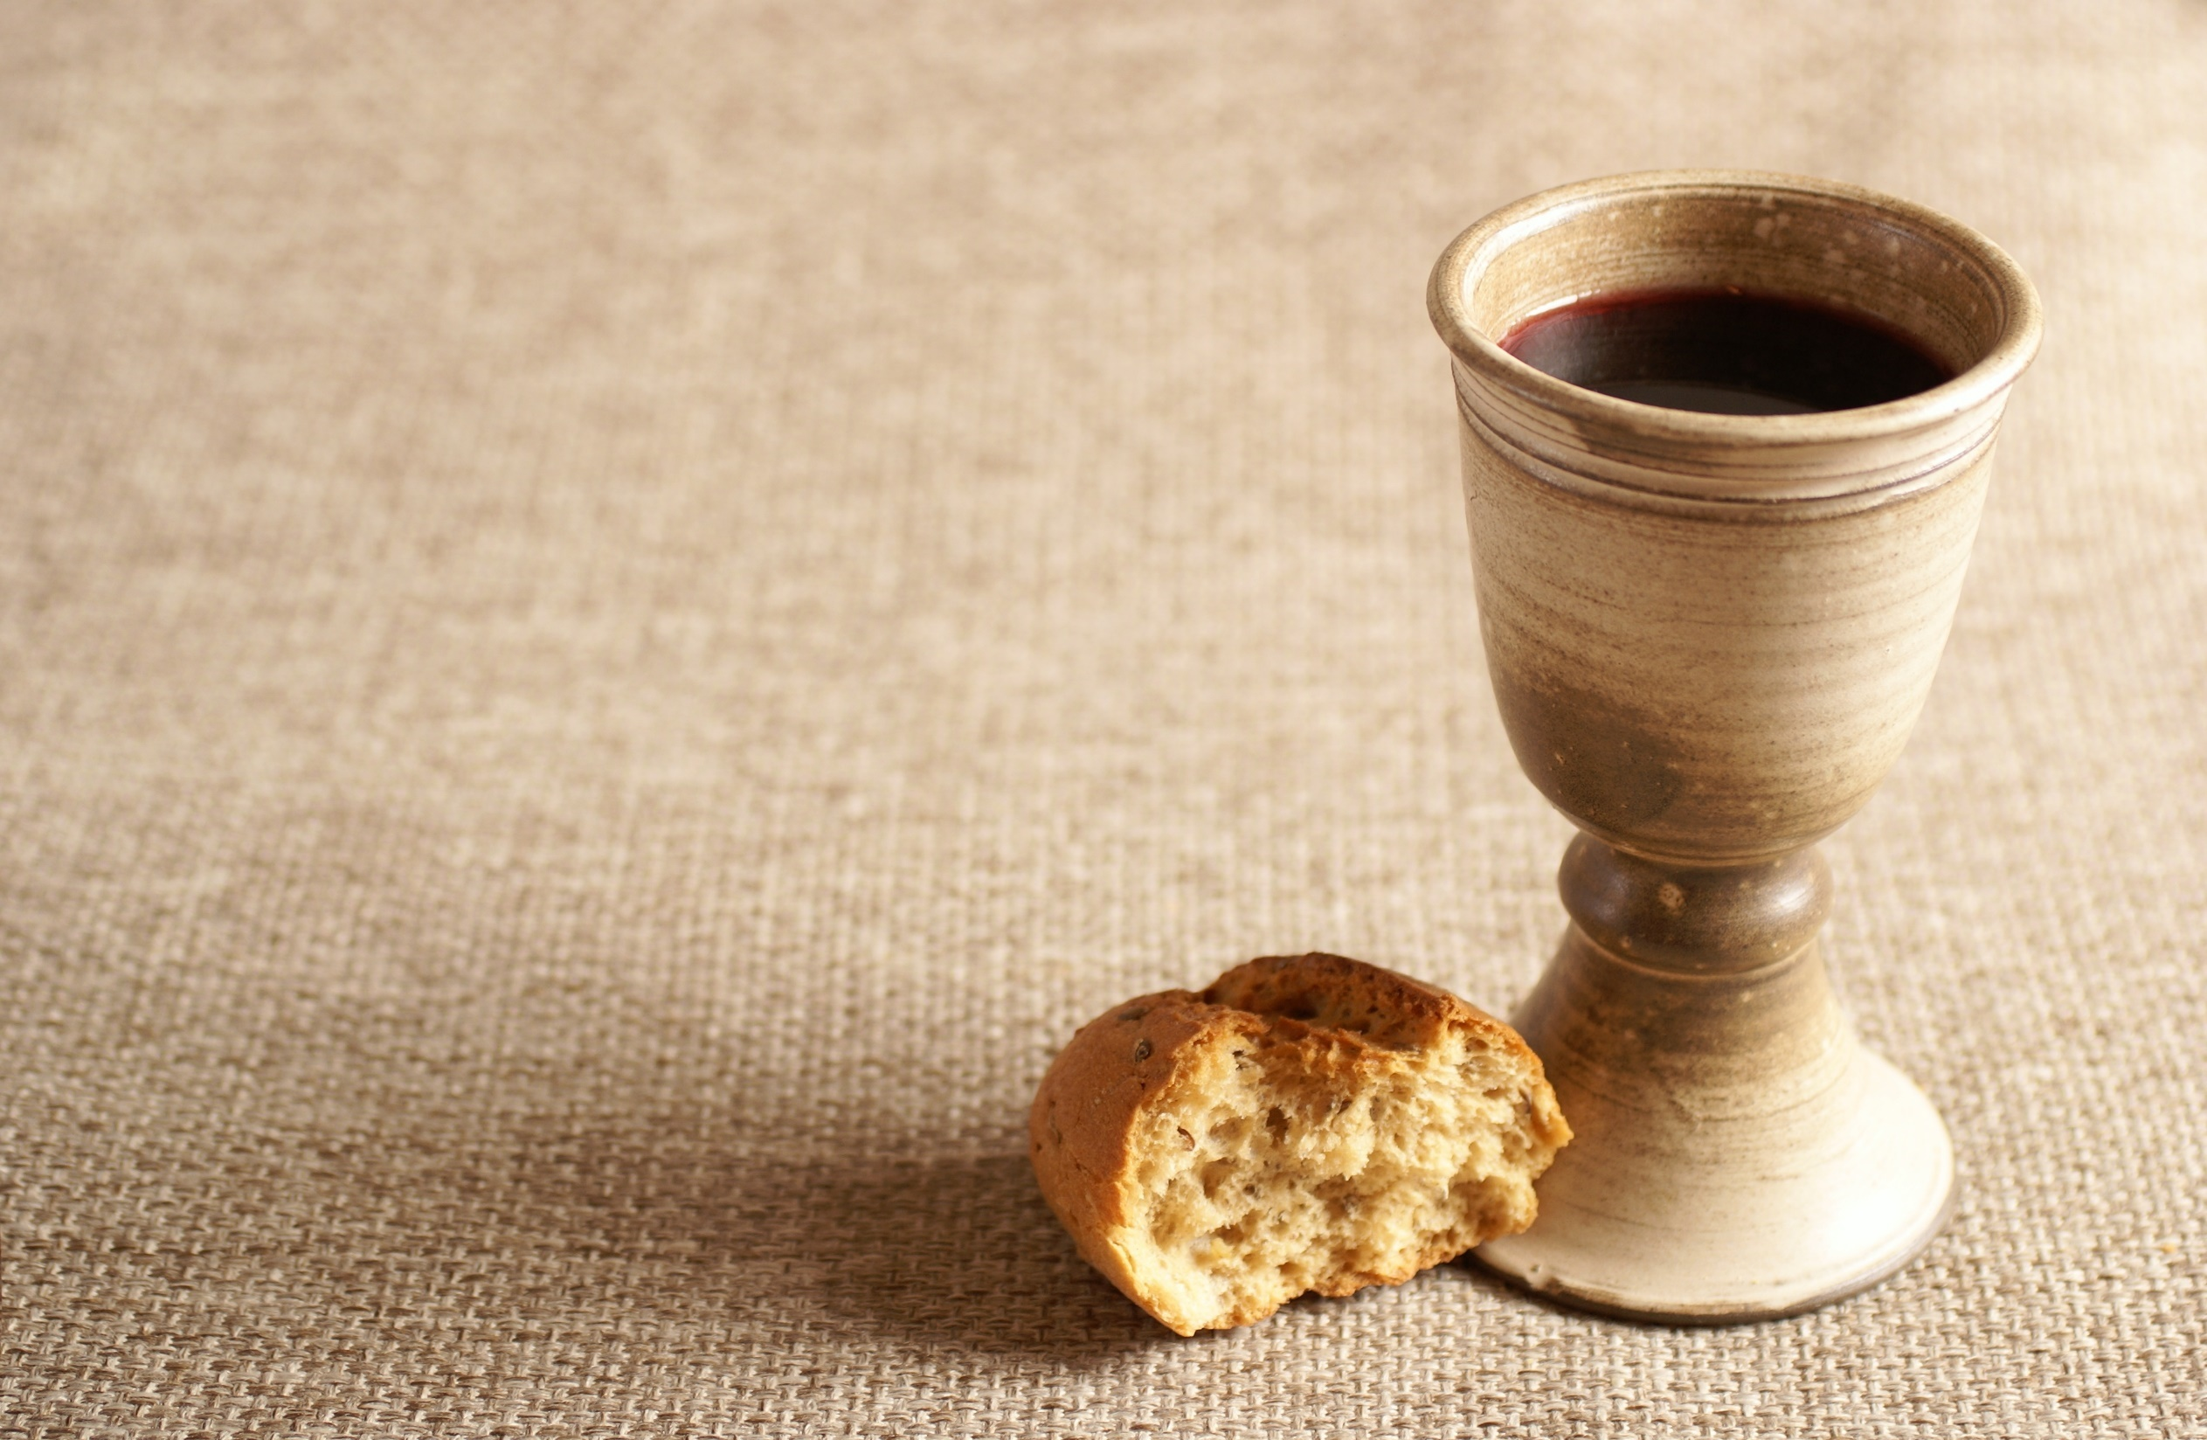
Bearing and Following the WORD into the World Holy Communion
We remember how he took the cup after supper, saying, “This cup that is poured out for you is the new covenant sealed in my blood. Whenever you drink of it. Do this in remembrance of me.”

Slide 47
Bearing and Following the WORD into the World Holy Communion
God of grace, pour out your Holy Spirit upon us and upon these your gifts of bread and wine, that the bread we break and the cup we bless may be the communion of the body and the blood of Christ.

Slide 48
Bearing and Following the WORD into the World Holy Communion
We come as One people and One body in Christ. We seek to exemplify your steadfast love and proclaim the saving grace and the good news of your salvation.

Slide 49
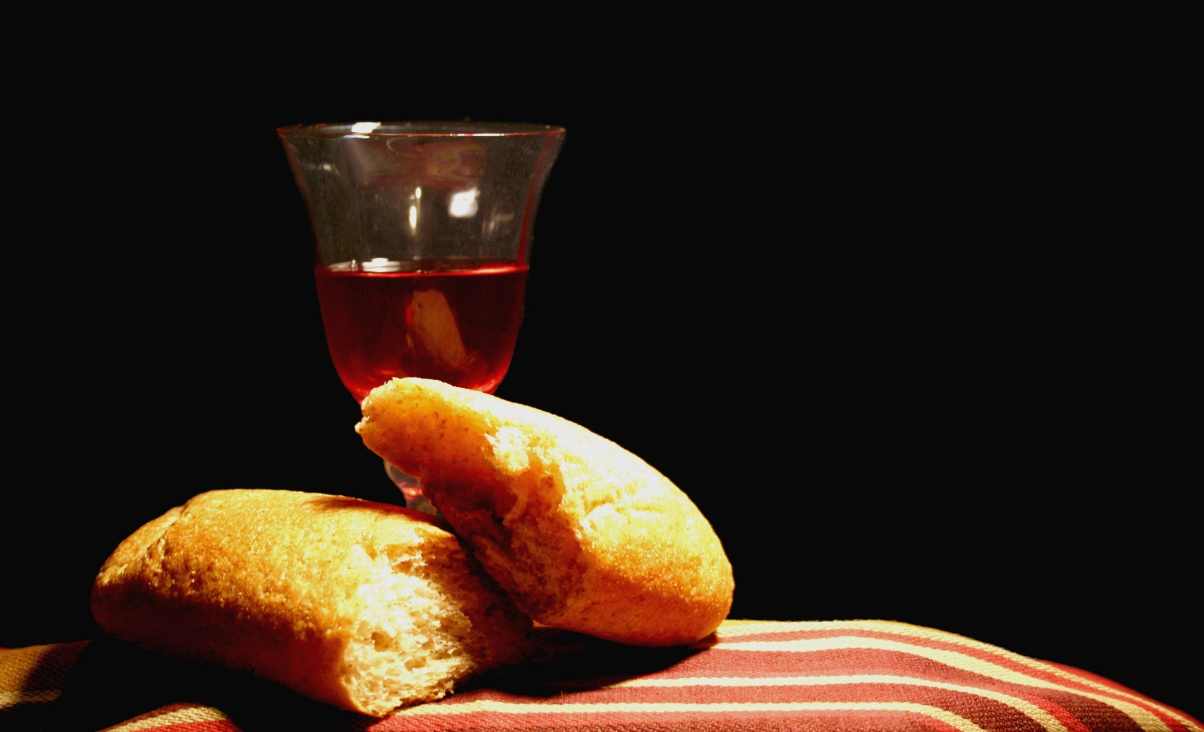
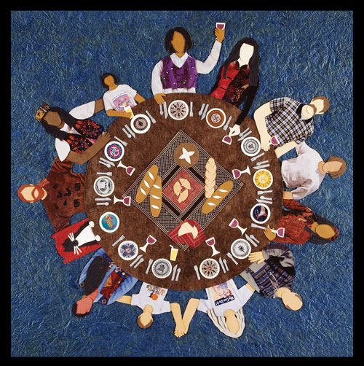
Bearing and Following the WORD into the World Holy Communion

Slide 50
Bearing and Following the WORD into the World
Prayer after the Communion: (in unison)
:
Lead us, O God, by the power of your Spirit to live as love commands. Bound to Christ, set us free for joyful obedience and service. As Jesus gave his life for ours, help us to live our lives for others with humility and persistent courage. Give us strength to serve you faithfully through His presence in our lives. Amen.

Slide 51
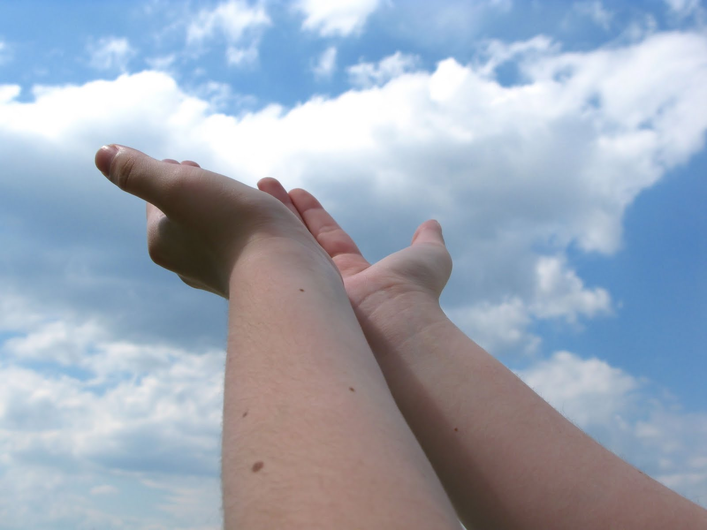
Bearing and Following the WORD into the World Deacons’ Benevolence Offering

Slide 52
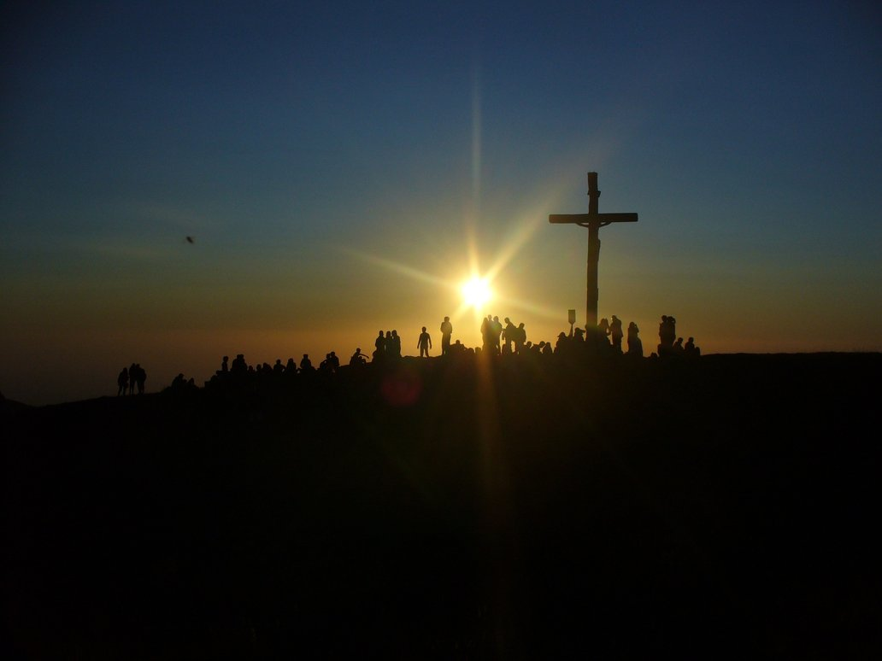
Sending Hymn #485 “We Know that Christ is Raised”
We know that Christ is raised and dies no more. Embraced by death he broke its fearful hold, and our despair he turned to blazing joy. Alleluia!

Slide 53
Sending Hymn #485 “We Know that Christ is Raised”
We share by water in his saving death. Reborn we share with him an Easter life as living members of a living Christ. Alleluia!

Slide 54
Sending Hymn #485 “We Know that Christ is Raised”
The Father's splendor clothes the Son with life. The Spirit's power shakes the church of God. Baptized we live with God the Three in One. Alleluia!

Slide 55
Sending Hymn #485 “We Know that Christ is Raised”
A new creation comes to life and grows as Christ's new body takes on flesh and blood. The universe, restored and whole, will sing: Alleluia!

Slide 56
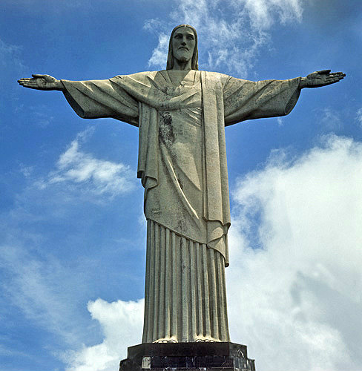
Bearing and Following the WORD into the World The Charge and Benediction

Slide 57
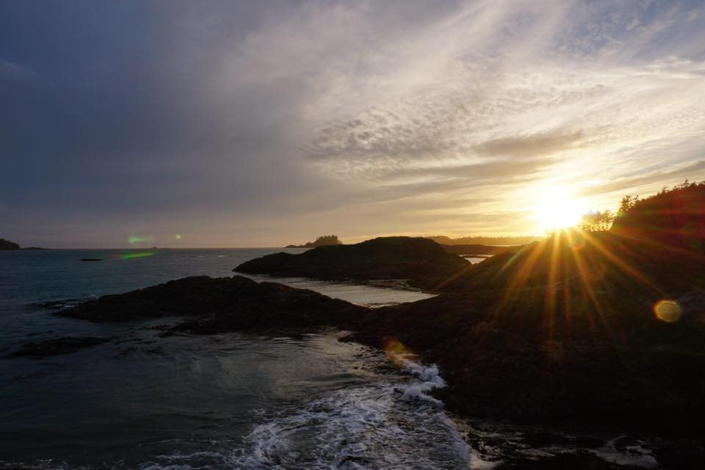
Bearing and Following the WORD into the World Benediction Response
# 547 “Go, My Children, with My Blessing”
(Stanza 1)
“Go, my children, with my blessing,
never alone. Waking, sleeping, I am with you,
you are my own. In my love’s baptismal river
I have made you mine forever. Go, my children, with my blessing,
you are my own.”

Slide 58
Homecrest Presbyterian Church Worship of the Lord’s Day Resurrection/Easter Sunday, April 1st, 2018

