Slide 1
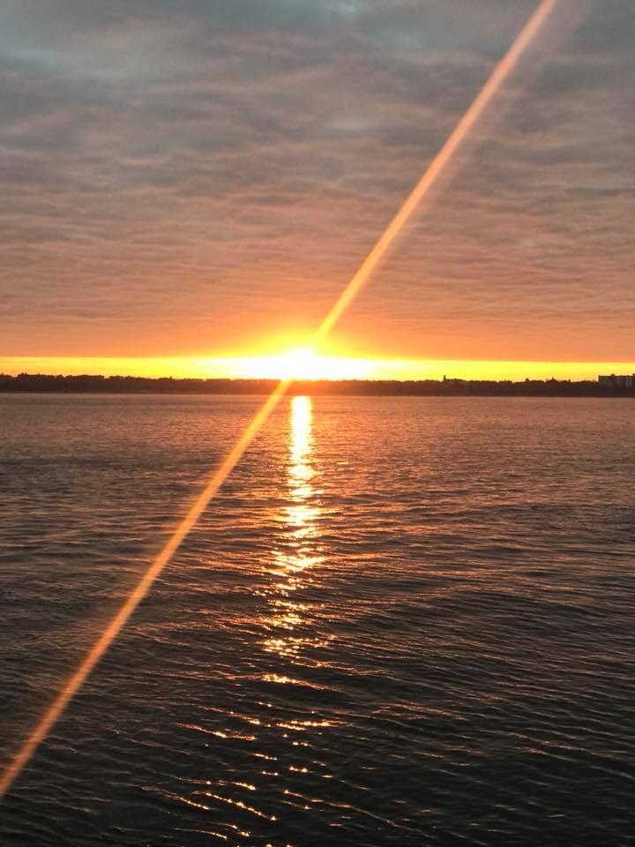
Homecrest Presbyterian Church Worship of the Lord’s Day January 14th, 2018 2st Sunday of Epiphany

Slide 2
Gathering Around the WORD Call to Worship (Based on 1 Samuel 3:9)
The one who calls you together this day
yearns for each of you and for all people to hear and be blessed.
Speak, Lord, for your servants are listening.
Blessed is the One who comes bringing trustworthy words for the healing of the world.
Speak, Lord, for your servants are listening.

Slide 3
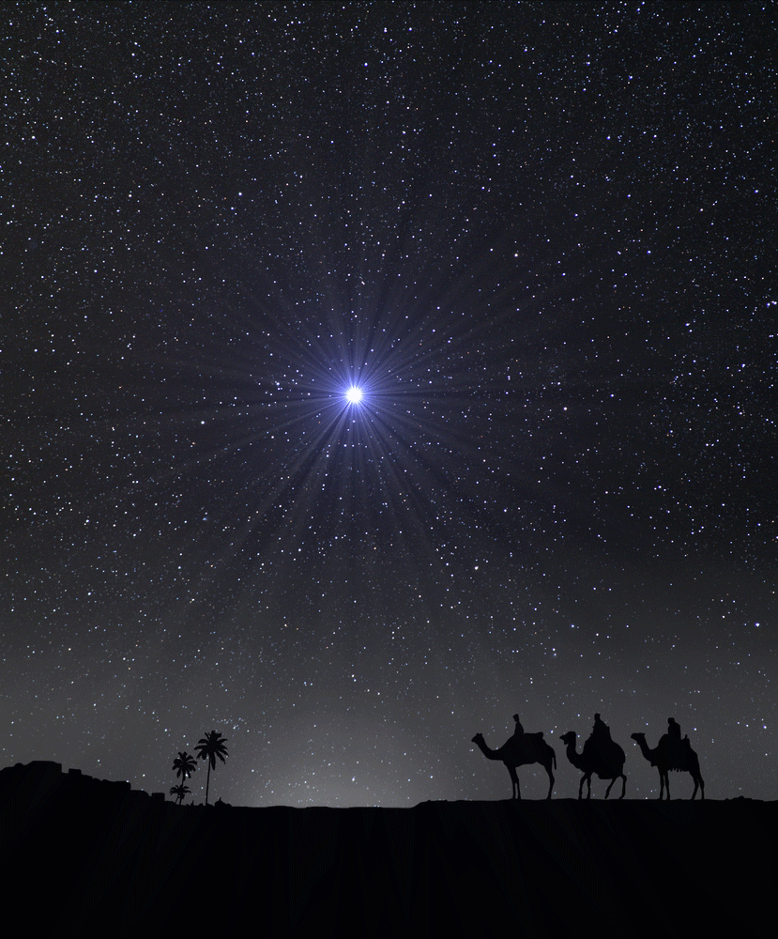
Gathering Around the WORD Gathering Hymn # 156 “Sing of God Made Manifest”
Sing of God made manifest in a child robust and blest, to whose home in Bethlehem where a star had guided them, magi came and gifts unbound, signs mysterious and profound: myrrh and frankincense and gold grave and God and king foretold.

Slide 4
Gathering Around the WORD Gathering Hymn # 156 “Sing of God Made Manifest”
Sing of God made manifest when at Jordan John confessed, “I should be baptized by you, but your bidding I will do.” Then from heaven a double sign— dove-like Spirit, voice divine— hailed the true Anointed One: “This is my beloved Son.”

Slide 5
Gathering Around the WORD Gathering Hymn # 156 “Sing of God Made Manifest”
Sing of God made manifest when Christ came as wedding guest and at Cana gave a sign, turning water into wine; further still was love revealed as he taught, forgave, and healed, bringing light and life to all who would listen to God’s call.

Slide 6
Gathering Around the WORD Gathering Hymn # 156 “Sing of God Made Manifest”
Sing of God made manifest on the cloud-capped mountain’s crest, where the law and prophets waned so that Christ alone remained: glimpse of glory, pledge of grace, given as Jesus set his face towards the waiting cross and grave, sign of hope that God would save.

Slide 7
Gathering Around the WORD Call to Confession Assured that the One who calls us to hear and obey already knows the confessions of our hearts and is ready to forgive, let us confess our sin before God and our neighbors.

Slide 8
Gathering Around the WORD Prayer of Confession (in Unison)
Holy God, you see into each of us and know us fully as creatures in need of your constant care. We confess that we have neither heard your word nor followed your will.
We have failed our nation, neighbors, families, friends, and ourselves.
Give us ears to hear your wisdom. Lead us to honesty and faith so that we may begin again with renewed strength; in Jesus’s name. Amen.

Slide 9
Gathering Around the WORD Declaration of Forgiveness
God knows the hearts of those who seek forgiveness, and by grace we have been saved.
In Jesus’s name we are forgiven. Our sins are no more. We have been made clean.
God strengths us with freedom through the Holy Spirit, in Christ Jesus. Thanks be to God, Amen.

Slide 10
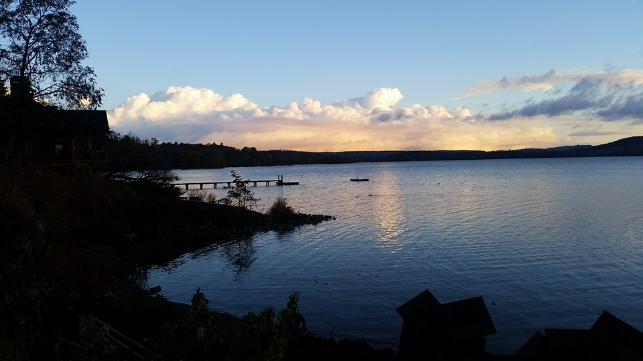
Gathering Around the WORD Gloria Patri
Glory be to the Father
and to the Son and to the Holy Ghost;
As it was in the beginning,
is now, and ever shall be,
world without end. Amen, Amen.

Slide 11
Gathering Around the WORD Passing of the Peace of Christ

Slide 12
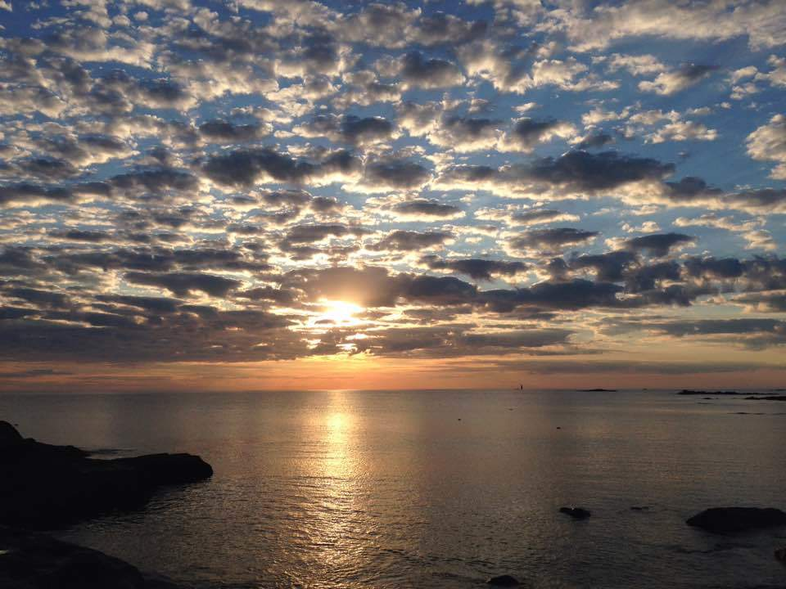
Proclaiming the WORD Message to the Youth/ Prayer of Illumination

Slide 13
Proclaiming the WORD Scripture Reading (1 Samuel 3:1-20)
¹Now the boy Samuel was ministering to the Lord under Eli. The word of the Lord was rare in those days; visions were not widespread.
²At that time Eli, whose eyesight had begun to grow dim so that he could not see, was lying down in his room; ³the lamp of God had not yet gone out, and Samuel was lying down in the temple of the Lord, where the ark of God was.

Slide 14
Proclaiming the WORD Scripture Reading (1 Samuel 3:1-20)
⁴Then the Lord called, “Samuel! Samuel!” and he said, “Here I am!” ⁵and ran to Eli, and said, “Here I am, for you called me.” But he said, “I did not call; lie down again.” So he went and lay down. ⁶The Lord called again, “Samuel!” Samuel got up and went to Eli, and said, “Here I am, for you called me.” But he said, “I did not call, my son; lie down again.” ⁷Now Samuel did not yet know the Lord, and the word of the Lord had not yet been revealed to him.

Slide 15
Proclaiming the WORD Scripture Reading (1 Samuel 3:1-20)
⁸The Lord called Samuel again, a third time. And he got up and went to Eli, and said, “Here I am, for you called me.” Then Eli perceived that the Lord was calling the boy. ⁹Therefore Eli said to Samuel, “Go, lie down; and if he calls you, you shall say, ‘Speak, Lord, for your servant is listening.’” So Samuel went and lay down in his place.

Slide 16
Proclaiming the WORD Scripture Reading (1 Samuel 3:1-20)
¹⁰Now the Lord came and stood there, calling as before, “Samuel! Samuel!” And Samuel said, “Speak, for your servant is listening.” ¹¹Then the Lord said to Samuel, “See, I am about to do something in Israel that will make both ears of anyone who hears of it tingle. ¹²On that day I will fulfill against Eli all that I have spoken concerning his house, from beginning to end.

Slide 17
Proclaiming the WORD Scripture Reading (1 Samuel 3:1-20)
¹³For I have told him that I am about to punish his house forever, for the iniquity that he knew, because his sons were blaspheming God, and he did not restrain them. ¹⁴Therefore I swear to the house of Eli that the iniquity of Eli’s house shall not be expiated by sacrifice or offering forever.”

Slide 18
Proclaiming the WORD Scripture Reading (1 Samuel 3:1-20)
¹⁵Samuel lay there until morning; then he opened the doors of the house of the Lord. Samuel was afraid to tell the vision to Eli. ¹⁶But Eli called Samuel and said, “Samuel, my son.” He said, “Here I am.” ¹⁷Eli said, “What was it that he told you? Do not hide it from me. May God do so to you and more also, if you hide anything from me of all that he told you.” ¹⁸So Samuel told him everything and hid nothing from him. Then he said, “It is the Lord; let him do what seems good to him.”

Slide 19
Proclaiming the WORD Scripture Reading (1 Samuel 3:1-20)
¹⁹As Samuel grew up, the Lord was with him and let none of his words fall to the ground. ²⁰And all Israel from Dan to Beer-sheba knew that Samuel was a trustworthy prophet of the Lord.

Slide 20
Proclaiming the WORD (I Samuel 3:1-20)
Can You Hear Me Now?

Slide 21
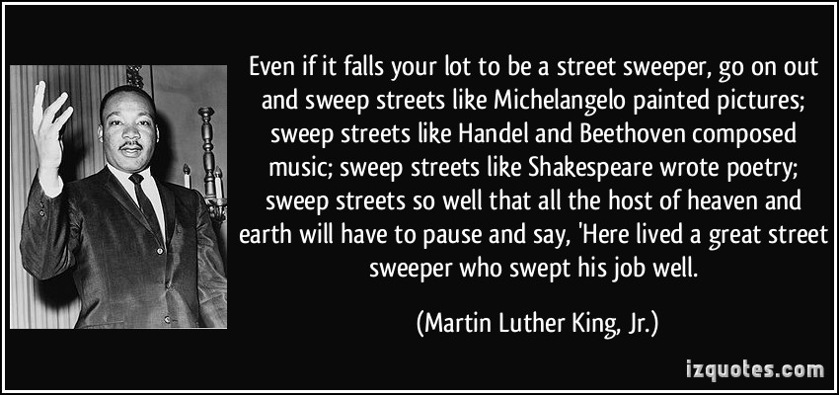
Proclaiming the WORD (I Samuel 3:1-20)
Can You Hear Me Now?

Slide 22
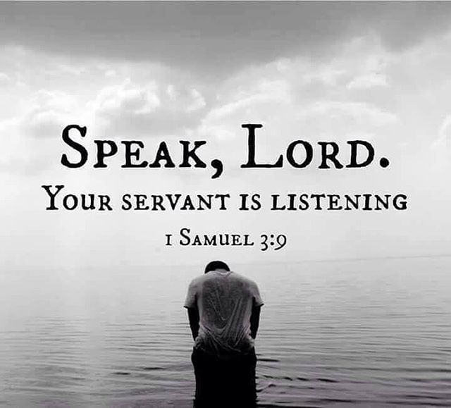
Proclaiming the WORD (I Samuel 3:1-20)
Can You Hear Me Now?

Slide 23
Responding Hymn # 722 “Lord, Speak to Me that I May Speak”
Lord, speak to me that I may speak in living echoes of your tone. As you have sought, so let me seek your erring children lost and lone.

Slide 24
Responding Hymn # 722 “Lord, Speak to Me that I May Speak”
O lead me, Lord, that I may lead the wandering and the wavering feet. O feed me, Lord, that I may feed your hungering ones with manna sweet.

Slide 25
Responding Hymn # 722 “Lord, Speak to Me that I May Speak”
O teach me, Lord, that I may teach the precious truths which you impart. And wing my words that they may reach the hidden depths of many a heart.

Slide 26
Responding Hymn # 722 “Lord, Speak to Me that I May Speak”
O fill me with your fullness, Lord, until my very heart o'erflow in kindling thought and glowing word, your love to tell, your praise to show.

Slide 27
Responding Hymn # 722 “Lord, Speak to Me that I May Speak”
O use me, Lord, use even me, just as you will, and when, and where until your blessed face I see, your rest, your joy, your glory share.

Slide 29
Bearing and Following the WORD into the World Announcements &
Sharing of Joys and Concerns
The afternoon Bible Study Group will resume downstairs at 12:30 in the basement this afternoon.
The Women's Group will continue to meet on Wednesdays at 7:30pm over at the Manse (2048 E 14th Street). They are currently studying the book of Isaiah. For more information, please contact Margaret or Cara.

Slide 30
Bearing and Following the WORD into the World Announcements &
Sharing of Joys and Concerns
Our Annual Congregational Meeting will take place on Next Sunday, 1/21 immediately after worship service.
Equipping the Saints Officers’ Training at Princeton Seminary on Saturday, 1/20 9am-3pm. For more information, please see the flyer or speak to Pastor Samson.

Slide 31
Bearing and Following the WORD into the World Prayer of the People & The Lord’s Prayer
Our Father, who art in heaven.
Halloweth be thy name.
Thy Kingdom come; Thy will be done
On earth as it is in heaven.
Give us this day our daily bread.
Forgive us our debts; as we forgive our debtors.
Lead us not into temptations, but deliver us from evil.
For Thine is the Kingdom, the Power, and the Glory forever. Amen.

Slide 32
Bearing and Following the WORD into the World Offering of our Gifts and our Lives
Musical Offering

Slide 33
Bearing and Following the WORD into the World Doxology and Offertory Prayer

Slide 34
Sending Hymn #69 “I, The Lord of Sea and Sky”
I, the Lord of sea and sky, I have heard my people cry. All who dwell in dark and sin my hand will save. I, who made the stars of night, I will make their darkness bright. Who will bear my light to them? Whom shall I send?

Slide 35
Sending Hymn #69 “I, The Lord of Sea and Sky”
Here I am, Lord. Is it I, Lord? I have heard you calling in the night. I will go, Lord, if you lead me. I will hold your people in my heart.

Slide 36
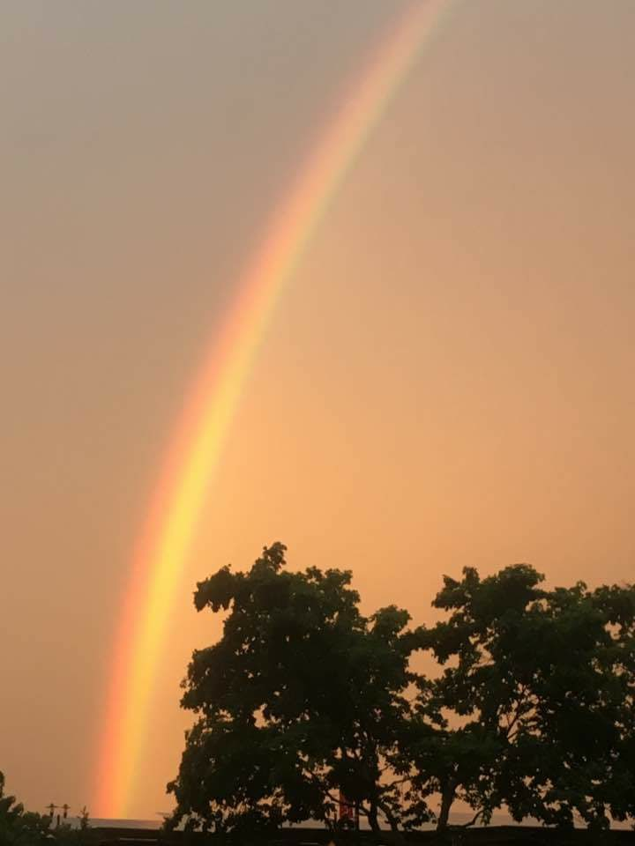
Sending Hymn #69 “I, The Lord of Sea and Sky”
I, the Lord of snow and rain, I have borne my people's pain. I have wept for love of them. They turn away. I will break their hearts of stone, give them hearts for love alone. I will speak my word to them. Whom shall I send?

Slide 37
Sending Hymn #69 “I, The Lord of Sea and Sky”
Here I am, Lord. Is it I, Lord? I have heard you calling in the night. I will go, Lord, if you lead me. I will hold your people in my heart.

Slide 38
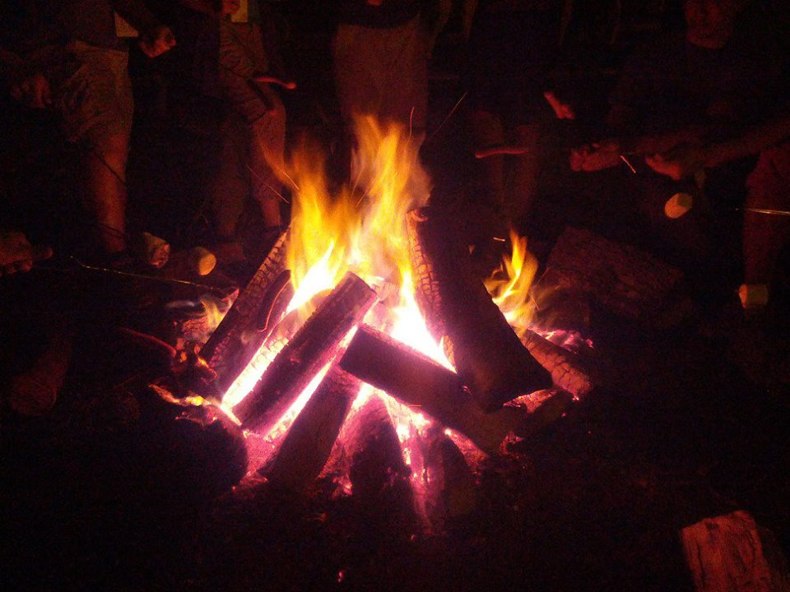
Sending Hymn #69 “I, The Lord of Sea and Sky”
I, the Lord of wind and flame, I will tend the poor and lame. I will set a feast for them. My hand will save. Finest bread I will provide till their hearts be satisfied. I will give my life to them. Whom shall I send?

Slide 39
Sending Hymn #69 “I, The Lord of Sea and Sky”
Here I am, Lord. Is it I, Lord? I have heard you calling in the night. I will go, Lord, if you lead me. I will hold your people in my heart.

Slide 40
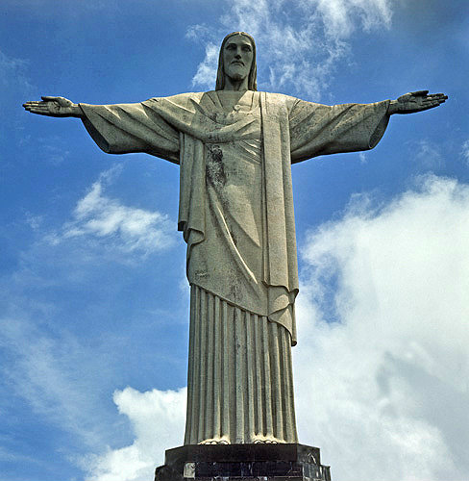
Bearing and Following the WORD into the World The Charge and Benediction

Slide 41
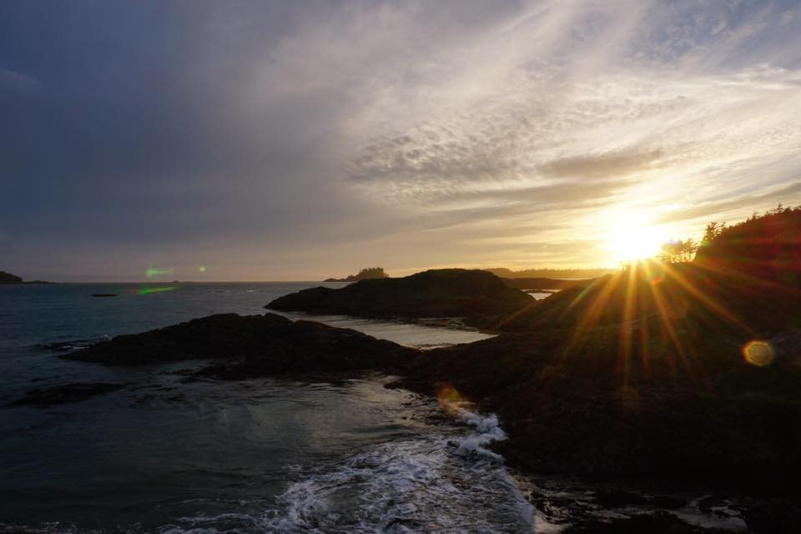
Bearing and Following the WORD into the World Benediction Response
# 547 “Go, My Children, With My Blessing” (Stanza 2)
Go, my children, sins forgiven,
at peace and pure. Here you learned how much I love you, what I can cure. Here you heard my dear Son’s story; here you touched him, saw his glory. Go, my children, sins forgiven,
at peace and pure.”

Slide 42
Homecrest Presbyterian Church Worship of the Lord’s Day January 14th, 2018 2st Sunday of Epiphany

