Slide 1
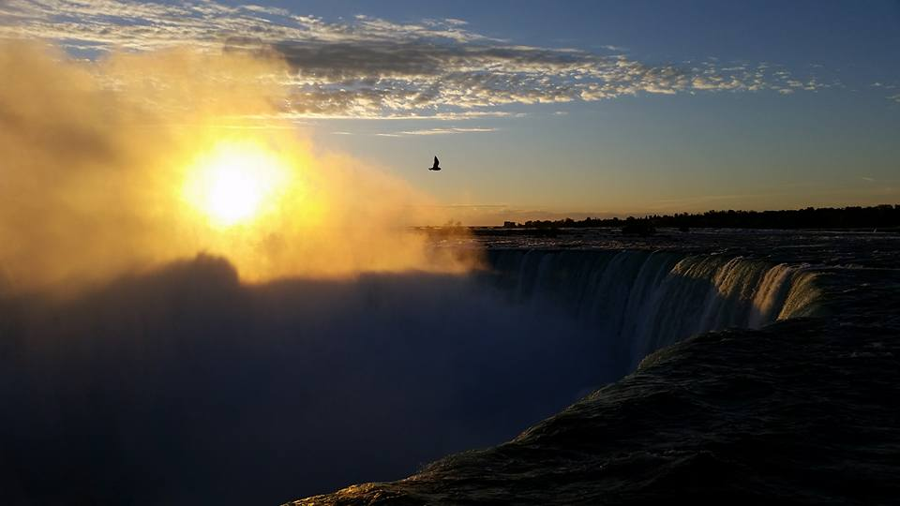
Homecrest Presbyterian Church Worship of the Lord’s Day January 7th, 2018 1st Sunday of Epiphany/ Baptism of the Lord Sunday

Slide 2
Gathering Around the WORD Call to Worship (Based on Genesis 1:1-2, Mark 1:1, 9-11)
In the beginning, God created the heavens and the earth. The Spirit of God swept over the face of the waters; then God said: Let there be light, and God saw that it was good.
At the beginning of his ministry, Jesus was baptized by John. The heavens opened, and the Spirit descended like a dove; then God said:
This is my beloved Son, in whom I am well pleased. We have gathered to bear witness to these happenings. Let us worship God.

Slide 3
Gathering Around the WORD Gathering Hymn # 39 “Great is Thy Faithfulness”
Great is thy faithfulness, O God my Father; there is no shadow of turning with thee. Thou changest not; thy compassions they fail not. As thou hast been thou forever wilt be. Great is thy faithfulness! Great is thy faithfulness! Morning by morning, new mercies I see. All I have needed thy hand hath provided. Great is thy faithfulness, Lord unto me!

Slide 4
Gathering Around the WORD Gathering Hymn # 39 “Great is Thy Faithfulness”
Summer and winter, and springtime and harvest, sun, moon, and stars in their courses above join with all nature in manifold witness to thy great faithfulness, mercy, and love. Great is thy faithfulness! Great is thy faithfulness! Morning by morning, new mercies I see. All I have needed thy hand hath provided. Great is thy faithfulness, Lord unto me!

Slide 5
Gathering Around the WORD Gathering Hymn # 39 “Great is Thy Faithfulness”
Pardon for sin and a peace that endureth, thine own dear presence to cheer and to guide, strength for today and bright hope for tomorrow: blessings all mine, with ten thousand beside! Great is thy faithfulness! Great is thy faithfulness! Morning by morning, new mercies I see. All I have needed thy hand hath provided. Great is thy faithfulness, Lord unto me!

Slide 6
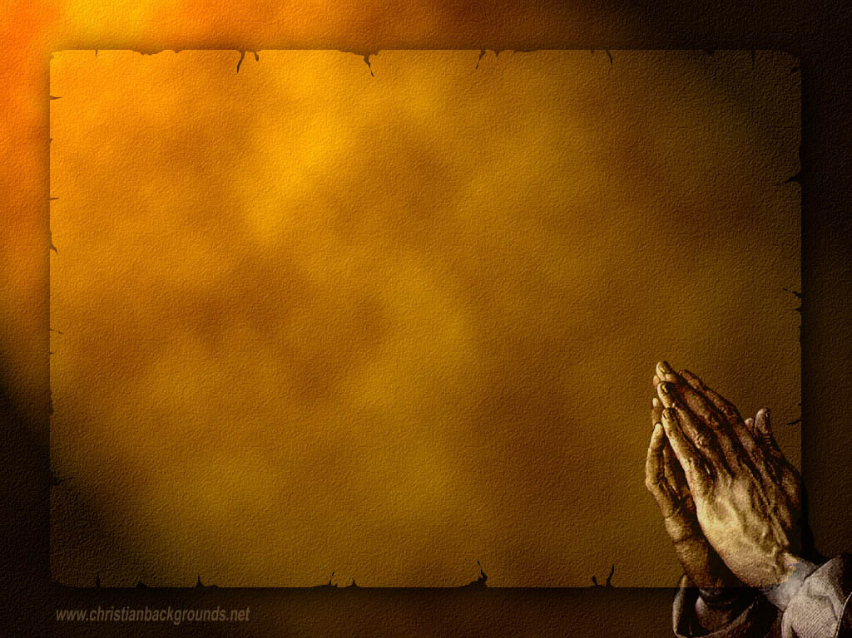
Gathering Around the WORD Call to Confession Through our baptism, Christ has drawn us out of the water and cleanse us of our sins. Christ has offered us this new hope, new life, and a new beginning. In humility and faith, let us come before God and our neighbors, confessing our sins and seeking God’s mercy and grace.

Slide 7
Gathering Around the WORD Prayer of Confession (in Unison)
(Psalm 51:10-12)
Create in us a clean heart, O God, and put a new and right spirit within us. Do not cast us away from your presence, and do not take your holy spirit from us. Restore to us the joy of your salvation, and sustain in us a willing spirit. Lord, hear our prayers we pray. Amen.

Slide 8
Gathering Around the WORD Declaration of Forgiveness
(Isaiah 42:6 and 9)
The Lord declares, “I have called you in righteousness, I have taken you by the hand and kept you; I have given you as a covenant to the people, a light to the nations. See, the former things have come to pass, and new things I have now declared.” Friends, through Christ, God has given us a new life. We have been forgiven.
Thanks be to God, Amen.

Slide 9
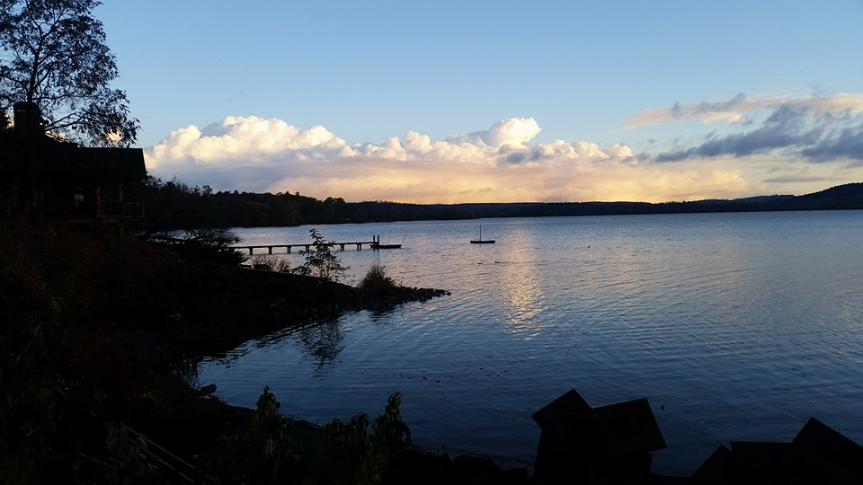
Gathering Around the WORD Gloria Patri
Glory be to the Father
and to the Son and to the Holy Ghost;
As it was in the beginning,
is now, and ever shall be,
world without end. Amen, Amen.

Slide 10
Gathering Around the WORD Passing of the Peace of Christ

Slide 11
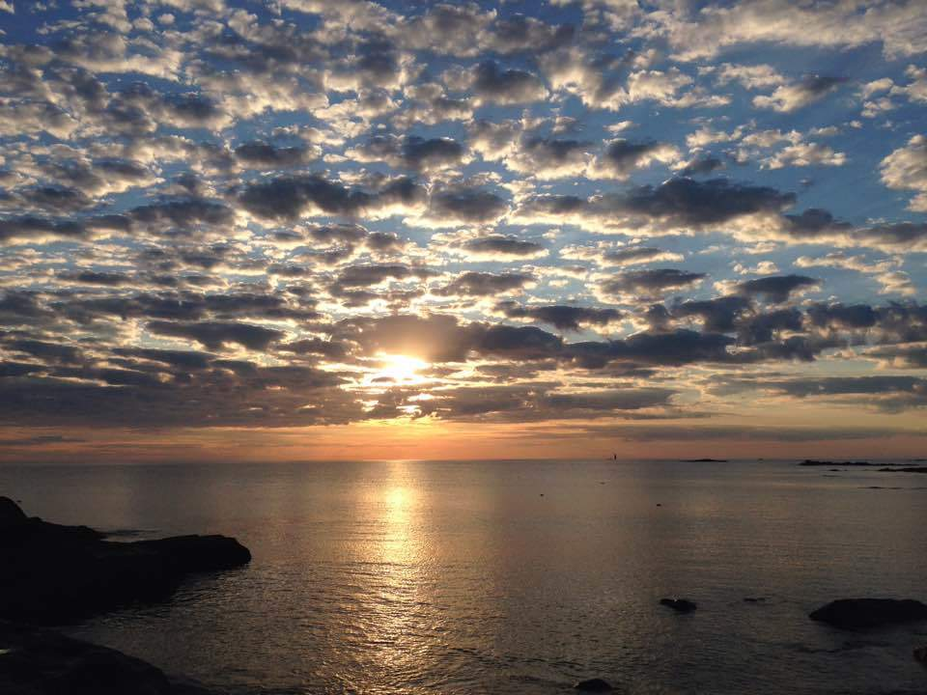
Proclaiming the WORD Message to the Youth/ Prayer of Illumination

Slide 12
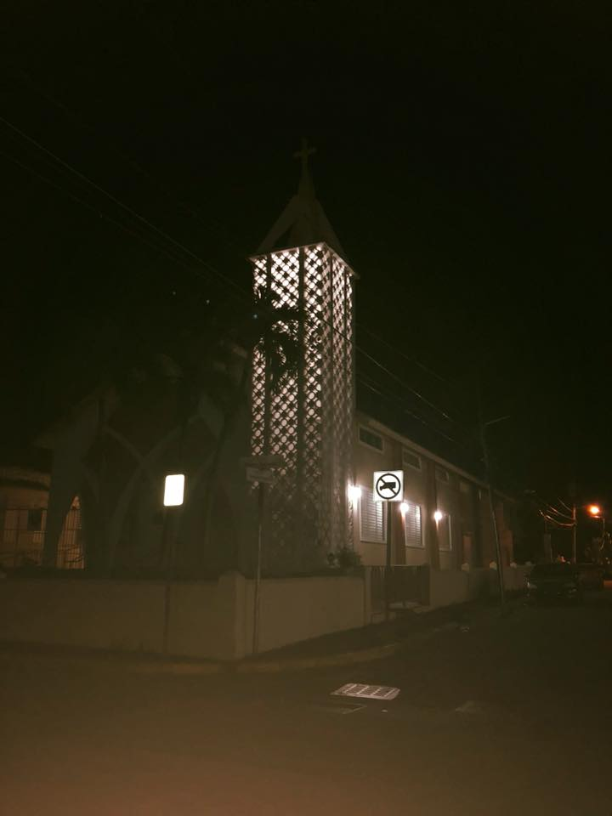

Slide 13
Proclaiming the WORD Responsive Reading (Psalm 29:1-11)
¹ Ascribe to the LORD, O heavenly beings, ascribe to the LORD glory and strength. ² Ascribe to the LORD the glory of his name; worship the LORD in holy splendor.
³ The voice of the LORD is over the waters; the God of glory thunders, the LORD, over mighty waters. ⁴ The voice of the LORD is powerful; the voice of the LORD is full of majesty.

Slide 14
Proclaiming the WORD Responsive Reading (Psalm 29:1-11)
⁵ The voice of the LORD breaks the cedars; the LORD breaks the cedars of Lebanon. ⁶ He makes Lebanon skip like a calf, and Sirion like a young wild ox.
⁷ The voice of the LORD flashes forth flames of fire. ⁸ The voice of the LORD shakes the wilderness; the LORD shakes the wilderness of Kadesh.

Slide 15
Proclaiming the WORD Responsive Reading (Psalm 29:1-11)
⁹ The voice of the LORD causes the oaks to whirl, and strips the forest bare; and in his temple all say, “Glory!”
¹⁰ The LORD sits enthroned over the flood; the LORD sits enthroned as king for ever. ¹¹ May the LORD give strength to his people! May the LORD bless his people with peace!

Slide 16
Proclaiming the WORD Scripture Reading (Genesis 1:1-5)
¹In the beginning when God created the heavens and the earth, ²the earth was a formless void and darkness covered the face of the deep, while a wind from God swept over the face of the waters. ³Then God said, “Let there be light”; and there was light. ⁴And God saw that the light was good; and God separated the light from the darkness. ⁵God called the light Day, and the darkness he called Night. And there was evening and there was morning, the first day.

Slide 17
Proclaiming the WORD Scripture Reading (Acts 19:1-7)
¹While Apollos was in Corinth, Paul passed through the interior regions and came to Ephesus, where he found some disciples. ²He said to them, “Did you receive the Holy Spirit when you became believers?” They replied, “No, we have not even heard that there is a Holy Spirit.” ³Then he said, “Into what then were you baptized?” They answered, “Into John’s baptism.” ⁴Paul said, “John baptized with the baptism of repentance, telling the people to believe in the one who was to come after him, that is, in Jesus.”

Slide 18
Proclaiming the WORD Scripture Reading (Acts 19:1-7)
⁵On hearing this, they were baptized in the name of the Lord Jesus. ⁶When Paul had laid his hands on them, the Holy Spirit came upon them, and they spoke in tongues and prophesied — ⁷altogether there were about twelve of them.

Slide 19
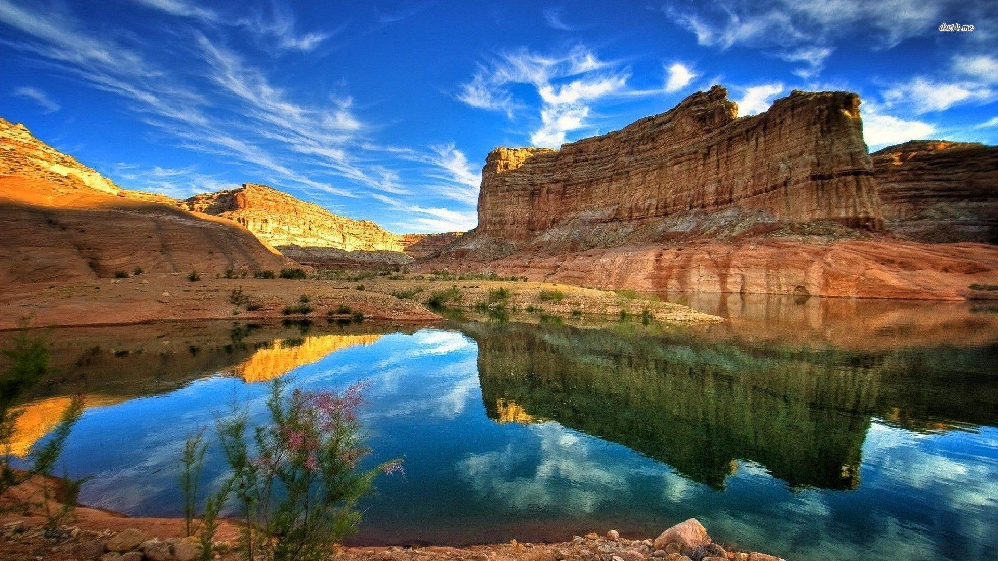
Proclaiming the WORD (Psalm 29:1-11, Genesis 1:1-5, Mark 1:4-11)
The Voice Cry Out

Slide 21
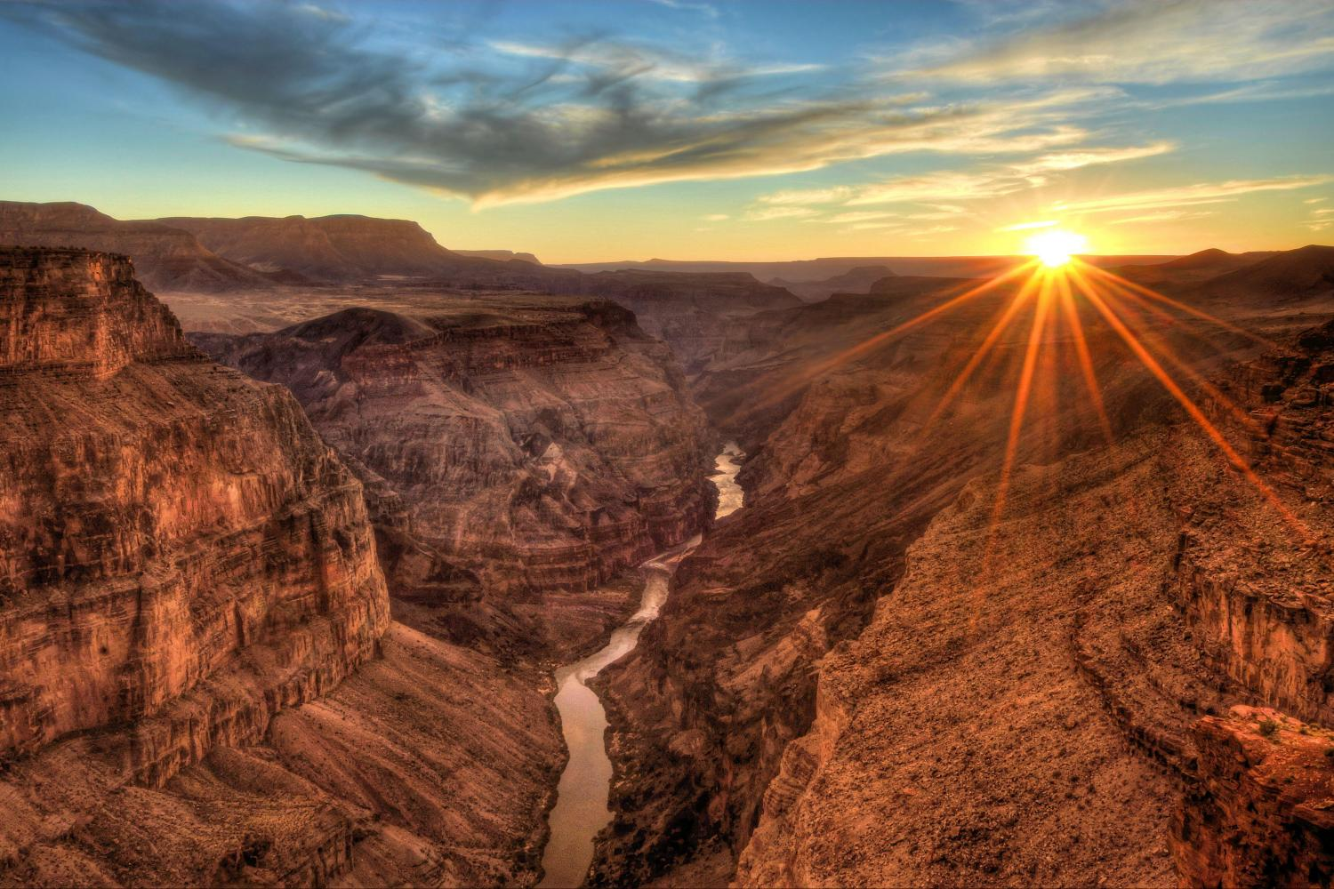
Proclaiming the WORD (Psalm 29:1-11, Genesis 1:1-5, Mark 1:4-11)
The Voice Cry Out

Slide 22
Responding Hymn # 475 “Come, Thou Fount of Every Blessing”
Come, thou Fount of every blessing; tune my heart to sing thy grace; streams of mercy, never ceasing, call for songs of loudest praise. Teach me some melodious sonnet, sung by flaming tongues above; praise the mount! I’m fixed upon it, mount of God’s unchanging love!

Slide 23
Responding Hymn # 475 “Come, Thou Fount of Every Blessing”
Here I raise my Ebenezer; hither by thy help I’m come; and I hope, by thy good pleasure, safely to arrive at home. Jesus sought me when a stranger, wandering from the fold of God; he, to rescue me from danger, interposed his precious blood.

Slide 24
Responding Hymn # 475 “Come, Thou Fount of Every Blessing”
O to grace how great a debtor daily I’m constrained to be! Let that grace now, like a fetter, bind my wandering heart to thee. Prone to wander, Lord, I feel it, prone to leave the God I love; here’s my heart; O take and seal it; seal it for thy courts above.

Slide 26
Bearing and Following the WORD into the World Announcements &
Sharing of Joys and Concerns
The afternoon Bible Study Group will NOT be meeting this afternoon. It will resume meeting next Sunday.
The Women's Group will continue to meet on Wednesdays at 7:30pm over at the Manse (2048 E 14th Street). They are currently studying the Gospel of Luke. For more information, please contact Margaret or Cara.
The Session will be meeting Tomorrow at 7pm.
All active elders please attend.

Slide 27
Bearing and Following the WORD into the World Announcements &
Sharing of Joys and Concerns
Our Annual Congregational Meeting will take place on Sunday, 1/21 immediately after worship service.
Equipping the Saints Officers’ Training at Princeton Seminary on Saturday, 1/20 9am-3pm. For more information, please see the flyer or speak to Pastor Samson.

Slide 28
Bearing and Following the WORD into the World Prayer of the People & The Lord’s Prayer
Our Father, who art in heaven.
Halloweth be thy name.
Thy Kingdom come; Thy will be done
On earth as it is in heaven.
Give us this day our daily bread.
Forgive us our debts; as we forgive our debtors.
Lead us not into temptations, but deliver us from evil.
For Thine is the Kingdom, the Power, and the Glory forever. Amen.

Slide 29
Bearing and Following the WORD into the World Offering of our Gifts and our Lives
Musical Offering

Slide 30
Bearing and Following the WORD into the World Doxology and Offertory Prayer

Slide 31
Bearing and Following the WORD into the World Holy Communion Hymn
# 688 “Spirit of the God, Descend Upon My Heart” (Stanzas 1,4,5)
Spirit of God, descend upon my heart; wean it from earth,
through all its pulses move; stoop to my weakness, mighty as thou art, and make me love thee as I ought to love.

Slide 32
Bearing and Following the WORD into the World Holy Communion Hymn
# 688 “Spirit of the God, Descend Upon My Heart” (Stanzas 1,4,5)
Teach me to feel that thou art always nigh. Teach me the struggles of the soul to bear, to check the rising doubt, the rebel sigh. Teach me the patience of unanswered prayer.

Slide 33
Bearing and Following the WORD into the World Holy Communion Hymn
# 688 “Spirit of the God, Descend Upon My Heart” (Stanzas 1,4,5)
Teach me to love thee as thine angels love, one holy passion filling all my frame; the baptism of the heaven-descended Dove, my heart an altar, and thy love the flame.

Slide 34
Bearing and Following the WORD into the World Holy Communion
We gather here on the beginning of the year as one body, joined around this table of God’s GRACE and LOVE. Jesus said, whenever two or three are gathered in God’s name, He is here among us. United in Christ's spirit, God revealed Godself to us, God’s Word became flesh to us through the birth of Christ our Savior. His the tangible presence of our hope.

Slide 35
Bearing and Following the WORD into the World Holy Communion
This is the table of the Heavenly Feast,
the joyful celebration of the people of God.
Christ invites everyone to eat the bread of life,
to drink the cup of the new covenant.

Slide 36
Bearing and Following the WORD into the World Holy Communion
The Lord be with you. And also with you.
Lift up your hearts. We lift them up to the Lord.
Let us give thanks to the Lord our God.
It is right to give our thanks and praise.

Slide 37
Bearing and Following the WORD into the World Holy Communion
With saints and the choir of angels,
we join our voices in singing:
Holy, Holy, Holy Lord, God of power and might,
Heaven and earth are full of your glory.
Hosanna in the highest.
Blessed is he who comes in the name of the Lord.
Hosanna in the highest.

Slide 38
Bearing and Following the WORD into the World Holy Communion
We give you thanks Holy God,
for Jesus, who came to be your living Word,
to baptize us with Spirit and fire,
to feed the hungry, to humble the mighty,
and to announce the good news of your coming realm.

Slide 39
Bearing and Following the WORD into the World Holy Communion
While gathered with the disciples, Jesus took bread, and when he had given thanks, He broke it and gave it to them, saying, This is my body, which is given for you. Do this in remembrance of me.

Slide 40
Bearing and Following the WORD into the World Holy Communion
In the same way after supper, he took a cup, saying, This cup that is poured out for you is the new covenant in my blood. I will not drink of the fruit of the vine until the kingdom of God comes.

Slide 41
Bearing and Following the WORD into the World Holy Communion
With thanksgiving and praise, we offer ourselves to you,
Sharing this holy meal, remembering Christ’s dying and rising, and praying: Come Lord Jesus!
Christ has died, Christ is risen, Christ will come again.

Slide 42
Bearing and Following the WORD into the World Holy Communion
Pour out your Holy Spirit upon us –
this bread, this cup, and your people—
Christ’s body and blood,
given in love for the world.
Make us one in the Spirit, one in the church,
and one with our Lord Jesus Christ.

Slide 43
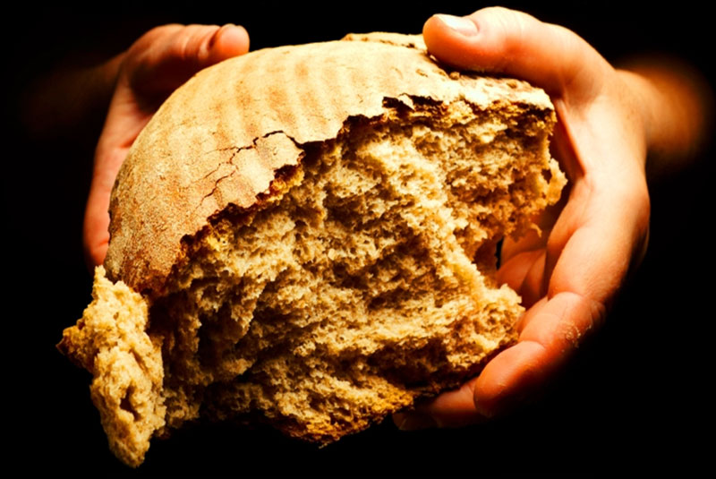
Bearing and Following the WORD into the World Holy Communion
Jesus said,
"I am the bread of life. Those who come to me shall never hunger; those who believe in me shall never thirst."
These are the gift of God
for the people of God.

Slide 44
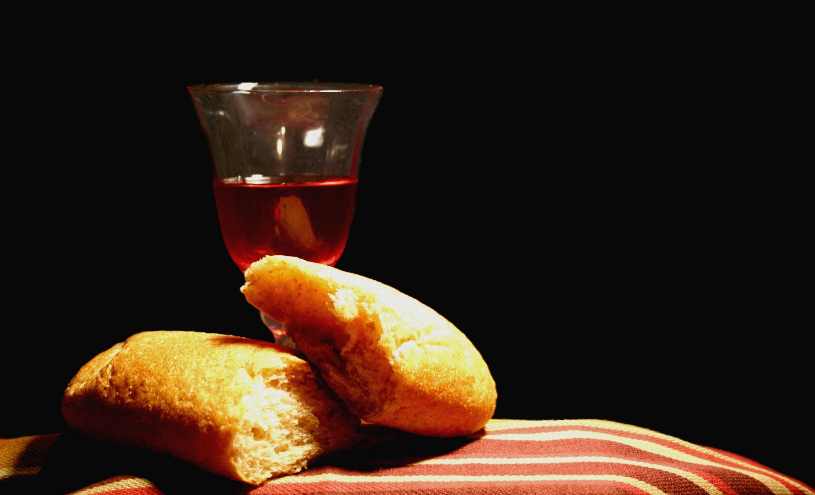
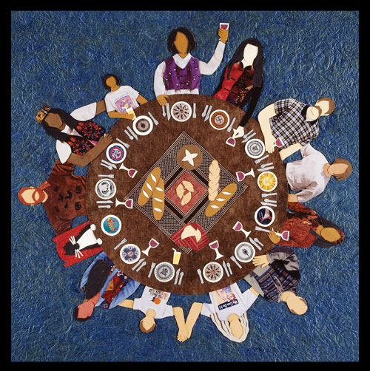
Bearing and Following the WORD into the World Holy Communion

Slide 45
:
Bearing and Following the WORD into the World
Prayer after the Communion: (in unison)
God of abundance and mercy: We joyfully give you thanks for your love and healing presence in our celebration of bread and wine. Bless these gifts that they may be for us the body and blood of Christ. Through our calling, send us out as your light in the world of darkness in order to manifest your grace and love to others. Amen.

Slide 46
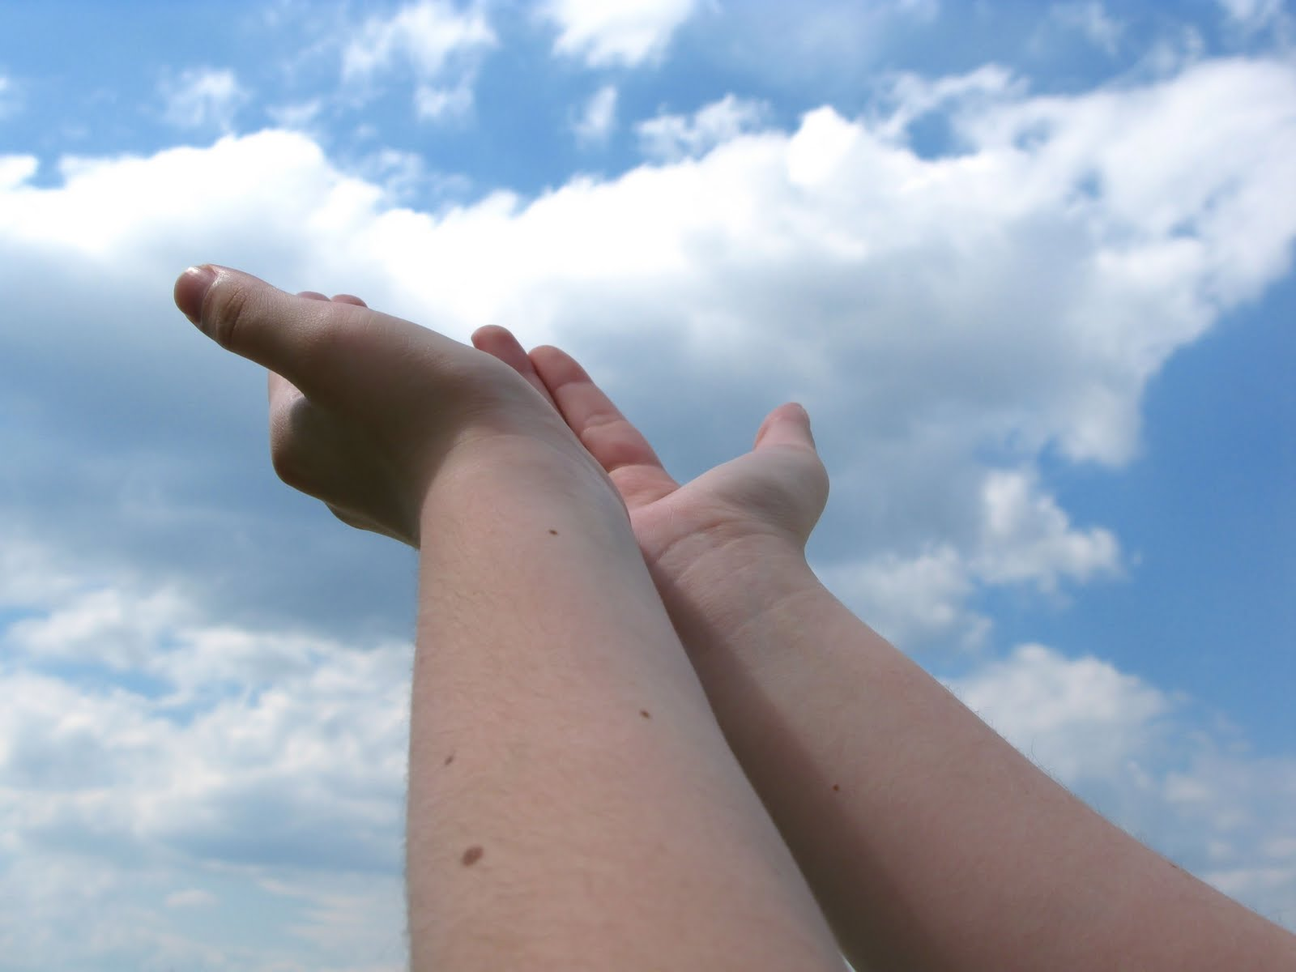
Bearing and Following the WORD into the World Deacons’ Benevolence Offering

Slide 47
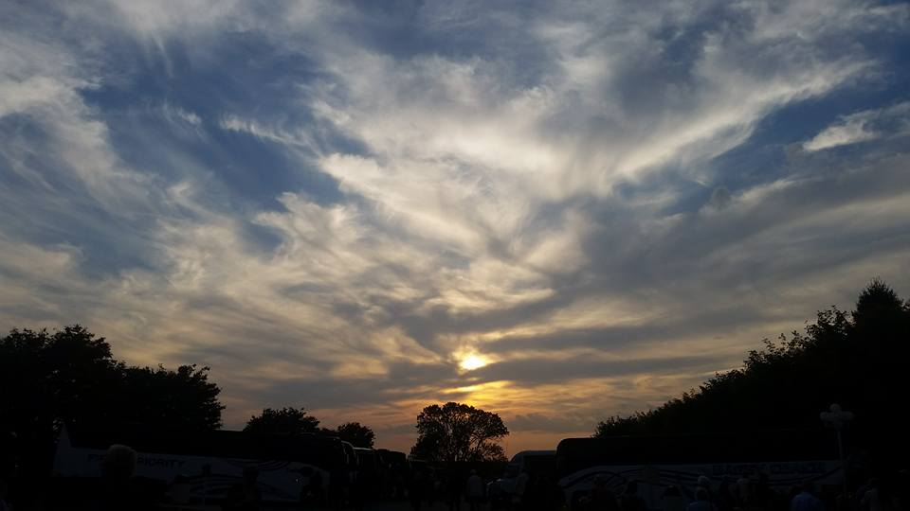
Sending Hymn #450 “Be Thou My Vision”
Be thou my vision,
O Lord of my heart; naught be all else to me,
save that thou art; thou my best thought,
by day or by night, waking or sleeping,
thy presence my light.

Slide 48
Sending Hymn #450 “Be Thou My Vision”
Be thou my wisdom,
and thou my true Word; I ever with thee
and thou with me, Lord; thou my soul’s shelter,
and thou my high tower; raise thou me heavenward,
O Power of my power.

Slide 49
Sending Hymn #450 “Be Thou My Vision”
Riches I heed not,
nor vain, empty praise; thou, mine inheritance, now and always; thou and thou only,
first in my heart, High King of Heaven,
my treasure thou art.

Slide 50
Sending Hymn #450 “Be Thou My Vision”
High King of Heaven,
my victory won, may I reach heaven’s joys, O bright heaven’s Sun! Heart of my own heart, whatever befall, still be my vision,
O Ruler of all.

Slide 51
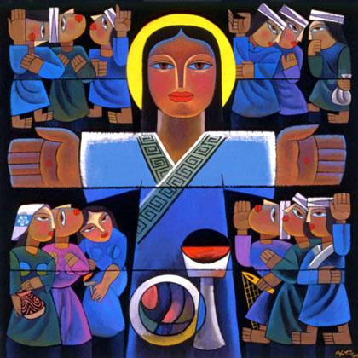
Bearing and Following the WORD into the World The Charge and Benediction

Slide 52
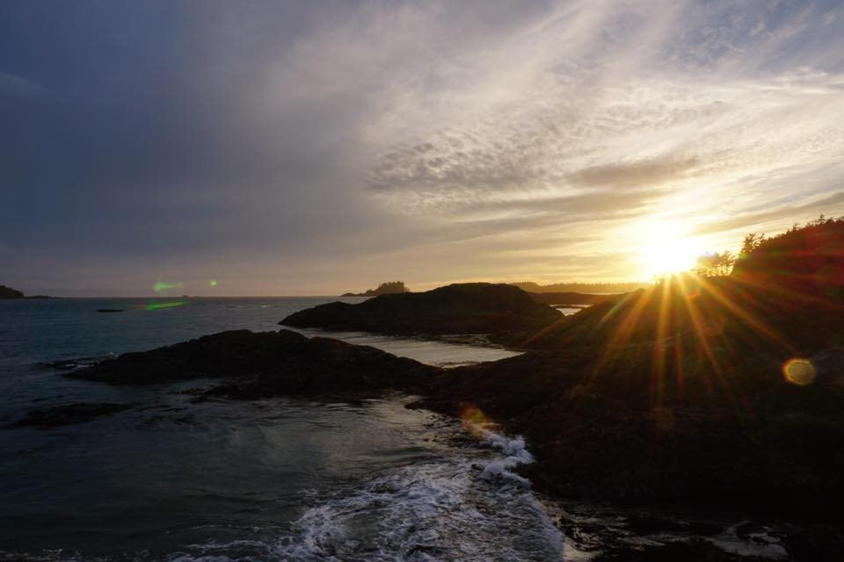
Bearing and Following the WORD into the World Benediction Response
# 547 “Go, My Children, With My Blessing” (Stanza 1)
“Go, my children,
with my blessing, never alone.
Waking, sleeping,
I am with you, you are my own. In my love’s baptismal river
I have made you mine forever. Go, my children, with my blessing, you are my own.”

Slide 53
Homecrest Presbyterian Church Worship of the Lord’s Day January 7th, 2018 1st Sunday of Epiphany/ Baptism of the Lord Sunday

