Slide 1
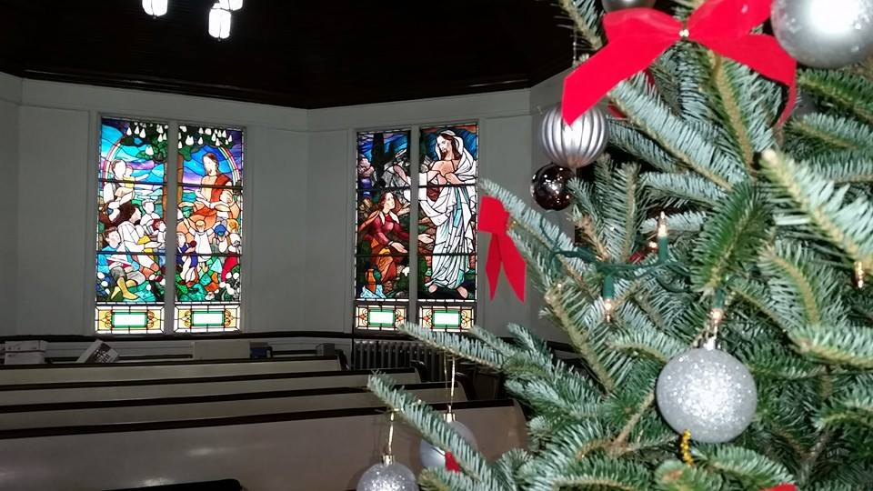
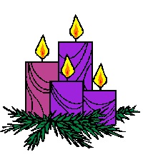
Homecrest Presbyterian Church Worship of the Lord’s Day December 24th, 2017 4th Sunday of Advent

Slide 2
Gathering Around the WORD Lighting of the Advent Candle/ Call to Worship – Chin Family

Slide 3
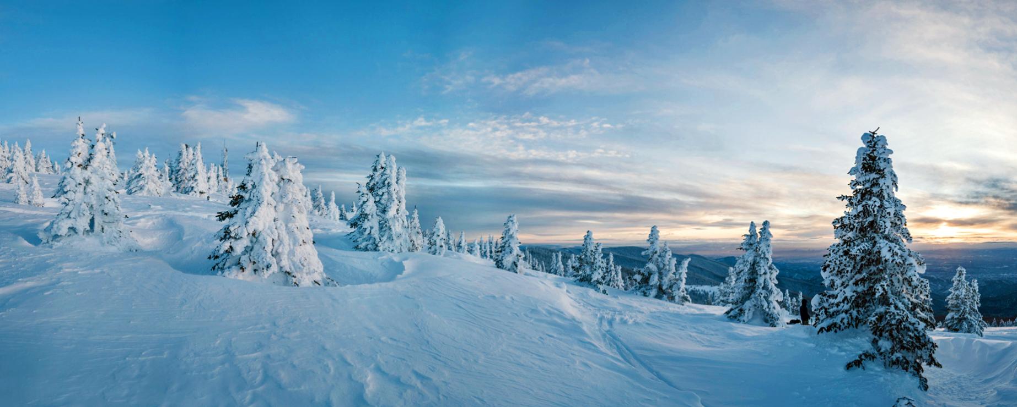
Gathering Around the WORD Gathering Hymn # 144 “In the Bleak Midwinter”
In the bleak midwinter, frosty wind made moan; earth stood hard as iron, water like a stone; snow had fallen, snow on snow, snow on snow, in the bleak midwinter, long ago.

Slide 4
Gathering Around the WORD Gathering Hymn # 144 “In the Bleak Midwinter”
Our God, heaven cannot hold him, nor earth sustain; heaven and earth shall flee away when he comes to reign: in the bleak midwinter a stable place sufficed the Lord God incarnate, Jesus Christ.

Slide 5
Gathering Around the WORD Gathering Hymn # 144 “In the Bleak Midwinter”
Angels and archangels may have gathered there; cherubim and seraphim thronged the air; but his mother only, in her maiden bliss, worshiped the beloved with a kiss.

Slide 6
Gathering Around the WORD Gathering Hymn # 144 “In the Bleak Midwinter”
What can I give him, poor as I am? If I were a shepherd, I would bring a lamb; if I were a wise man, I would do my part; yet what I can I give him: give my heart.

Slide 7
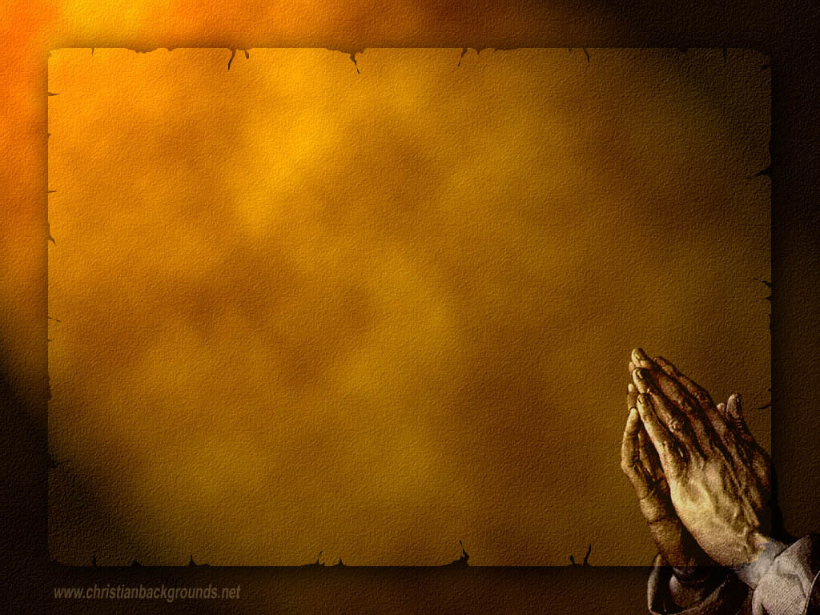
Gathering Around the WORD Call to Confession In Jesus Christ our Lord, the grace of God has appeared, the Word became flesh, bringing light to us all who are yearning for a Savior to come. With confidence and joy, let us confess our sins before God and our neighbors.

Slide 8
Gathering Around the WORD Prayer of Confession (in Unison)
Almighty God, we confess that our hearts have not been open to all that you have revealed to us in the nativity of your Son. You sent Christ to be born as a helpless Child, and yet we have not attended to suffering of children. You chose humble Mary to be mother of our Lord Jesus, and yet we have not attended to the struggles of women. The holy family could find no room in Bethlehem but a stable, and yet we have not attended to the cry of the homeless.

Slide 9
Gathering Around the WORD Prayer of Confession (in Unison)
You announced your birth to lowly shepherds, yet we ignore those who tend our farms and fields. Forgive our lack of attention, and free us for joyful compassion, that we may know Christ in serving others. Through Jesus Christ we pray, Amen.

Slide 10
Gathering Around the WORD Declaration of Forgiveness
Friends, through Christ, God has reconciled us and offered us a new life in spite of what we have and have not done. God’s LOVE is revealed and magnified to all of humanity.
This is the Good News that through our confession, God hears us. God redeems us through our expected Savior child Jesus. Thanks be to God, Amen.

Slide 11
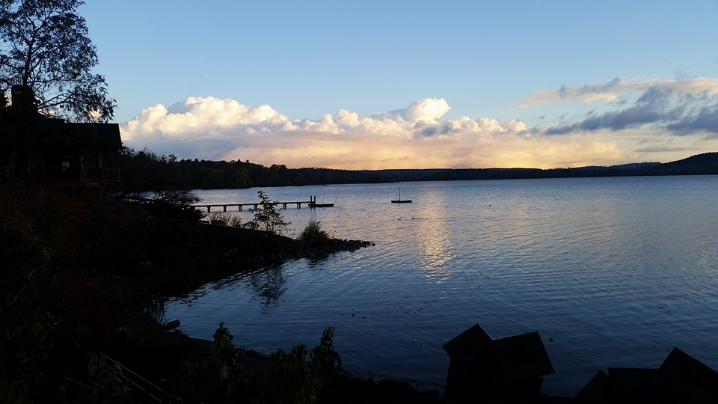
Gathering Around the WORD Gloria Patri
Glory be to the Father
and to the Son and to the Holy Ghost;
As it was in the beginning,
is now, and ever shall be,
world without end. Amen, Amen.

Slide 12
Gathering Around the WORD Passing of the Peace of Christ

Slide 13
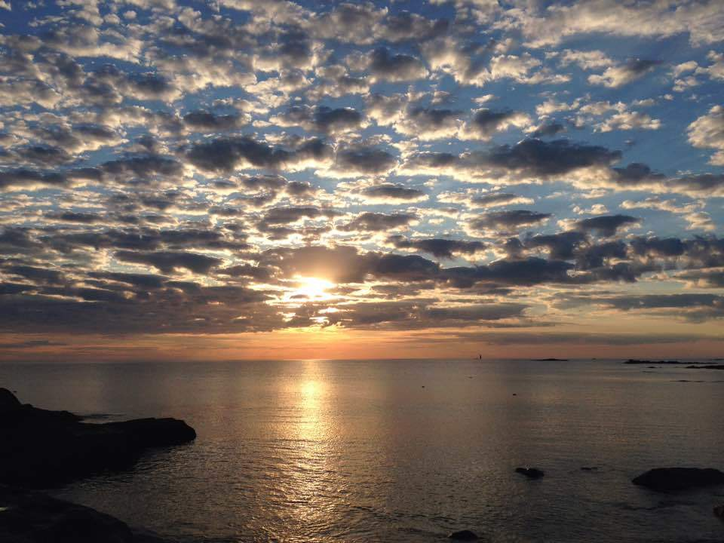
Proclaiming the WORD Message to the Youth/ Prayer of Illumination

Slide 14
Proclaiming the WORD Scripture Reading (Titus 2:11-14)
¹¹For the grace of God has appeared, bringing salvation to all, ¹²training us to renounce impiety and worldly passions, and in the present age to live lives that are self-controlled, upright, and godly, ¹³while we wait for the blessed hope and the manifestation of the glory of our great God and Savior, Jesus Christ. ¹⁴He it is who gave himself for us that he might redeem us from all iniquity and purify for himself a people of his own who are zealous for good deeds.

Slide 15
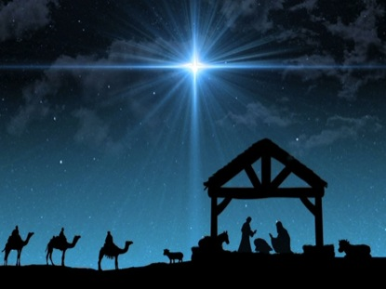
Proclaiming the WORD (Titus 2:11-14)
Grace Appears

Slide 16
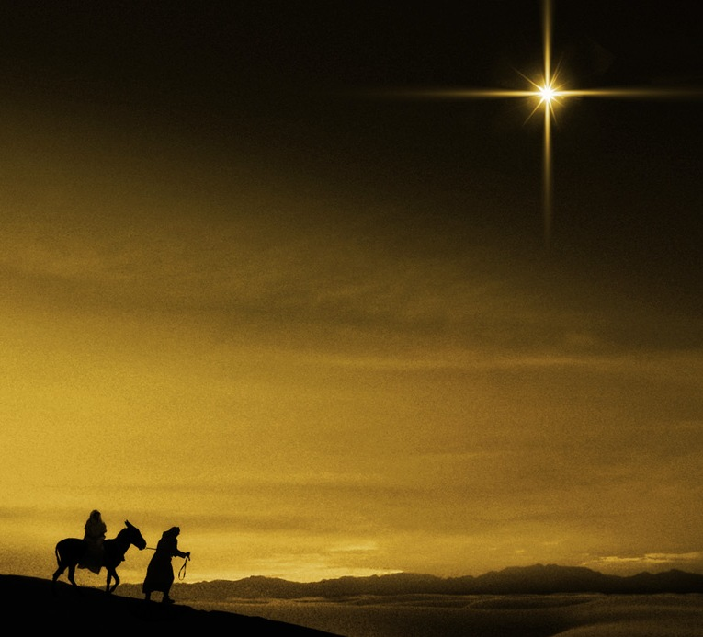
Responding Hymn # 142 “Angels, from the Realms of Glory”
Angels, from the realms of glory, wing your flight o’er all the earth; you, who sang creation’s story, now proclaim Messiah’s birth: come and worship, come and worship, worship Christ, the newborn king!

Slide 17
Responding Hymn # 142 “Angels, from the Realms of Glory”
Shepherds, in the fields abiding, watching o’er your flocks by night, God with us is now residing; yonder shines the infant light: come and worship, come and worship, worship Christ, the newborn king!

Slide 18
Responding Hymn # 142 “Angels, from the Realms of Glory”
Sages, leave your contemplations; brighter visions beam afar; seek the great desire of nations; you have seen his natal star: come and worship, come and worship, worship Christ, the newborn king!

Slide 19
Responding Hymn # 142 “Angels, from the Realms of Glory”
All creation, join in praising God the Father, Spirit, Son, evermore your voices raising to the eternal Three in One: come and worship, come and worship, worship Christ, the newborn king!

Slide 20
Bearing and Following the WORD into the World Affirmation of Faith - Christmas
We believe in God:
the creator and giver of life, who brought all creation to birth, who mothers us and fathers us, protecting, nurturing, and cherishing us.
We believe in Jesus Christ:
God born among us as a fragile baby, embodying both love and the need for love, and calling us to rest in God
as trustingly as a tiny child.

Slide 21
Bearing and Following the WORD into the World Affirmation of Faith - Christmas
We believe in the Holy Spirit:
breathed into us at our birth,
always drawing us on to be born again, encouraging, exhorting, comforting, nourishing our growth and inspiring our living.
We believe in the reconciliation of the world to God, through Christ. Hunted at birth and humiliated at death, Christ entered our fearful darkness so that we might enter his glorious light and share the life of his resurrection.

Slide 22
Bearing and Following the WORD into the World Affirmation of Faith - Christmas
And we believe that each new child is a glimpse of the face of God, a sign of the life to come, and a call to live in peace and celebrate living together. Glory to God in the highest, and peace to God's people on earth. Amen.

Slide 23
Bearing and Following the WORD into the World Announcements &
Sharing of Joys and Concerns
The afternoon Bible Study Group will NOT be meeting this afternoon.
The Women's Group will NOT be meeting this coming week.
Please join us tonight for our Christmas Eve Lesson and Carols Service at 8pm. We will be having reception and caroling immediately after the service as well. Please bring something to share for the evening celebration of the birth and the coming of our Savior.

Slide 24
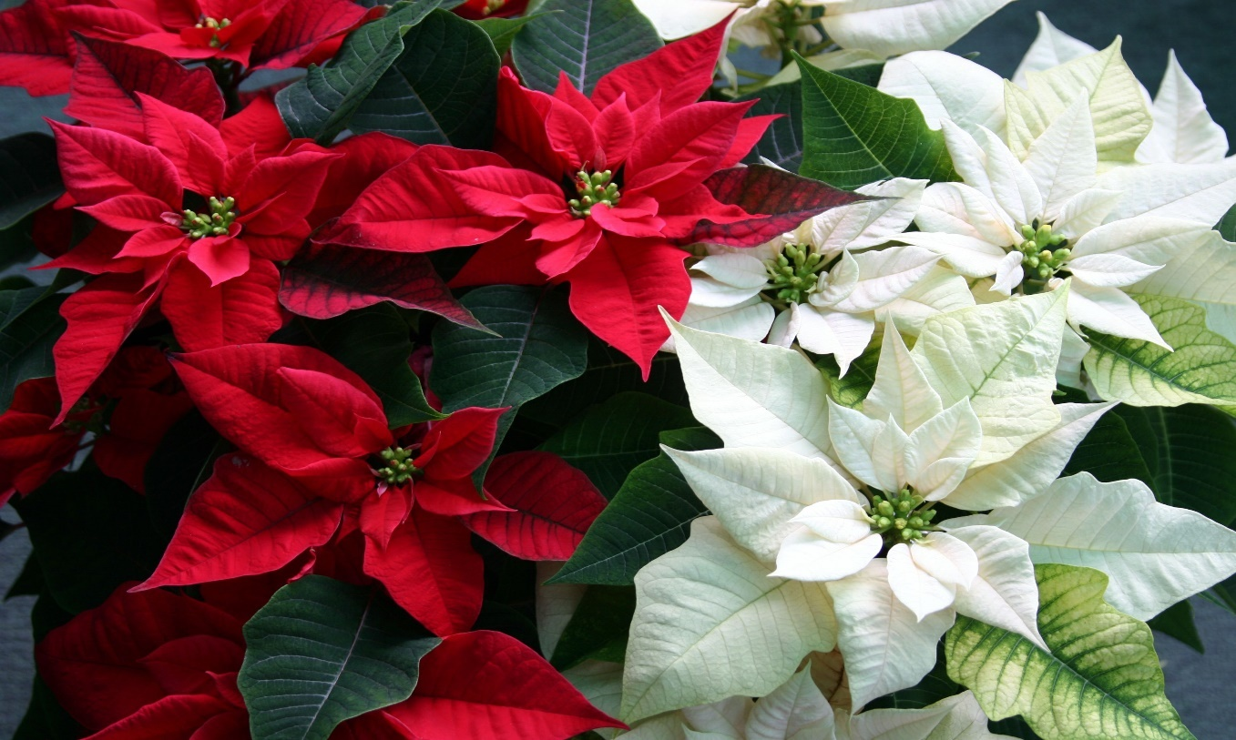
Bearing and Following the WORD into the World Announcements &
Sharing of Joys and Concerns
Our Chancel Poinsettia are provided by Raymond/Elva Blossom, Elloree Brown, Amy/David Dwan, Ken/Jae Lau, Margaret Lesman, Samson Tso, Yeming Wang, and Paul Wine.

Slide 25
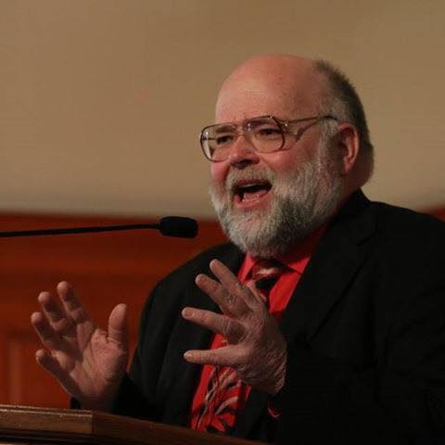
Bearing and Following the WORD into the World Announcements &
Sharing of Joys and Concerns
Rev. Mark Koenig will be our guest speaker next Sunday, 12/31.
Rev. Koenig is currently is the Advocate for Justice Ministries for the NYC Presbytery’s Committee on Witness to Society and the World. Most recently he served on staff in the PC(USA)’s Presbyterian Mission Agency as well as the director of the Presbyterian Ministry at the United Nations.

Slide 26
Bearing and Following the WORD into the World Prayer of the People & The Lord’s Prayer
Our Father, who art in heaven.
Halloweth be thy name.
Thy Kingdom come; Thy will be done
On earth as it is in heaven.
Give us this day our daily bread.
Forgive us our debts; as we forgive our debtors.
Lead us not into temptations, but deliver us from evil.
For Thine is the Kingdom, the Power, and the Glory forever. Amen.

Slide 27
Bearing and Following the WORD into the World Offering of our Gifts and our Lives
Musical Offering

Slide 28
Bearing and Following the WORD into the World Doxology and Offertory Prayer

Slide 29
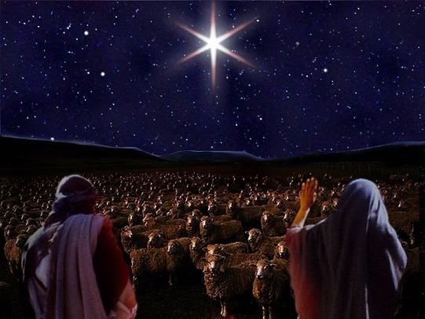
Sending Hymn #117 “While Shepherds Watched Their Flocks”
While shepherds watched
their flocks by night, all seated on the ground, the angel of the Lord came down, and glory shone around.

Slide 30
Sending Hymn #117 “While Shepherds Watched Their Flocks”
“Fear not,” said he, for mighty dread had seized their troubled mind: “Glad tidings of great joy I bring to you and humankind.

Slide 31
Sending Hymn #117 “While Shepherds Watched Their Flocks”
“To you, in David’s town this day, is born of David’s line the Savior, who is Christ the Lord, and this shall be the sign:

Slide 32
Sending Hymn #117 “While Shepherds Watched Their Flocks”
“The heavenly babe
you there shall find to human view displayed, all humbly wrapped in swathing bands, and in a manger laid.”

Slide 33
Sending Hymn #117 “While Shepherds Watched Their Flocks”
Thus spoke the seraph, and forthwith appeared a shining throng of angels praising God, who thus addressed their joyful song:

Slide 34
Sending Hymn #117 “While Shepherds Watched Their Flocks”
“All glory be to God on high, and to the earth be peace; good will to all from highest heaven begin and never cease!”

Slide 35
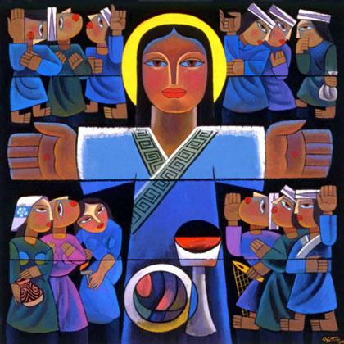
Bearing and Following the WORD into the World The Charge and Benediction

Slide 36
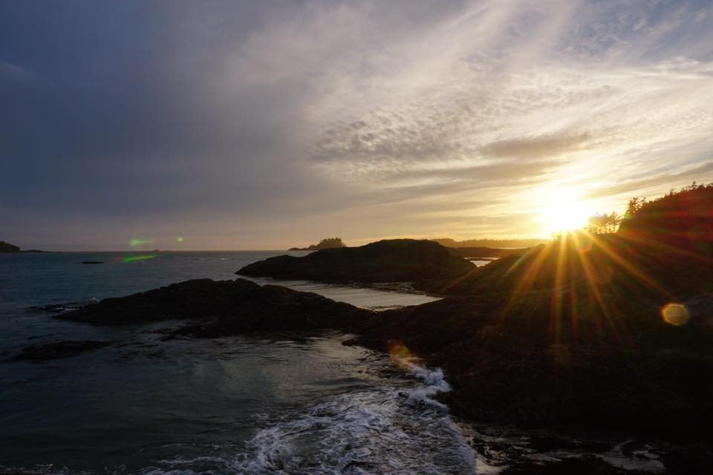
Bearing and Following the WORD into the World Benediction Response
# 540 “Farewell, Good Friends”
Farewell, Good friends!
Farewell, Good friends!
Shalom, Shalom!
Till we meet again,
till we meet again,
Shalom, Shalom!

Slide 37
Homecrest Presbyterian Church Worship of the Lord’s Day December 24th, 2017 4th Sunday of Advent

