Slide 1
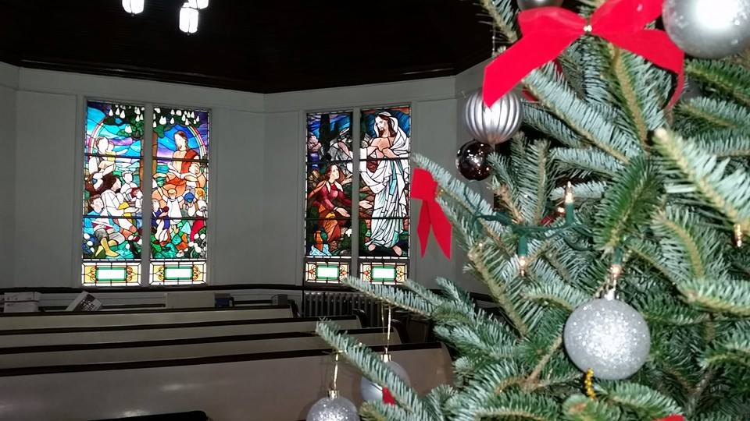
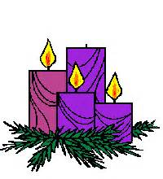
Homecrest Presbyterian Church Worship of the Lord’s Day December 17th, 2017 3rd Sunday of Advent

Slide 2
Gathering Around the WORD Lighting of the Advent Candle/ Call to Worship – Elloise Wagner

Slide 3
Gathering Around the WORD Gathering Hymn # 83 “Come, Thou Long-Expected Jesus”
Come, thou long-expected Jesus, born to set thy people free; from our fears and sins release us; let us find our rest in thee.

Slide 4
Gathering Around the WORD Gathering Hymn # 83 “Come, Thou Long-Expected Jesus”
Israel’s strength and consolation, hope of all the earth thou art; dear desire of every nation, joy of every longing heart.

Slide 5
Gathering Around the WORD Gathering Hymn # 83 “Come, Thou Long-Expected Jesus”
Born thy people to deliver, born a child and yet a king, born to reign in us forever, now thy gracious kingdom bring.

Slide 6
Gathering Around the WORD Gathering Hymn # 83 “Come, Thou Long-Expected Jesus”
By thine own eternal Spirit rule in all our hearts alone; by thine all-sufficient merit raise us to thy glorious throne.

Slide 7
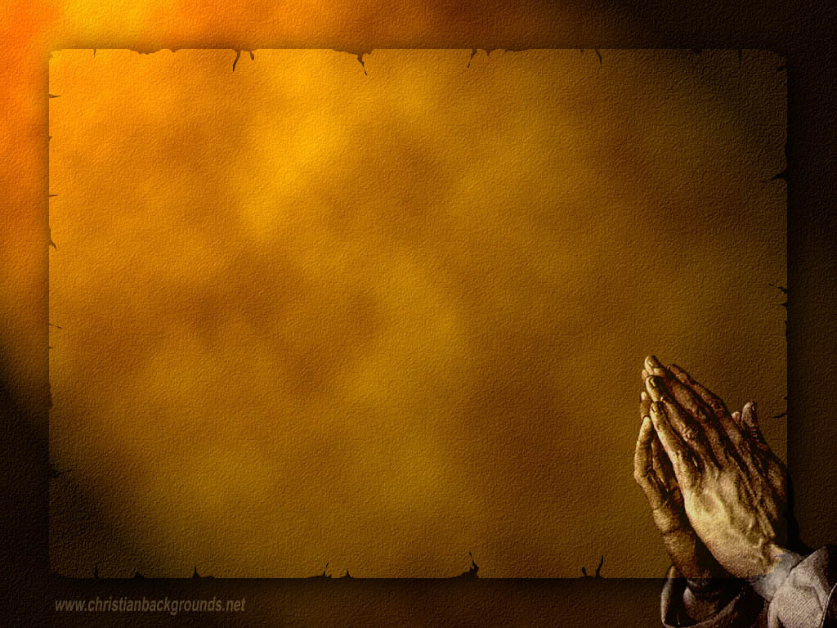
Gathering Around the WORD Call to Confession The season of Advent invites us to look carefully into our lives, upon self-examination of what we have done wrong….to see what God has done through God’s mercy and grace. Assuring that God hears our repentance, let us turn our minds to the truth, confessing our sins to God and one another.

Slide 8
Gathering Around the WORD Prayer of Confession (in Unison)
The Lord is near. In your presence, Holy God, we confess that we need repentance. We have broken your commands against idolatry – idolatry of our earthly needs and carvings. We do not live in peace with your creation or your people. We have not trusted your word, and we are afraid living in fear and anxiety. Forgive us, restore us, and turn our shame into JOY, for the sake of the One who proclaims the good news and for the sake of all the world, Amen.

Slide 9
Gathering Around the WORD Declaration of Forgiveness
Friends, even though we have continued to live in sins, through our confession and penitence, God has restored us into a right relationship with God through the coming of a Savior.
Thanks be to God, Amen.

Slide 10
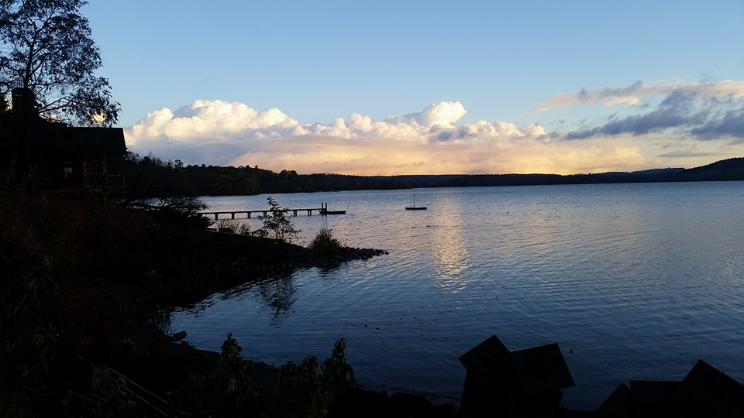
Gathering Around the WORD Gloria Patri
Glory be to the Father
and to the Son and to the Holy Ghost;
As it was in the beginning,
is now, and ever shall be,
world without end. Amen, Amen.

Slide 11
Gathering Around the WORD Passing of the Peace of Christ

Slide 12
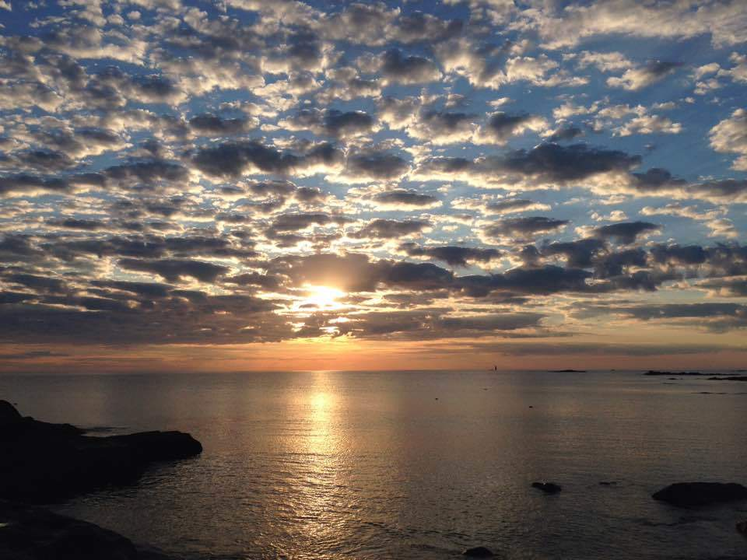
Proclaiming the WORD Message to the Youth/ Prayer of Illumination

Slide 13
Proclaiming the WORD Scripture Reading (Luke 1:46b-55)
My soul magnifies the Lord, and my spirit rejoices in God my Savior, for he has looked with favor on the lowliness of his servant.
Surely, from now on all generations will call me blessed; for the Mighty One has done great things for me, and holy is his name. His mercy is for those who fear him from generation to generation.

Slide 14
Proclaiming the WORD Scripture Reading (Luke 1:46b-55)
He has shown strength with his arm; he has scattered the proud in the thoughts of their hearts. He has brought down the powerful from their thrones, and lifted up the lowly; he has filled the hungry with good things, and sent the rich away empty.

Slide 15
Proclaiming the WORD Scripture Reading (Luke 1:46b-55)
He has helped his servant Israel, in remembrance of his mercy, according to the promise he made to our ancestors, to Abraham and to his descendants forever.”

Slide 16
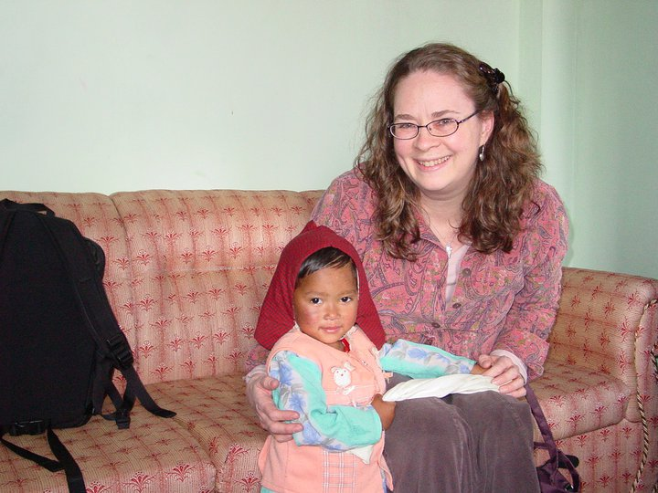
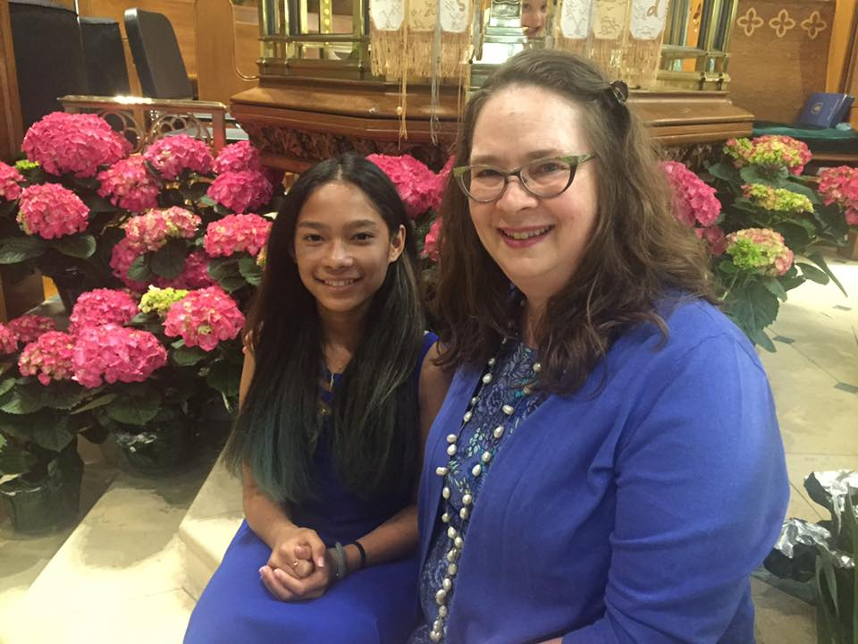
Proclaiming the WORD (Luke 1:46b-55)
Turning Fear into Hope and Joy

Slide 17
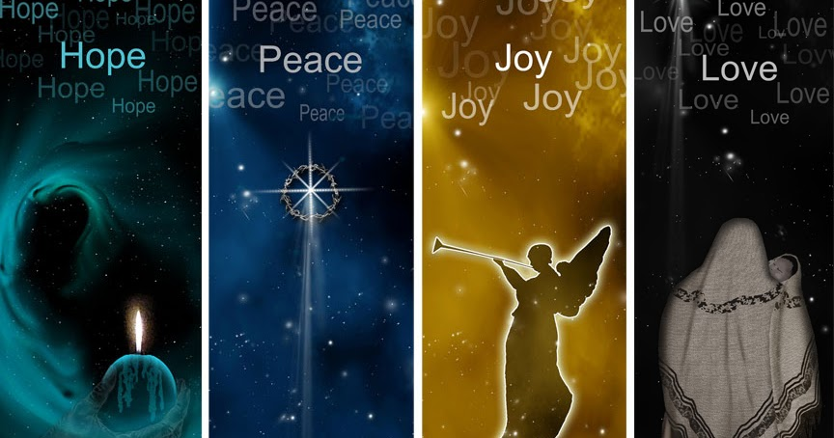
Proclaiming the WORD (Luke 1:46b-55)
Turning Fear into Hope and Joy

Slide 18
Proclaiming the WORD (Luke 1:46b-55)
Turning Fear into Hope and Joy
“And Jesus said: Don’t Be Afraid”
by Shirley Erena Murray
And Jesus said: Don’t be afraid –
I’ve come to turn your fear into hope,
I’ve come to take you through the deep,
to be your friend until the end,
and give you troubled hearts to sleep.

Slide 19
Proclaiming the WORD (Luke 1:46b-55)
Turning Fear into Hope and Joy
“And Jesus said: Don’t Be Afraid”
by Shirley Erena Murray
And Jesus said: Don’t be afraid –
I know your emptiness and grief,
I hear your words of unbelief, but if you will,
I’ll heal your soul and give your doubting heart relief.

Slide 20
Proclaiming the WORD (Luke 1:46b-55)
Turning Fear into Hope and Joy
“And Jesus said: Don’t Be Afraid”
by Shirley Erena Murray
And Jesus said: Don’t be afraid –
I am the Way, I am the Light,
I am the Truth that holds you tight,
and in God’s home you have a room,
a place of welcome and delight.

Slide 21
Responding Hymn # 99 “My Soul Gives Glory to My God – Song of Mary”
My soul gives glory to my God; my heart pours out its praise. God lifted up my lowliness in many marvelous ways.

Slide 22
Responding Hymn # 99 “My Soul Gives Glory to My God – Song of Mary”
My God has done great things for me: yes, holy is God’s name. All people will declare me blessed, and blessings they shall claim.

Slide 23
Responding Hymn # 99 “My Soul Gives Glory to My God – Song of Mary”
From age to age to all who fear, such mercy love imparts, dispensing justice far and near, dismissing selfish hearts.

Slide 24
Responding Hymn # 99 “My Soul Gives Glory to My God – Song of Mary”
Love casts the mighty
from their thrones, promotes the insecure, leaves hungry spirits satisfied; the rich seem suddenly poor.

Slide 25
Responding Hymn # 99 “My Soul Gives Glory to My God – Song of Mary”
Praise God, whose loving covenant supports those in distress, remembering past promises with present faithfulness.

Slide 26
Bearing and Following the WORD into the World An Advent ffirmation of Faith – Nathan Nettleton
We believe in God, creator and lover of the earth, origin and destiny of us all.
We believe in Jesus the Christ—
God coming to us in the fragile promise of a baby yet unborn— who emerges as the herald of hope, God's laughter in the face of despair. Plunged into death and hell, he broke free the captives, and is leading the way to the land of promise where justice and peace will flourish.

Slide 27
Bearing and Following the WORD into the World An Advent ffirmation of Faith – Nathan Nettleton
We believe in the Holy Spirit, who implants the seed of truth, brings us to birth as the body of Christ, and empowers us to confront and transform all that is corrupt, degrading and deceitful.

Slide 28
Bearing and Following the WORD into the World An Advent ffirmation of Faith – Nathan Nettleton
We believe in the coming reign of God. Announced by the Baptist, it has drawn near to us in Jesus, and will be consummated in the glorious marriage of earth and heaven, when all who have passed through the world's deep sorrow will be raised from the waters, robed in righteousness, and gathered into the joyous fulfilment of God's desire.
For the coming of that day on this day, we work and pray: Come, Lord Jesus, Come!

Slide 29
Bearing and Following the WORD into the World Announcements &
Sharing of Joys and Concerns
The afternoon Bible Study Group will be meeting after service downstairs in the basement at 12:30pm. We will be using the Advent Devotional for our study.

Slide 30
Bearing and Following the WORD into the World Announcements &
Sharing of Joys and Concerns
The Women's Group will continue to meet every Wednesdays at 7:30pm over at the Manse (2048 E 14th Street). They are currently studying the Gospel of Luke. For more information, please see Margaret and Cara.

Slide 31
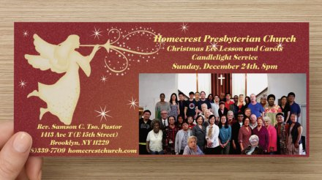
Bearing and Following the WORD into the World Announcements &
Sharing of Joys and Concerns
Our Christmas Card is ready to be picked up. Please take one per household unless you are sharing this to invite your friends and relatives to join us for our Christmas Eve Lesson and Carols Service on 12/24 at 8pm. We will be having reception and caroling immediately after the service as well.

Slide 32
Bearing and Following the WORD into the World Prayer of the People & The Lord’s Prayer
Our Father, who art in heaven.
Halloweth be thy name.
Thy Kingdom come; Thy will be done
On earth as it is in heaven.
Give us this day our daily bread.
Forgive us our debts; as we forgive our debtors.
Lead us not into temptations, but deliver us from evil.
For Thine is the Kingdom, the Power, and the Glory forever. Amen.

Slide 33
Bearing and Following the WORD into the World Offering of our Gifts and our Lives
Musical Offering

Slide 34
Bearing and Following the WORD into the World Doxology and Offertory Prayer

Slide 35
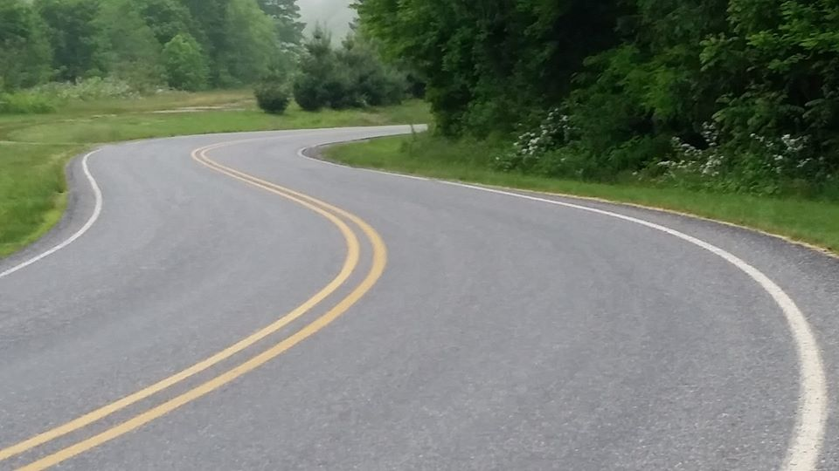
Sending Hymn #106 “Prepare the Way, O Zion”
Prepare the way, O Zion, your Christ is drawing near! Let every hill and valley a level way appear. Greet One who comes in glory, foretold in sacred story. O blest is Christ who came in God’s most holy name.

Slide 36
Sending Hymn #106 “Prepare the Way, O Zion”
He brings God’s rule, O Zion; he comes from heaven above. His rule is peace and freedom, and justice, truth, and love. Lift high your praise resounding, for grace and joy abounding. O blest is Christ who came in God’s most holy name.

Slide 37
Sending Hymn #106 “Prepare the Way, O Zion”
Fling wide your gates, O Zion; your Savior’s rule embrace, and tidings of salvation proclaim in every place. All lands will bow rejoicing, their adoration voicing. O blest is Christ who came in God’s most holy name.

Slide 38
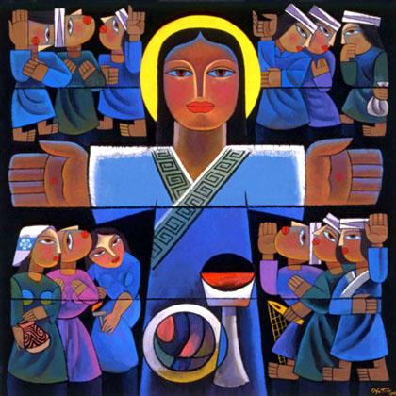
Bearing and Following the WORD into the World The Charge and Benediction

Slide 39
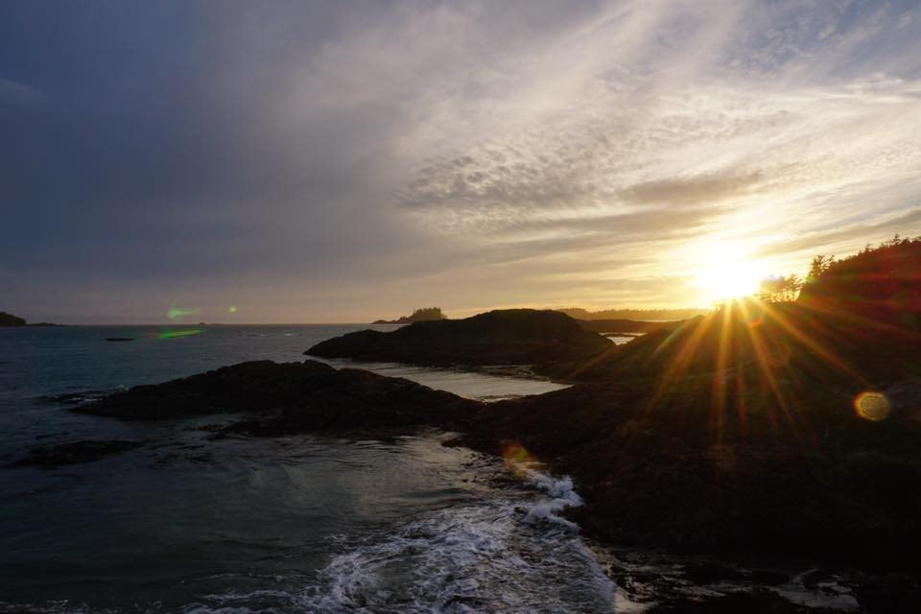
Bearing and Following the WORD into the World Benediction Response
# 540 “Farewell, Good Friends”
Farewell, Good friends!
Farewell, Good friends!
Shalom, Shalom!
Till we meet again,
till we meet again,
Shalom, Shalom!

Slide 40
Homecrest Presbyterian Church Worship of the Lord’s Day December 17th, 2017 3rd Sunday of Advent

