Slide 1
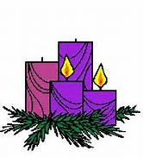
Homecrest Presbyterian Church Worship of the Lord’s Day December 10th, 2017 2nd Sunday of Advent

Slide 2
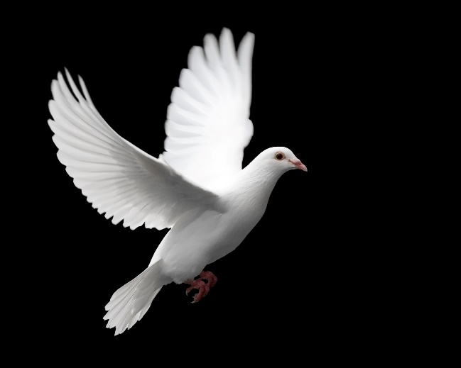
Gathering Around the WORD Lighting of the Advent Candle/ Call to Worship – Steven Kreger

Slide 3
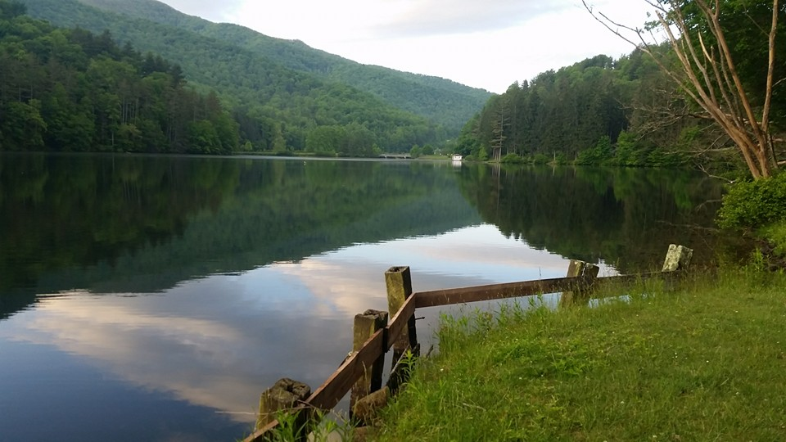
Gathering Around the WORD Gathering Hymn # 623 “I’ve Got Peace Like a River”
I’ve got peace like a river; I’ve got peace like a river; I’ve got peace like a river, in my soul.
I’ve got peace like a river; I’ve got peace like a river; I’ve got peace like a river, in my soul.

Slide 4
Gathering Around the WORD Gathering Hymn # 623 “I’ve Got Peace Like a River”
I’ve got joy like a fountain; I’ve got joy like a fountain; I’ve got joy like a fountain, in my soul. I’ve got joy like a fountain; I’ve got joy like a fountain; I’ve got joy like a fountain, in my soul.

Slide 5
Gathering Around the WORD Gathering Hymn # 623 “I’ve Got Peace Like a River”
I’ve got love like an ocean; I’ve got love like an ocean; I’ve got love like an ocean, in my soul. I’ve got love like an ocean; I’ve got love like an ocean; I’ve got love like an ocean, in my soul.

Slide 6
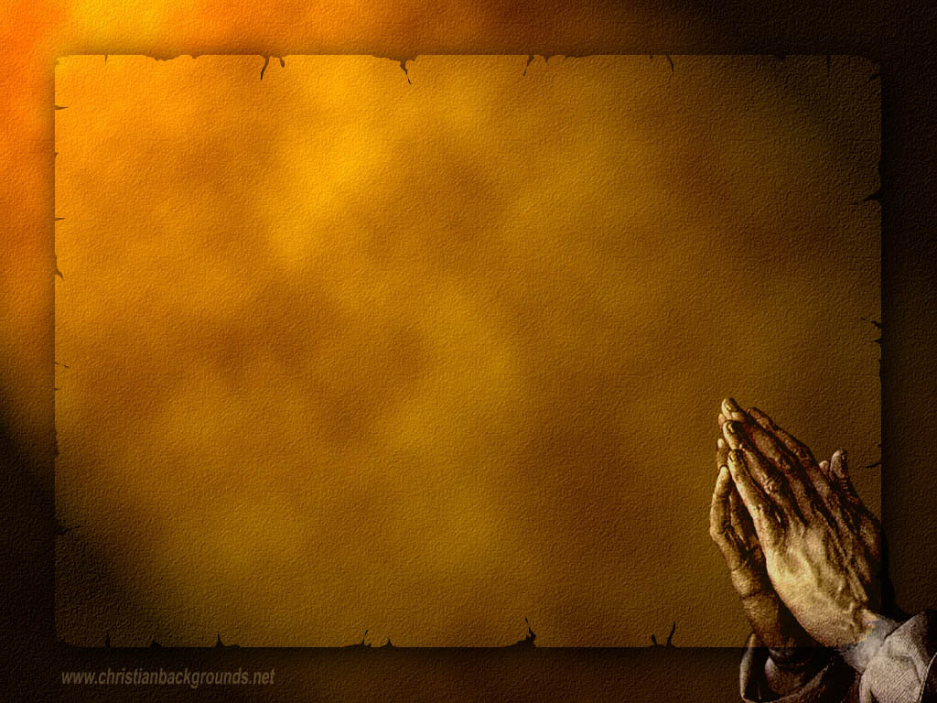
Gathering Around the WORD Call to Confession (Based on 2 Peter 3:9) Our God does not want anyone to perish but to come to repentance and to have eternal life. God sent his only begotten Son to us so that we may come to acknowledge and repent of our sins. Let us, therefore, come before God through the sincerity of our hearts and our contrite spirit.

Slide 7
Gathering Around the WORD Prayer of Confession (in Unison)
Refiner God, you have sent us prophets and we have not listened. We have not always determined what is best or made way for your reign in our lives, our church, and our society. Forgive us, we pray, and renew your covenant within us, for the sake of our Lord Jesus the Christ, Amen.

Slide 8
Gathering Around the WORD Declaration of Forgiveness
Friends this is the good news,
that if we repent of our sins,
God will surely forgive us.
The One who began a good work in us will bring it to completion. Grateful for the promise of joy and of peace that the expected Savior brings us. We are a forgiven people.
Thanks be to God, Amen.

Slide 9
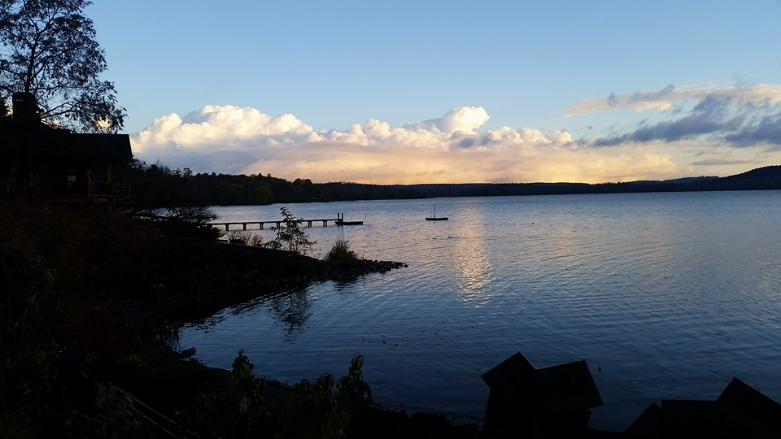
Gathering Around the WORD Gloria Patri
Glory be to the Father
and to the Son and to the Holy Ghost;
As it was in the beginning,
is now, and ever shall be,
world without end. Amen, Amen.

Slide 10
Gathering Around the WORD Passing of the Peace of Christ

Slide 11
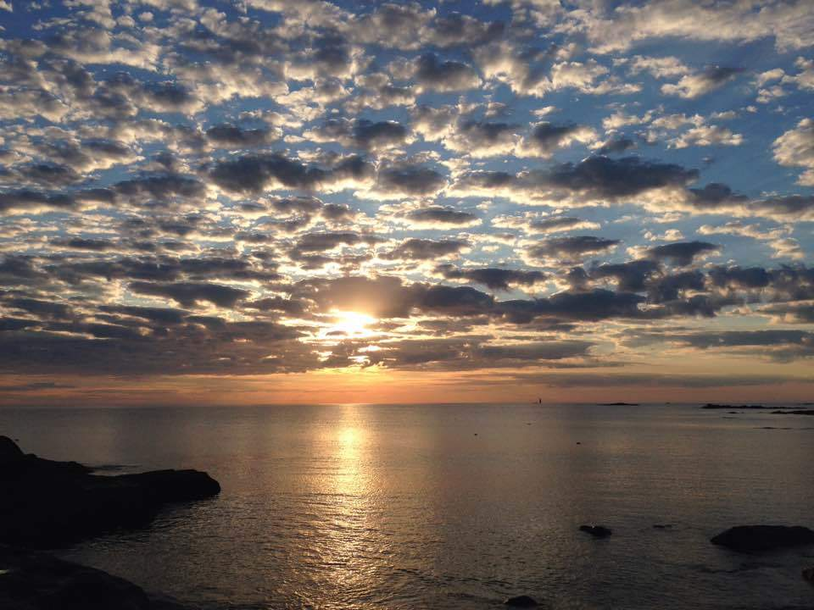
Proclaiming the WORD Message to the Youth/ Prayer of Illumination

Slide 12
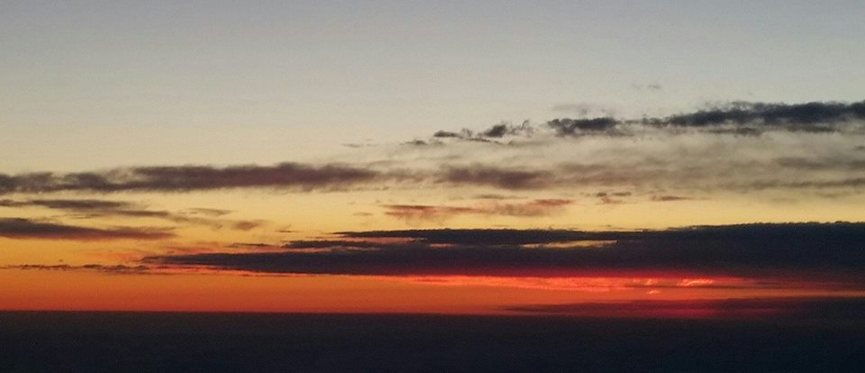
Proclaiming the WORD Responsive Reading (Isaiah 40:1-11)
¹ Comfort, O comfort my people, says your God. ² Speak tenderly to Jerusalem, and cry to her that she has served her term, that her penalty is paid, that she has received
from the Lord’s hand double for all her sins.

Slide 13
Proclaiming the WORD Responsive Reading (Isaiah 40:1-11)
³ A voice cries out: “In the wilderness prepare the way of the LORD, make straight in the desert a highway for our God. ⁴ Every valley shall be lifted up, and every mountain
and hill be made low; the uneven ground shall become level, and the rough places a plain.

Slide 14
Proclaiming the WORD Responsive Reading (Isaiah 40:1-11)
⁵ Then the glory of the LORD shall be revealed, and all people shall see it together, for the mouth of the LORD has spoken.”
⁶ A voice says, “Cry out!” And I said, “What shall I cry?” All people are grass, their constancy is like the flower of the field.

Slide 15
Proclaiming the WORD Responsive Reading (Isaiah 40:1-11)
⁷ The grass withers, the flower fades, when the breath of the LORD blows upon it; surely the people are grass.
⁸ The grass withers, the flower fades; but the word of our God
will stand forever.

Slide 16
Proclaiming the WORD Responsive Reading (Isaiah 40:1-11)
⁹ Get you up to a high mountain, O Zion, herald of good tidings; lift up your voice with strength, O Jerusalem, herald of good tidings, lift it up, do not fear; say to the cities of Judah, “Here is your God!” ¹⁰ See, the Lord GOD comes with might, and his arm rules for him; his reward is with him, and his recompense before him.

Slide 17
Proclaiming the WORD Responsive Reading (Isaiah 40:1-11)
¹¹ He will feed his flock like a shepherd; he will gather the lambs in his arms, and carry them in his bosom, and gently lead the mother sheep.

Slide 18
Proclaiming the WORD Scripture Reading (2 Peter 3:8-15a)
⁸But do not ignore this one fact, beloved, that with the Lord one day is like a thousand years, and a thousand years are like one day. ⁹The Lord is not slow about his promise, as some think of slowness, but is patient with you, not wanting any to perish, but all to come to repentance. ¹⁰But the day of the Lord will come like a thief, and then the heavens will pass away with a loud noise, and the elements will be dissolved with fire, and the earth and everything that is done on it will be disclosed.

Slide 19
Proclaiming the WORD Scripture Reading (2 Peter 3:8-15a)
¹¹Since all these things are to be dissolved in this way, what sort of persons ought you to be in leading lives of holiness and godliness, ¹²waiting for and hastening the coming of the day of God, because of which the heavens will be set ablaze and dissolved, and the elements will melt with fire? ¹³But, in accordance with his promise, we wait for new heavens and a new earth, where righteousness is at home.

Slide 20
Proclaiming the WORD Scripture Reading (2 Peter 3:8-15a)
¹⁴Therefore, beloved, while you are waiting for these things, strive to be found by him at peace, without spot or blemish;
^{15a}and regard the patience of our Lord as salvation.

Slide 21
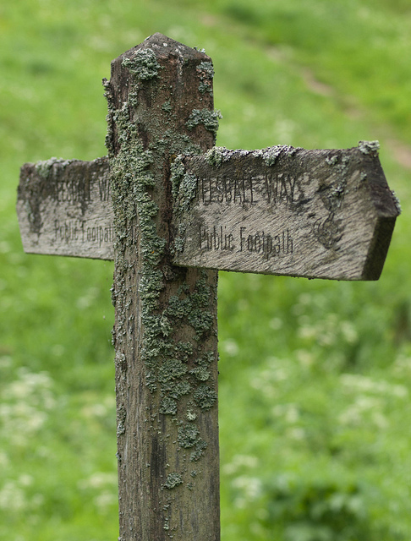
Proclaiming the WORD (Isaiah 40:1-11 and 2 Peter 8:15a)
Smoothing out the Rough Edges

Slide 22
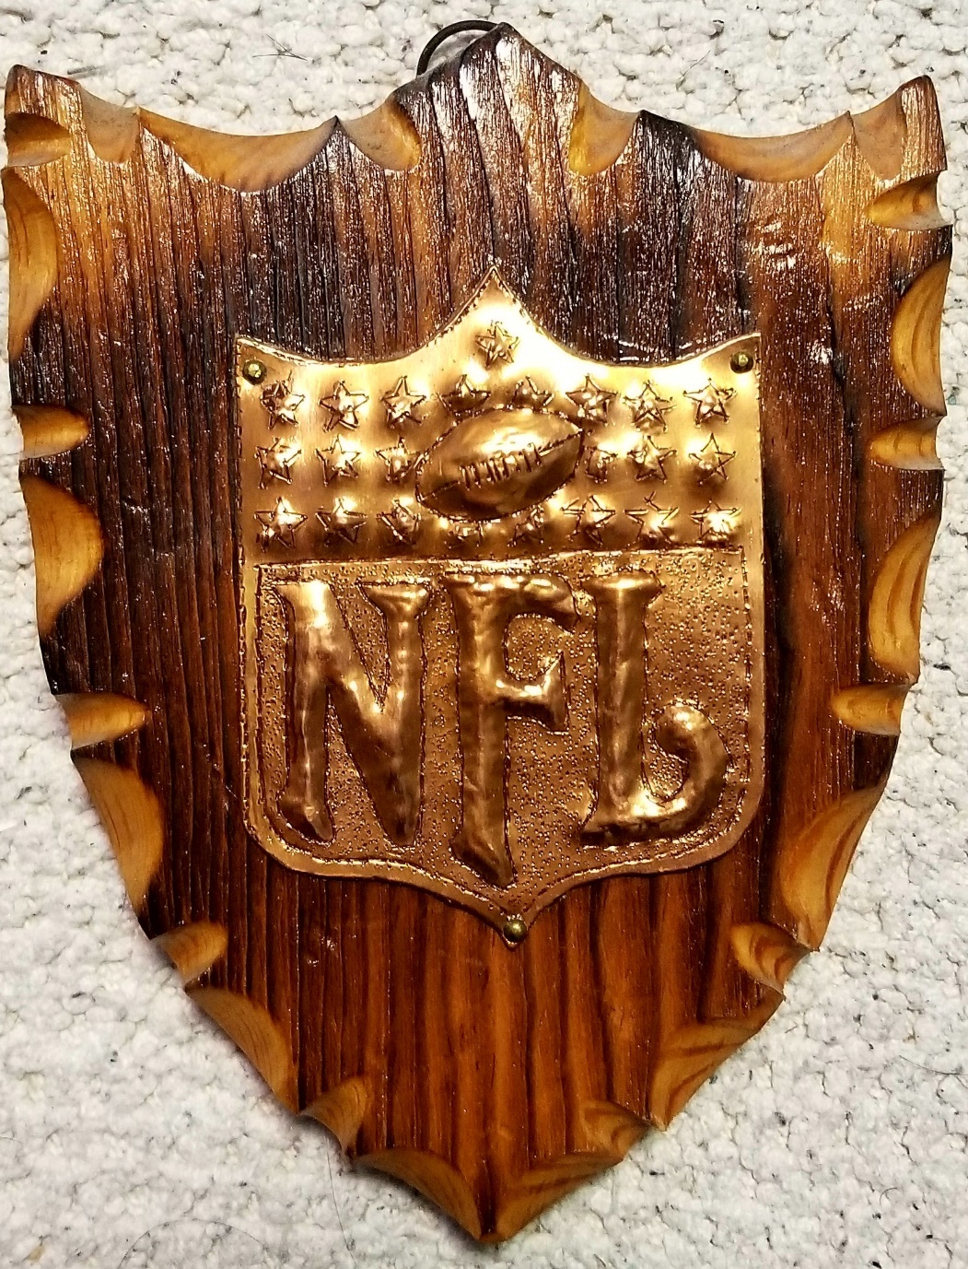
Proclaiming the WORD (Isaiah 40:1-11 and
2 Peter 8:15a)
Smoothing out
the Rough Edges

Slide 23
Proclaiming the WORD (Isaiah 40:1-11 and 2 Peter 8:15a)
Smoothing out the Rough Edges

Slide 24
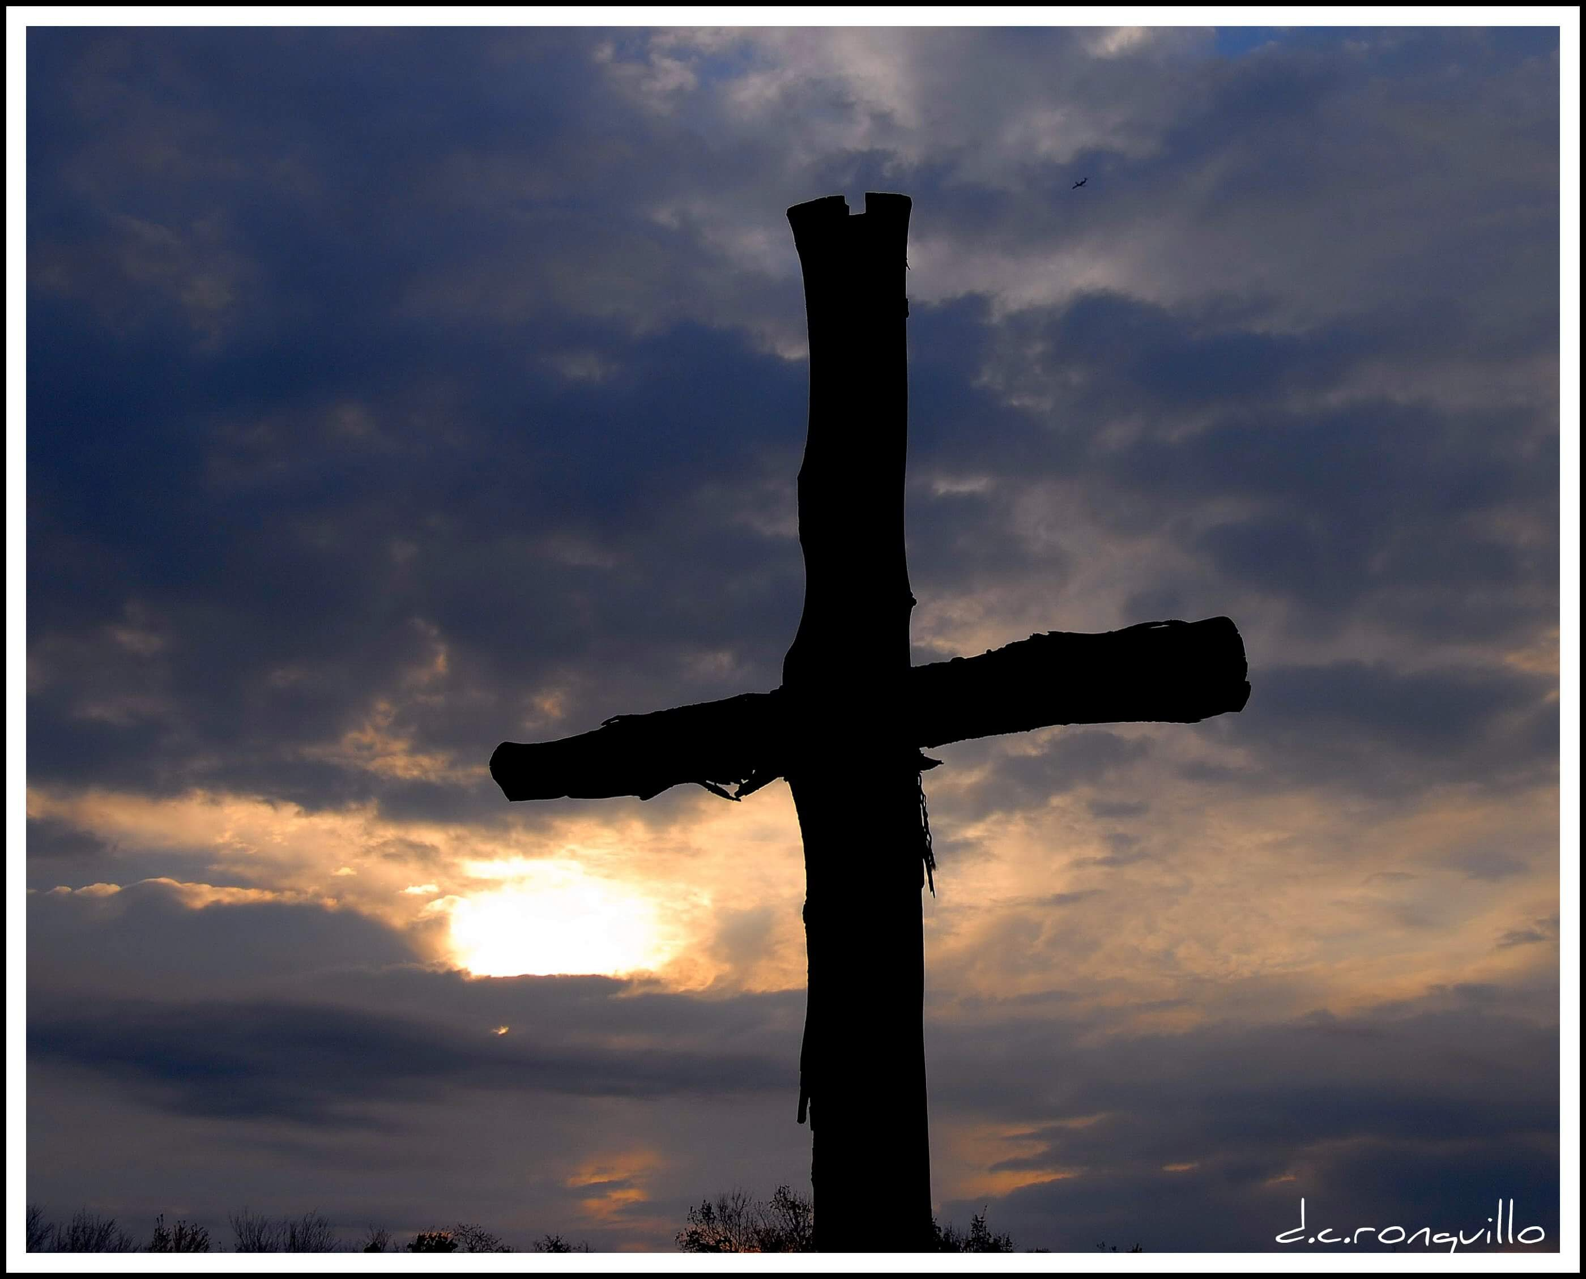
Proclaiming the WORD (Isaiah 40:1-11 and 2 Peter 8:15a)
Smoothing out the Rough Edges

Slide 25
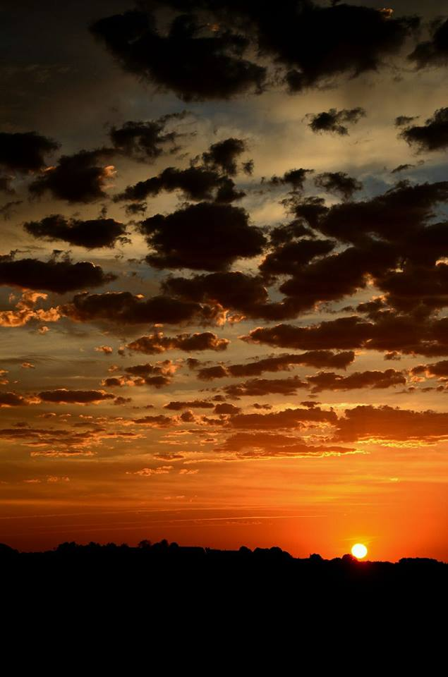
Responding Hymn # 87 “Comfort, Comfort Now My People”
“Comfort, comfort now my people; tell of peace!” So says our God. “Comfort those who sit in darkness mourning under sorrow’s load. To my people now proclaim that my pardon waits for them! Tell them that their sins I cover, and their warfare now is over.”

Slide 26
Responding Hymn # 87 “Comfort, Comfort Now My People”
For the herald’s voice is crying in the desert far and near, calling us to true repentance, since the reign of God is here. O, that warning cry obey! Now prepare for God a way. Let the valleys rise in meeting and the hills bow down in greeting.

Slide 27
Responding Hymn # 87 “Comfort, Comfort Now My People”
Straight shall be what long was crooked, and the rougher places plain. Let your hearts be true and humble, as befits God’s holy reign. For the glory of the Lord now on earth is shed abroad, and all flesh shall see the token that God’s word is never broken.

Slide 28
Bearing and Following the WORD into the World An Advent ffirmation of Faith – Nathan Nettleton
We believe in God, creator and lover of the earth, origin and destiny of us all.
We believe in Jesus the Christ—
God coming to us in the fragile promise of a baby yet unborn— who emerges as the herald of hope, God's laughter in the face of despair. Plunged into death and hell, he broke free the captives, and is leading the way to the land of promise where justice and peace will flourish.

Slide 29
Bearing and Following the WORD into the World An Advent ffirmation of Faith – Nathan Nettleton
We believe in the Holy Spirit, who implants the seed of truth, brings us to birth as the body of Christ, and empowers us to confront and transform all that is corrupt, degrading and deceitful.

Slide 30
Bearing and Following the WORD into the World An Advent ffirmation of Faith – Nathan Nettleton
We believe in the coming reign of God. Announced by the Baptist, it has drawn near to us in Jesus, and will be consummated in the glorious marriage of earth and heaven, when all who have passed through the world's deep sorrow will be raised from the waters, robed in righteousness, and gathered into the joyous fulfilment of God's desire.
For the coming of that day on this day, we work and pray: Come, Lord Jesus, Come!

Slide 31
Bearing and Following the WORD into the World Announcements &
Sharing of Joys and Concerns
The afternoon Bible Study Group WILL be meeting after service downstairs in the basement at 12:30pm. We will be using the Advent Devotional for our study.

Slide 32
Bearing and Following the WORD into the World Announcements &
Sharing of Joys and Concerns
The Women's Group will resume meeting on every Wednesdays at 7:30pm over at the Manse (2048 E 14th Street). They are currently studying the Gospel of Luke. For more information, please see Margaret and Cara.

Slide 33
Bearing and Following the WORD into the World Announcements &
Sharing of Joys and Concerns
We will also be running Coat Drive
if you wish to donate any gently used winter coats. Please drop off the coats no later than 12/17.

Slide 34
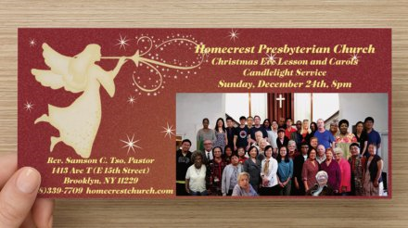
Bearing and Following the WORD into the World Announcements &
Sharing of Joys and Concerns
Our Christmas Card is ready to be picked up. Please take one per household unless you are sharing this to invite your friends and relatives to join us for our Christmas Eve Lesson and Carols Service on 12/24 at 8pm. We will be having reception and caroling immediately after the service as well.

Slide 35
Bearing and Following the WORD into the World Prayer of the People & The Lord’s Prayer
Our Father, who art in heaven.
Halloweth be thy name.
Thy Kingdom come; Thy will be done
On earth as it is in heaven.
Give us this day our daily bread.
Forgive us our debts; as we forgive our debtors.
Lead us not into temptations, but deliver us from evil.
For Thine is the Kingdom, the Power, and the Glory forever. Amen.

Slide 36
Bearing and Following the WORD into the World Offering of our Gifts and our Lives
Musical Offering

Slide 37
Bearing and Following the WORD into the World Doxology and Offertory Prayer

Slide 38
Sending Hymn #96 “On Jordan’s Bank the Baptist’s Cry”
On Jordan’s bank the Baptist’s cry announces that the Lord is nigh; awake and hearken, for he brings glad tidings of the King of kings!

Slide 39
Sending Hymn #96 “On Jordan’s Bank the Baptist’s Cry”
Then cleansed be every life from sin; make straight the way for God within, and let us all our hearts prepare for Christ to come and enter there.

Slide 40
Sending Hymn #96 “On Jordan’s Bank the Baptist’s Cry”
We hail you as our Savior, Lord, our refuge and our great reward; without your grace we waste away like flowers that wither and decay.

Slide 41
Sending Hymn #96 “On Jordan’s Bank the Baptist’s Cry”
Stretch forth your hand; our health restore, and make us rise to fall no more. O let your face upon us shine and fill the world with love divine.

Slide 42
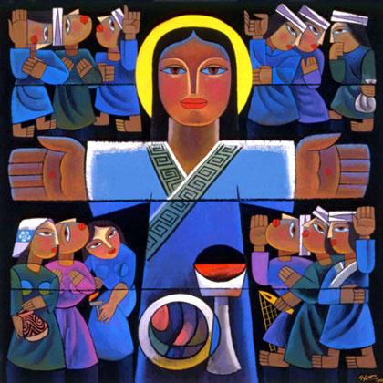
Bearing and Following the WORD into the World The Charge and Benediction

Slide 43
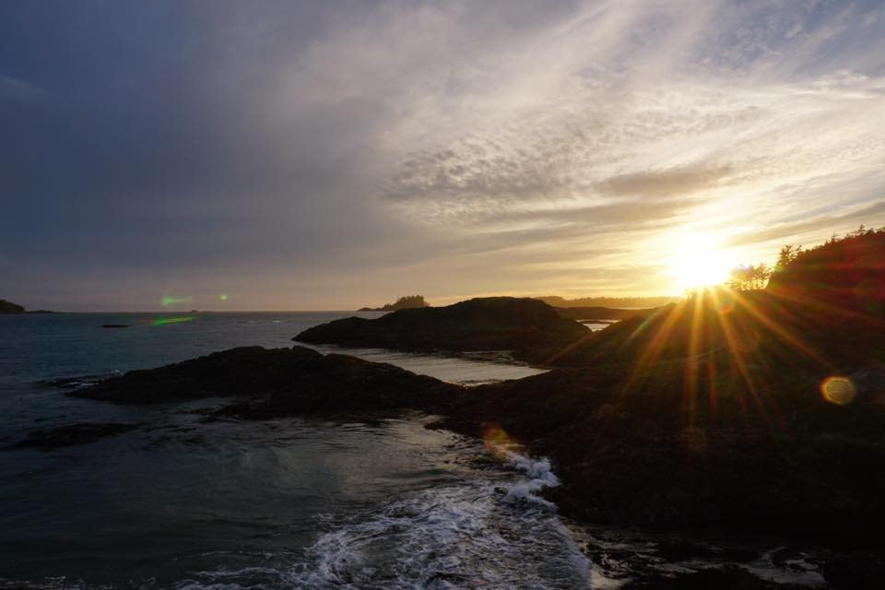
Bearing and Following the WORD into the World Benediction Response
# 542 “God Be with You Till We Meet Again”
(Stanza 4)
God be with you till we meet again;
keep love's banner floating o'er you; smite death's threatening wave before you: God be with you till we meet again.

Slide 44
Homecrest Presbyterian Church Worship of the Lord’s Day December 10th, 2017 2nd Sunday of Advent

