Slide 1
Homecrest Presbyterian Church Worship of the Lord’s Day December 3rd, 2017 1st Sunday of Advent

Slide 2
Gathering Around the WORD Lighting of the Advent Candle/ Call to Worship – Andrew Shemme

Slide 3
Gathering Around the WORD Gathering Hymn # 88 “O Come, O Come Emmanuel”
O come, O come, Emmanuel, and ransom captive Israel, that mourns in lonely exile here until the Son of God appear. Rejoice! Rejoice! Emmanuel shall come to thee, O Israel.

Slide 4
Gathering Around the WORD Gathering Hymn # 88 “O Come, O Come Emmanuel”
O come, thou Key of David, come, and open wide our heavenly home; make safe the way that leads on high, and close the path to misery. Rejoice! Rejoice! Emmanuel shall come to thee, O Israel.

Slide 5
Gathering Around the WORD Gathering Hymn # 88 “O Come, O Come Emmanuel”
O come, thou Dayspring, come and cheer our spirits by thine advent here; disperse the gloomy clouds of night, and death’s dark shadows put to flight. Rejoice! Rejoice! Emmanuel shall come to thee, O Israel.

Slide 6
Gathering Around the WORD Gathering Hymn # 88 “O Come, O Come Emmanuel”
O come, Desire of nations, bind all peoples in one heart and mind; bid envy, strife, and discord cease; fill the whole world with heaven’s peace. Rejoice! Rejoice! Emmanuel shall come to thee, O Israel.

Slide 7
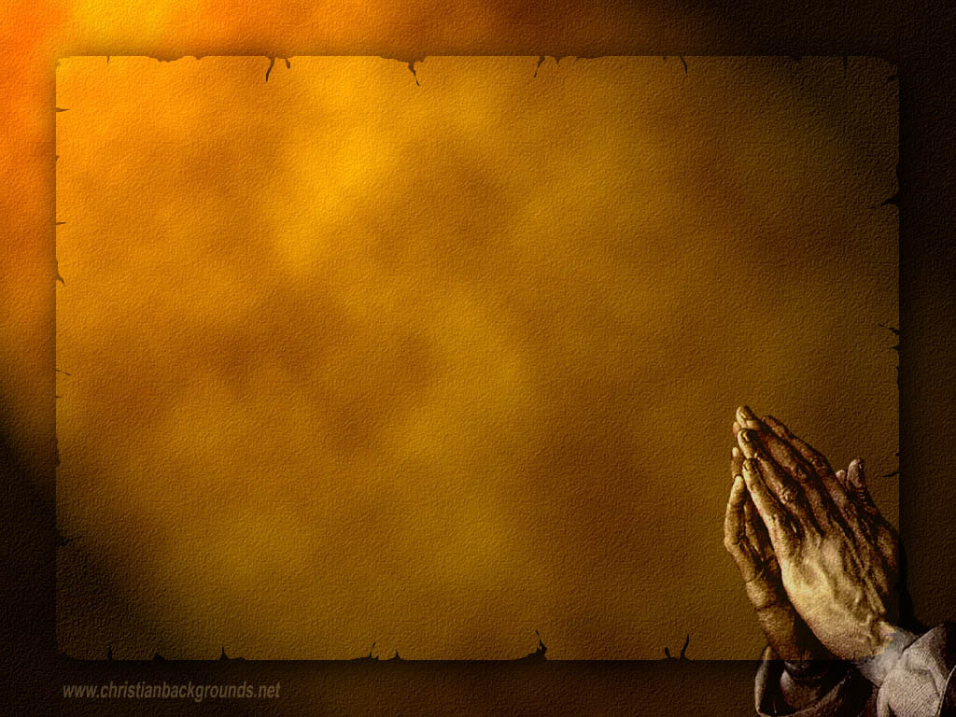
Gathering Around the WORD Call to Confession Like a faded, dry leaf that the wind blows away, our sins dry us up; faded and brittle, we are carried off by the wrongs we have done. Yet God loves us still and is able to restore and renew us with the water of life. In humility and faith, let us confess our sins before God in the presence and witness of our neighbors.

Slide 8
Gathering Around the WORD Prayer of Confession (in Unison)
Merciful God, we confess that we become distracted, even weary, in our discipleship. We keep busy schedules; we rush about. Captivated by technology, seduced by the lure of consumer goods, we do not remain alert to your divine presence in our lives, in the church, and in the world.

Slide 9
Gathering Around the WORD Prayer of Confession (in Unison)
Make us better doorkeepers of our lives, watching for you attentively. Awaken us to your surprising power and glory and peace, so we do not miss how near you are to our very own gates. Be gracious toward us, we pray, until we are gathered, from the ends of the earth to the ends of heaven, into your embrace. We pray in the name of Christ who was, and is, and is to come. Amen.

Slide 10
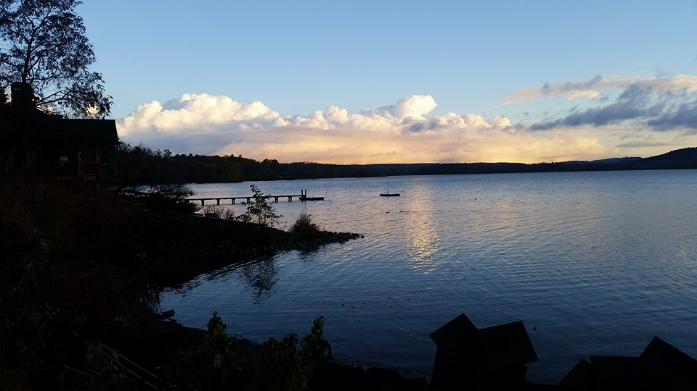
Gathering Around the WORD Gloria Patri
Glory be to the Father
and to the Son and to the Holy Ghost;
As it was in the beginning,
is now, and ever shall be,
world without end. Amen, Amen.

Slide 11
Gathering Around the WORD Passing of the Peace of Christ

Slide 12
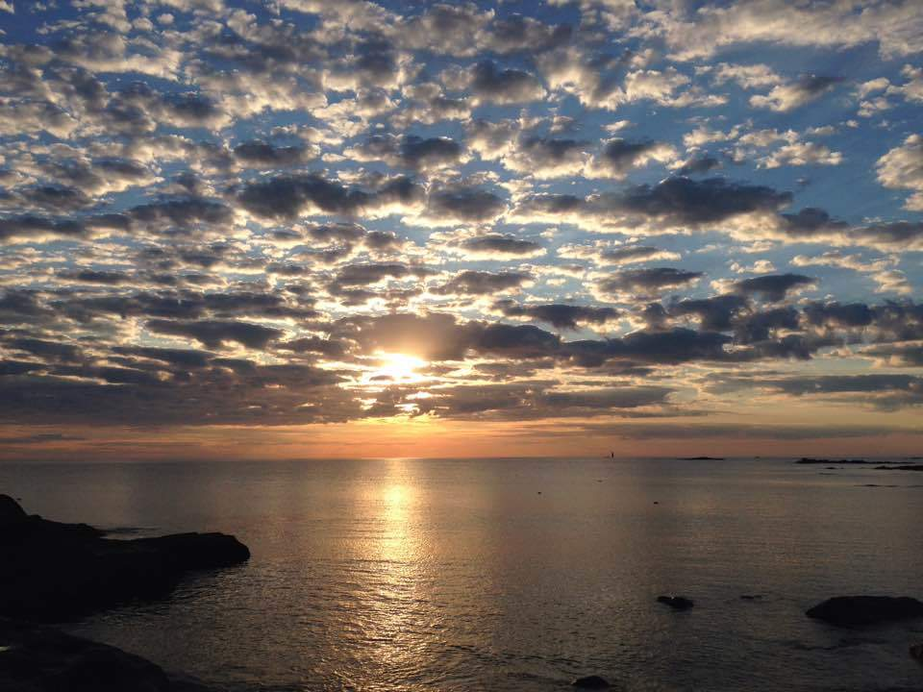
Proclaiming the WORD Message to the Youth/ Prayer of Illumination

Slide 13
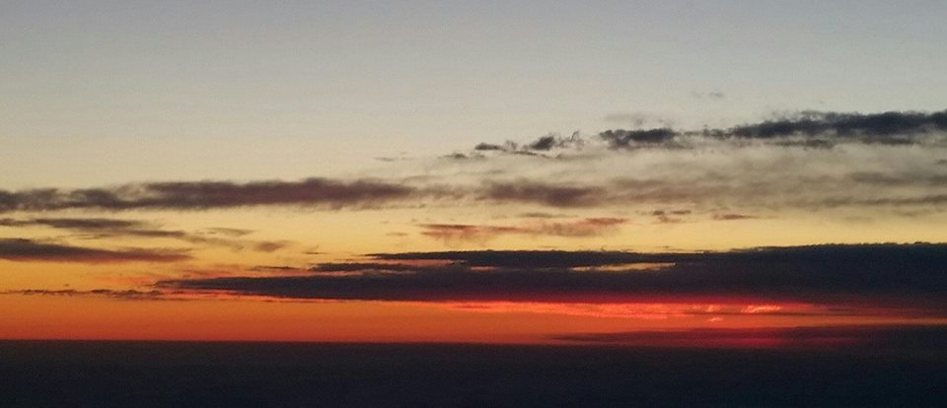
Proclaiming the WORD Scripture Reading (Mark 13:24-37)
²⁴“But in those days, after that suffering, the sun will be darkened, and the moon will not give its light, ²⁵ and the stars will be falling from heaven, and the powers in the heavens will be shaken. ²⁶Then they will see ‘the Son of Man coming in clouds’ with great power and glory. ²⁷Then he will send out the angels, and gather his elect from the four winds, from the ends of the earth to the ends of heaven.

Slide 14
Proclaiming the WORD Scripture Reading (Mark 13:24-37)
²⁸“From the fig tree learn its lesson: as soon as its branch becomes tender and puts forth its leaves, you know that summer is near. ²⁹So also, when you see these things taking place, you know that he is near, at the very gates. ³⁰Truly I tell you, this generation will not pass away until all these things have taken place. ³¹Heaven and earth will pass away, but my words will not pass away.

Slide 15
Proclaiming the WORD Scripture Reading (Mark 13:24-37)
³²“But about that day or hour no one knows, neither the angels in heaven, nor the Son, but only the Father. ³³Beware, keep alert; for you do not know when the time will come. ³⁴It is like a man going on a journey, when he leaves home and puts his slaves in charge, each with his work, and commands the doorkeeper to be on the watch.

Slide 16
Proclaiming the WORD Scripture Reading (Mark 13:24-37)
³⁵Therefore, keep awake — for you do not know when the master of the house will come, in the evening, or at midnight, or at cockcrow, or at dawn, ³⁶or else he may find you asleep when he comes suddenly. ³⁷And what I say to you I say to all:
Keep awake.”

Slide 17
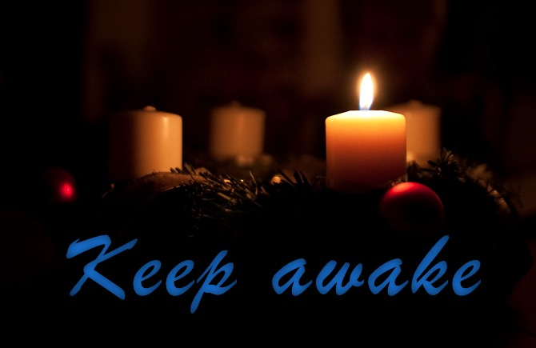
Proclaiming the WORD (Mark 13:24-37)
Keep Awake, It’s Coming

Slide 18
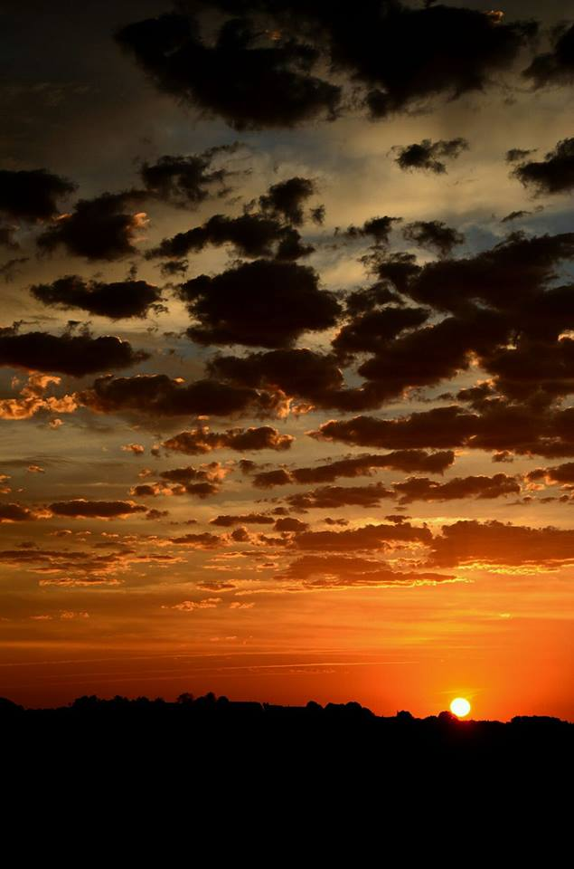
Responding Hymn # 663 “Awake My Soul and with the Sun”
Awake, my soul, and with the sun your daily stage of duty run; shake off dull sloth, and joyful rise to pay your morning sacrifice.

Slide 19
Responding Hymn # 663 “Awake My Soul and with the Sun”
Lord, I my vows to you renew. Disperse my sins as morning dew; guard my first springs
of thought and will, and with yourself my spirit fill.

Slide 20
Responding Hymn # 663 “Awake My Soul and with the Sun”
Direct, control, suggest, this day, all I design or do or say, that all my powers, with all their might, in your sole glory may unite.

Slide 21
Bearing and Following the WORD into the World An Advent ffirmation of Faith – Nathan Nettleton
We believe in God, creator and lover of the earth, origin and destiny of us all.
We believe in Jesus the Christ—
God coming to us in the fragile promise of a baby yet unborn— who emerges as the herald of hope, God's laughter in the face of despair. Plunged into death and hell, he broke free the captives, and is leading the way to the land of promise where justice and peace will flourish.

Slide 22
Bearing and Following the WORD into the World An Advent ffirmation of Faith – Nathan Nettleton
We believe in the Holy Spirit, who implants the seed of truth, brings us to birth as the body of Christ, and empowers us to confront and transform all that is corrupt, degrading and deceitful.

Slide 23
Bearing and Following the WORD into the World An Advent ffirmation of Faith – Nathan Nettleton
We believe in the coming reign of God. Announced by the Baptist, it has drawn near to us in Jesus, and will be consummated in the glorious marriage of earth and heaven, when all who have passed through the world's deep sorrow will be raised from the waters, robed in righteousness, and gathered into the joyous fulfilment of God's desire.
For the coming of that day on this day, we work and pray: Come, Lord Jesus, Come!

Slide 24
Bearing and Following the WORD into the World Announcements &
Sharing of Joys and Concerns
The afternoon Bible Study Group WILL be meeting after service downstairs in the basement at 12:30pm. We will be using the Advent Devotional for our study.
There are a few copies of the Presbyterian Church (USA)’s Advent Devotional available left at $1.50 each. Please use this daily devotional as we prepare our hearts for the season anticipating Christ’s coming.

Slide 25
Bearing and Following the WORD into the World Announcements &
Sharing of Joys and Concerns
The Session will be meeting Tomorrow at 7pm. All active elders please attend.
The Women's Group will resume meeting on every Wednesdays at 7:30pm over at the Manse (2048 E 14th Street). They are currently studying the Gospel of Luke. For more information, please see Margaret and Cara.

Slide 26
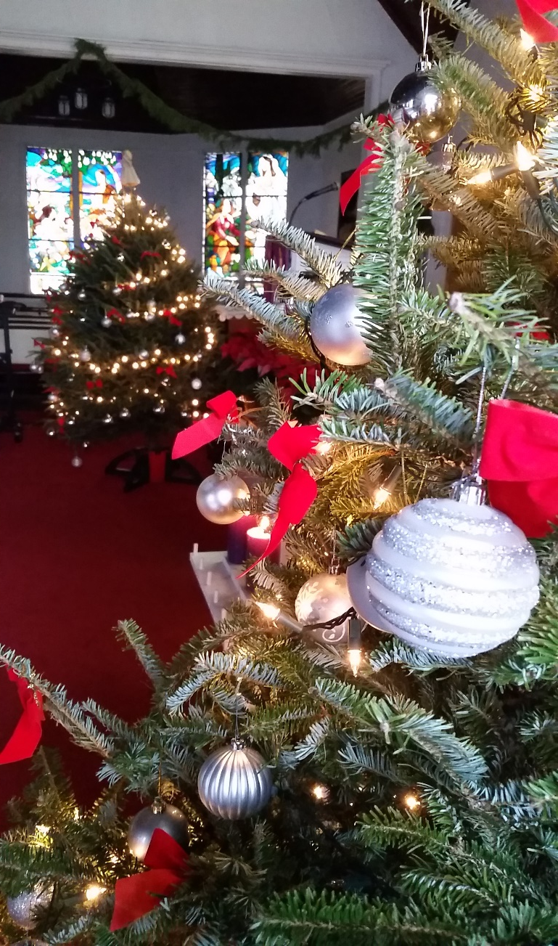
Bearing and Following the WORD into the World Announcements &
Sharing of Joys and Concerns
We will be putting up the Christmas trees and decorating the sanctuary on Friday, 12/8 at 6pm. Please come and help out if you can.

Slide 27
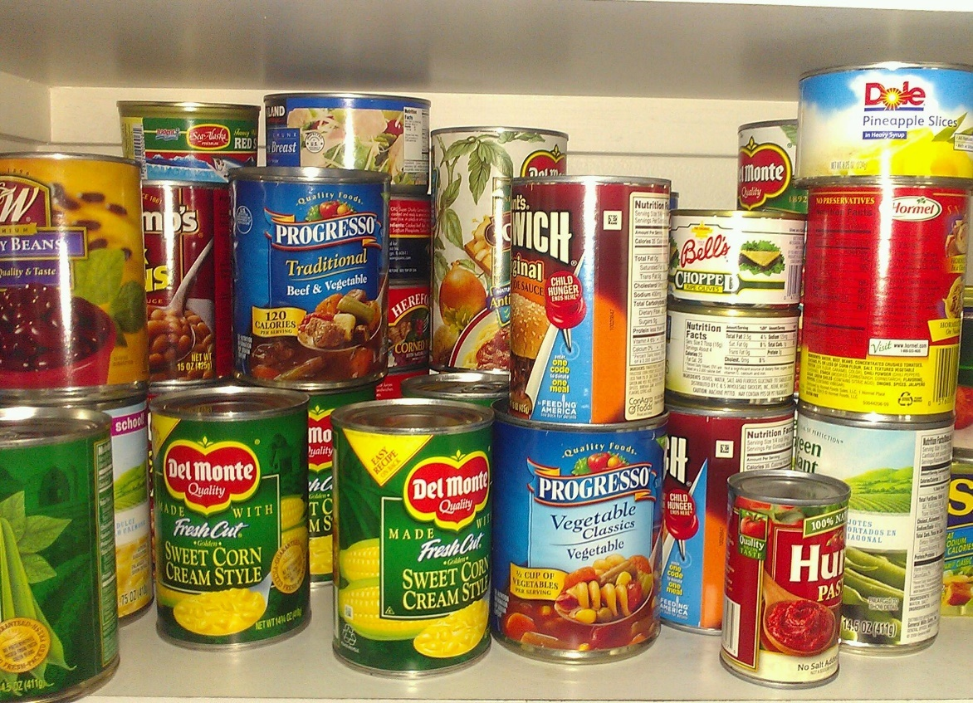
Bearing and Following the WORD into the World Announcements &
Sharing of Joys and Concerns
We will be conducting a non-perishable Food Drive. All food items to be donated to the food pantry at Kingslawn Presbyterian Church. Please donate if you CAN!!!

Slide 28
Bearing and Following the WORD into the World Announcements &
Sharing of Joys and Concerns
We will also be running Coat Drive
if you wish to donate any gently used winter coats. Please drop off the coats no later than 12/17.

Slide 29
Bearing and Following the WORD into the World Prayer of the People & The Lord’s Prayer
Our Father, who art in heaven.
Halloweth be thy name.
Thy Kingdom come; Thy will be done
On earth as it is in heaven.
Give us this day our daily bread.
Forgive us our debts; as we forgive our debtors.
Lead us not into temptations, but deliver us from evil.
For Thine is the Kingdom, the Power, and the Glory forever. Amen.

Slide 30
Bearing and Following the WORD into the World Offering of our Gifts and our Lives
Musical Offering

Slide 31
Bearing and Following the WORD into the World Doxology and Offertory Prayer

Slide 32
Bearing and Following the WORD into the World Holy Communion Hymn
# 504 “We Come as Guests Invited”
We come as guests invited when Jesus bids us dine, his friends on earth united to share the bread and wine; the bread of life is broken; the wine is freely poured for us, in solemn token of Christ our dying Lord.

Slide 33
Bearing and Following the WORD into the World Holy Communion Hymn
# 504 “We Come as Guests Invited”
We eat and drink, receiving from Christ the grace we need, and in our hearts believing on him by faith we feed; with wonder and thanksgiving for love that knows no end, we find in Jesus living our ever-present friend.

Slide 34
Bearing and Following the WORD into the World Holy Communion Hymn
# 504 “We Come as Guests Invited”
One bread is ours for sharing, one single fruitful vine, our fellowship declaring renewed in bread and wine: renewed, sustained, and given by token, sign, and word, the pledge and seal of heaven, the love of Christ our Lord.

Slide 35
Bearing and Following the WORD into the World Holy Communion
Friends, we gather now as one body, joined around this table of GRACE in Jesus’ name, where there are no strangers. Christ is the host at this Heavenly Feast and we are all invited and accepted through our faith in Him.

Slide 36
Bearing and Following the WORD into the World Holy Communion
Together we have come long expected, yearning our Savior to come once again through His promise. We celebrate God's presence among us, united in Christ's spirit, broken and whole all at once. We have come through Christ’s invitation to His table.

Slide 37
Bearing and Following the WORD into the World Holy Communion
The Lord be with you. And also with you.
Lift up your hearts. We lift them up to the Lord.
Let us give thanks to the Lord our God.
It is right to give our thanks and praise.

Slide 38
Bearing and Following the WORD into the World Holy Communion
How can we thank you, O God? For sun and moon and stars, for breath and life and all things good, for your steadfast promise and your faithful love, for the day that is surely coming when all things will be made new.

Slide 39
Bearing and Following the WORD into the World Holy Communion
Holy, Holy, Holy Lord, God of power and might,
Heaven and earth are full of your glory.
Hosanna in the highest.
Blessed is he who comes in the name of the Lord.
Hosanna in the highest.

Slide 40
Bearing and Following the WORD into the World Holy Communion
We give you thanks Holy God, for Jesus, who came to be your living Word, to baptize us with Spirit and with fire,
to feed the hungry, to humble the mighty, and to announce the good news of your coming realm.

Slide 41
Bearing and Following the WORD into the World Holy Communion
With thanksgiving, we remember how Jesus took bread, and after He had given thanks, He broke it and gave it to His disciples saying, “Take, Eat, this is my body, which is given for you. Do this in remembrance of me.”

Slide 42
Bearing and Following the WORD into the World Holy Communion
In the same way, after supper, He took the cup saying, this cup is a new covenant sealed in my blood, for “this is my blood, shed for you. Do this in remembrance of me.

Slide 43
Bearing and Following the WORD into the World Holy Communion
With thanks and praise we offer ourselves to you, O God. Sharing this holy meal, remembering Christ’s dying and rising and His coming once again, and praying: Come Lord Jesus, Come! Maranatha!

Slide 44
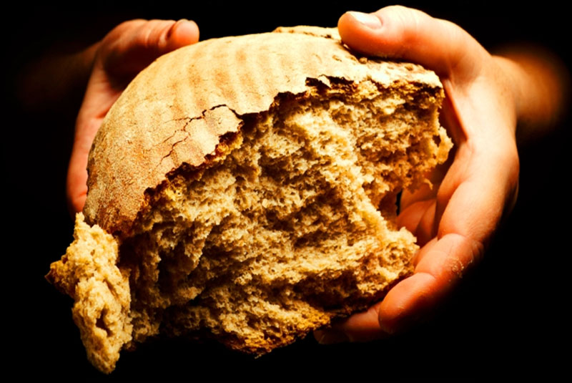
Bearing and Following the WORD into the World Holy Communion
Jesus said, "I am the bread of life. Those who come to me shall never hunger; those who believe in me shall never thirst." These are the gift of God for the people of God.

Slide 45
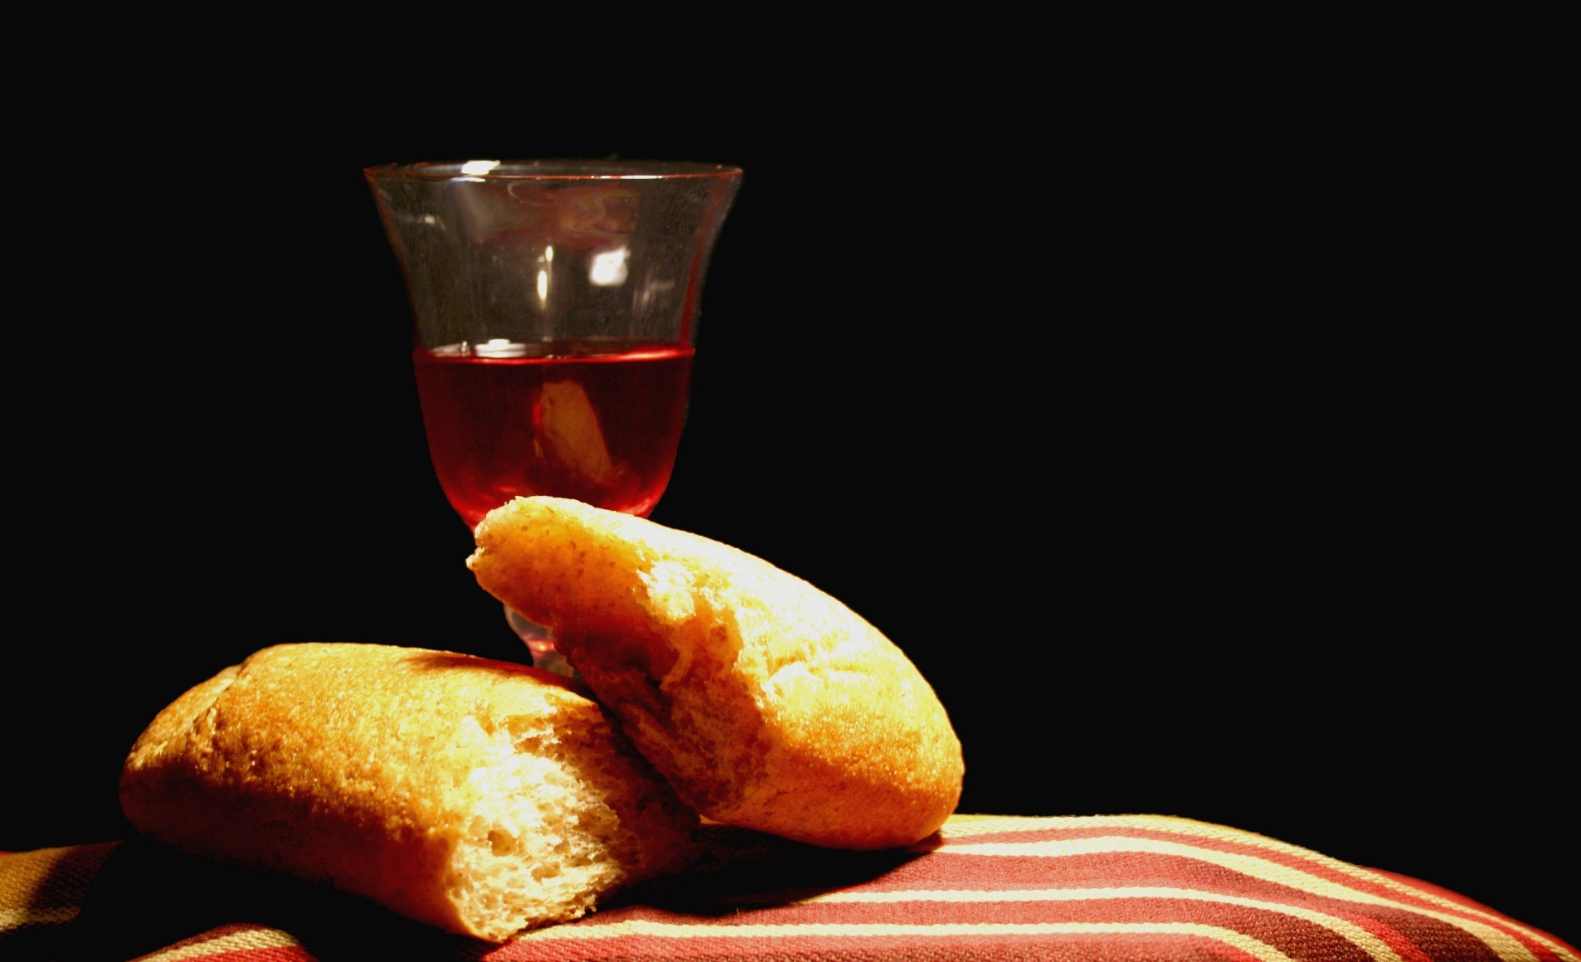
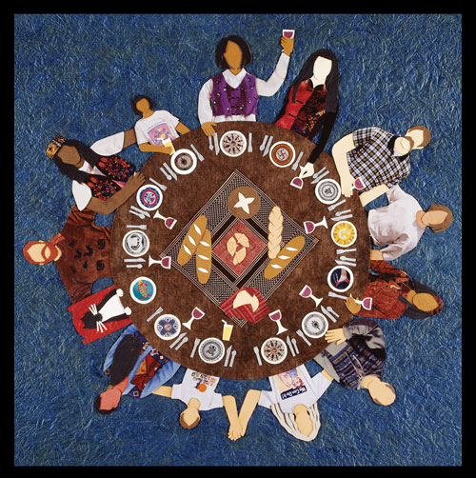
Bearing and Following the WORD into the World Holy Communion

Slide 46
:
Bearing and Following the WORD into the World
Prayer after the Communion: (in unison)
Make us gentle, joyful, thankful people, O God, serving our neighbors, worshiping you alone. Keep us in the peace of Christ until you gather us at your table in glory.

Slide 47
:
Bearing and Following the WORD into the World
Prayer after the Communion: (in unison)
Even now, a voice is crying in the wilderness:
Prepare the way of the Lord!
Through Christ, with Christ, in Christ,
in the unity of the Holy Spirit,
all glory and honor are yours, almighty God,
now and forever. Amen.

Slide 48
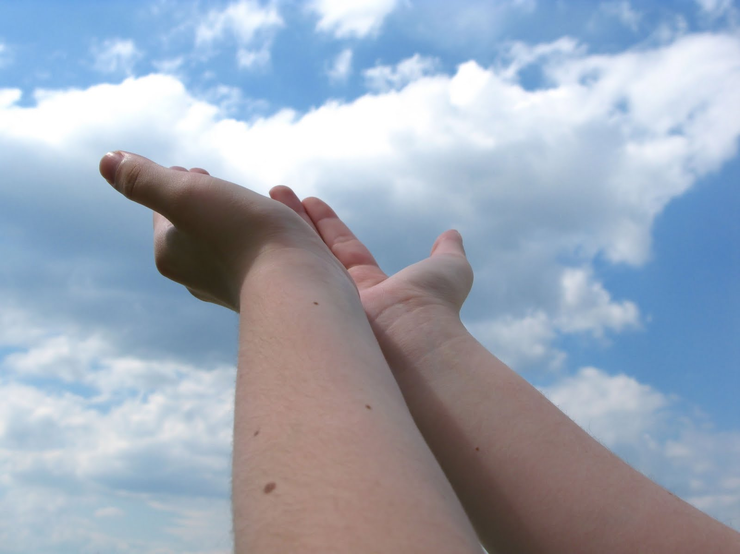
Bearing and Following the WORD into the World Deacons’ Benevolence Offering

Slide 49
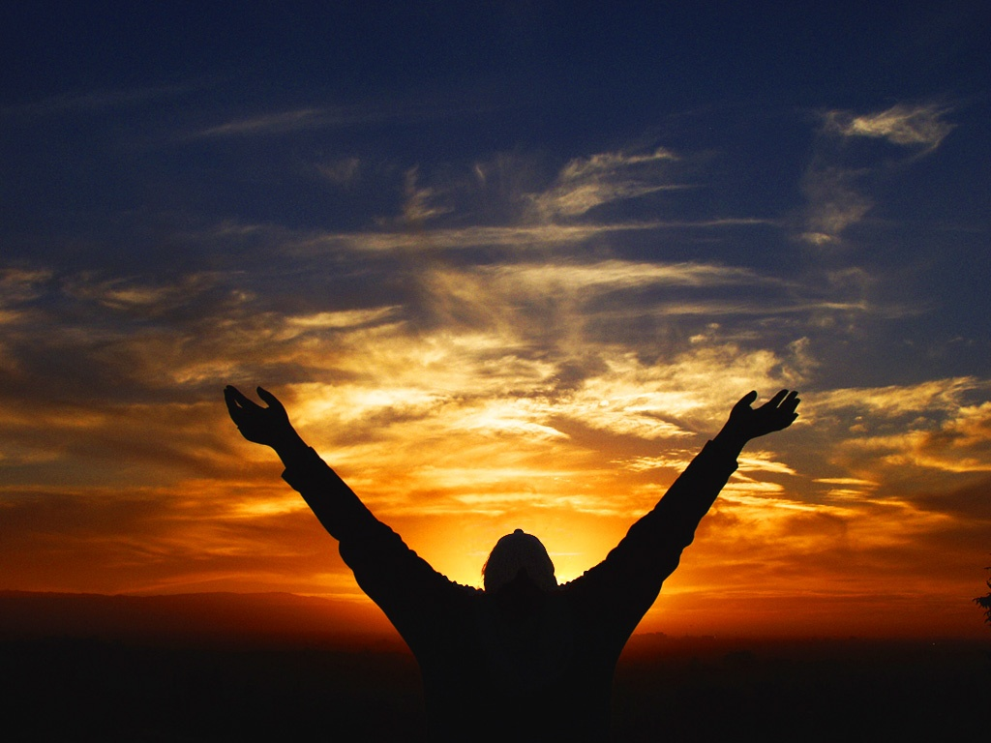
Sending Hymn #82 “Come Thou, Long Expected Jesus”
Come, thou long-expected Jesus, born to set thy people free; from our fears and sins release us; let us find our rest in thee.
Israel’s strength and consolation, hope of all the earth thou art; dear desire of every nation, joy of every longing heart.

Slide 50
Sending Hymn #82 “Come Thou, Long Expected Jesus”
Born thy people to deliver, born a child and yet a king, born to reign in us forever, now thy gracious kingdom bring. By thine own eternal Spirit rule in all our hearts alone; by thine all-sufficient merit raise us to thy glorious throne.

Slide 51
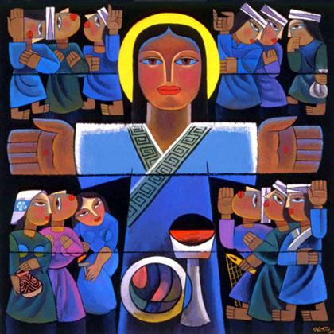
Bearing and Following the WORD into the World The Charge and Benediction

Slide 52
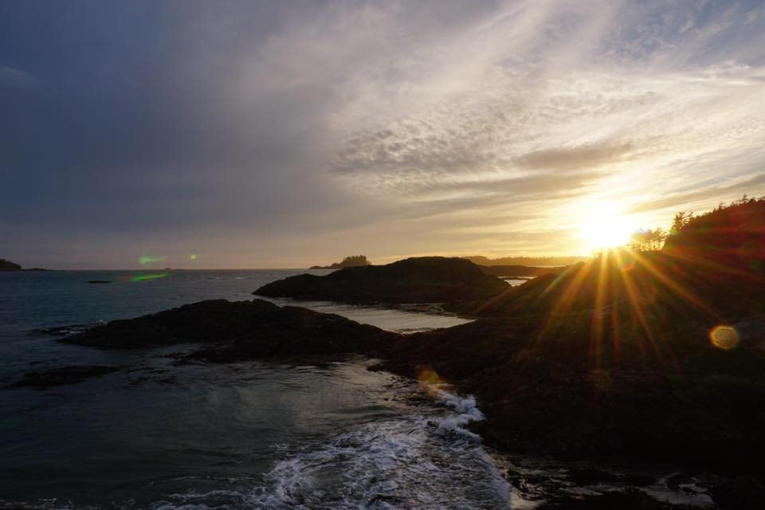
Bearing and Following the WORD into the World Benediction Response
# 542 “God Be with You Till We Meet Again”
(Stanza 3)
God be with you till we meet again;
when life's perils thick confound you, put unfailing arms around you:
God be with you till we meet again.

Slide 53
Homecrest Presbyterian Church Worship of the Lord’s Day December 3rd, 2017 1st Sunday of Advent

