Slide 1
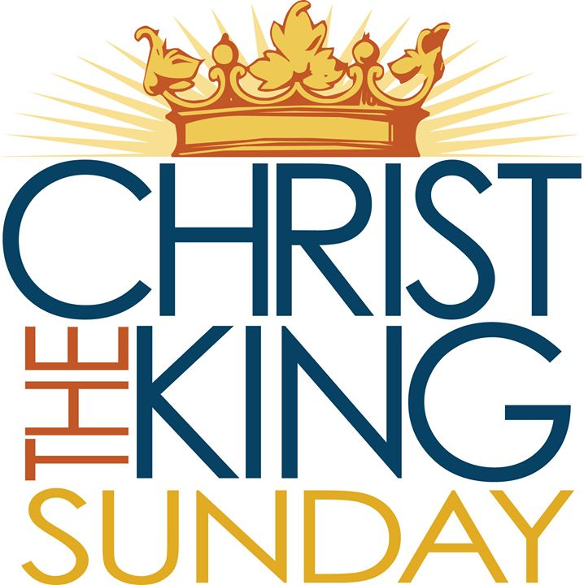
Homecrest Presbyterian Church Worship of the Lord’s Day November 26th, 2017 Christ the King (Reign of Christ) Sunday

Slide 2
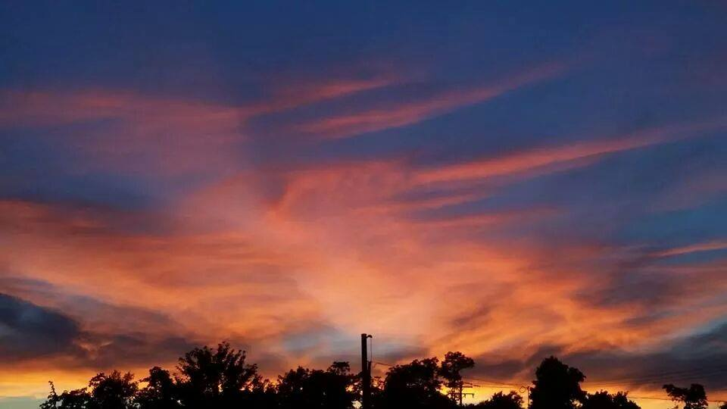
Gathering Around the WORD Call To Worship
(Based on Ezekiel 34:15-16 and Matthew 25:31-46)
The Lord God is our shepherd.
We are the people of God’s pasture,
the sheep of God’s hand.
God will seek the lost, feed the hungry, and strengthen the weak.
But the proud and power-hungry
will be fed with justice.

Slide 3
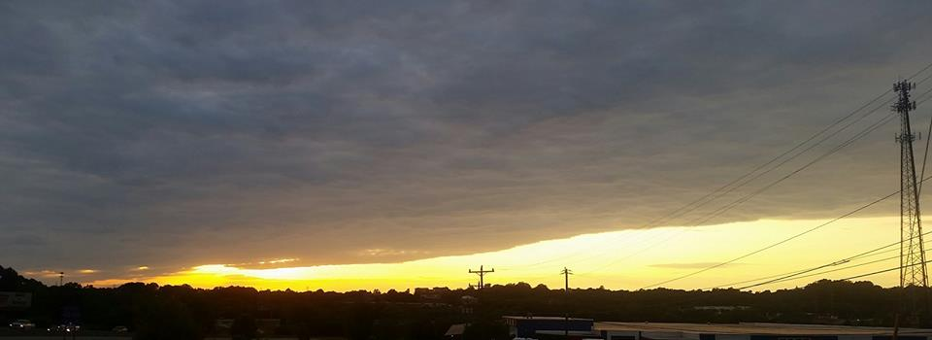
Gathering Around the WORD Gathering Hymn # 265 “Jesus Shall Reign Wherever the Sun”
Jesus shall reign where'er the sun does its successive journeys run; his kingdom stretch from shore to shore, till moons shall wax and wane no more.

Slide 4
Gathering Around the WORD Gathering Hymn # 265 “Jesus Shall Reign Wherever the Sun”
To him shall endless prayer be made, and praises throng to crown his head; his name, like sweet perfume, shall rise with every morning sacrifice.

Slide 5
Gathering Around the WORD Gathering Hymn # 265 “Jesus Shall Reign Wherever the Sun”
People and realms of every tongue dwell on his love with sweetest song, and infant voices shall proclaim their early blessings on his name.

Slide 6
Gathering Around the WORD Gathering Hymn # 265 “Jesus Shall Reign Wherever the Sun”
Blessings abound where'er he reigns: the prisoners leap to loose their chains; the weary find eternal rest, and all who suffer want are blest.

Slide 7
Gathering Around the WORD Gathering Hymn # 265 “Jesus Shall Reign Wherever the Sun”
Let every creature rise and bring honors peculiar to our King; angels descend with songs again, and earth repeat the loud Amen!

Slide 8
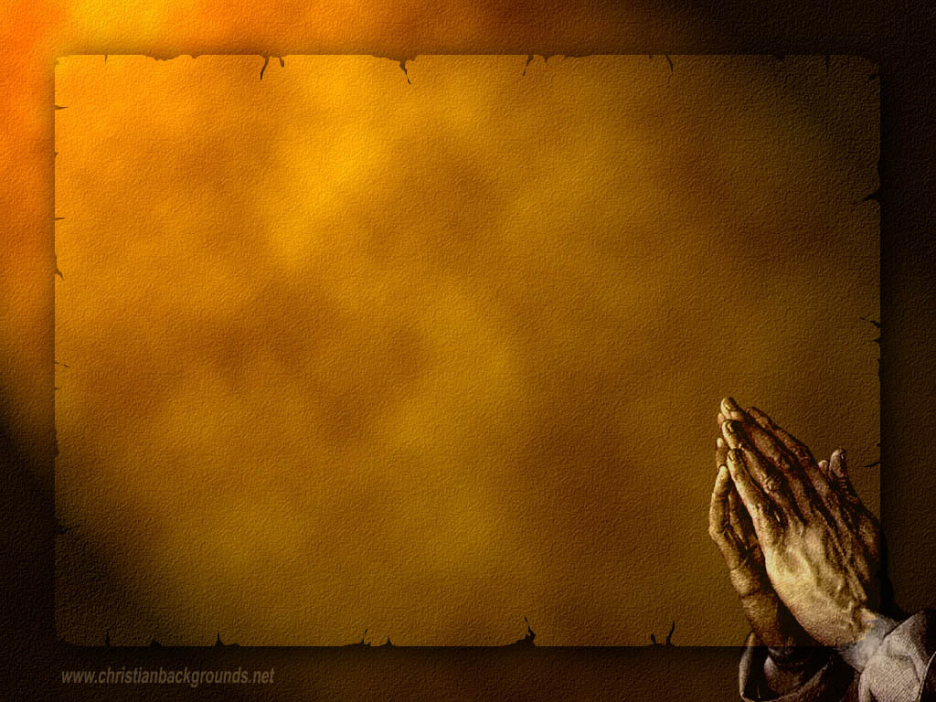
Gathering Around the WORD Call to Confession Our God is gracious and merciful, for our omnipotent Christ reigns throughout all of creation. God desires us to be truthful of our thoughts, words, and actions. With sincere and repentant hearts, let us confess our sins against God and our neighbors.

Slide 9
Gathering Around the WORD Prayer of Confession (in Unison)
Sovereign God, we confess that we are not ready for your holy realm. You guide us toward right paths, but we refuse to follow where you lead. You love and feed and care for us, but we fail to love and serve others. Forgive us, merciful God, so that we may return to your fold and rejoice in your presence; through Jesus Christ our Lord, the Lamb upon the throne, Amen.

Slide 10
Gathering Around the WORD Declaration of Forgiveness
Sisters and brothers, God seeks the lost sheep and feeds them with justice. However long we wander, however far we stray, God’s steadfast love endures forever. Sister and brothers, be assured that in Jesus Christ we are forgiven. Thanks be to God, Amen.

Slide 11
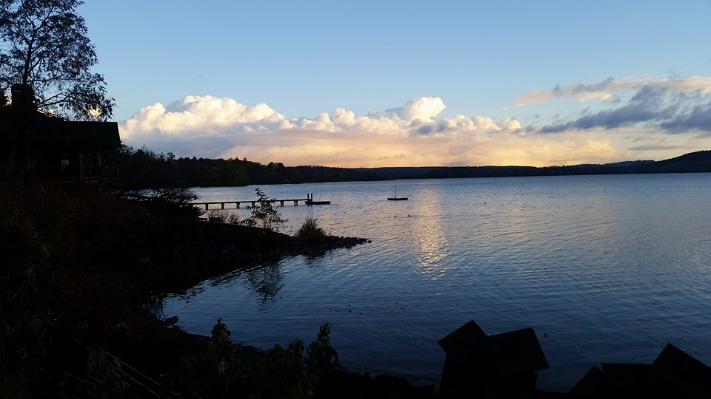
Gathering Around the WORD Gloria Patri
Glory be to the Father
and to the Son and to the Holy Ghost;
As it was in the beginning,
is now, and ever shall be,
world without end. Amen, Amen.

Slide 12
Gathering Around the WORD Passing of the Peace of Christ

Slide 13
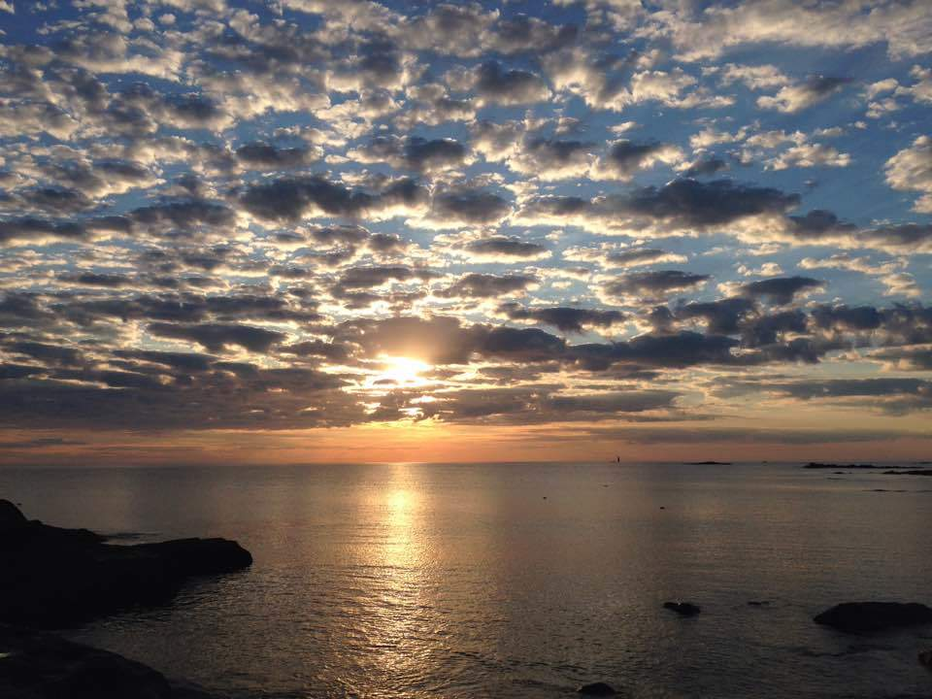
Proclaiming the WORD Message to the Youth/ Prayer of Illumination

Slide 14
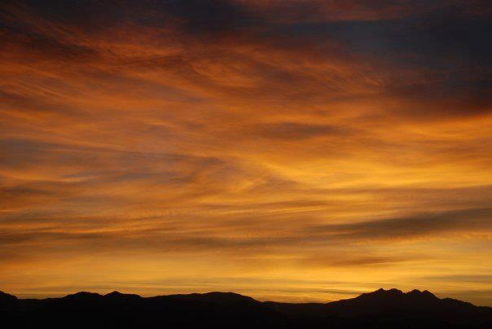
Proclaiming the WORD Responsive Reading (Psalm 72:5-19)
May he live while the sun endures, and as long as the moon, throughout all generations.
⁶ May he be like rain that falls on the mown grass, like showers that water the earth.
⁷ In his days may righteousness flourish and peace abound, until the moon is no more.
⁸ May he have dominion from sea to sea, and from the River to the ends of the earth.
⁹ May his foes bow down before him, and his enemies lick the dust.
¹⁰ May the kings of Tarshish and of the isles render him tribute, may the kings of Sheba and Seba bring gifts.

Slide 15
Proclaiming the WORD Responsive Reading (Psalm 72:5-19)
¹¹ May all kings fall down before him, all nations give him service.
¹² For he delivers the needy when they call, the poor and those who have no helper.
¹³ He has pity on the weak and the needy, and saves the lives of the needy.
¹⁴ From oppression and violence he redeems their life; and precious is their blood in his sight.
.

Slide 16
Proclaiming the WORD Responsive Reading (Psalm 72:5-19)
¹⁵ Long may he live! May gold of Sheba be given to him. May prayer be made for him continually, and blessings invoked for him all day long.
¹⁶ May there be abundance of grain in the land; may it wave on the tops of the mountains; may its fruit be like Lebanon; and may people blossom in the cities like the grass of the field.

Slide 17
Proclaiming the WORD Responsive Reading (Psalm 72:5-19)
¹⁷ May his name endure forever, his fame continue as long as the sun. May all nations be blessed in him; may they pronounce him happy.
¹⁸ Blessed be the LORD, the God of Israel, who alone does wondrous things.
¹⁹ Blessed be his glorious name forever; may his glory fill the whole earth.
Amen and Amen.

Slide 18
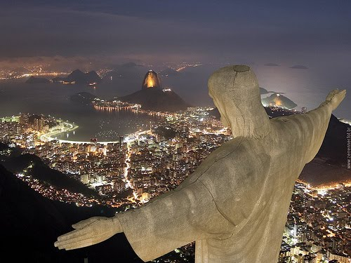
Proclaiming the WORD (Psalm 72:5-19)
Who’s the Boss?

Slide 19
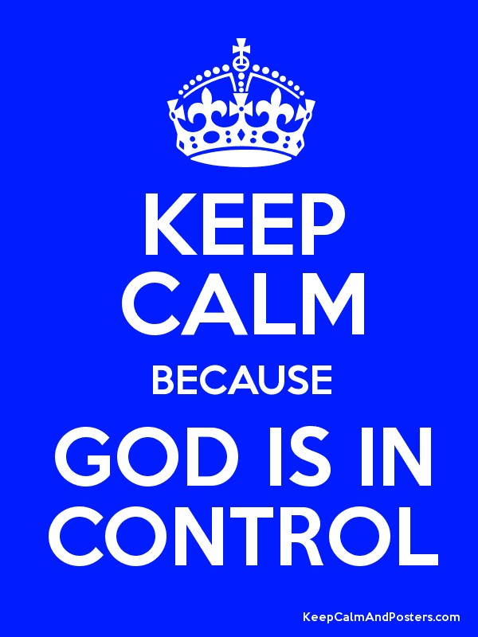
Proclaiming the WORD (Psalm 72:5-19)
Who’s the Boss?

Slide 20
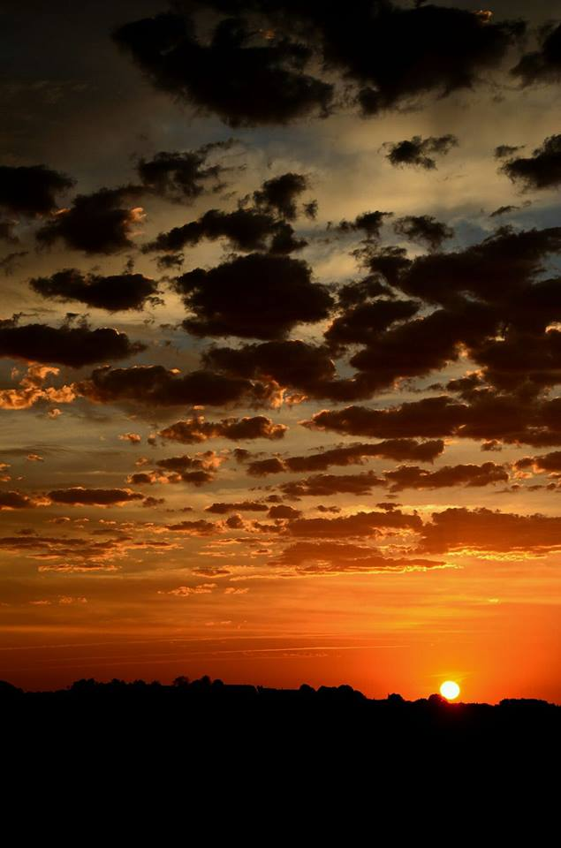
Responding Hymn # 268 “Crown Him with Many Crown”
Crown him with many crowns, the Lamb upon his throne; hark, how the heavenly anthem drowns all music but its own! Awake, my soul, and sing of him who died for thee, and hail him as thy matchless King through all eternity.

Slide 21
Responding Hymn # 268 “Crown Him with Many Crown”
Crown him the Lord of love; behold his hands and side, rich wounds, yet visible above, in beauty glorified: no angel in the sky can fully bear that sight, but downward bends his burning eye at mysteries so bright.

Slide 22
Responding Hymn # 268 “Crown Him with Many Crown”
Crown him the Lord of peace, whose power a scepter sways from pole to pole, that wars may cease, absorbed in prayer and praise. His reign shall know no end; and round his pierced feet fair flowers of paradise extend their fragrance ever sweet.

Slide 23
Responding Hymn # 268 “Crown Him with Many Crown”
Crown him the Lord of years, the potentate of time; creator of the rolling spheres, ineffably sublime. All hail, Redeemer, hail! For thou hast died for me; thy praise shall never, never fail throughout eternity.

Slide 24
Bearing and Following the WORD into the World Affirmation of Faith – Ephesians 1:17-23
¹⁷We pray that the God of our Lord Jesus Christ, the Father of glory, may give us a spirit of wisdom and revelation as we come to know him, ¹⁸so that, with the eyes of our heart enlightened, we may know what is the hope to which he has called us, what are the riches of his glorious inheritance among the saints, ¹⁹and what is the immeasurable greatness of his power for us who believe, according to the working of his great power.

Slide 25
Bearing and Following the WORD into the World Affirmation of Faith – Ephesians 1:17-23
²⁰We believe God put this power to work in Christ when he raised him from the dead and seated him at his right hand in the heavenly places, ²¹far above all rule and authority and power and dominion, and above every name that is named, not only in this age but also in the age to come. ²²And he has put all things under his feet and has made him the head over all things for the church, ²³which is his body, the fullness of him who fills all in all.

Slide 26
Bearing and Following the WORD into the World Announcements &
Sharing of Joys and Concerns
The afternoon Bible Study Group will continue this afternoon, downstairs in the basement at 12:30pm next Sunday.
The Women's Group will meet every Wednesday 7:30pm over at the Manse (2048 E 14th Street). For more information, please see Margaret and Cara.

Slide 27
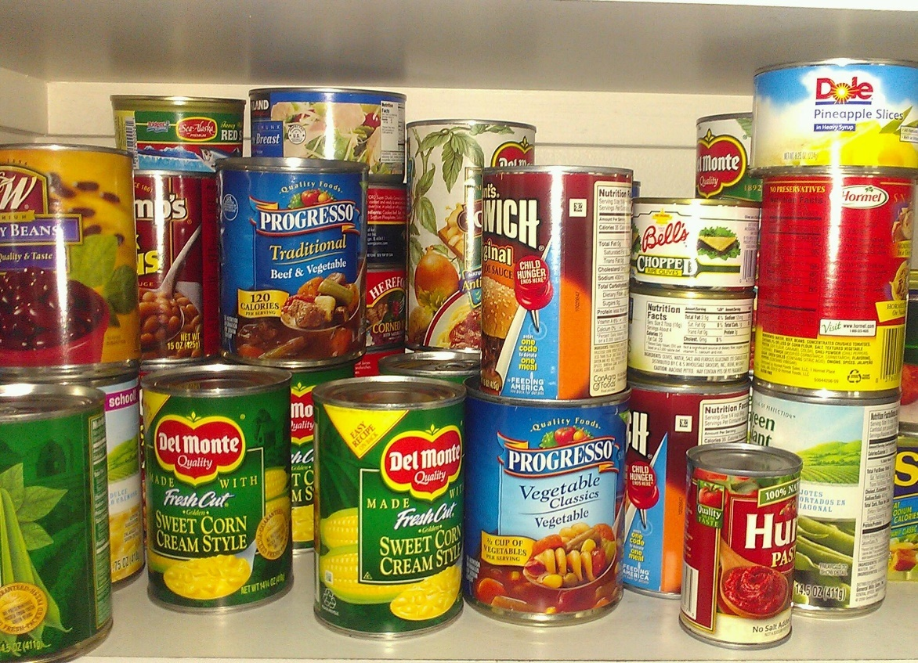
Bearing and Following the WORD into the World Announcements &
Sharing of Joys and Concerns
We will be conducting a non-perishable Food Drive. All food items to be donated to the food pantry at Kingslawn Presbyterian Church. Please donate if you CAN!!!

Slide 28
Bearing and Following the WORD into the World Announcements &
Sharing of Joys and Concerns
The next Session Meeting will be Monday, 12/6 at 7pm.

Slide 29
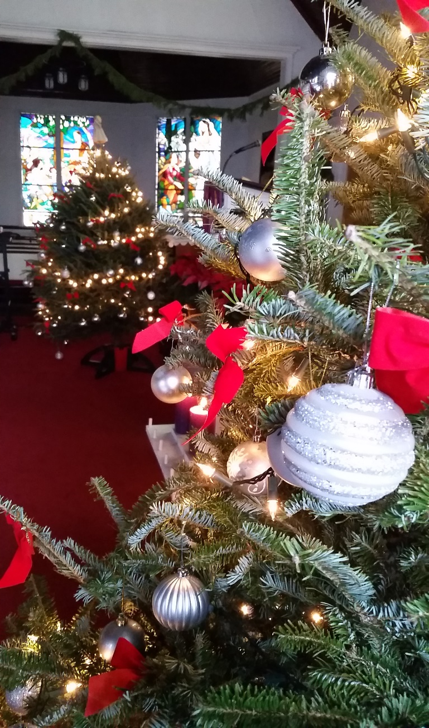
Bearing and Following the WORD into the World Announcements &
Sharing of Joys and Concerns
We will be putting up the Christmas trees and decorating the sanctuary on Friday, 12/8 at 6pm. Please come and help out if you can.

Slide 30
Bearing and Following the WORD into the World Prayer of the People & The Lord’s Prayer
Our Father, who art in heaven.
Halloweth be thy name.
Thy Kingdom come; Thy will be done
On earth as it is in heaven.
Give us this day our daily bread.
Forgive us our debts; as we forgive our debtors.
Lead us not into temptations, but deliver us from evil.
For Thine is the Kingdom, the Power, and the Glory forever. Amen.

Slide 31
Bearing and Following the WORD into the World Offering of our Gifts and our Lives
Musical Offering

Slide 32
Bearing and Following the WORD into the World Doxology and Offertory Prayer

Slide 33
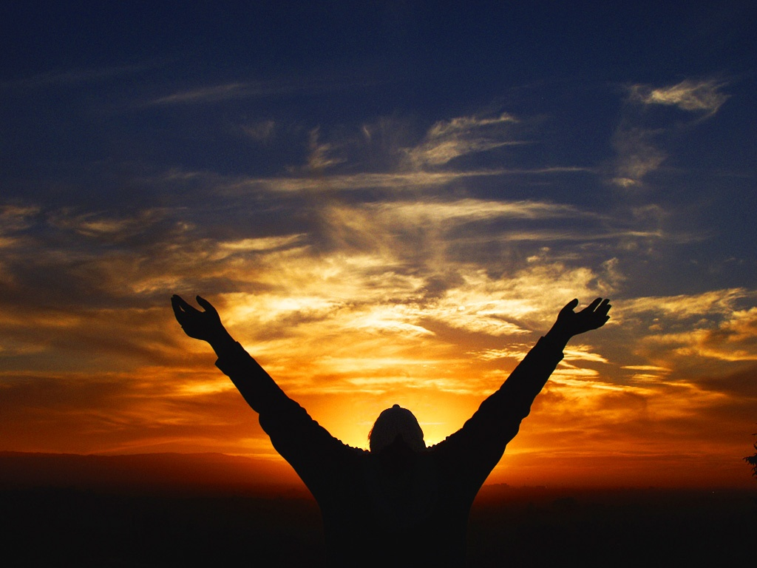
Sending Hymn #269 “Lean On, O King Eternal”
Lead on, O King eternal! The day of march has come; henceforth in fields of conquest your tents shall be our home. Through days of preparation your grace has made us strong, and now, O King eternal, we lift our battle song.

Slide 34
Sending Hymn #269 “Lean On, O King Eternal”
Lead on, O King eternal, till sin's fierce war shall cease, and holiness shall whisper the sweet amen of peace; for not with swords' loud clashing, nor roll of stirring drums; with deeds of love and mercy the heavenly kingdom comes.

Slide 35
Sending Hymn #269 “Lean On, O King Eternal”
Lead on, O King eternal: we follow, not with fears, for gladness breaks like morning where'er your face appears; your cross is lifted o'er us; we journey in its light. The crown awaits the conquest; lead on, O God of might!

Slide 36
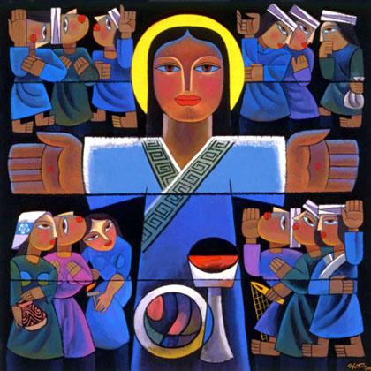
Bearing and Following the WORD into the World The Charge and Benediction

Slide 37
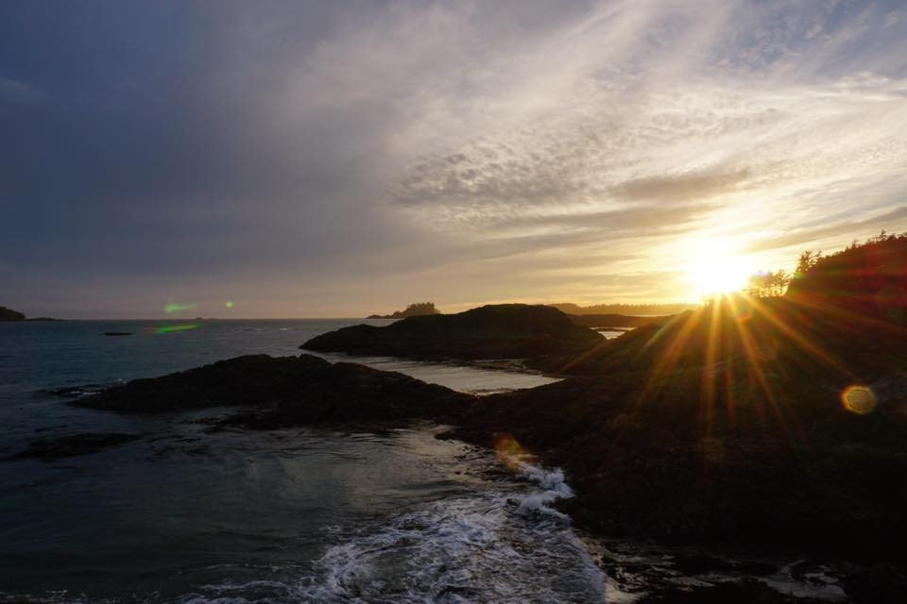
Bearing and Following the WORD into the World Benediction Response
# 542 “God Be with You Till We Meet Again”
(Stanza 2)
God be with you till we meet again;
unseen wings protecting hide you, daily manna still provide you:
God be with you till we meet again.

Slide 38
Homecrest Presbyterian Church Worship of the Lord’s Day November 26th, 2017 Christ the King (Reign of Christ) Sunday

