Slide 1
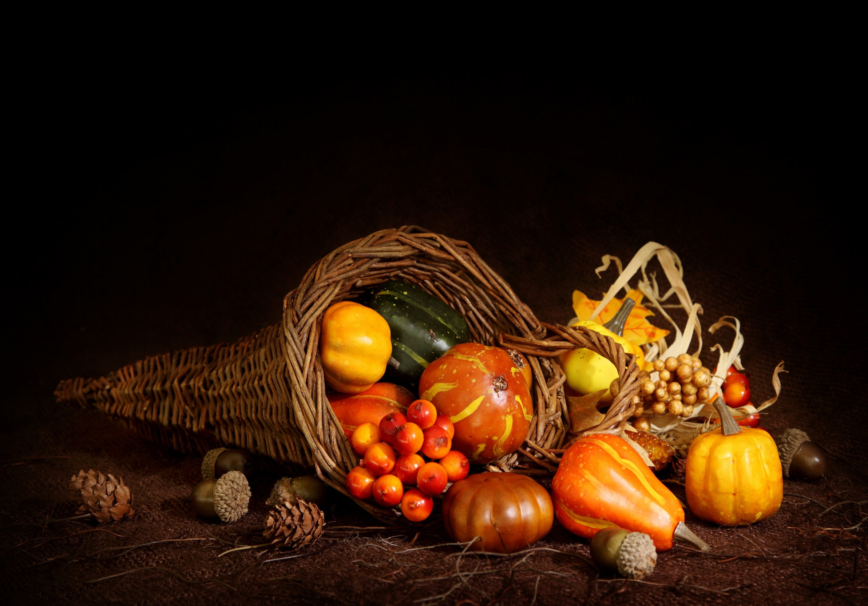
Homecrest Presbyterian Church Worship of the Lord’s Day November 19th, 2017

Slide 2
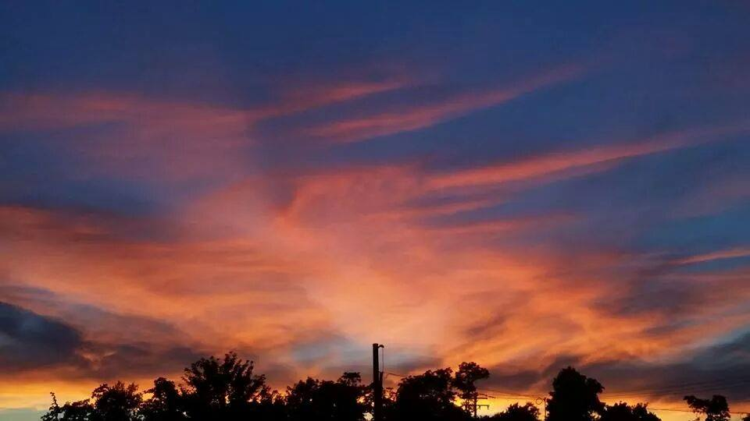
Gathering Around the WORD Call To Worship
(Based on Psalm 100)
Make a joyful noise to the LORD, all the earth.
Worship the LORD with gladness; come into his presence with singing.
Know that the LORD is God. It is he who made us, and we are his; We are his people, and the sheep of his pasture.
Enter his gates with thanksgiving, and his courts with praise. Give thanks to him, bless his name.
For the LORD is good; his steadfast love endures forever, and his faithfulness to all generations.

Slide 3
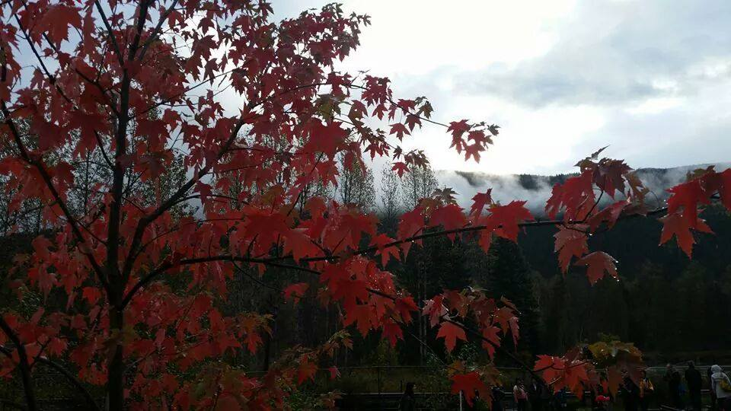
Gathering Around the WORD Gathering Hymn # 644 “Give Thanks, O Christian People”
Give thanks, O Christian people, for workers of our day who heed the call to service and make it their life's way to go to feed the hungry, to tend to those in need, to work for equal justice, till all God's folk are freed.

Slide 4
Gathering Around the WORD Gathering Hymn # 644 “Give Thanks, O Christian People”
Give thanks, O Christian people, for leaders of our years who live to share with others our joy when Christ appears, to teach the ones who seek light, to guide the faltering feet, to lead the followers forward our living Lord to meet.

Slide 5
Gathering Around the WORD Gathering Hymn # 644 “Give Thanks, O Christian People”
Give thanks, O Christian people, for all who love the Lord, who live each day believing in God's eternal Word: to share Christ's love in living, to witness with each deed, to use the talents given to plant the gospel seed.

Slide 6
Gathering Around the WORD Gathering Hymn # 644 “Give Thanks, O Christian People”
Give thanks, O Christian people, for life in fellowship with all who trust our Savior their serving to equip: to ease another's burdens, to cope in joy and stress, to magnify God's message and Christ's great love confess.

Slide 7
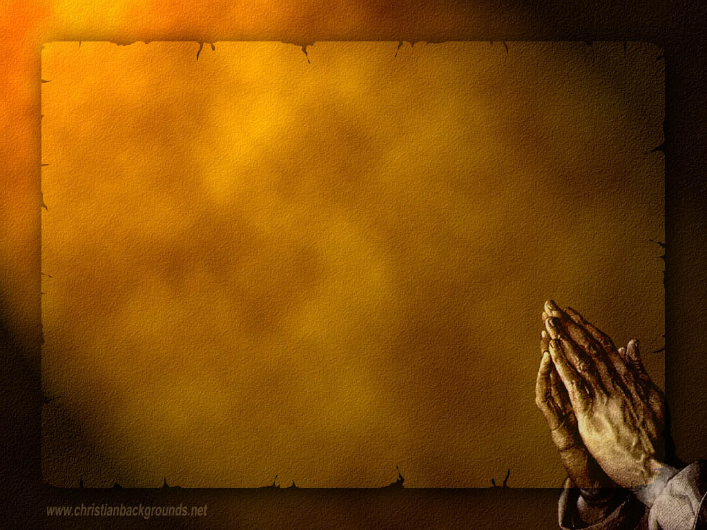
Gathering Around the WORD Call to Confession Our God is gracious and merciful. He attends to our needs and listens to our cries. We, however, must be truthful to our God, turning our sinful ways and confessing our wrongs against God and our neighbors. In humility and confidence that God hears us, let us lift up our hearts in our prayer of confession.

Slide 8
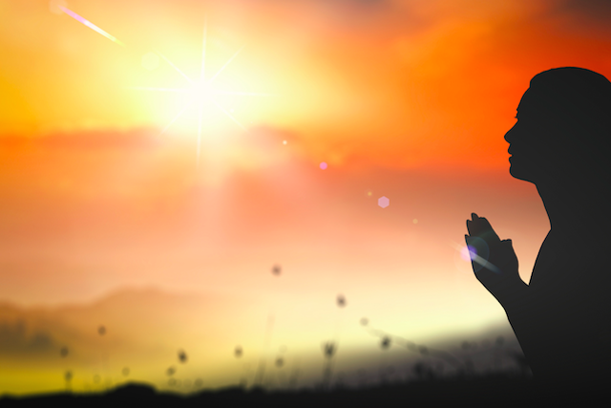
Gathering Around the WORD Prayer of Confession (in Unison)
Almighty God, you have shown us the ways of justice and nurtured us with love. Even so, we have not lived according to your will. When we are oppressed or unjustly accused, we cling to fear and forget to trust in your deliverance. When we are giddy with power and abuse the rights of others, we hold tight to our privilege and forget your laws.

Slide 9
Gathering Around the WORD Prayer of Confession (in Unison)
Have mercy on us, Lord, for we are weak and prone to disobedience. Hear our confession, and respond to us with kindness, that we might turn to you again, walk in the light, and live in equity and peace; through Christ our Lord we pray, Amen.

Slide 10
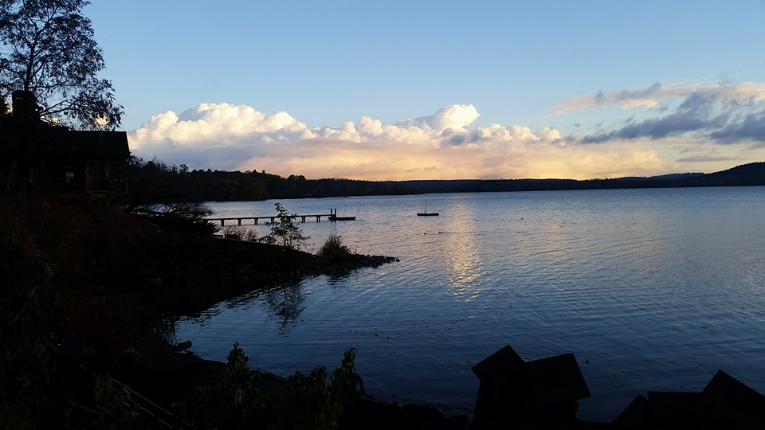
Gathering Around the WORD Gloria Patri
Glory be to the Father
and to the Son and to the Holy Ghost;
As it was in the beginning,
is now, and ever shall be,
world without end. Amen, Amen.

Slide 11
Gathering Around the WORD Passing of the Peace of Christ

Slide 12
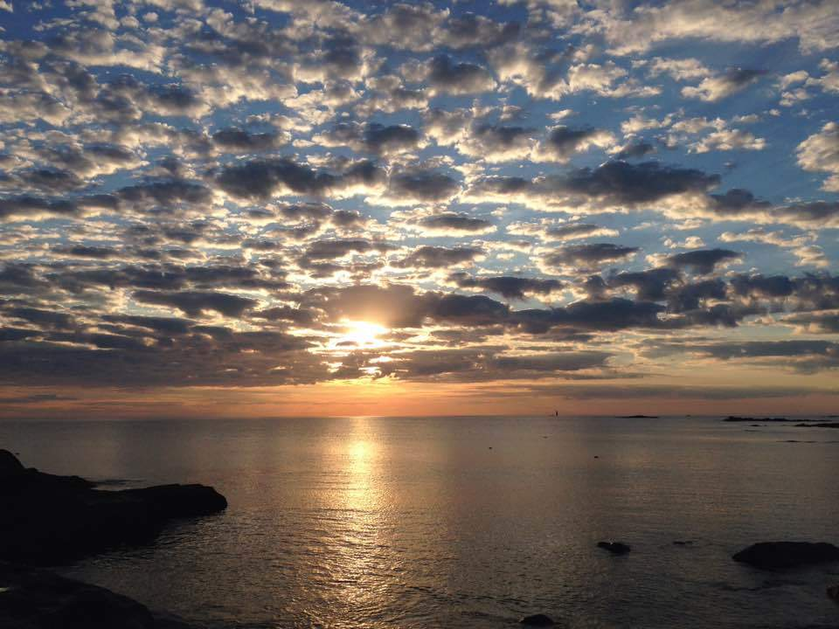
Proclaiming the WORD Message to the Youth/ Prayer of Illumination

Slide 13
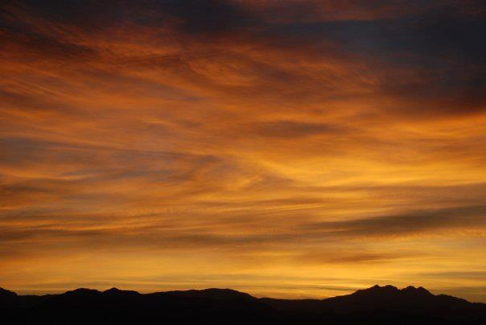
Proclaiming the WORD Scripture Reading (Luke 17:11-19)
On the way to Jerusalem Jesus was going through the region between Samaria and Galilee. ¹² As he entered a village, ten lepers approached him. Keeping their distance, ¹³ they called out, saying, "Jesus, Master, have mercy on us!" ¹⁴ When he saw them, he said to them, "Go and show yourselves to the priests." And as they went, they were made clean.

Slide 14
Proclaiming the WORD Scripture Reading (Luke 17:11-19)
¹⁵ Then one of them, when he saw that he was healed, turned back, praising God with a loud voice. ¹⁶ He prostrated himself at Jesus' feet and thanked him. And he was a Samaritan. ¹⁷ Then Jesus asked, "Were not ten made clean? But the other nine, where are they? ¹⁸ Was none of them found to return and give praise to God except this foreigner?" ¹⁹ Then he said to him, "Get up and go on your way; your faith has made you well."

Slide 15
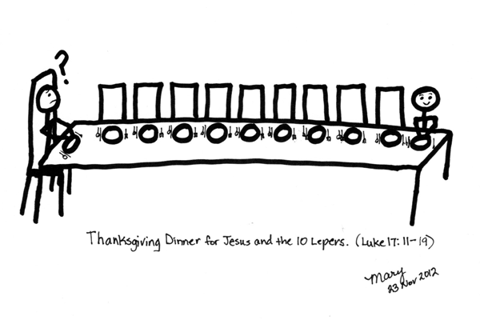
Proclaiming the WORD (Luke 17:11-19)
Where are the other nine?

Slide 16
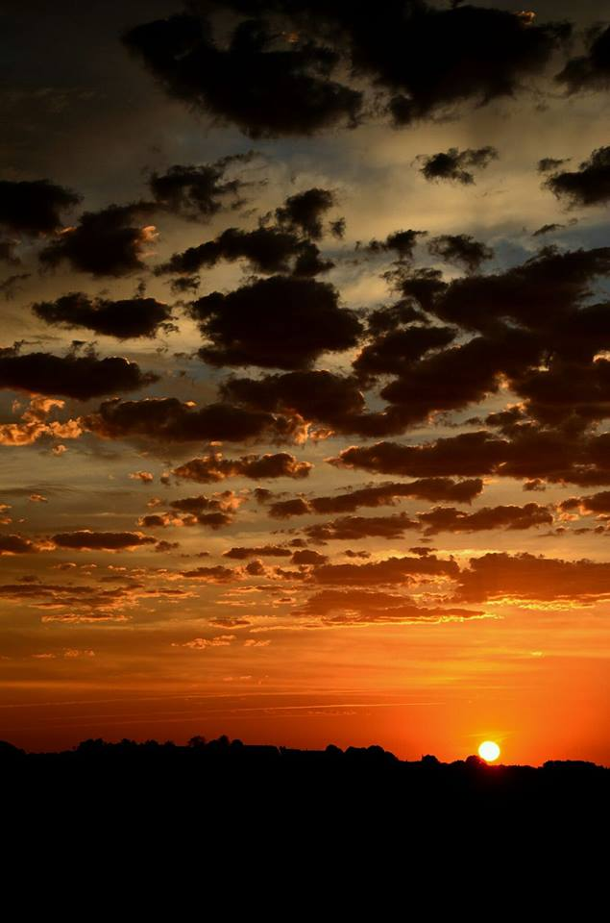
Responding Hymn # 652 “A Grateful Heart”
A grateful heart is what I bring, a song of praise, my offering. Among the saints I lift my voice: in you, O God, I will rejoice.

Slide 17
Responding Hymn # 652 “A Grateful Heart”
Your name is known in all the lands. You feed the poor with gentle hands. Your word is true, your works are just; in you, O God, the faithful trust.

Slide 18
Responding Hymn # 652 “A Grateful Heart”
With saving love you set us free, and still you dwell in mystery with wisdom none can comprehend. Your praise, O God, will never end.

Slide 19
Bearing and Following the WORD into the World Affirmation of Faith – A Brief Statement of Faith (Presbyterian Church USA) Section 3
We trust in God, whom Jesus called Abba, Father. In sovereign love God created the world good and makes everyone equally in God’s image male and female, of every race and people, to live as one community. But we rebel against God;
we hide from our Creator.

Slide 20
Bearing and Following the WORD into the World Affirmation of Faith – A Brief Statement of Faith (Presbyterian Church USA) Section 3
Ignoring God’s commandments, we violate the image of God
in others and ourselves, accept lies as truth,
exploit neighbor and nature, and threaten death to the planet
entrusted to our care. We deserve God’s condemnation. Yet God acts with justice and mercy
to redeem creation.

Slide 21
Bearing and Following the WORD into the World Affirmation of Faith – A Brief Statement of Faith (Presbyterian Church USA) Section 3
In everlasting love, the God of Abraham and Sarah
chose a covenant people to bless all families of the earth. Hearing their cry, God delivered the children of Israel from the house of bondage.

Slide 22
Bearing and Following the WORD into the World Affirmation of Faith – A Brief Statement of Faith (Presbyterian Church USA) Section 3
Loving us still, God makes us heirs with Christ of the covenant. Like a mother
who will not forsake her nursing child, like a father
who runs to welcome the prodigal home, God is faithful still.

Slide 23
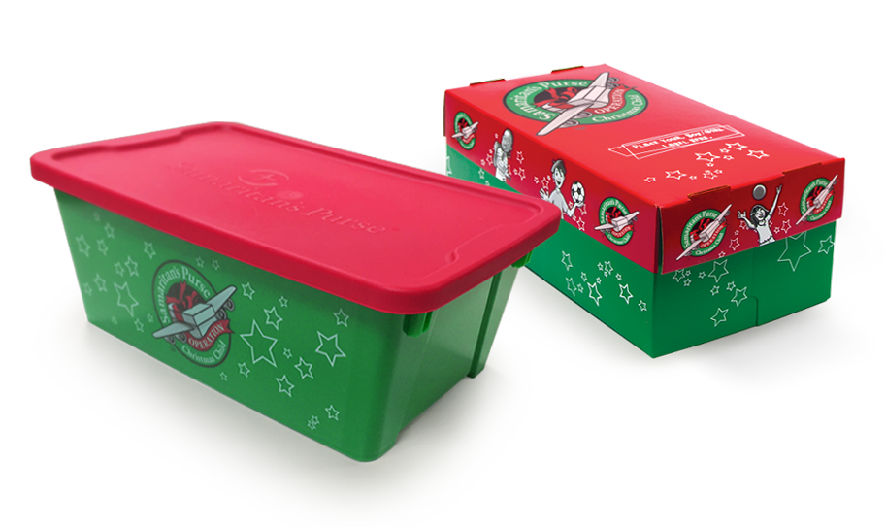
Bearing and Following the WORD into the World Announcements &
Sharing of Joys and Concerns
Special thanks to all those who contributed and helped set-up, served, and cleaned up with last night’s Thanksgiving Dinner, as well as those who contributed to the Operation Christmas Child shoeboxes.

Slide 24
Bearing and Following the WORD into the World Announcements &
Sharing of Joys and Concerns
The afternoon Bible Study Group will continue this afternoon, downstairs in the basement at 12:30pm next Sunday.
The Women's Group will meet every Wednesday 7:30pm over at the Manse (2048 E 14th Street). For more information, please see Margaret and Cara.

Slide 25
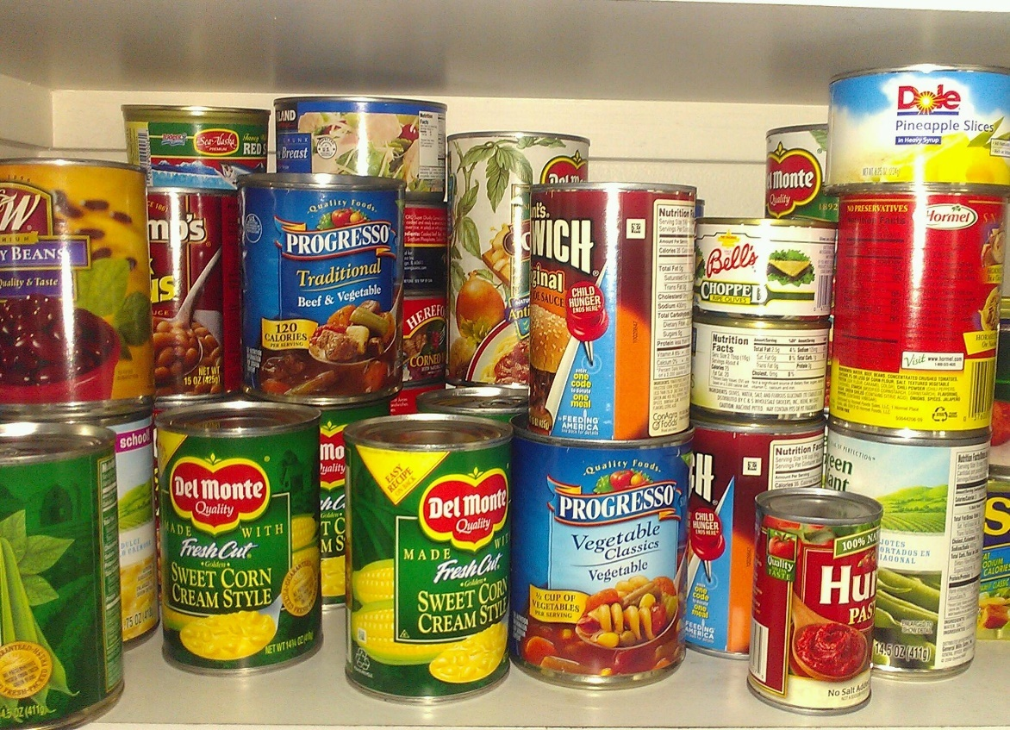
Bearing and Following the WORD into the World Announcements &
Sharing of Joys and Concerns
We will be conducting a non-perishable Food Drive. All food items to be donated to the food pantry at Kingslawn Presbyterian Church. Please donate if you CAN!!!

Slide 26
Bearing and Following the WORD into the World Prayer of the People & The Lord’s Prayer
Our Father, who art in heaven.
Halloweth be thy name.
Thy Kingdom come; Thy will be done
On earth as it is in heaven.
Give us this day our daily bread.
Forgive us our debts; as we forgive our debtors.
Lead us not into temptations, but deliver us from evil.
For Thine is the Kingdom, the Power, and the Glory forever. Amen.

Slide 27
Bearing and Following the WORD into the World Offering of our Gifts and our Lives
Musical Offering

Slide 28
Bearing and Following the WORD into the World Doxology and Offertory Prayer

Slide 29
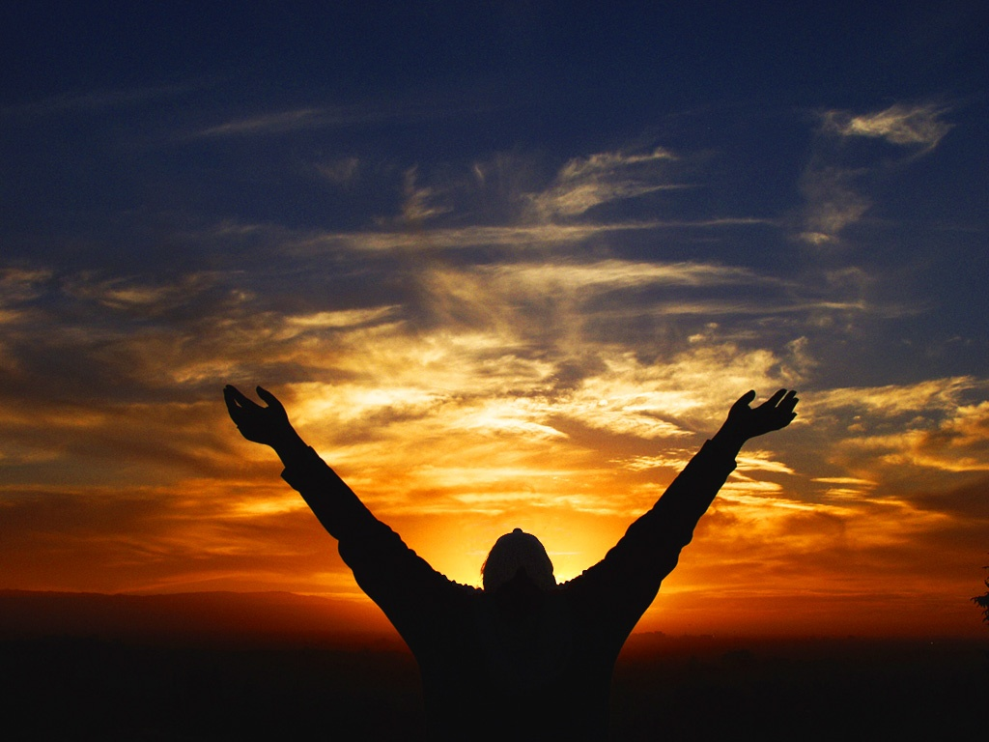
Sending Hymn #550 “Give Praise to the LORD”
Give praise to the Lord,
and sing a new song; amid all the saints
God's praises prolong; a song to your Maker
and Ruler now raise, all children of Zion:
rejoice and give praise.

Slide 30
Sending Hymn #550 “Give Praise to the LORD”
With timbrel and harp
and joyful acclaim, with gladness, O God,
we praise your great name; for now in your people
good pleasure you seek; with robes of salvation
you cover the meek.

Slide 31
Sending Hymn #550 “Give Praise to the LORD”
In glory exult,
all saints of the Lord; with song in the night
high praises accord; go forth in God's service and
strong in God's might to conquer all evil
and stand for the right.

Slide 32
Sending Hymn #550 “Give Praise to the LORD”
For this is God's word:
the saints shall not fail, but over the earth
their power shall prevail; all kingdoms and nations shall
yield to their sway. To God give the glory;
sing praises for aye.

Slide 33
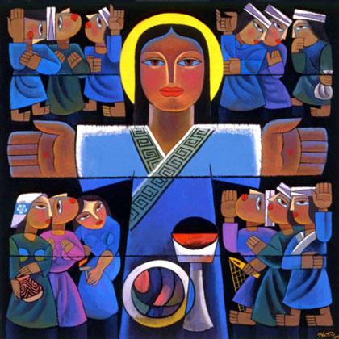
Bearing and Following the WORD into the World The Charge and Benediction

Slide 34
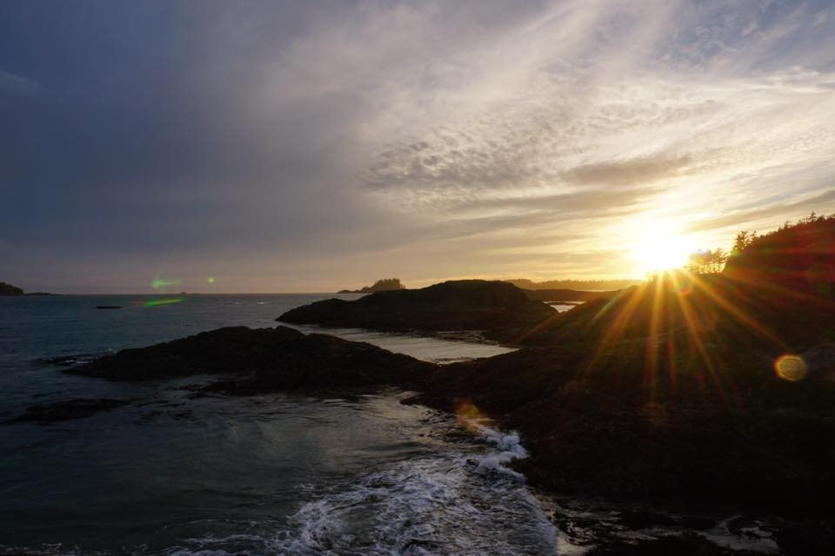
Bearing and Following the WORD into the World Benediction Response
# 542 “God Be with You Till We Meet Again”
(Stanza 1)
God be with you till we meet again;
loving counsels guide, uphold you, with a shepherd's care enfold you:
God be with you till we meet again.

Slide 35
Homecrest Presbyterian Church Worship of the Lord’s Day November 19th, 2017

