Slide 1
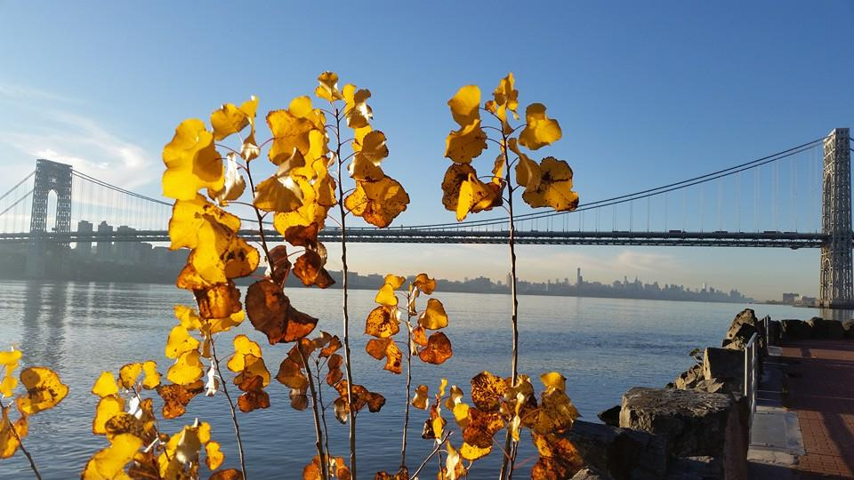
Homecrest Presbyterian Church Worship of the Lord’s Day November 5th, 2017

Slide 2
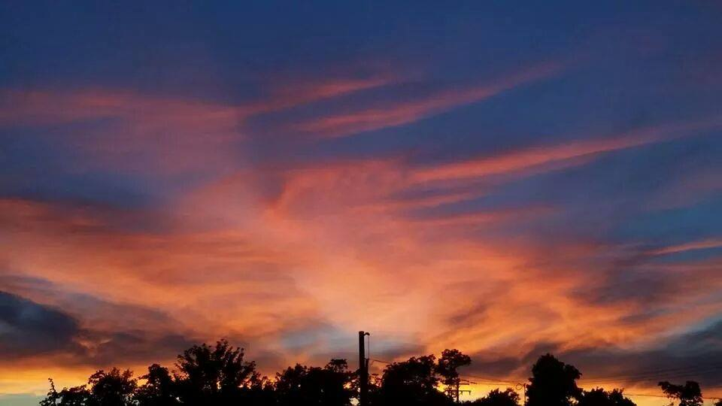
Gathering Around the WORD Call To Worship
(Based on Psalm 107:1-3)
O give thanks to the LORD, for he is good; for his steadfast love endures forever. Let the redeemed of the LORD say so, those he redeemed from trouble and gathered in from the lands, We have gathered from the east and from the west, from the north and from the south. We have come to worship you, O Lord.

Slide 3
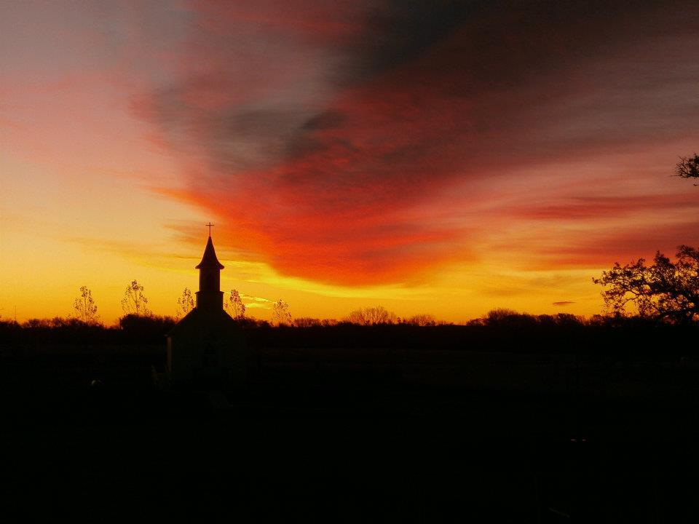
Gathering Around the WORD Gathering Hymn # 336 “We Gather Together”
We gather together
to ask the Lord's blessing; he chastens and hastens
his will to make known; the wicked oppressing
now cease from distressing. Sing praises to his name;
he forgets not his own.

Slide 4
Gathering Around the WORD Gathering Hymn # 336 “We Gather Together”
Beside us to guide us,
our God with us joining, ordaining, maintaining
his kingdom divine; so from the beginning
the fight we were winning; thou, Lord, wast at our side;
all glory be thine!

Slide 5
Gathering Around the WORD Gathering Hymn # 336 “We Gather Together”
We all do extol thee,
thou leader triumphant, and pray that thou still
our defender wilt be. Let thy congregation
escape tribulation; thy name be ever praised!
O Lord, make us free!

Slide 6
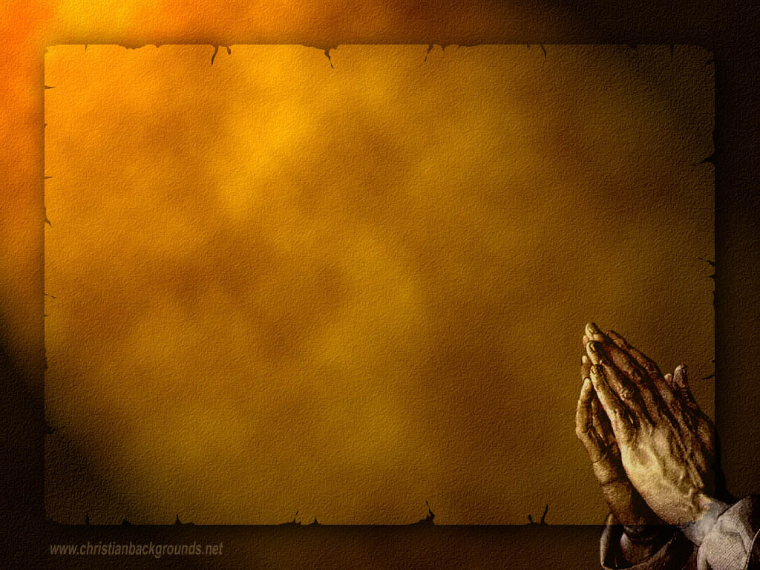
Gathering Around the WORD Call to Confession (Psalm 107:4-7) The Psalmist reminded us that some wandered in desert wastes, finding no way to an inhabited town; they were hungry and thirsty and their soul fainted within them. Then they cried to the LORD in their trouble and he delivered them from their distress; Friends, in humility and faith, let us set aside our personal pride and turn back to God confessing our sins in the company of witnesses all around us.

Slide 7
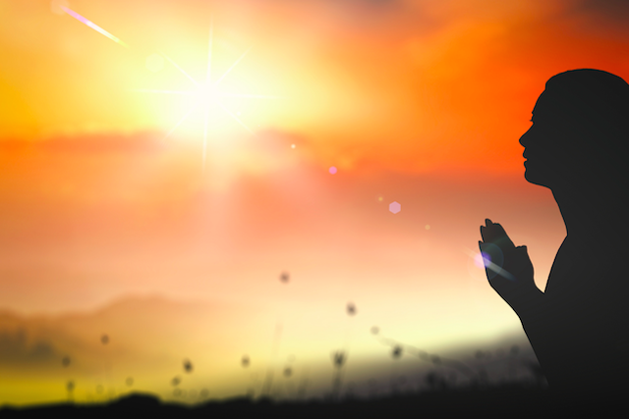
Gathering Around the WORD Prayer of Confession (in Unison)
Lord God, only you are holy.
Yet we imagine that we are righteous, excusing our own faults while pointing out those of others. We are quick to lay burdens upon our neighbor but slow to help with their own. We take credit and give blame.
In spite of the grace you have shown to us, we are slow to show mercy. Forgive us, O God, and wash us clean, that we may serve you with joy and thanksgiving, Amen.

Slide 8
Gathering Around the WORD Declaration of Forgiveness
The mercy of the Lord is from everlasting to everlasting. As God continues to pour out the Spirit upon us, God is declaring that we are blessed and that our sins have been forgiven. Go and sin no more. Thanks be to God, Amen.

Slide 9
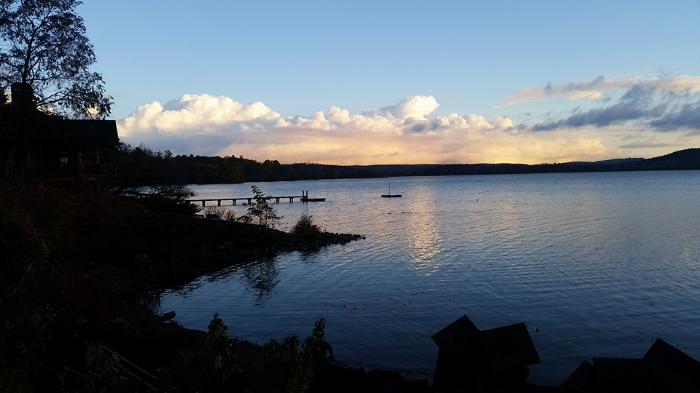
Gathering Around the WORD Gloria Patri
Glory be to the Father
and to the Son and to the Holy Ghost;
As it was in the beginning,
is now, and ever shall be,
world without end. Amen, Amen.

Slide 10
Gathering Around the WORD Passing of the Peace of Christ

Slide 11
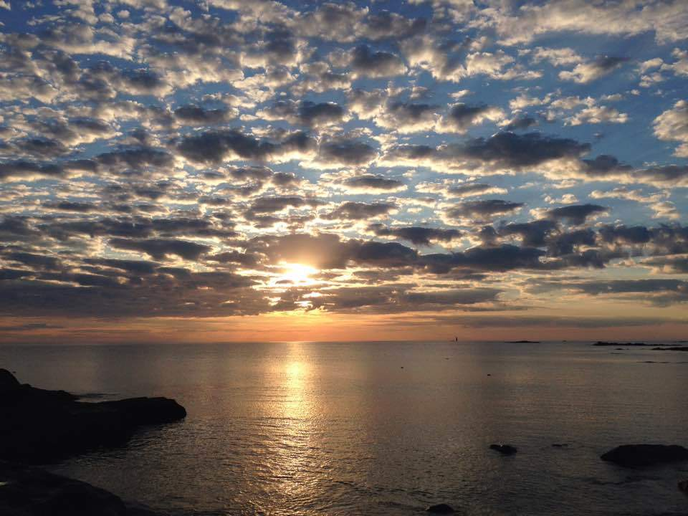
Proclaiming the WORD Message to the Youth/ Prayer of Illumination

Slide 12
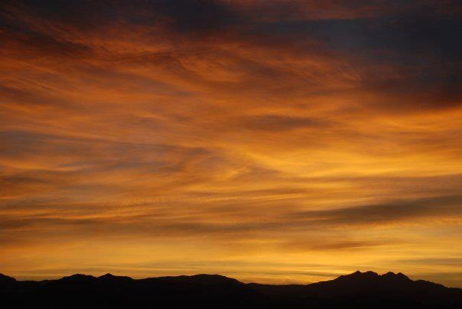
Proclaiming the WORD Scripture Reading (Joshua 3:7-17)
⁷The LORD said to Joshua, “This day I will begin to exalt you in the sight of all Israel, so that they may know that I will be with you as I was with Moses.⁸You are the one who shall command the priests who bear the ark of the covenant, ‘When you come to the edge of the waters of the Jordan, you shall stand still in the Jordan.’”⁹Joshua then said to the Israelites, “Draw near and hear the words of the LORD your God.”

Slide 13
Proclaiming the WORD Scripture Reading (Joshua 3:7-17)
¹⁰Joshua said, “By this you shall know that among you is the living God who without fail will drive out from before you the Canaanites, Hittites, Hivites, Perizzites, Girgashites, Amorites, and Jebusites: ¹¹the ark of the covenant of the Lord of all the earth is going to pass before you into the Jordan. ¹²So now select twelve men from the tribes of Israel, one from each tribe. ¹³When the soles of the feet of the priests who bear the ark of the LORD, the Lord of all the earth, rest in the waters of the Jordan, the waters of the Jordan flowing from above shall be cut off; they shall stand in a single heap.”

Slide 14
Proclaiming the WORD Scripture Reading (Joshua 3:7-17)
¹⁴When the people set out from their tents to cross over the Jordan, the priests bearing the ark of the covenant were in front of the people. ¹⁵Now the Jordan overflows all its banks throughout the time of harvest. So when those who bore the ark had come to the Jordan, and the feet of the priests bearing the ark were dipped in the edge of the water, ¹⁶the waters flowing from above stood still, rising up in a single heap far off at Adam, the city that is beside Zarethan, while those flowing toward the sea of the Arabah, the Dead Sea, were wholly cut off. Then the people crossed over opposite Jericho.

Slide 15
Proclaiming the WORD Scripture Reading (Joshua 3:7-17)
¹⁷While all Israel were crossing over on dry ground, the priests who bore the ark of the covenant of the LORD stood on dry ground in the middle of the Jordan, until the entire nation finished crossing over the Jordan.

Slide 16
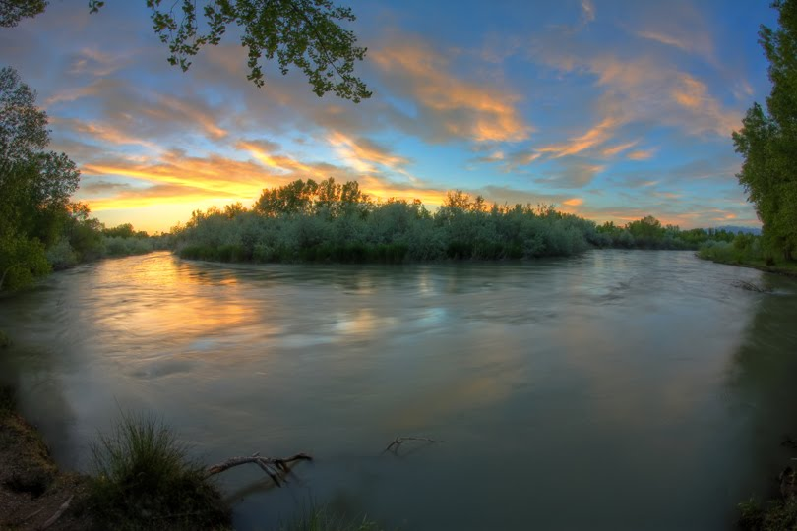
Proclaiming the WORD (Joshua 3:7-17)
Beyond the Jordan

Slide 17
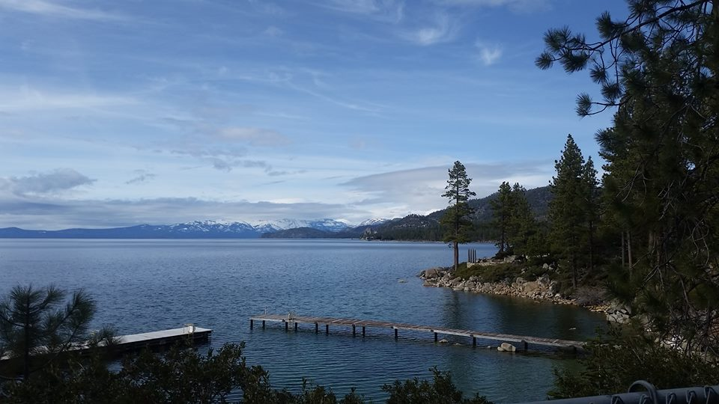
Responding Hymn # 738 “O Master, Let Me Walk with Thee”
O Master, let me walk with thee in lowly paths of service free; tell me thy secret; help me bear the strain of toil, the fret of care.

Slide 18
Responding Hymn # 738 “O Master, Let Me Walk with Thee”
Help me the slow of heart to move by some clear, winning word of love; teach me the wayward feet to stay, and guide them in the homeward way.

Slide 19
Responding Hymn # 738 “O Master, Let Me Walk with Thee”
Teach me thy patience, still with thee in closer, dearer company, in work that keeps faith sweet and strong, in trust that triumphs over wrong.

Slide 20
Responding Hymn # 738 “O Master, Let Me Walk with Thee”
In hope that sends a shining ray far down the future's broadening way; in peace that only thou canst give, with thee, O Master, let me live.

Slide 22
Bearing and Following the WORD into the World Announcements &
Sharing of Joys and Concerns
The afternoon Bible Study Group will NOT be meeting this afternoon. It will resume downstairs in the basement at 12:30pm next Sunday.
The Session will be meeting Tomorrow at 7pm.
The Women's Group will continue to meet every Wednesday 7:30pm over at the Manse (2048 E 14th Street). For more information, please see Margaret and Cara.

Slide 23
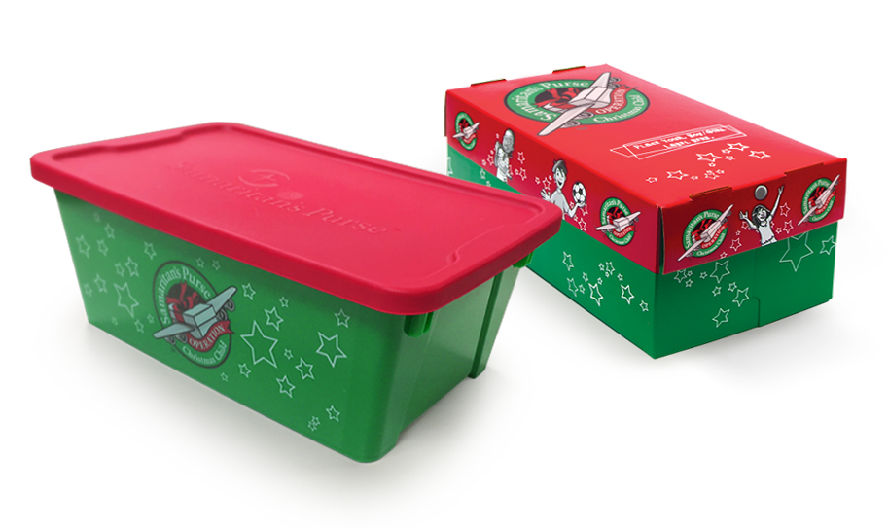
Bearing and Following the WORD into the World Announcements &
Sharing of Joys and Concerns
Operation Christmas Child Shoeboxes will be collected on Next Sunday, 11/12. If you are interested in participating again this year, please pick up one of the flyers.

Slide 24
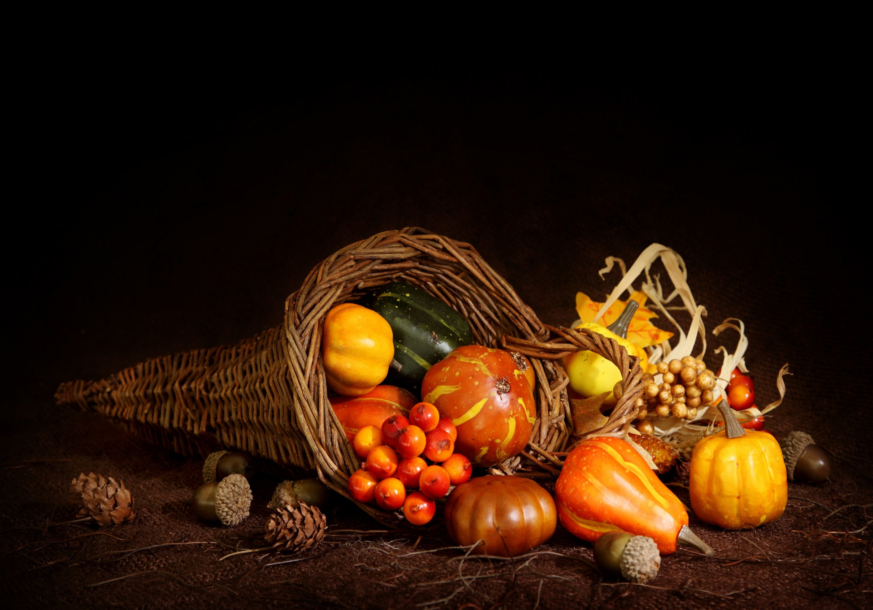
Bearing and Following the WORD into the World Announcements &
Sharing of Joys and Concerns
Our Annual Thanksgiving Dinner will be on Saturday, 11/18 at 6pm.

Slide 25
Bearing and Following the WORD into the World Prayer of the People & The Lord’s Prayer
Our Father, who art in heaven.
Halloweth be thy name.
Thy Kingdom come; Thy will be done
On earth as it is in heaven.
Give us this day our daily bread.
Forgive us our debts; as we forgive our debtors.
Lead us not into temptations, but deliver us from evil.
For Thine is the Kingdom, the Power, and the Glory forever. Amen.

Slide 26
Bearing and Following the WORD into the World Offering of our Gifts and our Lives
Musical Offering

Slide 27
Bearing and Following the WORD into the World Doxology and Offertory Prayer

Slide 28
Bearing and Following the WORD into the World Holy Communion Hymn
# 503 “Lord, We Have Come At Your Own Invitation”
Lord, we have come at your own invitation, chosen by you, to be counted your friends; yours is the strength that sustains dedication; ours, a commitment we know never ends.

Slide 29
Bearing and Following the WORD into the World Holy Communion Hymn
# 503 “Lord, We Have Come At Your Own Invitation”
Here, at your table, confirm our intention; give it your seal of forgiveness and grace; teach us to serve without pride or pretension, Lord, in your kingdom, whatever our place.

Slide 30
Bearing and Following the WORD into the World Holy Communion Hymn
# 503 “Lord, We Have Come At Your Own Invitation”
When, at your table, each time of returning, vows are renewed and our courage restored, may we increasingly glory in learning all that it means to accept you as Lord.

Slide 31
Bearing and Following the WORD into the World Holy Communion
Friends, we have gathered around this table of grace, as God’s people and saints of this world, where there are no strangers. Christ is the host at this Heavenly Feast and we are all invited for as long as we profess our faith and trust in Him. We celebrate God's presence among us, united in Christ's spirit, broken and whole all at once.

Slide 32
Bearing and Following the WORD into the World Holy Communion
Through God’s reconciling love and unconditional grace, transformation takes place around this table, where strangers become friends, sinners redeemed, brokenness restored and wounded healed.

Slide 33
Bearing and Following the WORD into the World Holy Communion
The Lord be with you. And also with you.
Lift up your hearts. We lift them up to the Lord.
Let us give thanks to the Lord our God.
It is right to give our thanks and praise.

Slide 34
Bearing and Following the WORD into the World Holy Communion
Blessed are you, O Christ, in the fullness of your sovereign glory, we proclaim the mystery of faith:
Christ has died, Christ is risen,
Christ will come again.
With thanksgiving, we shall receive this bread which our Lord Jesus took, after He blessed it, broke it, and gave it to his disciples, saying, take eat, this is my body, given for you.

Slide 35
Bearing and Following the WORD into the World Holy Communion
With confidence, we shall drink from this cup that Jesus blessed, saying, this is the new covenant sealed in my blood. Do this in remembrance of me.
With thanks and praise we offer ourselves to you, just as Christ offered himself to our own salvation. O God. As we share this holy meal, we remember Christ’s dying and rising, praying: Come Lord Jesus!

Slide 36
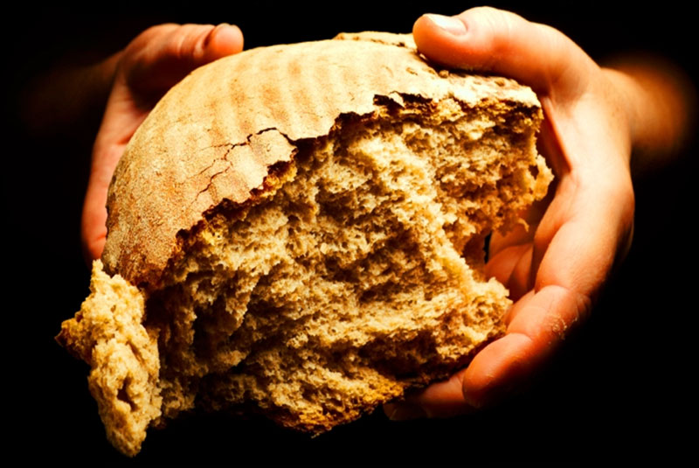
Bearing and Following the WORD into the World Holy Communion
Jesus said, "I am the bread of life. Those who come to me shall never hunger; those who believe in me shall never thirst." These are the gift of God for the people of God.

Slide 37
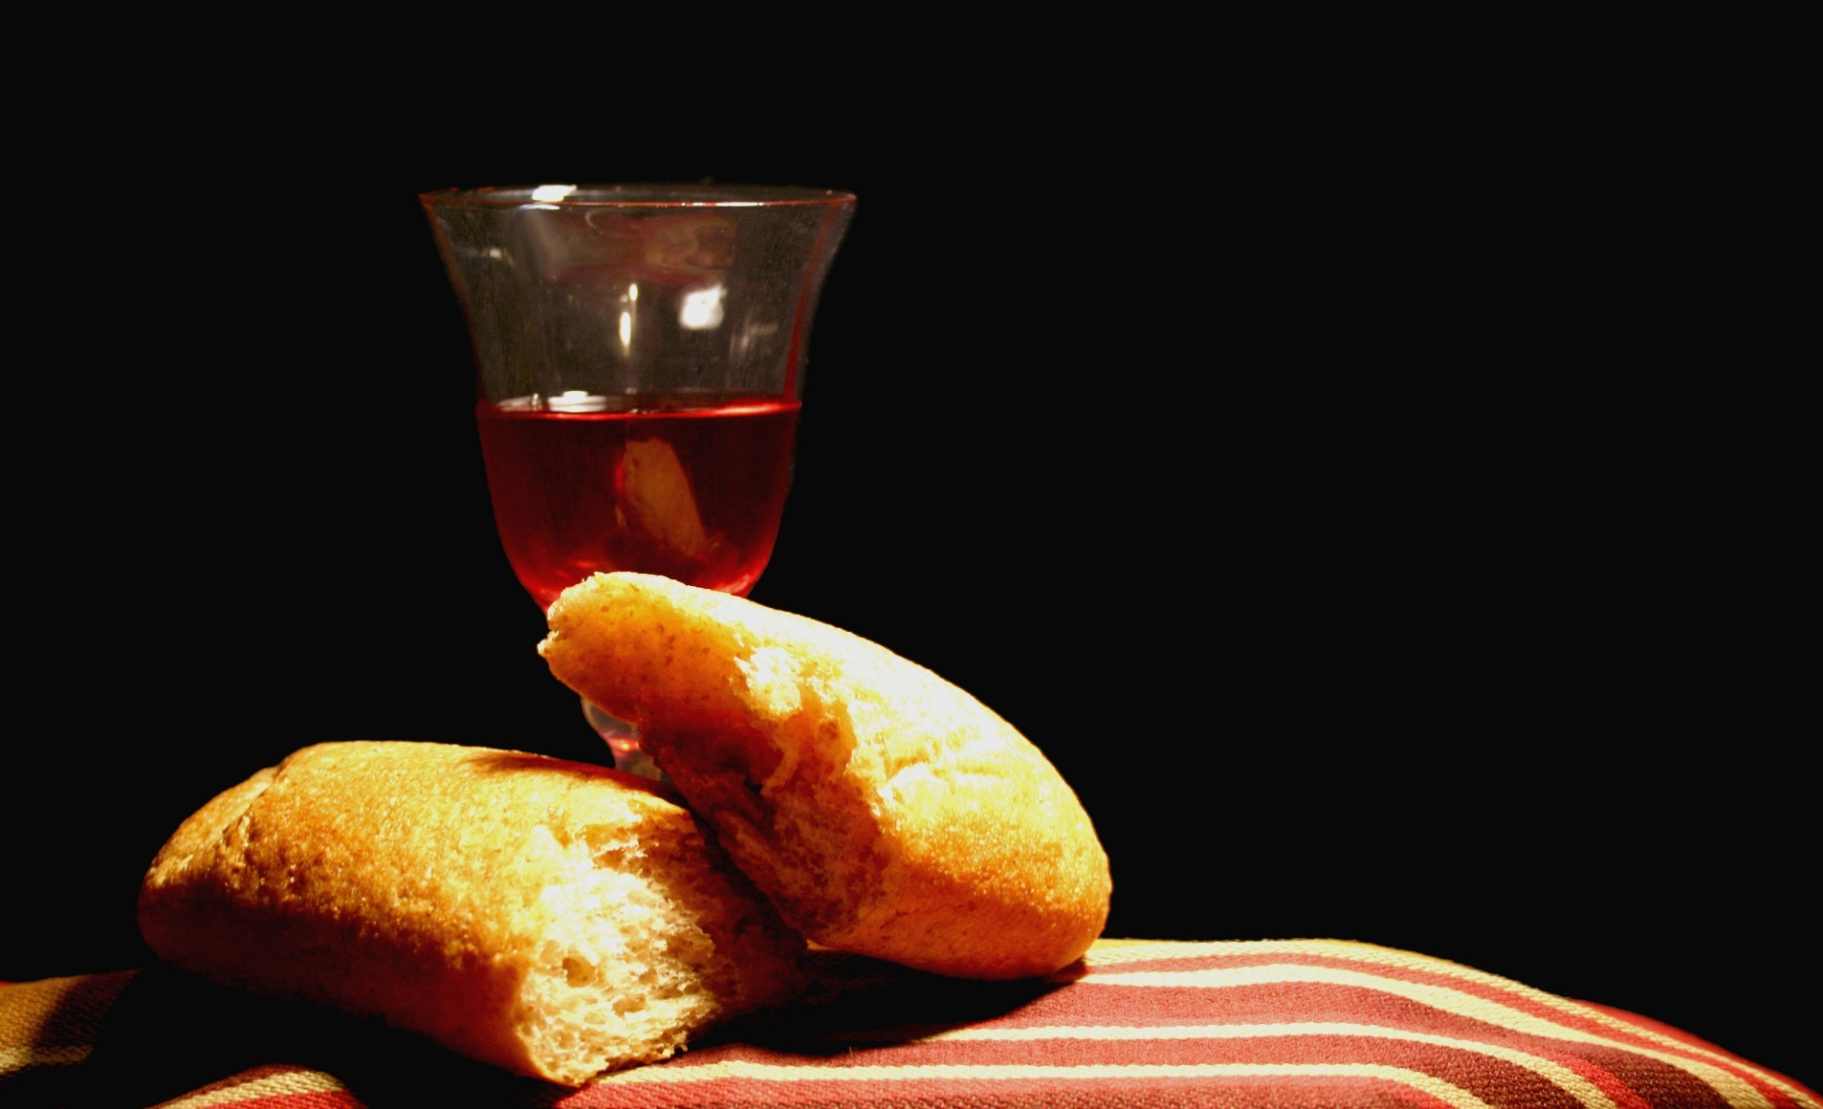
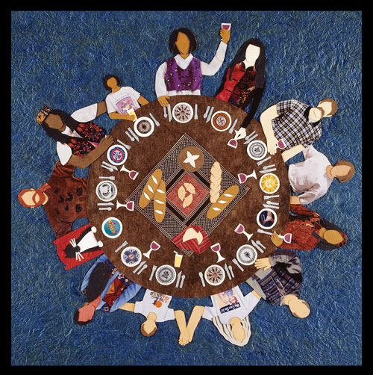
Bearing and Following the WORD into the World Holy Communion

Slide 38
:
Bearing and Following the WORD into the World
Prayer after the Communion: (in unison)
Lord Jesus Christ, in Spirit you have fed us with your body and quenched us with your blood. We look forward to the day when you shall come again to fill our hearts with grace, peace and hope.

Slide 39
:
Bearing and Following the WORD into the World
Prayer after the Communion: (in unison)
Enable us now to go out to share your love to others in this season of Thanksgiving. Humble our hearts and pour out your Spirit upon us, as we have be nourished by the Bread of Life and quenched by the Cup of Salvation. Thanks be to God, Amen.

Slide 40
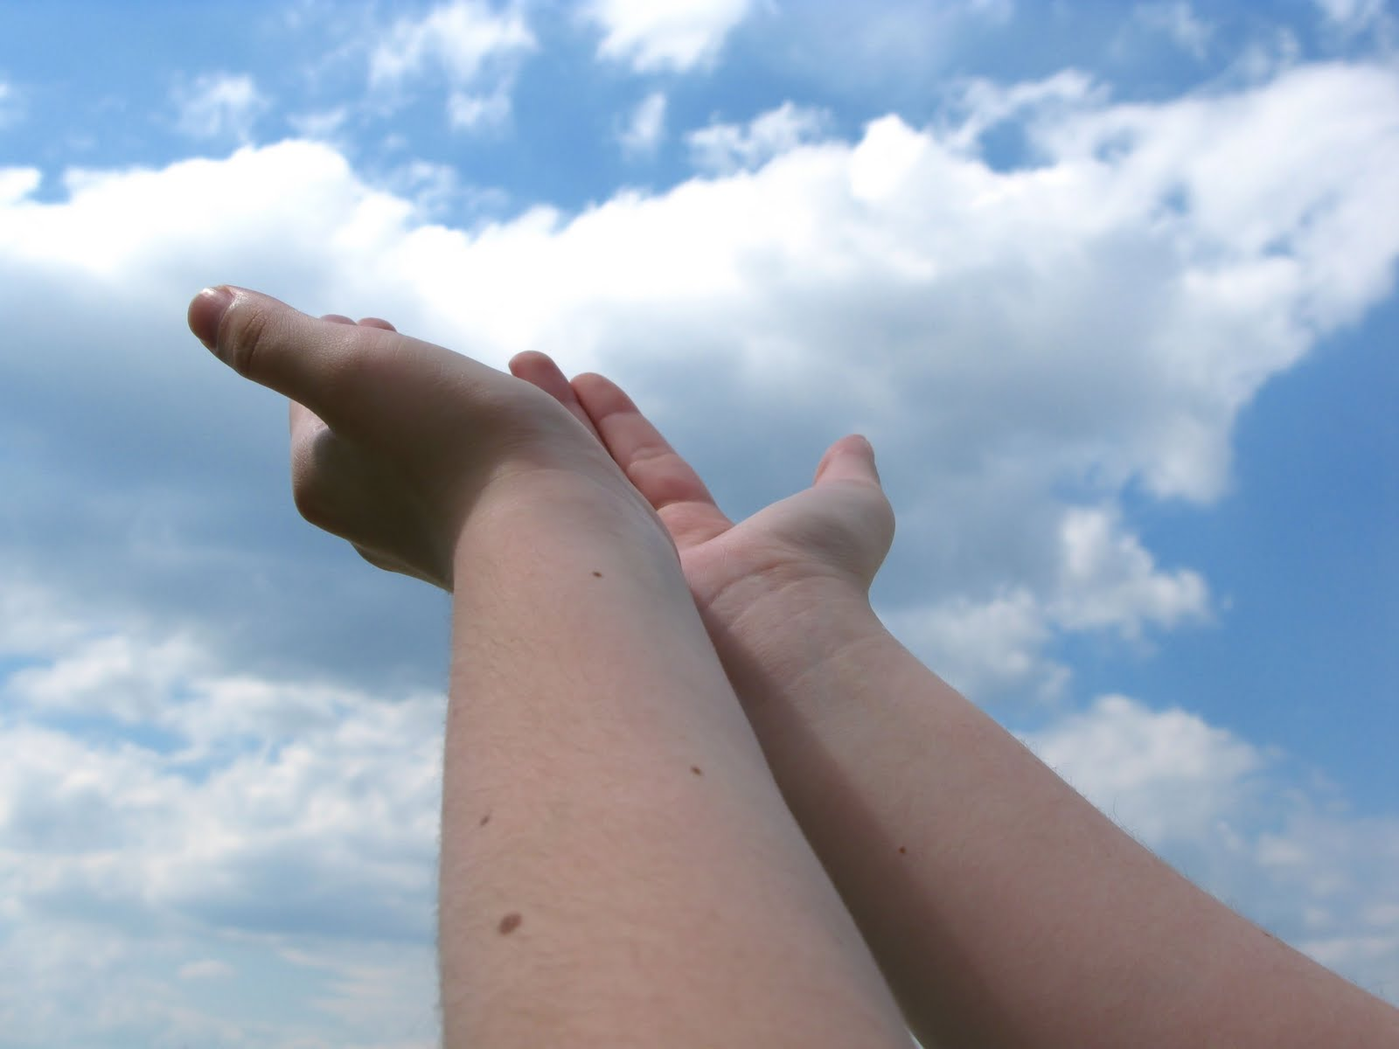
Bearing and Following the WORD into the World Deacons’ Benevolence Offering

Slide 41
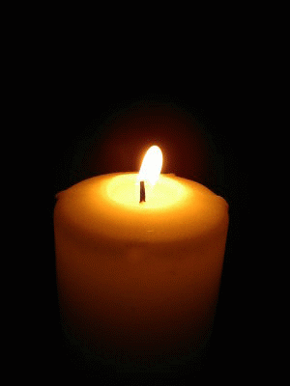
Sending Hymn #733 “We All Are One in Mission”
We all are one in mission; we all are one in call, our varied gifts united by Christ, the Lord of all. A single, great commission compels us from above to plan and work together that all may know Christ’s love

Slide 42
Sending Hymn #733 “We All Are One in Mission”
We all are called for service to witness in God’s name. Our ministries are different; our purpose is the same: to touch the lives of others by God’s surprising grace, so every folk and nation may feel God’s warm embrace.

Slide 43
Sending Hymn #733 “We All Are One in Mission”
Now let us be united and let our song be heard. Now let us be a vessel for God’s redeeming word. We all are one in mission; we all are one in call, our varied gifts united by Christ, the Lord of all.

Slide 44
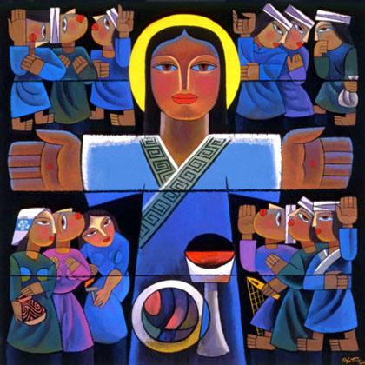
Bearing and Following the WORD into the World The Charge and Benediction

Slide 45
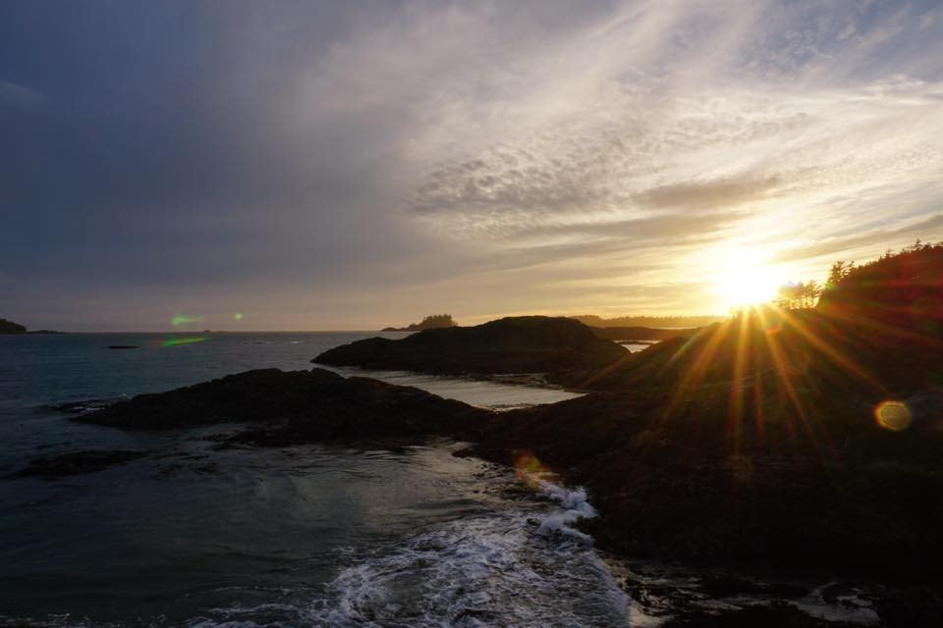
Bearing and Following the WORD into the World Benediction Response
# 547 “Go, My Children, with My Blessing”
(Stanza 2)
“Go, my children, sins forgiven,
at peace and pure. Here you learned how much I love you,
what I can cure.
Here you heard my dear Son’s story;
here you touched him, saw his glory. Go, my children, sins forgiven,
at peace and pure.”

Slide 46
Homecrest Presbyterian Church Worship of the Lord’s Day November 5th, 2017

