Slide 1
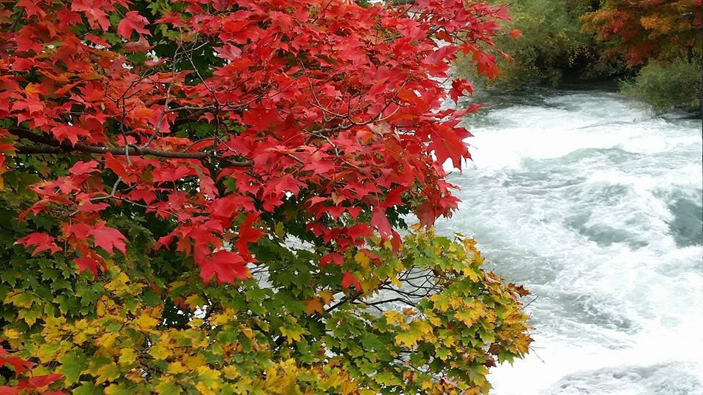
Homecrest Presbyterian Church Worship of the Lord’s Day October 8th, 2017 27th Sunday in Ordinary Time

Slide 2
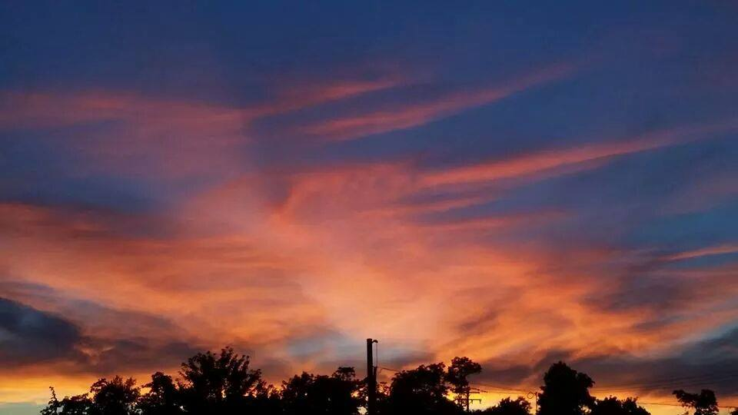
Gathering Around the WORD Call To Worship
(Based on Philippians 3:7-8 and Matthew 21:42)
Whatever gains we had, these we have come to regard as loss because of Christ.
We regard everything as loss because of the surpassing value of knowing Christ Jesus our Lord.
As the Scriptures promise: the stone that the builders rejected has become the cornerstone. This is the Lord’s doing!

Slide 3
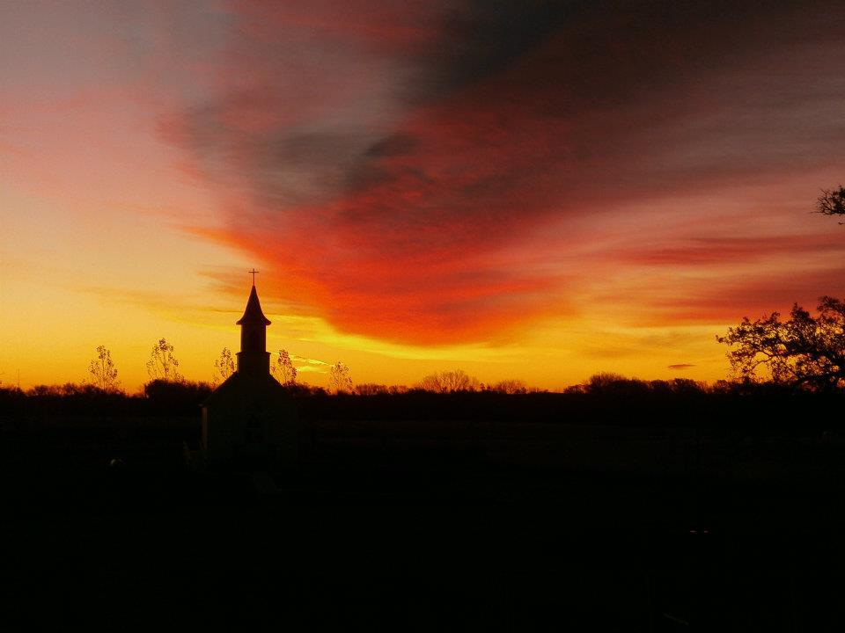
Gathering Around the WORD Gathering Hymn # 386 “Come, Worship God”
Come, worship God,
who is worthy of honor; enter God’s presence
with thanks and a song! You are the rock
of your people’s salvation to whom our jubilant praises belong.

Slide 4
Gathering Around the WORD Gathering Hymn # 386 “Come, Worship God”
Ruled by your might
are the heights of the mountains; held in your hands
are the depths of the earth. Yours is the sea,
yours the land, for you made them, God above all gods,
who gave us our birth.

Slide 5
Gathering Around the WORD Gathering Hymn # 386 “Come, Worship God”
We are your people,
the sheep of your pasture; you are our Maker, and to you we pray. Gladly we kneel
in obedience before you; great is the one
whom we worship this day!

Slide 6
Gathering Around the WORD Gathering Hymn # 386 “Come, Worship God”
Now let us listen,
for you speak among us; open our hearts
to receive what you say. Peace be to all
who remember your goodness, trust in your word,
and rejoice in your way!

Slide 7
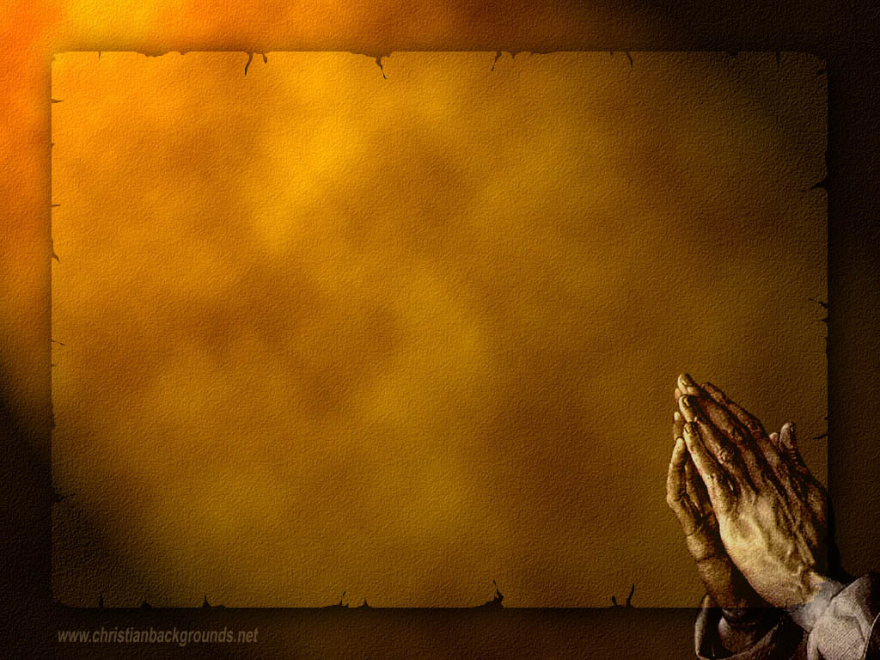
Gathering Around the WORD Call to Confession (Philippians 3:4b-9) Whatever good we may have done is nothing comparing to the righteousness of Christ. Whatever wrong we may have is nothing comparing to the grace of God. With faith in Christ’s righteousness and confidence in God’s grace, let us confess our sins before God in the company of our neighbors as witnesses.

Slide 8
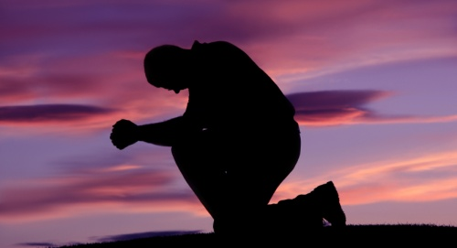
Gathering Around the WORD Prayer of Confession (in Unison)
Loving God, you have planted us like a vineyard on a fertile hill. You cleared away the stones, planted us with choice vines, and kept watch over us by night and day. But we have not yielded the good fruit that you expected or desired. We are overgrown with sin, choked with violence and injustice.
Forgive us, we pray. Uproot our evil, prune away our sin, and shower upon us the gift of your grace; through Jesus Christ our Lord, Amen.

Slide 9
Gathering Around the WORD Declaration of Forgiveness
Our salvation does not depend on anything that you and I have done, but comes from the grace of God alone through faith in Jesus Christ.
This is the good news: in Jesus Christ we are forgiven, Thanks be to God, Amen.

Slide 10
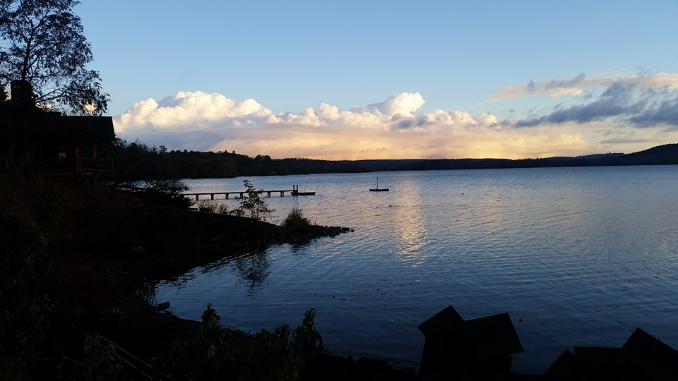
Gathering Around the WORD Gloria Patri
Glory be to the Father
and to the Son and to the Holy Ghost;
As it was in the beginning,
is now, and ever shall be,
world without end. Amen, Amen.

Slide 11
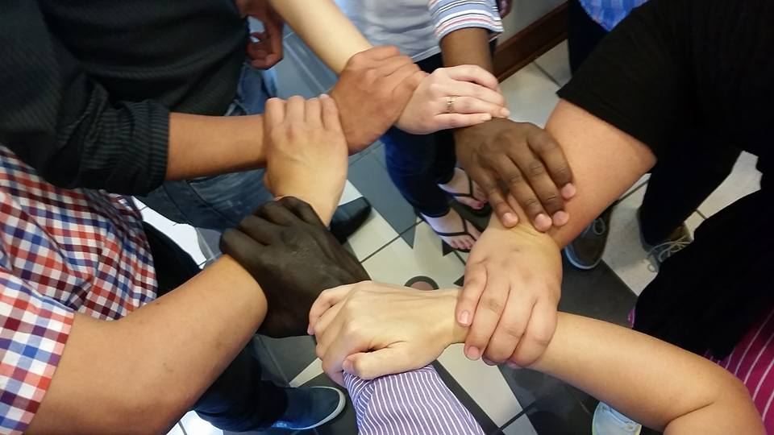
Gathering Around the WORD Passing of the Peace of Christ

Slide 12
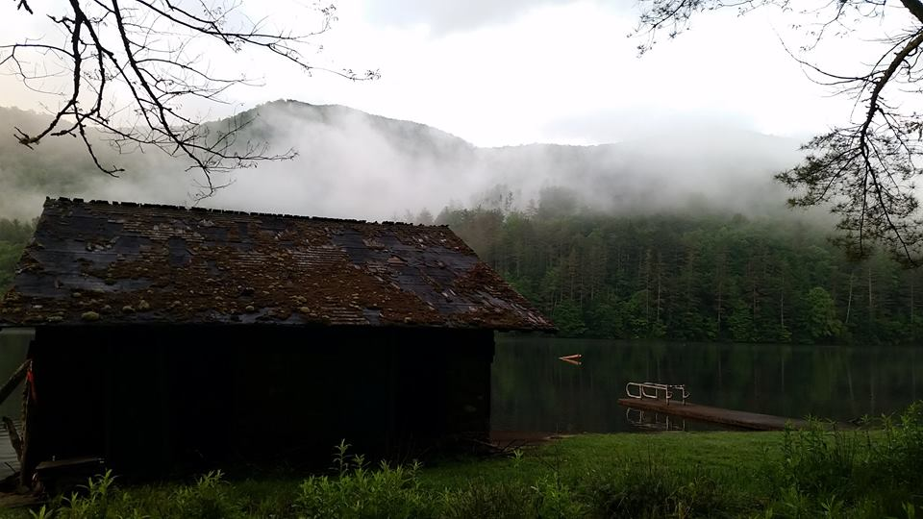
Proclaiming the WORD Message to the Youth/ Prayer of Illumination

Slide 13
Proclaiming the WORD Scripture Reading (Isaiah 5:1-7)
Let me sing for my beloved my love-song concerning his vineyard: My beloved had a vineyard on a very fertile hill. ² He dug it and cleared it of stones, and planted it with choice vines; he built a watchtower in the midst of it, and hewed out a wine vat in it; he expected it to yield grapes, but it yielded wild grapes.
³ And now, inhabitants of Jerusalem and people of Judah, judge between me and my vineyard. ⁴ What more was there to do for my vineyard that I have not done in it? When I expected it to yield grapes, why did it yield wild grapes?

Slide 14
Proclaiming the WORD Scripture Reading (Isaiah 5:1-7)
⁵ And now I will tell you what I will do to my vineyard. I will remove its hedge, and it shall be devoured; I will break down its wall, and it shall be trampled down. ⁶ I will make it a waste; it shall not be pruned or hoed, and it shall be overgrown with briers and thorns; I will also command the clouds that they rain no rain upon it.
⁷ For the vineyard of the LORD of hosts is the house of Israel, and the people of Judah are his pleasant planting; he expected justice, but saw bloodshed; righteousness, but heard a cry!

Slide 15
Proclaiming the WORD Scripture Reading (Philippians 3:4-14)
^{4b}If anyone else has reason to be confident in the flesh, I have more: ⁵circumcised on the eighth day, a member of the people of Israel, of the tribe of Benjamin, a Hebrew born of Hebrews; as to the law, a Pharisee; ⁶as to zeal, a persecutor of the church; as to righteousness under the law, blameless.

Slide 16
Proclaiming the WORD Scripture Reading (Philippians 3:4-14)
⁷Yet whatever gains I had, these I have come to regard as loss because of Christ. ⁸More than that, I regard everything as loss because of the surpassing value of knowing Christ Jesus my Lord. For his sake I have suffered the loss of all things, and I regard them as rubbish, in order that I may gain Christ ⁹and be found in him, not having a righteousness of my own that comes from the law, but one that comes through faith in Christ, the righteousness from God based on faith. ¹⁰I want to know Christ and the power of his resurrection and the sharing of his sufferings by becoming like him in his death, ¹¹if somehow I may attain the resurrection from the dead.

Slide 17
Proclaiming the WORD Scripture Reading (Philippians 3:4-14)
¹²Not that I have already obtained this or have already reached the goal; but I press on to make it my own, because Christ Jesus has made me his own. ¹³Beloved, I do not consider that I have made it my own; but this one thing I do: forgetting what lies behind and straining forward to what lies ahead, ¹⁴I press on toward the goal for the prize of the heavenly call of God in Christ Jesus.

Slide 18
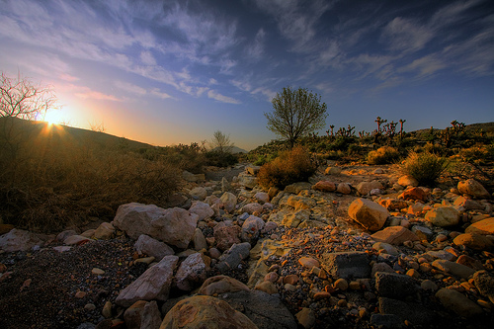
Proclaiming the WORD (Isaiah 5:1-7 and Philippians 3:4-14)
A Gospel from the Desert

Slide 19
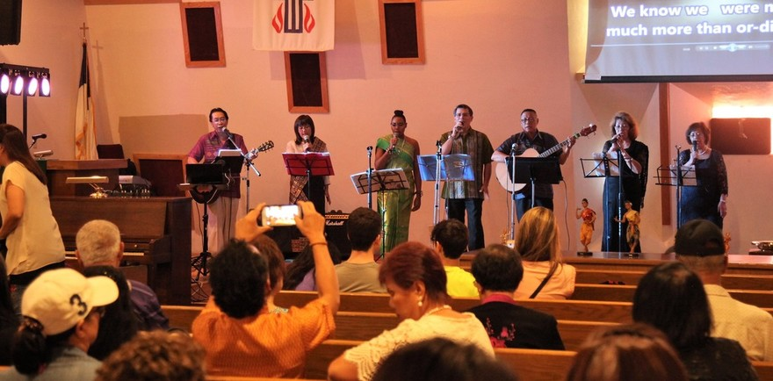
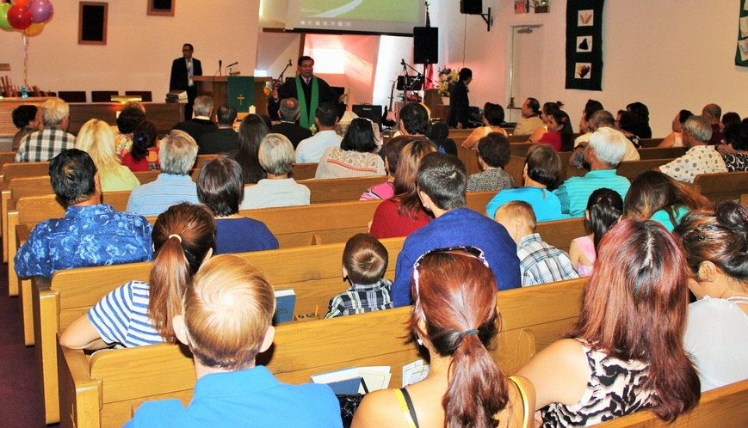
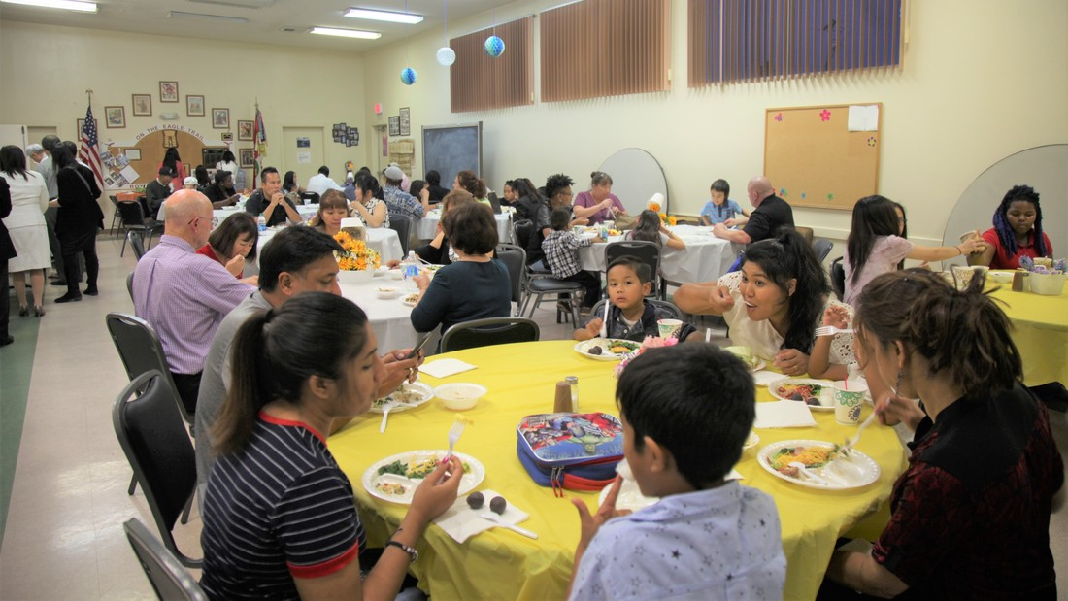
Proclaiming the WORD (Isaiah 5:1-7 and Philippians 3:4-14)
A Gospel from the Desert

Slide 20
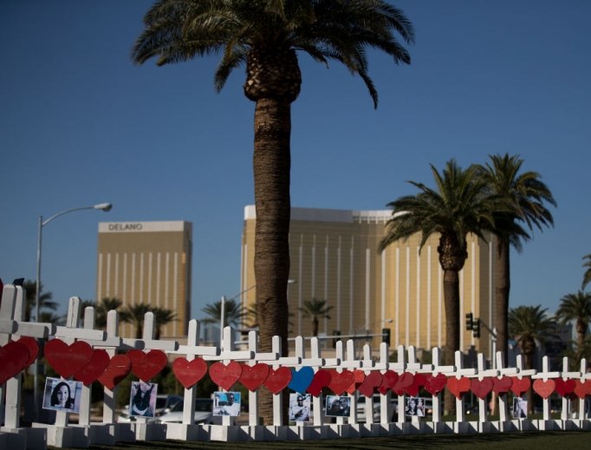
Proclaiming the WORD (Isaiah 5:1-7 and Philippians 3:4-14)
A Gospel from the Desert

Slide 21
Proclaiming the WORD (Isaiah 5:1-7 and Philippians 3:4-14)
A Gospel from the Desert

Slide 22
A Psalm of Deliverance (Psalm 140)
Deliver me, O LORD, from evildoers; protect me from those who are violent, ² who plan evil things in their minds and stir up wars continually. ³ They make their tongue sharp as a snake's, and under their lips is the venom of vipers.
⁴ Guard me, O LORD, from the hands of the wicked; protect me from the violent who have planned my downfall. ⁵ The arrogant have hidden a trap for me, and with cords they have spread a net, along the road they have set snares for me.

Slide 23
A Psalm of Deliverance (Psalm 140)
⁶ I say to the LORD, "You are my God; give ear, O LORD, to the voice of my supplications." ⁷ O LORD, my Lord, my strong deliverer, you have covered my head in the day of battle. ⁸ Do not grant, O LORD, the desires of the wicked; do not further their evil plot.
⁹ Those who surround me lift up their heads; let the mischief of their lips overwhelm them! ¹⁰ Let burning coals fall on them! Let them be flung into pits, no more to rise! ¹¹ Do not let the slanderer be established in the land; let evil speedily hunt down the violent!

Slide 24
A Psalm of Deliverance (Psalm 140)
¹² I know that the LORD maintains the cause of the needy, and executes justice for the poor. ¹³ Surely the righteous shall give thanks to your name; the upright shall live in your presence.

Slide 25
Responding Hymn # 451 “Open My Eyes, That I May See”
Open my eyes, that I may see glimpses of truth thou hast for me. Place in my hands the wonderful key that shall unclasp and set me free. Silently now I wait for thee, ready, my God, thy will to see. Open my eyes; illumine me, Spirit divine!

Slide 26
Responding Hymn # 451 “Open My Eyes, That I May See”
Open my ears, that I may hear voices of truth thou sendest clear. And while the wave notes fall on my ear, everything false will disappear. Silently now I wait for thee, ready, my God, thy will to see. Open my ears; illumine me, Spirit divine!

Slide 27
Responding Hymn # 451 “Open My Eyes, That I May See”
Open my mouth, and let me bear gladly the warm truth everywhere. Open my heart, and let me prepare love with thy children thus to share. Silently now I wait for thee, ready, my God, thy will to see. Open my heart; illumine me, Spirit divine!

Slide 28
Bearing and Following the WORD into the World Announcements &
Sharing of Joys and Concerns
The Sunday afternoon Bible Study Group will resume this afternoon at 12:30pm downstairs in the basement.
The Wednesday evening Women’s Group will meet every Wednesday 7:30pm over at the Manse (2048 E 14th Street). They are currently studying the Book of Mark

Slide 29
Bearing and Following the WORD into the World Announcements &
Sharing of Joys and Concerns
The next Session Meeting will be Tomorrow, 10/9 at 7pm. All active elders please attend.
The NYC Presbytery will be hosting its annual Presbytery Resource Day on Saturday, 11/4 at Brick Presbyterian Church in Manhattan. For more information and registration, please pick up one of the flyers on the back-table.

Slide 30
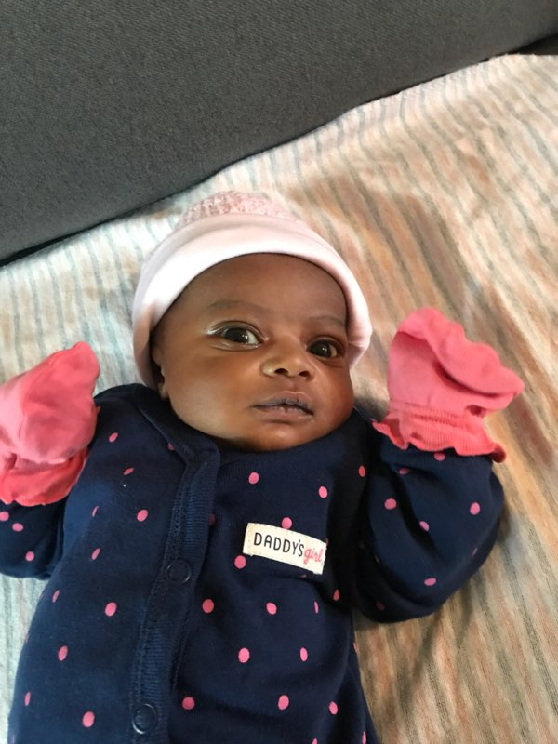
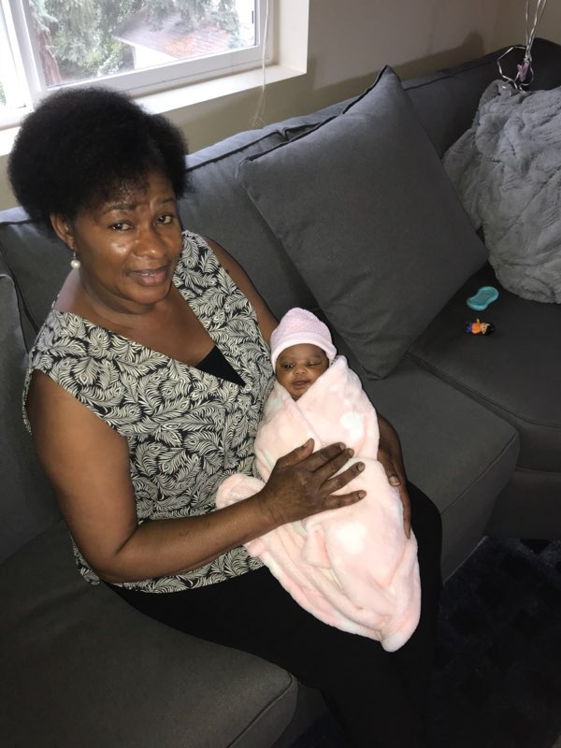
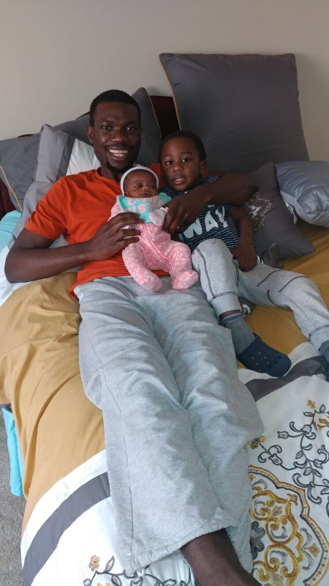
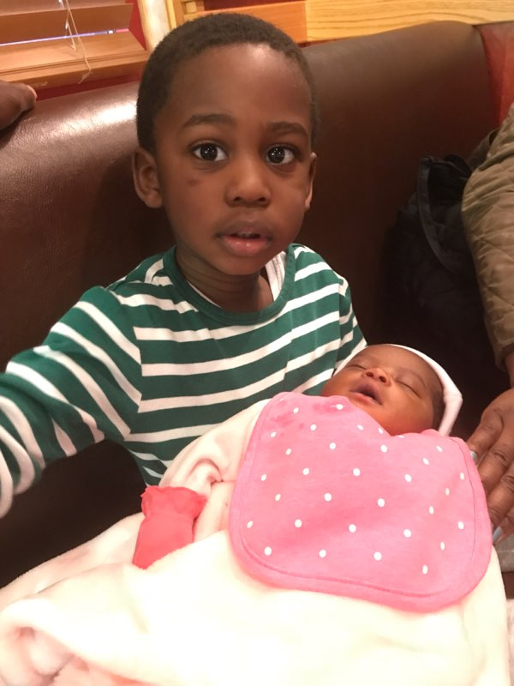
Bearing and Following the WORD into the World Announcements &
Sharing of Joys and Concerns
Tamira Eleanor Nyasulu
Born 9/20/17

Slide 31
Bearing and Following the WORD into the World Prayer of the People & The Lord’s Prayer
Our Father, who art in heaven.
Halloweth be thy name.
Thy Kingdom come; Thy will be done
On earth as it is in heaven.
Give us this day our daily bread.
Forgive us our debts; as we forgive our debtors.
Lead us not into temptations, but deliver us from evil.
For Thine is the Kingdom, the Power, and the Glory forever. Amen.

Slide 32
Bearing and Following the WORD into the World Offering of our Gifts and our Lives
Musical Offering

Slide 33
Bearing and Following the WORD into the World Doxology and Offertory Prayer

Slide 34
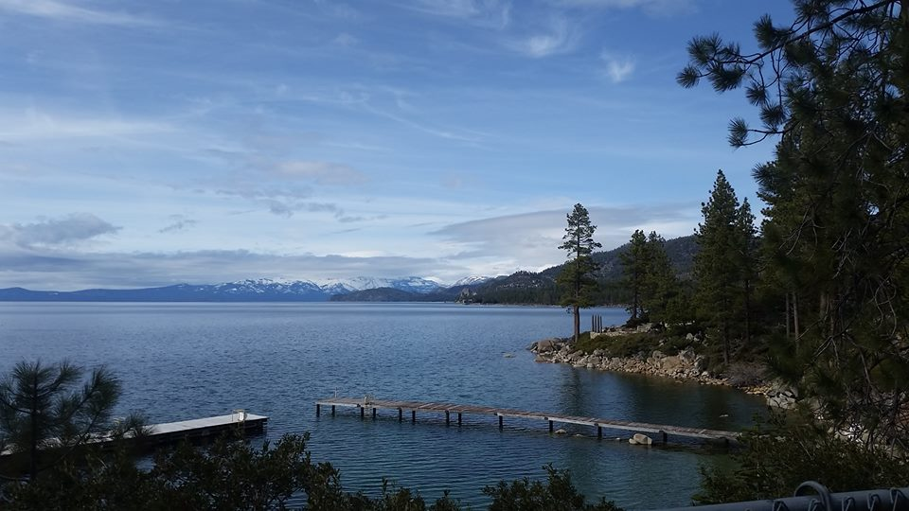
Sending Hymn “God Creates a Blessed Newness”
God creates a blessed newness;
Now it springs forth, don’t you see?
Come, you people of creation,
Gather now at God’s decree.
Do not fear for God is with us;
Pay no heed to things of old.
We are servants of the Sacred;
Wondrous works will we behold!

Slide 35
Sending Hymn “God Creates a Blessed Newness”
See who gathers at the table,
All invited by our Lord;
Varied people, many colors,
All commissioned by the Word.
Many ways are Gosple stories
Shared among God’s people dear.
Let us gather round the table
All with eager ears to hear.

Slide 36
Sending Hymn “God Creates a Blessed Newness”
Newness comes and, with it, struggle,
But our tests cause us to grow.
Things will change but God is present
More than we could ever know.
Give us courage, Lord, and wisdom
For the days which lie ahead.
May we live as your disciples,
Nurtured by your daily bread.

Slide 37
Sending Hymn “God Creates a Blessed Newness”
We are witnesses of mercy,
We are called to testify.
Gifts of grace in all abundance,
Steadfast love in strong supply.
God will guide and we will gather;
Leaning forward, called by name.
What great blessings lie before us,
God’s to give and ours to claim.

Slide 38
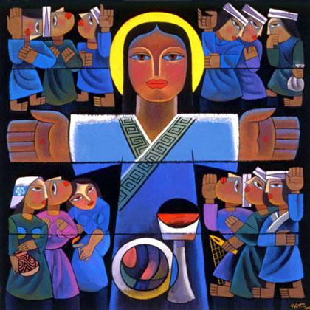
Bearing and Following the WORD into the World The Charge and Benediction

Slide 39
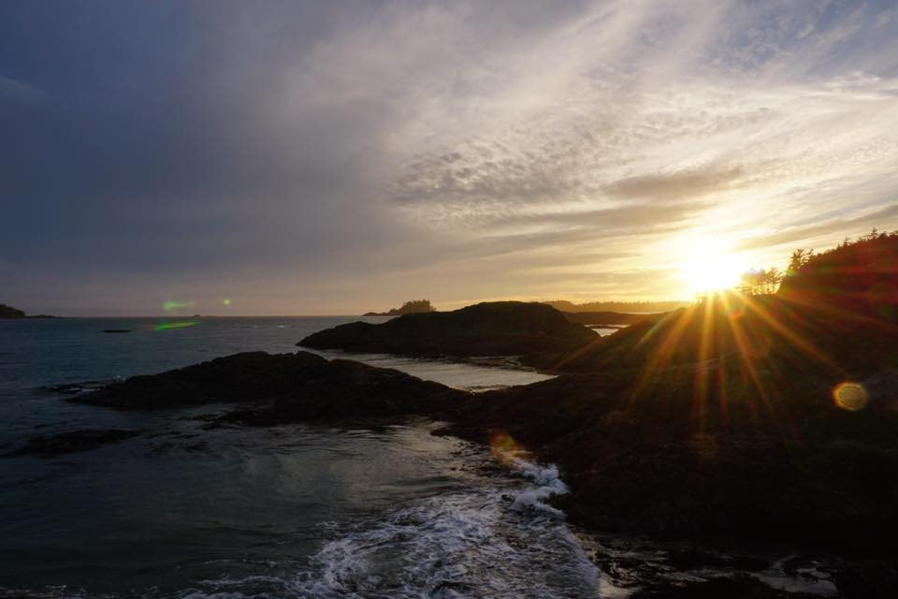
Bearing and Following the WORD into the World Benediction Response
# 540 “Farewell, Good Friends”
Farewell, good friends! Farewell, good friends! Shalom, shalom! Till we meet again, till we meet again, shalom, shalom.

Slide 40
Homecrest Presbyterian Church Worship of the Lord’s Day October 8th, 2017 27th Sunday in Ordinary Time

