Slide 1
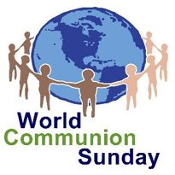
Homecrest Presbyterian Church Worship of the Lord’s Day October 1st, 2017 26th Sunday in Ordinary Time

Slide 2
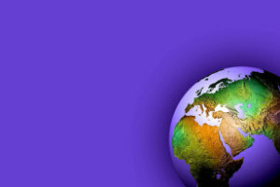
Gathering Around the WORD Call To Worship
Today we are invited to a joyful feast,
hosted by our Savior Jesus Christ.
All who are hungry will find the bread of life here. All who thirsty will find will find a fountain of grace here.
All who are lost will find safety here.
All who are lonely will find a friend here.
All who are broken will find healing here. All who have been wandering
will find a home here. For this is a heavenly banquet, and you are welcome here! Come, let us worship God!

Slide 3
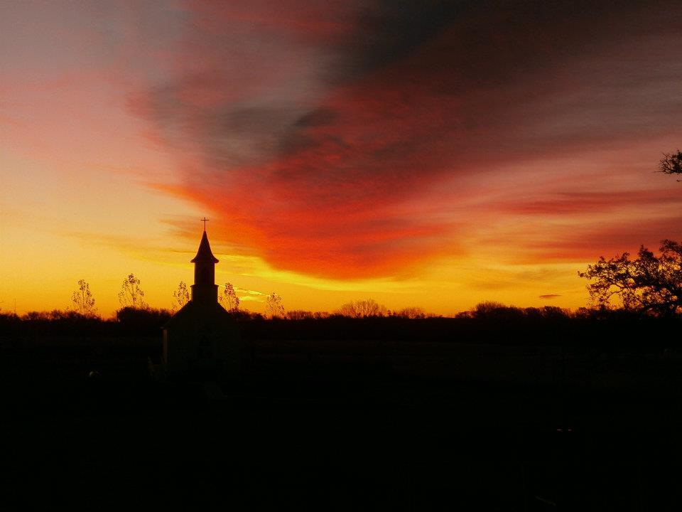
Gathering Around the WORD Gathering Hymn # 305 “Come Sing, O Church, In Joy!”
Come sing, O church, in joy! Come join, O church, in song! For Christ the Lord has led us through the ages long! In bold accord, come celebrate the journey now and praise the Lord!

Slide 4
Gathering Around the WORD Gathering Hymn # 305 “Come Sing, O Church, In Joy!”
Long years have come and gone, and still God reigns supreme, empowering us to catch the vision, dream the dream! In bold accord, come celebrate the journey now and praise the Lord!

Slide 5
Gathering Around the WORD Gathering Hymn # 305 “Come Sing, O Church, In Joy!”
Let courage be our friend; let wisdom be our guide, as we in mission magnify the Crucified! In bold accord, come celebrate the journey now and praise the Lord!

Slide 6
Gathering Around the WORD Gathering Hymn # 305 “Come Sing, O Church, In Joy!”
Come sing, O church, in joy! Come join, O church, in song! For Christ the Lord has triumphed o'er the ages long! In bold accord, come celebrate the journey now and praise the Lord!

Slide 7
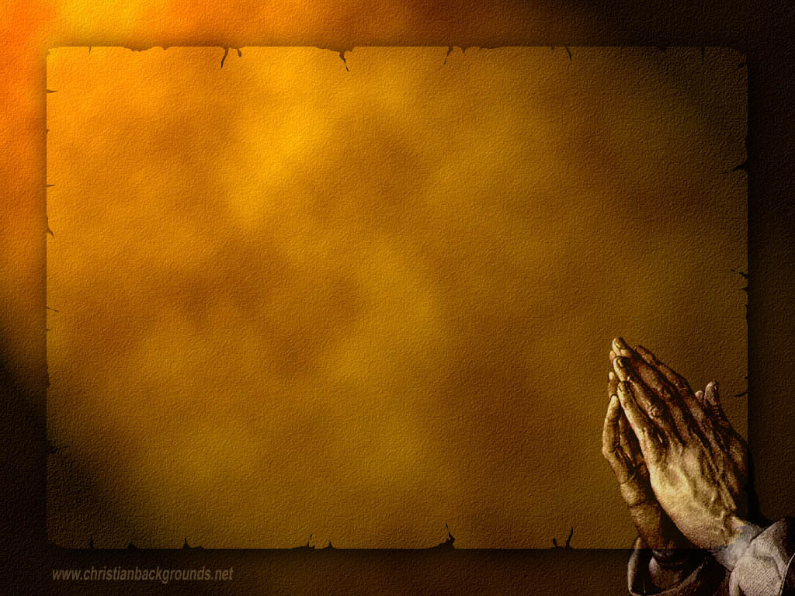
Gathering Around the WORD Call to Confession (John 3:16-17) "For God so loved the world that he gave his only Son, so that whoever believes in him may not perish but may have eternal life. Indeed, God did not send the Son into the world to condemn the world, but in order that the world might be saved through him.”

Slide 8
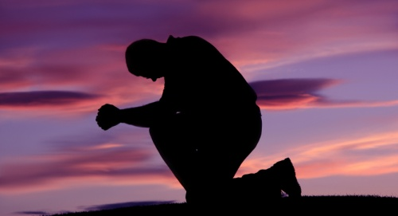
Gathering Around the WORD Prayer of Confession (in Unison)
Gracious God,
We gather here today as a rebellious people. We want to act out your intentions for us, but we get sidetracked by the false glitter of the world. You tell us to honor creation but we use other people, animals, and plants for our own gain.

Slide 9
Gathering Around the WORD Prayer of Confession (in Unison)
You offer bread to every living creature, and we steal that bread from our brothers and sisters in the name of greed. You promise us new life but we shrink back in fear, clinging to our death-dealing ways.
Heal us, O Lord, lest we destroy ourselves and the planet. We need your healing presence among us, through Jesus Christ we pray, Amen.

Slide 10
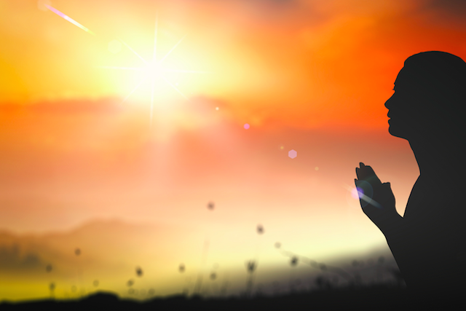
Gathering Around the WORD Declaration of Forgiveness
Through Christ, we have been received as God’s children.
We have been redeemed by God’s mercy and love and our sins have been forgiven.
Thanks be to God, Amen.

Slide 11
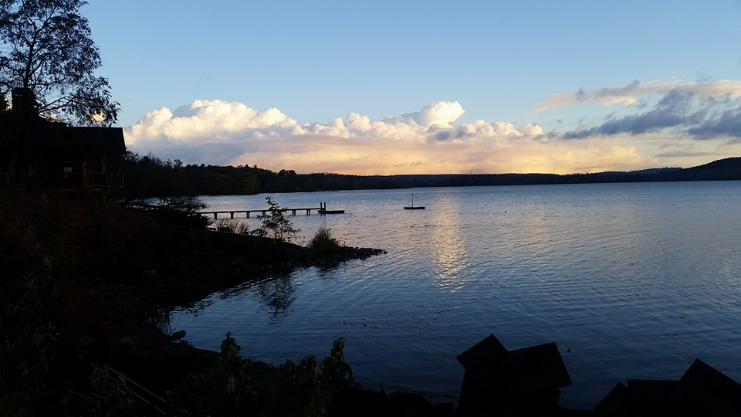
Gathering Around the WORD Gloria Patri
Glory be to the Father
and to the Son and to the Holy Ghost;
As it was in the beginning,
is now, and ever shall be,
world without end. Amen, Amen.

Slide 12
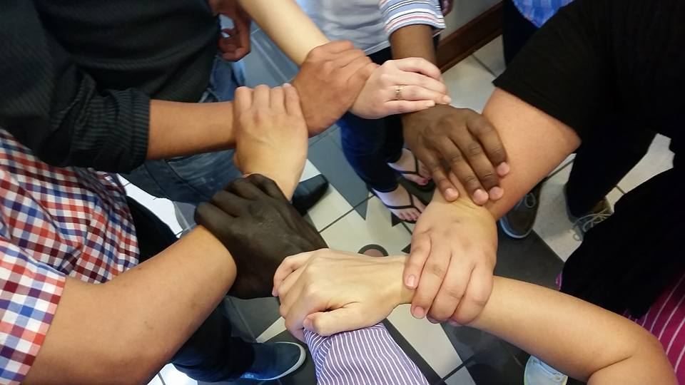
Gathering Around the WORD Passing of the Peace of Christ

Slide 13
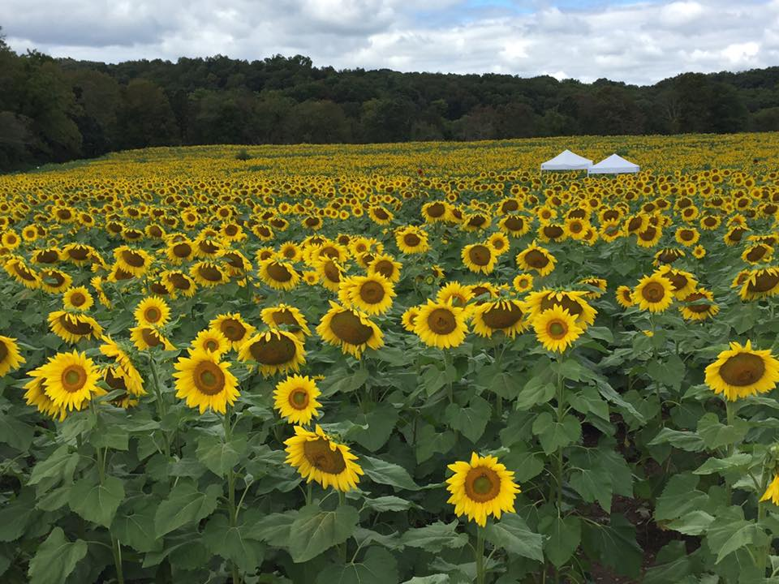
Proclaiming the WORD Message to the Youth/ Prayer of Illumination

Slide 14
Proclaiming the WORD Scripture Reading (Philippians 2:1-13)
¹If then there is any encouragement in Christ, any consolation from love, any sharing in the Spirit, any compassion and sympathy, ²make my joy complete: be of the same mind, having the same love, being in full accord and of one mind. ³Do nothing from selfish ambition or conceit, but in humility regard others as better than yourselves. ⁴Let each of you look not to your own interests, but to the interests of others.

Slide 15
Proclaiming the WORD Scripture Reading (Philippians 2:1-13)
⁵Let the same mind be in you that was in Christ Jesus, ⁶ who, though he was in the form of God, did not regard equality with God as something to be exploited, ⁷ but emptied himself, taking the form of a slave, being born in human likeness. And being found in human form, ⁸ he humbled himself and became obedient to the point of death — even death on a cross.

Slide 16
Proclaiming the WORD Scripture Reading (Philippians 2:1-13)
⁹ Therefore God also highly exalted him and gave him the name that is above every name, ¹⁰ so that at the name of Jesus every knee should bend, in heaven and on earth and under the earth, ¹¹ and every tongue should confess that Jesus Christ is Lord, to the glory of God the Father.

Slide 17
Proclaiming the WORD Scripture Reading (Philippians 2:1-13)
¹²Therefore, my beloved, just as you have always obeyed me, not only in my presence, but much more now in my absence, work out your own salvation with fear and trembling; ¹³for it is God who is at work in you, enabling you both to will and to work for his good pleasure.

Slide 18
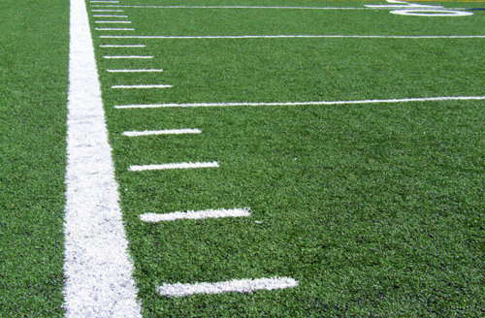
Proclaiming the WORD (Philippians 2:1-13)
From the Sideline

Slide 19
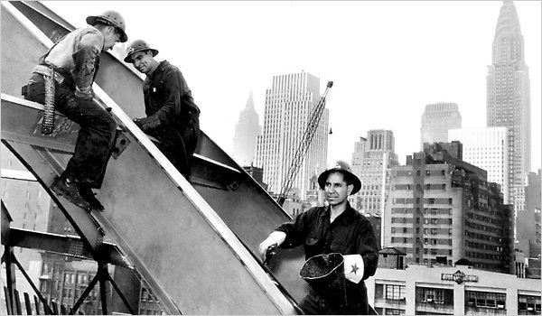
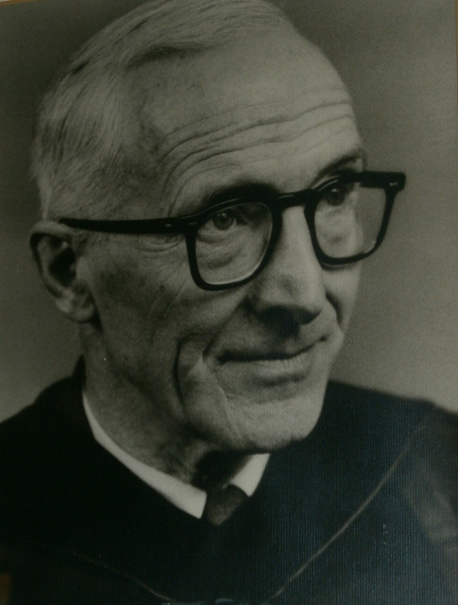
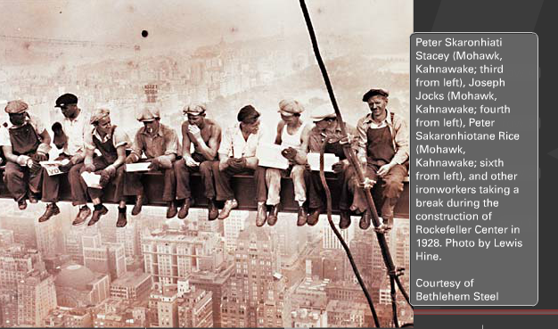
Proclaiming the WORD (Philippians 2:1-13)
From the Sideline

Slide 20
Proclaiming the WORD (Philippians 2:1-13)
From the Sideline

Slide 21
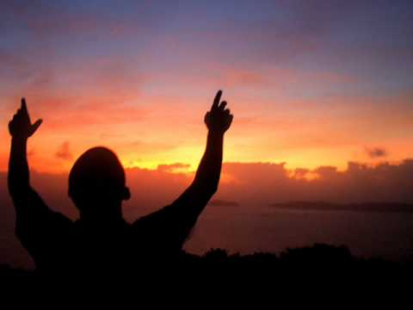
Responding Hymn # 442 “Just as I am, Without One Plea”
Just as I am, without one plea but that thy blood was shed for me, and that thou biddest me come to thee, O Lamb of God, I come; I come!

Slide 22
Responding Hymn # 442 “Just as I am, Without One Plea”
Just as I am, though tossed about with many_a conflict, many_a doubt, fightings and fears within, without, O Lamb of God, I come; I come!

Slide 23
Responding Hymn # 442 “Just as I am, Without One Plea”
Just as I am, thou wilt receive, wilt welcome, pardon, cleanse, relieve; because thy promise I believe, O Lamb of God, I come; I come!

Slide 24
Responding Hymn # 442 “Just as I am, Without One Plea”
Just as I am, thy love unknown has broken every barrier down; now to be thine, yea, thine alone, O Lamb of God, I come; I come!

Slide 25
Responding to the WORD
Affirmation of Faith – World Communion Sunday (Excerpt from Confession of Belhar)
We Believe that Christ's work of reconciliation is made manifest in the church as the community of believers who have been reconciled with God and with one another;
We Believe that unity is, therefore, both a gift and an obligation for the church of Jesus Christ; that through the working of God's Spirit it is a binding force, yet simultaneously a reality which must be earnestly pursued and sought: one which the people of God must continually be built up to attain;

Slide 26
Responding to the WORD
Affirmation of Faith – World Communion Sunday (Excerpt from Confession of Belhar)
We Believe that this unity must become visible so that the world may believe that separation, enmity and hatred between people and groups is sin which Christ has already conquered, and accordingly that anything which threatens this unity may have no place in the church and must be resisted;
We Believe that God has entrusted the church with the message of reconciliation in and through Jesus Christ.

Slide 27
Responding to the WORD
Affirmation of Faith – World Communion Sunday (Excerpt from Confession of Belhar)
We Believe that the church is called to be the salt of the earth and the light of the world.
We Believe that the church is witness both by word and by deed to the new heaven and the new earth in which righteousness dwells.
We Believe in one holy, universal Christian church, the communion of saints called from the entire human family.

Slide 28
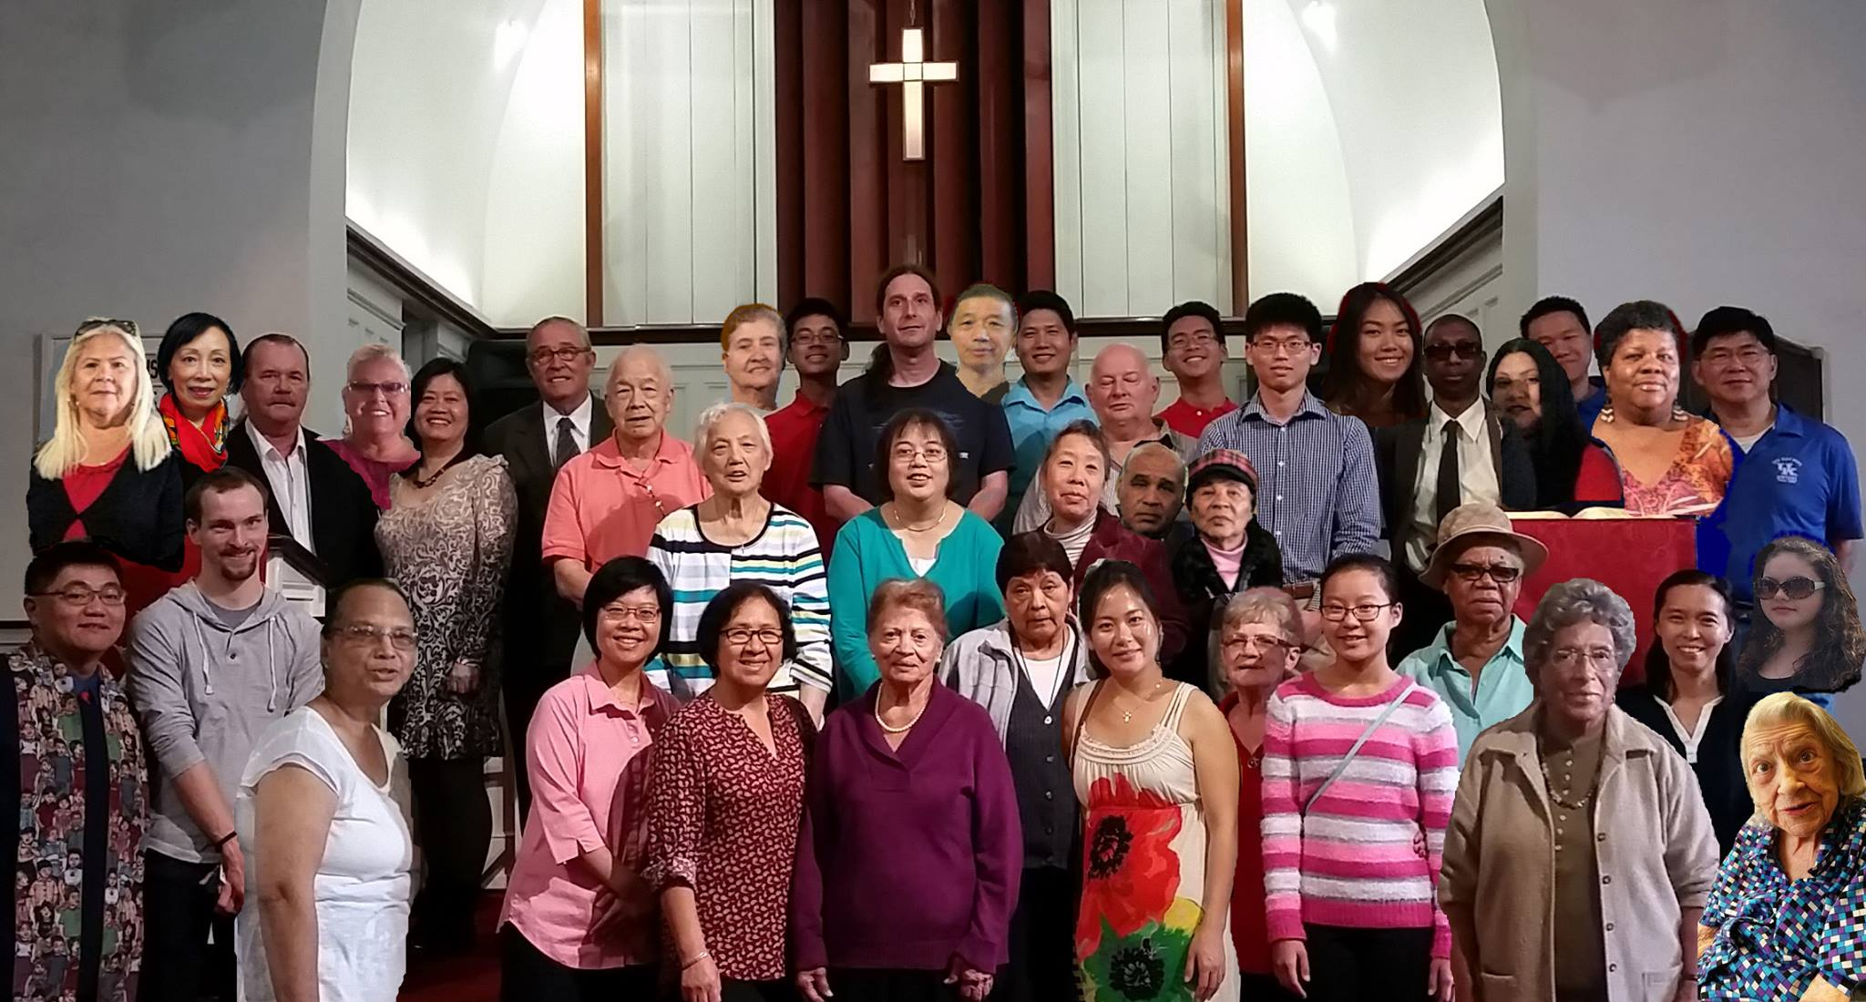
Bearing and Following the WORD into the World Announcements &
Sharing of Joys and Concerns
We will be taking our Annual Group photo for this year’s Christmas Card immediately after service. Please stay behind.

Slide 29
Bearing and Following the WORD into the World Announcements &
Sharing of Joys and Concerns
The Sunday afternoon Bible Study Group will NOT be meeting this afternoon. It will resume next Sunday at 12:30pm downstairs in the basement.
The Wednesday evening Women’s Group will meet every Wednesday 7:30pm over at the Manse (2048 E 14th Street)

Slide 30
Bearing and Following the WORD into the World Announcements &
Sharing of Joys and Concerns
The next Session Meeting will be Monday, 10/9 at 7pm. All active elders please attend.
Save the Date! The NYC Presbytery will be hosting its annual Presbytery Resource Day on Saturday, 11/4 at Brick Presbyterian Church in Manhattan. More registration information is forthcoming.

Slide 31
Bearing and Following the WORD into the World Prayer of the People & The Lord’s Prayer
Our Father, who art in heaven.
Halloweth be thy name.
Thy Kingdom come; Thy will be done
On earth as it is in heaven.
Give us this day our daily bread.
Forgive us our debts; as we forgive our debtors.
Lead us not into temptations, but deliver us from evil.
For Thine is the Kingdom, the Power, and the Glory forever. Amen.

Slide 32
Bearing and Following the WORD into the World Offering of our Gifts and our Lives
Musical Offering

Slide 33
Bearing and Following the WORD into the World Doxology and Offertory Prayer

Slide 34
Bearing and Following the WORD into the World Holy Communion Hymn
# 509 “All Who Hunger, Gather Gladly”
All who hunger, gather gladly; holy manna is our bread. Come from wilderness and wandering. Here, in truth, we will be fed. You that yearn for days of fullness, all around us is our food. Taste and see the grace eternal. Taste and see that God is good.

Slide 35
Bearing and Following the WORD into the World Holy Communion Hymn
# 509 “All Who Hunger, Gather Gladly”
All who hunger, never strangers, seeker, be a welcome guest. Come from restlessness and roaming. Here, in joy, we keep the feast. We that once were lost and scattered in communion's love have stood. Taste and see the grace eternal. Taste and see that God is good.

Slide 36
Bearing and Following the WORD into the World Holy Communion Hymn
# 509 “All Who Hunger, Gather Gladly”
All who hunger, sing together; Jesus Christ is living bread. Come from loneliness and longing. Here, in peace, we have been led. Blest are those who from this table live their days in gratitude. Taste and see the grace eternal. Taste and see that God is good.

Slide 37
Bearing and Following the WORD into the World Holy Communion
Friends, we gather now as one body, joined around this table of GRACE. People will come from East and West, North and South, to the heart of God’s presence bearing witness to the unity of God’s love for all humanity. United in Christ's spirit, broken and whole all at once, Christ is the host of this table and we are Christ’s invited guests from all walks of life. Come, just as you are….as God’s children!

Slide 38
Bearing and Following the WORD into the World Holy Communion
Through God’s reconciling love and unconditional grace, transformation takes place around this table, where strangers become friends, sinners redeemed, brokenness restored and wounded healed.

Slide 39
Bearing and Following the WORD into the World Holy Communion
The Lord be with you. And also with you.
Lift up your hearts. We lift them up to the Lord.
Let us give thanks to the Lord our God.
It is right to give our thanks and praise.

Slide 40
Bearing and Following the WORD into the World Holy Communion
On this World Communion Sunday, it is our greatest joy to give you thanks and praise to feast among your people whom you’ve scattered and united all around the world. God’s presence is felt in all of our lives, whoever, wherever, whenever two or three are gathered in Christ’s name.

Slide 41
Bearing and Following the WORD into the World Holy Communion
Therefore we praise you, joining our voices with the choir of creation and all the saints of all times and places who forever sing to the glory of your name:
Holy, Holy, Holy Lord, God of power and might, heaven and earth are full of your glory. Hosanna in the highest. Blessed is he who comes in the name of the Lord. Hosanna in the highest.

Slide 42
Bearing and Following the WORD into the World Holy Communion
With thanksgiving, we will receive this bread which our Lord Jesus took, after He blessed it, broke it, and gave it to his disciples, saying, take, eat, this is my body, given for you.
In the same way, we dedicate this cup which Jesus blessed, saying, this is the new covenant sealed in my blood. Drink all of it, do this in remembrance of me.

Slide 43
Bearing and Following the WORD into the World Holy Communion
With thanks and praise we offer ourselves to you,
O God. Sharing this holy meal, remembering Christ’s dying and rising, and praying:
Come Lord Jesus!
Jesus said, "I am the bread of life. Those who come to me shall never hunger; those who believe in me shall never thirst." These are the gift of God for the people of God.

Slide 44
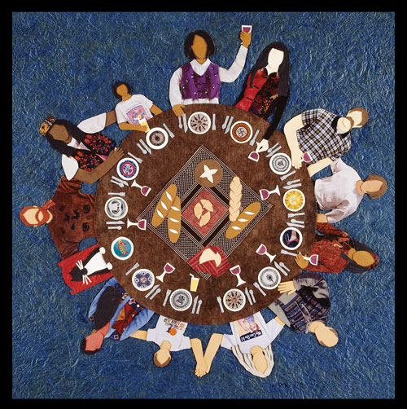
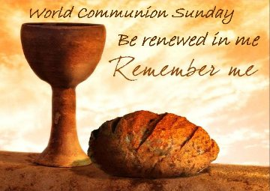
Bearing and Following the WORD into the World Holy Communion

Slide 45
Bearing and Following the WORD into the World
Prayer after the Communion: (in unison)
:
Lord Jesus Christ, in Spirit you have fed us with your body and quenched us with your blood. We look forward to the day when you shall come again to fill our hearts with grace, peace and hope.

Slide 46
Bearing and Following the WORD into the World
Prayer after the Communion: (in unison)
:
Enable us now to go out to share your love to others. Humble our hearts so we may serve others, as you have served us through your Son Jesus Christ.
Through Christ, with Christ, in Christ, in the unity of the Holy Spirit, all glory and honor are yours, Almighty God, now and forever, Amen.

Slide 47
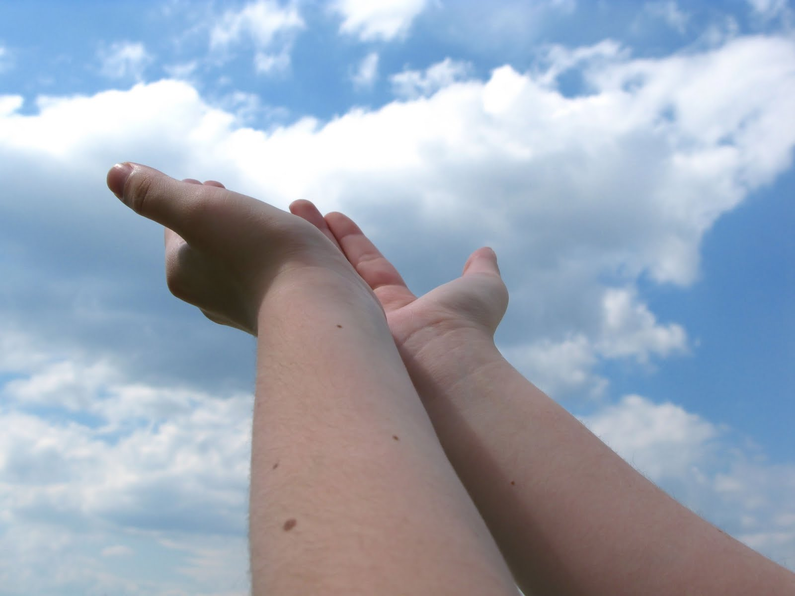
Bearing and Following the WORD into the World Deacons’ Benevolence Offering

Slide 48
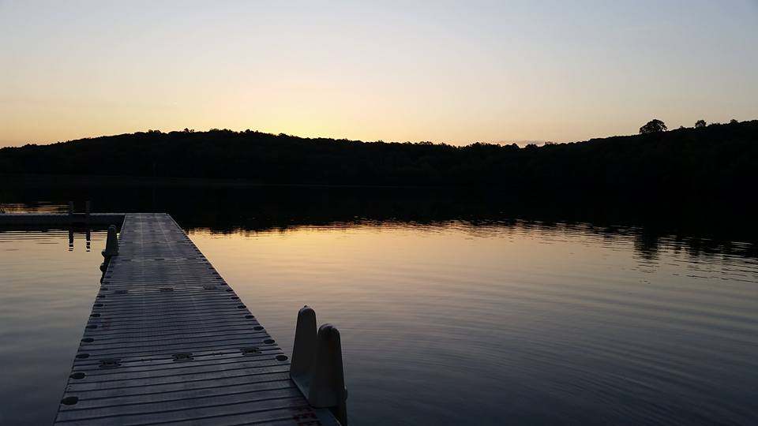
Sending Hymn # 765 “May the God of Hope Go with Us”
May the God of hope go with us every day, filling all our lives with love and joy and peace. May the God of justice speed us on our way, bringing light and hope to every land and race. Praying, let us work for peace; singing, share our joy with all; working for a world that's new, faithful when we hear Christ's call.

Slide 49
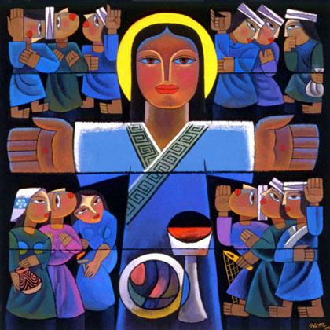
Bearing and Following the WORD into the World The Charge and Benediction

Slide 50
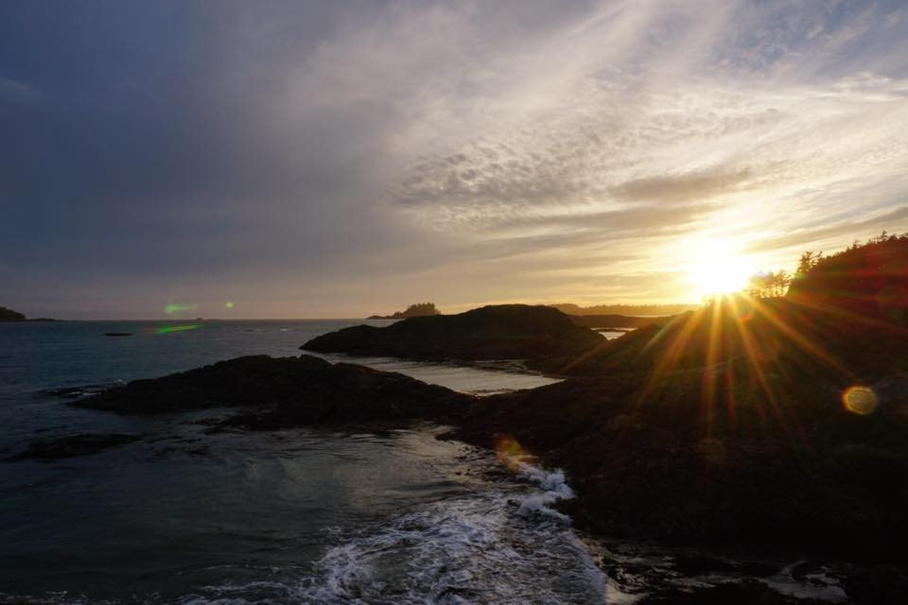
Bearing and Following the WORD into the World Benediction Response
# 540 “Farewell, Good Friends”
Farewell, good friends! Farewell, good friends! Shalom, shalom! Till we meet again, till we meet again, shalom, shalom.

Slide 51
Homecrest Presbyterian Church Worship of the Lord’s Day October 1st, 2017 26th Sunday in Ordinary Time

