Slide 1
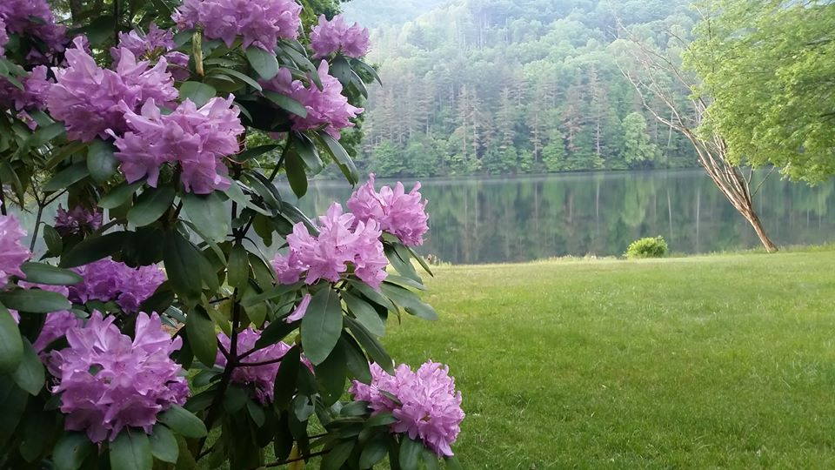
Homecrest Presbyterian Church Worship of the Lord’s Day September 17th, 2017 24th Sunday in Ordinary Time

Slide 2
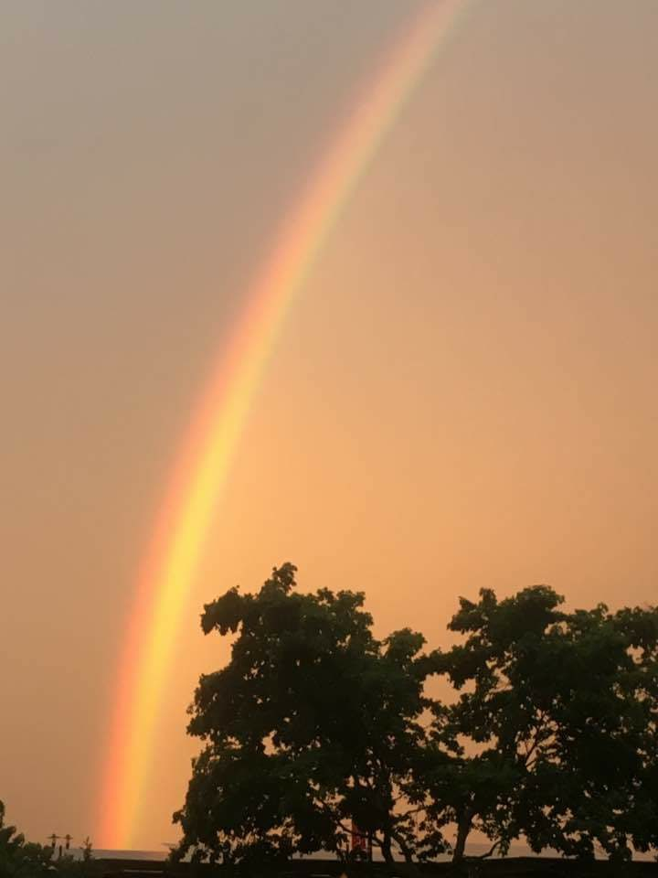
Gathering Around the WORD Call To Worship (Based on Exodus 15:1-3)
We will sing to the LORD, for he has triumphed gloriously; horse and rider he has thrown into the sea. The LORD is our strength and our might, and he has become our salvation; this is our God, and we will praise him, our father’s God, and we will exalt him. The LORD is a warrior; the LORD is his name.
Come, let us worship God.

Slide 3
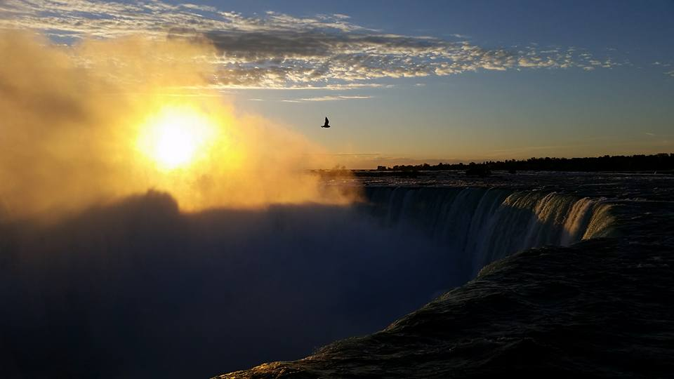
Gathering Around the WORD Gathering Hymn # 49 “The God of Abraham’s Praise”
The God of Abraham praise, who reigns enthroned above, the Ancient of Eternal Days, the God of love! The Lord, the great I am, by earth and heaven confessed, we bow before your holy name, forever blest.

Slide 4
Gathering Around the WORD Gathering Hymn # 49 “The God of Abraham’s Praise”
Your spirit still flows free, high surging where it will. In prophet's word you spoke of old and you speak still. Established is your law, and changeless it shall stand, deep writ upon the human heart by your strong hand.

Slide 5
Gathering Around the WORD Gathering Hymn # 49 “The God of Abraham’s Praise”
Your goodly land we seek, with peace and plenty blest, a land of sacred liberty and Sabbath rest. There milk and honey flow, and oil and wine abound, and trees of life forever grow with mercy crowned.

Slide 6
Gathering Around the WORD Gathering Hymn # 49 “The God of Abraham’s Praise”
You have eternal life implanted in the soul; your love shall be our strength and stay, while ages roll. We praise you, living God! We praise your holy name: the first, the last, beyond all thought, and still the same!

Slide 7
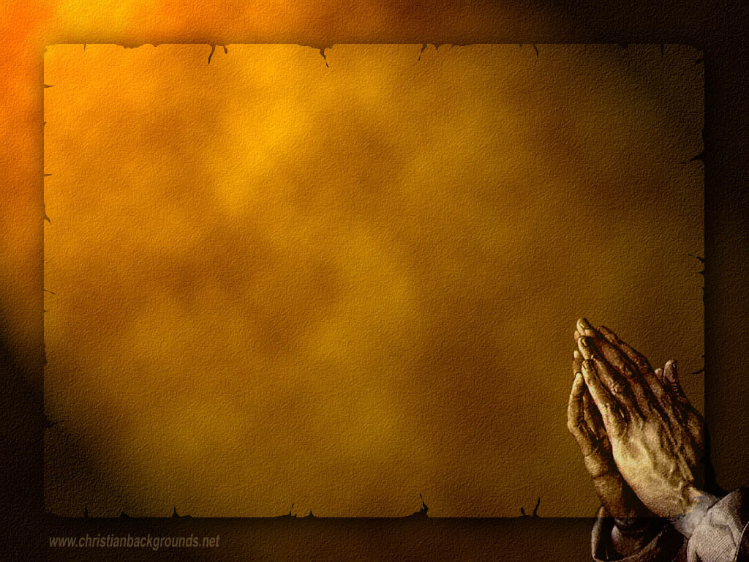
Gathering Around the WORD Call to Confession God speaks to us in the grandiose of creation and the power of nature, yet God also speaks to us in the stillness of our hearts and in tender care. God delights in us when we lift our hearts up in prayer before him. In humility and faith, let us confess our sins before God in the company and witness of our neighbors.

Slide 8
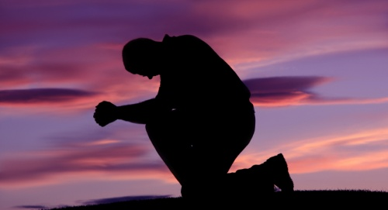
Gathering Around the WORD Prayer of Confession (in Unison)
Gracious and loving God, you lived for us – we have not lived for you. You have forgiven us – we have not forgiven others. You have loved us – we have not loved ourselves nor have we loved one another. Take pity on us and forgive us, God. Help us to forgive. Help us to live for you and to love through Jesus Christ, Amen.

Slide 9
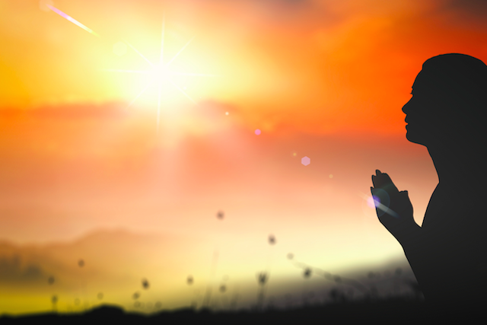
Gathering Around the WORD Declaration of Forgiveness
God is merciful and gracious and is Lord of us all. Reconciled to the God who loves us, let us live and love through Christ our Lord. People of God, our sins are forgiven.
Thanks be to God, Amen.

Slide 10
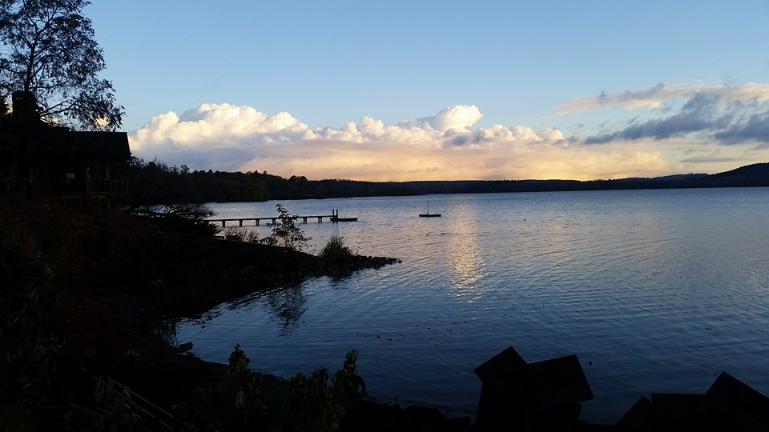
Gathering Around the WORD Gloria Patri
Glory be to the Father
and to the Son and to the Holy Ghost;
As it was in the beginning,
is now, and ever shall be,
world without end. Amen, Amen.

Slide 11
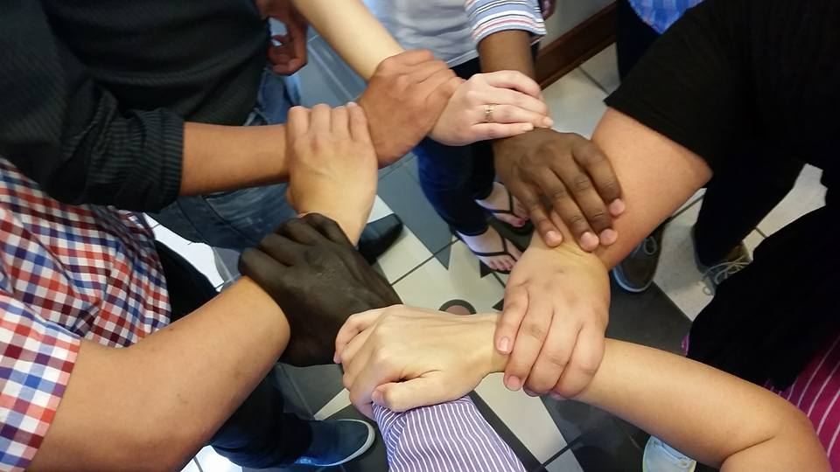
Gathering Around the WORD Passing of the Peace of Christ

Slide 12
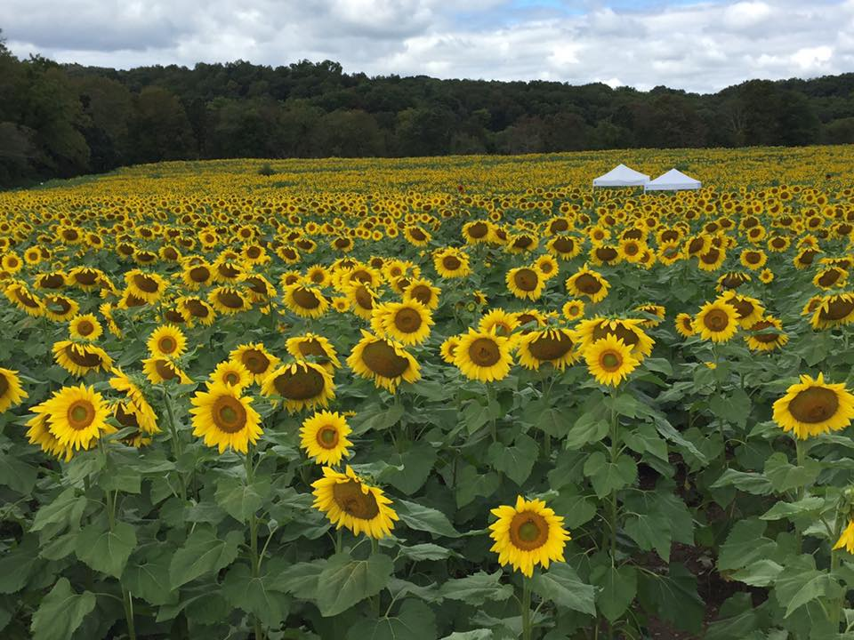
Proclaiming the WORD Message to the Youth/ Prayer of Illumination

Slide 13
Proclaiming the WORD Scripture Reading (Romans 14:1-12)
¹Welcome those who are weak in faith, but not for the purpose of quarreling over opinions. ²Some believe in eating anything, while the weak eat only vegetables. ³Those who eat must not despise those who abstain, and those who abstain must not pass judgment on those who eat; for God has welcomed them. ⁴Who are you to pass judgment on servants of another? It is before their own lord that they stand or fall. And they will be upheld, for the Lord is able to make them stand.

Slide 14
Proclaiming the WORD Scripture Reading (Romans 14:1-12)
⁵Some judge one day to be better than another, while others judge all days to be alike. Let all be fully convinced in their own minds. ⁶Those who observe the day, observe it in honor of the Lord. Also those who eat, eat in honor of the Lord, since they give thanks to God; while those who abstain, abstain in honor of the Lord and give thanks to God.

Slide 15
Proclaiming the WORD Scripture Reading (Romans 14:1-12)
⁷We do not live to ourselves, and we do not die to ourselves. ⁸If we live, we live to the Lord, and if we die, we die to the Lord; so then, whether we live or whether we die, we are the Lord’s. ⁹For to this end Christ died and lived again, so that he might be Lord of both the dead and the living.

Slide 16
Proclaiming the WORD Scripture Reading (Romans 14:1-12)
¹⁰Why do you pass judgment on your brother or sister? Or you, why do you despise your brother or sister? For we will all stand before the judgment seat of God. ¹¹For it is written, “As I live, says the Lord, every knee shall bow to me, and every tongue shall give praise to God.” ¹²So then, each of us will be accountable to God.

Slide 17
Proclaiming the WORD Scripture Reading (Matthew 18:21-35)
²¹Then Peter came and said to him, “Lord, if another member of the church sins against me, how often should I forgive? As many as seven times?” ²²Jesus said to him, “Not seven times, but, I tell you, seventy-seven times.
²³“For this reason the kingdom of heaven may be compared to a king who wished to settle accounts with his slaves. ²⁴When he began the reckoning, one who owed him ten thousand talents was brought to him. ²⁵and, as he could not pay, his lord ordered him to be sold, together with his wife and children and all his possessions, and payment to be made.

Slide 18
Proclaiming the WORD Scripture Reading (Matthew 18:21-35)
²⁶So the slave fell on his knees before him, saying, ‘Have patience with me, and I will pay you everything.’ ²⁷And out of pity for him, the lord of that slave released him and forgave him the debt. ²⁸But that same slave, as he went out, came upon one of his fellow slaves who owed him a hundred denarii; and seizing him by the throat, he said, ‘Pay what you owe.’ ²⁹Then his fellow slave fell down and pleaded with him, ‘Have patience with me, and I will pay you.’ ³⁰But he refused; then he went and threw him into prison until he would pay the debt.

Slide 19
Proclaiming the WORD Scripture Reading (Matthew 18:21-35)
³¹When his fellow slaves saw what had happened, they were greatly distressed, and they went and reported to their lord all that had taken place. ³²Then his lord summoned him and said to him, ‘You wicked slave! I forgave you all that debt because you pleaded with me. ³³Should you not have had mercy on your fellow slave, as I had mercy on you?’ ³⁴And in anger his lord handed him over to be tortured until he would pay his entire debt. ³⁵So my heavenly Father will also do to every one of you, if you do not forgive your brother or sister from your heart.”

Slide 20
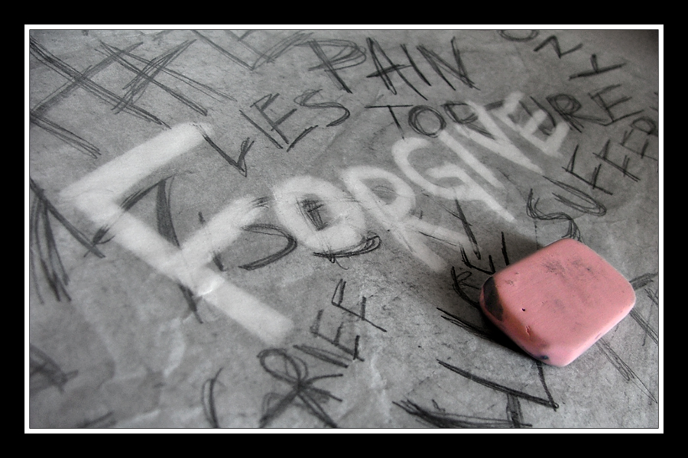
Proclaiming the WORD (Romans 14:1-12 and Matthew 18:21-35)
Forget to Forgive

Slide 21
Responding Hymn # 445 “God, How Can We Forgive”
God, how can we forgive when bonds of love are torn? How can we rise and start anew, our trust reborn? When human loving fails and every hope is gone, your love gives strength beyond our own to face the dawn.

Slide 22
Responding Hymn # 445 “God, How Can We Forgive”
When we have missed the mark, and tears of anguish flow, how can you still release our guilt, the debt we owe? The ocean depth of grace surpasses all our needs. A priest who shares our human pain, Christ intercedes.

Slide 23
Responding Hymn # 445 “God, How Can We Forgive”
Who dares to throw the stone to damn another's sin, when you, while knowing all our past, forgive again? No more we play the judge, for by your grace we live. As you, O God, forgive our sin, may we forgive.

Slide 24
Responding to the WORD
Affirmation of Faith (Excerpt from Confession of 1967)
(Section 9.31)
To be reconciled to God is to be sent into the world as God’s reconciling community. This community, the church universal, is entrusted with God’s message of reconciliation and shares God’s labor of healing the enmities which separate people from God and from each other. Christ has called the church to this mission and given it the gift of the Holy Spirit. The church maintains continuity with the apostles and with Israel by faithful obedience to his call.

Slide 25
Bearing and Following the WORD into the World Announcements &
Sharing of Joys and Concerns
Special thanks for all those who participated and contributed to the Pot-Luck BBQ/Picnic yesterday.
The Wednesday evening Women’s Group will meet every Wednesday over at the Manse (2048 E 14th Street) and the Sunday afternoon Bible Study Group will continue this afternoon at 12:30pm downstairs in the basement.

Slide 26
Bearing and Following the WORD into the World Announcements &
Sharing of Joys and Concerns
Susan Yee’s husband – Philip Yee‘s Wake service will be this afternoon from 3-6pm at Aievoli Funeral Home at 1275 65th Street (13th Ave). His burial will be tomorrow at Mt. Pleasant Cemetary in Valhalla, NY. Please pray for the Yee Family.

Slide 27
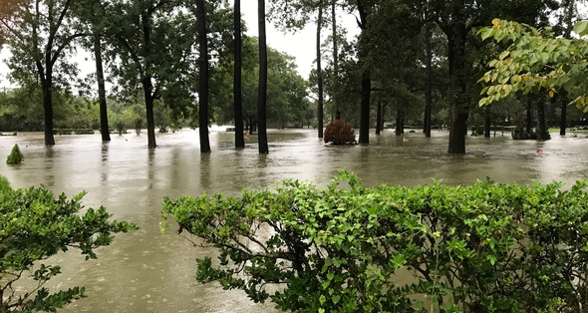
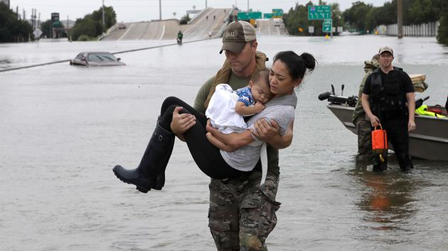
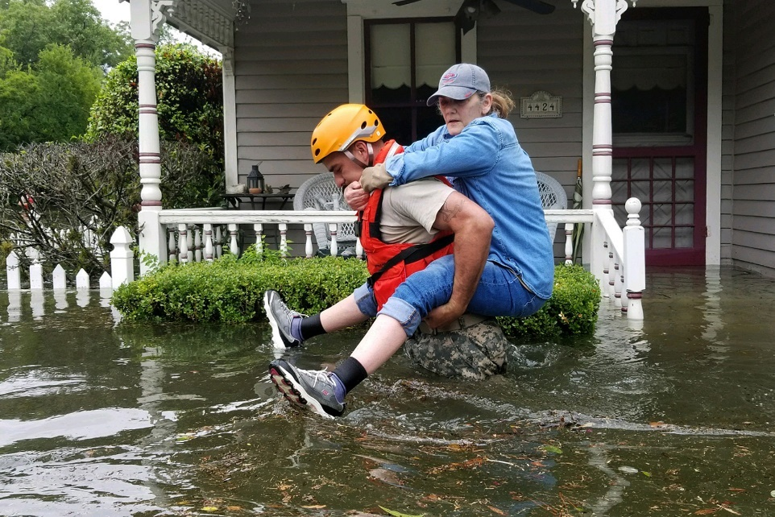
Bearing and Following the WORD into the World Announcements &
Sharing of Joys and Concerns
Hurricane Relief
Presbyterian Disaster Assistance (pda.pcusa.org) or other worthy charitable organization. Please give generously if you can and continue to lift up those affected in our prayers.

Slide 28
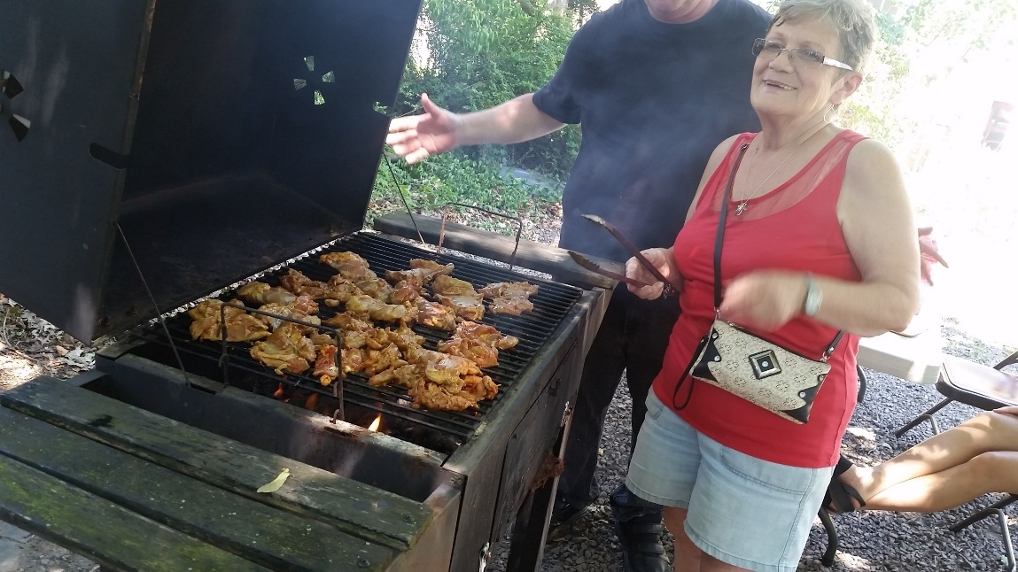
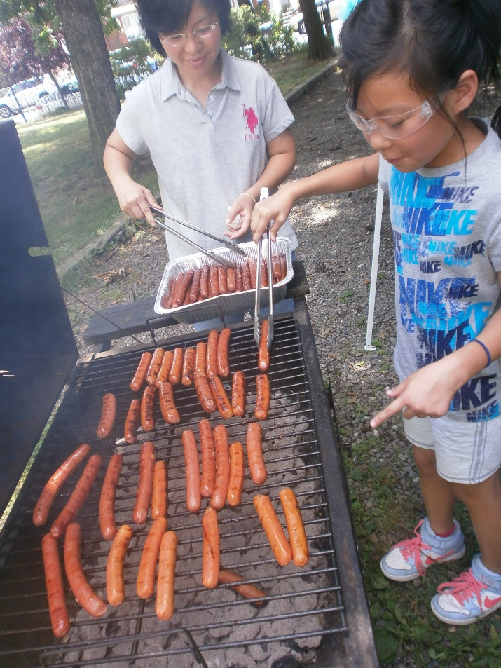
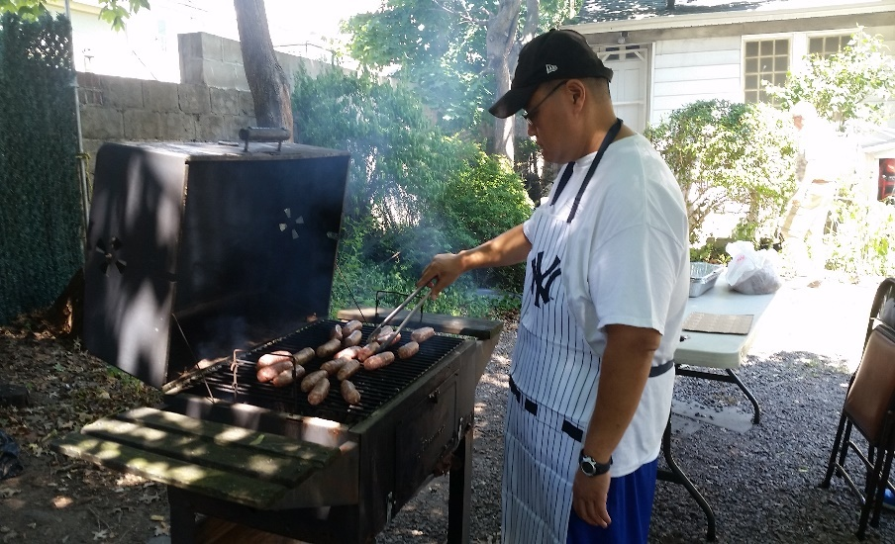
Bearing and Following the WORD into the World Announcements &
Sharing of Joys and Concerns
Special thanks for all those who participated and contributed to the Pot-Luck BBQ/Picnic yesterday.

Slide 29
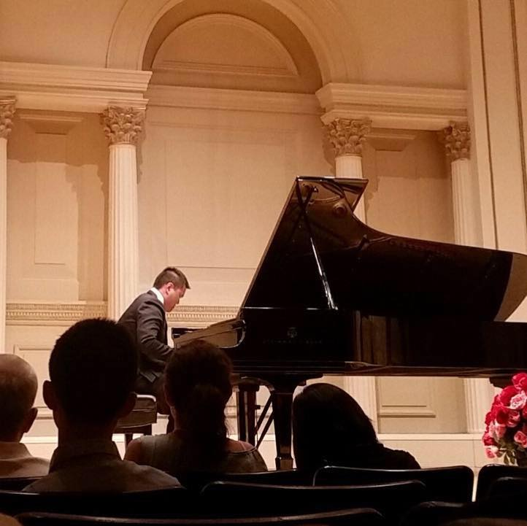
Brian will be performing at the
Carnegie Hall’s Weill Recital Hall
Sunday, 9/24/17 @7:30pm
Tickets: $30/$40/$50
(On-line Process Fee Applies)
www.carnegiehall.org

Slide 30
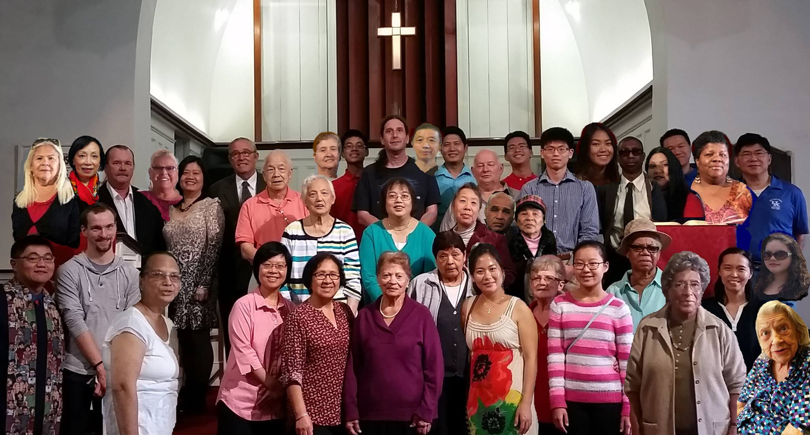
Bearing and Following the WORD into the World Announcements &
Sharing of Joys and Concerns
Rev. Grace Bowen will be our guest speaker next Sunday. Pastor Samson will be on Study Leave this week.
Our Annual Group photo for the Christmas Card will be taken on Sunday, 10/1

Slide 31
Bearing and Following the WORD into the World Prayer of the People & The Lord’s Prayer
Our Father, who art in heaven.
Halloweth be thy name.
Thy Kingdom come; Thy will be done
On earth as it is in heaven.
Give us this day our daily bread.
Forgive us our debts; as we forgive our debtors.
Lead us not into temptations, but deliver us from evil.
For Thine is the Kingdom, the Power, and the Glory forever. Amen.

Slide 32
Bearing and Following the WORD into the World Offering of our Gifts and our Lives
Musical Offering

Slide 33
Bearing and Following the WORD into the World Doxology and Offertory Prayer

Slide 34
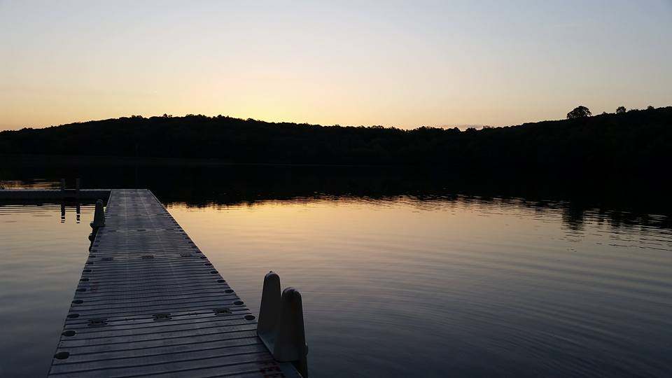
Sending Hymn # 447 “We Are Forgiven”
We are forgiven. We are forgiven. Thanks be to God. Thanks be to God. We are forgiven. We are forgiven. Thanks be to God. Thanks be to God.

Slide 35
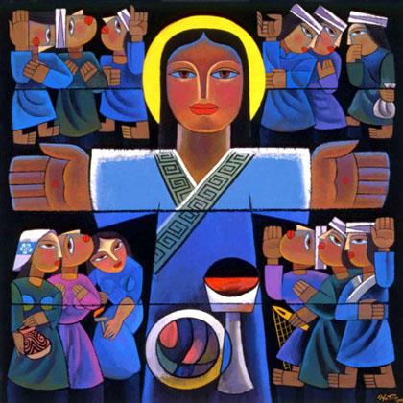
Bearing and Following the WORD into the World The Charge and Benediction

Slide 36
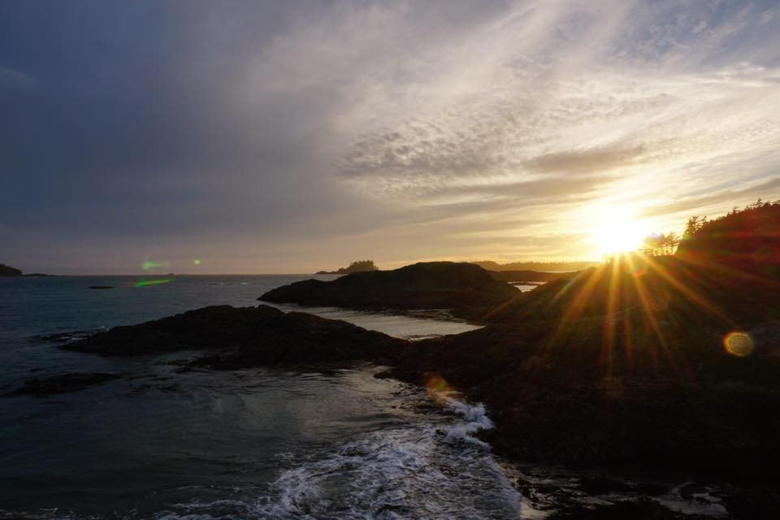
Bearing and Following the WORD into the World Benediction Response
# 542 “God Be with You Till We Meet Again”
(Stanza 4)
God be with you till we meet again;
keep love's banner floating o'er you; smite death's threatening wave before you:
God be with you till we meet again.

Slide 37
Homecrest Presbyterian Church Worship of the Lord’s Day September 17th, 2017 24th Sunday in Ordinary Time

