Slide 1
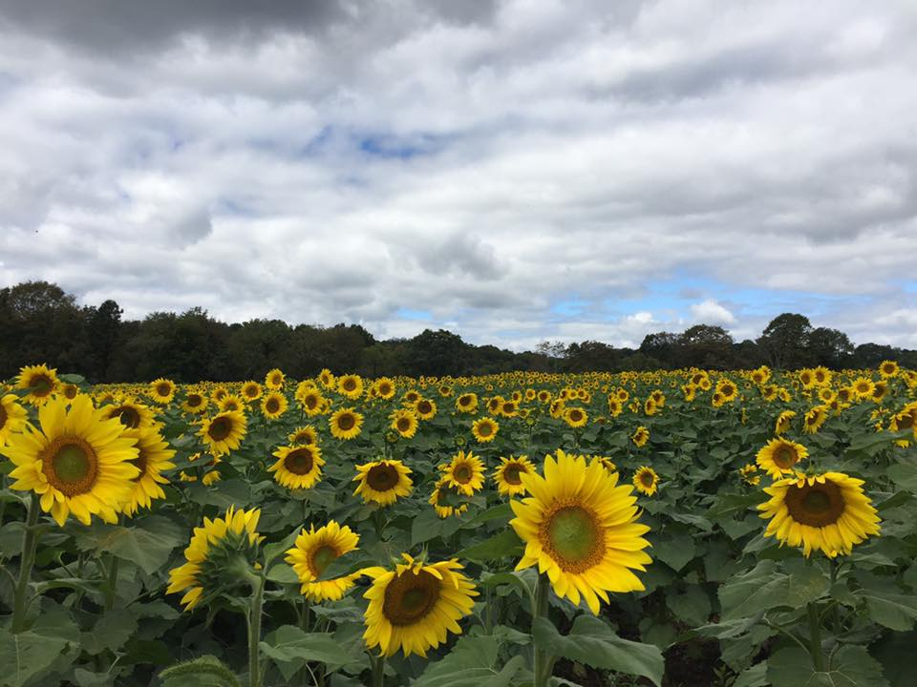
Homecrest Presbyterian Church Worship of the Lord’s Day September 10th, 2017 23rd Sunday in Ordinary Time

Slide 2
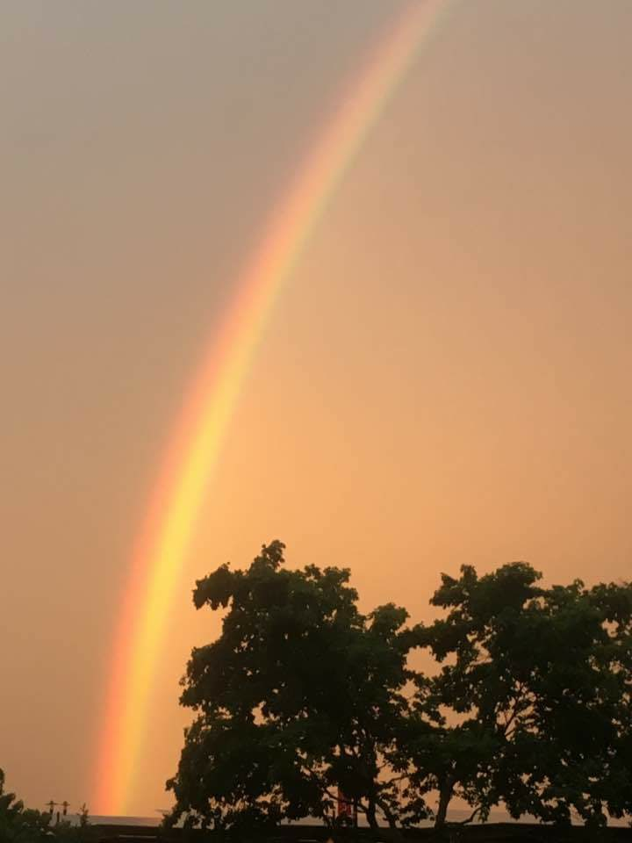
Gathering Around the WORD Call To Worship (Based on Psalm 149:1-4)
Praise the Lord! Sing to the Lord a new song,
his praise in the assembly of the faithful. Let Israel be glad in its Maker;
Let the children of Zion rejoice in their King. Let them praise his name with dancing, making melody to him with tambourine and lyre. For the Lord takes pleasure in his people;
he adorns the humble with victory.

Slide 3
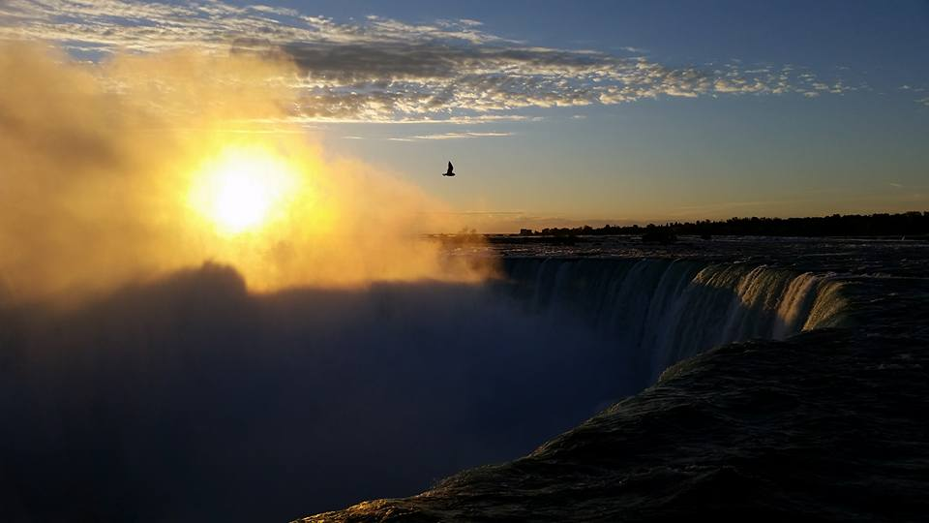
Gathering Around the WORD Gathering Hymn # 329 “God Is Our Refuge and Our Strength”
God is our refuge and our strength, our ever-present aid, and therefore, though the earth be moved, we will not be afraid;

Slide 4
Gathering Around the WORD Gathering Hymn # 329 “God Is Our Refuge and Our Strength”
Though hills amid the seas be cast, though foaming waters roar, yea, though the mighty billows shake the mountains on the shore.

Slide 5
Gathering Around the WORD Gathering Hymn # 329 “God Is Our Refuge and Our Strength”
Where God abides a river flows; that city will rejoice. But nations fear and kingdoms shake before God's thundering voice.

Slide 6
Gathering Around the WORD Gathering Hymn # 329 “God Is Our Refuge and Our Strength”
Since God is in the midst of it, the city walls shall stand, secure and safe with God's sure help, when trouble is at hand.

Slide 7
Gathering Around the WORD Call to Confession God so loves us as to bathe us with grace and feed us with mercy and forgive us our sins. Confident in this, let us now turn to God in humility, confessing our sins against God and our neighbors.

Slide 8
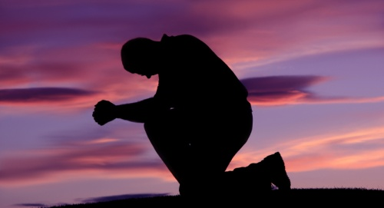
Gathering Around the WORD Prayer of Confession (in Unison)
Loving God, while we were still slaves to sin, you died for our salvation. Yet we still worship the false gods of the world, forgetting that you are Lord. Loving worldly wealth, we have not loved you with our whole heart nor loved our neighbors as ourselves. Trusting worldly strength, we have not trusted your word nor followed the Word-made-flesh. We have not shown mercy to others as you have shown mercy to us. Forgive us we pray, in Christ’s name, Amen.

Slide 9
Gathering Around the WORD Declaration of Forgiveness (in Unison) (Based on Romans 8:34)
Friends, hear the good news of the gospel:
Who is in a position to condemn?
Only Christ. And Christ died for us; Christ rose for us; Christ reigns in power for us; Christ prays for us.
Believe in the good news of the gospel that in Jesus Christ, we are forgiven.
Thanks be to God, Amen.

Slide 10
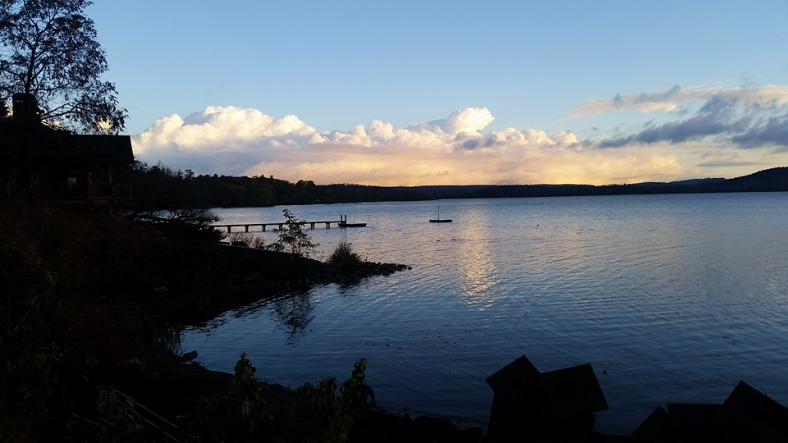
Gathering Around the WORD Gloria Patri
Glory be to the Father
and to the Son and to the Holy Ghost;
As it was in the beginning,
is now, and ever shall be,
world without end. Amen, Amen.

Slide 11
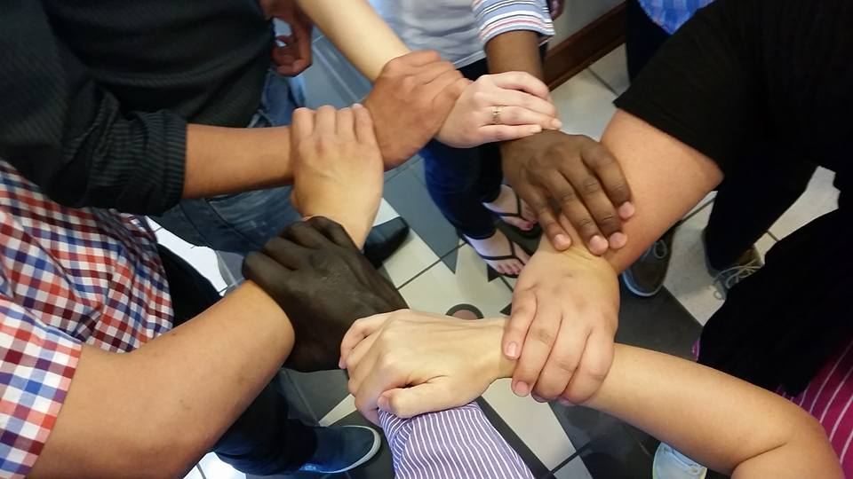
Gathering Around the WORD Passing of the Peace of Christ

Slide 12
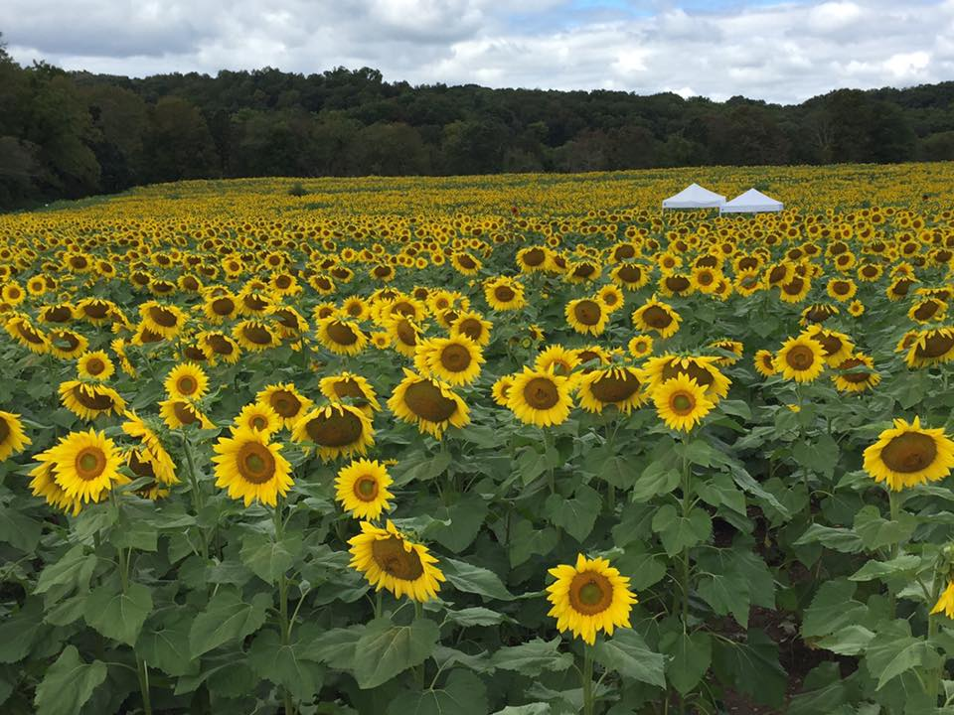
Proclaiming the WORD Message to the Youth/ Prayer of Illumination

Slide 13
Proclaiming the WORD Scripture Reading (Romans 13:8-14)
⁸Owe no one anything, except to love one another; for the one who loves another has fulfilled the law. ⁹The commandments, “You shall not commit adultery; You shall not murder; You shall not steal; You shall not covet”; and any other commandment, are summed up in this word, “Love your neighbor as yourself.” ¹⁰Love does no wrong to a neighbor; therefore, love is the fulfilling of the law.

Slide 14
Proclaiming the WORD Scripture Reading (Romans 13:8-14)
¹¹Besides this, you know what time it is, how it is now the moment for you to wake from sleep. For salvation is nearer to us now than when we became believers; ¹²the night is far gone, the day is near. Let us then lay aside the works of darkness and put on the armor of light; ¹³let us live honorably as in the day, not in reveling and drunkenness, not in debauchery and licentiousness, not in quarreling and jealousy. ¹⁴Instead, put on the Lord Jesus Christ, and make no provision for the flesh, to gratify its desires.

Slide 15
Proclaiming the WORD Scripture Reading (Matthew 18:15-20)
¹⁵“If another member of the church sins against you, go and point out the fault when the two of you are alone. If the member listens to you, you have regained that one. ¹⁶But if you are not listened to, take one or two others along with you, so that every word may be confirmed by the evidence of two or three witnesses. ¹⁷If the member refuses to listen to them, tell it to the church; and if the offender refuses to listen even to the church, let such a one be to you as a Gentile and a tax collector.

Slide 16
Proclaiming the WORD Scripture Reading (Matthew 18:15-20)
¹⁸Truly I tell you, whatever you bind on earth will be bound in heaven, and whatever you loose on earth will be loosed in heaven. ¹⁹Again, truly I tell you, if two of you agree on earth about anything you ask, it will be done for you by my Father in heaven. ²⁰For where two or three are gathered in my name, I am there among them.”

Slide 17
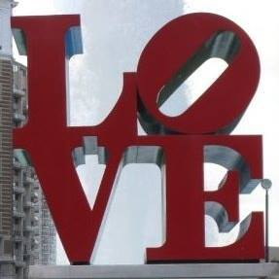
Proclaiming the WORD (Romans 13:8-14 and Matthew 18:15-20)
Give LOVE a Chance

Slide 18
Responding Hymn # 203 “Jesu, Jesu, Fill Us with Your Love”
Jesu, Jesu, fill us with your love; show us how to serve
the neighbors we have from you. Kneels at the feet of his friends, silently washes their feet, Master who acts as a slave to them.

Slide 19
Responding Hymn # 203 “Jesu, Jesu, Fill Us with Your Love”
Jesu, Jesu, fill us with your love; show us how to serve
the neighbors we have from you. Neighbors are wealthy and poor, varied in color and race; neighbors are near us and far away.

Slide 20
Responding Hymn # 203 “Jesu, Jesu, Fill Us with Your Love”
Jesu, Jesu, fill us with your love; show us how to serve
the neighbors we have from you.
These are the ones we should serve; these are the ones we should love; all these are neighbors to us and you.

Slide 21
Responding Hymn # 203 “Jesu, Jesu, Fill Us with Your Love”
Jesu, Jesu, fill us with your love; show us how to serve
the neighbors we have from you. Loving puts us on our knees, willing to wash others’ feet; this is the way we should live like you.

Slide 22
Responding Hymn # 203 “Jesu, Jesu, Fill Us with Your Love”
Jesu, Jesu, fill us with your love; show us how to serve
the neighbors we have from you.

Slide 23
Responding to the WORD
Affirmation of Faith (Excerpt from Confession of 1967)
(Section 9.45 b)
God’s reconciliation in Jesus Christ is the ground of the peace, justice, and freedom among nations which all powers of government are called to serve and defend. The church, in its own life, is called to practice the forgiveness of enemies and to commend to the nations as practical politics the search for cooperation and peace. This search requires that the nations pursue fresh and responsible relations across every line of conflict, even at risk to national security, to reduce areas of strife and to broaden international understanding.

Slide 24
Responding to the WORD
Affirmation of Faith (Excerpt from Confession of 1967)
(Section 9.45 b)
Reconciliation among nations becomes peculiarly urgent as countries develop nuclear, chemical, and biological weapons, diverting human power and resources from constructive uses and risking the annihilation of humankind. Although nations may serve God’s purposes in history, the church which identifies the sovereignty of any one nation or any one way of life with the cause of God denies the Lordship of Christ and betrays its calling.

Slide 25
Bearing and Following the WORD into the World Announcements &
Sharing of Joys and Concerns
The Wednesday evening Women’s Group will meet every Wednesday over at the Manse (2048 E 14th Street) and the Sunday afternoon Bible Study Group will resume this afternoon at 12:30pm downstairs in the basement.
Session Meeting will be Tomorrow, 9/11 at 7pm

Slide 26
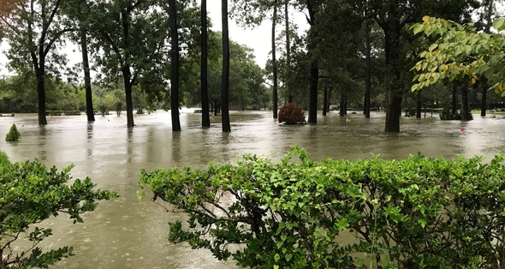
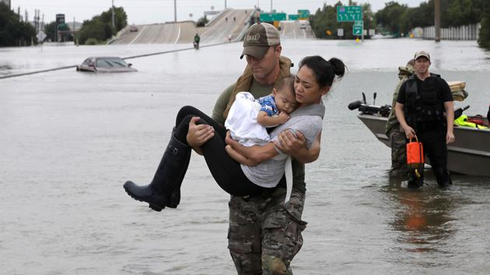
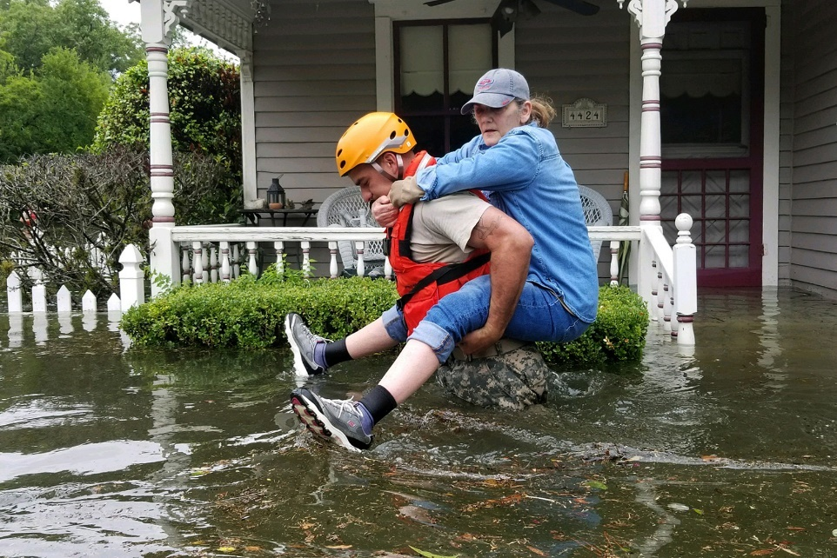
Bearing and Following the WORD into the World Announcements &
Sharing of Joys and Concerns
Hurricane Relief
Presbyterian Disaster Assistance (pda.pcusa.org) or other worthy charitable organization. Please give generously if you can and continue to lift up those affected in our prayers.

Slide 27
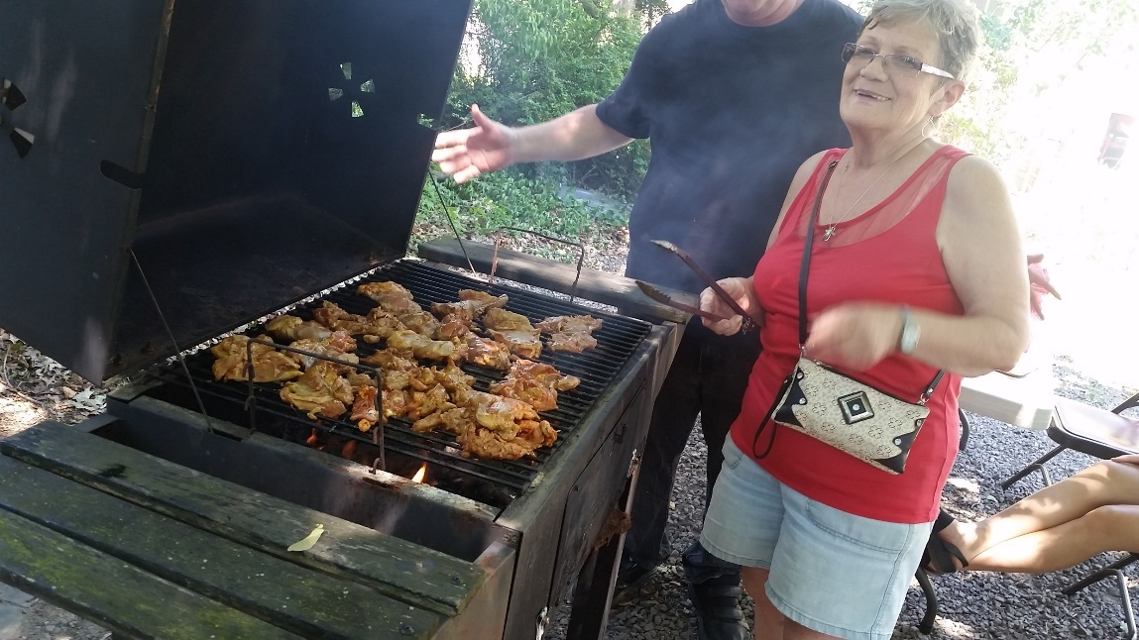
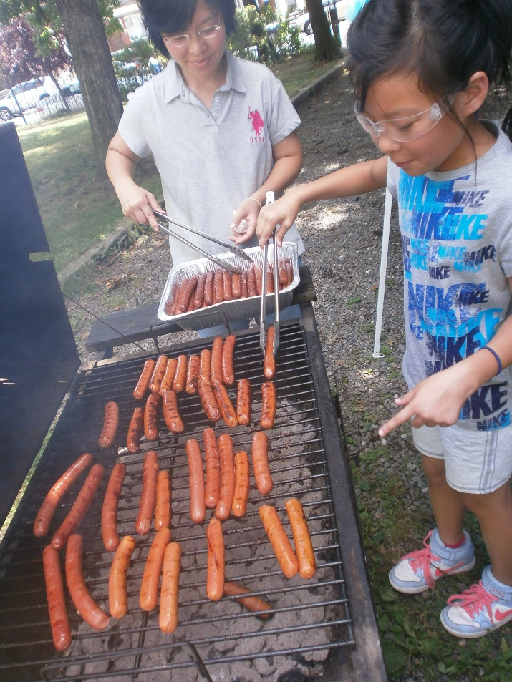
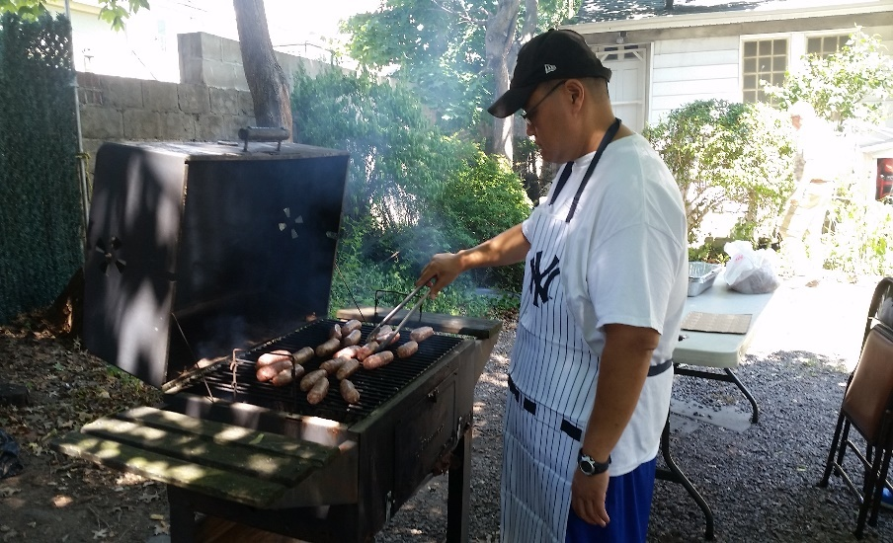
Bearing and Following the WORD into the World Announcements &
Sharing of Joys and Concerns
We will be having a Pot-Luck BBQ/Picnic on this coming Saturday, 9/16 at Noon. There is a sign-up sheet for what each can bring for this event, as we need to coordinate who is bringing what and to make sure that we have enough. Friends and families are welcome to join us. If we all bring something, we will have a lot.

Slide 28
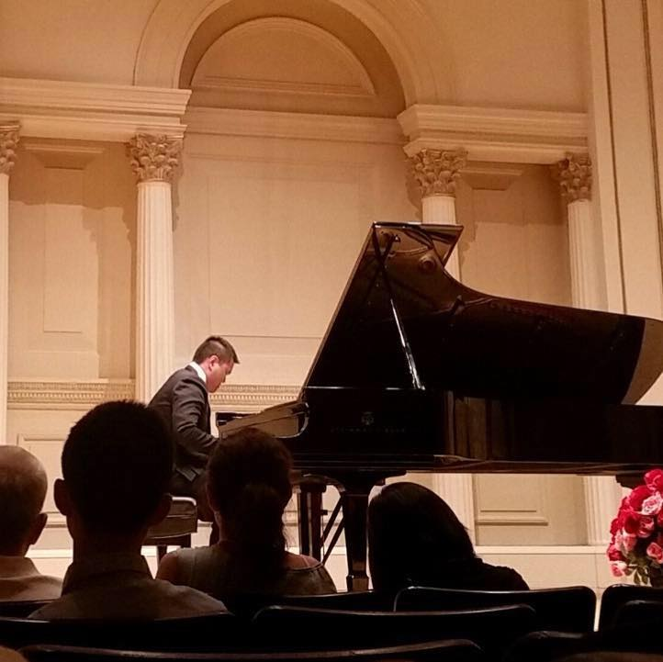
Brian will be performing at the
Carnegie Hall’s Weill Recital Hall
Sunday, 9/24/17 @7:30pm
Tickets: $30/$40/$50
(On-line Process Fee Applies)
www.carnegiehall.org

Slide 29
Bearing and Following the WORD into the World Prayer of the People & The Lord’s Prayer
Our Father, who art in heaven.
Halloweth be thy name.
Thy Kingdom come; Thy will be done
On earth as it is in heaven.
Give us this day our daily bread.
Forgive us our debts; as we forgive our debtors.
Lead us not into temptations, but deliver us from evil.
For Thine is the Kingdom, the Power, and the Glory forever. Amen.

Slide 30
Bearing and Following the WORD into the World Offering of our Gifts and our Lives
Musical Offering

Slide 31
Bearing and Following the WORD into the World Doxology and Offertory Prayer

Slide 32
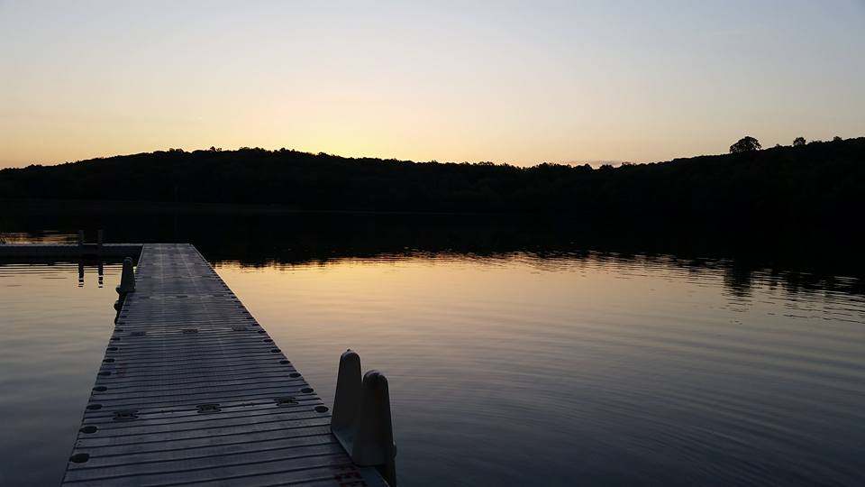
Sending Hymn #69 “I, the Lord of Sea and Sky” (Here I am, Lord)
I, the Lord of sea and sky, I have heard my people cry. All who dwell in dark and sin my hand will save. I, who made the stars of night, I will make their darkness bright. Who will bear my light to them? Whom shall I send?

Slide 33
Sending Hymn #69 “I, the Lord of Sea and Sky” (Here I am, Lord)
Here I am, Lord. Is it I, Lord? I have heard you calling in the night. I will go, Lord, if you lead me. I will hold your people in my heart.

Slide 34
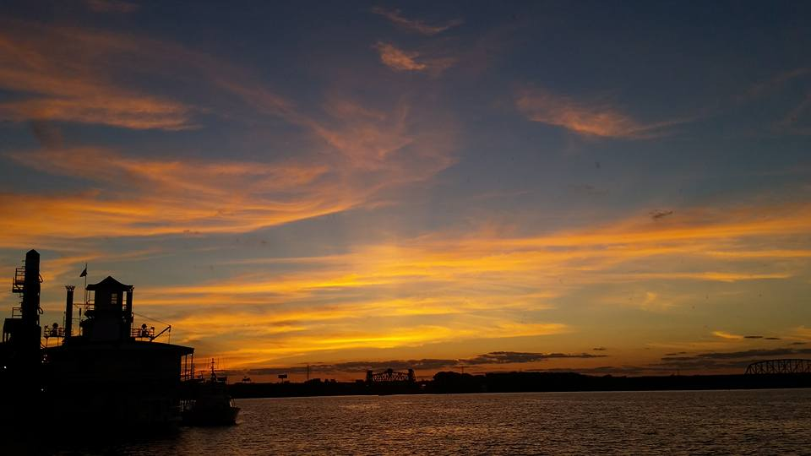
Sending Hymn #69 “I, the Lord of Sea and Sky” (Here I am, Lord)
I, the Lord of snow and rain, I have borne my people's pain. I have wept for love of them. They turn away. I will break their hearts of stone, give them hearts for love alone. I will speak my word to them. Whom shall I send?

Slide 35
Sending Hymn #69 “I, the Lord of Sea and Sky” (Here I am, Lord)
Here I am, Lord. Is it I, Lord? I have heard you calling in the night. I will go, Lord, if you lead me. I will hold your people in my heart.

Slide 36
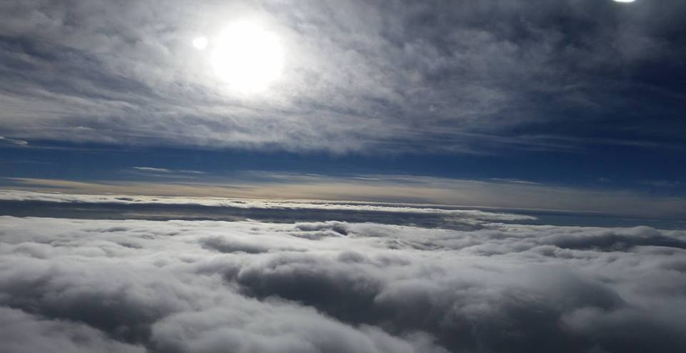
Sending Hymn #69 “I, the Lord of Sea and Sky” (Here I am, Lord)
I, the Lord of wind and flame, I will tend the poor and lame. I will set a feast for them. My hand will save. Finest bread I will provide till their hearts be satisfied. I will give my life to them. Whom shall I send?

Slide 37
Sending Hymn #69 “I, the Lord of Sea and Sky” (Here I am, Lord)
Here I am, Lord. Is it I, Lord? I have heard you calling in the night. I will go, Lord, if you lead me. I will hold your people in my heart.

Slide 38
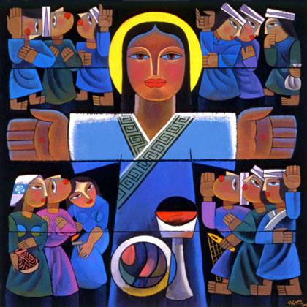
Bearing and Following the WORD into the World The Charge and Benediction

Slide 39
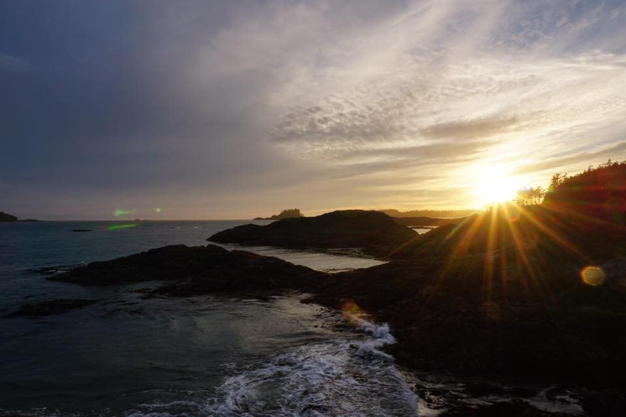
Bearing and Following the WORD into the World Benediction Response
# 542 “God Be with You Till We Meet Again”
(Stanza 3)
God be with you till we meet again; when life's perils thick confound you, put unfailing arms around you: God be with you till we meet again

Slide 40
Homecrest Presbyterian Church Worship of the Lord’s Day September 10th, 2017 23rd Sunday in Ordinary Time

