Slide 1
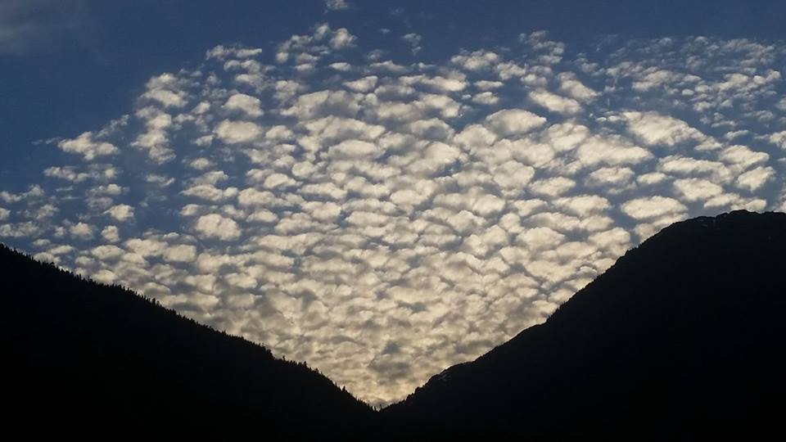
Homecrest Presbyterian Church Worship of the Lord’s Day July 30th, 2017 17th Sunday in Ordinary Time

Slide 2
Gathering Around the WORD Call To Worship/Gathering Hymn #59 “The Steadfast Love of the Lord” Psalm 1-5:1-10, 42-43
The steadfast love of the Lord never ceases; God’s mercies never come to an end. They are new every morning,
new every morning; Great is your faithfulness, O Lord, Great is your faithfulness.

Slide 3
Gathering Around the WORD Call To Worship/Gathering Hymn #59 “The Steadfast Love of the Lord” Psalm 1-5:1-10, 42-43
Give thanks to the Lord and call upon God’s name; make known the deeds of the Lord among the peoples.
Sing to the Lord, sing praises, and speak of all God’s marvelous works.

Slide 4
Gathering Around the WORD Call To Worship/Gathering Hymn #59 “The Steadfast Love of the Lord” Psalm 1-5:1-10, 42-43
Glory in God’s holy name; let the hearts of those
who seek the Lord rejoice.
Search for the Lord
and the strength of the Lord; continually seek the face of God.

Slide 5
Gathering Around the WORD Call To Worship/Gathering Hymn #59 “The Steadfast Love of the Lord” Psalm 1-5:1-10, 42-43
Remember the marvels God has done, the wonders and the judgments
of God’s mouth,
O offspring of Abraham, God’s servant, O children of Jacob, God’s chosen.

Slide 6
Gathering Around the WORD Call To Worship/Gathering Hymn #59 “The Steadfast Love of the Lord” Psalm 1-5:1-10, 42-43
The steadfast love of the Lord never ceases; God’s mercies never come to an end. They are new every morning,
new every morning; Great is your faithfulness, O Lord, Great is your faithfulness.

Slide 7
Gathering Around the WORD Call To Worship/Gathering Hymn #59 “The Steadfast Love of the Lord” Psalm 1-5:1-10, 42-43
The Lord is our God, whose judgments prevail
in all the world. The Lord has always been
mindful of the covenant, the promise made for a thousand generations:

Slide 8
Gathering Around the WORD Call To Worship/Gathering Hymn #59 “The Steadfast Love of the Lord” Psalm 1-5:1-10, 42-43
The covenant made with Abraham, the oath sworn to Isaac, which God established
as a statute for Jacob, and everlasting covenant for Israel.

Slide 9
Gathering Around the WORD Call To Worship/Gathering Hymn #59 “The Steadfast Love of the Lord” Psalm 1-5:1-10, 42-43
For God remembered the holy promise and Abraham, chosen to serve. So God led forth the people with gladness, the chosen ones with shouts of joy.

Slide 10
Gathering Around the WORD Call To Worship/Gathering Hymn #59 “The Steadfast Love of the Lord” Psalm 1-5:1-10, 42-43
The steadfast love of the Lord never ceases; God’s mercies never come to an end. They are new every morning,
new every morning; Great is your faithfulness, O Lord, Great is your faithfulness.

Slide 11
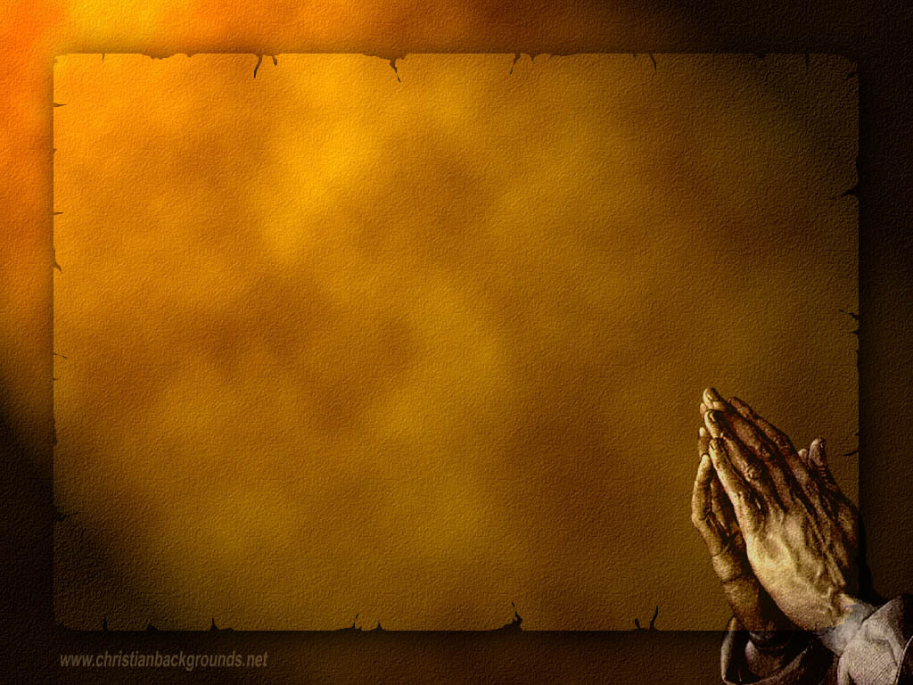
Gathering Around the WORD Call to Confession Sisters and brothers, God never forgets God’s promises; God’s covenant endures in every generation. We are free to speak the truth about our lives because God’s faithfulness embraces us as we examine our hearts.

Slide 12
Gathering Around the WORD Prayer of Confession (in Unison)
O God you created the world and named it very good, yet we turned away from you and others almost immediately. Again and again you shower us with the good news of the Gospel in Jesus Christ, but we stereotype others and build walls among us. You throw your seed on all types of people and situations, but frequently we make hesitant steps towards justice, instead of bold moves. All too often we bear no fruit.

Slide 13
Gathering Around the WORD Prayer of Confession (in Unison)
Forgive us, O God of mercy and hope.
By your Spirit transform us into good soil,
where seed grows into great fruits of promises.

Slide 14
Gathering Around the WORD Declaration of Forgiveness (Based on Romans 8:31-39) What then are we to say about these things? If God is for us, who is against us? Sisters and brothers, nothing we have done, nothing we will ever do, is enough to separate us from the love of God made known in Jesus Christ. Our sins have been forgiven. Thanks be to God. Amen.

Slide 15
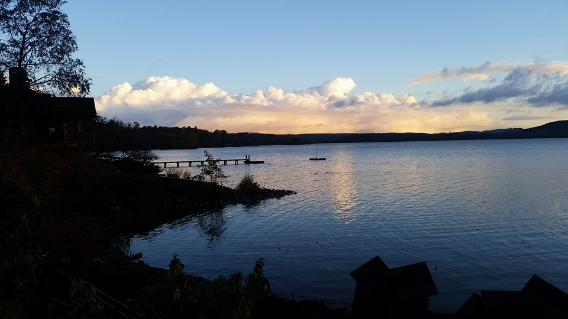
Gathering Around the WORD Gloria Patri
Glory be to the Father
and to the Son and to the Holy Ghost;
As it was in the beginning,
is now, and ever shall be,
world without end. Amen, Amen.

Slide 16
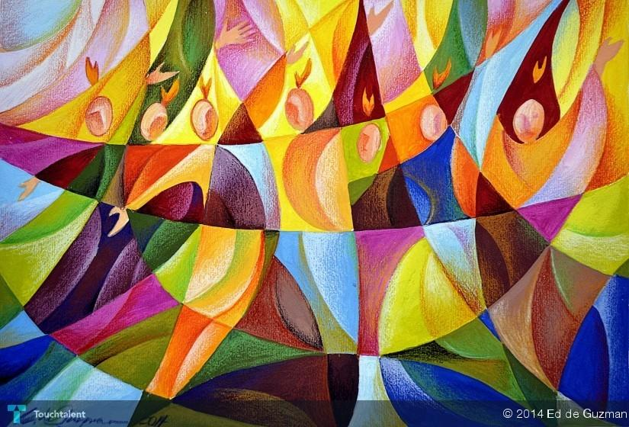
Gathering Around the WORD Passing of the Peace of Christ

Slide 17
Proclaiming the WORD Message to the Youth/ Prayer of Illumination

Slide 18
Proclaiming the WORD Scripture Reading (Genesis 29:15-28)
¹⁵Then Laban said to Jacob, “Because you are my kinsman, should you therefore serve me for nothing? Tell me, what shall your wages be?” ¹⁶Now Laban had two daughters; the name of the elder was Leah, and the name of the younger was Rachel. ¹⁷Leah’s eyes were lovely, and Rachel was graceful and beautiful. ¹⁸Jacob loved Rachel; so he said, “I will serve you seven years for your younger daughter Rachel.”

Slide 19
Proclaiming the WORD Scripture Reading (Genesis 29:15-28)
¹⁹Laban said, “It is better that I give her to you than that I should give her to any other man; stay with me.” ²⁰So Jacob served seven years for Rachel, and they seemed to him but a few days because of the love he had for her.

Slide 20
Proclaiming the WORD Scripture Reading (Genesis 29:15-28)
²¹Then Jacob said to Laban, “Give me my wife that I may go in to her, for my time is completed.” ²²So Laban gathered together all the people of the place, and made a feast. ²³But in the evening he took his daughter Leah and brought her to Jacob; and he went in to her. ²⁴(Laban gave his maid Zilpah to his daughter Leah to be her maid.)

Slide 21
Proclaiming the WORD Scripture Reading (Genesis 29:15-28)
²⁵When morning came, it was Leah! And Jacob said to Laban, “What is this you have done to me? Did I not serve with you for Rachel? Why then have you deceived me?” ²⁶Laban said, “This is not done in our country — giving the younger before the firstborn. ²⁷Complete the week of this one, and we will give you the other also in return for serving me another seven years.” ²⁸Jacob did so, and completed her week; then Laban gave him his daughter Rachel as a wife.

Slide 22
Proclaiming the WORD Scripture Reading (Romans 8:26-39)
²⁶Likewise the Spirit helps us in our weakness; for we do not know how to pray as we ought, but that very Spirit intercedes with sighs too deep for words. ²⁷And God, who searches the heart, knows what is the mind of the Spirit, because the Spirit intercedes for the saints according to the will of God.

Slide 23
Proclaiming the WORD Scripture Reading (Romans 8:26-39)
²⁸We know that all things work together for good for those who love God, who are called according to his purpose. ²⁹For those whom he foreknew he also predestined to be conformed to the image of his Son, in order that he might be the firstborn within a large family. ³⁰And those whom he predestined he also called; and those whom he called he also justified; and those whom he justified he also glorified.

Slide 24
Proclaiming the WORD Scripture Reading (Romans 8:26-39)
³¹What then are we to say about these things? If God is for us, who is against us? ³²He who did not withhold his own Son, but gave him up for all of us, will he not with him also give us everything else? ³³Who will bring any charge against God's elect? It is God who justifies. ³⁴Who is to condemn? It is Christ Jesus, who died, yes, who was raised, who is at the right hand of God, who indeed intercedes for us. ³⁵Who will separate us from the love of Christ? Will hardship, or distress, or persecution, or famine, or nakedness, or peril, or sword?

Slide 25
Proclaiming the WORD Scripture Reading (Romans 8:26-39)
³⁶As it is written, "For your sake we are being killed all day long; we are accounted as sheep to be slaughtered." ³⁷No, in all these things we are more than conquerors through him who loved us. ³⁸For I am convinced that neither death, nor life, nor angels, nor rulers, nor things present, nor things to come, nor powers, ³⁹nor height, nor depth, nor anything else in all creation, will be able to separate us from the love of God in Christ Jesus our Lord.

Slide 26
Proclaiming the WORD (Genesis 29:15-28 and Romans 8:12-25)

Slide 27
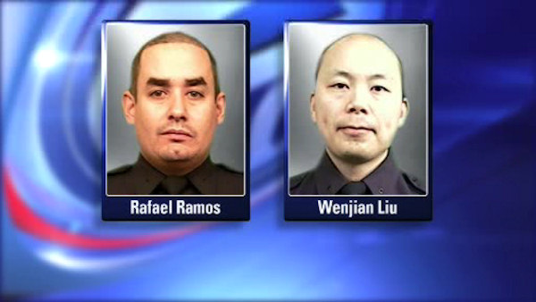
Proclaiming the WORD (Genesis 29:15-28 and Romans 8:12-25)
All Things Work Together for Good

Slide 28
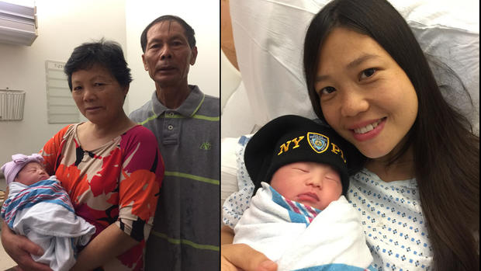
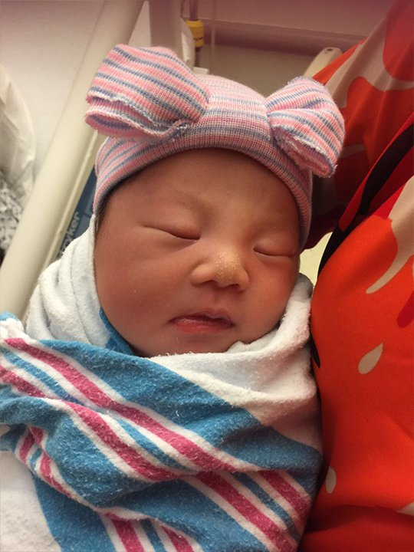
Proclaiming the WORD (Genesis 29:15-28 and Romans 8:12-25)
All Things Work Together for Good

Slide 29
Proclaiming the WORD (Genesis 29:15-28 and Romans 8:12-25)

Slide 30
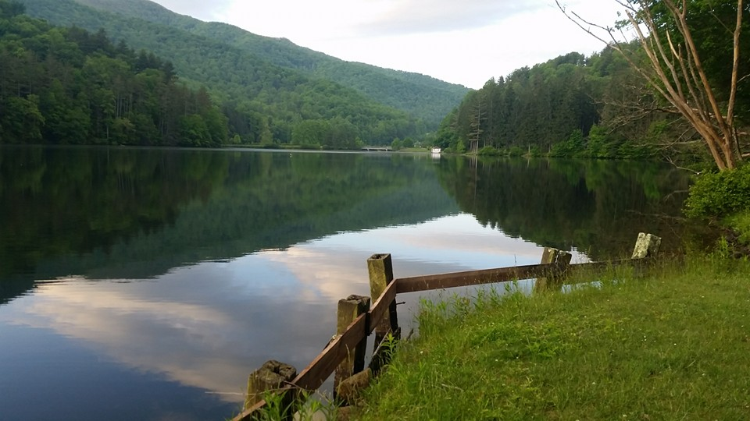
Responding Hymn # 840 “It Is Well with My Soul (When Peace Like a River)
When peace like a river attendeth my way, when sorrows like sea billows roll, whatever my lot, thou hast taught me to say, it is well, it is well with my soul. It is well (It is well)
with my soul (with my soul); it is well; it is well with my soul.

Slide 31
Responding Hymn # 840 “It Is Well with My Soul (When Peace Like a River)
Though Satan should buffet, though trials should come, let this blest assurance control, that Christ hath regarded my helpless estate, and hath shed his own blood for my soul. It is well (It is well)
with my soul (with my soul); it is well; it is well with my soul.

Slide 32
Responding Hymn # 840 “It Is Well with My Soul (When Peace Like a River)
He lives: O the bliss of this glorious thought. My sin, not in part, but the whole, is nailed to the cross and I bear it no more. Praise the Lord, praise the Lord, O my soul! It is well (It is well)
with my soul (with my soul); it is well; it is well with my soul.

Slide 33
Responding Hymn # 840 “It Is Well with My Soul (When Peace Like a River)
Lord, hasten the day when our faith shall be sight, the clouds be rolled back as a scroll, the trumpet shall sound
and the Lord shall descend; even so it is well with my soul. It is well (It is well)
with my soul (with my soul); it is well; it is well with my soul.

Slide 34
Responding to the WORD
Affirmation of Faith
(Excerpt from Confession of Belhar)
We believe in the triune God, Father, Son, and Holy Spirit,
Who gathers, protects and cares for the church through Word and Spirit. This God has done since the beginning of the world and will do to the end.
We believe that Christ’s work of reconciliation is made manifest in the church as the community of believers who have been reconciled with God and with one another.

Slide 35
Responding to the WORD
Affirmation of Faith
(Excerpt from Confession of Belhar)
We believe that unity is, therefore, both a gift and an obligation for the church of Jesus Christ.
We believe that through the working of God’s Spirit, it is a binding force, yet simultaneously a reality. Which must be earnestly pursued and sought: one which the people of God must continually be built up to attain.
We believe that the church must together come to know the height and the breadth and the depth of the love of Christ.

Slide 36
Responding to the WORD
Affirmation of Faith
(Excerpt from Confession of Belhar)
We believe that together we are built up to the statue of Christ, the new humanity.
We believe that we must together know and bear one another’s burdens, thereby fulfilling the law of Christ.
We believe that we are called to admonish, and comfort one another; To suffer with one another for the sake of righteousness; to pray together; and together serve God in this world.

Slide 37
Bearing and Following the WORD into the World Announcements &
Sharing of Joys and Concerns
The afternoon Bible Study Group and the Women’s Group will be taking the months of July and August off. It will resume in September.
Special thanks for those who participated and contributed to the pot-luck movie event yesterday, as we learned more about our faith and our relationship with our sovereign God. If you have other movie recommendations that lead to deeper spiritual conversations and reflections, please let Margaret or the Pastor know for future consideration.

Slide 38
Bearing and Following the WORD into the World Prayer of the People & The Lord’s Prayer
Our Father, who art in heaven.
Halloweth be thy name.
Thy Kingdom come; Thy will be done
On earth as it is in heaven.
Give us this day our daily bread.
Forgive us our debts; as we forgive our debtors.
Lead us not into temptations, but deliver us from evil.
For Thine is the Kingdom, the Power, and the Glory forever. Amen.

Slide 39
Bearing and Following the WORD into the World Offering of our Gifts and our Lives
Musical Offering

Slide 40
Bearing and Following the WORD into the World Doxology and Offertory Prayer

Slide 41
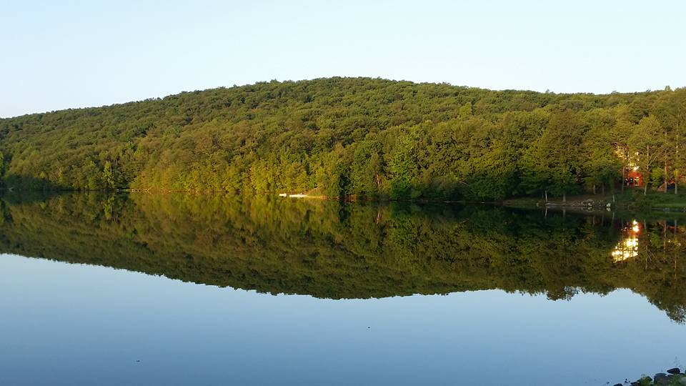
Responding Hymn # 634 “To God Be the Glory”
To God be the glory; great things he has done! So loved he the world that he gave us his Son, who yielded his life an atonement for sin, and opened the life-gate that all may go in.

Slide 42
Responding Hymn # 634 “To God Be the Glory”
Praise the Lord, praise the Lord; let the earth hear his voice! Praise the Lord, praise the Lord; let the people rejoice! O come to the Father through Jesus the Son, and give him the glory: great things he has done!

Slide 43
Responding Hymn # 634 “To God Be the Glory”
Great things he has taught us; great things he has done, and great our rejoicing through Jesus the Son; but purer and higher and greater will be our wonder, our transport, when Jesus we see.

Slide 44
Responding Hymn # 634 “To God Be the Glory”
Praise the Lord, praise the Lord; let the earth hear his voice! Praise the Lord, praise the Lord; let the people rejoice! O come to the Father through Jesus the Son, and give him the glory: great things he has done!

Slide 45
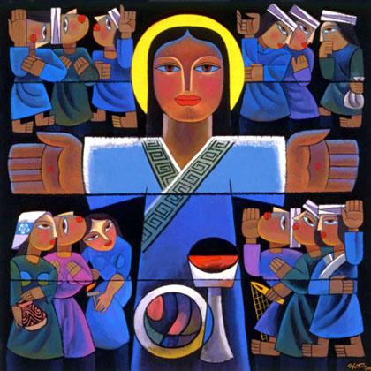
Bearing and Following the WORD into the World The Charge and Benediction

Slide 46
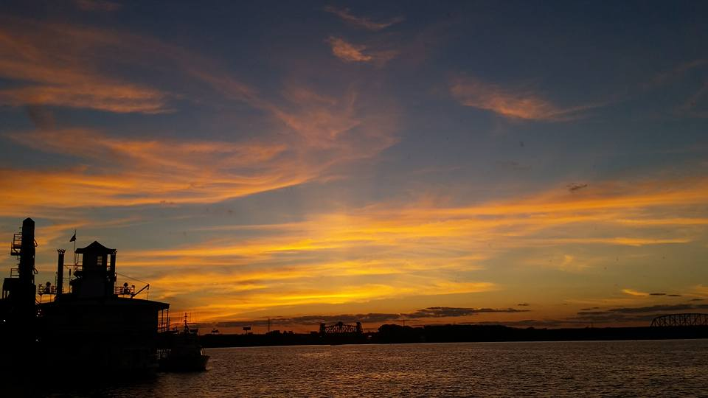
Bearing and Following the WORD into the World Benediction Response
# 541 “God Be with You Till We Meet Again”
(Stanza 1)
God be with you till we meet again;
loving counsels guide, uphold you,
with a shepherd’s care enfold you:
God be with you till we meet again.

Slide 47
Homecrest Presbyterian Church Worship of the Lord’s Day July 23rd, 2017 16th Sunday in Ordinary Time

Slide 48
Homecrest Presbyterian Church Worship of the Lord’s Day July 30th, 2017 17th Sunday in Ordinary Time

