Slide 1
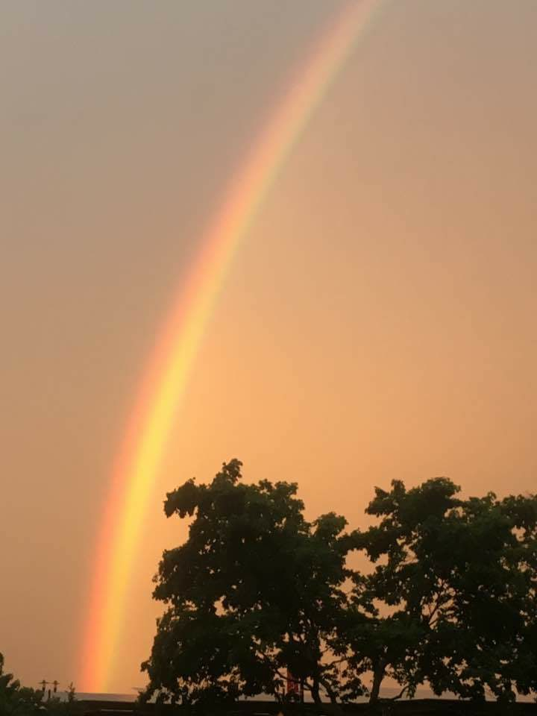
Homecrest Presbyterian Church Worship of the Lord’s Day July 2nd, 2017 4th Sunday after Pentecost

Slide 2
Gathering Around the WORD Call To Worship (Psalm 145:8-9, 14; Matthew 11:28-30)
Jesus says: Come to me, and I will give you rest. The Lord is gracious and merciful, full of compassion, abounding in love. Jesus says:
My yoke is easy, and my burden is light.
The Lord supports those wh`o are weak,
and lifts up those who are falling.

Slide 3
Gathering Hymn # 540 “We Come as Guest Invited”
We come as guests invited when Jesus bids us dine, his friends on earth united to share the bread and wine; the bread of life is broken; the wine is freely poured for us, in solemn token of Christ our dying Lord.

Slide 4
Gathering Hymn # 540 “We Come as Guest Invited”
We eat and drink, receiving from Christ the grace we need, and in our hearts believing on him by faith we feed; with wonder and thanksgiving for love that knows no end, we find in Jesus living our ever-present friend.

Slide 5
Gathering Hymn # 540 “We Come as Guest Invited”
One bread is ours for sharing, one single fruitful vine, our fellowship declaring renewed in bread and wine: renewed, sustained, and given by token, sign, and word, the pledge and seal of heaven, the love of Christ our Lord.

Slide 6
Gathering Around the WORD Call to Confession God gives us the freedom to choose what is right and what is wrong, yet time after time, we choose what’s best for ourselves and not for God or our neighbors. We’ve neglected God’s good will for his creation and rebelled against God’s command. In humility and faith, let us confess and repent of our sins before God and our neighbors.

Slide 7
Gathering Around the WORD Prayer of Confession (in Unison)
O God of mercy and grace, grant us the privilege to serve you. Grant us the will to follow you. Grant us the love to share with our neighbors. Forgive us for our own human selfish desires. Help us to see your will instead of ours. Through Jesus Christ our Lord and Savior, Amen.

Slide 8
Gathering Around the WORD Declaration of Forgiveness (Based on 1 Peter 1:3) Blessed be the God and Father of our Lord Jesus Christ! By his great mercy he has given us a new birth into a living hope through the resurrection of Jesus Christ from the dead. Thanks be to God, Amen.

Slide 9
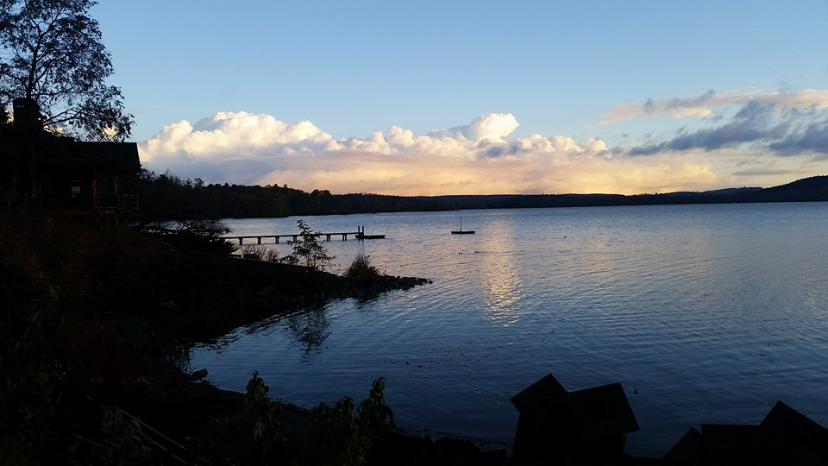
Gathering Around the WORD Gloria Patri
Glory be to the Father
and to the Son and to the Holy Ghost;
As it was in the beginning,
is now, and ever shall be,
world without end. Amen, Amen.

Slide 10
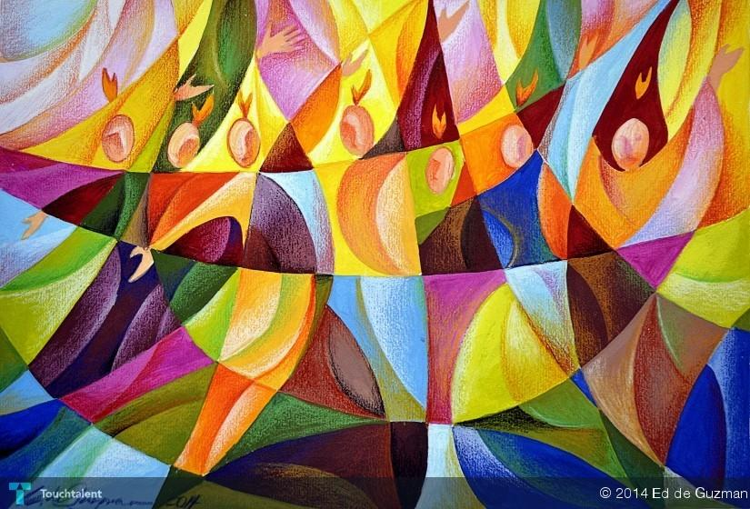
Gathering Around the WORD Passing of the Peace of Christ

Slide 11
Proclaiming the WORD Message to the Youth/ Prayer of Illumination

Slide 12
Proclaiming the WORD Scripture Reading (Romans 7:15-25)
I do not understand my own actions. For I do not do what I want, but I do the very thing I hate. ¹⁶ Now if I do what I do not want, I agree that the law is good. ¹⁷ But in fact it is no longer I that do it, but sin that dwells within me. ¹⁸ For I know that nothing good dwells within me, that is, in my flesh. I can will what is right, but I cannot do it. ¹⁹ For I do not do the good I want, but the evil I do not want is what I do. ²⁰ Now if I do what I do not want, it is no longer I that do it, but sin that dwells within me.

Slide 13
Proclaiming the WORD Scripture Reading (Romans 7:15-25)
²¹ So I find it to be a law that when I want to do what is good, evil lies close at hand. ²² For I delight in the law of God in my inmost self, ²³ but I see in my members another law at war with the law of my mind, making me captive to the law of sin that dwells in my members. ²⁴ Wretched man that I am! Who will rescue me from this body of death? ²⁵ Thanks be to God through Jesus Christ our Lord! So then, with my mind I am a slave to the law of God, but with my flesh I am a slave to the law of sin.

Slide 14
Proclaiming the WORD Scripture Reading (Matthew 11:25-30)
At that time Jesus said, "I thank you, Father, Lord of heaven and earth, because you have hidden these things from the wise and the intelligent and have revealed them to infants; ²⁶ yes, Father, for such was your gracious will.
²⁷ All things have been handed over to me by my Father; and no one knows the Son except the Father, and no one knows the Father except the Son and anyone to whom the Son chooses to reveal him.

Slide 15
Proclaiming the WORD Scripture Reading (Matthew 11:25-30)
²⁸ "Come to me, all you that are weary and are carrying heavy burdens, and I will give you rest. ²⁹ Take my yoke upon you, and learn from me; for I am gentle and humble in heart, and you will find rest for your souls. ³⁰ For my yoke is easy, and my burden is light."

Slide 16
Proclaiming the WORD (Romans 7:15-25 and Matthew 11:25-30)

Slide 17
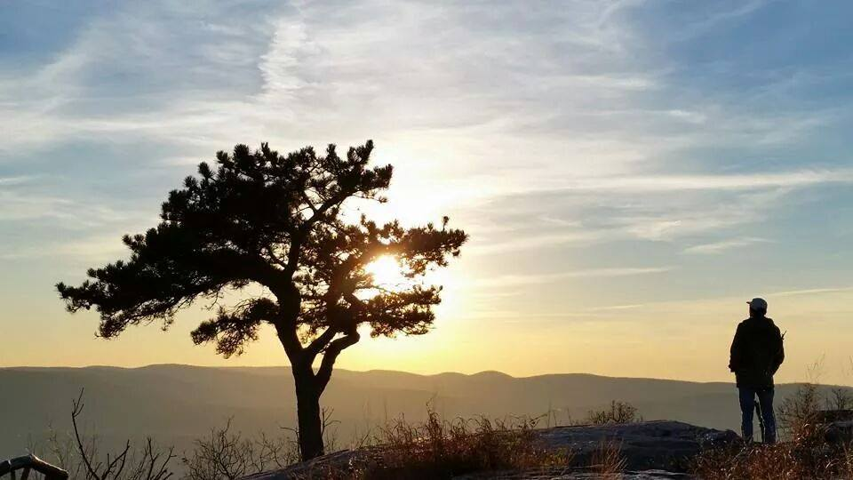
Responding Hymn # 337 “My Country, ‘Tis of Thee”
My country, 'tis of thee, sweet land of liberty, of thee I sing: land where my fathers died, land of the pilgrims' pride, from every mountainside let freedom ring.

Slide 18
Responding Hymn # 337 “My Country, ‘Tis of Thee”
My country, 'tis of thee, sweet land of liberty, of thee I sing: land where my fathers died, land of the pilgrims' pride, from every mountainside let freedom ring.

Slide 19
Responding Hymn # 337 “My Country, ‘Tis of Thee”
My native country, thee, land of the noble free, thy name I love; I love thy rocks and rills, thy woods and templed hills; my heart with rapture thrills like that above.

Slide 20
Responding Hymn # 337 “My Country, ‘Tis of Thee”
Let music swell the breeze, and ring from all the trees sweet freedom's song. Let mortal tongues awake; let all that breathe partake; let rocks their silence break, the sound prolong.

Slide 21
Responding Hymn # 337 “My Country, ‘Tis of Thee”
Our fathers' God, to thee, author of liberty, to thee we sing. Long may our land be bright with freedom's holy light; protect us by thy might, great God, our King.

Slide 22
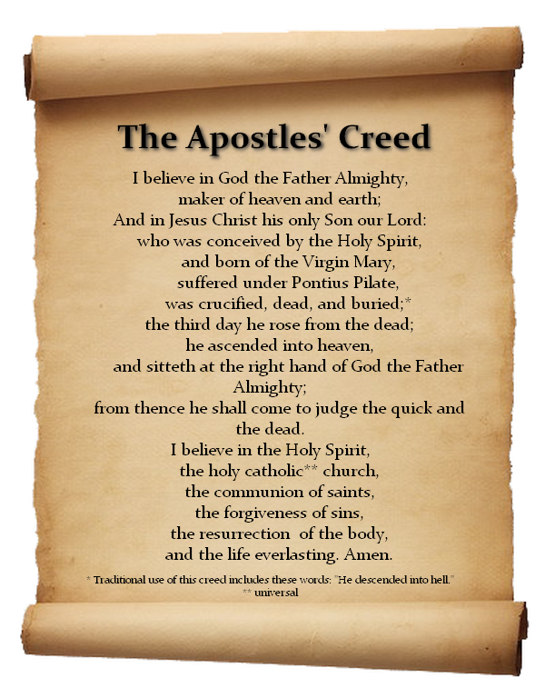
Responding to the WORD
Affirmation of Faith

Slide 23
Bearing and Following the WORD into the World Announcements &
Sharing of Joys and Concerns
The afternoon Bible Study Group will be taking the months of July and August off. It will resume in September.
The Women's Group will continue over at the Manse (2048 E 14th Street) every Wednesday evening @ 7:30pm. They are currently studying the book of Mark. For more information, please contact Margaret Lesman or Cara Chin.

Slide 24
Bearing and Following the WORD into the World Announcements &
Sharing of Joys and Concerns
Pastor Samson will be away on 7/9 and 7/16 to attend the Presbyterian Church’s Big Tent gathering in St. Louis and also for vacation. Rev. Grace May of the Women of Wonders, Inc. will be our guest speakers for those Sundays. Rev. May is an at-large member of the NYC Presbytery.

Slide 25
Bearing and Following the WORD into the World Prayer of the People & The Lord’s Prayer
Our Father, who art in heaven.
Halloweth be thy name.
Thy Kingdom come; Thy will be done
On earth as it is in heaven.
Give us this day our daily bread.
Forgive us our debts; as we forgive our debtors.
Lead us not into temptations, but deliver us from evil.
For Thine is the Kingdom, the Power, and the Glory forever. Amen.

Slide 26
Bearing and Following the WORD into the World Offering of our Gifts and our Lives
Musical Offering

Slide 27
Bearing and Following the WORD into the World Doxology and Offertory Prayer

Slide 28
Bearing and Following the WORD into the World Holy Communion Hymn
# 510 “We Gather Here in Jesus’ Name”
We gather here in Jesus’ name; his love is burning in our hearts
like living flame; for through the loving Son
the Father makes us one: come, take the bread;
come, drink the wine; come, share the Lord.

Slide 29
Bearing and Following the WORD into the World Holy Communion Hymn
# 510 “We Gather Here in Jesus’ Name”
No one is a stranger here; everyone belongs. Finding our forgiveness here, we in turn forgive all wrongs.

Slide 30
Bearing and Following the WORD into the World Holy Communion Hymn
# 510 “We Gather Here in Jesus’ Name”
He joins us here; he breaks the bread; the Lord who pours the cup
is risen from the dead; the one we love the most
is now our gracious host: come, take the bread;
come, drink the wine; come, share the Lord.

Slide 31
Bearing and Following the WORD into the World Holy Communion Hymn
# 510 “We Gather Here in Jesus’ Name”
We are now a family, of which the Lord is head. Though unseen, he meets us here in the breaking of the bread.

Slide 32
Bearing and Following the WORD into the World Holy Communion Hymn
# 510 “We Gather Here in Jesus’ Name”
We’ll gather soon where angels sing; we’ll see the glory
of our Lord and coming King; now we anticipate
the feast for which we wait: come, take the bread;
come drink the wine; come, share the Lord.

Slide 33
Bearing and Following the WORD into the World Holy Communion
Friends, we gather now as one body, joined around this table of GRACE. Here we celebrate God's presence among us, united in Christ's spirit, broken and whole all at once;

Slide 34
Bearing and Following the WORD into the World Holy Communion
This is the table of the Heavenly Feast, the joyful celebration of the people of God. Christ invites those who confess their faith and baptized in Him to eat the bread of life and to drink the cup of the new covenant.

Slide 35
Bearing and Following the WORD into the World Holy Communion
The Lord be with you. And also with you.
Lift up your hearts. We lift them up to the Lord.
Let us give thanks to the Lord our God.
It is right to give our thanks and praise.

Slide 36
Bearing and Following the WORD into the World Holy Communion
O Lord our God, pour out Your Spirit upon your people. We have come undeserving of your grace. Yet you have poured out your blessings upon us. You have filled us with your graceful presence, both in body and in soul.

Slide 37
Bearing and Following the WORD into the World Holy Communion
By your life-giving Spirit, you have renewed us and re-created us. We’ve called upon your name and you’ve heard us.
Therefore we join our voices with saints and angels and all the faithful of every time and place singing:

Slide 38
Bearing and Following the WORD into the World Holy Communion
Holy, Holy, Holy Lord,
God of power and might,
Heaven and earth are full of your glory.
Hosanna in the highest.
Blessed is he who comes in the name of the Lord.
Hosanna in the highest.

Slide 39
Bearing and Following the WORD into the World Holy Communion
We give you thanks that you have made us one with him as he is one with you and the Holy Spirit.
With thanksgiving, we will receive this bread which our Lord Jesus took, after He blessed it, broke it, and gave it to his disciples, saying, this is my body, given for you.

Slide 40
Bearing and Following the WORD into the World Holy Communion
With confidence, we dedicate this cup that Jesus blessed, saying, this is the new covenant sealed in my blood.
Do this, remembering me.

Slide 41
Bearing and Following the WORD into the World Holy Communion
With thanks and praise we offer ourselves to you, O God.
Sharing this holy meal, remembering Christ’s dying and rising, and praying: Come Lord Jesus!
Christ has died, Christ is risen,
Christ will come again.

Slide 42
Bearing and Following the WORD into the World Holy Communion
Jesus said, "I am the bread of life. They who come to me shall never hunger; they who believe in me shall never thirst." These are the gift of God for the people of God.

Slide 43
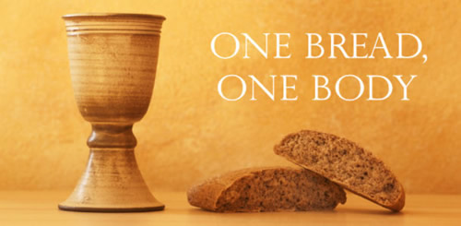
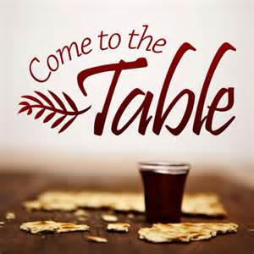
Bearing and Following the WORD into the World Holy Communion

Slide 44
Bearing and Following the WORD into the World
Prayer after the Communion: (in unison)
:
Lord Jesus Christ, in Spirit you have fed us with your body and quenched us with your blood. We look forward to the day when you shall come again to fill our hearts with grace, peace and hope.

Slide 45
Bearing and Following the WORD into the World
Prayer after the Communion: (in unison)
:
Enable us now to go out to share your love to others. Humble our hearts so we may serve others, as you have served us through your Son Jesus Christ.

Slide 46
Bearing and Following the WORD into the World
Prayer after the Communion: (in unison)
:
Through Christ, with Christ, in Christ, in the unity of the Holy Spirit, all glory and honor are yours, Almighty God, now and forever, Amen.

Slide 47
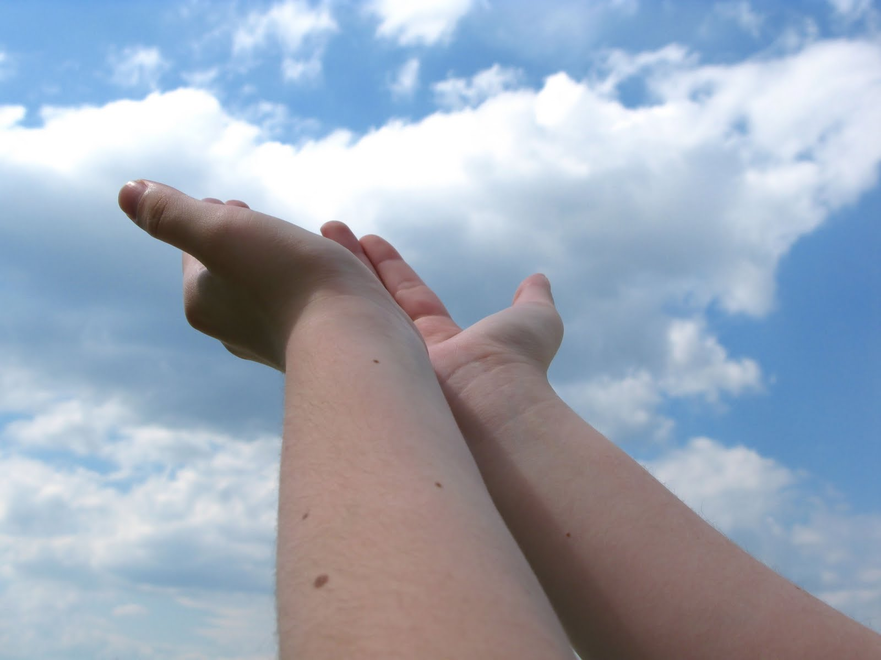
Bearing and Following the WORD into the World Deacons’ Benevolence Offering

Slide 48
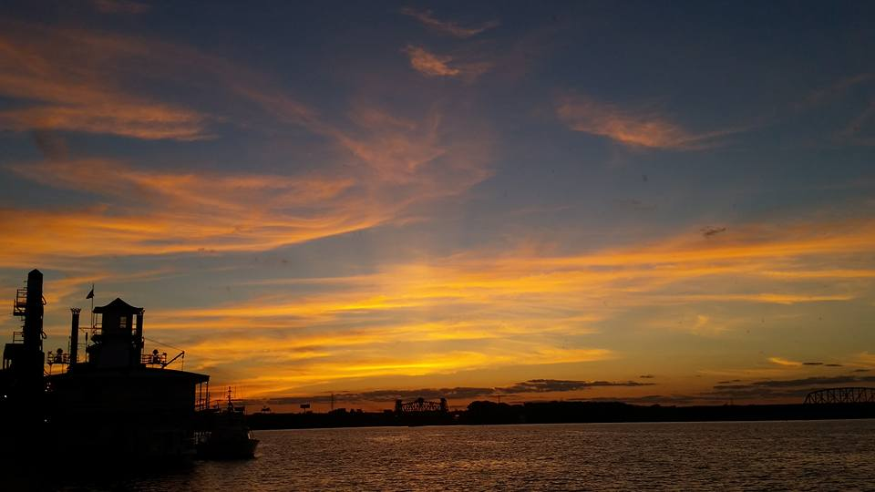
Responding Hymn # 338 “O Beautiful for Spacious Skies”
O beautiful for spacious skies, for amber waves of grain, for purple mountain majesties above the fruited plain! America! America! God shed his grace on thee, and crown thy good with brotherhood from sea to shining sea!

Slide 49
Responding Hymn # 338 “O Beautiful for Spacious Skies”
O beautiful for heroes proved in liberating strife, who more than self their country loved, and mercy more than life! America! America! God mend thine every flaw; confirm thy soul in self-control, thy liberty in law!

Slide 50
Responding Hymn # 338 “O Beautiful for Spacious Skies”
O beautiful for patriot dream that sees beyond the years thine alabaster cities gleam, undimmed by human tears! America! America! May God thy gold refine till all success be nobleness and every gain divine!

Slide 51
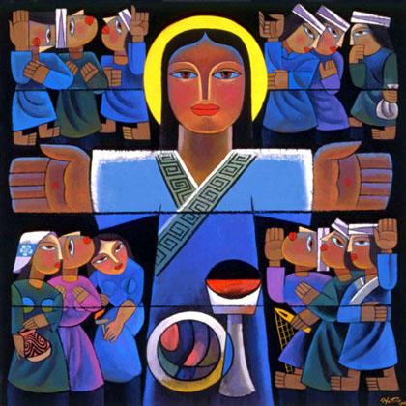
Bearing and Following the WORD into the World The Charge and Benediction

Slide 52
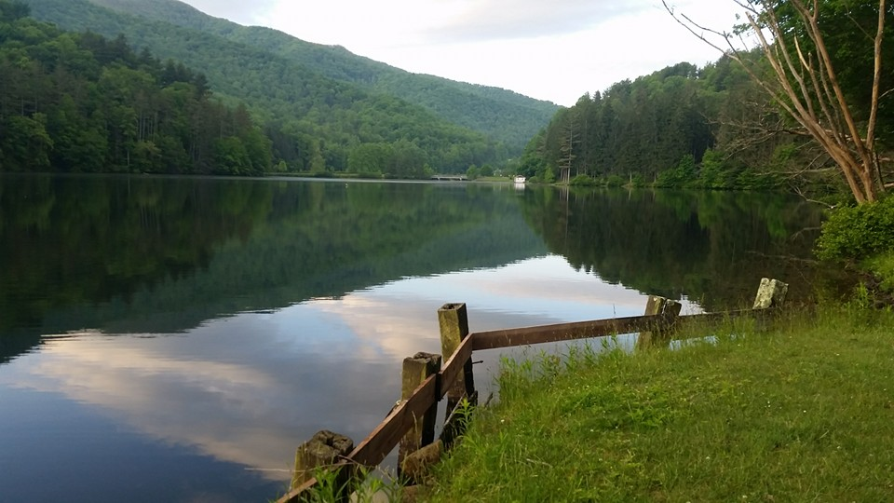
Bearing and Following the WORD into the World Benediction Response
# 541 “God Be with You Till We Meet Again” (Stanza 2)
God be with you till we meet again;
unseen wings protecting hide you, daily manna still provide you:
God be with you till we meet again.

Slide 53
Homecrest Presbyterian Church Worship of the Lord’s Day July 2nd, 2017 4th Sunday after Pentecost

