Slide 1
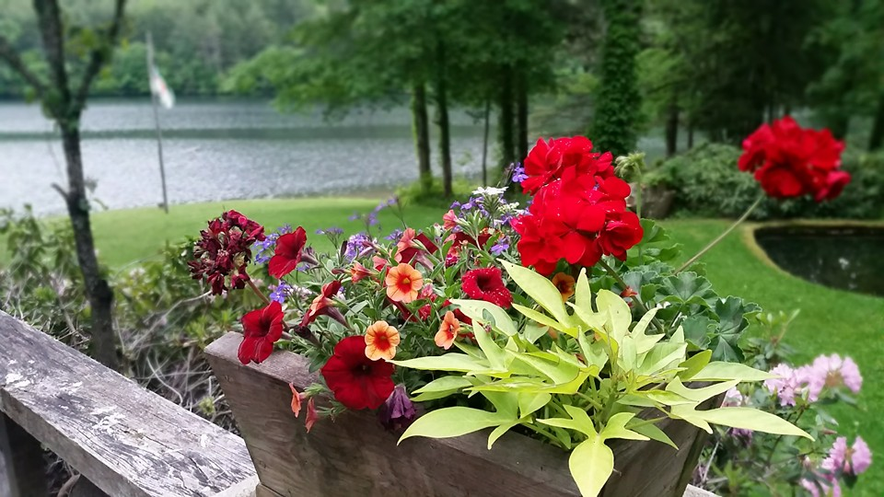
Homecrest Presbyterian Church Worship of the Lord’s Day May 21st, 2017 6th Sunday of Easter

Slide 2
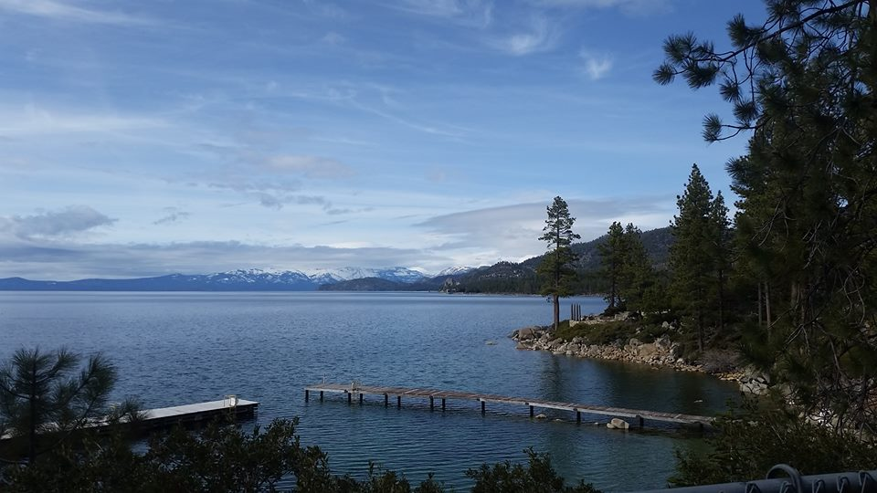
Gathering Around the WORD Call To Worship (Based on Psalm 66:8-9, 16-17)
Bless our God, O peoples,
let the sound of his praise be heard, who has kept us among the living,
and has not let our feet slip.
Come and hear, all you who fear God,
and we shall proclaim what he has done for us.
We cry aloud to our God,
and he will be extolled with our tongues.

Slide 3
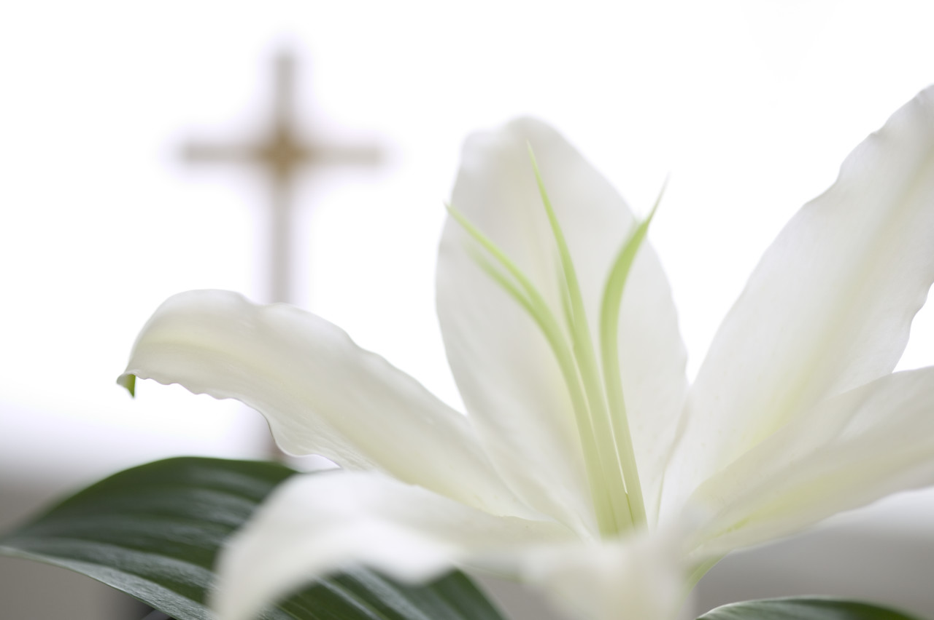
Gathering Hymn #54 “Make a Joyful Noise to God” (Psalm 66)
Make a joyful noise to God! All creation sings your praise! Great your wonders here displayed, unexcelled throughout our days. Glorious is your sacred name, ages old, yet still the same.

Slide 4
Gathering Hymn #54 “Make a Joyful Noise to God” (Psalm 66)
Come and see what God has done, great the blessings to the just: walked the chosen through the sea, brought their enemies to dust. Let us lift a thankful voice for God's mercies, and rejoice!

Slide 5
Gathering Hymn #54 “Make a Joyful Noise to God” (Psalm 66)
Bless the Lord, our refuge sure; let our songs of praise be heard! By whose justice, we are tried; by whose grace, our guilt deferred. When our life's sure end shall come, bring us to your heavenly home.

Slide 6
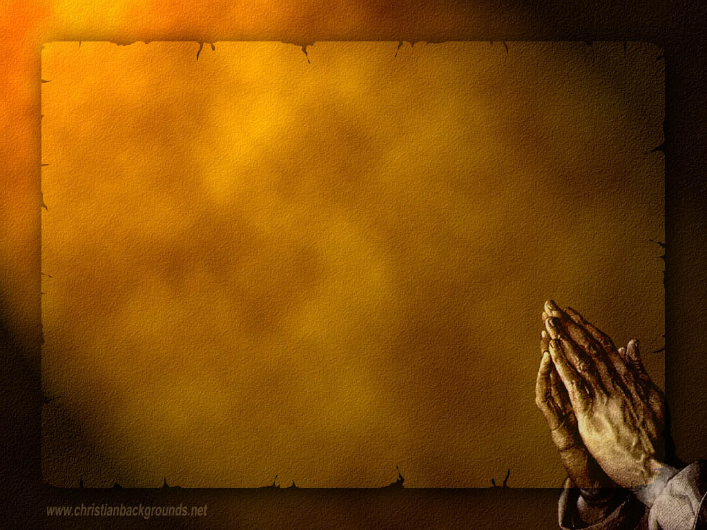
Gathering Around the WORD Call to Confession Scripture reminds us that whoever believes in Christ will not be put to shame. Christ is our redeemer and our hope of salvation. Confident in this promise, let us confess our sin before God and one another.

Slide 7
Gathering Around the WORD Prayer of Confession (in unison)
Holy One, we confess to you and to one another that we have not always followed Christ’s example. When we have been abused, we have been abusive to others in return. We have gone astray in our action and our thoughts. Forgive us, Lord. Lead us back into your fold and guard our souls in Jesus’ name. Amen.

Slide 8
Gathering Around the WORD Declaration of Forgiveness Sisters and brothers, God forgives, restores, and strengthens us through our risen Christ. Know that we are forgiven and be at peace. Through God’s grace and mercy, we thank God for giving us new opportunities to honor him and serve him. Thanks be to God, Amen.

Slide 9
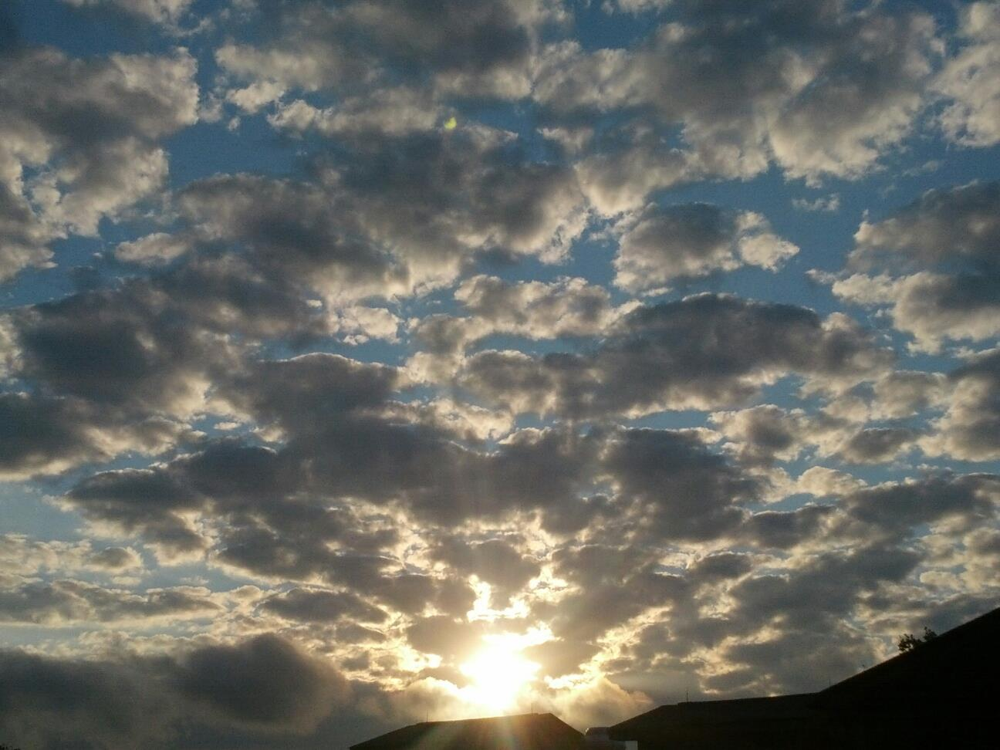
Gathering Around the WORD Gloria Patri
Glory be to the Father
and to the Son and to the Holy Ghost;
As it was in the beginning,
is now, and ever shall be,
world without end. Amen, Amen.

Slide 10
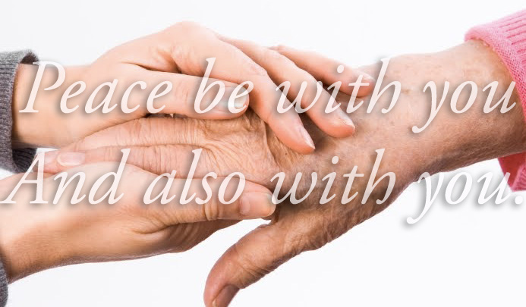
Gathering Around the WORD Passing of the Peace of Christ

Slide 11
Proclaiming the WORD Message to the Youth/ Prayer of Illumination

Slide 12
Proclaiming the WORD Scripture Reading (1 Peter 3:13-22)
¹³Now who will harm you if you are eager to do what is good? ¹⁴But even if you do suffer for doing what is right, you are blessed. Do not fear what they fear, and do not be intimidated, ¹⁵but in your hearts sanctify Christ as Lord. Always be ready to make your defense to anyone who demands from you an accounting for the hope that is in you; ¹⁶yet do it with gentleness and reverence.

Slide 13
Proclaiming the WORD Scripture Reading (1 Peter 3:13-22)
Keep your conscience clear, so that, when you are maligned, those who abuse you for your good conduct in Christ may be put to shame. ¹⁷For it is better to suffer for doing good, if suffering should be God’s will, than to suffer for doing evil. ¹⁸For Christ also suffered for sins once for all, the righteous for the unrighteous, in order to bring you to God.

Slide 14
Proclaiming the WORD Scripture Reading (1 Peter 3:13-22)
He was put to death in the flesh, but made alive in the spirit, ¹⁹in which also he went and made a proclamation to the spirits in prison, ²⁰who in former times did not obey, when God waited patiently in the days of Noah, during the building of the ark, in which a few, that is, eight persons, were saved through water. ²¹And baptism, which this prefigured, now saves you — not as a removal of dirt from the body, but as an appeal to God for a good conscience, through the resurrection of Jesus Christ, ²²who has gone into heaven and is at the right hand of God, with angels, authorities, and powers made subject to him.

Slide 15
Proclaiming the WORD Scripture Reading (John 14:15-21)
¹⁵“If you love me, you will keep my commandments. ¹⁶And I will ask the Father, and he will give you another Advocate, to be with you for ever. ¹⁷This is the Spirit of truth, whom the world cannot receive, because it neither sees him nor knows him. You know him, because he abides with you, and he will be in you.

Slide 16
Proclaiming the WORD Scripture Reading (John 14:15-21)
¹⁸“I will not leave you orphaned; I am coming to you. ¹⁹In a little while the world will no longer see me, but you will see me; because I live, you also will live. ²⁰On that day you will know that I am in my Father, and you in me, and I in you. ²¹They who have my commandments and keep them are those who love me; and those who love me will be loved by my Father, and I will love them and reveal myself to them.”

Slide 17
Proclaiming the WORD Ready, Set, Go…
(1 Peter 3:13-22 and John 14:15-21)

Slide 18
Responding Hymn # 366 “Love Divine, All Loves Excelling”
Love divine, all loves excelling, Joy of heaven, to earth come down, fix in us thy humble dwelling; all thy faithful mercies crown. Jesus, thou art all compassion; pure, unbounded love thou art; visit us with thy salvation; enter every trembling heart.

Slide 19
Responding Hymn # 366 “Love Divine, All Loves Excelling”
Breathe, O breathe thy loving Spirit into every troubled breast; let us all in thee inherit; let us find the promised rest. Take away the love of sinning; Alpha and Omega be; end of faith, as its beginning, set our hearts at liberty.

Slide 20
Responding Hymn # 366 “Love Divine, All Loves Excelling”
Come, Almighty, to deliver; let us all thy life receive; suddenly return, and never, nevermore thy temples leave. Thee we would be always blessing, serve thee as thy hosts above, pray, and praise thee without ceasing, glory in thy perfect love.

Slide 21
Responding Hymn # 366 “Love Divine, All Loves Excelling”
Finish then thy new creation; pure and spotless let us be; let us see thy great salvation perfectly restored in thee: changed from glory into glory, till in heaven we take our place, till we cast our crowns before thee, lost in wonder, love, and praise.

Slide 22
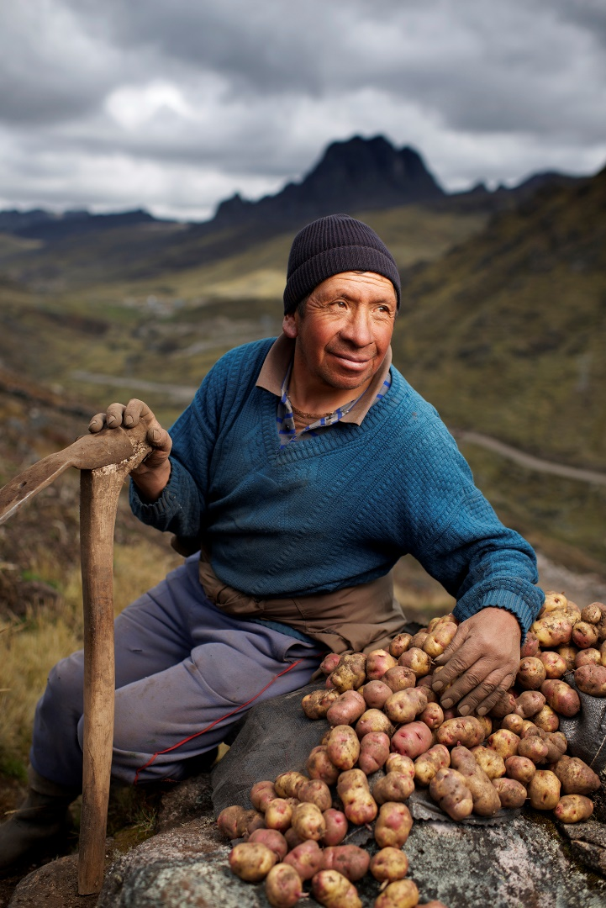
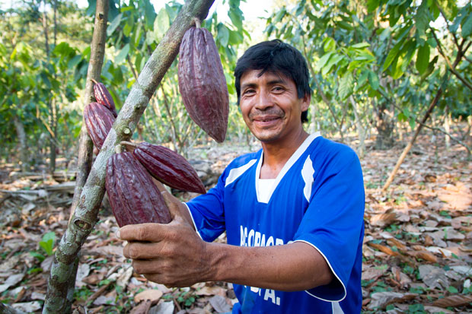
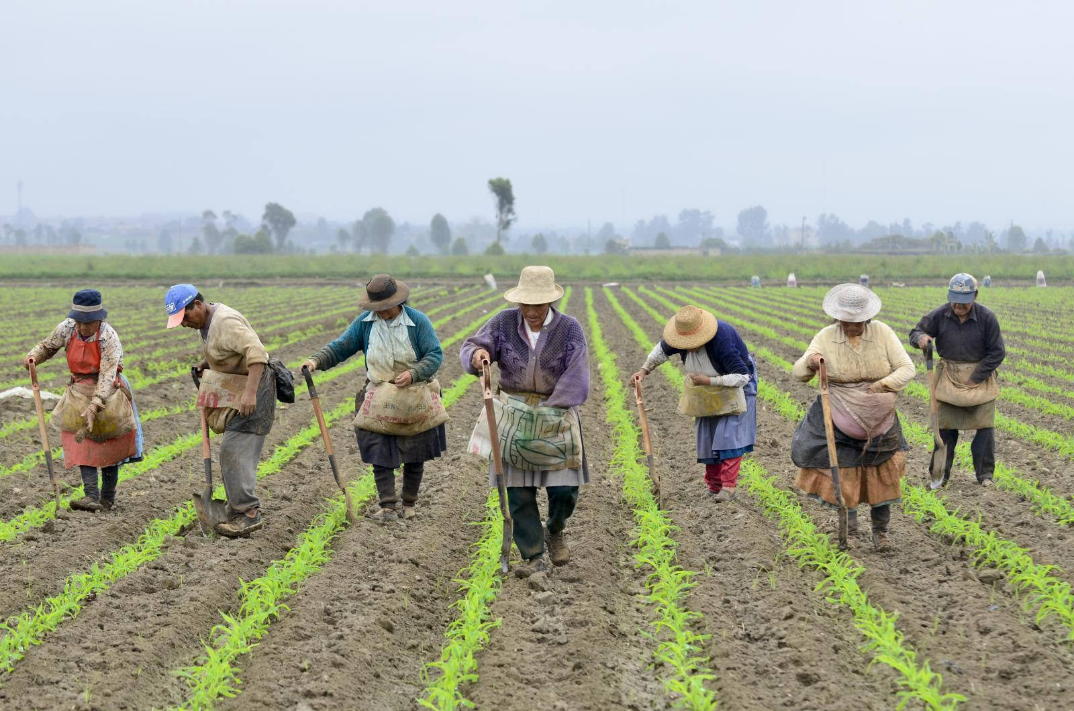
Responding to the WORD
Minutes of Mission
Presbyterian Hunger Program

Slide 23
Bearing and Following the WORD into the World Announcements &
Sharing of Joys and Concerns
The afternoon Bible Study Group will resume next Sunday downstairs at 12:30pm. We are continuing the series with 365 Days Daily Devotional written by John Calvin, in commemoration of the 500th Anniversary of the Protestant Reformation. All are welcomed.
The Women's Group will be meeting over at the Manse (2048 E 14th Street) every Wednesday evening @ 7:30pm. They are currently studying the book of Mark. For more information, please contact Margaret Lesman or Cara Chin.

Slide 24
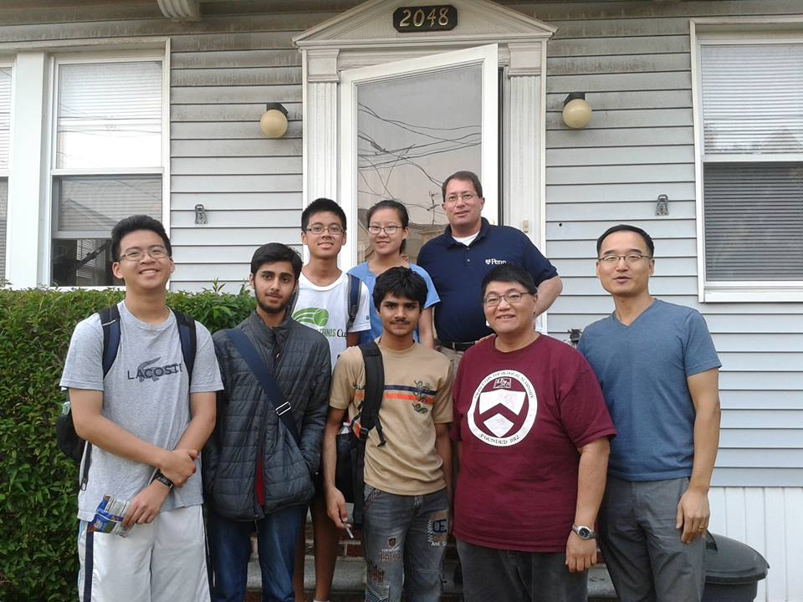
Bearing and Following the WORD into the World Announcements &
Sharing of Joys and Concerns
FREE SAT Preparation Courses, 5/30 - 6/2 4-7pm over at the Manse. For more information, please see Pastor Samson and pick up one of the flyers on the back table. Invite your neighbors/friends and their youths.

Slide 25
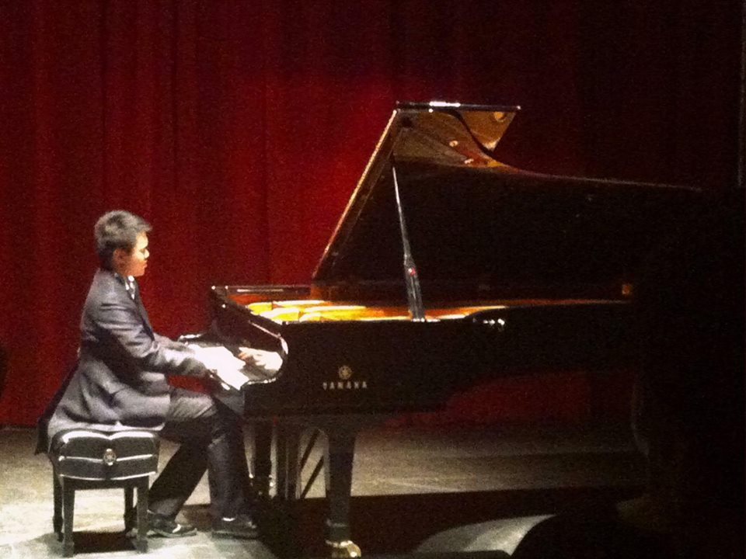
Bearing and Following the WORD into the World Announcements &
Sharing of Joys and Concerns
Our music director – Brian Lam will be having a recital at Brooklyn College Recital Hall on 6/11 at 5:30pm
Special Ticket rate of $15 for Church members only.
See Brian if you are interested.

Slide 26
Bearing and Following the WORD into the World Prayer of the People & The Lord’s Prayer
Our Father, who art in heaven.
Halloweth be thy name.
Thy Kingdom come; Thy will be done
On earth as it is in heaven.
Give us this day our daily bread.
Forgive us our debts; as we forgive our debtors.
Lead us not into temptations, but deliver us from evil.
For Thine is the Kingdom, the Power, and the Glory forever. Amen.

Slide 27
Bearing and Following the WORD into the World Offering of our Gifts and our Lives

Slide 28
Bearing and Following the WORD into the World Doxology and Offertory Prayer

Slide 29
Responding Hymn # 546 “Lord, Dismiss Us with Your Blessing”
Lord, dismiss us with your blessing; fill our hearts with joy and peace; let us each, your love possessing, triumph in redeeming grace. O refresh us, O refresh us, traveling through this wilderness.

Slide 30
Responding Hymn # 546 “Lord, Dismiss Us with Your Blessing”
Thanks we give and adoration for your gospel's joyful sound; may the fruits of your salvation in our hearts and lives abound. Ever faithful, ever faithful to your truth may we be found.

Slide 31
Responding Hymn # 546 “Lord, Dismiss Us with Your Blessing”
Savior, when your love shall call us, from our struggling pilgrim way, let no fear of death appall us, glad your summons to obey. May we ever, may we ever reign with you in endless day.

Slide 32
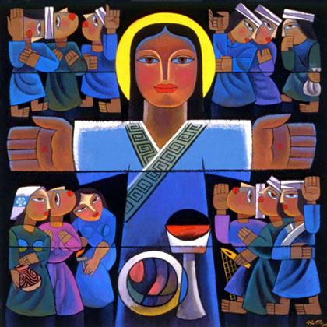
Bearing and Following the WORD into the World The Charge and Benediction

Slide 33
Bearing and Following the WORD into the World Benediction Response
# 540 “Farewell, Good Friends”
Farewell, Good friends!
Farewell, Good friends! Shalom, shalom! Till we meet again, till we meet again,
Shalom, Shalom.

Slide 34
Homecrest Presbyterian Church Worship of the Lord’s Day May 21st, 2017 6th Sunday of Easter

