Slide 1
Homecrest Presbyterian Church Worship of the Lord’s Day April 9th, 2017

Slide 2
Gathering Around the WORD Call to Worship
Awake to the day of triumph for our Savior!
Give thanks for this day that leads to the cross!
We have come with your branches,
Hosannas, and songs!
We shall fill the air with welcome to the Lord!
Blessed is the one who comes in the name of the Lord! Peace in heaven and glory in the highest heaven!
Hosanna! Hosanna! Hosanna in the highest!

Slide 3
Gathering Hymn # 196 “All Glory, Laud, and Honor”
All glory, laud, and honor to thee, Redeemer, King, to whom the lips of children made sweet hosannas ring!
Thou art the King of Israel, thou David’s royal Son, who in the Lord’s name comest, the King and blessed One.

Slide 4
Gathering Hymn # 196 “All Glory, Laud, and Honor”
All glory, laud, and honor to thee, Redeemer, King, to whom the lips of children made sweet hosannas ring!
The people of the Hebrews with palms before thee went; our praise and prayers and anthems before thee we present.

Slide 5
Gathering Hymn # 196 “All Glory, Laud, and Honor”
All glory, laud, and honor to thee, Redeemer, King, to whom the lips of children made sweet hosannas ring!
To thee, before thy passion, they sang their hymns of praise; to thee, now high exalted, our melody we raise.

Slide 6
Gathering Hymn # 196 “All Glory, Laud, and Honor”
All glory, laud, and honor to thee, Redeemer, King, to whom the lips of children made sweet hosannas ring!
Thou didst accept their praises; accept the prayers we bring, who in all good delightest, thou good and gracious King!

Slide 7
Gathering Hymn # 196 “All Glory, Laud, and Honor”
All glory, laud, and honor to thee, Redeemer, King, to whom the lips of children made sweet hosannas ring!

Slide 8
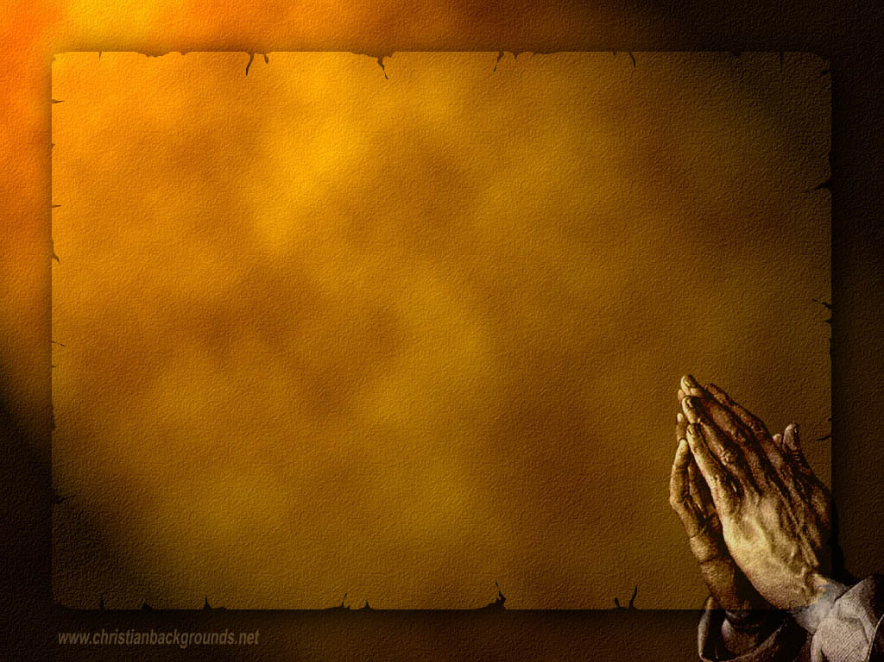
Gathering Around the WORD Call to Confession As Christ entered Jerusalem to offer us God’s redeeming grace, as he entered he kept knocking at the doors of our hearts. Although we may shout aloud to welcome Him into town, yet we have refused to let Him and others into our hearts. Let us come before God in a contrite spirit, confessing our wrongs and seeking God’s grace and forgiveness against God and our neighbors.

Slide 9
Gathering Around the WORD Prayer of Confession (in unison) God of heaven and earth, we give you thanks for sending us Jesus Christ in your name. We confess that in times of trial we too often deny him. We demand an outcome according to our ways instead of yours. Forgive us and heal us, we pray. Help us to put our faith forward not in the princes of this world, but only in the Prince of Peace, in whose name we pray, Amen.

Slide 10
Gathering Around the WORD Declaration of Forgiveness Christ came to help us and to save us. We have waved our branches in welcoming the King of kings into our lives. We have been declared righteous because of God’s unconditional grace and our faith in Jesus Christ. Thanks be to God, Amen

Slide 11
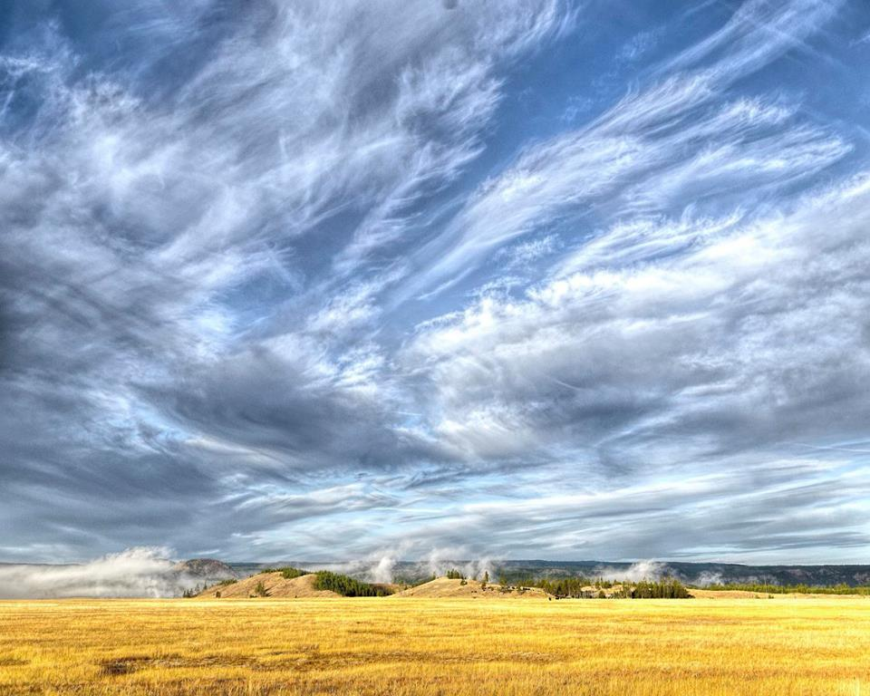
Gathering Around the WORD Gloria Patri
Glory be to the Father
and to the Son and to the Holy Ghost;
As it was in the beginning,
is now, and ever shall be,
world without end. Amen, Amen.

Slide 12
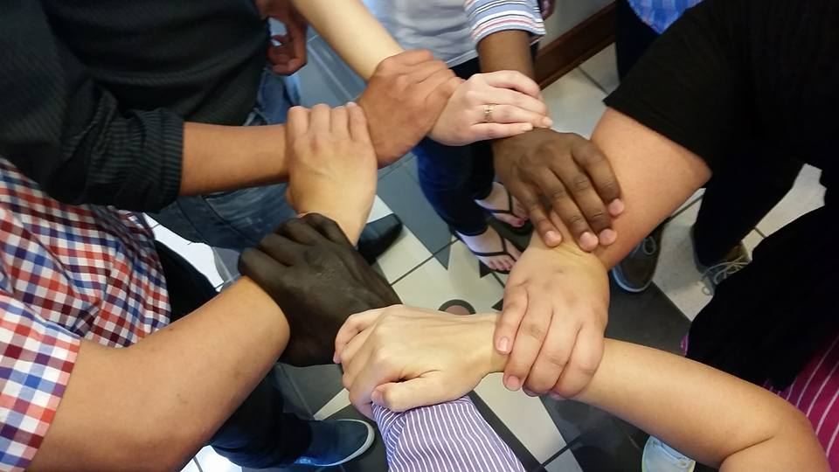
Gathering Around the WORD Passing of the Peace of Christ
(I John 14:27)
Jesus said, “Peace I leave with you; my peace I give to you. I do not give to you as the world gives. Do not let your hearts be troubled, and do not let them be afraid.”

Slide 13
Proclaiming the WORD Message to the Youth/ Prayer of Illumination

Slide 14
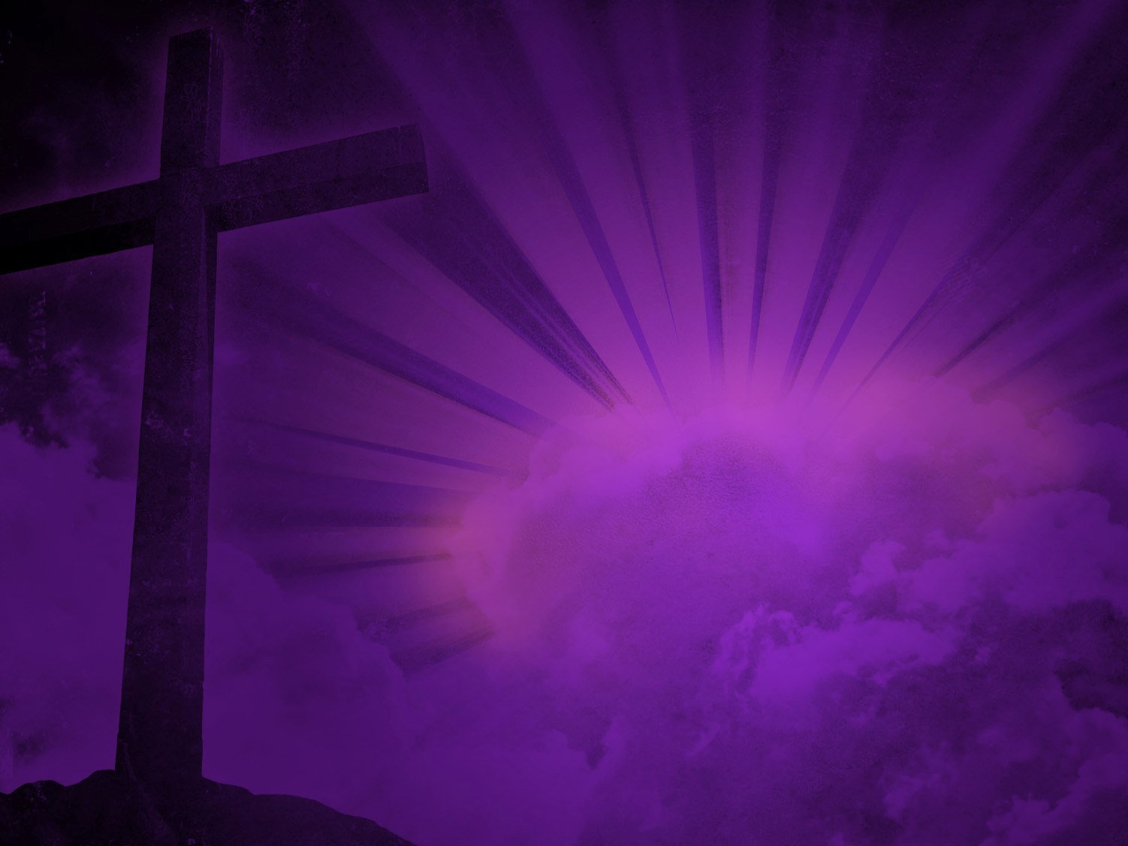
Proclaiming the WORD Responsive Reading – Psalm 118:1-2, 19-29
O give thanks to the LORD, for he is good; his steadfast love endures for ever!
Let Israel say,
“His steadfast love endures for ever.”
Open to me the gates of righteousness, that I may enter through them and give thanks to the LORD.
This is the gate of the LORD;
the righteous shall enter through it.

Slide 15
Proclaiming the WORD Responsive Reading – Psalm 118:1-2, 19-29
I thank you that you have answered me and have become my salvation. The stone that the builders rejected has become the chief cornerstone. This is the LORD’s doing; it is marvelous in our eyes. This is the day that the LORD has made; let us rejoice and be glad in it. Save us, we beseech you, O LORD! O LORD, we beseech you, give us success!
Blessed is the one who comes in the name of the
LORD. We bless you from the house of the LORD.

Slide 16
Proclaiming the WORD Responsive Reading – Psalm 118:1-2, 19-29
²⁷ The LORD is God, and he has given us light. Bind the festal procession with branches, up to the horns of the altar. ²⁸ You are my God, and I will give thanks to you; you are my God, I will extol you.
²⁹ O give thanks to the LORD, for he is good, for his steadfast love endures forever.

Slide 17
Proclaiming the WORD Scripture Reading – Matthew 21:1-11
When they had come near Jerusalem and had reached Bethphage, at the Mount of Olives, Jesus sent two disciples, saying to them, “Go into the village ahead of you, and immediately you will find a donkey tied, and a colt with her; untie them and bring them to me. If anyone says anything to you, just say this, ‘The Lord needs them.’ And he will send them immediately.” ⁴This took place to fulfill what had been spoken through the prophet, saying,

Slide 18
Proclaiming the WORD Scripture Reading – Matthew 21:1-11
⁵ “Tell the daughter of Zion, Look, your king is coming to you, humble, and mounted on a donkey, and on a colt, the foal of a donkey.”
⁶The disciples went and did as Jesus had directed them; ⁷they brought the donkey and the colt, and put their cloaks on them, and he sat on them. ⁸A very large crowd spread their cloaks on the road, and others cut branches from the trees and spread them on the road.

Slide 19
Proclaiming the WORD Scripture Reading – Matthew 21:1-11
⁹The crowds that went ahead of him and that followed were shouting, “Hosanna to the Son of David!
Blessed is the one who comes
in the name of the Lord! Hosanna in the highest heaven!”
¹⁰When he entered Jerusalem, the whole city was in turmoil, asking, “Who is this?” ¹¹The crowds were saying, “This is the prophet Jesus from Nazareth in Galilee.”

Slide 20
Proclaiming the WORD (Psalm 118:1-2, 19-29, Matthew 21:1-11)
Ministry of Hospitality (Welcome)

Slide 21
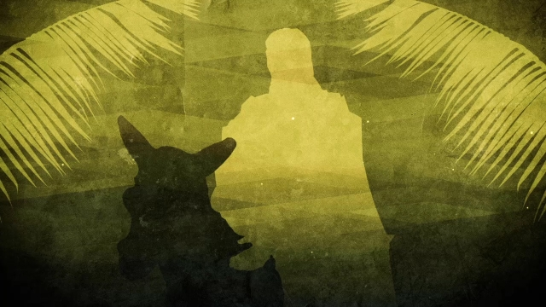
Responding Hymn # 198 “Ride On! Ride On In Majesty!”
Ride on! ride on in majesty! Hark! all the tribes hosanna cry; thy humble beast pursues its road with palms and scattered garments strowed.

Slide 22
Responding Hymn # 198 “Ride On! Ride On In Majesty!”
Ride on! ride on in majesty! In lowly pomp ride on to die; O Christ, thy triumphs now begin o'er captive death and conquered sin.

Slide 23
Responding Hymn # 198 “Ride On! Ride On In Majesty!”
Ride on! ride on in majesty! The hosts of angels in the sky look down with sad and wondering eyes to see the approaching sacrifice.

Slide 24
Responding Hymn # 198 “Ride On! Ride On In Majesty!”
Ride on! ride on in majesty! In lowly pomp ride on to die; bow thy meek head to mortal pain; then take, O God, thy power, and reign.

Slide 25
Responding to the WORD
Affirmation of Faith – (Philippians 2:5-11)
Let the same mind be in you that was in Christ Jesus, who, though he was in the form of God, did not regard equality with God as something to be exploited, but emptied himself, taking the form of a slave, being born in human likeness. And being found in human form, he humbled himself and became obedient to the point of death - even death on a cross.

Slide 26
Responding to the WORD
Affirmation of Faith – (Philippians 2:5-11)
Therefore, God also highly exalted him and gave him the name that is above every name, so that at the name of Jesus every knee should bend, in heaven and on earth and under the earth, and every tongue should confess that Jesus Christ is Lord, to the glory of God the Father.

Slide 27
Bearing and Following the WORD into the World Announcements &
Sharing of Joys and Concerns
The afternoon Bible Study Group will continue today downstairs in the basement at 12:30pm.
The Women's Group meets on every Wednesdays at 7:30pm over at the Manse (2048 E 14th Street). They are currently studying Gospel of Mark. For more information, please see Margaret and Cara.

Slide 28
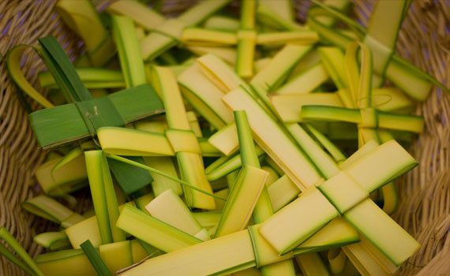
Bearing and Following the WORD into the World Announcements &
Sharing of Joys and Concerns
We will be visiting and distributing Palm Crosses at St. Joachim & Anne Nursing and Rehab Center.

Slide 29
Bearing and Following the WORD into the World Announcements &
Sharing of Joys and Concerns
Good Friday Worship Service, 4/14 7pm. We will be joined by Sheepshead Bay Resurrection and King’s Chapel this year.
Resurrection (Easter) Sunday Worship Service will be on 4/16 11am.

Slide 30
Bearing and Following the WORD into the World Prayer of the People & The Lord’s Prayer
Our Father, who art in heaven.
Halloweth be thy name.
Thy Kingdom come; Thy will be done
On earth as it is in heaven.
Give us this day our daily bread.
Forgive us our debts; as we forgive our debtors.
Lead us not into temptations, but deliver us from evil.
For Thine is the Kingdom, the Power, and the Glory forever. Amen.

Slide 31
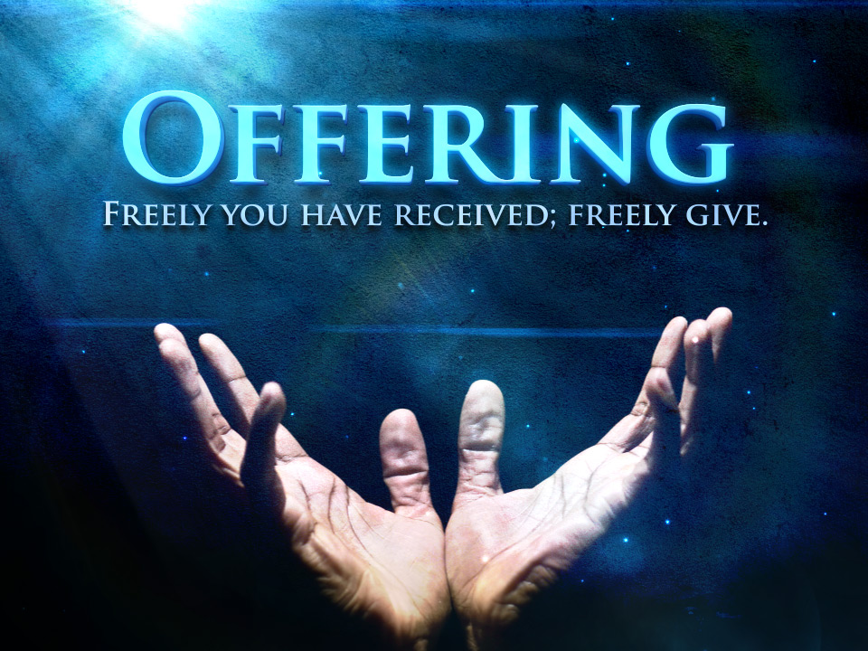
Bearing and Following the WORD into the World Offering of our Gifts and our Lives

Slide 32
Bearing and Following the WORD into the World Doxology and Offertory Prayer

Slide 33
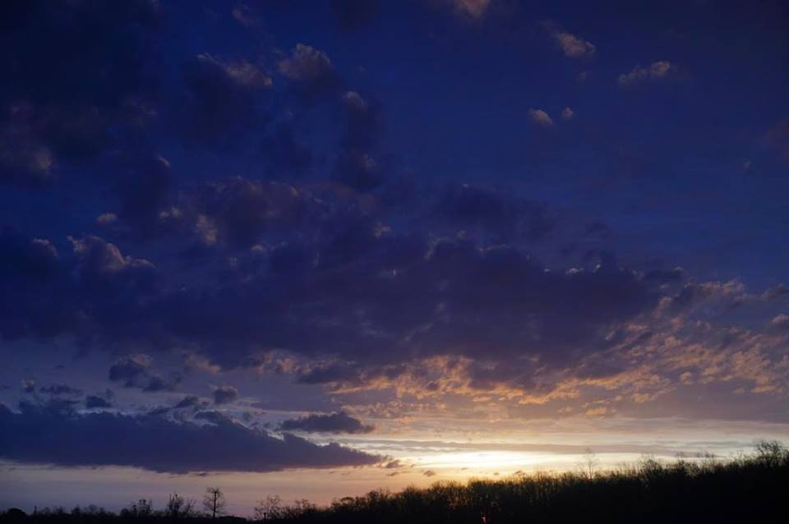
Sending Hymn # 197 “Hosanna, Loud Hosanna”
Hosanna, loud hosanna, the little children sang; through pillared court and temple the joyful anthem rang. To Jesus, who had blessed them, close folded to his breast, the children sang their praises, the simplest and the best.

Slide 34
Sending Hymn # 197 “Hosanna, Loud Hosanna”
From Olivet they followed 'mid an exultant crowd, the victor palm branch waving, and chanting clear and loud; the Lord of earth and heaven rode on in lowly state, nor scorned that little children should on his bidding wait.

Slide 35
Sending Hymn # 197 “Hosanna, Loud Hosanna”
“Hosanna in the highest!” That ancient song we sing, for Christ is our Redeemer; the Lord of heaven, our King. O may we ever praise him with heart and life and voice, and in his blissful presence eternally rejoice.

Slide 36
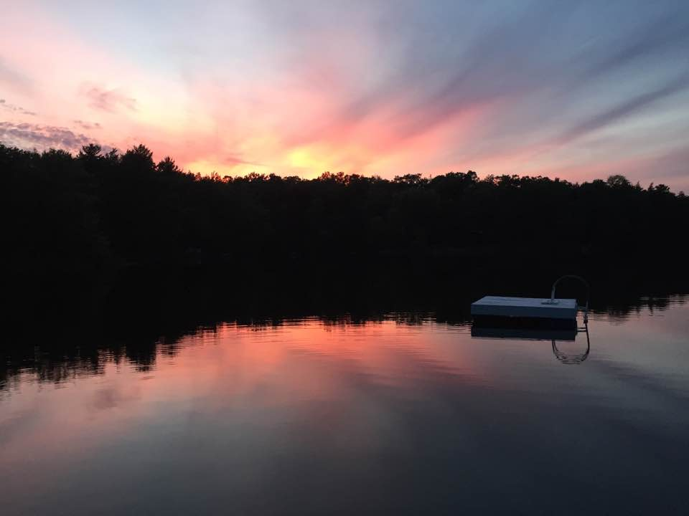
Bearing and Following the WORD into the World The Charge and Benediction

Slide 37
Bearing and Following the WORD into the World Benediction Response
# 547 “Go, My Children, with My Blessing”
(Stanza 2)
Go, my children, sins forgiven, at peace and pure. Here you learned how much I love you,
what I can cure. Here you heard my dear Son’s story;
here you touched him, saw his glory. Go, my children, sins forgiven, at peace and pure.

Slide 38
Homecrest Presbyterian Church Worship of the Lord’s Day April 9th, 2017

