Slide 1
Homecrest Presbyterian Church Worship of the Lord’s Day April 2nd, 2017 5th Sunday in Lent / Holy Communion

Slide 2
Gathering Around the WORD Call to Worship
O mortal, can these bones live?
Only the Lord God knows.
O people, hope in the Lord.
With the Lord there is steadfast love
and great power to redeem.
We have come to worship the immortal God!

Slide 3
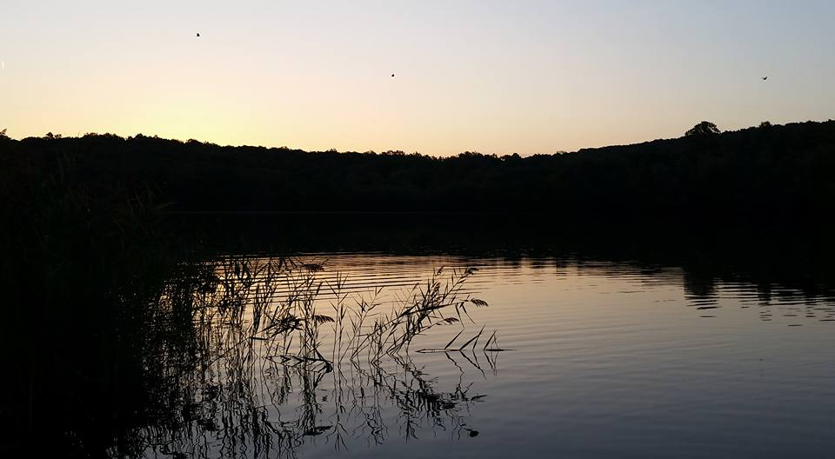
Gathering Hymn # 286 “Breathe on me, Breath of God”
Breathe on me, Breath of God; fill me with life anew, that I may love what thou dost love, and do what thou wouldst do.

Slide 4
Gathering Hymn # 286 “Breathe on me, Breath of God”
Breathe on me, Breath of God, until my heart is pure, until with thee I will one will, to do and to endure.

Slide 5
Gathering Hymn # 286 “Breathe on me, Breath of God”
Breathe on me, Breath of God, till I am wholly thine, until this earthly part of me glows with thy fire divine.

Slide 6
Gathering Hymn # 286 “Breathe on me, Breath of God”
Breathe on me, Breath of God, so shall I never die, but live with thee the perfect life of thine eternity.

Slide 7
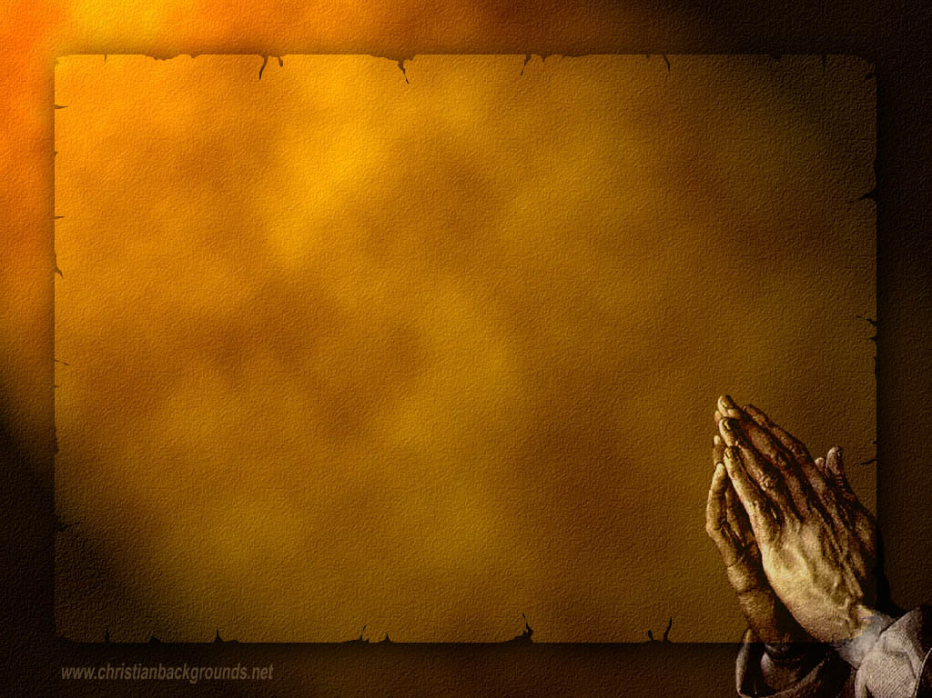
Gathering Around the WORD Call to Confession (Romans 8:6, 10) To set the mind on the flesh is death, but to set the mind on the Spirit is life and peace. Trusting in the Spirit of God, let us confess our sins before God and our neighbors.

Slide 8
Gathering Around the WORD Prayer of Confession (in unison) Psalm 130:1-6 Out of the depths we cry to you, O LORD. Lord, hear our voices! Let your ears be attentive to the voice of our supplications. If you, O LORD, should mark iniquities, Lord, who could stand? But there is forgiveness with you, so that you may be revered. We wait for the LORD, our soul waits, and in his word we hope; Our soul waits for the Lord more than those who watch for the morning.

Slide 9
Gathering Around the WORD Declaration of Forgiveness (Psalm 130:7-8) O Israel, hope in the LORD! For with the LORD there is steadfast love, and with him is great power to redeem. It is he who will redeem Israel from all its iniquities. God has revived us through the Spirit and given us new life. Thanks be to God, Amen.

Slide 10
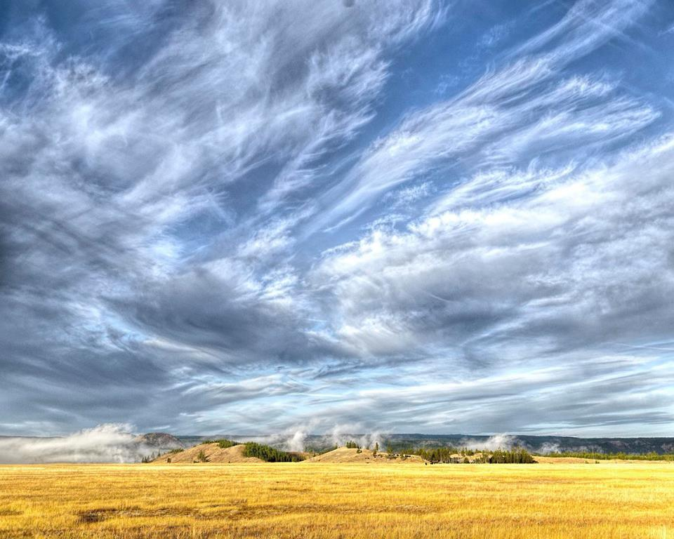
Gathering Around the WORD Gloria Patri
Glory be to the Father
and to the Son and to the Holy Ghost;
As it was in the beginning,
is now, and ever shall be,
world without end. Amen, Amen.

Slide 11
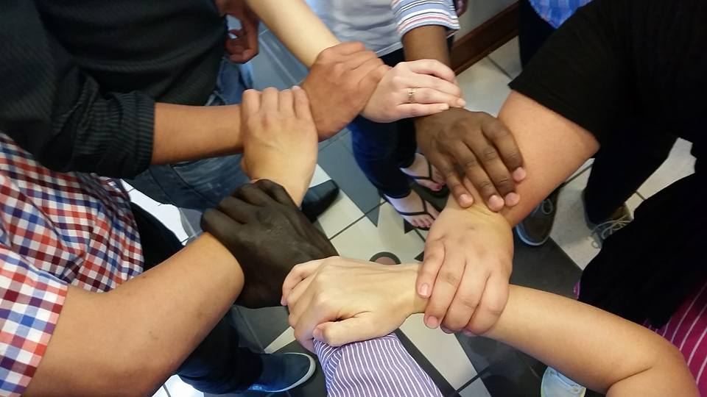
Gathering Around the WORD Passing of the Peace of Christ
Beloved, let us love one another, because love is from God; everyone who loves is born of God and knows God. Whoever does not love does not know God, for God is love. Sisters and Brothers, let us pass the peace of Christ and the love of God with one another. (I John 4:7-8)

Slide 12
Proclaiming the WORD Message to the Youth/ Prayer of Illumination

Slide 13
Proclaiming the WORD Scripture Reading – Ezekiel 37:1-14
¹The hand of the LORD came upon me, and he brought me out by the spirit of the LORD and set me down in the middle of a valley; it was full of bones. ²He led me all around them; there were very many lying in the valley, and they were very dry. ³He said to me, “Mortal, can these bones live?” I answered, “O Lord GOD, you know.” ⁴Then he said to me, “Prophesy to these bones, and say to them: O dry bones, hear the word of the LORD.

Slide 14
Proclaiming the WORD Scripture Reading – Ezekiel 37:1-14
⁵Thus says the Lord GOD to these bones: I will cause breath to enter you, and you shall live. ⁶I will lay sinews on you, and will cause flesh to come upon you, and cover you with skin, and put breath in you, and you shall live; and you shall know that I am the LORD.”

Slide 15
Proclaiming the WORD Scripture Reading – Ezekiel 37:1-14
⁷So I prophesied as I had been commanded; and as I prophesied, suddenly there was a noise, a rattling, and the bones came together, bone to its bone. ⁸I looked, and there were sinews on them, and flesh had come upon them, and skin had covered them; but there was no breath in them. ⁹Then he said to me, “Prophesy to the breath, prophesy, mortal, and say to the breath: Thus says the Lord GOD: Come from the four winds, O breath, and breathe upon these slain, that they may live.”

Slide 16
Proclaiming the WORD Scripture Reading – Ezekiel 37:1-14
¹⁰I prophesied as he commanded me, and the breath came into them, and they lived, and stood on their feet, a vast multitude.
¹¹Then he said to me, “Mortal, these bones are the whole house of Israel. They say, ‘Our bones are dried up, and our hope is lost; we are cut off completely.’

Slide 17
Proclaiming the WORD Scripture Reading – Ezekiel 37:1-14
¹²Therefore prophesy, and say to them, Thus says the Lord GOD: I am going to open your graves, and bring you up from your graves, O my people; and I will bring you back to the land of Israel. ¹³And you shall know that I am the LORD, when I open your graves, and bring you up from your graves, O my people. ¹⁴I will put my spirit within you, and you shall live, and I will place you on your own soil; then you shall know that I, the LORD, have spoken and will act,” says the LORD.

Slide 18
Proclaiming the WORD Scripture Reading – John 11:17-27, 38-45
¹⁷When Jesus arrived, he found that Lazarus had already been in the tomb four days. ¹⁸Now Bethany was near Jerusalem, some two miles away, ¹⁹and many of the Jews had come to Martha and Mary to console them about their brother. ²⁰When Martha heard that Jesus was coming, she went and met him, while Mary stayed at home. ²¹Martha said to Jesus, “Lord, if you had been here, my brother would not have died. ²²But even now I know that God will give you whatever you ask of him.”

Slide 19
Proclaiming the WORD Scripture Reading – John 11:17-27, 38-45
²³Jesus said to her, “Your brother will rise again.” ²⁴Martha said to him, “I know that he will rise again in the resurrection on the last day.” ²⁵Jesus said to her, “I am the resurrection and the life. Those who believe in me, even though they die, will live, ²⁶and everyone who lives and believes in me will never die. Do you believe this?” ²⁷She said to him, “Yes, Lord, I believe that you are the Messiah, the Son of God, the one coming into the world.”

Slide 20
Proclaiming the WORD Scripture Reading – John 11:17-27, 38-45
³⁸Then Jesus, again greatly disturbed, came to the tomb. It was a cave, and a stone was lying against it. ³⁹Jesus said, “Take away the stone.” Martha, the sister of the dead man, said to him, “Lord, already there is a stench because he has been dead four days.” ⁴⁰Jesus said to her, “Did I not tell you that if you believed, you would see the glory of God?” ⁴¹So they took away the stone. And Jesus looked upward and said, “Father, I thank you for having heard me.

Slide 21
Proclaiming the WORD Scripture Reading – John 11:17-27, 38-45
⁴²I knew that you always hear me, but I have said this for the sake of the crowd standing here,
so that they may believe that you sent me.”
⁴³When he had said this, he cried with a loud voice, “Lazarus, come out!” ⁴⁴The dead man came out, his hands and feet bound with strips of cloth, and his face wrapped in a cloth. Jesus said to them, “Unbind him, and let him go.”
⁴⁵Many of the Jews therefore, who had come with Mary and had seen what Jesus did, believed in him.

Slide 22
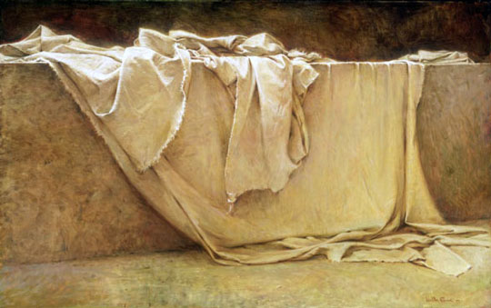
Proclaiming the WORD (Ezekiel 37:1-14, John 11:17-27, 38-44)
Unbinding and Letting Go

Slide 23
Responding Hymn # 279 “Come Holy Spirit, Heavenly Dove”
Come, Holy Spirit, heavenly Dove, with all thy quickening powers; kindle a flame of sacred love in these cold hearts of ours.

Slide 24
Responding Hymn # 279 “Come Holy Spirit, Heavenly Dove”
In vain we tune our formal songs; in vain we strive to rise; hosannas languish on our tongues, and our devotion dies.

Slide 25
Responding Hymn # 279 “Come Holy Spirit, Heavenly Dove”
Dear Lord, and shall we ever live at this poor dying rate? Our love so faint, so cold to thee, and thine to us so great!

Slide 26
Responding Hymn # 279 “Come Holy Spirit, Heavenly Dove”
Come, Holy Spirit, heavenly Dove, with all thy quickening powers; come, shed abroad a Savior's love, and that shall kindle ours.

Slide 27
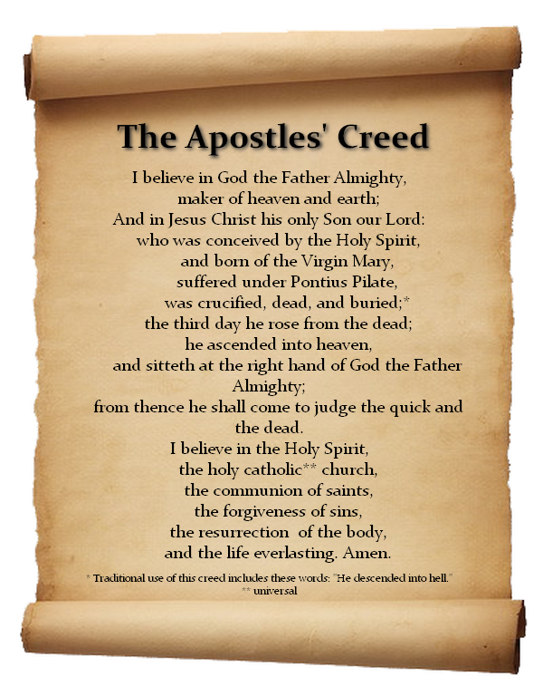
Responding to the WORD
Affirmation of Faith

Slide 28
Bearing and Following the WORD into the World Announcements &
Sharing of Joys and Concerns
The afternoon Bible Study Group will resume next Sunday downstairs in the basement today, at 12:30pm.
The Women's Group meets on every Wednesdays at 7:30pm over at the Manse (2048 E 14th Street). They are currently studying Gospel of Mark. For more information, please see Margaret and Cara.

Slide 29
Bearing and Following the WORD into the World Announcements &
Sharing of Joys and Concerns
Lenten Breakfast will conclude next Sunday. Please arrive before 10:15.
The Session will be meeting Tomorrow, April 3 at 7pm.

Slide 30
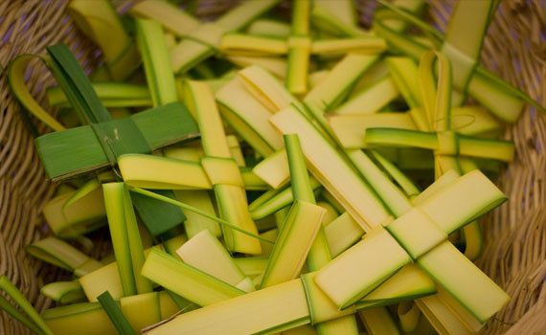
Bearing and Following the WORD into the World Announcements &
Sharing of Joys and Concerns
We will be visiting and distributing Palm Crosses at the nursing home Next Sunday on Palm Sunday, 4/9 after service. We will be making these crosses on Saturday, 4/8 at 10am.

Slide 31
Bearing and Following the WORD into the World Announcements &
Sharing of Joys and Concerns
Good Friday Worship Service, 4/14 7pm. We will be joined by Sheepshead Bay Resurrection and King’s Chapel this year.
Resurrection (Easter) Sunday Worship Service will be on 4/16 11am.

Slide 32
Bearing and Following the WORD into the World Prayer of the People & The Lord’s Prayer
Our Father, who art in heaven.
Halloweth be thy name.
Thy Kingdom come; Thy will be done
On earth as it is in heaven.
Give us this day our daily bread.
Forgive us our debts; as we forgive our debtors.
Lead us not into temptations, but deliver us from evil.
For Thine is the Kingdom, the Power, and the Glory forever. Amen.

Slide 33
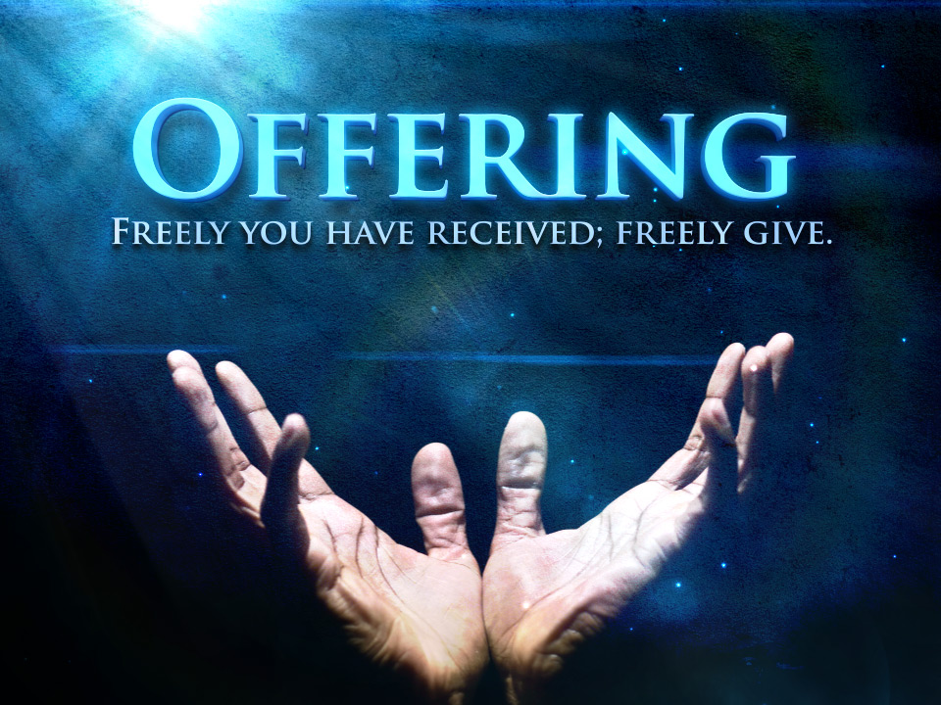
Bearing and Following the WORD into the World Offering of our Gifts and our Lives

Slide 34
Bearing and Following the WORD into the World Doxology and Offertory Prayer

Slide 35
Communion Hymn # 288 “Spirit of the Living God”
Spirit of the Living God,
Fall afresh on me.
Spirit of the Living God,
Fall afresh on me. Melt me; Mold me; Fill me; Use me.
Spirit of the living God, fall afresh on me.
(2X)

Slide 36
Bearing and Following the WORD into the World Holy Communion
God the Spirit calls us even as dry bones in the valley. You have given us new life through your grace and power of the resurrection. You have called us into the same Spirit that binds us all together as one body through one faith, one lord, and one baptism.

Slide 37
Bearing and Following the WORD into the World Holy Communion
Together, we have joined around this table of LOVE. We celebrate God's presence among us wherever the Spirit leads us through our struggles and challenges. We acknowledge that we have fallen short of your grace and are in need of God’s forgiveness.

Slide 38
Bearing and Following the WORD into the World Holy Communion
This is the table of the Heavenly Feast, the joyful celebration of the people of God.
Christ invites those who confess their faith and baptized in Him to eat the bread of life and to drink the cup of the new covenant.

Slide 39
Bearing and Following the WORD into the World Holy Communion
The Lord be with you. And also with you.
Lift up your hearts. We lift them up to the Lord.
Let us give thanks to the Lord our God.
It is right to give our thanks and praise.

Slide 40
Bearing and Following the WORD into the World Holy Communion
Holy God, we praise you for your love: bringing order out of chaos, breathing life into dust, challenging us to see the world as you intend it to be, opening our eyes of our hearts with compassion to those who need your grace.

Slide 41
Bearing and Following the WORD into the World Holy Communion
Therefore we join our voices with saints and angels and all the faithful of every time and place singing:
Holy, Holy, Holy Lord, God of power and might,
Heaven and earth are full of your glory.
Hosanna in the highest.
Blessed is he who comes in the name of the Lord.
Hosanna in the highest.

Slide 42
Bearing and Following the WORD into the World Holy Communion
We give you thanks for Jesus Christ: Word made flesh, light of the world, living water, the good shepherd and the gate, the way, the truth, and the life.
On the night before He died, Jesus took bread, and after giving thanks, He broke it, and gave it to His disciples, saying: Take, Eat, this is my body, which is given for you. Do this in remembrance of me.

Slide 43
Bearing and Following the WORD into the World Holy Communion
In the same way after supper, He took a cup, saying,
This cup is the new covenant sealed in my blood, poured out for you for the forgiveness of sins. Whenever you drink of it, Do this in remembrance of me.

Slide 44
Bearing and Following the WORD into the World Holy Communion
With thanks and praise we offer ourselves to you, O God. Sharing this holy meal, remembering Christ’s dying and rising, and praying:
Come Lord Jesus!
Christ has died, Christ is risen,
Christ will come again.

Slide 45
Bearing and Following the WORD into the World Holy Communion
Pour out your Holy Spirit upon us – this bread, this cup, and your people— Christ’s body and blood, given in love for the world.
Make us One in the Spirit, One in the church, and One with Christ our Lord.

Slide 46
Bearing and Following the WORD into the World Holy Communion
Jesus said, "I am the bread of life.
They who come to me shall never hunger;
they who believe in me shall never thirst.“
These are the gift of God for the people of God.

Slide 47
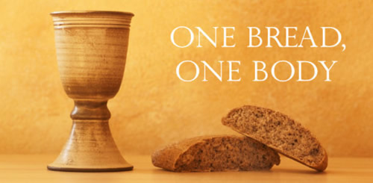
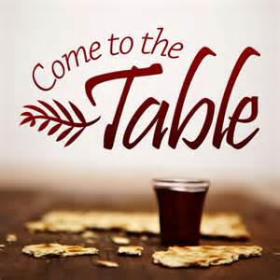
Bearing and Following the WORD into the World Holy Communion

Slide 48
Bearing and Following the WORD into the World
Prayer after the Communion: (in unison)
:
God of abundance and mercy, we joyfully give you thanks for your eternal love and healing presence in our celebration of bread and wine.
Bless these gifts that they may be for us the body and blood of Christ. Enable us to attend faithfully to our callings as your servants with others and throughout the world. Amen.

Slide 49
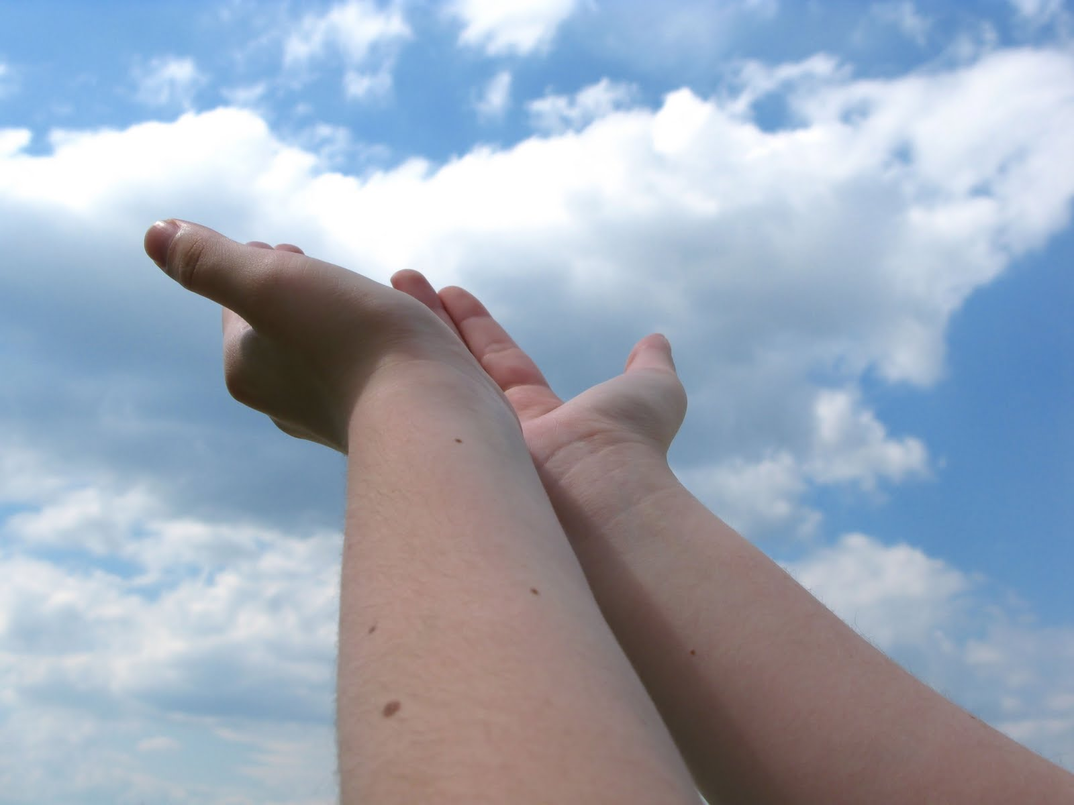
Bearing and Following the WORD into the World Deacons’ Benevolence Offering

Slide 50
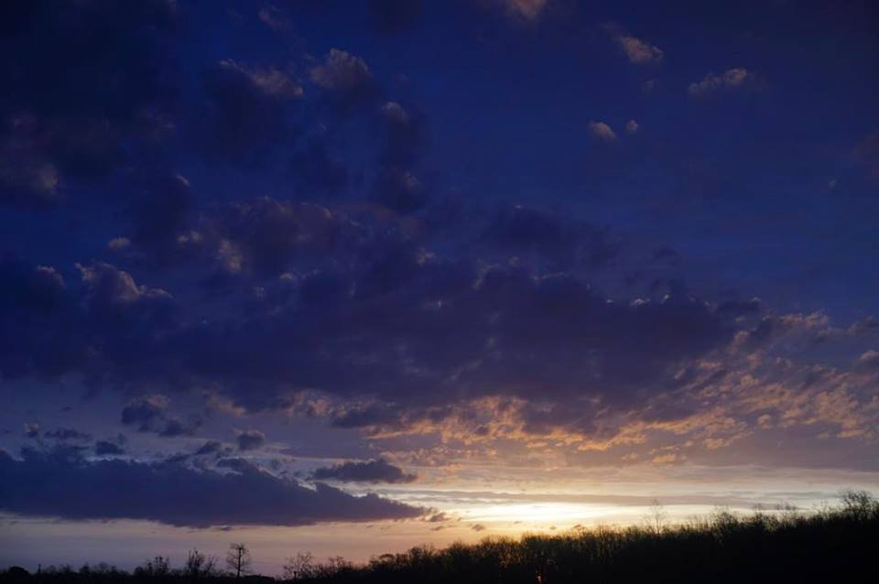
Sending Hymn # 300 “We Are One In the Spirit”
We are one in the Spirit;
we are one in the Lord; we are one in the Spirit;
we are one in the Lord, and we pray that all unity
may one day be restored: And they’ll know we are Christians
by our love, by our love; yes, they’ll know we are Christians by our love.

Slide 51
Sending Hymn # 300 “We Are One In the Spirit”
We will walk with each other;
we will walk hand in hand; we will walk with each other;
we will walk hand in hand, and together we’ll spread the news
that God is in our land: And they’ll know we are Christians
by our love, by our love; yes, they’ll know we are Christians by our love.

Slide 52
Sending Hymn # 300 “We Are One In the Spirit”
We will work with each other;
we will work side by side; we will work with each other;
we will work side by side, and we’ll guard human dignity
and save human pride: And they’ll know we are Christians
by our love, by our love; yes, they’ll know we are Christians by our love.

Slide 53
Sending Hymn # 300 “We Are One In the Spirit”
All praise to the Father,
from whom all things come, and all praise to Christ Jesus,
God’s only Son, and all praise to the Spirit,
who makes us one: And they’ll know we are Christians
by our love, by our love; yes, they’ll know we are Christians by our love.

Slide 54
Bearing and Following the WORD into the World The Charge and Benediction

Slide 55
Bearing and Following the WORD into the World Benediction Response
# 547 “Go, My Children, with My Blessing”
(Stanza 1)
Go, my children, with my blessing, never alone.
Waking, sleeping, I am with you, you are my own. In my love’s baptismal river
I have made you mine forever.
Go, my children, with my blessing, you are my own.

Slide 56
Homecrest Presbyterian Church Worship of the Lord’s Day April 2nd, 2017 5th Sunday in Lent / Holy Communion

