Slide 1
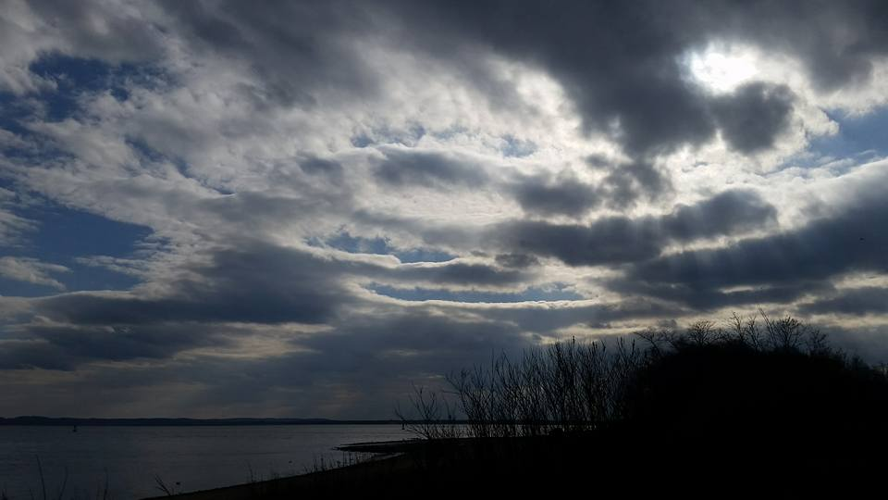
Homecrest Presbyterian Church Worship of the Lord’s Day February 5th, 2017 5th Sunday of Epiphany

Slide 2
Gathering Around the WORD Call to Worship
If the human body, body of blood and muscle is to live, it needs salt.
If the body of Christ, body of peace and justice is to live, it needs us!
If the earthly creation, bustling and blooming is to flourish, it needs the sun’s light.
If the new creation we are in Christ is to flourish, it needs the Spirit’s light!

Slide 3
Gathering Around the WORD Call to Worship
Jesus says we are salt of the earth,
light of the world. Briny and bright,
we are God’s faithful people.
We shall be who we are meant to be in Christ: a welcoming oasis, a compassionate community, a justice-making people,
giving glory to God!

Slide 4
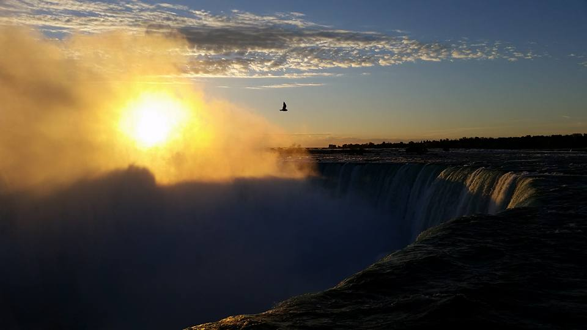
Gathering Hymn # 336 “We Gather Together”
We gather together
to ask the Lord's blessing; he chastens and hastens
his will to make known; the wicked oppressing
now cease from distressing. Sing praises to his name;
he forgets not his own.

Slide 5
Gathering Hymn # 336 “We Gather Together”
Beside us to guide us,
our God with us joining, ordaining, maintaining
his kingdom divine; so from the beginning
the fight we were winning; thou, Lord, wast at our side;
all glory be thine!

Slide 6
Gathering Hymn # 336 “We Gather Together”
We all do extol thee,
thou leader triumphant, and pray that thou still
our defender wilt be. Let thy congregation
escape tribulation; thy name be ever praised!
O Lord, make us free!

Slide 7
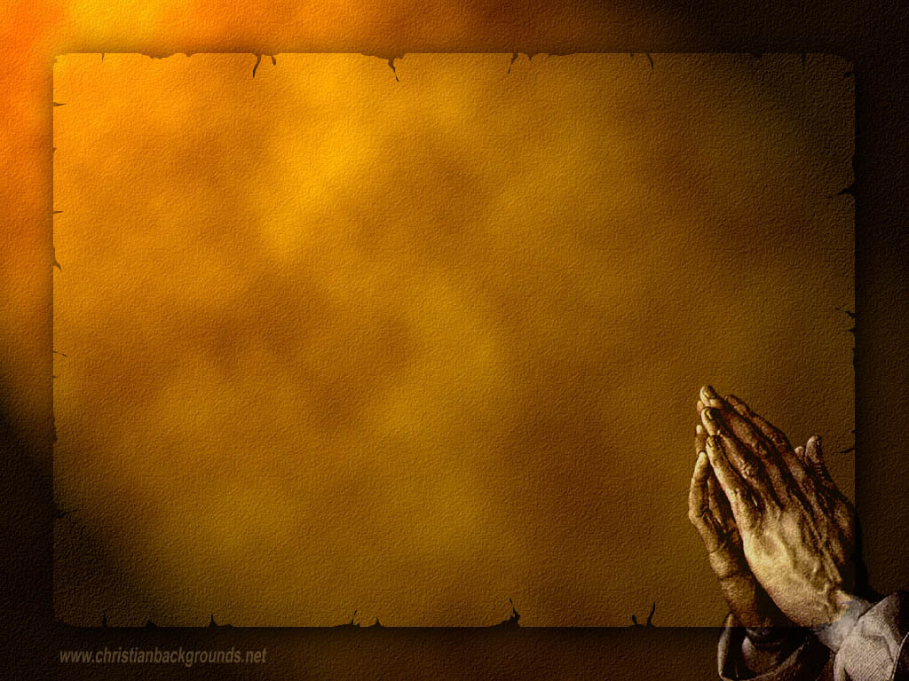
Gathering Around the WORD Call to Confession God has gathered us to be the shining light in this world that is often filled with darkness. God had called us to seek righteousness instead of evil. Yet from time to time, we’ve fallen and gone astray. In humility and faith, through the power of the Holy Spirit, let us come before God and our neighbors in our prayer of confession

Slide 8
Gathering Around the WORD Prayer of Confession (in unison) Almighty God, we have come to worship you with our lips, but have dishonored you with our actions. We have prayed for you to end the suffering in our world, yet we have not practiced compassion and generosity toward others. Our faith has become the source of quarrelling rather than a testimony to your grace. Forgive our self-righteousness and give us integrity of heart, that we may shine forth the light of your salvation, through Jesus Christ our Lord, Amen.

Slide 9
Gathering Around the WORD Declaration of Forgiveness In mercy God has reached out to the confessed sinner to come and stand in righteousness before Him. This is the Good News that in Jesus Christ, we are forgiven. Thanks be to God, Amen.

Slide 10
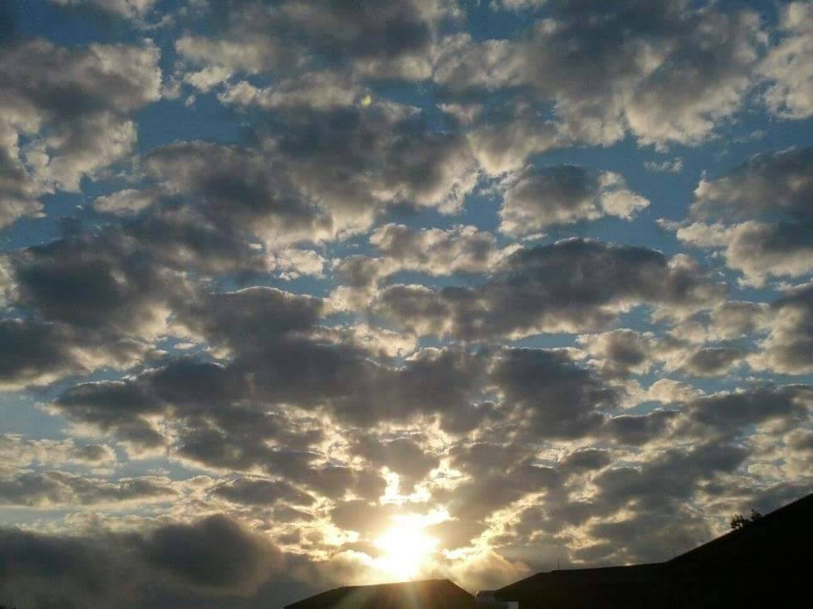
Gathering Around the WORD Gloria Patri
Glory be to the Father
and to the Son and to the Holy Ghost;
As it was in the beginning,
is now, and ever shall be,
world without end. Amen, Amen.

Slide 11
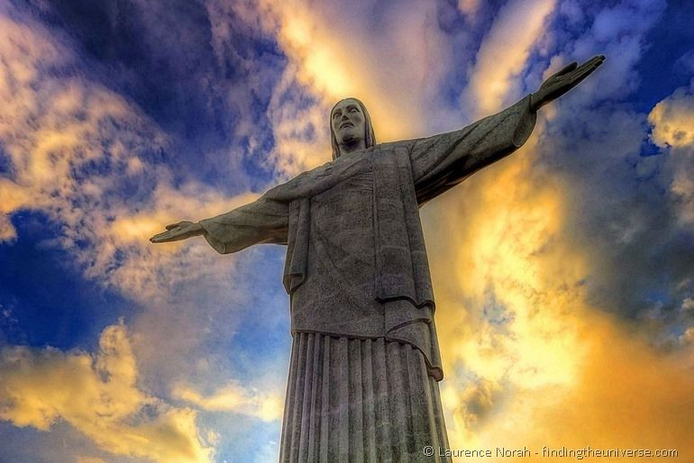
Gathering Around the WORD Passing of the Peace of Christ
Jesus said, “Peace I leave with you; my peace I give to you. I do not give to you as the world gives. Do not let your hearts be troubled, and do not let them be afraid.” (John 14:27)

Slide 12
Proclaiming the WORD Message to the Youth/ Prayer of Illumination

Slide 13
Proclaiming the WORD Scripture Reading – Matthew 5:13-20
¹³“You are the salt of the earth; but if salt has lost its taste, how can its saltiness be restored? It is no longer good for anything, but is thrown out and trampled under foot.
¹⁴“You are the light of the world. A city built on a hill cannot be hid. ¹⁵No one after lighting a lamp puts it under the bushel basket, but on the lampstand, and it gives light to all in the house. ¹⁶In the same way, let your light shine before others, so that they may see your good works and give glory to your Father in heaven.

Slide 14
Proclaiming the WORD Scripture Reading – Matthew 5:13-20
¹⁷“Do not think that I have come to abolish the law or the prophets; I have come not to abolish but to fulfill. ¹⁸For truly I tell you, until heaven and earth pass away, not one letter, not one stroke of a letter, will pass from the law until all is accomplished.

Slide 15
Proclaiming the WORD Scripture Reading – Matthew 5:13-20
¹⁹Therefore, whoever breaks one of the least of these commandments, and teaches others to do the same, will be called least in the kingdom of heaven; but whoever does them and teaches them will be called great in the kingdom of heaven. ²⁰For I tell you, unless your righteousness exceeds that of the scribes and Pharisees, you will never enter the kingdom of heaven.”

Slide 16
Proclaiming the WORD (Matthew 5:13-20)
Salt and Light

Slide 17
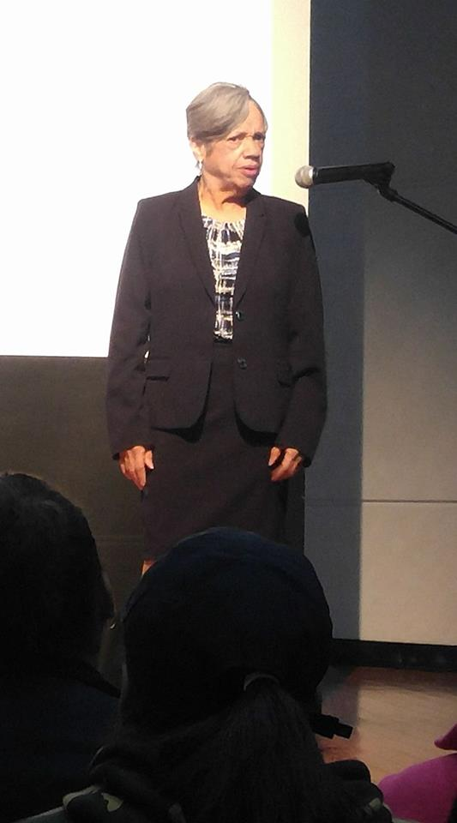
Proclaiming the WORD (Matthew 5:13-20)
Salt and Light

Slide 18
Proclaiming the WORD (Matthew 5:13-20)
Salt and Light

Slide 19
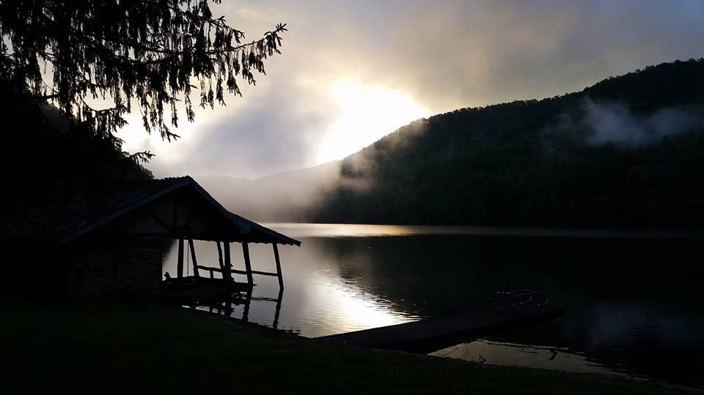
Responding Hymn # 744 “Arise Your Light Has Come”
Arise, your light is come! The Spirit's call obey; show forth the glory of your God, which shines on you today.

Slide 20
Responding Hymn # 744 “Arise Your Light Has Come”
Arise, your light is come! Fling wide the prison door; proclaim the captives' liberty, good tidings to the poor.

Slide 21
Responding Hymn # 744 “Arise Your Light Has Come”
Arise, your light is come! All you in sorrow born, bind up the brokenhearted ones and comfort those who mourn.

Slide 22
Responding Hymn # 744 “Arise Your Light Has Come”
Arise, your light is come! The mountains burst in song! Rise up like eagles on the wing; God's power will make us strong.

Slide 23
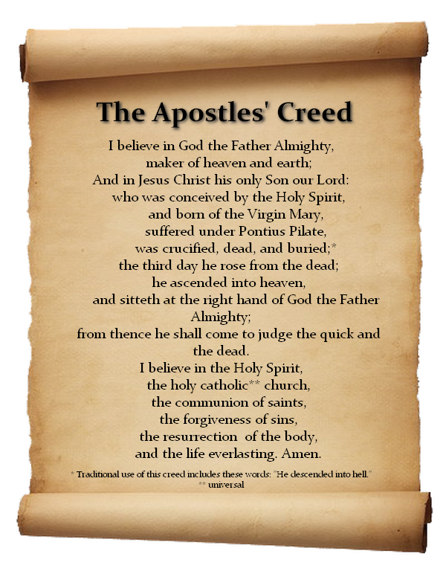
Responding to the WORD
Affirmation of Faith

Slide 24
Bearing and Following the WORD into the World Announcements &
Sharing of Joys and Concerns
Session Meeting tomorrow at 7pm.
All active elders please attend.

Slide 25
Bearing and Following the WORD into the World Announcements &
Sharing of Joys and Concerns
The afternoon Bible Study Group will NOT be meeting today, but will resume on Next Sunday in the basement, at 12:30pm. We are currently studying a new series on “365 Days with John Calvin” edited by Joel R. Beeke in commemoration of the 500th Anniversary of the Protestant Reformation this year.
The Women's Group meets on every Wednesdays at 7:30pm over at the Manse (2048 E 14th Street). They are currently studying Gospel of Mark. For more information, please see Margaret and Cara.

Slide 26
Bearing and Following the WORD into the World Announcements &
Sharing of Joys and Concerns
We are currently updating our Church Directory. Please verify your relevant information i.e., address, phones, email, birthday with a working draft copy on the back table. If the information is correct, please put a ( ✓) mark next to your name.

Slide 27
Bearing and Following the WORD into the World Announcements &
Sharing of Joys and Concerns
As a connectional member congregation of the Presbyterian Church (USA), the Synod of the Northeast and the Presbytery of NYC, we partner in shared ministry and mission with the larger entities of the church. Our combined Per-Capita rate for 2017 is $40.97 per member. There is a special envelope within the offering envelope box that may be used. Please give generously as you are able.

Slide 28
Bearing and Following the WORD into the World Prayer of the People & The Lord’s Prayer
Our Father, who art in heaven.
Halloweth be thy name.
Thy Kingdom come; Thy will be done
On earth as it is in heaven.
Give us this day our daily bread.
Forgive us our debts; as we forgive our debtors.
Lead us not into temptations, but deliver us from evil.
For Thine is the Kingdom, the Power, and the Glory forever. Amen.

Slide 29
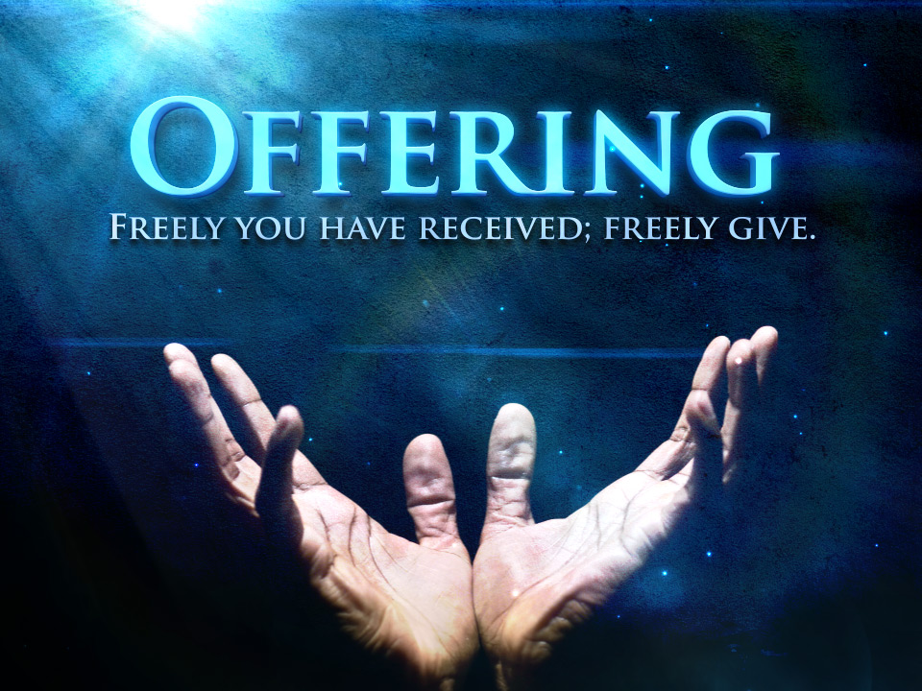
Bearing and Following the WORD into the World Offering of our Gifts and our Lives

Slide 30
Bearing and Following the WORD into the World Doxology and Offertory Prayer

Slide 31
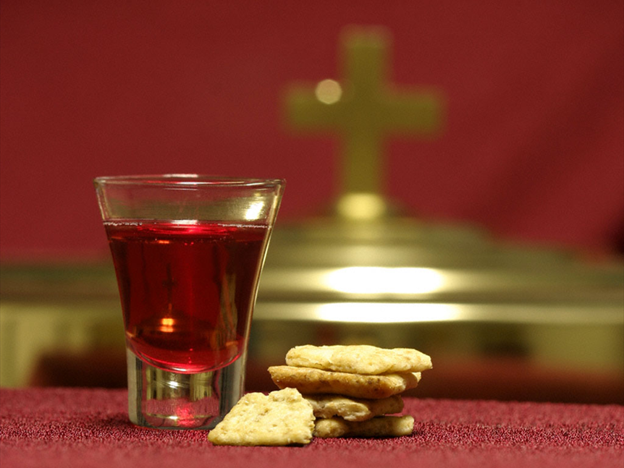
Communion Hymn # 509 “All Who Hunger, Gather Gladly”
All who hunger, gather gladly; holy manna is our bread. Come from wilderness and wandering. Here, in truth, we will be fed. You that yearn for days of fullness, all around us is our food. Taste and see the grace eternal. Taste and see that God is good.

Slide 32
Communion Hymn # 509 “All Who Hunger, Gather Gladly”
All who hunger, never strangers, seeker, be a welcome guest. Come from restlessness and roaming. Here, in joy, we keep the feast. We that once were lost and scattered in communion's love have stood. Taste and see the grace eternal. Taste and see that God is good.

Slide 33
Communion Hymn # 509 “All Who Hunger, Gather Gladly”
All who hunger, sing together; Jesus Christ is living bread. Come from loneliness and longing. Here, in peace, we have been led. Blest are those who from this table live their days in gratitude. Taste and see the grace eternal. Taste and see that God is good.

Slide 34
Bearing and Following the WORD into the World Holy Communion
Welcome to the LORD’s table of Grace and Blessings. There is only one host and we are all invited guests of this Heavenly feast of Thanksgiving. We invite all those who are baptized to come and experience God’s presence around this table.
We have come, not because we are righteous, but we have come because we are in need of God’s grace that is abundantly poured out before us and shed for our salvation.

Slide 35
Bearing and Following the WORD into the World Holy Communion
The Lord be with you. And also with you.
Let us open our hearts. We open them up to our God.
Let us give thanks to the God of Light.
It is right to give God our thanks and praise.
Bright shining God, inner light of all faithful souls,
we celebrate your gifts of love, creation, and art.
We rejoice that you have made us in your image
and call us to live in your limitless love.
You bring peoples and leaders to the dawn of your rising.

Slide 36
Bearing and Following the WORD into the World Holy Communion
You sent your only Son, our morning star, to light a way in our night and lead us to justice and peace.
Your Holy Spirit shines good news into our lives.
Each day break you call us to feed the hungry, bring recovery of sight, liberate the oppressed, heal the brokenhearted and bind up their wounds, and keep watch for the dawn of your commonwealth on earth.

Slide 37
Bearing and Following the WORD into the World Holy Communion
For all of this we give you thanks, O God.
On the night he was betrayed,
Jesus took bread, and after giving thanks
broke it and gave it to his disciples, saying,
Take, eat; this is my body given for you.
Whenever you do this, do it in remembrance of me.

Slide 38
Bearing and Following the WORD into the World Holy Communion
After supper, he took the cup, saying,
This cup is the new covenant, sealed in my blood,
shed for you for the forgiveness of sins.
Whenever you drink it, do it in remembrance of me.
Therefore we proclaim the mystery of our faith:
Christ has died. Christ is risen. Christ will come again.

Slide 39
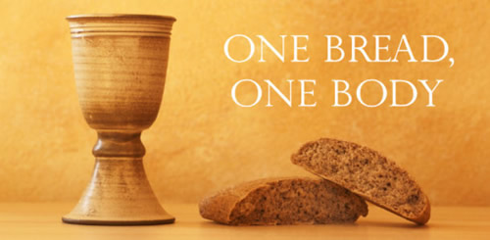
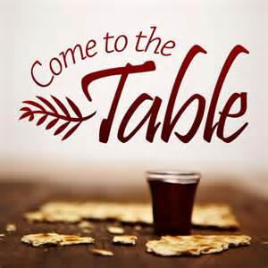
Bearing and Following the WORD into the World Holy Communion

Slide 40
Bearing and Following the WORD into the World
Prayer after the Communion: (in unison)
:
By your Spirit, we ask your blessings upon partaking this bread and this cup that they may become for us the presence of Christ among us. Shine your light and your love on the offering of our lives. Enlighten us that we may be your people, the body of the risen Christ, the light of the world, set apart to serve this earth that you have made.
Through Christ, with Christ, in Christ, in the unity of the Holy Spirit, we praise you now and forever, O Eternal Light. Amen.

Slide 41
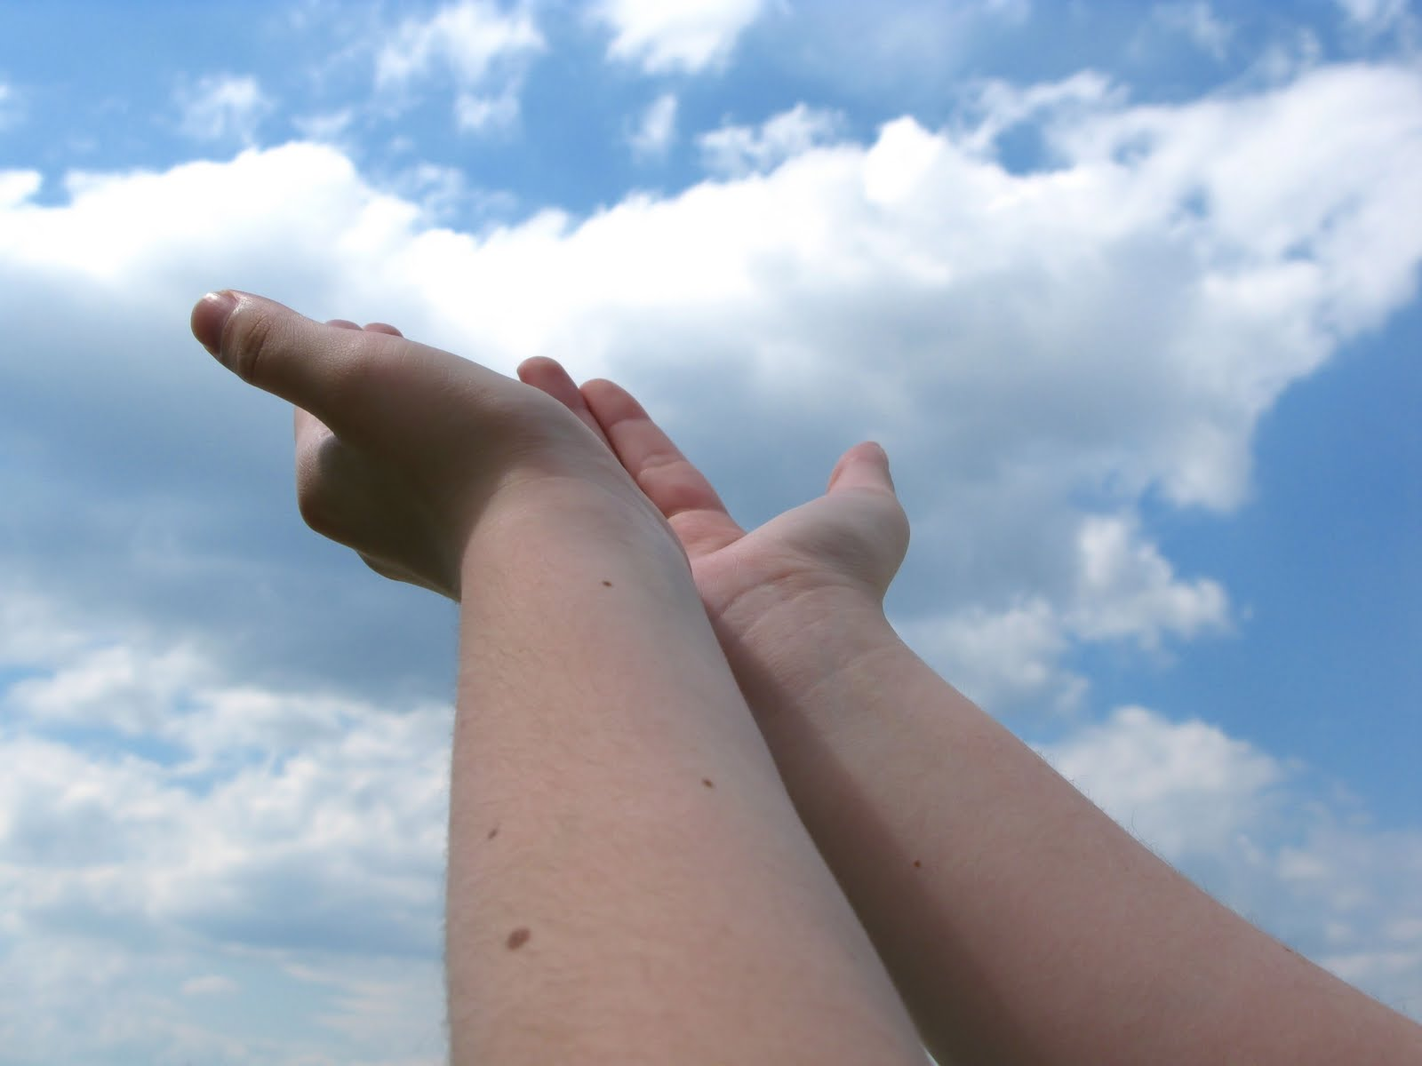
Bearing and Following the WORD into the World Deacons’ Benevolence Offering

Slide 42
Sending Hymn # 298 “Lord, You Give the Great Commission
Lord, you call us to your service: “In my name baptize and teach.” That the world may trust your promise, life abundant meant for each, give us all new fervor, draw us closer in community: with the Spirit’s gifts empower us for the work of ministry. Refrain: Here I am, Lord. Is it I, Lord? I have heard you calling in the night. I will go, Lord, if you lead me. I will hold your people in my heart.

Slide 43
Sending Hymn # 298 “Lord, You Give the Great Commission
Lord, you show us love’s true measure: “Father, what they do, forgive.” Yet we hoard as private treasure all that you so freely give. May your care and mercy lead us to a just society: with the Spirit’s gifts empower us for the work of ministry. Refrain: Here I am, Lord. Is it I, Lord? I have heard you calling in the night. I will go, Lord, if you lead me. I will hold your people in my heart.

Slide 44
Sending Hymn # 298 “Lord, You Give the Great Commission
Lord, you bless with words assuring: “I am with you to the end.” Faith and hope and love restoring, may we serve as you intend, and, amid the cares that claim us, hold in mind eternity: with the Spirit’s gifts empower us for the work of ministry. Refrain: Here I am, Lord. Is it I, Lord? I have heard you calling in the night. I will go, Lord, if you lead me. I will hold your people in my heart.

Slide 45
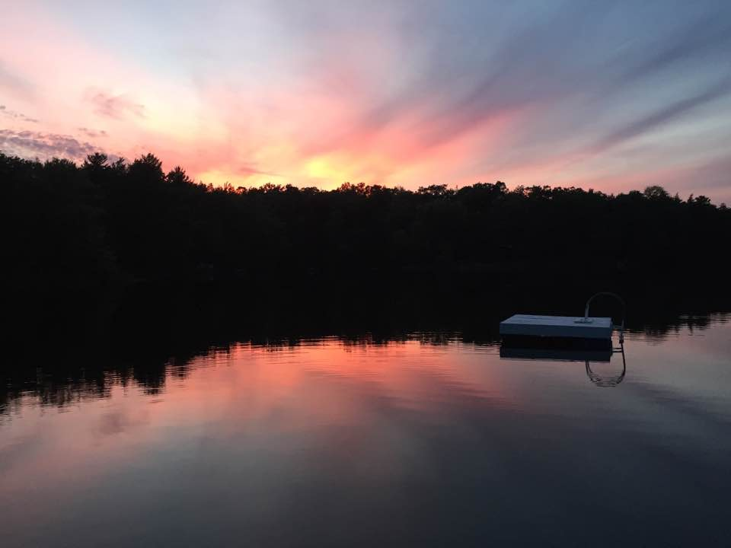
Bearing and Following the WORD into the World The Charge and Benediction

Slide 46
Bearing and Following the WORD into the World Benediction Response
# 540 “Farewell, Good Friends!”
Farewell, Good Friends!
Farewell, Good Friends!
Shalom, Shalom! Till we meet again, Till we meet again,
Shalom, Shalom.

Slide 47
Homecrest Presbyterian Church Worship of the Lord’s Day February 5th, 2017 5th Sunday of Epiphany

