Slide 1
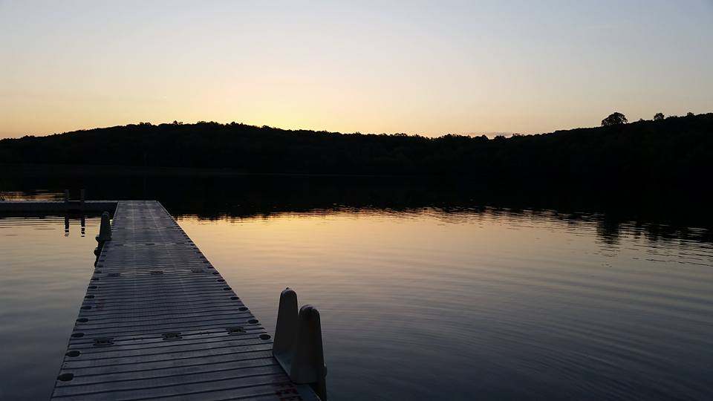
Homecrest Presbyterian Church Worship of the Lord’s Day January 29th, 2017 4th Sunday of Epiphany

Slide 2
Gathering Around the WORD Call to Worship (Based on Matthew 5:3-14)
Jesus said, Blessed are the poor in spirit,
for theirs is the kingdom of heaven.
Blessed are those who mourn,
for they will be comforted.
Blessed are the meek,
for they will inherit the earth.
Blessed are those who hunger and thirst for righteousness, for they will be filled.

Slide 3
Gathering Around the WORD Call to Worship (Based on Matthew 5:3-14)
Blessed are the merciful, for they will receive mercy.
Blessed are the pure in heart,
for they will see God.
Blessed are the peacemakers,
for they will be called children of God.
Blessed are those who are persecuted for righteousness' sake, for theirs is the kingdom of heaven.
Rejoice and be glad, for your reward is great in heaven.
We are the salt of the earth and the light of the world. Let us come and worship God.

Slide 4
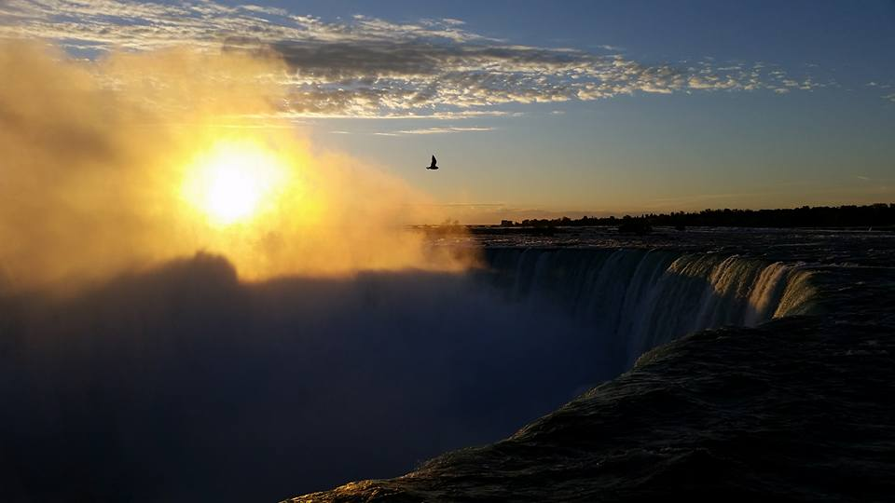
Gathering Hymn # 4 “Holy God, We Praise Your Name”
Holy God, we praise your name; Lord of all, we bow before you. All on earth your scepter claim; all in heaven above adore you. Infinite your vast domain, everlasting is your reign.

Slide 5
Gathering Hymn # 4 “Holy God, We Praise Your Name”
Hark! The glad celestial hymn angel choirs above are raising; cherubim and seraphim, in unceasing chorus praising, fill the heavens with sweet accord: “Holy, holy, holy Lord!”

Slide 6
Gathering Hymn # 4 “Holy God, We Praise Your Name”
All apostles join the strain as your sacred name they hallow; prophets swell the glad refrain, and the blessed martyrs follow, and from morn to set of sun, through the church the song goes on.

Slide 7
Gathering Hymn # 4 “Holy God, We Praise Your Name”
Holy Father, Holy Son, Holy Spirit: three we name you, while in essence only one; undivided God we claim you, and adoring, bend the knee while we own the mystery.

Slide 8
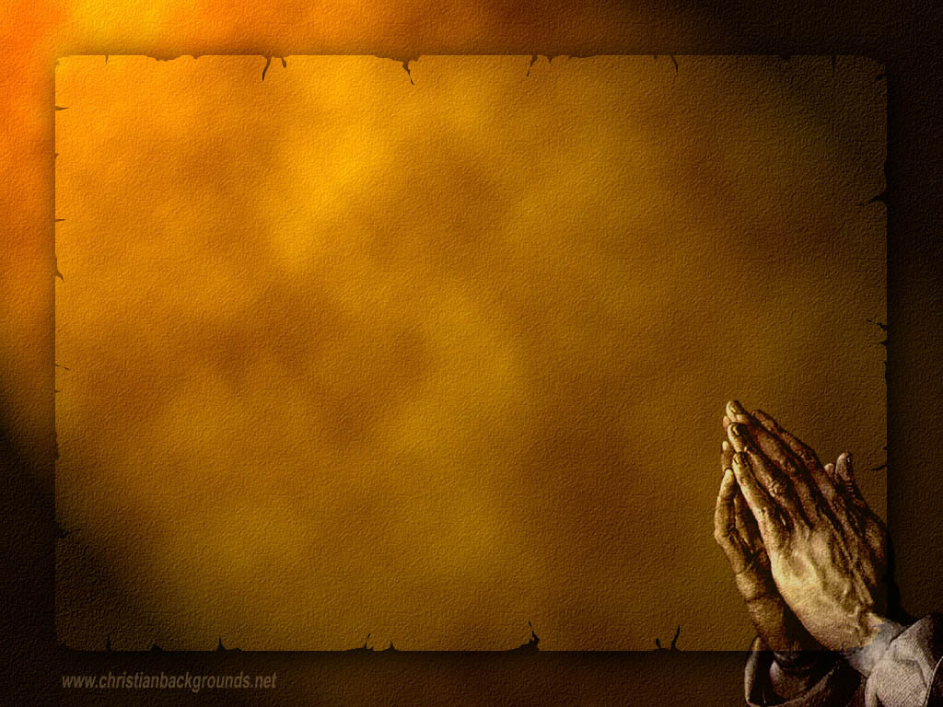
Gathering Around the WORD Call to Confession God is merciful and willing to shed His grace upon all those who come to Him in penitence. In humility and faith, let us join our hearts for the Prayer of Confession.

Slide 9
Gathering Around the WORD Prayer of Confession (in unison) Merciful God, we have not done what is blameless and right, nor spoken truth from the heart with love. We do not keep your word, and when we participate in gossip, our words and deeds cause pain. Forgive us by the power of your mercy, that we might stand in the goodness of Christ and walk in the light of His love, Amen.

Slide 10
Gathering Around the WORD Declaration of Forgiveness (Based on Micah 6:8) What does the Lord require of us? But to Do Justice, to Love Kindness and to Walk Humbly with our God. Friends, let us walk in the path that Christ has set out for us. Thanks be to God, Amen.

Slide 11
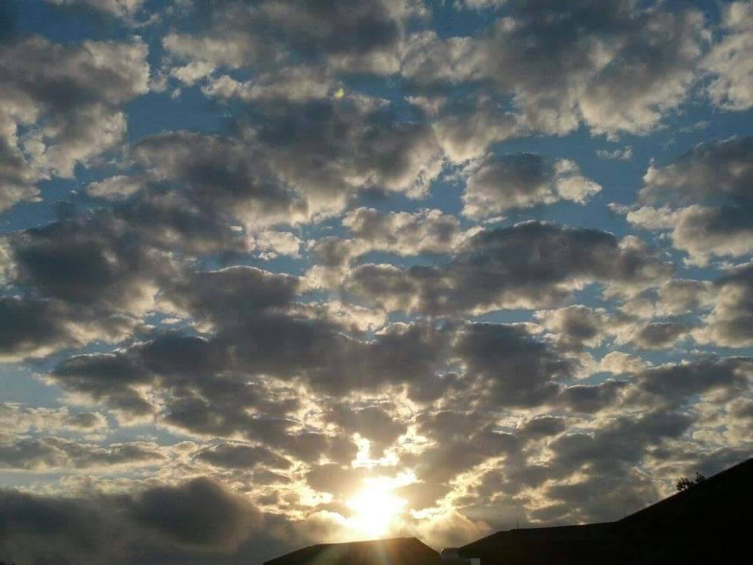
Gathering Around the WORD Gloria Patri
Glory be to the Father
and to the Son and to the Holy Ghost;
As it was in the beginning,
is now, and ever shall be,
world without end. Amen, Amen.

Slide 12
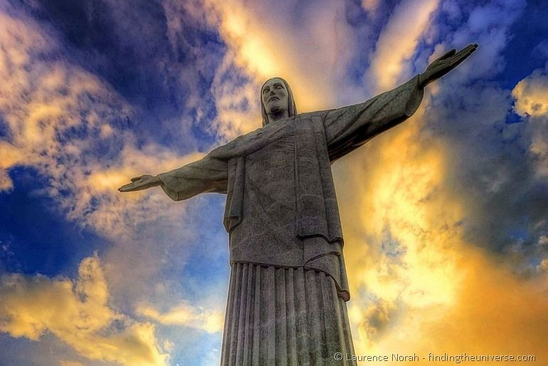
Gathering Around the WORD Passing of the Peace of Christ
Jesus said, “Peace I leave with you; my peace I give to you. I do not give to you as the world gives. Do not let your hearts be troubled, and do not let them be afraid.” (John 14:27)

Slide 13
Proclaiming the WORD Message to the Youth/ Prayer of Illumination

Slide 14
Proclaiming the WORD Scripture Reading – Micah 6:1-8
¹ Hear what the LORD says: Rise, plead your case before the mountains, and let the hills hear your voice. ² Hear, you mountains, the controversy of the LORD, and you enduring foundations of the earth; for the LORD has a controversy with his people, and he will contend with Israel.
³ “O my people, what have I done to you? In what have I wearied you? Answer me! ⁴ For I brought you up from the land of Egypt, and redeemed you from the house of slavery; and I sent before you Moses, Aaron, and Miriam.

Slide 15
Proclaiming the WORD Scripture Reading – Micah 6:1-8
⁵ O my people, remember now what King Balak of Moab devised, what Balaam son of Beor answered him, and what happened from Shittim to Gilgal, that you may know the saving acts of the LORD.”
⁶ “With what shall I come before the LORD, and bow myself before God on high? Shall I come before him with burnt offerings, with calves a year old?

Slide 16
Proclaiming the WORD Scripture Reading – Micah 6:1-8
⁷ Will the LORD be pleased with thousands of rams, with ten thousands of rivers of oil? Shall I give my firstborn for my transgression, the fruit of my body for the sin of my soul?”
⁸ He has told you, O mortal, what is good; and what does the LORD require of you but to do justice, and to love kindness, and to walk humbly with your God?

Slide 17
Proclaiming the WORD Scripture Reading – 1 Corinthians 1:18-31
¹⁸For the message about the cross is foolishness to those who are perishing, but to us who are being saved it is the power of God. ¹⁹For it is written, “I will destroy the wisdom of the wise, and the discernment of the discerning
I will thwart.”

Slide 18
Proclaiming the WORD Scripture Reading – 1 Corinthians 1:18-31
²⁰Where is the one who is wise? Where is the scribe? Where is the debater of this age? Has not God made foolish the wisdom of the world? ²¹For since, in the wisdom of God, the world did not know God through wisdom, God decided, through the foolishness of our proclamation, to save those who believe. ²²For Jews demand signs and Greeks desire wisdom, ²³but we proclaim Christ crucified, a stumbling block to Jews and foolishness to Gentiles, ²⁴but to those who are the called, both Jews and Greeks, Christ the power of God and the wisdom of God.

Slide 19
Proclaiming the WORD Scripture Reading – 1 Corinthians 1:18-31
²⁵For God’s foolishness is wiser than human wisdom, and God’s weakness is stronger than human strength.
²⁶Consider your own call, brothers and sisters: not many of you were wise by human standards, not many were powerful, not many were of noble birth. ²⁷But God chose what is foolish in the world to shame the wise; God chose what is weak in the world to shame the strong;

Slide 20
Proclaiming the WORD Scripture Reading – 1 Corinthians 1:18-31
²⁸God chose what is low and despised in the world, things that are not, to reduce to nothing things that are, ²⁹so that no one might boast in the presence of God. ³⁰He is the source of your life in Christ Jesus, who became for us wisdom from God, and righteousness and sanctification and redemption, ³¹in order that, as it is written, “Let the one who boasts, boast in the Lord.”

Slide 21
Proclaiming the WORD (Micah 6:1-8 and I Corinthians 1:18-31)
It’s Your Call

Slide 22
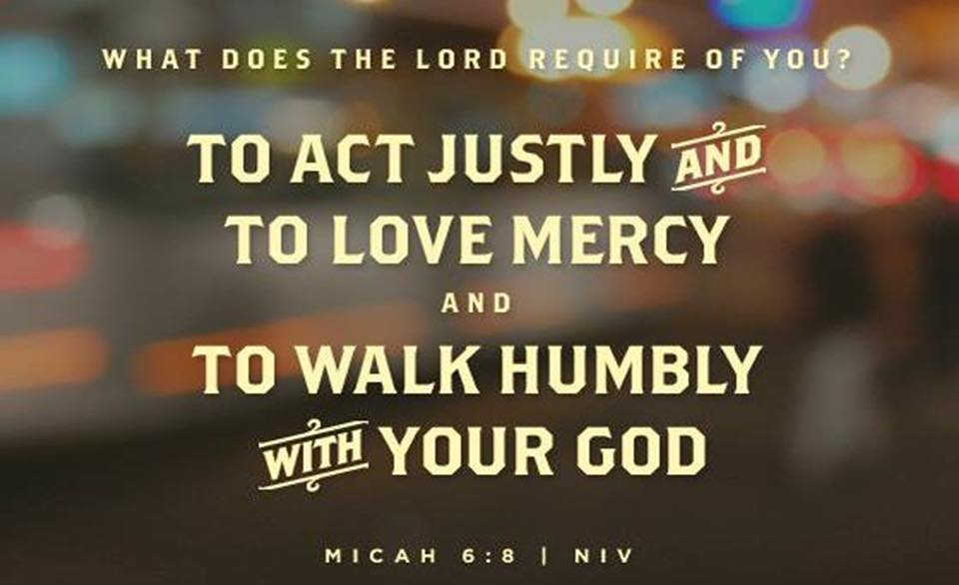

Slide 23
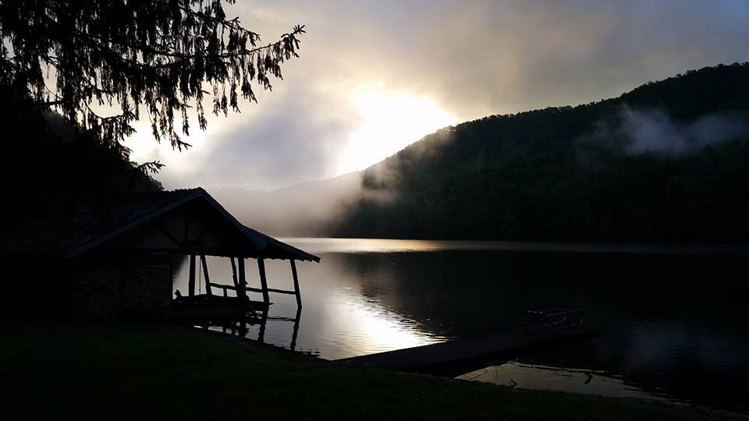
Responding Hymn # 757 “Today We Are Called to be Disciples”
Today we all are called to be disciples of the Lord, to help to set the captive free, make plowshare out of sword, to feed the hungry, quench their thirst, make love and peace our fast, to serve the poor and homeless first, our ease and comfort last.

Slide 24
Responding Hymn # 757 “Today We Are Called to be Disciples”
God made the world and at its birth ordained our human race to live as stewards of the earth, responding to God's grace. But we are vain and sadly proud; we sow not peace but strife. Our discord spreads a deadly cloud that threatens all of life.

Slide 25
Responding Hymn # 757 “Today We Are Called to be Disciples”
Pray justice may come rolling down as in a mighty stream, with righteousness in field and town to cleanse us and redeem. For God is longing to restore an earth where conflicts cease, a world that was created for a harmony of peace.

Slide 26
Responding Hymn # 757 “Today We Are Called to be Disciples”
May we in service to our God act out the living word, and walk the road the saints have trod till all have seen and heard. As stewards of the earth may we give thanks in one accord to God who calls us all to be disciples of the Lord.

Slide 27
Responding to the WORD
Ordination and Installation of Officers
(See Insert for the Constitutional Questions)
Deacons
Class of 2020 (3-year term):
Joseph Dwan and Patricia Sohan
Elders
Class of 2018 (1-year term): Paul Wine Class of 2020 (3-year term): Susan Yee

Slide 28
Bearing and Following the WORD into the World Announcements &
Sharing of Joys and Concerns
The afternoon Bible Study Group will resume on Today in the basement, at 12:30pm. We are currently studying a new series on “365 Days with John Calvin” edited by Joel R. Beeke in commemoration of the 500th Anniversary of the Protestant Reformation this year.
The Women's Group meets on every Wednesdays at 7:30pm over at the Manse (2048 E 14th Street). They are currently studying Gospel of Mark. For more information, please see Margaret and Cara.

Slide 29
Bearing and Following the WORD into the World Announcements &
Sharing of Joys and Concerns
We are currently updating our Church Directory. Please verify your relevant information i.e., address, phones, email, birthday with a working draft copy on the back table. If the information is correct, please put a ( ✓) mark next to your name.

Slide 30
Bearing and Following the WORD into the World Prayer of the People & The Lord’s Prayer
Our Father, who art in heaven.
Halloweth be thy name.
Thy Kingdom come; Thy will be done
On earth as it is in heaven.
Give us this day our daily bread.
Forgive us our debts; as we forgive our debtors.
Lead us not into temptations, but deliver us from evil.
For Thine is the Kingdom, the Power, and the Glory forever. Amen.

Slide 31
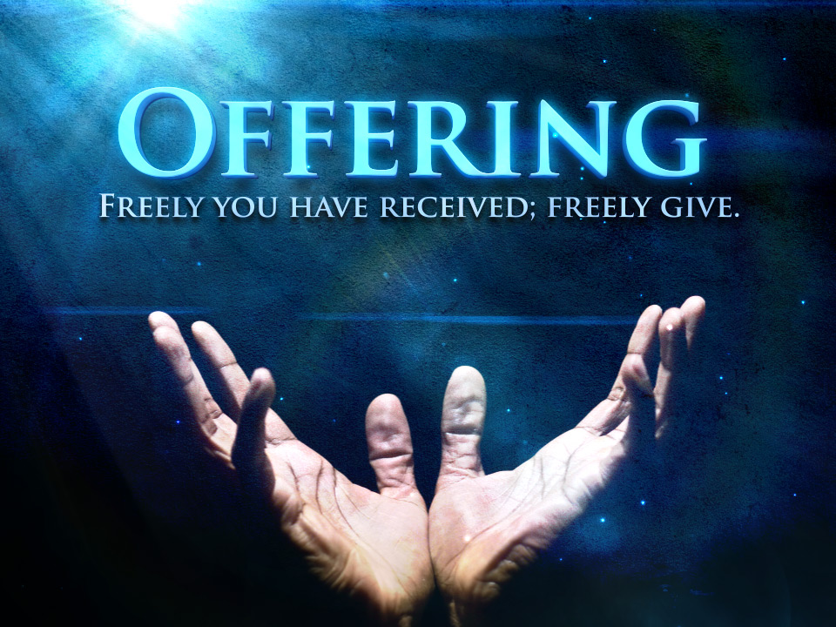
Bearing and Following the WORD into the World Offering of our Gifts and our Lives

Slide 32
Bearing and Following the WORD into the World Doxology and Offertory Prayer

Slide 33
Sending Hymn # 69 “Here I Am, Lord”
I, the Lord of sea and sky, I have heard my people cry. All who dwell in dark and sin my hand will save. I, who made the stars of night, I will make their darkness bright. Who will bear my light to them? Whom shall I send? Refrain: Here I am, Lord. Is it I, Lord? I have heard you calling in the night. I will go, Lord, if you lead me. I will hold your people in my heart.

Slide 34
Sending Hymn # 69 “Here I Am, Lord”
Here I am, Lord. Is it I, Lord? I have heard you calling in the night. I will go, Lord, if you lead me. I will hold your people in my heart.

Slide 35
Sending Hymn # 69 “Here I Am, Lord”
I, the Lord of snow and rain, I have borne my people's pain. I have wept for love of them. They turn away. I will break their hearts of stone, give them hearts for love alone. I will speak my word to them. Whom shall I send? Refrain: Here I am, Lord. Is it I, Lord? I have heard you calling in the night. I will go, Lord, if you lead me. I will hold your people in my heart.

Slide 36
Sending Hymn # 69 “Here I Am, Lord”
Here I am, Lord. Is it I, Lord? I have heard you calling in the night. I will go, Lord, if you lead me. I will hold your people in my heart.

Slide 37
Sending Hymn # 69 “Here I Am, Lord”
I, the Lord of wind and flame, I will tend the poor and lame. I will set a feast for them. My hand will save. Finest bread I will provide till their hearts be satisfied. I will give my life to them. Whom shall I send? Refrain: Here I am, Lord. Is it I, Lord? I have heard you calling in the night. I will go, Lord, if you lead me. I will hold your people in my heart.

Slide 38
Sending Hymn # 69 “Here I Am, Lord”
Here I am, Lord. Is it I, Lord? I have heard you calling in the night. I will go, Lord, if you lead me. I will hold your people in my heart.

Slide 39
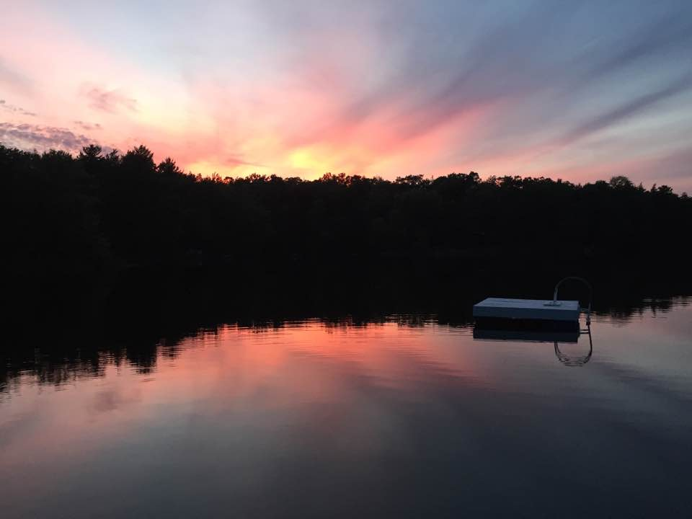
Bearing and Following the WORD into the World The Charge and Benediction

Slide 40
Bearing and Following the WORD into the World Benediction Response
# 540 “Farewell, Good Friends!”
Farewell, Good Friends!
Farewell, Good Friends!
Shalom, Shalom! Till we meet again, Till we meet again,
Shalom, Shalom.

Slide 41
Homecrest Presbyterian Church Worship of the Lord’s Day January 29th, 2017 4th Sunday of Epiphany

