Slide 1
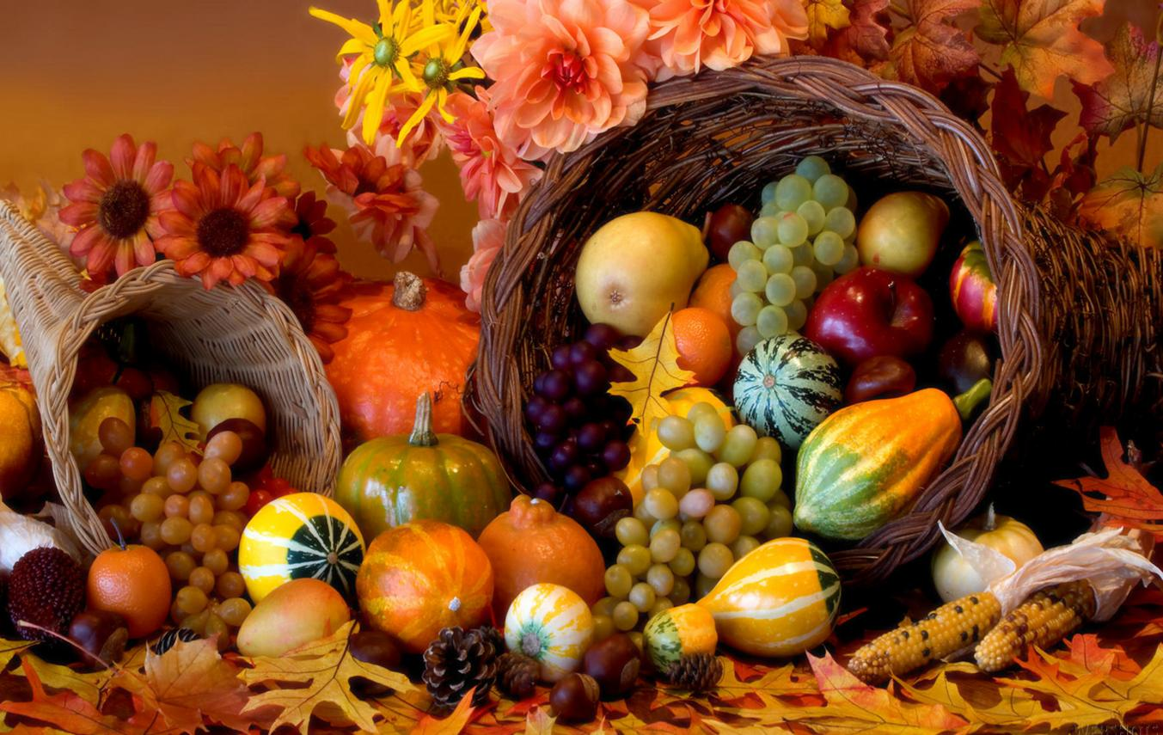
Homecrest Presbyterian Church Worship of the Lord’s Day 1st Sunday in Advent November 27th, 2016

Slide 2
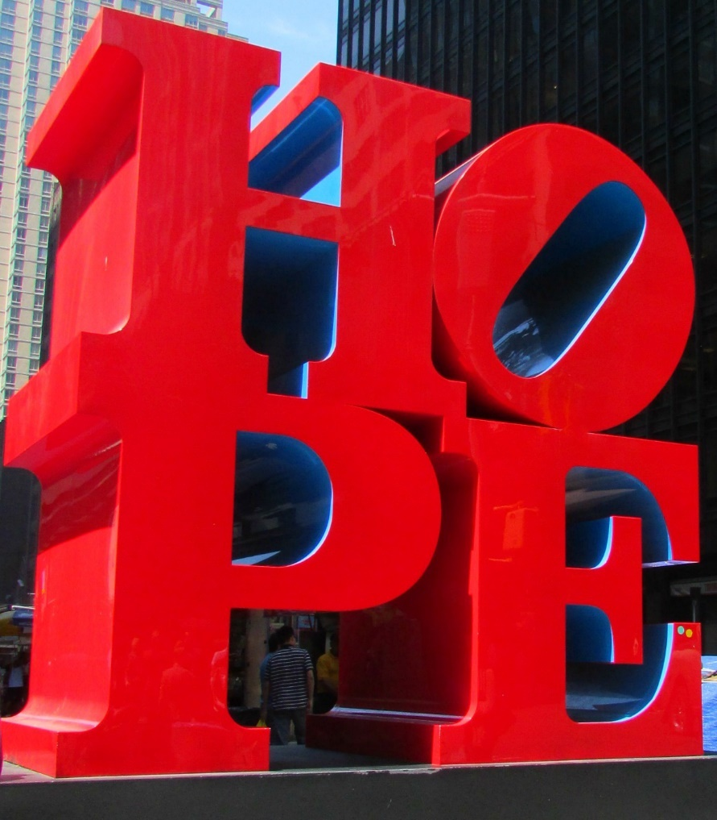
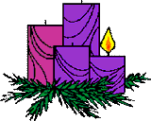
Gathering Around the WORD Lighting of the 1st Advent Candle / Call to Worship

Slide 3
Gathering Hymn # 652 “A Grateful Heart” (Psalm 111)
A grateful heart is what I bring, a song of praise, my offering. Among the saints I lift my voice: in you, O God, I will rejoice.

Slide 4
Gathering Hymn # 652 “A Grateful Heart” (Psalm 111)
Your name is known in all the lands. You feed the poor with gentle hands. Your word is true, your works are just; in you, O God, the faithful trust.

Slide 5
Gathering Hymn # 652 “A Grateful Heart” (Psalm 111)
With saving love you set us free, and still you dwell in mystery with wisdom none can comprehend. Your praise, O God, will never end.

Slide 6
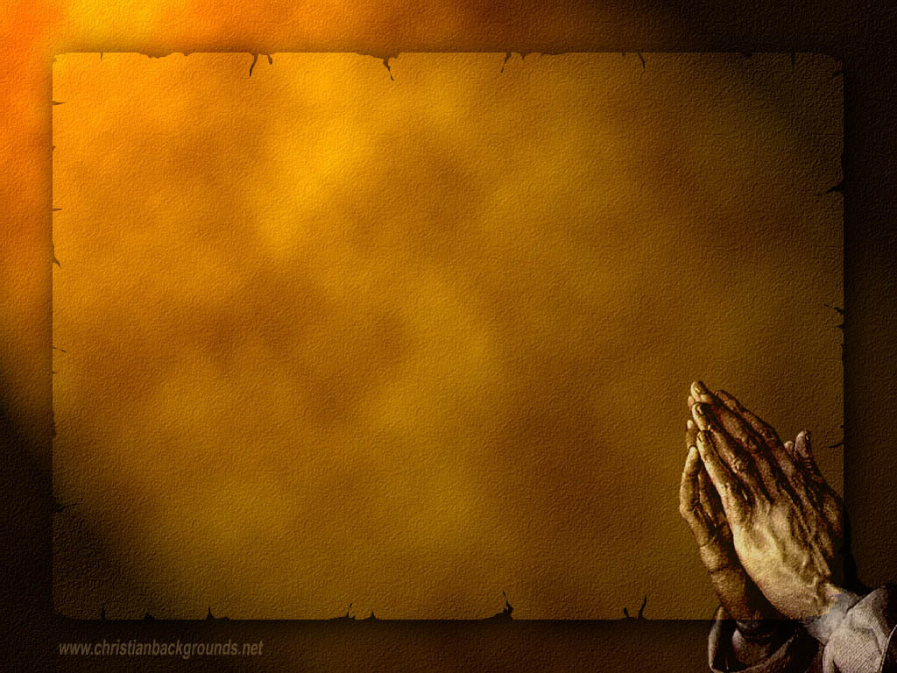
Gathering Around the WORD Call to Confession The season of Advent is about anticipation of what is to come. We’ve been reminded to take a closer examination upon our lives, as we seek God through repentance and plead for God’s forgiveness and grace. In humility and faith, let us confess our sins before God and our neighbors.

Slide 7
Gathering Around the WORD Prayer of Confession (in unison) God of night and day, there is no shadow that can conceal our sins from you and no secret that you will not bring to light. O God, forgive us of our sinful and selfish thoughts that we may have, renew us in love, and teach us to live in ways that would bring honor and glory to your name; through Jesus Christ our Lord, Amen.

Slide 8
Gathering Around the WORD Declaration of Forgiveness The Lord is gracious unto those who call upon his name. Christ has reached out to us through his work on the cross. He continues to bear witness among us through his forgiveness and reconciliation. In Christ, we have been saved and given a chance in life. Thanks be to God, Amen.

Slide 9
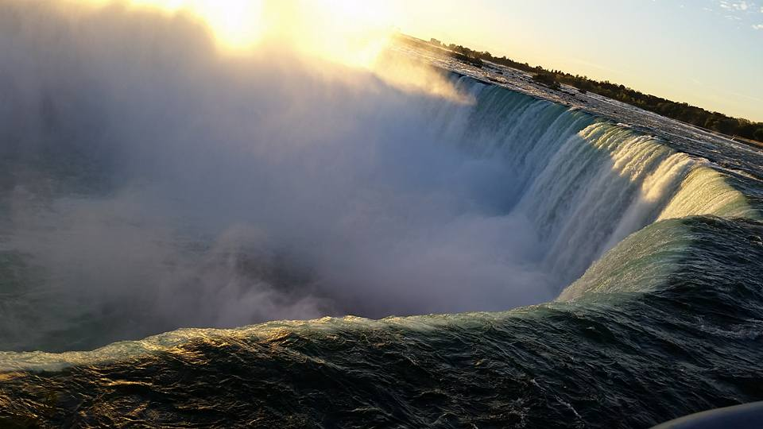
Gathering Around the WORD Gloria Patri
Glory be to the Father
and to the Son and to the Holy Ghost;
As it was in the beginning,
is now, and ever shall be,
world without end. Amen, Amen.

Slide 10
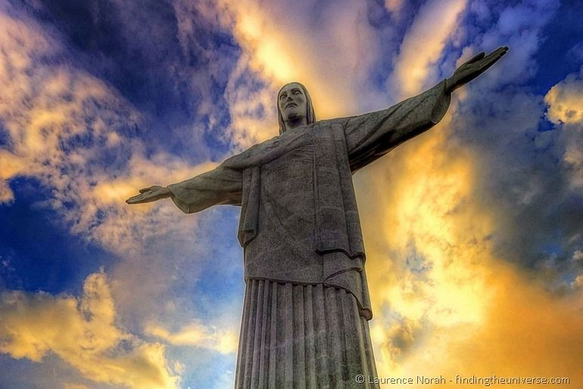
Gathering Around the WORD Passing of the Peace of Christ
Jesus said, “Peace I leave with you; my peace I give to you. I do not give to you as the world gives. Do not let your hearts be troubled, and do not let them be afraid.” (John 14:27)

Slide 11
Proclaiming the WORD Message to the Youth/ Prayer of Illumination

Slide 12
Proclaiming the WORD Scripture Reading (Matthew 24:36-44)
"But about that day and hour no one knows, neither the angels of heaven, nor the Son, but only the Father. ³⁷ For as the days of Noah were, so will be the coming of the Son of Man. ³⁸ For as in those days before the flood they were eating and drinking, marrying and giving in marriage, until the day Noah entered the ark, ³⁹ and they knew nothing until the flood came and swept them all away, so too will be the coming of the Son of Man.

Slide 13
Proclaiming the WORD Scripture Reading (Matthew 24:36-44)
⁴⁰ Then two will be in the field; one will be taken and one will be left. ⁴¹ Two women will be grinding meal together; one will be taken and one will be left.
⁴² Keep awake therefore, for you do not know on what day your Lord is coming. ⁴³ But understand this: if the owner of the house had known in what part of the night the thief was coming, he would have stayed awake and would not have let his house be broken into. ⁴⁴ Therefore you also must be ready, for the Son of Man is coming at an unexpected hour.

Slide 14
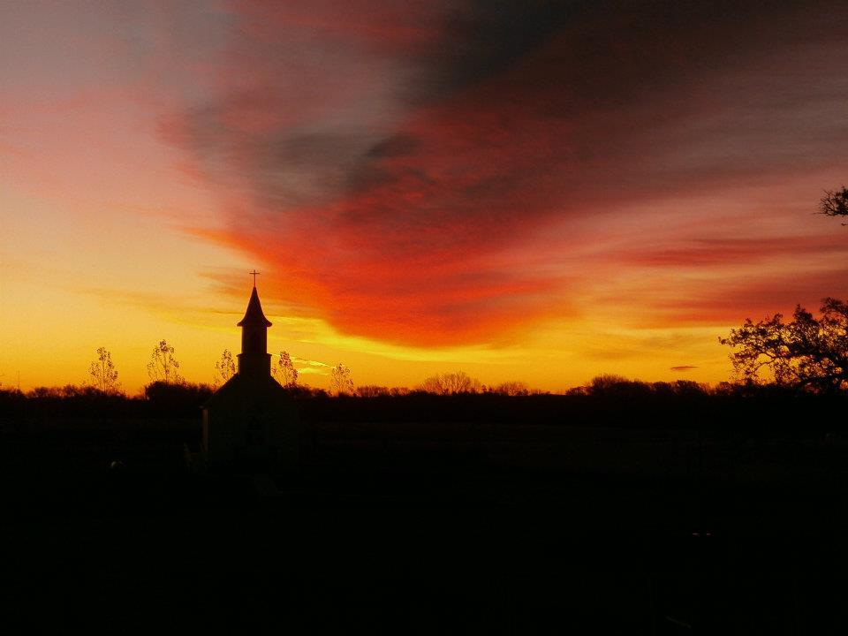
Proclaiming the WORD Staying Awake!
(Matthew 24:36-44)

Slide 15
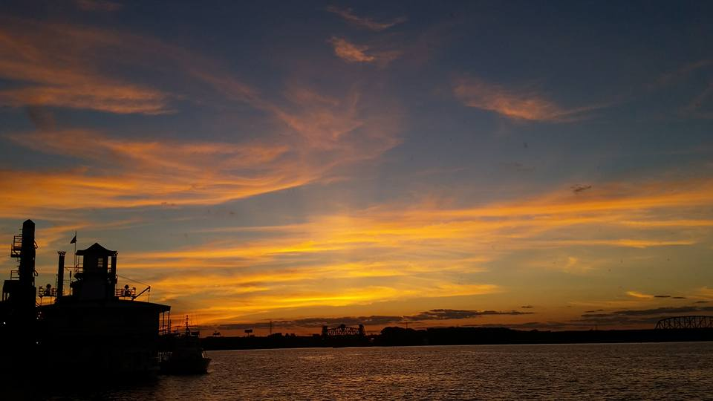
Responding Hymn # 663 “Awake, My Soul, and with the Sun”
Awake, my soul, and with the sun your daily stage of duty run; shake off dull sloth, and joyful rise to pay your morning sacrifice.

Slide 16
Responding Hymn # 663 “Awake, My Soul, and with the Sun”
Lord, I my vows to you renew. Disperse my sins as morning dew; guard my first springs of thought and will, and with yourself my spirit fill.

Slide 17
Responding Hymn # 663 “Awake, My Soul, and with the Sun”
Direct, control, suggest, this day, all I design or do or say, that all my powers, with all their might, in your sole glory may unite.

Slide 18
Responding to the WORD
Affirmation of Faith
(Romans 5:1-5)
Since we are justified by faith, we have peace with God through our Lord Jesus Christ, through whom we have obtained access to this grace in which we stand; and we boast in our hope of sharing the glory of God. And not only that, but we also boast in our sufferings, knowing that suffering produces endurance, and endurance produces character, and character produces hope, and hope does not disappoint us, because God's love has been poured into our hearts through the Holy Spirit that has been given to us.

Slide 19
Bearing and Following the WORD into the World Announcements &
Sharing of Joys and Concerns
The afternoon Bible Study Group will continue after worship service downstairs in the basement at 12:30pm. We will be spending time together in study and discussion base on the Advent Calendar Devotional – A Journey of Memories.
The Women's Group will resume meeting on every Wednesdays at 7:30pm over at the Manse (2048 E 14th Street). They are currently studying the minor prophets in the Old Testament. For more information, please see Margaret and Cara.

Slide 20
Bearing and Following the WORD into the World Announcements &
Sharing of Joys and Concerns
Limited copies of the Presbyterian Church (USA)’s Advent Calendar Devotional are still available at $2 each. Please deposit the money into the box on the back table.

Slide 21
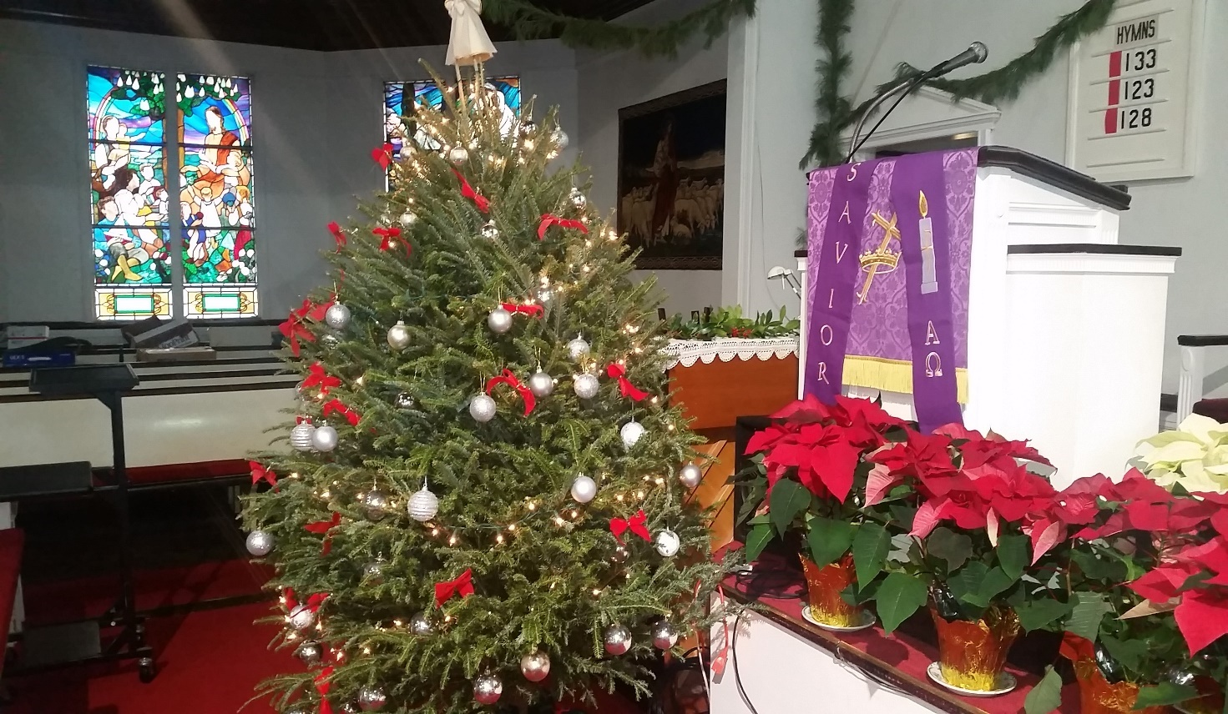
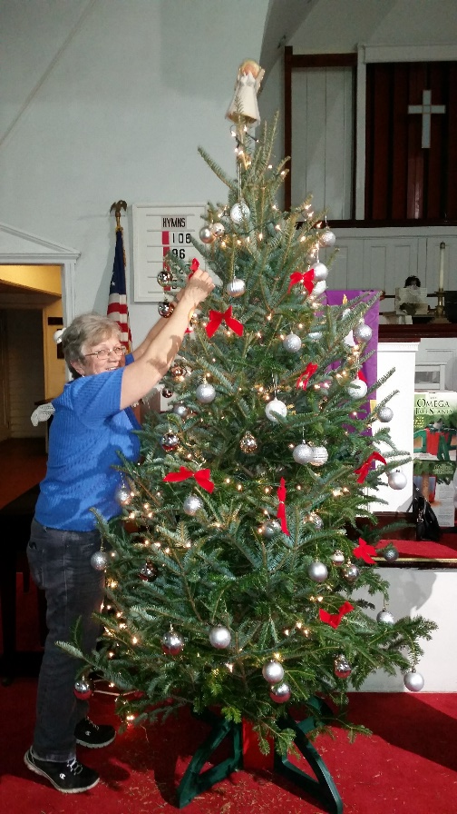
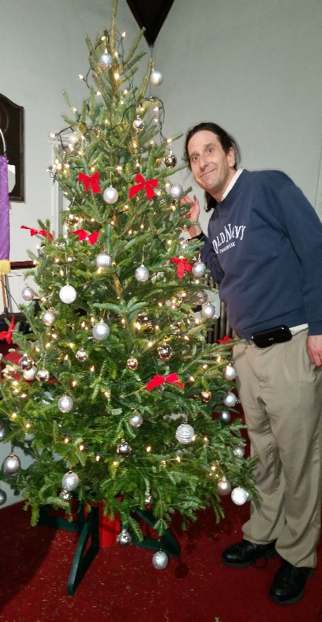
Bearing and Following the WORD into the World Announcements &
Sharing of Joys and Concerns
We will be putting up the Christmas decorations this coming Friday @ 7pm. Please come and help out if you are available.

Slide 22
Bearing and Following the WORD into the World Announcements &
Sharing of Joys and Concerns
The next Session Meeting will be Monday, 12/5 @ 7pm. All active elders please attend.

Slide 23
Bearing and Following the WORD into the World Prayer of the People & The Lord’s Prayer
Our Father, who art in heaven.
Halloweth be thy name.
Thy Kingdom come; Thy will be done
On earth as it is in heaven.
Give us this day our daily bread.
Forgive us our debts; as we forgive our debtors.
Lead us not into temptations, but deliver us from evil.
For Thine is the Kingdom, the Power, and the Glory forever. Amen.

Slide 24
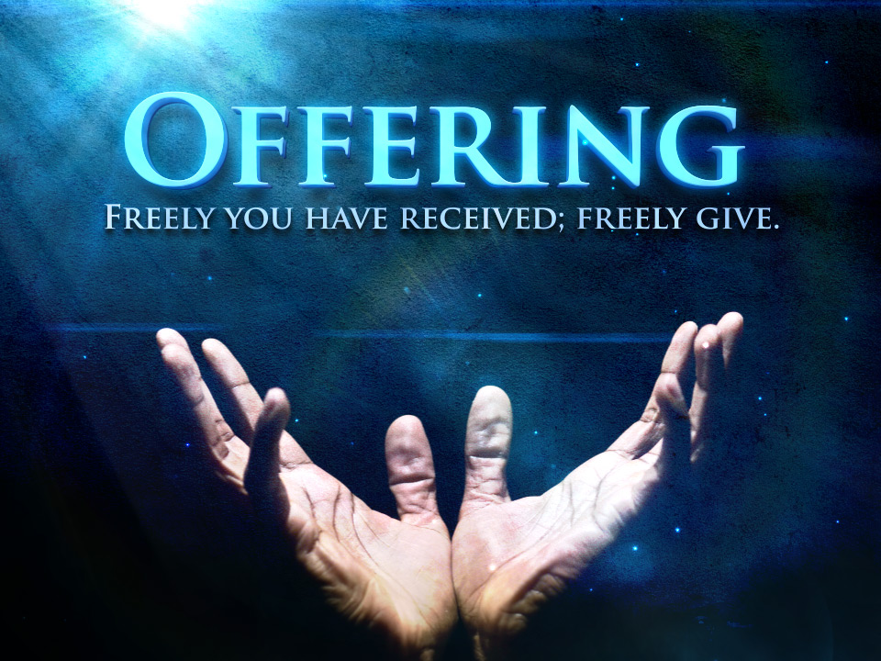
Bearing and Following the WORD into the World Offering of our Gifts and our Lives

Slide 25
Bearing and Following the WORD into the World Doxology and Offertory Prayer

Slide 26
Sending Hymn # 104 “O Lord, How Shall I Meet You”
O Lord, how shall I meet you, how welcome you aright? Your people long to greet you, my hope, my heart’s delight! O kindle, Lord most holy, a lamp within my breast, to do in spirit lowly all that may please you best.

Slide 27
Sending Hymn # 104 “O Lord, How Shall I Meet You”
Love caused your incarnation; love brought you down to me; your thirst for my salvation procured my liberty. O love beyond all telling, that led you to embrace in love, all loves excelling, our lost and fallen race.

Slide 28
Sending Hymn # 104 “O Lord, How Shall I Meet You”
You come, O Lord, with gladness, in mercy and goodwill, to bring an end to sadness and bid our fears be still. In patient expectation we live for that great day when your renewed creation your glory shall display.

Slide 29
Bearing and Following the WORD into the World The Charge and Benediction

Slide 30
Bearing and Following the WORD into the World Benediction Response
#541 “God Be With You Till We Meet Again”
(Stanza 1)
God be with you till we meet again;
loving counsels guide, uphold you, with a shepherd's care enfold you:
God be with you till we meet again.

Slide 31
Homecrest Presbyterian Church Worship of the Lord’s Day 1st Sunday in Advent November 27th, 2016

