Slide 1
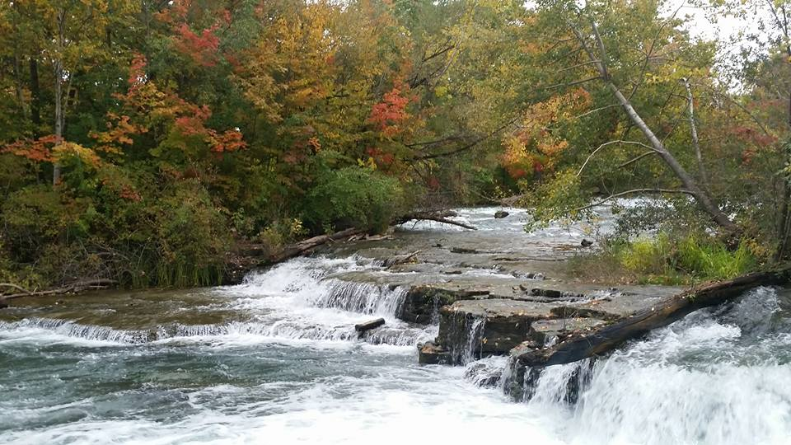
Homecrest Presbyterian Church Worship of the Lord’s Day November 6th, 2016

Slide 2
Gathering Around the WORD Call To Worship (Psalm 98:4-6)
Make a joyful noise to the Lord, all the earth; break forth into joyous song and sing praises.
Sing praises to the Lord with the lyre, with the lyre and the sound of melody.
With trumpets and the sound of the horn, make a joyful noise before the King, the Lord.
Come, make a joyful noise, sing praises! Let us worship the Lord!

Slide 3
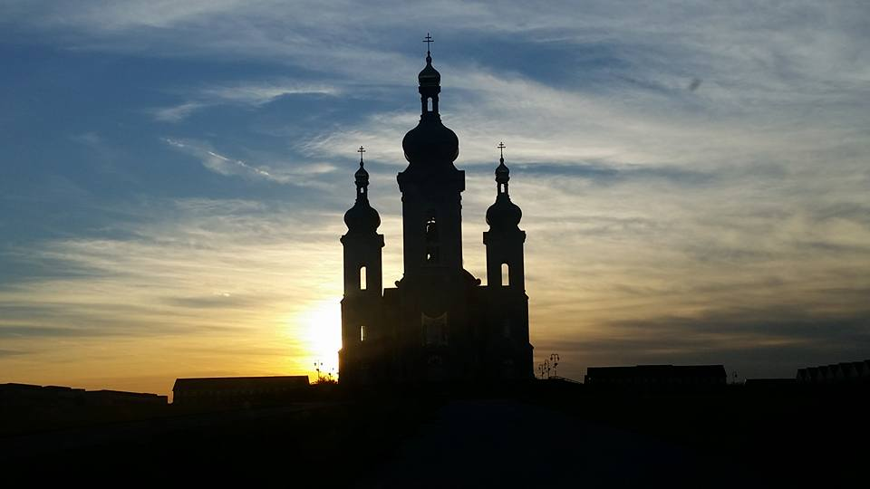
Gathering Hymn # 41 “O Worship the King, All Glorious Above”
O worship the King, all glorious above! O gratefully sing God's power and God’s love: our shield and defender, the Ancient of Days, pavilioned in splendor and girded with praise.

Slide 4
Gathering Hymn # 41 “O Worship the King, All Glorious Above”
O tell of God's might; O sing of God's grace, whose robe is the light, whose canopy space, whose chariots of wrath the deep thunderclouds form; and bright is God's path on the wings of the storm.

Slide 5
Gathering Hymn # 41 “O Worship the King, All Glorious Above”
The earth with its store of wonders untold, Almighty, your power has founded of old; established it fast by a changeless decree, and round it has cast, like a mantle, the sea.

Slide 6
Gathering Hymn # 41 “O Worship the King, All Glorious Above”
Your bountiful care what tongue can recite? It breathes in the air; it shines in the light; it streams from the hills; it descends to the plain, and sweetly distills in the dew and the rain.

Slide 7
Gathering Hymn # 41 “O Worship the King, All Glorious Above”
Frail children of dust, and feeble as frail, in you do we trust, nor find you to fail; your mercies, how tender, how firm to the end, our Maker, Defender, Redeemer, and Friend.

Slide 8
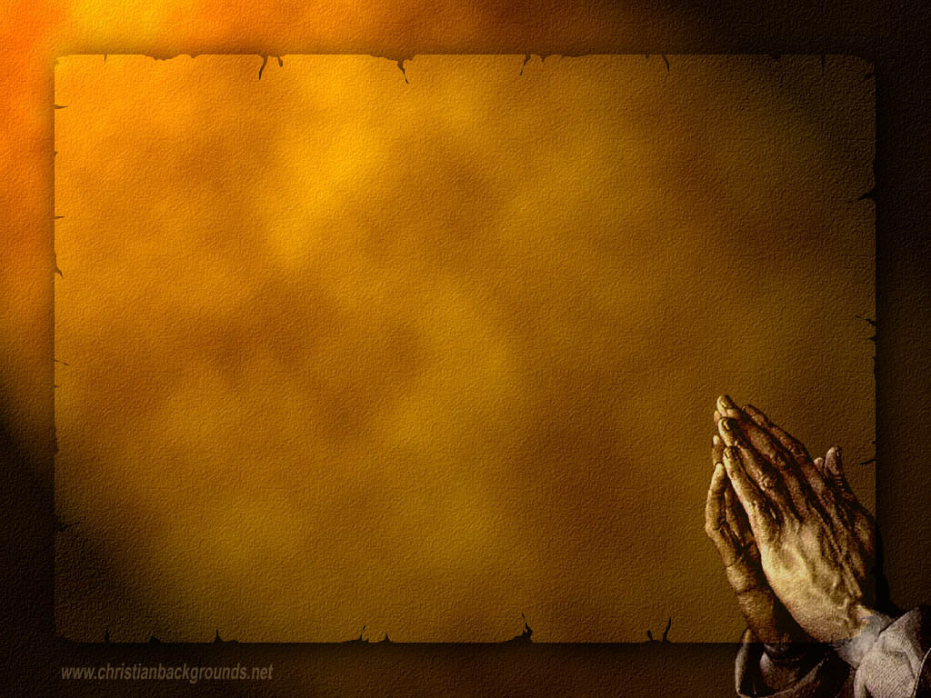
Gathering Around the WORD Call to Confession (Based on Psalm 145:18) The psalmist assures us that the Lord is near to all who call on God in truth. So with that assurance of God’s presence, God’s steadfast love, and God’s overwhelming mercy, let us confess our sins before God and one another.

Slide 9
Gathering Around the WORD Prayer of Confession (in unison) Holy God, we come before you a broken people in a broken world. We confess we have ignored, yet again, your assured presence. We have forged our own paths and charted our own waters. In the name of independence, we have ignored your aid, your comfort, and your peace. We have called upon you in desperation rather than recalling your mighty and faithful acts in all times and places. Forgive us. You have been with us in exile and liberation; be with us even now. Amen.

Slide 10
Gathering Around the WORD Declaration of Forgiveness (Psalm 145:19, 21) God hears the cry of the beloved and saves them. Rest assured that in Jesus Christ, we are forgiven because God delights in our sincere prayers and confessions. Praise the Lord, and bless God’s holy name forever. Amen.

Slide 11
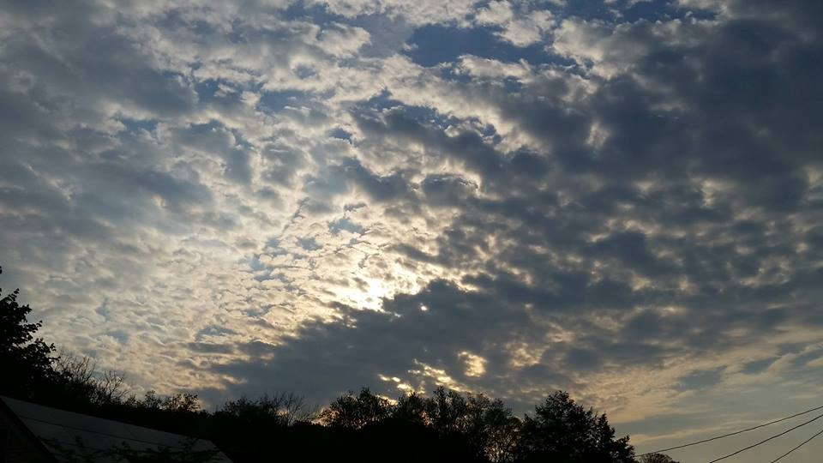
Gathering Around the WORD Gloria Patri
Glory be to the Father
and to the Son and to the Holy Ghost;
As it was in the beginning,
is now, and ever shall be,
world without end. Amen, Amen.

Slide 12
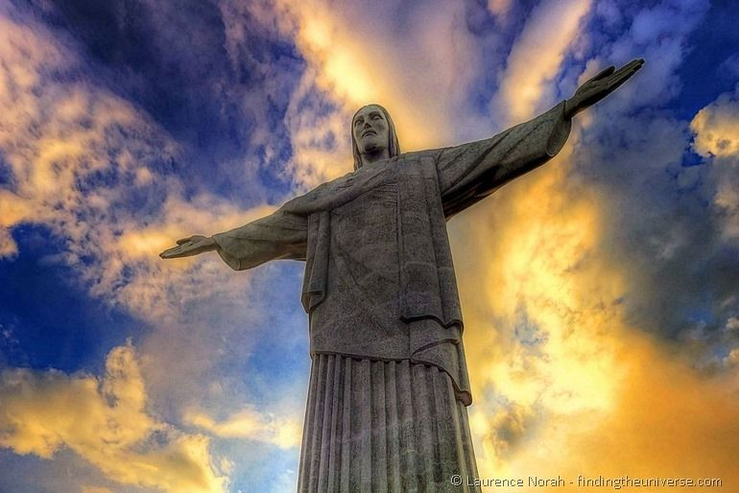
Gathering Around the WORD Passing of the Peace of Christ
Jesus said, “Peace I leave with you; my peace I give to you. I do not give to you as the world gives. Do not let your hearts be troubled, and do not let them be afraid.” (John 14:27)

Slide 13
Proclaiming the WORD Message to the Youth/ Prayer of Illumination

Slide 14
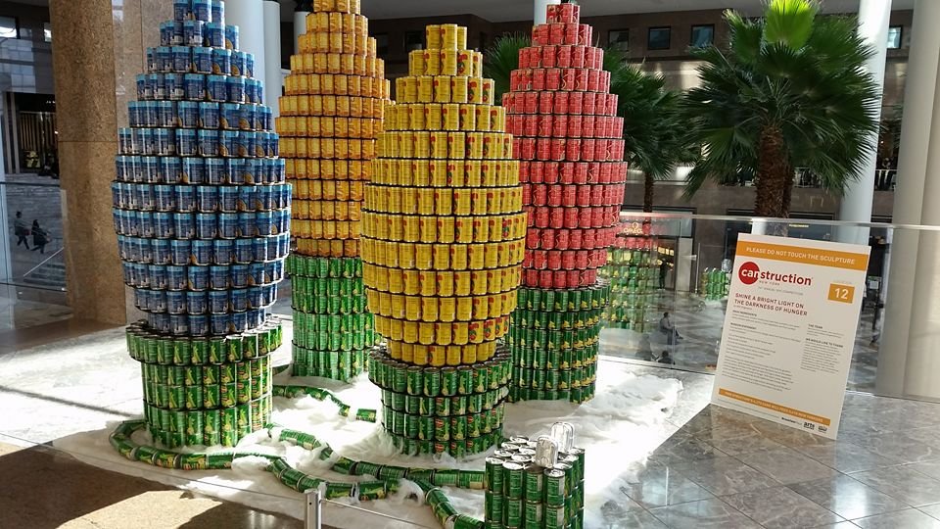
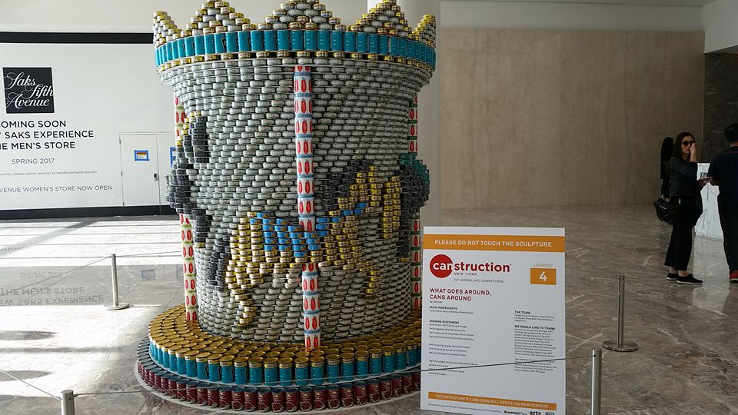
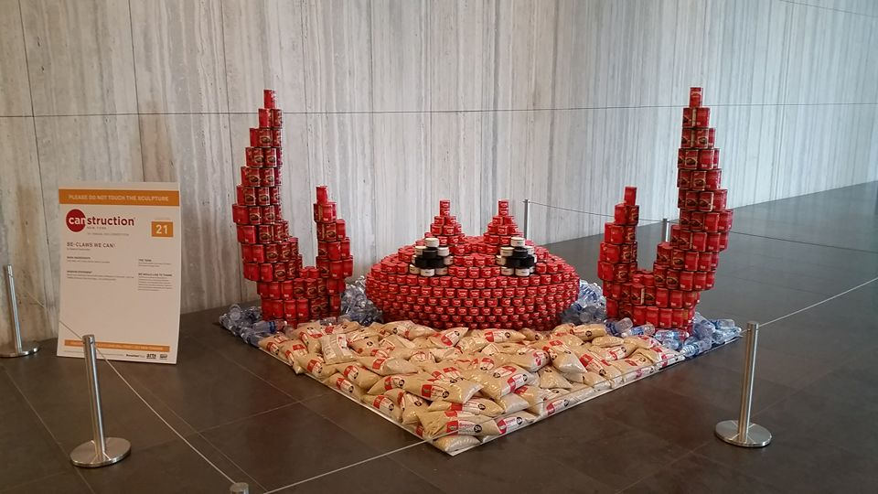
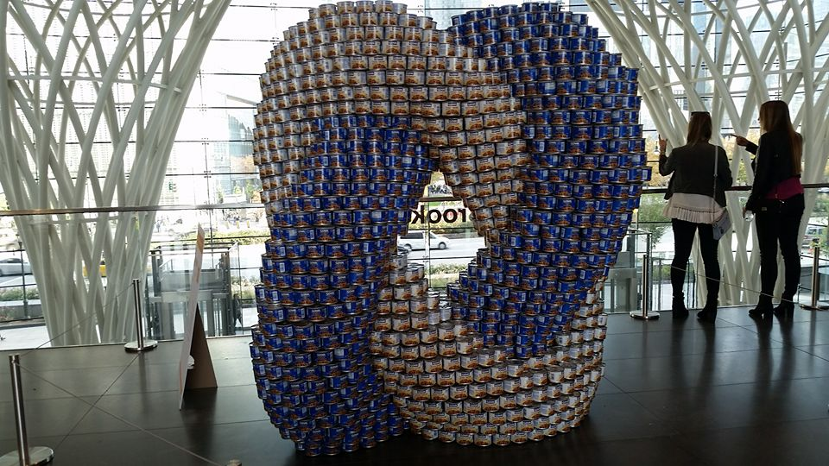
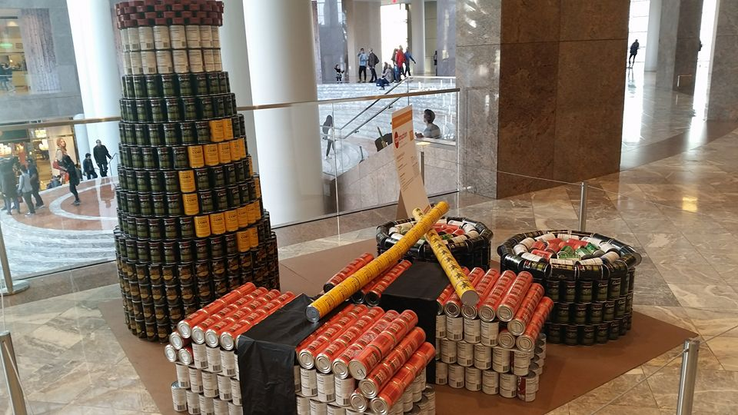

Slide 15
Proclaiming the WORD Scripture Reading (To Be Read Responsively) (Psalm 145:1-5, 17-21)
¹I will extol you, my God and King,
and bless your name forever and ever.
²Every day I will bless you,
and praise your name forever and ever.
³Great is the Lord, and greatly to be praised;
his greatness is unsearchable.
⁴One generation shall laud your works to another, and shall declare your mighty acts.
⁵On the glorious splendor of your majesty,
and on your wondrous works, I will meditate.
¹⁷The Lord is just in all his ways, and kind in all his doings.

Slide 16
Proclaiming the WORD Scripture Reading (To Be Read Responsively) (Psalm 145:1-5, 17-21)
¹⁸The Lord is near to all who call on him,
to all who call on him in truth.
¹⁹He fulfills the desire of all who fear him;
he also hears their cry, and saves them.
²⁰The Lord watches over all who love him,
but all the wicked he will destroy.
²¹My mouth will speak the praise of the Lord,
and all flesh will bless his holy name forever and ever.

Slide 17
Proclaiming the WORD Scripture Reading (2 Thessalonians 2:1-5, 13-17)
¹As to the coming of our Lord Jesus Christ and our being gathered together to him, we beg you, brothers and sisters, ²not to be quickly shaken in mind or alarmed, either by spirit or by word or by letter, as though from us, to the effect that the day of the Lord is already here. ³Let no one deceive you in any way; for that day will not come unless the rebellion comes first and the lawless one is revealed, the one destined for destruction

Slide 18
Proclaiming the WORD Scripture Reading (2 Thessalonians 2:1-5, 13-17)
⁴He opposes and exalts himself above every so-called god or object of worship, so that he takes his seat in the temple of God, declaring himself to be God. ⁵Do you not remember that I told you these things when I was still with you?

Slide 19
Proclaiming the WORD Scripture Reading (2 Thessalonians 2:1-5, 13-17)
¹³But we must always give thanks to God for you, brothers and sisters beloved by the Lord, because God chose you as the first fruits for salvation through sanctification by the Spirit and through belief in the truth. ¹⁴For this purpose he called you through our proclamation of the good news, so that you may obtain the glory of our Lord Jesus Christ. ¹⁵So then, brothers and sisters, stand firm and hold fast to the traditions that you were taught by us, either by word of mouth or by our letter.

Slide 20
Proclaiming the WORD Scripture Reading (2 Thessalonians 2:1-5, 13-17)
¹⁶Now may our Lord Jesus Christ himself and God our Father, who loved us and through grace gave us eternal comfort and good hope, ¹⁷comfort your hearts and strengthen them in every good work and word.

Slide 21
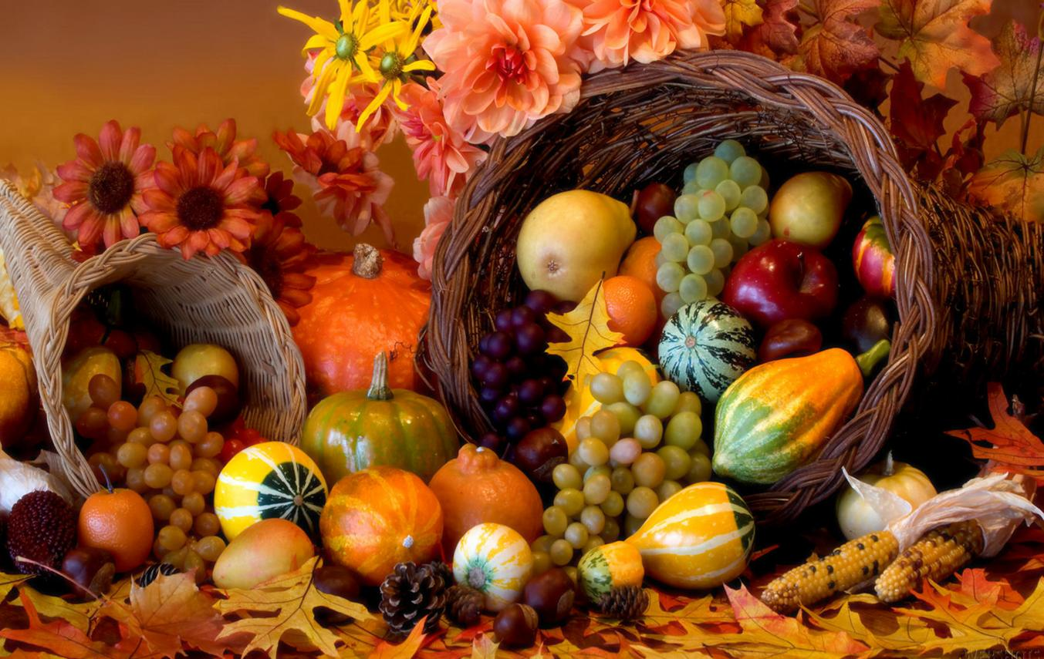
Proclaiming the WORD Chosen First Fruits
(Psalm 145:1-5, 17-21, 2 Thessalonians 2:1-5, 13-17)

Slide 22
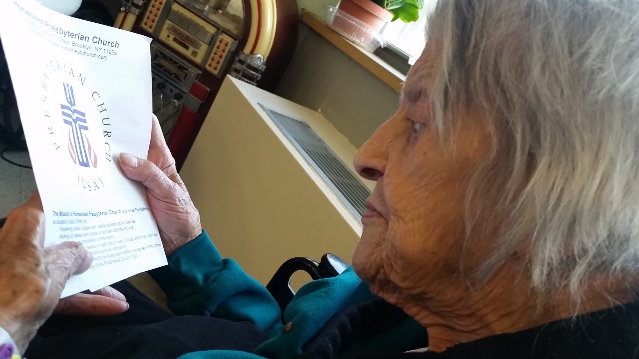
Proclaiming the WORD Chosen First Fruits
(Psalm 145:1-5, 17-21, 2 Thessalonians 2:1-5, 13-17)

Slide 23
Proclaiming the WORD Chosen First Fruits
(Psalm 145:1-5, 17-21, 2 Thessalonians 2:1-5, 13-17)

Slide 24
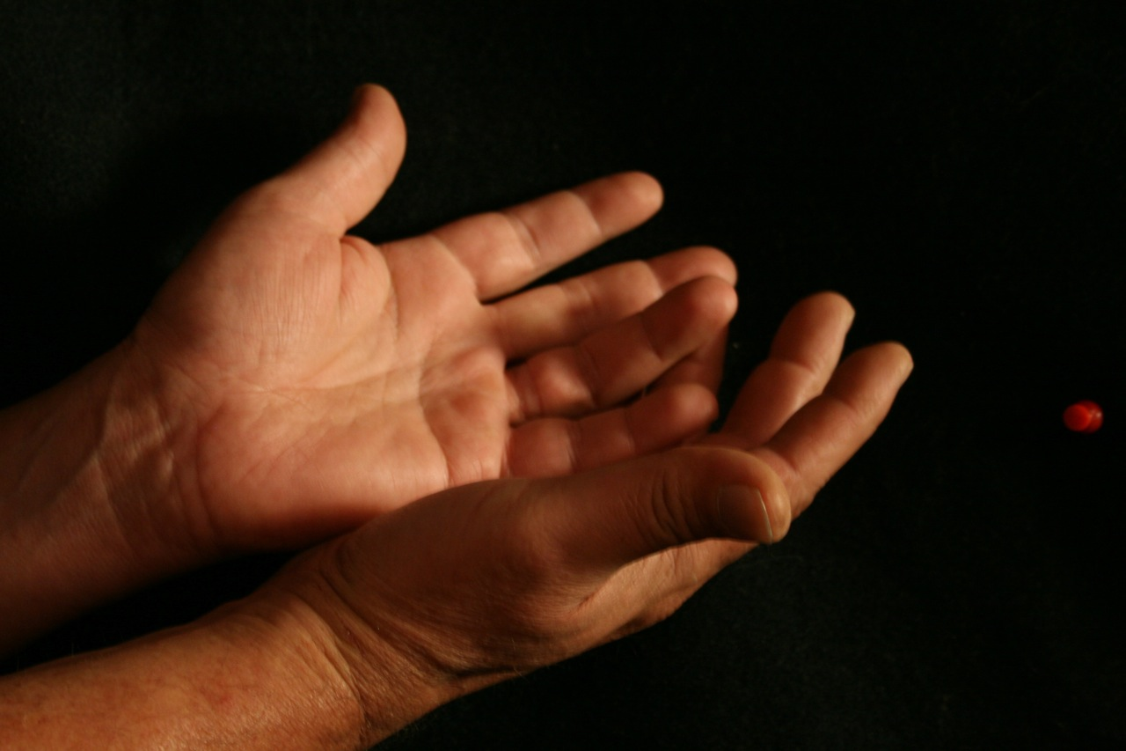
Responding Hymn # 644 “Give Thanks, O Christian People”
Give thanks, O Christian people, for workers of our day who heed the call to service and make it their life's way to go to feed the hungry, to tend to those in need, to work for equal justice, till all God's folk are freed.

Slide 25
Responding Hymn # 644 “Give Thanks, O Christian People”
Give thanks, O Christian people, for leaders of our years who live to share with others our joy when Christ appears, to teach the ones who seek light, to guide the faltering feet, to lead the followers forward our living Lord to meet.

Slide 26
Responding Hymn # 644 “Give Thanks, O Christian People”
Give thanks, O Christian people, for all who love the Lord, who live each day believing in God's eternal Word: to share Christ's love in living, to witness with each deed, to use the talents given to plant the gospel seed.

Slide 27
Responding Hymn # 644 “Give Thanks, O Christian People”
Give thanks, O Christian people, for life in fellowship with all who trust our Savior their serving to equip: to ease another's burdens, to cope in joy and stress, to magnify God's message and Christ's great love confess.

Slide 28
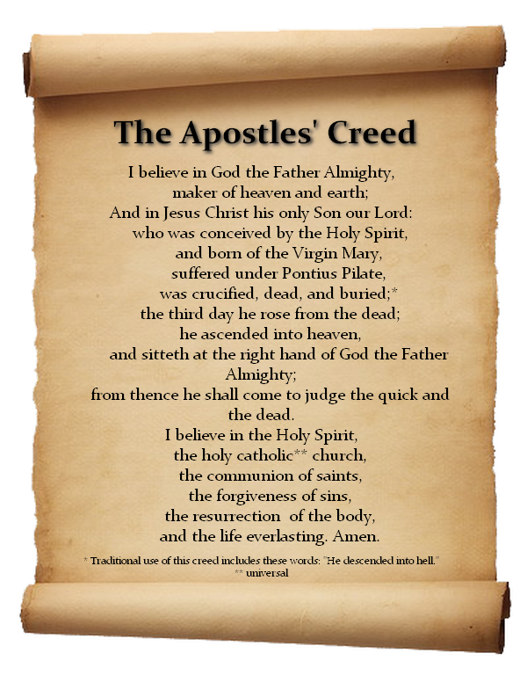
Responding to the WORD
Affirmation of Faith

Slide 29
Bearing and Following the WORD into the World Announcements &
Sharing of Joys and Concerns
The Sunday afternoon Bible Study groups will NOT be meeting today. We will resume next Sunday.
The Women's Group will be meeting on every Wednesday, @ 7:30pm over at the Manse (2048 E 14th Street). For more information, please see Margaret or Cara.
The next Session Meeting will be tommorow at 7pm. All active elders please attend.

Slide 30
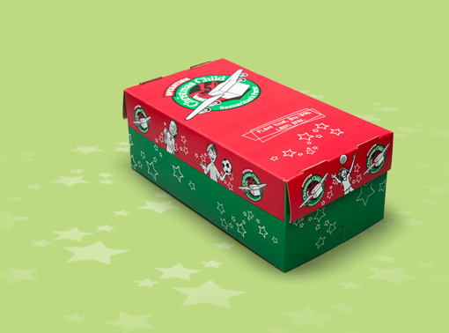
Bearing and Following the WORD into the World Announcements &
Sharing of Joys and Concerns
Operation Christmas Child Shoeboxes will be collected Next Sunday, 11/13. If you are interested in participating again this year, please pick up one of the flyers.

Slide 31
Bearing and Following the WORD into the World Announcements &
Sharing of Joys and Concerns
Our annual Thanksgiving Dinner will be on Saturday, 11/19 at 6pm. For tickets, please see Paul. $10 for adult and $5 for children. We will also be receiving canned and non-perishable food for donation during the Thanksgiving Dinner.

Slide 32
Bearing and Following the WORD into the World Prayer of the People & The Lord’s Prayer
Our Father, who art in heaven.
Halloweth be thy name.
Thy Kingdom come; Thy will be done
On earth as it is in heaven.
Give us this day our daily bread.
Forgive us our debts; as we forgive our debtors.
Lead us not into temptations, but deliver us from evil.
For Thine is the Kingdom, the Power, and the Glory forever. Amen.

Slide 33
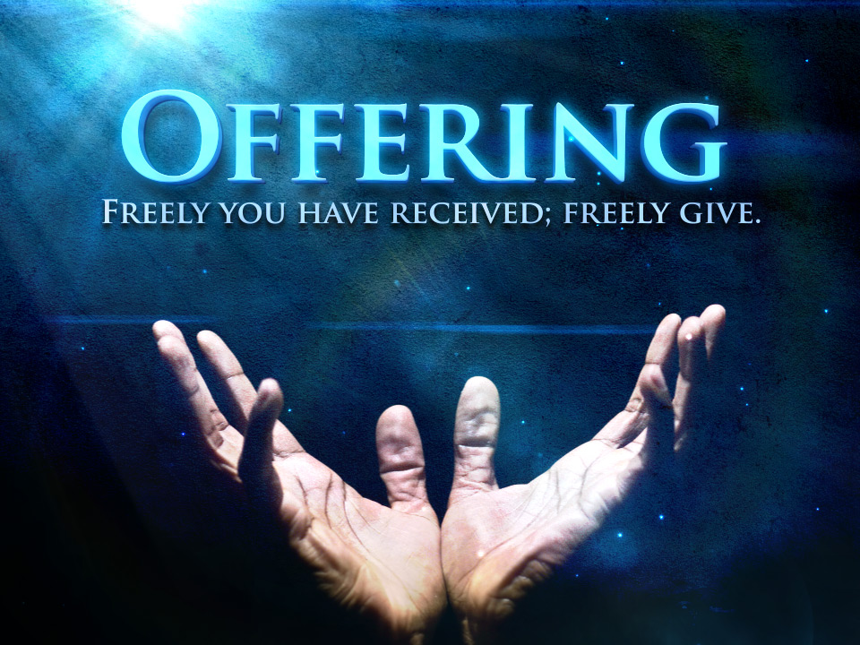
Bearing and Following the WORD into the World Offering of our Gifts and our Lives

Slide 34
Bearing and Following the WORD into the World Doxology and Offertory Prayer

Slide 35
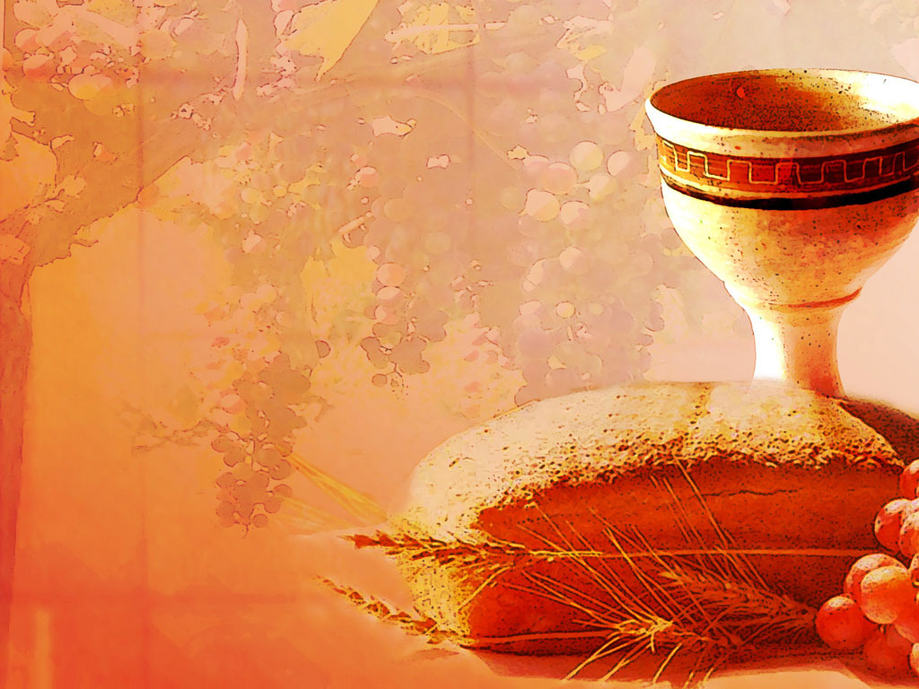
Communion Hymn # 42 “Your Faithfulness, O Lord Is Sure” (Psalm 145)
Your faithfulness, O Lord, is sure in all your words, your gracious deeds; you gently lift all burdened souls and well provide for all our needs.

Slide 36
Communion Hymn # 42 “Your Faithfulness, O Lord Is Sure” (Psalm 145)
The eyes of all are fixed on you; by you their wants are all supplied; your open hand is bountiful and every soul is satisfied.

Slide 37
Communion Hymn # 42 “Your Faithfulness, O Lord Is Sure” (Psalm 145)
Lord, you are just in all your ways, and kind in everything you do; forever near you stand to hear and help all those who call on you.

Slide 38
Communion Hymn # 42 “Your Faithfulness, O Lord Is Sure” (Psalm 145)
My mouth shall speak your praise, O Lord; my soul shall bless your holy name; let all things living join the song of praise, from age to age the same.

Slide 39
Bearing and Following the WORD into the World Holy Communion
Friends, we have gathered around this table of grace, as God’s people and saints of this world, where there are no strangers. Christ is the host at this Heavenly Feast and we are all invited for as long as we profess our faith and trust in Him. We celebrate God's presence among us, united in Christ's spirit, broken and whole all at once.

Slide 40
Bearing and Following the WORD into the World Holy Communion
Through God’s reconciling love and unconditional grace, transformation takes place around this table, where strangers become friends, sinners redeemed, brokenness restored and wounded healed.

Slide 41
Bearing and Following the WORD into the World Holy Communion
The Lord be with you. And also with you.
Lift up your hearts. We lift them up to the Lord.
Let us give thanks to the Lord our God.
It is right to give our thanks and praise.

Slide 42
Bearing and Following the WORD into the World Holy Communion
Blessed are you, O Christ, in the fullness of your sovereign glory, we proclaim the mystery of faith:
Christ has died, Christ is risen, Christ will come again.

Slide 43
Bearing and Following the WORD into the World Holy Communion
With thanksgiving, we shall receive this bread which our Lord Jesus took, after He blessed it, broke it, and gave it to his disciples, saying, this is my body, given for you.
With confidence, we shall drink from this cup that Jesus blessed, saying, this is the new covenant sealed in my blood. Do this in remembrance of me.

Slide 44
Bearing and Following the WORD into the World Holy Communion
With thanks and praise we offer ourselves to you, O God. Sharing this holy meal, remembering Christ’s dying and rising, and praying: Come Lord Jesus!
Jesus said, "I am the bread of life. Those who come to me shall never hunger; those who believe in me shall never thirst." These are the gift of God for the people of God.

Slide 45
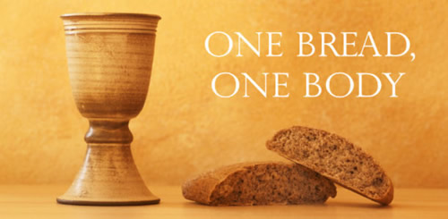
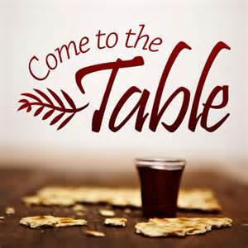
Bearing and Following the WORD into the World Holy Communion

Slide 46
Bearing and Following the WORD into the World
Prayer after the Communion: (in unison)
:
Lord Jesus Christ, in Spirit you have fed us with your body and quenched us with your blood. We look forward to the day when you shall come again to fill our hearts with grace, peace and hope.

Slide 47
Bearing and Following the WORD into the World
Prayer after the Communion: (in unison)
:
Enable us now to go out to share your love to others in this season of Thanksgiving. Humble our hearts and pour out your Spirit upon us, as we have be nourished by the Bread of Life and quenched by the Cup of Salvation. Thanks be to God, Amen.

Slide 48
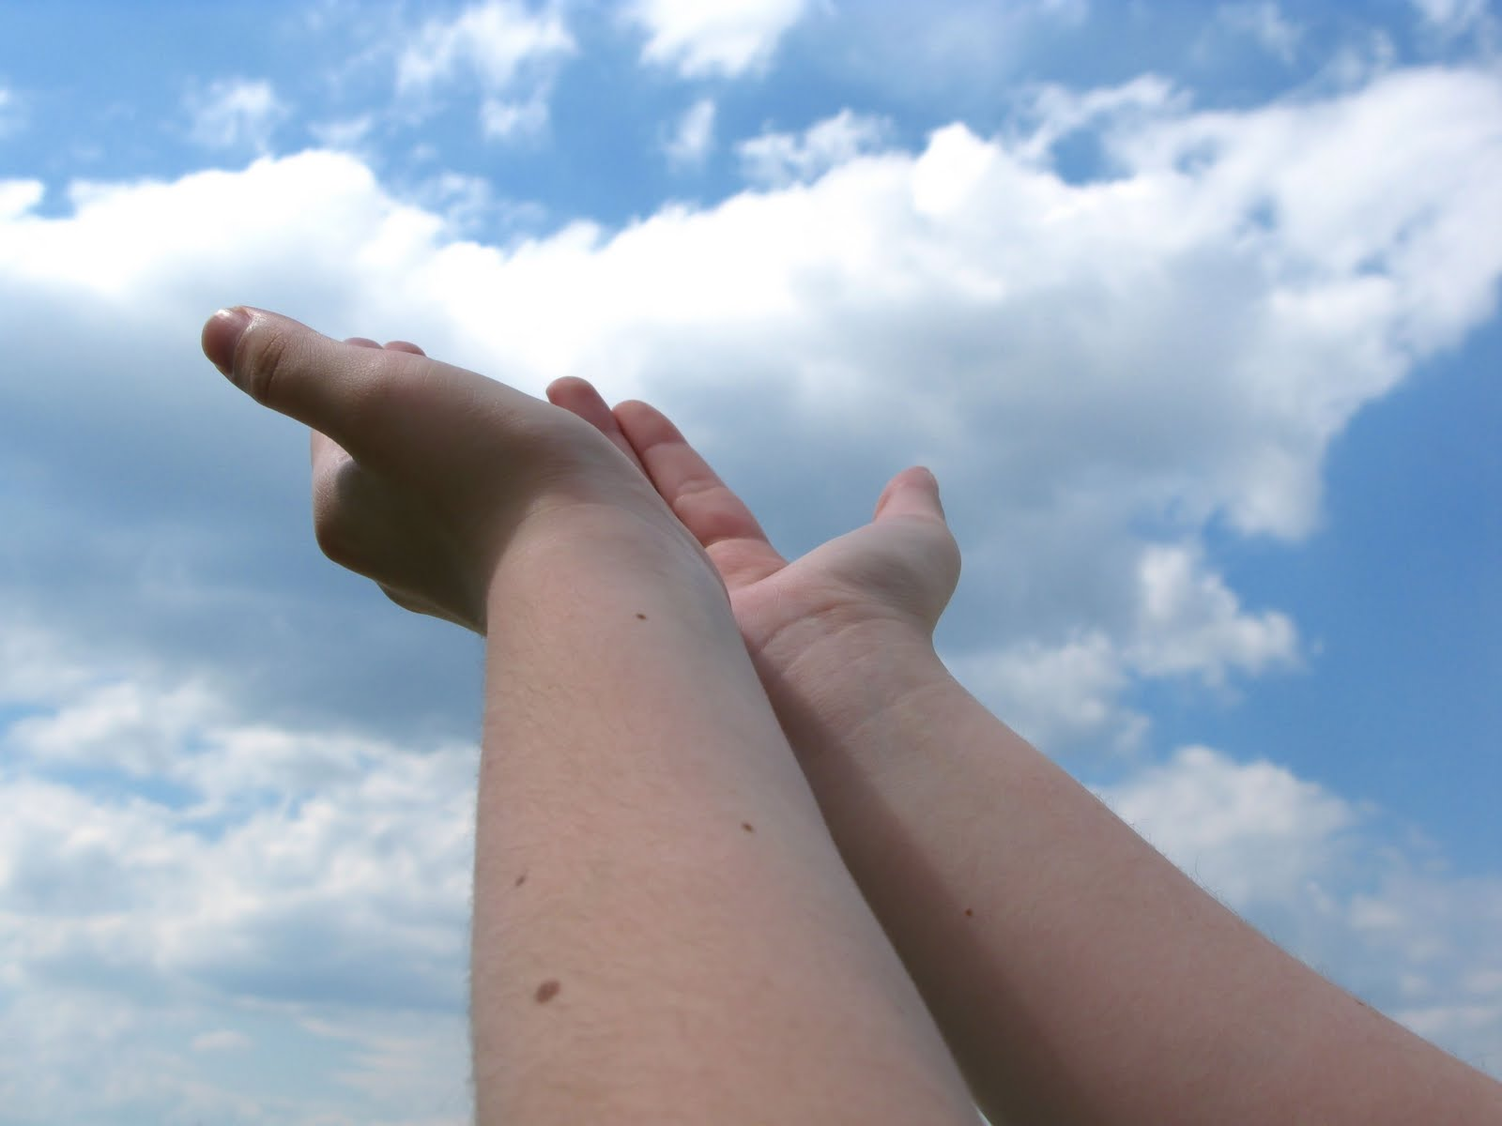
Bearing and Following the WORD into the World Deacons’ Benevolence Offering

Slide 49
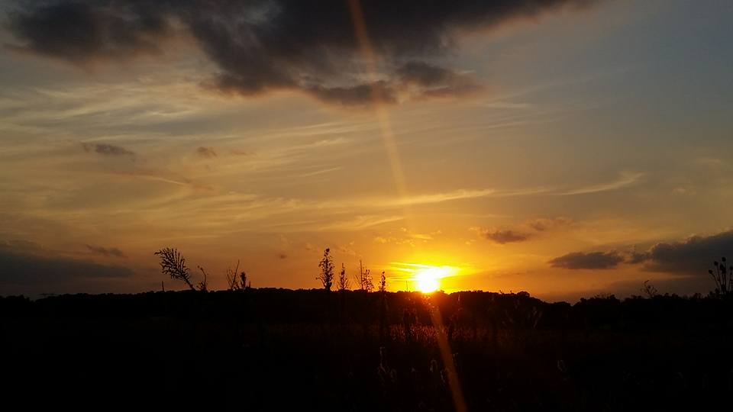
Sending Hymn # 546 “Lord, Dismiss Us With Your Blessing”
Lord, dismiss us with your blessing; fill our hearts with joy and peace; let us each, your love possessing, triumph in redeeming grace. O refresh us, O refresh us, traveling through this wilderness.

Slide 50
Sending Hymn # 546 “Lord, Dismiss Us With Your Blessing”
Thanks we give and adoration for your gospel's joyful sound; may the fruits of your salvation in our hearts and lives abound. Ever faithful, ever faithful to your truth may we be found.

Slide 51
Sending Hymn # 546 “Lord, Dismiss Us With Your Blessing”
Savior, when your love shall call us, from our struggling pilgrim way, let no fear of death appall us, glad your summons to obey. May we ever, may we ever reign with you in endless day.

Slide 52
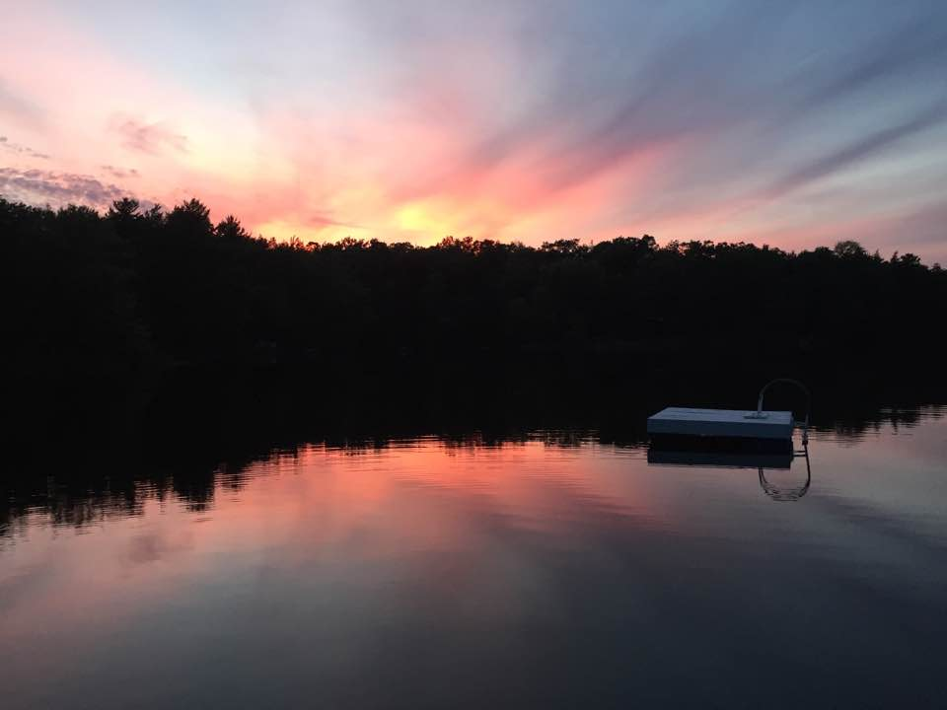
Bearing and Following the WORD into the World The Charge and Benediction

Slide 53
Bearing and Following the WORD into the World Benediction Response
#540 “Farewell, Good Friends”
Farewell good friends! Farewell, good friends! Shalom, Shalom!
Till we meet again, till we meet again, shalom, shalom.

Slide 54
Homecrest Presbyterian Church Worship of the Lord’s Day November 6th, 2016

